Slide 1
STRUCTURES AND UNIONS
Swati V. S.

Slide 2
Agenda
Declaration and definition of structures.
Self referential structure.
Nested structure.
Structure alignment.
Structure padding and packing.
Bit fields.
Unions.
Real time example of union.

Slide 3

Why structures????
Structures are also called as RECORDS.
Structure is a collection of one or more variables, possibly of different types, grouped together under a single name.

Slide 4
Declaration of structure
Declaration of the structure provides one more data type in addition to the built in data types.
struct tag
{
data_type1 member1;
data_type2 member2;
data_type3 member3;
};
Declaration does not reserve any space in memory for the members, space is reserved only when the variables of this structure type are declared.

Slide 5
Declaration and Initialization of structure variables
With structure declaration
Using the struct tag
struct student
{
char name[20];
int roll;
float marks;
}stu1={“xyz”,67,78};
struct student stu2={“ab",62,71.1};
struct student
{
int mark1;
float mark2;
int mark3;
} sub1={67};

Slide 6
Accessing the members of the structure
Using dot operator
int main(void)
{
struct result{
int marks;
char grade;
}A1,B1;
A1.marks=80; A1.grade=‘A’;
B1=A1;
printf(“Marks = %d”,B1.marks);
printf(“grade = %c”B1.grade);
return 0;
}
Using arrow operator
struct node
{
int data;
};
struct node *ptr;
ptr → data

Slide 7

Nested structure(structure within a structure)
Nesting of a structure within itself is invalid
struct student{
char name[20];
int roll no;
struct date
{
int day;
int month;
int year;
}birthdate;
float marks;
}stu1,stu2;
stu1.birthdate.day
struct time{
int hr;
int min;
int sec;
};
struct date{
int day;
int month;
int year;
struct time t;
};
struct student{
char name[20];
struct date dob;
}stu1,stu2;
stu1.dob.t.hr

Slide 8
Self referential structure
Structure contains pointer that point to the structure variables of type struct tag.
These type of structures are helpful in implementing data structures like linked list and trees.
struct node{
int data;
struct node *link;
};
struct node *temp;

Slide 9
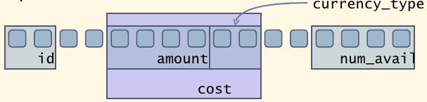
Structure alignment
struct COST{
int amount;
char currency_type[2];
};
struct PART{
char id[2];
struct COST cost;
int num_avial;
}part;

Slide 10
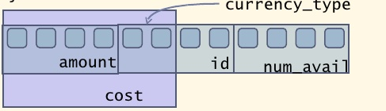
Structure alignment
struct COST{
int amount;
char currency_type[2];
};
struct PART{
struct COST cost;
char id[2];
int num_avial;
}part;

Slide 11


Structure padding and packing
On a 32 bit machine, the processing word size will be 4 bytes.
To maintain the proper alignment of data structure padding is done.
How to avoid padding
structure packing

Slide 12
#pragma directive(#pragma <directive name>)
#pragma pack(power of 2)
#pragma pack(push , power of 2)
#pragma pack (pop)
#pragma startup <function_name> [priority]
#pragma exit <function_name> [priority]

Slide 13
Bitfields
What are Unnamed bit fields?
What is the significance of unnamed field width zero?
struct tag { struct tag{
unsigned int a:4; unsigned int a:4;
unsigned int b:3; unsigned int b:3;
int :0; int : 1;
int y:24; int y:24;
}st1; }st1;
sizeof(st1)??? sizeof(st1) ???
8 4

Slide 14
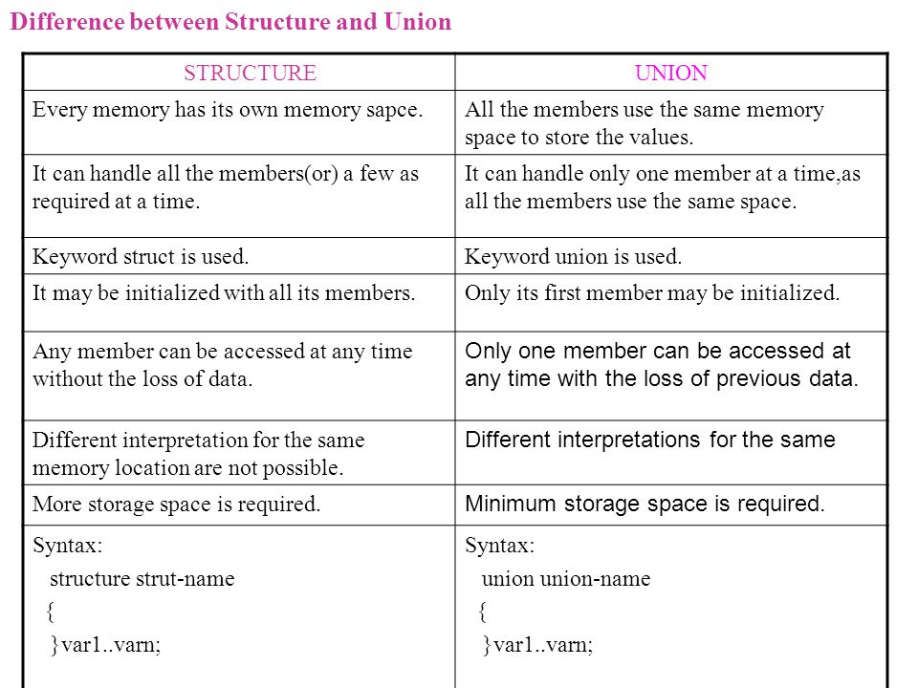
Union

Slide 15
Real time example of union
How was this presentation?
Excellent
Good
Fair
None of these

