Slide 1
Binary Trees, Inorder, Pre order, Post order Traversal
SANDEEP S K

Slide 2
Contents
Trees
Terminology
Binary Tree
Properties of Binary Tree
Types of Binary tree
Threaded Binary Tree
Application of Trees

Slide 3
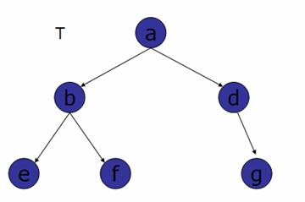
Trees
A tree is a non-empty set one element of which is designated the root of the tree while the remaining elements are partitioned into non-empty sets each of which is a subtree of the root.

Slide 4
Why Trees ?
Trees are used to store information that naturally forms a hierarchy.
Trees (BST) provide moderate access/search (quicker than Linked List and slower than arrays).
Trees provide moderate insertion/deletion (quicker than Arrays and slower than Unordered Linked Lists).
Like Linked Lists, Trees also don’t have an upper limit on number of nodes as nodes are linked using pointers.

Slide 5
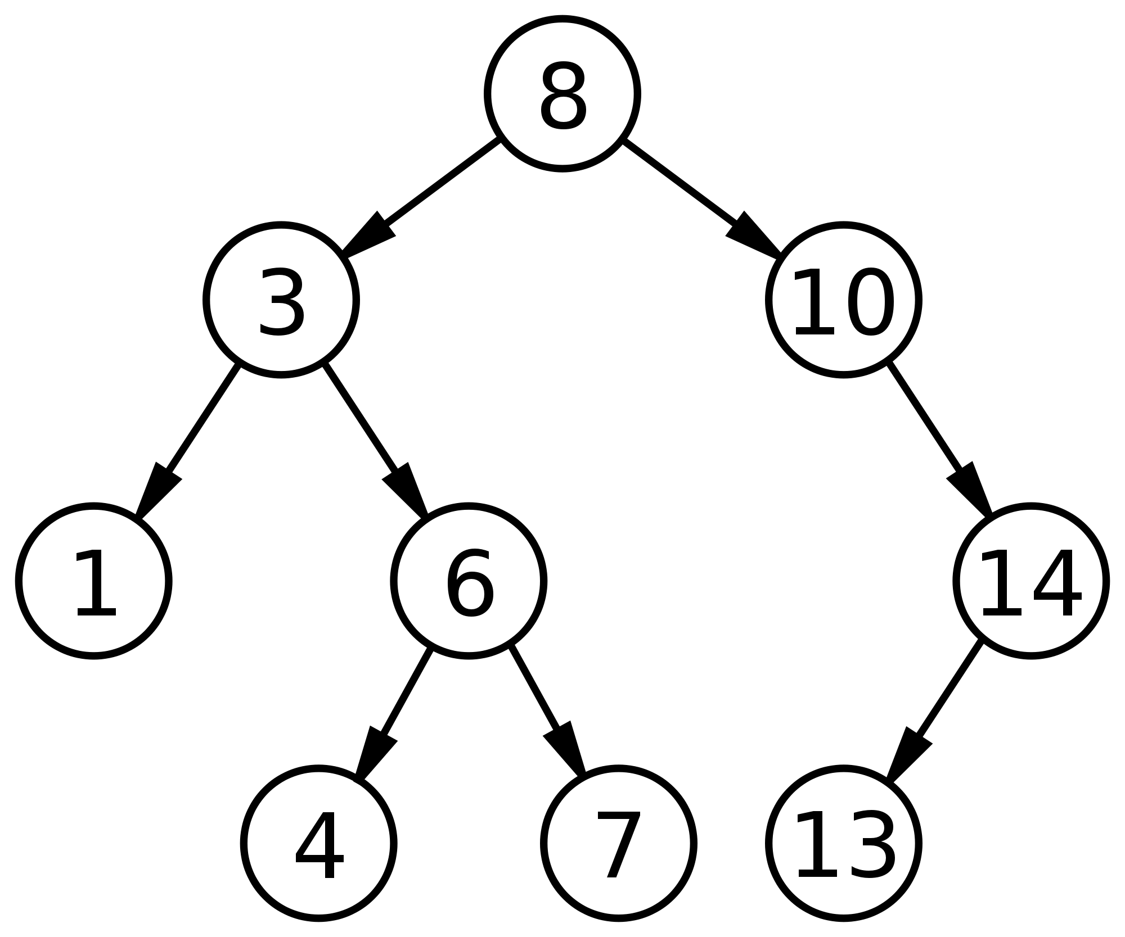
Terminology
Root – 8
Siblings –{(3-10), (1-6),(4-7)}
Parent –{(8->3),(8->10)
Child -{(4->6),(14->10)}
Ancestors -{(1->3,8)
(14 ->10,8)}
Descendants-{(10->14,3)}
Leaves -{1,4,7,13}
Depth (level) of 3 is –> 1
Height of tree is ->3
Degree of node 6 -> 2
Root
Siblings
Subtree
Leaves

Slide 6
Terminology
Depth : The length of the path (or the number of edges) from the root to that node.
Height : It is the longest path from that node to its leaves.
Degree of a node : The maximum number of possible children for every node in the tree.

Slide 7
Binary Search Tree
A Binary Search Tree (BST) is a tree in which all the nodes follow the below-mentioned properties −
  The left sub-tree of a node has a key less than to its parent node's key.
  The right sub-tree of a node has a key greater than or equal to its parent node's key.
Operations on BST :
Insertion O(h)
Deletion O(h)
Search O(h)

Slide 8



Deletion
Node to be deleted is leaf
Node to be deleted has one leaf
Node to be deleted has two children

Slide 9
Properties of Binary Tree
# - Number of
#Nodes(MAX) in tree = 2^{height+1} - 1
#Nodes at level i^{th} <= 2^{i}
Height (MAX) = Nodes - 1
Height (MIN) = log₂(#Nodes + 1) - 1
#Edges = #Nodes – 1
#External Nodes <= 2^{height}
#External Nodes=#Internal Nodes+1
3
5
6
7
5
5
3
8
3
8
2
4
6
9
2
4
6
9

Slide 10
BST Traversal - Preorder
Algorithm:
Until all nodes are traversed −
Step 1 − Visit root node.
Step 2 − Recursively
traverse left subtree.
Step 3 − Recursively
traverse right subtree
5
3
8
2
4
6
9
5 | 3 | 2 | 4 | 8 | 6 | 9

Slide 11
BST Traversal - Inorder
Algorithm:
Until all nodes are traversed −
Step 1 − Recursively
traverse left subtree.
Step 2 − Visit root node.
Step 3 − Recursively
traverse right subtree.
5
3
8
2
4
6
9
2 | 3 | 4 | 5 | 6 | 8 | 9

Slide 12
BST Traversal - Postorder
Algorithm:
Until all nodes are traversed −
Step 1 − Recursively
traverse left subtree.
Step 2 − Recursively
traverse right subtree.
Step 3 − Visit root node.
5
3
8
2
4
6
9
2 | 4 | 3 | 6 | 9 | 8 | 5

Slide 13
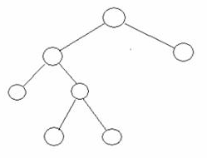
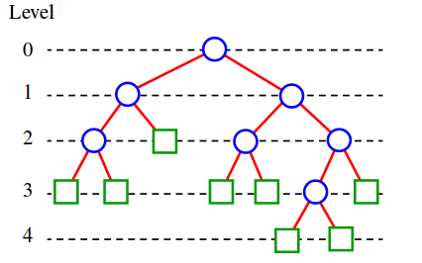
Types of Binary Tree
Strictly Binary Tree(SBT)
A BT is SBT if each node is a leaf or has exactly two children or child.
SBT has (Non_leaf_Nodes + 1) leaf_Nodes
Extended Binary Tree
The binary tree obtained by adding dummy nodes to a binary tree is called as Extended Binary Tree.

Slide 14
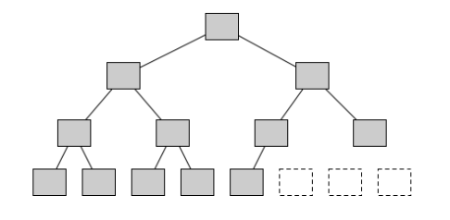
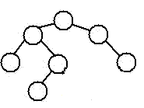
Types of Binary Tree
Complete Binary Tree
All levels are full except for the deepest level, which is partially filled from the left.
Balanced Binary Tree
The tree in which every leaf is not more than a certain distance away from the root than any other leaf (OR)
Height of left_subtree and right_subtree is not more than 1.
max_level(leafNode)–min_level(leafNode) <= k,
k=1

Slide 15
Applications of Binary Tree
Search applications – Library records.
Used in heap-sort; fast implementations of Dijkstra's algorithm.
Constructed by compilers and (implicitly) calculators to parse expressions.
+
*
/
2
4
9
3

Slide 16
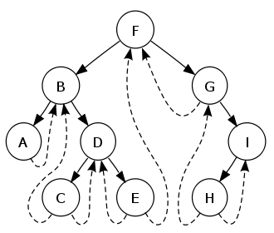
Threaded Binary Tree
A binary tree is threaded by making all right child pointers that would normally be null point to the inorder successor of the node (if it exists), and all left child pointers that would normally be null point to the inorder predecessor of the node.

Slide 17
Queries ?

Slide 18
Feedback

