Slide 1
POINTERS
          Saikiran Polisetty

Slide 2
CONTENTS :
Introduction to Pointers
Pointers Declaration and Initialization
Types of Pointers
Pointer Arithmetic
Pointers & Arrays
Character Pointer
Double Pointer
Function Pointer

Slide 3
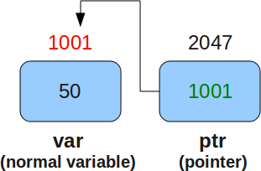
Introduction to Pointers :
Pointer is a variable which holds the address of other variable (referencing a location in memory) and capable of obtaining the value stored at that location, known as dereferencing the pointer.
1001 Address of variable
2047 Address of pointer

Slide 4
Pointers Declaration & Initialization :
Declaration of pointer :
data-type * variable_name ;
Initialization (or definition) of pointer :
int a; int a;
int *ptr = &a; (or) int *ptr;
ptr = &a;
(&) Address operator
(* ) Indirection (or) Dereference operator

Slide 5
Importance of Pointers :
The pointers are more efficient in handling the data types.
Pointers reduce the length and complexity of a program.
Pointers give us the ability to implement complex data structures like linked lists, trees, etc.
Dynamic memory Allocation.
Used for returning more than one value from a function.

Slide 6
Types of Pointers :
Wild Pointer
NULL Pointer
Void Pointer
Dangling Pointer

Slide 7
Wild Pointer :
Uninitialized pointers are known as wild pointers because they point to some random memory location and may cause a program to behave unpredictably.
Example :
#include<stdio.h>
int main()
{
int *ptr; // Ptr is a wild pointer, as it is not initialized Yet
printf("%d", *ptr); //pointing nothing, stored with the garbage value
return 0;
}

Slide 8
Cont..
How to avoid wild pointer ?
int *ptr = NULL;
(or)
int a ;
int *ptr = &a;

Slide 9
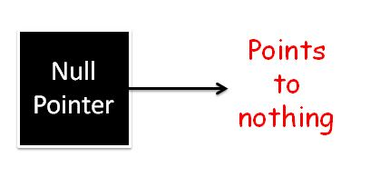
Null Pointer :
Pointer which is initialized with NULL value is considered as NULL pointer. NULL is a macro defined constant in header files.
int *ptr = NULL;
NULL #define NULL ((void *)0)

Slide 10
Void Pointer :
Void pointer is a generic pointer which is capable of storing address of any data type.
void * pointer_name;
Ex: void *ptr; // ptr is declared as Void pointer
char ch;
int inum;
float fnum;
ptr = &ch; // ptr has address of character data
ptr = &inum; // ptr has address of integer data
ptr = &fnum; // ptr has address of float data

Slide 11
Dangling Pointer :
Dangling pointers arise when an object is deleted or De-allocated, without modifying the value of the pointer, so that the pointer still points to the memory location of the De-allocated memory.
Example :
void function()
{
int *ptr = (int *) malloc(SIZE);
free(ptr); //ptr now becomes dangling pointer
}

Slide 12
Cont..
Example 2 :
#include<stdio.h>
void fun(void);
int *p;
int main()
{
fun();
printf(“%d”,*p); // P is Dangling pointer
}
void fun()
{
int a=10;
p = &a;
printf(“%d”,*p);
}

Slide 13
Pointer Arithmetic :
All types of arithmetic operations are possible with pointers. The only valid operation that can be performed are :
1. Addition of an integer to a pointer and increment operations.
new_address= current_address + (number * size_of(data type))
new_address= current_address + size_of(data type)
2. Subtraction of an integer from a pointer and decrement operation.
new_address= current_address - (number * size_of(data type))
new_address= current_address + size_of(data type)
3. Subtraction of a pointer from another pointer of same type.

Slide 14
Contd..
Pointer comparisons:
Relational operators (==, !=, <, <=, >, >=) can be used with pointers
==, !=
If both pointers are NULL (or) both contain address of same variable.
Between void pointer & other pointer.
2) >, < , <= , >=
Valid between pointers of same type.
Both pointers point to elements of arrays of same data type.

Slide 15
Pointer and Arrays :
Suppose we declare an array arr,
int a[5]={ 1, 2, 3, 4, 5 }; // a is equal to &arr[0] by default
int *p;
p = a; (or) p = &a; /* If p is a pointer to an integer, declared as sets p to point to element zero of a */
a[i] ----> *(p + i) ----> value at i^{th} position
&a[i] ----> (p + i) ----> address at i^{th} position
a[i] = *(a + i) = *(i + a) = i[a]
&a[i] = &*(a + i) = (i + a) = &i[a]
p
5000
5000
5004
5008
5012
5016
2000
1 | 2 | 3 | 4 | 5

Slide 16
Pointer to Array :
we can use a pointer to point to an Array, and then we can use that pointer to access the array.
The declaration
int arr[5] = {1, 2, 3, 4, 5}; //a[i] - refers to the i-th element of the array.
int (*ptr)[5];
5000
5004
5008
5012
5016
1 | 2 | 3 | 4 | 5
arr[0]
arr[1]
arr[2]
arr[3]
arr[4]
ptr
5000
3000

Slide 17
Array of Pointers :
Array of pointers in C can be declared like an array of integers or characters. Each element of a pointer array is bound to store address of same data type.
data_type *identifier[size];
Example : int arr[5] = {1, 2, 3, 4, 5};
int *ap[5] = {arr, arr + 1, arr + 2, arr + 3, arr + 4};
7000
7004
7008
7012
7016
5000 | 5004 | 5008 | 5012 | 5016
ap[0]
ap[1]
ap[2]
ap[3]
ap[4]

Slide 18
Character Pointer :
char arr1[6] = {'G', 'E', 'S', 'L', '\0' };
G | E | S | L | ‘\0’
char arr2[ ] = “ARRAY”;
A | R | R | A | Y | ‘\0’
char *str = “GLOBAL”;
G | L | O | B | A | L | ‘\0’

Slide 19
Cont..
int main (void)
{
char arr1[6] = {'G', 'E', 'S', 'L'};
char arr2[ ] = “ARRAY”;
char *str = “GLOBAL”;
arr1[3] = ‘z’;
arr2[3] = ‘y’;
str[3] = ‘x’; // invalid
str = “HELLO”; //valid
arr2[ ] = “WORLD”; //invalid
return 0;
}

Slide 20
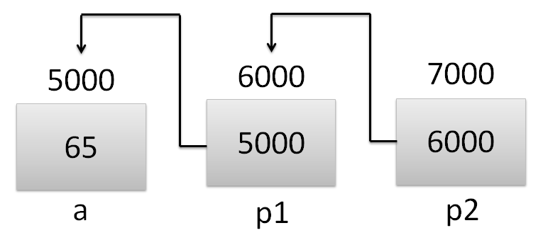
Double Pointer (Pointer to Pointer) :
Example:
int a = 65;
int *p1 = &a;
int **p2 = &pa;
Value of a | a | *p1 | **p2 | 65
Addresss of a | &a | p1 | *p2 | 5000
Value of p1 | &a | p1 | *p2 | 5000
Address of p1 |  | &p1 | p2 | 6000
Value of p2 |  | &p1 | p2 | 6000
Address of p2 |  |  | &p2 | 7000

Slide 21
Function Pointer :
A pointer which keeps address of a function is known as function pointer.
function return type (*Pointer_name)(function argument list);
Example :
void fun(int a)
{
printf("Value of a is %d\n", a);
}
int main()
{
void (*ptr)(int) = fun;
ptr(10);
return 0;
}

Slide 22
Queries ??

