Slide 1
Software Engineering
            Hemanth CH

Slide 2
Contents
Managing software projects
  Project management concepts
  Risk Management
  project scheduling
STLC
Testing strategies & techniques

Slide 3
Managing software projects:
Software project management is the Discipline of defining and achieving targets while optimizing the use of resources(time, money, people, Materials,energy, space, etc) over the course of a
project.

Slide 4
  Project management concepts
Project management involves Planning, Monitoring, control of people, process, and events that occur during software development.
planning is a procedural step in project management, where required documentation is created to ensure successful project completion.
Monitoring is the regular observation and recording of activities taking place in a project and check on how project activities are processing.
Control of people and process is assigning tasks to people and controlling the process.

Slide 5
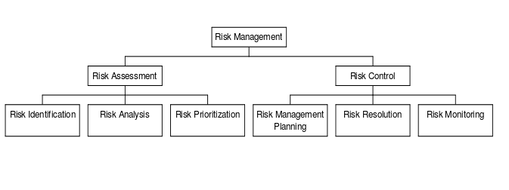
Risk management
Risk management can be defined as a systematic process for identifying, analyzing andcontrolling risks in projects.

Slide 6
Project scheduling:
Schedule is a listing of a project's milestones, activities, and deliverables, usually with intended start and finish dates.
Scheduling decides “which tasks to be taken up and when”.

Slide 7
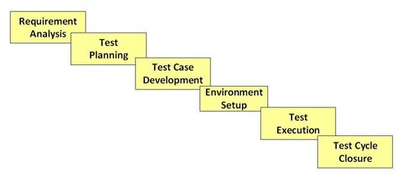
Software testing
Lifecycle

Slide 8
Testing strategies & techniues
Unit testing
Unit testing is a software development process in which the smallest testable parts of an application, called units, are individually and independently tested for proper operation.
Integration testing
This is a phase of software testing where all components and modules of code are integrated to test as a group.
System testing
This is a testing conducted on a complete system to evaluate the system's compliance with its specified requirements.

Slide 9
Regression testing
This is also a black box testing technique that verifies that software previously developed and tested still performs correctly even after it was changed or interfaced with other software. Changes may include software enhancements, patches, configuration changes, etc.
Acceptence testing
A testing technique performed to determine whether or not the software system has met the requirement specifications and required criteria for delivery to end users.

