Slide 1
Software Engineering
Hemanth CH

Slide 2
contents
Software
types of software
Software engineering
Layered technology
SDLC
Process models

Slide 3
SOFTWARE
A software is a general term for various kinds of program that executes with in a computer of any size and architecture.

Slide 4
Types of software
System software
Application software
Embedded software
Web application
AI software

Slide 5
System software:
Collection of programs written to service other programs.
Application software:
Application software, or simply applications, are often called productivity programs because they enable the user to complete tasks.
Embedded software:
Embedded software resides with in a product or system and used to control features and functions for the end user and for system itself.

Slide 6
Web -applications:
Webapps in simple words are a set of linked hypertext files that present information using text and graphics.
AI :
AI software makes use of nonnumerical algorithems to solve complex problems that are not capable to computation.

Slide 7
What & Why ?
Software engineering means applying the principles of engineering to the software development field.
To get efficient and reliable software product software engineering came in to existence.

Slide 8
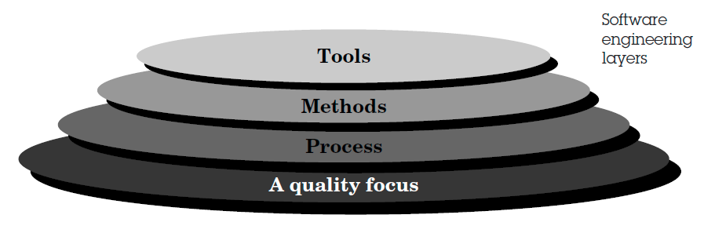
Software engineering - Layered technology

Slide 9
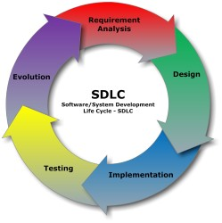
SDLC(Software development lifecycle)

Slide 10
Process models

Slide 11
Process Model
Process models define a distinct set of activities, actions, tasks and work products that are required to engineer high-quality software.
Process models provide a roadmap for software engineering work.

Slide 12
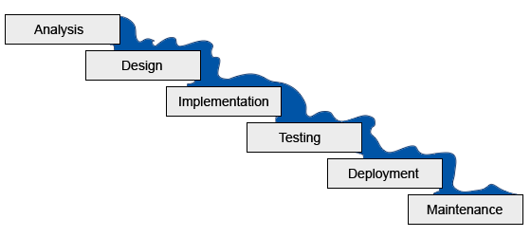
Waterfall model

Slide 13
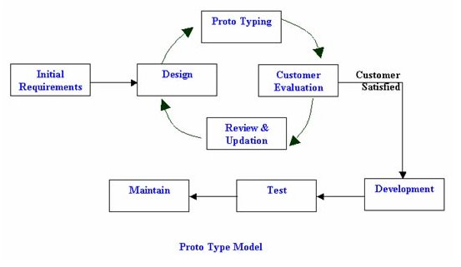
Prototype model

Slide 14
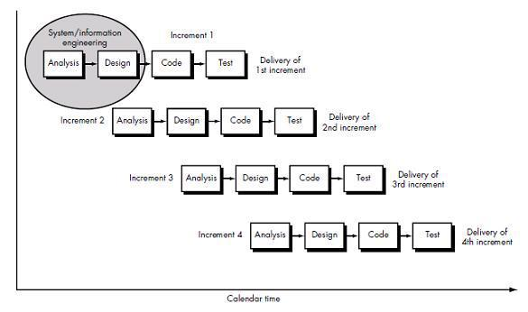
Increment model

Slide 15
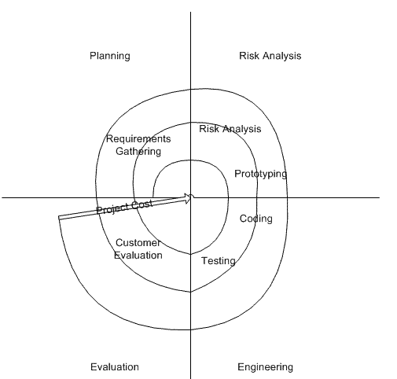
Spiral model

Slide 16
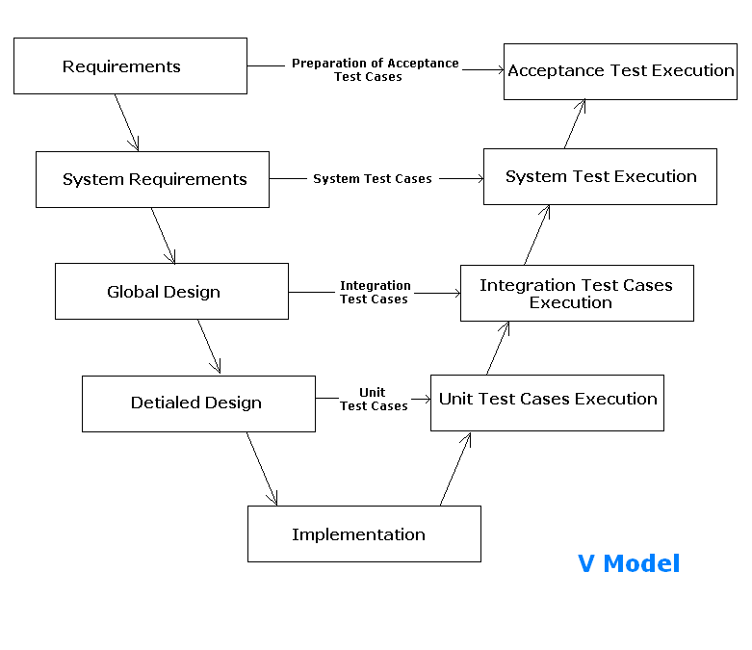
V – model

Slide 17
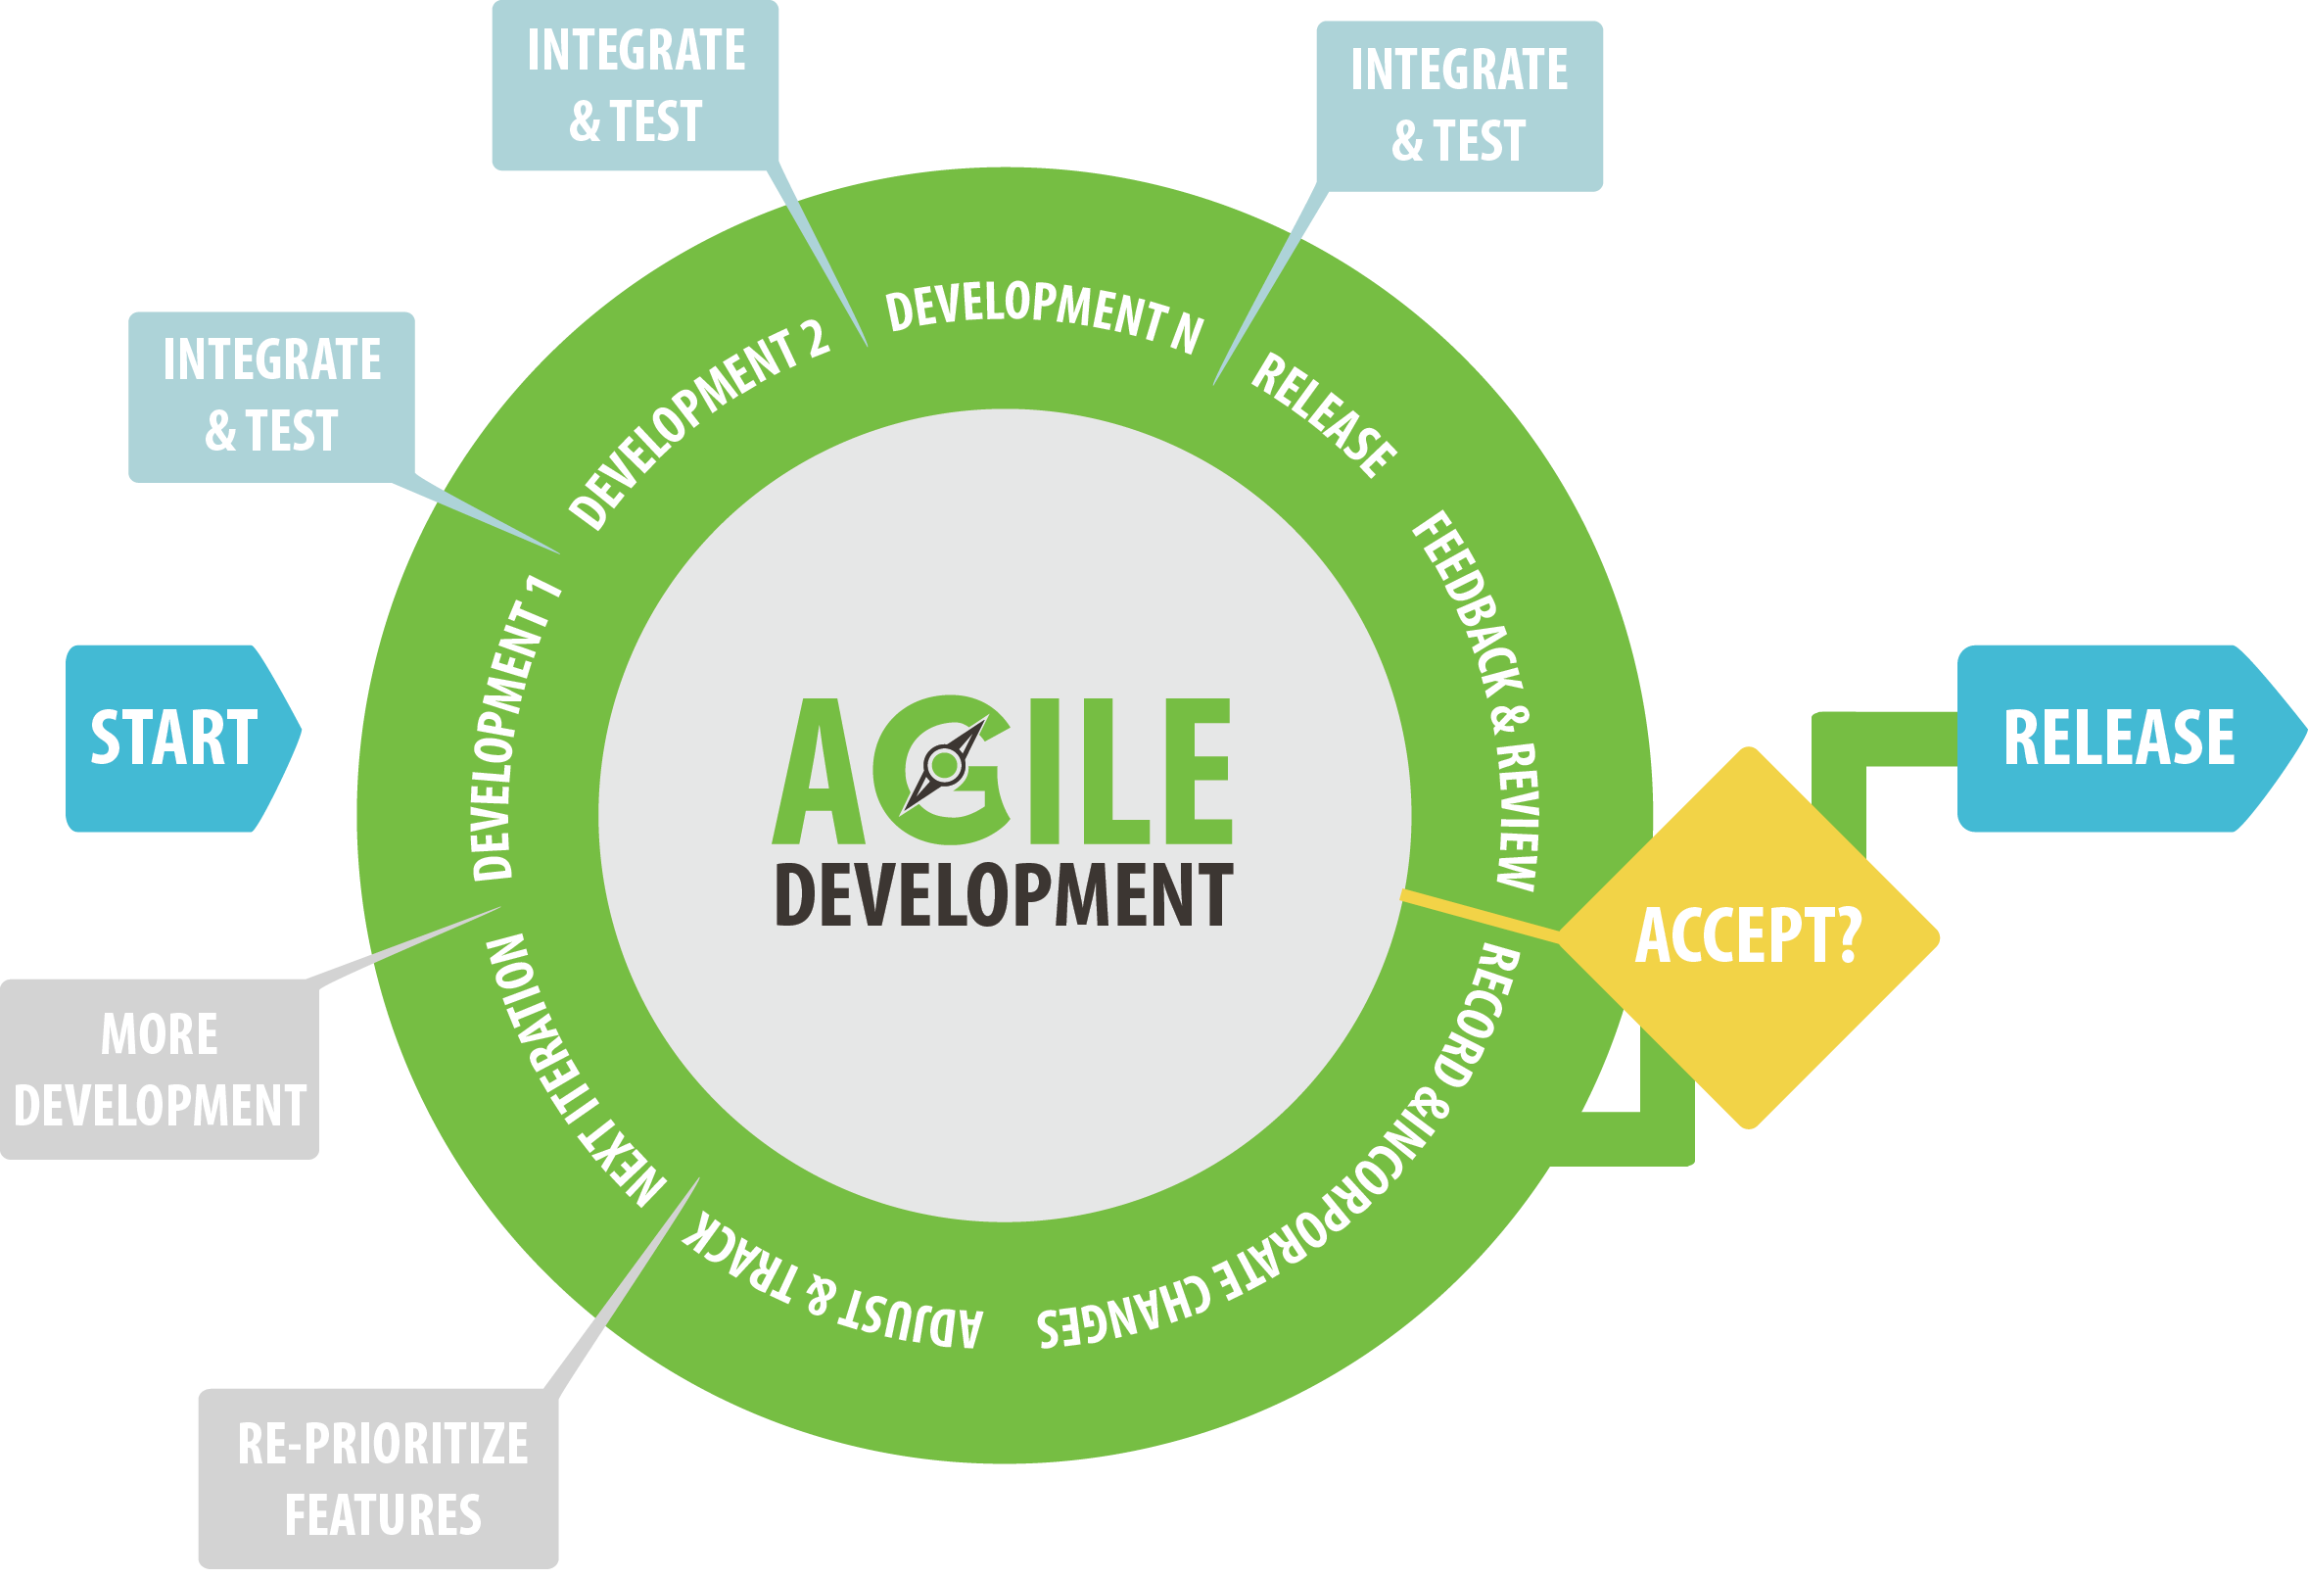
Agile development model

