Slide 1
LINKED LIST OPERATIONS
Shweta D'souza

Slide 2
CONTENTS
Introduction to linked lists
Types of linked lists
Singly linked lists
Doubly linked lists
Circular linked lists
Time complexity of linked lists
Advantages and disadvantages

Slide 3
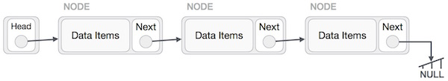
INTRODUCTION TO LINKED LISTS
Why Linked Lists?
What is a Linked List?
  Linked list can be visualized as a chain of nodes, where
  every node points to the next node.

Slide 4
TYPES OF LINKED LISTS
Singly linked list
Doubly linked list
Circular linked list

Slide 5
SINGLY LINKED LIST
Contains nodes which have data and address, which points to the
next node in sequence of nodes.
Head
1000
10 2000
20 3000
30 NULL
1000
2000
3000

Slide 6
DOUBLY LINKED LIST
Each node contains data, address of previous node and address
of next node in sequence of nodes.
100
Head
NULL 1 200
100 1 300
200 1 NULL
100
200
300

Slide 7
CIRCULAR LINKED LIST
Last node of the linked list contains the address of the first node
and forms a circular chain.
1000
Head
10 2000
20 3000
30 1000
1000
3000
2000

Slide 8
TIME COMPLEXITY OF LINKED LISTS
1. Indexing | Θ(n)
2. Insert / Delete at beginning | Θ(1)
3. Insert / Delete at end | Θ(n) , Θ(1)
4. Insert / Delete in middle | Search time + Θ(1)
5. Wasted space | Θ(n)

Slide 9
LINKED LIST (Cont...)
ADVANTAGES
Dynamic size
Ease of insertion / deletion
DISADVANTAGES
Random access of elements
not allowed.
Extra memory space needed
for pointer.

Slide 10
Any Queries ?

