Slide 1
FUNCTION STACK
VENKAT

Slide 2
CONTENTS:
MEMORY LAYOUT
INTRODUCTION TO STACK
PROLOGUE
BODY
EPILOGUE
CONCLUSION

Slide 3
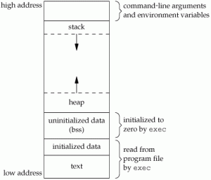
MEMORY LAYOUT:
A typical memory representation of C program consists of following sections.
1. Text segment
2. Initialized data segment
3. Uninitialized data segment
4. Stack
5. Heap

Slide 4
INTRODUCTION TO STACK :
STACK : When a program starts executing, a section of memory is set aside for the program called stack.
Stack operation is a top down operation.
DATA REGISTERS : AX, BX, CX, DX.
POINTER REGISTERS : Stack pointer (SP)
Base pointer (BP)
Instruction pointer (IP)

Slide 5
INTRODUCTION TO STACK :
STACK POINTER : It points to the top of the stack. It points to the most recent entry or last value put onto the stack.
BASE POINTER : It helps in referencing the parameter variables passed to a subroutine.
INSTRUCTION POINTER : stores the offset address of the next instruction to be executed.

Slide 6
INTRODUCTION TO STACK :
PUSH : It is used to store data into stack.
using push operation stack pointer is decreased first and then content of register will store on that stack.
POP : It is used to retrieve data from stack.
Using pop operation data is retrieved first and then stack pointer increased by one.

Slide 7
PROLOGUE :
Prologue prepares for the function execution and allocates some address space for the function execution.
Creates stack frame.
PUSH ebp;
mov esp , ebp;
sub 0x20, esp;

Slide 8
EPILOGUE :
Prepares function to leave the function execution / body.
Add 0x10;
pop ebp;
pop eip;
Prologue and epilogue are always complimentary actions.

Slide 9
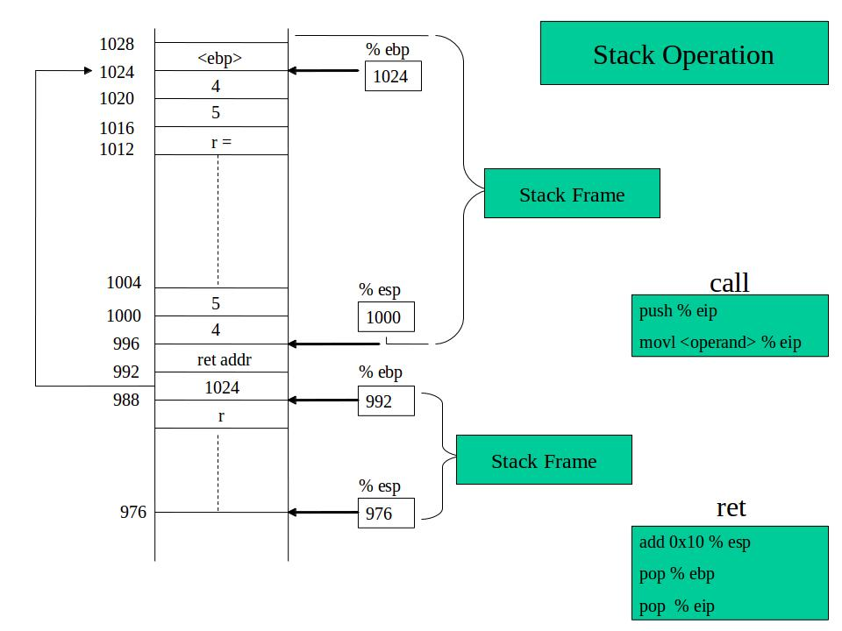

Slide 10
QUERIES???

