Slide 1

Automated Verbatim Classification Pipeline Using LLM + SharePoint & Databricks
MURIEL BOUYAUD
THIERRY FRICOTEAUX

Slide 2
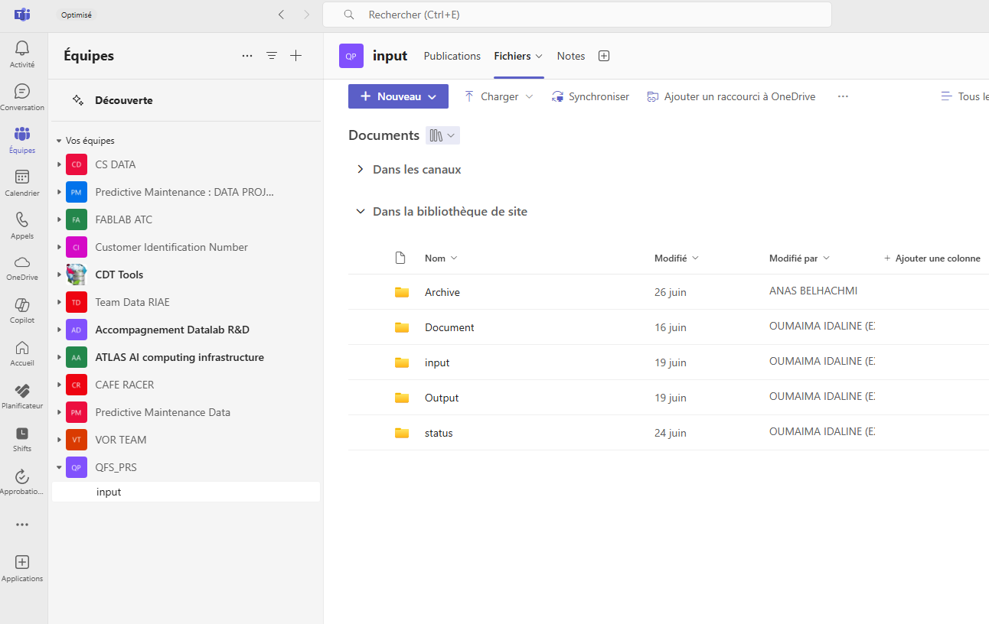
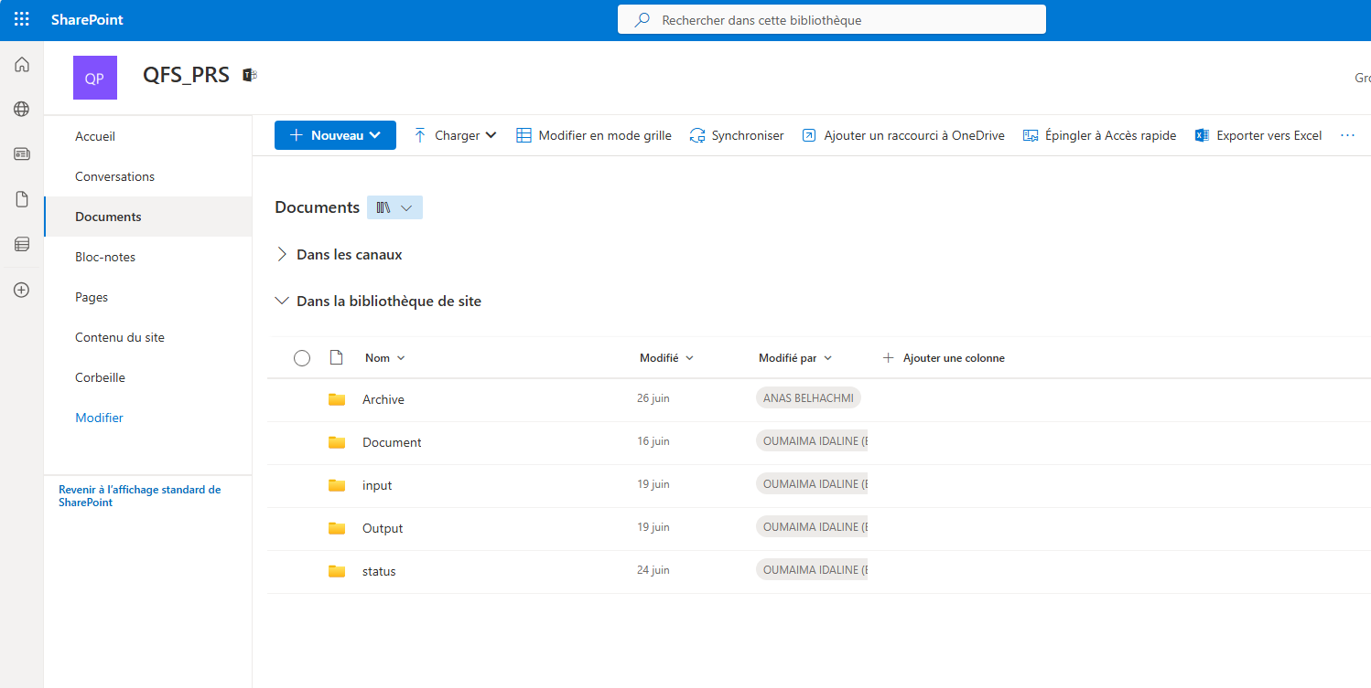
Access the SharePoint Channel
Open Teams or use a web browser
Go to the SharePoint channel QFS PRS : https://shiftup.sharepoint.com/sites/QFS_PRS/
Open the following folders:
-Input → to upload input files
-Output → to find classification results
-Status → to check processing status
-Archive → to check processed files
Note: Access to the QFS PRS SharePoint channel requires permission.
Please request access by sending an email to: anas.belhachmi@stellantis.com
cv
Access via Microsoft Teams
Access via Web Browse

Slide 3
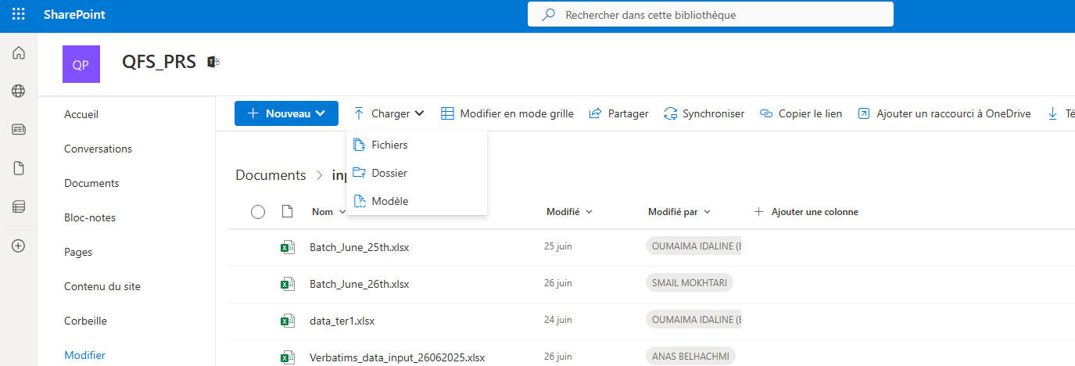
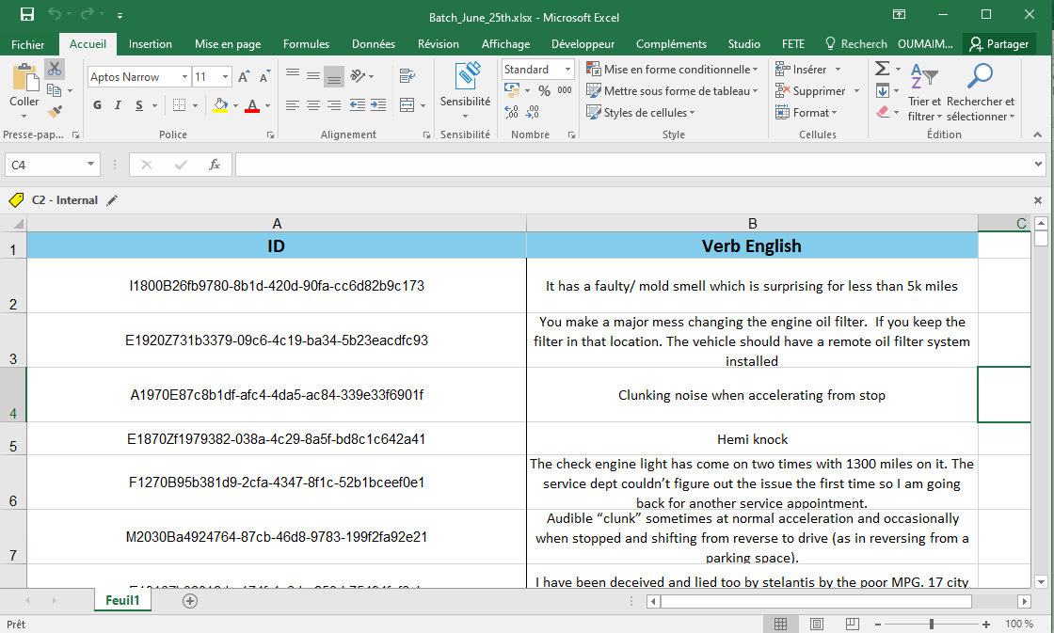
Upload an Input File
Go to the Input folder in the QFS PRS SharePoint channel to upload your file
File format: Excel .xlsx , .csv , .xls
Required columns:
ID (verbatim identifier)
Verb English (text to classify)
Important: Column names must be exactly ‘ID’ and ‘Verb English’
⚠️ Critical Reminders ✅
❗ Please make sure your Excel file
Contains only one worksheet (one sheet)
INPUT Folder in sharepoint
Excel input File

Slide 4
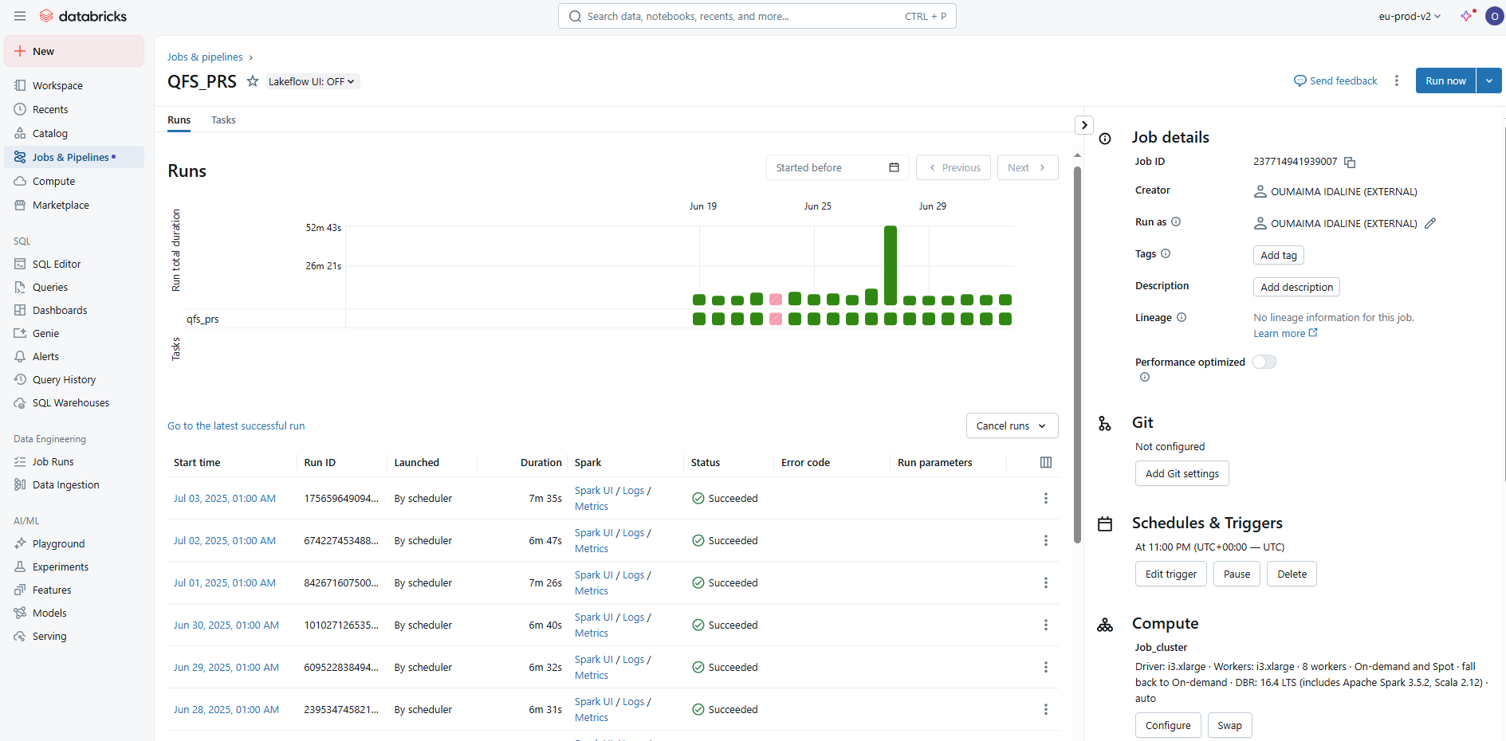
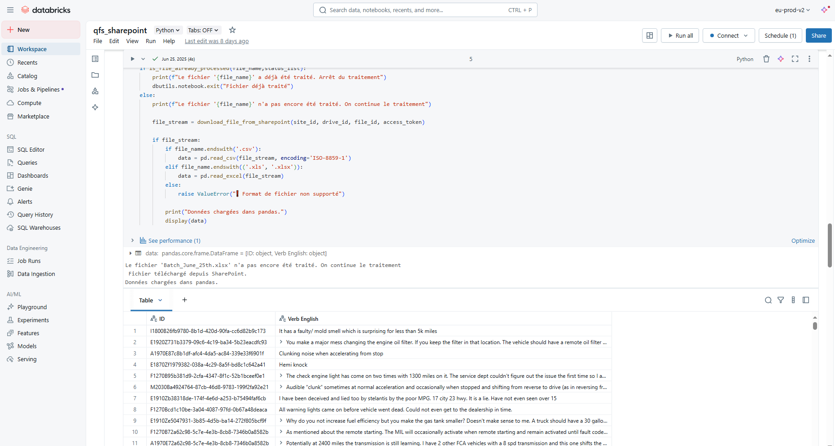
Automatic Processing (Databricks)
What Happens After uploading a file ?
A scheduled Databricks job runs every NIGHT
It checks the Input folder for new files
The file is processed using an LLM classification model
Output is automatically generated
It processes only one file per run— no manual action needed
⚠️ Critical Reminders :
✅ Only the most recently added or modified file in the Input folder will be processed. ➕ Please upload one file at a time. ❌ If multiple files are present, only the latest one will be taken, others will be ignored.
cc
Databricks Notebook (llm model)
Databricks Job

Slide 5
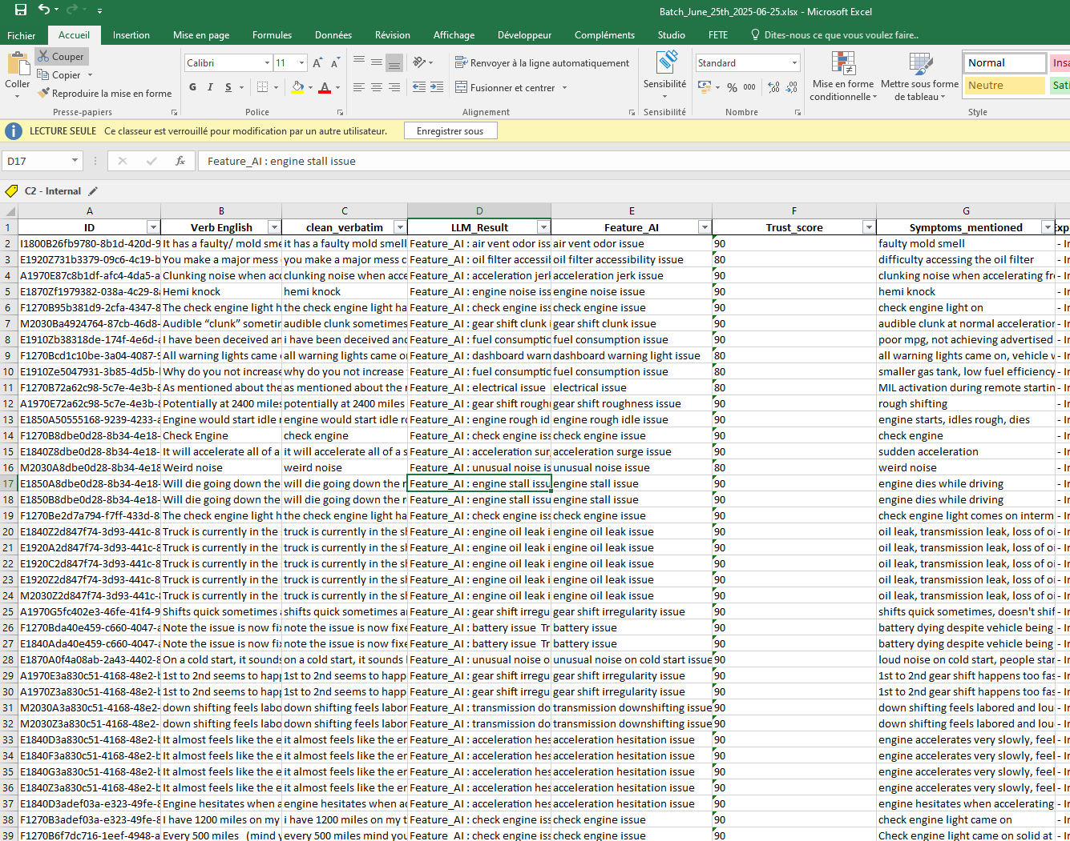
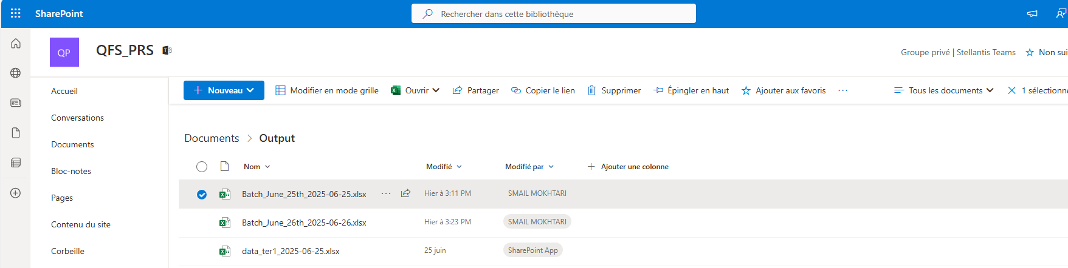
Retrieve the Output File
Once the job runs and completes successfully:
The output file is saved in the Output folder on SharePoint
File format: Excel .xlsx
File naming convention:
<inputFileName>_<processingDate>.xlsx
Ex:
Input file : ‘Batch_June_25th.xlsx’
Output_file: ‘Batch_June_25th_2025-06-25.xlsx’
Output Folder in sharepoint
Excel Output File

Slide 6
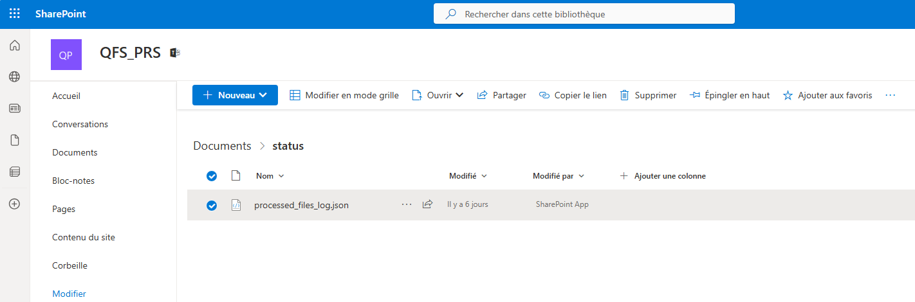
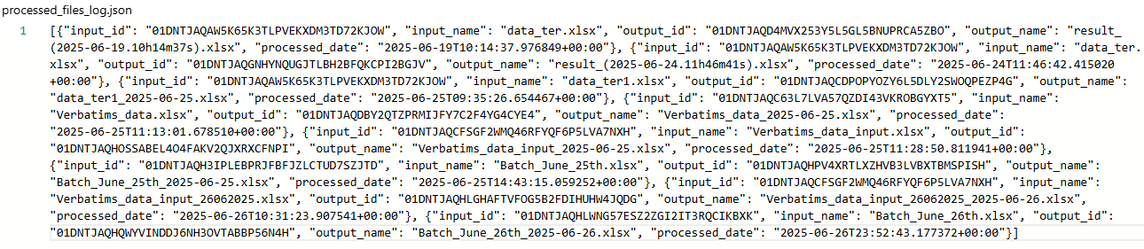
Check the Status
The Status folder contains one single JSON file, named like: processed_file_log.json
This JSON file is updated after each job run to add new entries.
For each processed file, it stores:
-input_id : identifier of the input file
-input_name : name of the input file
-output_id : dentifier of the output file
-output_name : name of the output file
-processed_date : date and time of processing
Processed_file_log.json
Status Folder in sharepoint

