Slide 1

Data Analysis : Brazil E-Commerce

Slide 2

Chapter 1) Sales Analysis
Trend Analysis
Customer Segmentation and Purchase Amount
Analysis and Considerations Part 1
Analysis and Consideration Part 2

Slide 3
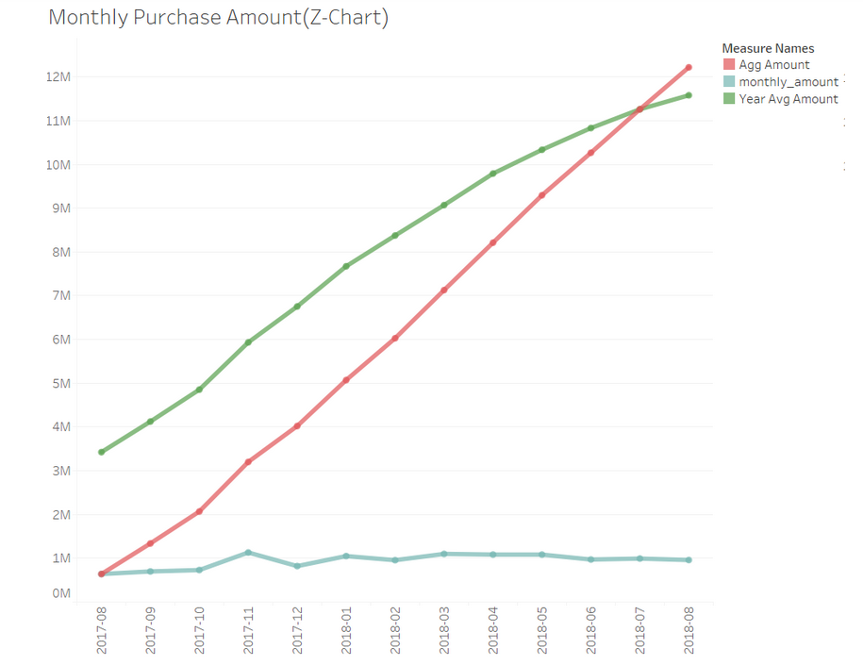
1) Trend Analysis * Short-Term Trend : Sales has been in the increasing trend for the first six months, followed by decreasing and steady around 1 million. * Mid-Term Trend: The medium-term line shows how sales have built up over the 12 months. * Long-Term Improvement: Looking the longer-term rolling 12-month figures, the company has enjoyed an unprecedented level of growth in sales.

Slide 4
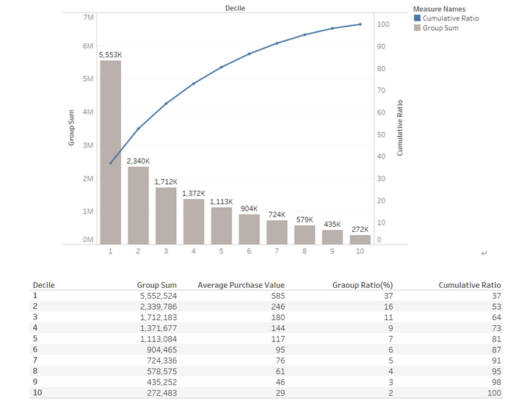
2) Customer Segmentation and Purchase Amount

Slide 5
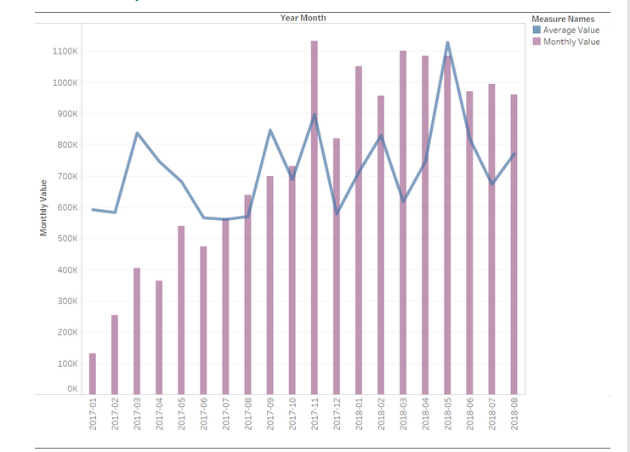
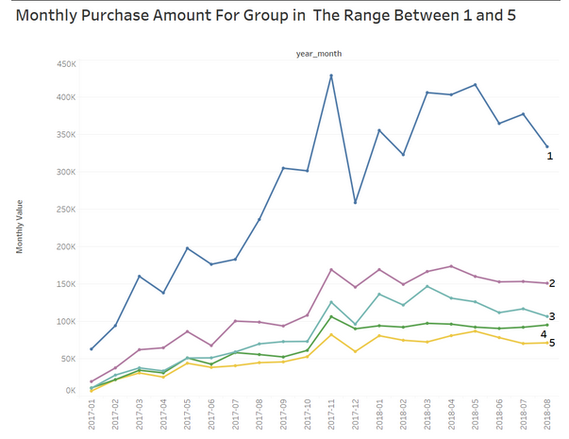
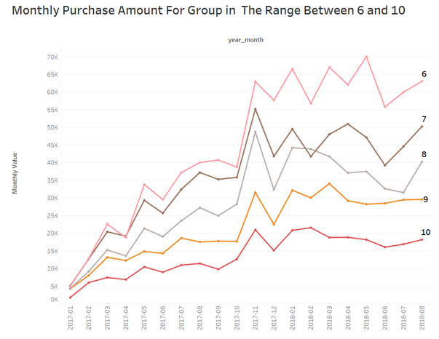

Slide 6
Analysis and Considerations (1)
The latest movement shows sales have kept either decreasing or constant around a certain level.
Special attention must be on those groups that can generate a strong influence on the overall sales.
There is no overturning from the decreasing trend in decile 1, the highly influential group in company sales. A suitable marketing strategy that aims at this group seems to be required to encourage their spendings.

Slide 7
RFM Analysis and Considerations (2)

Slide 8
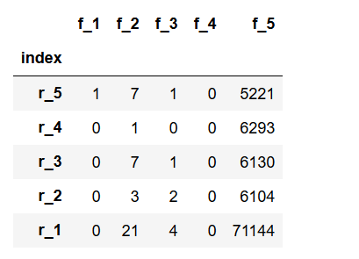
One Time Buyer Problem
Customer acquisition seems to be hard as most of its customers have not yet come back after placing their first order.
Poor Customer Loyalty
The top of the left also implies customers tend to make infrequent and fewer purchases after the initial purchase.
Recommendation
A though investigation on the causes of higher customer churn and an immediate measure to deal with it should be necessary.

Slide 9
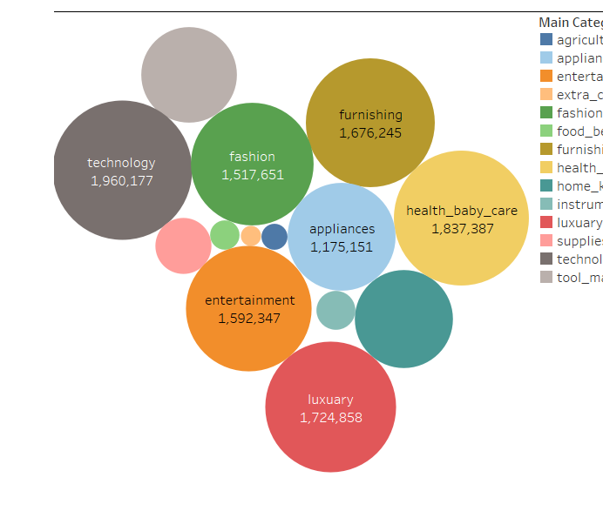
Part 2. Product Segmentation

Slide 10
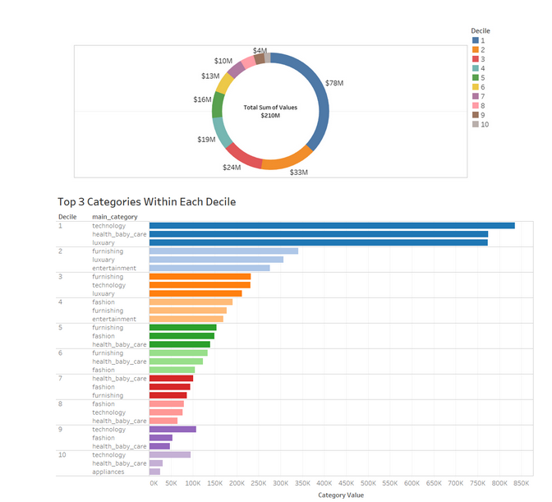
Product Popularity Among Groups

