Slide 1
NoSQL
#
CopyLeft©
Ajinkya

Slide 2

You are the CTO!!!

Slide 3
Before NoSQL?

Slide 4

Relational & SQL!!!
Notes:
Codd paper was published in 1970 and first relational db was released in 1980

Slide 5
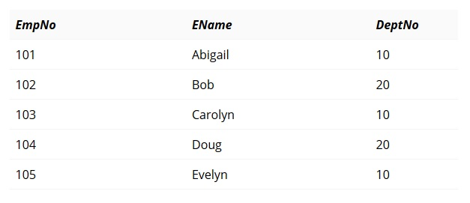
Things were simple…
Record
Notes:
Relational uses tabular data model, based on row and column

Slide 6







Slide 7
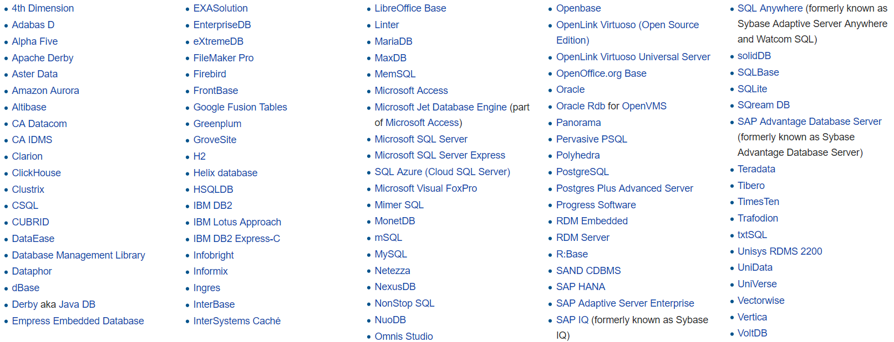
Around 120….
- Wikipedia

Slide 8
NoSQL!!!

Slide 9










Currently > 225
Notes:
NoSQL started around 2000

Slide 10
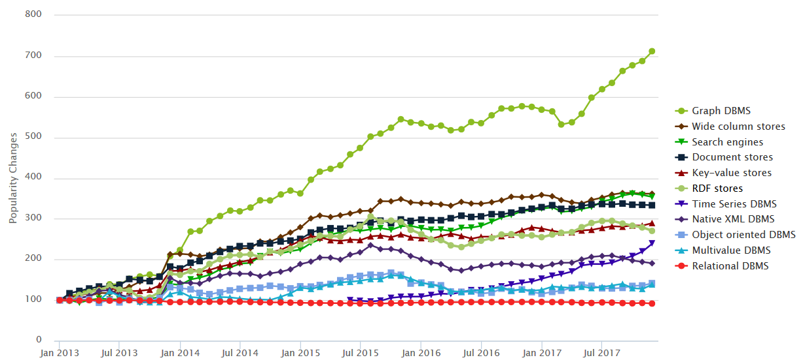
Popularity of Databases…
Source : Db-Engines.com

Slide 11
Why are you moving away from me ☹?
- Yours RDBMS

Slide 12
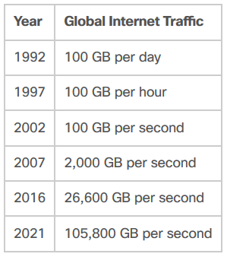
Data is growing every day second…
Source : Cisco.com
Notes:
Data is getting doubled every 2 year and will double in every 8 hour by 2021. We are at zettabyte and last scale is yottabyte.

Slide 13
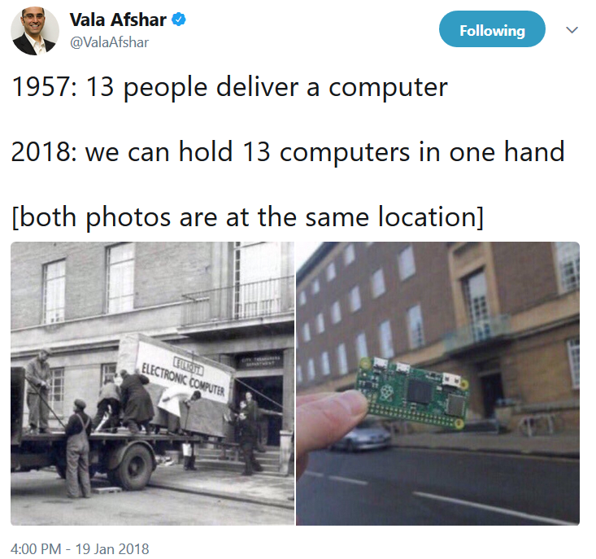

Slide 14

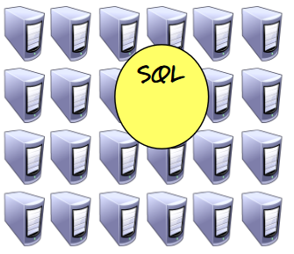

Scaling relational DB is Expensive….

Slide 15
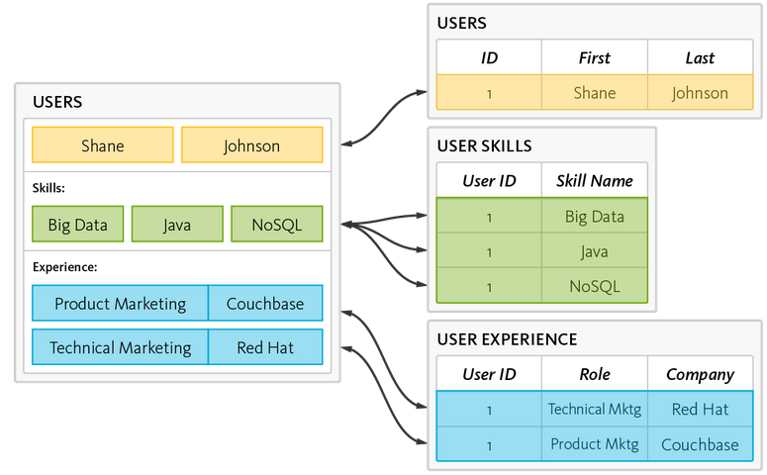
ORM
Relational DB
Object

Slide 16
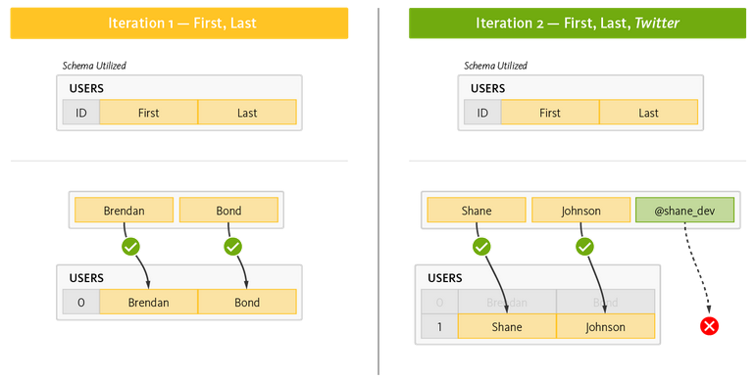
Things are changing fast, really fast…

Slide 17

NoSQL to rescue!!!

Slide 18
#NoSQL
NoSQL?
Notes:
It is just a hashtag

Slide 19
NoSQL….
No Relational and no SQL
Designed to run on a cluster
Don’t have fixed schema
Tend to be open source

Slide 20
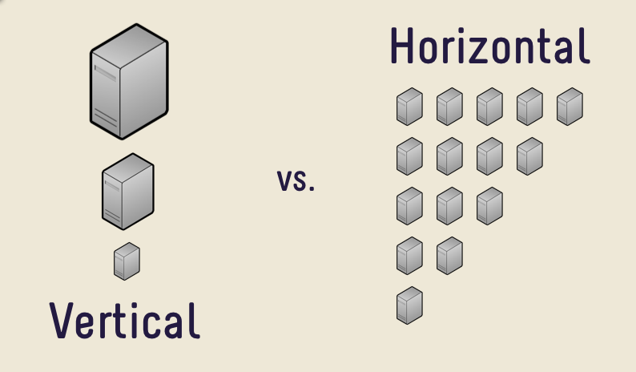
NoSQL is made to scale….

Slide 21
NoSQL are Schema – Less…
Don’t enforce rigid schema
Don’t enforce strict type limitation
Models business usage

Slide 22
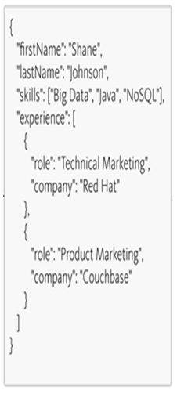
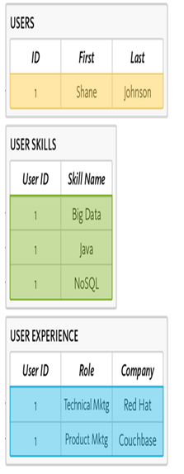
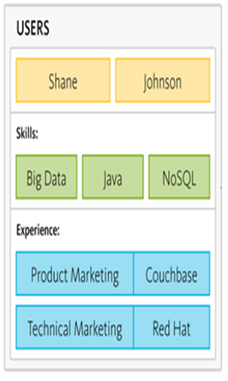
Relational
NoSQL
Vs
Notes:
Schema on write (NoSQL) vs Schema on read

Slide 23
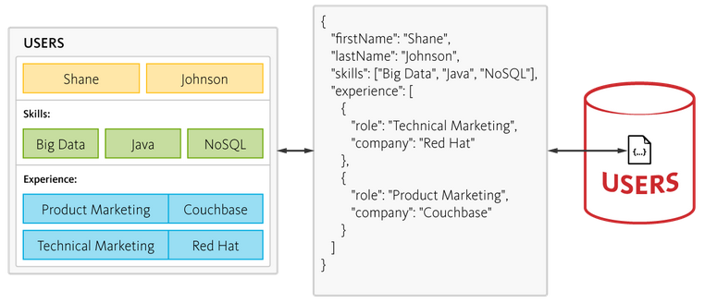
No more Object – Relational mismatch!!!

Slide 24
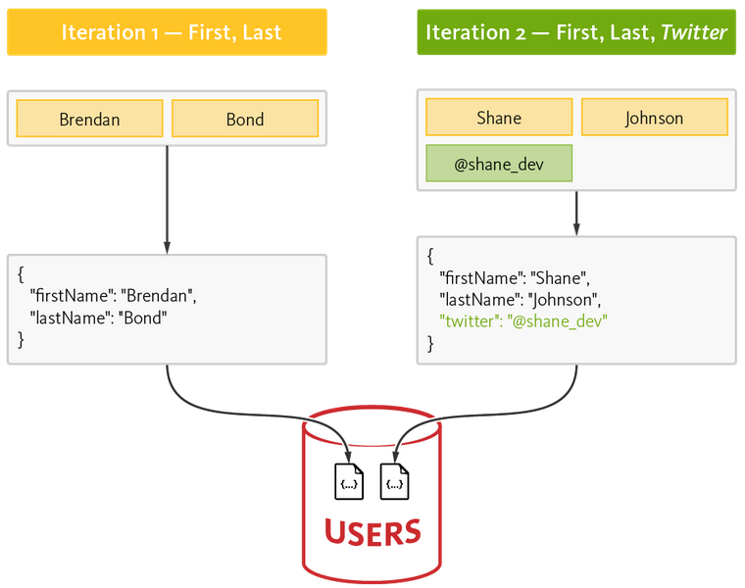
Adapt to changes…

Slide 25
Types of NoSQL Db…
Key – Value
Document Store
Column store
Graph
Multi Model

Slide 26
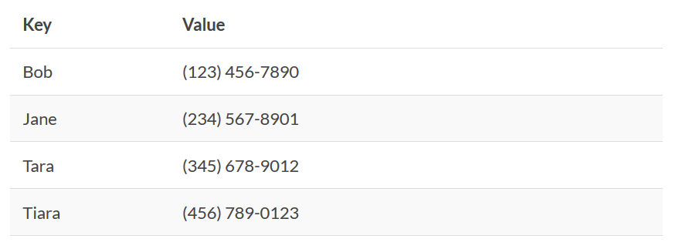
Key – Value …
Notes:
Dynamo, Redis

Slide 27
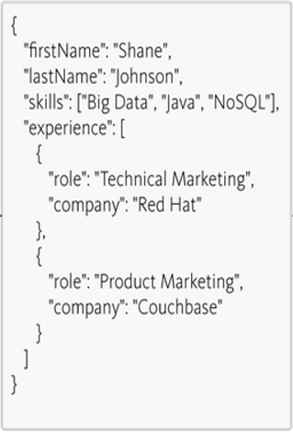
Document Store …
Notes:
Mongo, Couch db

Slide 28
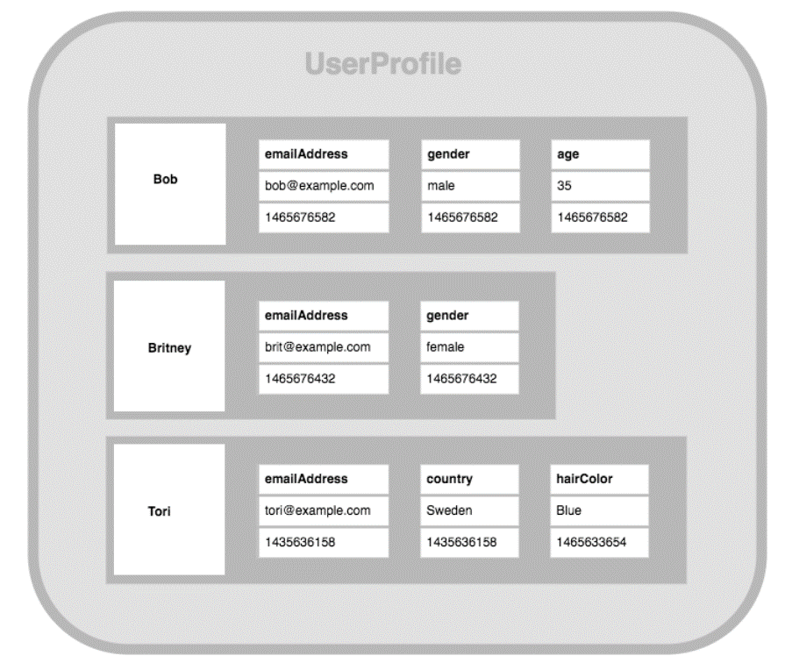
Column Store …
Notes:
Hadoop, Cassandra

Slide 29
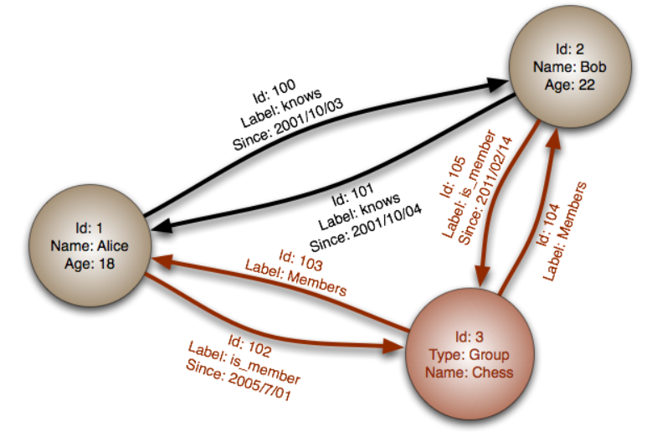
Graph …
Notes:
Neo4j, Titan

Slide 30

NoSQL a silver bullet?

Slide 31
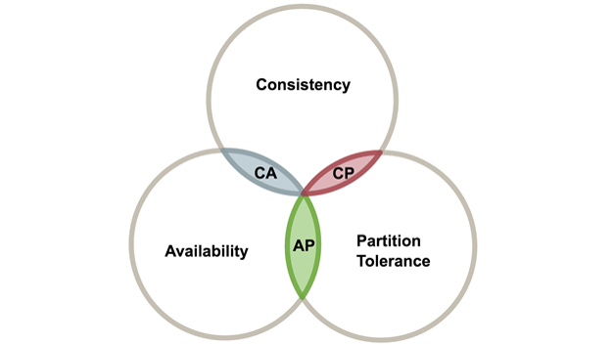
Flexibility vs Consistency…

Slide 32
And….
Relations model is still relevant
Tools
Familiarity

Slide 33

What is next?

Slide 34
Polyglot Persistence might be the next thing!!!

Slide 35
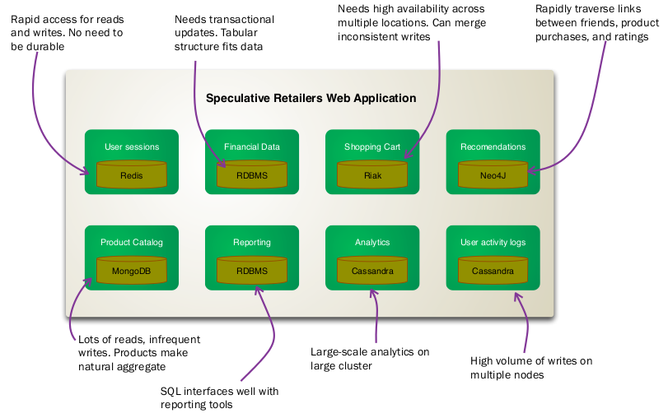
Source : MartinFowler.com
Notes:
Ajinkya
1. my SQL for structured data storage like wall posts, user info etc. 2. MEMCACHED, a memory caching system that is used to speed up dynamic database driven websites. 3. Haystack for managing photos. 4.Cassandra for inbox search. 5. Varnish 6. Hip hop for php. 7. Scribe.

Slide 36
?

