Slide 1
Advanced Data Analytics Logbook

Slide 2
IT Request
…

Slide 3
IT Request
Dimension Data

Slide 4
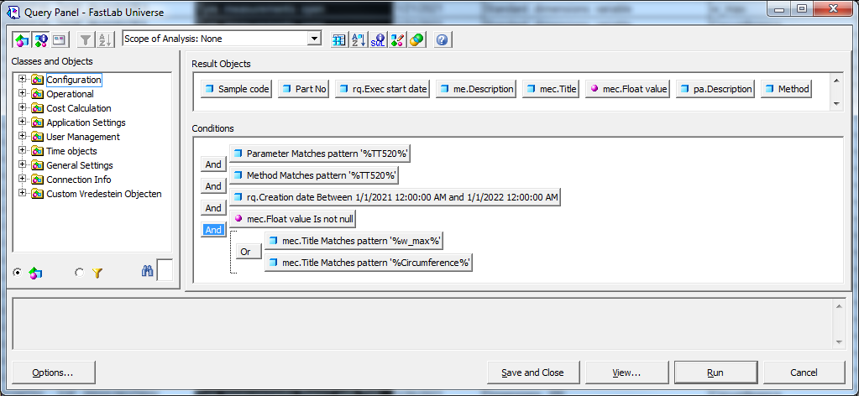
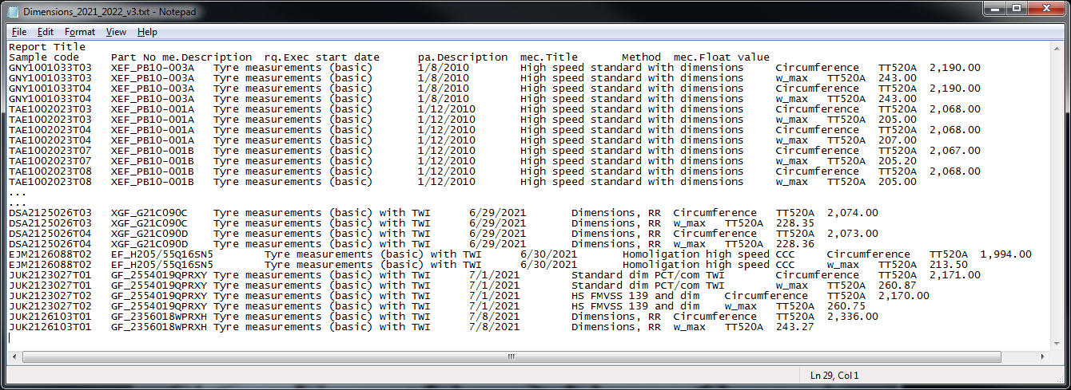
Dimension data [1]
Example selection
Motivation:
Prepare data mining for planned Data Analytics internship with the goal to predict cured tyre dimensions (outer diameter (OD) and width) based on cavity and tyre specifications
The output data (OD and width) are stored in
The input data (D-spec and perhaps more) are stored in Interspec
Business Objects (BO) query and example selection
BO queries were used to get an idea about the amount of data available
A typical query and the results are shown on the right. (Further filtering based on the method title is pending)
Subsequently, the following examples were selected based request age and specification type (experimental (X) or not and plant (EF / GF):
TAE0940000T03 (2009, XEF)
EJM2126088T02 (2021, EF)
DIT1824089T05 (2018, GF)
DSA2125026T04 (2021, XGF)
Notes:
Purple RGB: 149, 25, 239
Dark gray RGB: 105, 105, 105 (light gray is default Abaqus)

Slide 5
Dimension data [2]
Example data
Based on example 1 - TAE0940000T03
Request: TAE0940000T
Sample: TAE0940000T03
Specification: XEF_PB09-169A
Output:
w_max from method TT520A (229 mm)
Circumference from method TT520A (2209 mm)
Assumptions: rim dimensions and inflation pressure are determined by the specification and SOP
Input:
Information stored in the D-spec is very limited w.r.t., for example, EF_H205/55Q16SN5 [22] (example 2)
Is the amount of data related to the specification or the version of the specification / frame?
Based on example 2 - EJM2126088T02
Request: EJM2126088T
Sample: EJM2126088T02
Specification: EF_H205/55Q16SN5
Multiple versions of the specification are present. How to select the right one?
Output:
w_max from method TT520A (229 mm)
Circumference from method TT520A (2209 mm)
Assumptions: rim dimensions and inflation pressure are determined by the specification and SOP
Input:
Master drawing information from D-spec
Segment information from D-spec
Construction type from D-spec
D-spec information from D-spec
Currently, it is not clear which data we need (needs to be discussed with designers and tyre engineers). But it is good to know whether these data above can be retrieved or not.
Additional material (rubber and reinforcement) codes might be required. This is available in the “Materials and compounds” section in the D-spec. Can the code be linked to lab data (for example compound modulus)?
Notes:
Purple RGB: 149, 25, 239
Dark gray RGB: 105, 105, 105 (light gray is default Abaqus)

Slide 6
Dimension data [3]
Questions
Q) There are ~20k lines in the txt-file on slide 4 which means ~10k data points (with both Circumference and w_max). However, the amount of data stored in the D-spec for specification XEF_PB09-169A (example 1) might be too limited to be useful. Is the amount of data in Interspec related to the date the specification was created (old => new version)? Or can different specifications created today contain different amounts of data?
Q) Is it possible to get more information about the versions: amount of data stored, when this version was used, etc.?
Q) Specifications can have different version: for example, EF_H205/55Q16SN5 contains 23 versions which were current at different times between November 2018 and July 2021. Is it possible to retrieve the data from a specific version based on some date (date of the tyre building, test execution, etc.)?
Q) Just to be sure: is it possible to retrieve all the data that are visible in Interspec (related to “Master drawing general”, “Master drawing”, “Tread grooves”, “Parent segment”, etc.)?
Q) Perhaps not for predicting the Tyre Dimensions, but for other performances such as Rolling Resistance, it will be required to get information about the mechanical properties of the (rubber or reinforcement) materials in the specifications. Looking at EF_H205/55Q16SN5 [22], we see --- in the “Materials and compounds” section in the D-spec --- that EC_FE02 is used for the ply. Is it possible to:
drill down and get the rubber compound and reinforcement codes used in EC_FE02 (EM_766 and GR_8312, respectively, but this will depend on the date) and
to get the properties of the materials stored in Interspec (for example: “EM_766 => Properties => “Properties FM” => “Hardness” and “Rebound”) or Unilab (for example data coming from TP046BA or TP047AA)?
Notes:
Purple RGB: 149, 25, 239
Dark gray RGB: 105, 105, 105 (light gray is default Abaqus)

Slide 7
IT Request
HS Data – See datamodel_lims_questions_v01 excel file

Slide 8
Queries
in finding relationship of GF/XGF_Current part numbers between:
TT520X (Overall Dia, Section Width) (1st priority)
D-spec (all cavity and all construction parameters) (1st priority)
Bill of materials (2nd priority)
Understanding link between spec revision and test result.
Peter:
I have created a saved-query (named: query_sc_related_partno) by which you can retrieve a partno related to sample.
This is an example-query.
By replacing the sample-code by your requested sample you can retrieve the sample-code for that sample.
Do you have permissions to execute the saved-query by me?
I hope this query helps you to find a solution for your analysis. If not, then let us know.
An important reminder for you is, that the data in AWS-redshift-environment is only data from Unilab created after 2019.
If you need more data for your analysis we have to discuss that with Shailender/Alban.
Peter:
Because of the migration from our pilot-environment to the base apollo-environment all the settings were taking into account, except for the saved-queries.
It seemed that these were user-dependent and were not part of database or redshift-settings (very strange), so I had to create them again.
I have created them again in our new redshift-apollo-environment. I hope you can see them now, please let me know if you can’t.
--QUERY: query_sc_partno:
--
select sc.sc, sc.st, gk.gk, gk.VALUE
from unilab.utsc sc
, unilab.utscgk gk
where sc.sc = gk.sc
and gk.gk = 'PART_NO'
and gk.value like 'GF_2556017QT5NV'
;
--QUERY: query_sc_related_partno
--
select sc.sc, sc.st, gk.gk, gk.VALUE
from unilab.utsc sc
, unilab.utscgk gk
where sc.sc like 'DSA2109003T01'
and sc.sc = gk.sc
and gk.gk = 'PART_NO'
--and gk.value like 'GF_2556017QT5NV'
;

Slide 9
Goal of the activity would be to predict SW and OD using our databases: Interspec and Athena
Requirements are especially strict with OEMs – where tolerances are lower vs. replacement market
Better prediction would be beneficial:
• Give Tire Engineers freedom to operate and freedom to design (using all available constructions)
• In addition – and in worst case – additional moulds would not be needed
• All moulds could be designed with OEM accuracy – removing need for dedicated OEM moulds (e.g. Wintrac Pro mould would be same for OEM and Replacement)
Reasons simulations are not suitable for predicting SW and OD: PCI (Post Curing Inflation) is not available
Analysis to split between ENS and GYO
Input parameters from Interspec:
Width
AR
Rim Type
STD/RFT
Mold N.
MBW
MBW "
OD mold
SW mold
Measuring rim Measuring rim "
OD tire
SW tire
Body ply type
n. of body ply
Apex height
Layout spiral
Type spiral
Belt material
Belt angle PCI pressure - Rim Reinforce OD growth SW growth
+ rim protector info
+ ???
Results from Unilab:
OD SW
Future application proposals:
• in Xpert (@Kars Reinders – to be discussed possibility with)
• designers would design cavity based on dimensions’ boundaries and Engineer’s desired construction
Next step would be to connect with Kashyap’s approach and go to the IT.

Slide 10
Thank you

