Slide 1
Unilab Developer Training
Unilab Database Training

Slide 2
Topics (1)
Unilab database training
  Conventions used
  Structure of the Unilab database
  Detailed discussion of the Unilab tables
  Querying the database
Unilab Architecture
  2 tier / 3 tier architecture
  Concept of event manager
  Concept of distributed event manager

Slide 3
Topics (2)
Introduction to the DB API’s
  Definition and use of API’s
  Structure of the API’s
  Functional reference
Customizing Unilab
  Unilab custom functions
  Introduction to DB custom functions
  Introduction to client custom functions
  How to use custom functions

Slide 4
Simatic IT Unilab
Database

Slide 5
Database
Naming Conventions
Structure of the Database
Detailed description of the Tables
Querying the Database

Slide 6
DB Conventions
Object naming convention
utstpp
Unilab
Unilab sub-object type
DB object
type
Unilab object type

Slide 7
DB Conventions (2)
DB object types
  i index
  k primary key
  r role
  t table
  v view
Packages
  unapi + object type
  un + custom function type

Slide 8
DB Conventions (3)
List of abbreviations
  Unilab objects (e.g. st, pp, up)
  Object properties (e.g. hs, ar)
  Config. versus operat. (e.g. pr - pa)
Table naming examples
  Main object table : utst
  History : utsths
  Relation between objects: utstpp
  Attributes on relation: utstppau

Slide 9
Database
Naming Conventions
Structure of the Database
Detailed description of the Tables
Querying the Database

Slide 10
DB Structure
DB Model
  Object structure => DB structure
  Configuration versus Operational
    Functional differences
    Technical differences
  Fixed table structure

Slide 11
Configuration Model
Method
sheet
Info field
definition
uses
filter
Parameter
definition
Info
profile
Sample
type
Parameter
profile
Request
type

Slide 12
Object structure
Access rights
grp. key 1
Object
standard properties
Attributes
.
.
.
History
Life cycle
uses
other
objects
standard
properties
Attributes

Slide 13
Table Model
utst.ar*
Example:
Sample Type
utst
utstau
utsths
utst.lc
st - pp
utstpp
utstppau

Slide 14
Access rights
Sample type
Attributes
std. properties
History
Life cycle
uses
parameter
prof
standard
properties
Attributes
Access rights
Parameter profile
std. properties
Attributes
History
Configuration
Life cycle
uses
parameter
standard
properties
Attributes

Slide 15
Operational Model
Request
Info
card
Sample
Parameter group
Parameter
Info
field
Method
Raw
data

Slide 16
Access rights
Sample
Sample
Attributes
std. properties
History
Life cycle
uses
parameter
prof
Parameter group
standard
properties
Attributes
Access rights
Operational
Parameter group
std. properties
Attributes
History
Life cycle
Parameter
uses
parameter
standard
properties
Attributes

Slide 17
utsc.ar*
Sample
utsc
utscau
utschs
utsc.lc
Parameter group
utscpg
utscpgau
utscpg.ar*
Operational(2)
utscpg
utscpgau
utscpghs
utscpg.lc
Parameter
utscpa
utscpaau

Slide 18
Database
Naming Conventions
Structure of the Database
Detailed description of the Tables
Querying the Database

Slide 19
Table structure
Main object table
utxx
xx
version*
description
...
...
lc
ss
active
allow_modify
ar1
...
ar16
primary key
all std. attributes
only if object has
access rights
* Not in utsc, utrq
Notes:
Version
On configuration level
Always part of primary Key (with our without 21CFR11 license)
Examle 21 CFR 11 license
Sample typex 0001.00
Sample typex 0002.00
For non 21CFR11 -> value is set to 0000.00 (demo data) or 0001.00 (newly created objects)
AR*
Number of columns can be up to 128 (128 dd)
Number is decided upon DB creation
Default = 16

Slide 20
Table structure (2)
Used Object (Configuration)
utxxyy
xx
version
seq
yy
...
...
primary key
all std. attributes

Slide 21
Table structure (3)
utscpa
Operational object
sc
pg
pgnode
pa
panode
...
lc
ss
active
allow_modify
ar1
...
ar16
primary key
all std. attributes

Slide 22
Node numbering
Nodes on all levels
  pgnode, panode, menode, icnode, iinode, rdnode
Each node only relates to one level
  pgnode: sc - pg relation
Nodes add up downward
  sc - pg - pa: pgnode AND panode
Node numbering allows
  insert before (*)
  insert between
  append

Slide 23
Node Numbering(2)
Example
970117-001
    Chemical
      pH
      Moisture
        M1
        M2
    Microbiological
Node
1000000
  1000000
  2000000
    1000000
    2000000
2000000

Slide 24
Attribute tables
utxxau
Au configuration tables
  Utau
  Utauhs
  Value lists
    Utaulist
    utausql
xx
version*
au
auseq
value
* Not in operational tables

Slide 25
Group key tables
Table structure identical to attributes
  Not all objects have group keys
    Only st, sc, rt, rq and me
utxxgk
xx
version*
gk
gkseq
value
* Not in operational tables

Slide 26
Group key tables -
Group key definition
utgkxx
  Example: utgkst, utgksc
  One table per object type
  utgkxxlist, utgkxxsql
  utgkrules
utgkxx
gk
Description
...
all gk properties

Slide 27
Group key tables (2)
Special tables per group key
  E.g. group key ‘supplier’ on st
    Special table utstgksupplier
    Columns: st, supplier
Use
  Safety: dynamic tables
  Recreation of structures
  In GUI: overview of all group keys
DO NEVER INSERT MANUALLY
INTO ANY TABLE

Slide 28
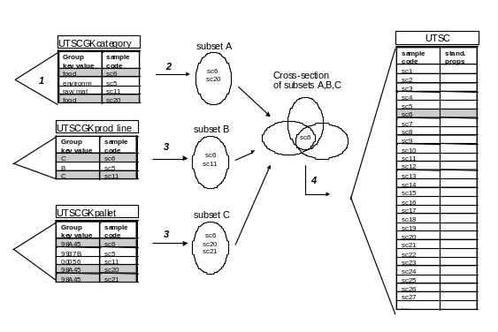
Group key mechanism

Slide 29
Group key tables - Overview
Group keys
for object
Group key
definition
utxxgk
utgkxxlist
utxxgkyy1
utgkxx
utgkxxsql
utxxgkyy2
utxxgk...
Dynamic
group key
tables

Slide 30

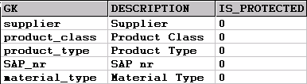


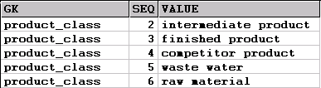
Group key tables - Example
Group keys
for object
Group key
definition
utstgk
utgkst
utstgkproduct_class
utstgksap_nr
utgkstlist
Dynamic
group key
tables

Slide 31
DB Model - Requests
Group keys
Access rights
Request
Request
Attributes
std. properties
Parameter
Profiles
History
Life cycle
uses
samples
Sample
Access rights
Sample
std. properties
Attributes
History
Life cycle

Slide 32
DB Model - Requests
utrqgk
utrq.ar
Request
utrq
utrqau
utrqpp
utrqhs
Utrq.lc
utrqsc
Sample
Utsc.ar
utsc
utscau
Utrqpp uses seq in stead of nodes!
utschs
Utsc.lc

Slide 33
Request Types
utrt.ar
utrtgk
utrt
utrtst
utrtau
utstau
utrths
utrtppau
utrtip
utrt.lc
utrtpp

Slide 34
DB Model Worksheets
Physical DB model of “worksheet”
utwsgkOpenSheets
utwsgk
utws
utwsau
utwshs
utwssc
utwsii
utwsme
Physical DB model of “worksheet type”
utwt
utwtau
utwths
utwtrows
row
st
sc
create [Y|N]

Slide 35
Equipment
Access rights
Equipment
attributes
History
Measurement ranges
Life cycle
History
Equipment constants
History
Interventions
Communication drivers
uteqar
uteq
uteqau
uteqhs
uteqmr
Uteq.lc
uteqctold
uteqct
uteqcalog
uteqca
utcd

Slide 36
User profiles / users - Model
Experience level
Qualification level
User profile
Functional access rights
Functional access rights
Preferences
Preferences
History
Tasks
Task Details
preferencelist
tasks
Task Details
Users
in
profile
Task pref
Tasks
Task Value Lists
Preferences
Functional access rights
Outlookpages
Data Domains
Outlookpage tasks
User (address)

Slide 37
User profiles / users - Model
utupel
utqualification
utup
utupfa
utfa
utuppref
utpref
utupus
utpreflist
utuptk
utuptkdetails
uttk
utupustkdetails
uttkpref
utupus
utupustk
utupustkvaluelists
utupuspref
utupusfa
utupusoutlookpages
utdd
utupusoutlooktasks
utad

Slide 38
Life cycles - States
Life cycles
States
  utss
  utsswl: worklist assignment rules
Life cycle
Transactions
Actions
Authorisation
utlc
utlctr
utlcaf
utlcus

Slide 39
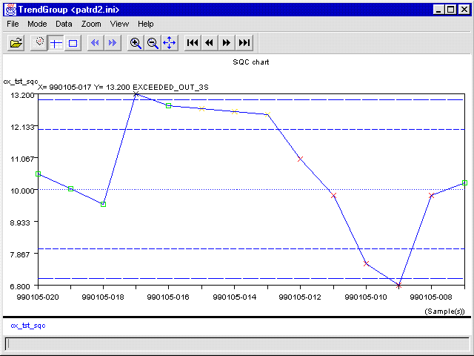
Tables for Trending and Reporting
Copy of results into special table
  Trending
  Alarm exceptions
    utresultexception
utscpa
utscpatd

Slide 40
Special Tables (1)
Specs
  utppspa, utppspb, utppspc
  utscpaspa, utscpaspb, utscpaspc
Reanalysis tables
  utrscxx (e.g. utrscpa)
  utrscpaspa: specs valid for reanalyses
  utrscrd: raw data for reanalyses
Unilink
  utul…
Layouts
  utly, utuicomponent
Unique code masks / Counters
  utuc,…/ utcounter

Slide 41
Special Tables (2)
  Sample type based freq → utstprfreq, utstmtfreq
  Lookup table → utlu
  Shortcuts → utshortcut
  Delays → utdelay
  Week numbers → utweeknr
  year numbers → utyearnr
  Archiving → utarchindex, uttoarchive
  Predefined comment → utcomment
  Decode for reporting → utdecode
  Editable tables → utedtbl
  Long text table → utlongtext
  Print command → utprintcmds
  Variable Format → utvformat
  Title format → uttitlefmt

Slide 42
Special Tables (3)
General tables
  utsystem : system setting
  utobjects : general object properties
  utapplic : Application names
  utotdetails : Object type details
  utdba : for restricted use by DBA (DBA settings in DB)
Error logging
  uterror
  Logging of errors on DB side
  Only general failures are logged

Slide 43
Other Tables
Add-on tables
  Custom tables for customer / project
  ATXX
BusinessObjects tables
  OBJ_XX : security domain + document domain
  UNV_XX : universe domain
  DS_XX : part of document domain
Oracle tables

Slide 44
Column Data Types
CHAR
  Only CHAR(1) or CHAR(2)
    Boolean flags:
      ‘0’ = FALSE / ‘1’ = TRUE
    Access rights
      ‘N’ = No Access / ‘R’ = Read Only / ‘W’ = Write
VARCHAR2
  All strings
  Length conventions:
    Object IDs 20
    Descriptions, titles 40
    Values (ii, me, pa,...) 40
    lc, ss 2
    Comments (why in hs) 255

Slide 45
Column Data Types (2)
DATE
  All relevant dates (e.g. sample dates)
    creation date / sampling date / exec_start_date / date1...date5
RAW
  Color coding / Shortcut keys
NUMBER
  Sequencing (3)
  Numeric values (3 or 4)
    E.g. priority, delay, freq_val
  Nodes (9)
FLOAT
  Numeric result values
    value_f
  Specs

Slide 46
Physical Structure
Used table spaces
  uni_datac : configuration data
  uni_datao : operational data
  uni_indexc : configuration indexes
  uni_indexo: operational indexes
  uni_BO: BusinessObjects table space
  uni_temp: temporary table space
  uni_rollback: rollback table space
All tables, indexes, constraints have storage clauses

Slide 47
DB Installation Issues
Installation sizes
  3 pre-configured DB sizes:
    Small (5000 samples)
    Medium (15000 samples)
    Large (50000 samples)
  Use crdbnew.xls for custom
    Estimation of DB size
    Creation of install script
Take care about !!
  Full audit trail
  Keeping method sheet details on-line
  Copying attributes from configuration

Slide 48
Database
Naming Conventions
Structure of the Database
Detailed description of the Tables
Querying the Database

Slide 49
Querying the DB
Views vs Tables
  Always use the views to query ALL tables
  On user creation, correct synonyms are created
  Name of view = name of table (except 2nd char)
    uvst instead of utst
    uvuppref instead of utuppref
  Use DB-API in applications
    Insures Multilab
    Performs required joins

Slide 50

Querying the Database
Select
Insert
Delete
Update
Select
DB
API
Select
uvxx
View based
on data access
utxx

Slide 51
Data Access for User Profiles
DB
Domain 3
up7
up2
Domain 4
up3
…
up97
Domain 1
up 1
up34
Domain 5
up4
up8
up9
up10
up11
Domain 2
up5
up6
up45
  Each User Profile (up) belongs to one specific data domain

Slide 52
View uvxx for dd2
Col1
Col2
......
Coln
WHERE ar2 <> ‘N’
aaaaaa bbbbbbb .............. cccccccccccc
Col1
Col2
......
Coln
1
2
.....
15
16
aaaaaa bbbbbbb .............. cccccccccccc R W .......... R W
Access rights
on main object
Table utxx

Slide 53
View uvxxYY for dd2
Col1
Col2
......
Coln
Access rights
on details of object
WHERE ar2 <> ‘N’
aaaaaa bbbbbbb .............. cccccccccccc
Col1
Col2
......
Coln
1
2
.....
15
16
Col1
Col2
......
Coln
aaaaaa bbbbbbb .............. cccccccccccc R W .......... R W
aaaaaa bbbbbbb .............. cccccccccccc
Table utxx
Table utxxyy

Slide 54
View uvxx for dd2
Col1
Col2
......
Coln
ALL
aaaaaa bbbbbbb .............. cccccccccccc
No Access rights
Col1
Col2
......
Coln
aaaaaa bbbbbbb .............. cccccccccccc
Table utxx

Slide 55


Select up
NO dd selection
Default up:
up2
Current up:
dd2
Schema dd2
uvxx

Slide 56
SELECT *
FROM uvxx
Current up:
up2
Default up:
up2
schema us1
Dynamic
SQL
uvxx = up2.uvxx
SELECT *
FROM ~dd~.uvxx
SELECT *
FROM up2.uvxx
Schema up2
uvxx
Transparant
access

Slide 57
Simatic IT Unilab
Architecture

Slide 58


2 Tier vs 3 Tier Architecture
2-tier clients
(classical applications)
SQL/Net
Database server
Database: Oracle
DB
Web server
3-tier clients
(web-based applications)
O/S: any O/S supporting Internet Explorer
HTTP

Slide 59
Event Management
Simatic IT
Unilab
Client
Server
DB API
C1
C1
C2
C2
DB
Event
Queue
Event Manager
Notes:
Every action triggered from within a Unilab 4 application calls the appropriate API on DB side.
DB APIs (Application Programming Interfaces) are PL/SQL custom functions implementing all Unilab 4 functionality. DB APIs have following functions:
check of the user’s access rights to modify the current object;
update of the Unilab 4 database;
insert of event(s) in the event queue.
The events are picked up by the event manager. The event manager then evaluates the life cycle of the corresponding object and performs the required state transitions (this is, when the corresponding conditions are met).
Since the event manager processes all events associated with database updates, the event manager must be running to be able to start an application.

Slide 60
Event Manager Tables
Events:
  utev
  utevtimed: timed events
  utevlog: logging in case of error
  utevtrace
Client Event Manager
  utclient
  utclientalert

Slide 61
Asynchronous Event Manager
Application
1
Call
Insert
event
DB API
….
Update
…
InsertEvent()
Commit
event
queue
Return
status
2
A
Read
event
4
3
Commit
Alert
Event
manager
Delete
event
B

Slide 62
Approach to Process Event
  Step 1: Life cycle evaluation
  Step 2 : Change of status
    First condition met
    New status
    New value for allow_modify and active flag
  Step 3: Evaluation Worklist Assignment Rules
  Step 4: Execution Actions

Slide 63
Multiple Event Managers
Transaction 1
API
Event
manager 1
API
API
API
Update
event
queue
DB
API
Update
API
API
Event
manager 2
API
Transaction 2

Slide 64
Distributed Event Manager
Client event mgr
User
Application
Client API
Client
custom
functions
DLL
SQL / Net
DB API
Event
manager
Server
stored
procedures
event
queue
timed
events
DB
Notes:
The database event manager is not able to execute program logic running on the client(such as custom VC++ code). For that purpose, the client event manager has been introduced.
The database event manager sends an alert to the client event manager to have the appropriate client custom functions executed.

Slide 65
Event queue
ScPaResultUpdated
DB
Event
manager
Method sheet x
Open
Calculate
Save
Sample Life cycle evaluation
A: PrintScLabel()
Execute
Client
Event
manager
Unicf.DLL
CF_PrintScLabel(…)
{
. . .
}
Created
Executed
Execute
C: result(s) is(are) out of spec
<any cmd>
A:AlertSend ('ExecuteCmdOnClient',
‘<any cmd>’)
DB
Client
Out of spec
Notes:
The client event manager contributes significantly to the flexibility of the system, particularly in the following situations:
Recalculation of a method sheet whenever one or more cells have been updated;
Triggering of the label printing function (for samples and requests) from within the database (action in the object’s life cycle);
Execution of any Windows command

Slide 66
Starting / Stopping Evmr
Sys.DBA_Jobs
  All running event managers
    Multiple event managers (multiple instances)
    TimedEvent manager
    Equipment manager job
Scripts
  Strtevmr.sql
    Starts all event managers
  Stopevmr.sql
    Stops all event managers

