Slide 1

Unilab basics

Slide 2
Contents
Unilab basics
Short introduction unilab
Vredestein implementation
Overview different customisations

Slide 3
Unilab
Short intro unilab
Traditional “LIMS”
Storage measured data
  Instrument interfacing
Check for specifications
Support of the lab workflow

Slide 4
Unilab-applications
Short intro unilab
Analyser
Configurator
Define:
  Group keys
  Layouts
  Tasks
  Life cycles

Slide 5
General idea: filtered Lists
Short intro unilab

Slide 6
Users and authorization
Short intro unilab
Users are grouped in according to role (user-profiles) These have simular taks and rights
A user can have more than one role
The user interface and system behaviour is mainly dependent on the role
Every user has limited ability to adjust the interface

Slide 7
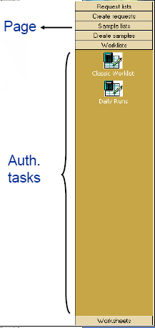
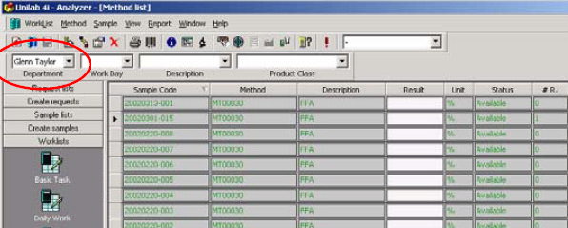
Outlook-bar
Short intro unilab
Pages with Taks
Task is a template:
  On which elements to filter
  A default layout
Layout: Definition of the columns

Slide 8
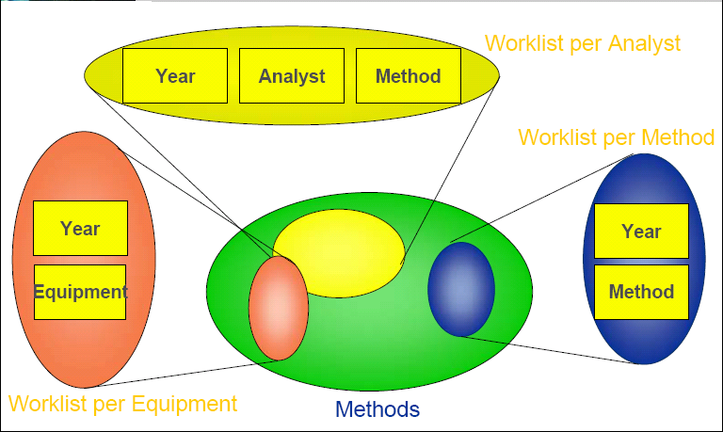
Filtering within tasks
Short intro unilab

Slide 9
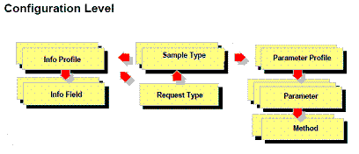
Configuration: “templates”
Short intro unilab

Slide 10
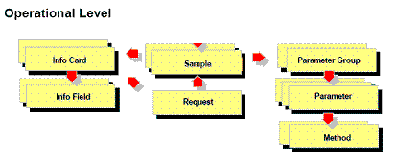
Operational: filled “templates”
Short intro unilab

Slide 11
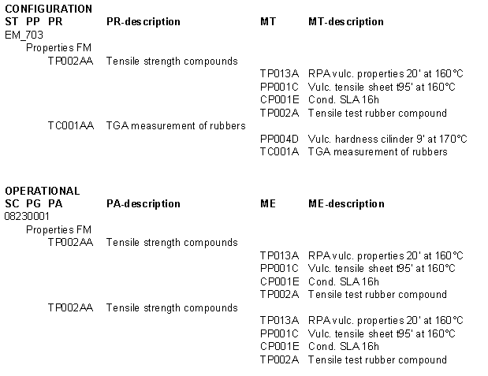
Example

Slide 12
Standard /user attributes & Group keys
Short intro unilab
Every object have predefined “standard attributes” to
  Identity the object
  Change the behaviour
Every object can have user attributes
  Allow for custom extra information
  Allow for custom object behaviour
  Allow for “services” to run
Some objects can have group keys
  Possible to filter on

Slide 13
Information on object-link
Short intro unilab
Also the link between the objects can hold information (standard and user).
Definitions in configuration on the link can overwrite fields of on the operiational object

Slide 14
Specifications and PPKYES
Short intro unilab
Specifications on the link between parameter profile and parameter
Parameter profile unique per specification using PPKEY “product”

Slide 15
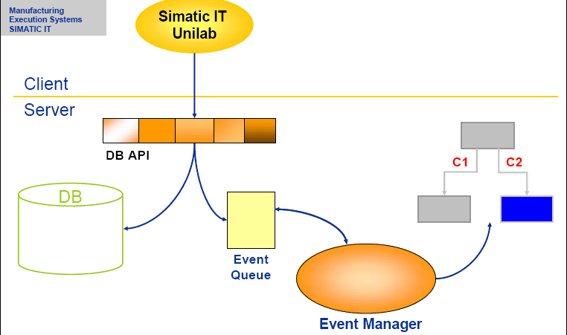
System architecture

Slide 16
Event driven client server
Short intro unilab
Functionality implemented on client (user interaction and calculation) and database (life-cycles and event-manager)
Client actions and database jobs can create events that will be handled on the database and can create subsequent events.
What you see on screen <> database. Create explicit events
  Refresh the filtering values
  Refresh a list
  Save info fields
  Confirm a method

Slide 17
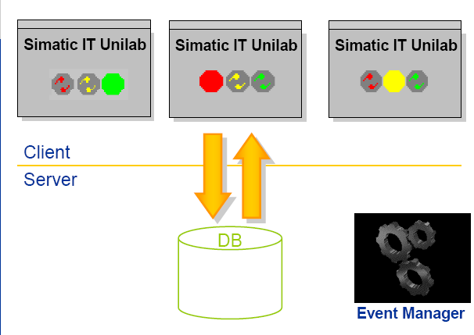
Traffic light
Notes:
Green: Normal operation
Red: Saving or retrieving from database
Yellow: Events manager is processing events of last transaction

Slide 18
Object states
Short intro unilab
Basic unilab
Planned
Available
Completed
Cancelled

Slide 19
Life cycle
Short intro unilab
How to get from one state to another

Slide 20
Object life cycle
Short intro unilab
Authoriations: Who is allowed to perform a transition from one status to another
Conditions: When to go from one status to another
Actions: What actions to perform after a status transistion

Slide 21
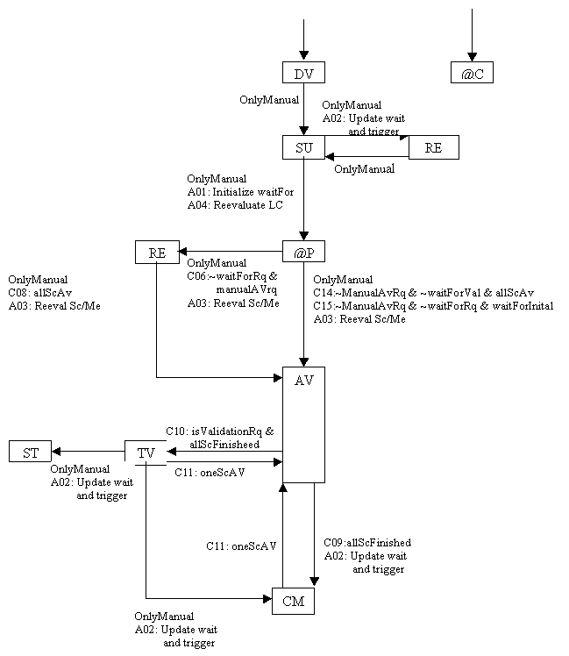
Example
RQ
Life cycle

Slide 22
Interaction between objects
Short intro unilab
Operational object based on configurational object
Change in state on lower level triggers higher level to evaluate status
Standard “Completion” of method <> State completed

Slide 23
Method creates parametes
Short intro unilab
Default: One measurement delivers one result me-result -> pa-result
Optionally method cell can be setup to create parameters with result so they can be checked against spec

Slide 24
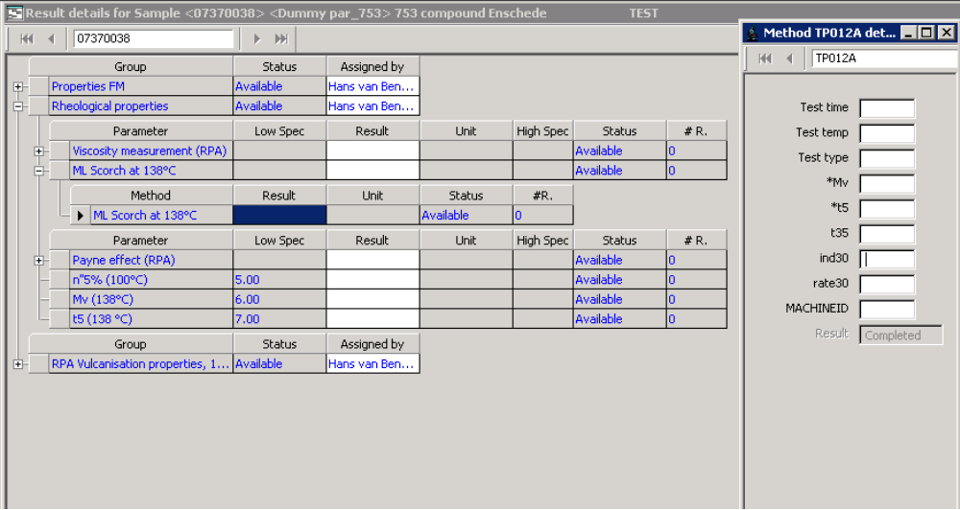
Voorbeeld 1

Slide 25


Voorbeeld1

Slide 26
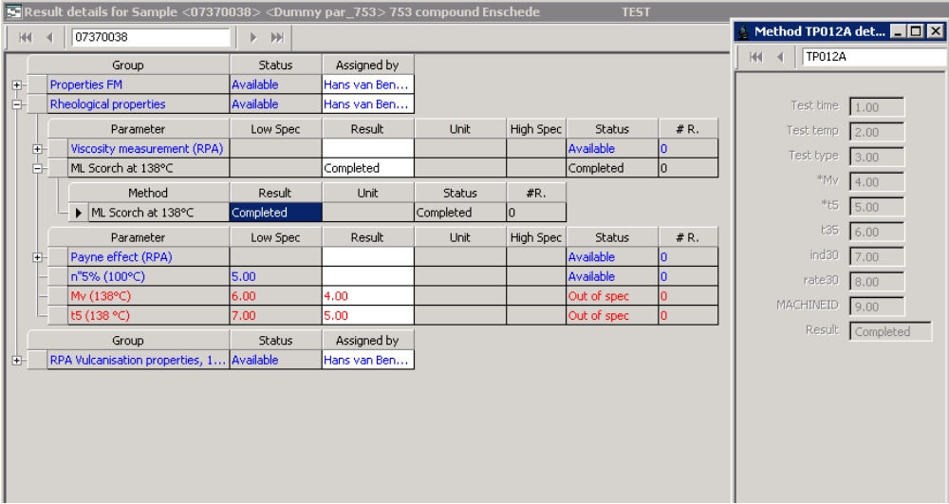
Voorbeeld 1

Slide 27
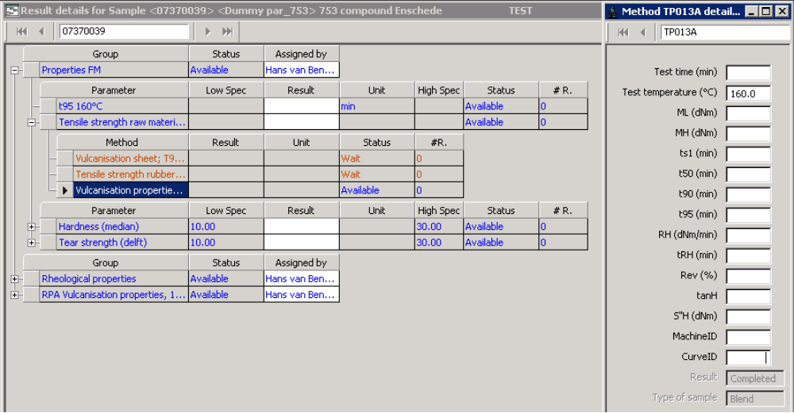
Voorbeeld 2

Slide 28
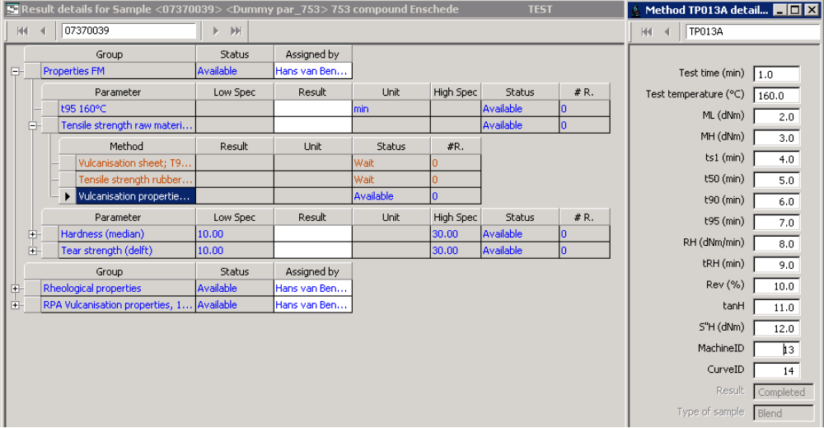
Voorbeeld 2

Slide 29
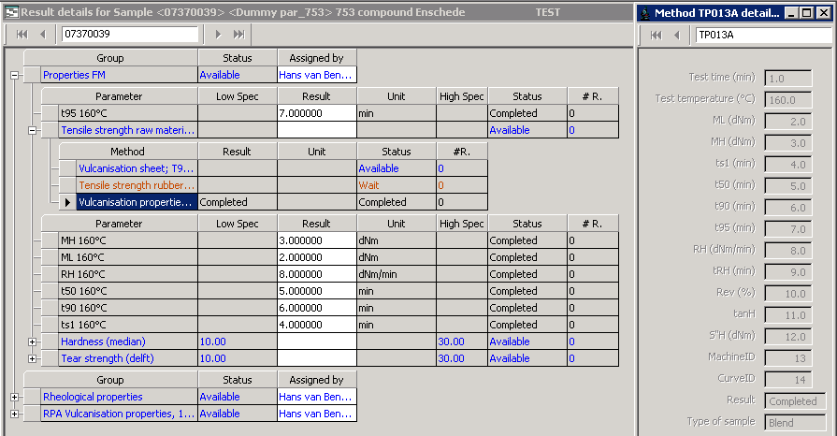
Voorbeeld 2

Slide 30
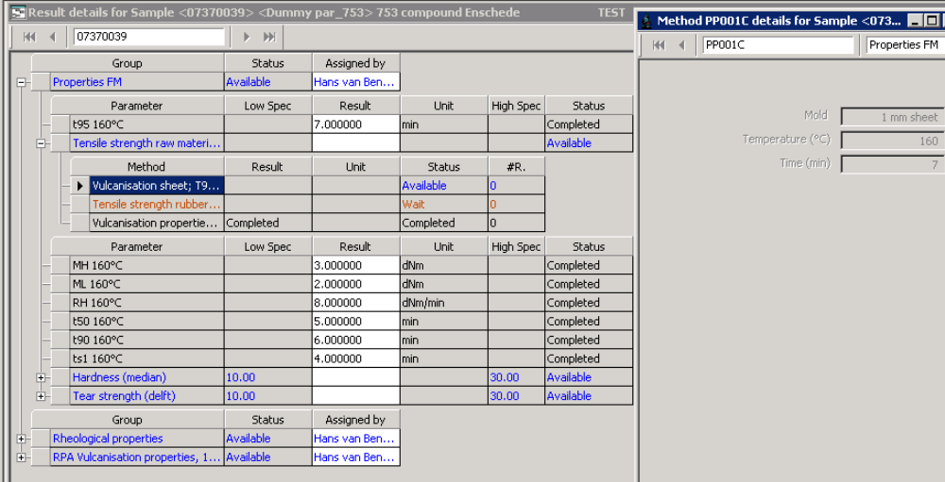
Voorbeeld 2

Slide 31
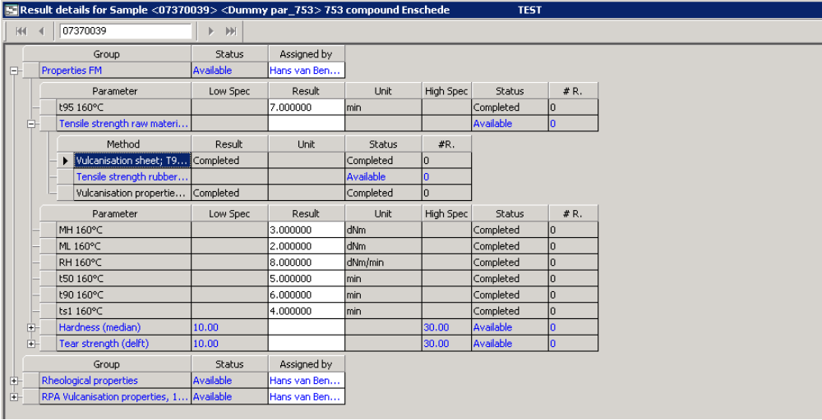
Voorbeeld 2

Slide 32
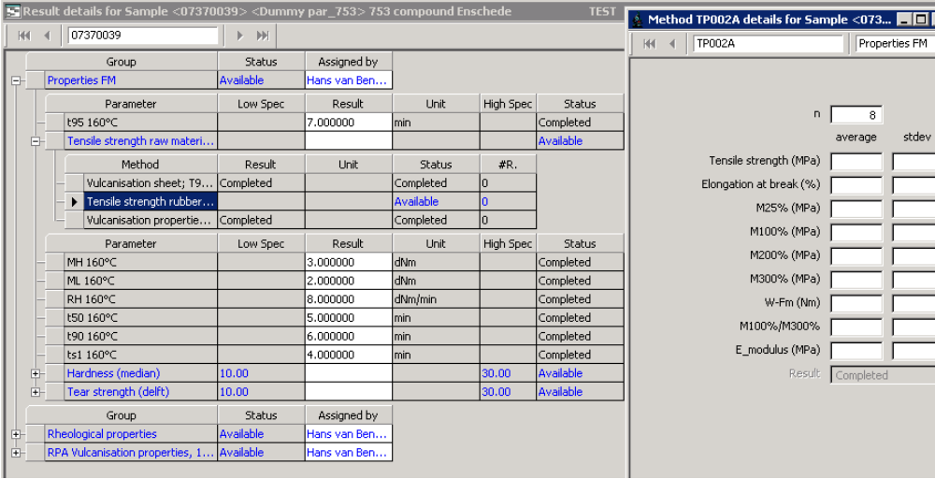
Voorbeeld 2

Slide 33
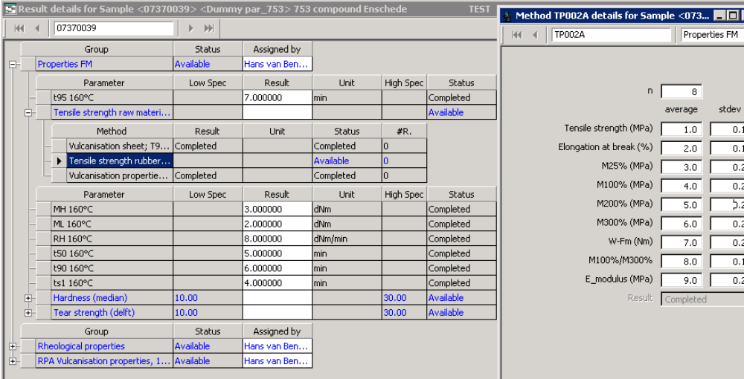
Voorbeeld 2

Slide 34
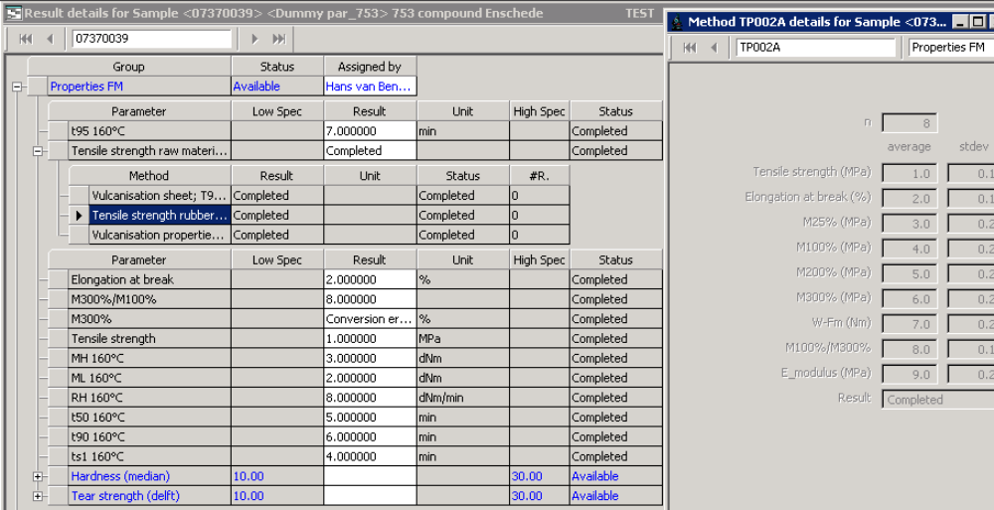
Voorbeeld 3

Slide 35
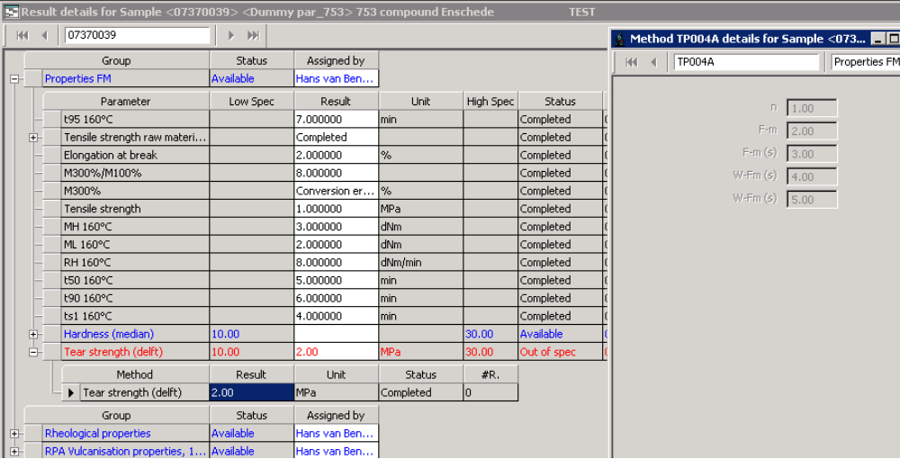
Voorbeeld 3

Slide 36
Freedom of implementation
Short intro unilab
Every object has “Standard attributes (checkboxes)” to change behaviour
Conditions and actions and definition of life cycles is custom

