Slide 1

Apollo LIMS Data Structure
For the Specification Management using Universal Classification
Patrick Simon, CONTACT Software 2023/08/04

Slide 2
FRAMES
Configuration Catalog Classes
Frame Structure
Frame Data Classes
Spec. Structure Element
(apollo_spec_element)
Specification Property
(apollo_spec_property)
Reference Text
(apollo_reference_text)
UC Catalog Property
(cs_property)
Frame
Universal Classification Class (cs_classification_class)
Section
Free Text Ref Text
Classification Property Group (cs_class_property_group)
Subsection
Class Property
(cs_class_property)
Free Text
Ref Text
Property Group
Property Group Template Entry
(apollo_pg_template_entry)
Display Template
Property (Block)
Display Template (for SP)
Attribute / Property Column
Frame Structure Text
(frame_structure)

Slide 3
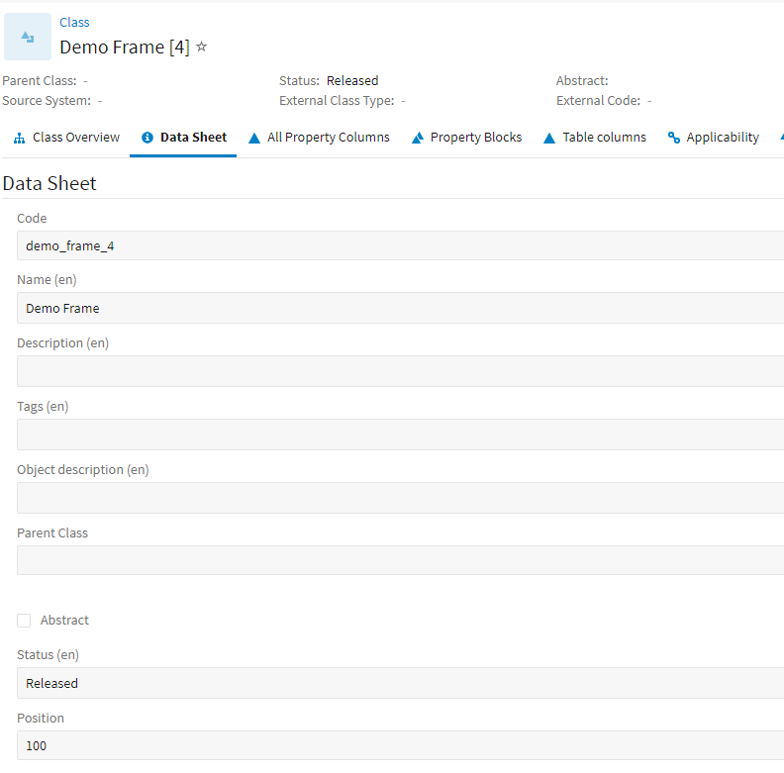
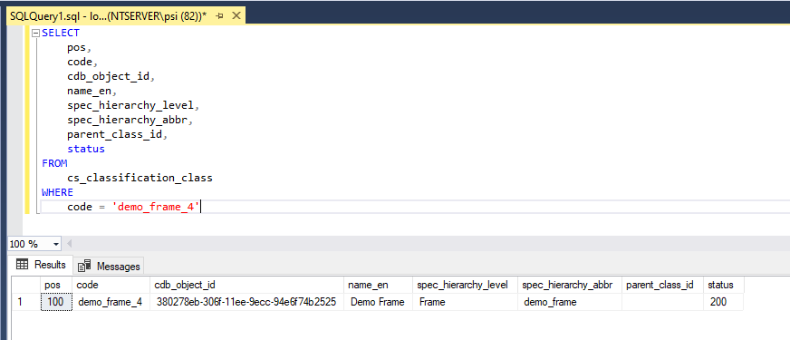
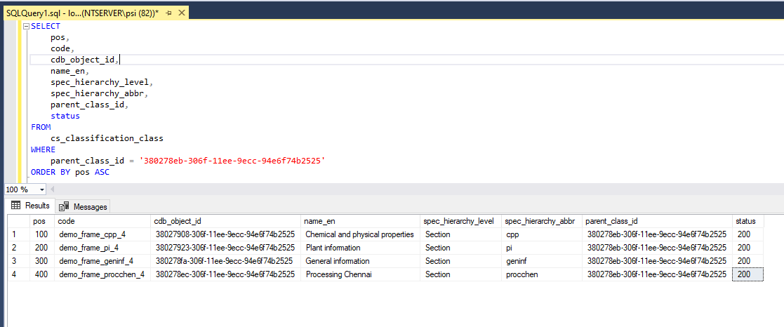
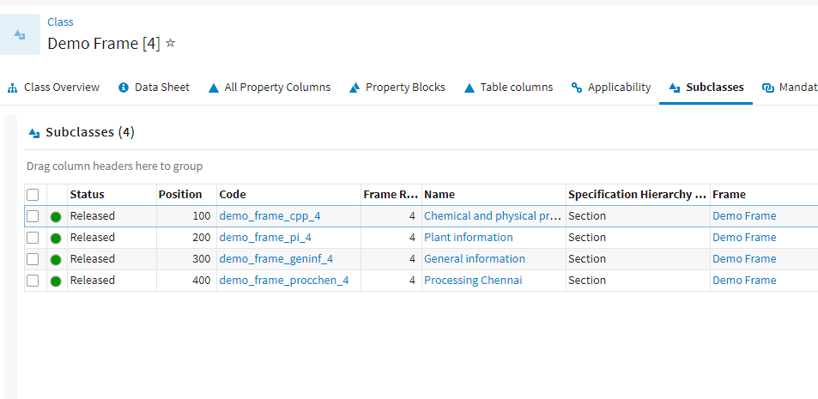
Frames in CONTACT Elements
Corresponding SQL
Frame metadata
Frame sections

Slide 4
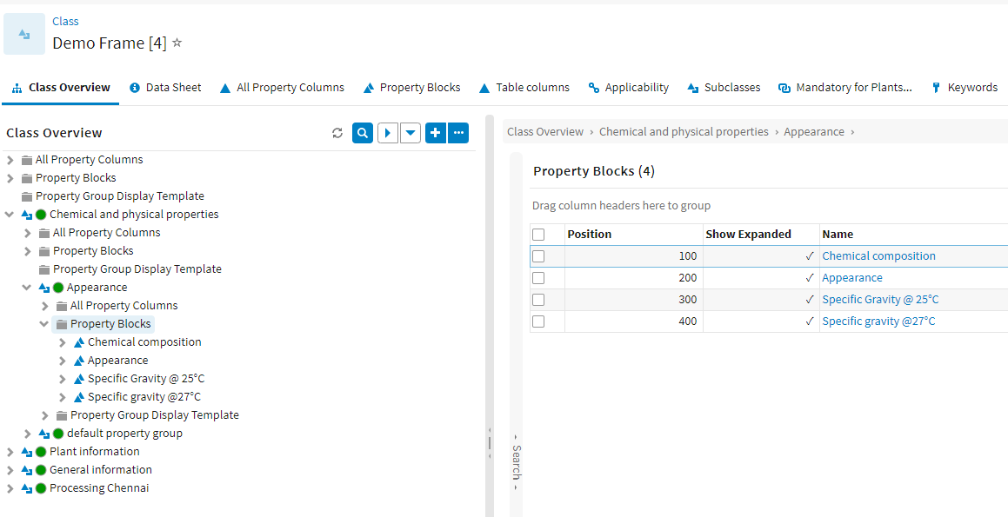
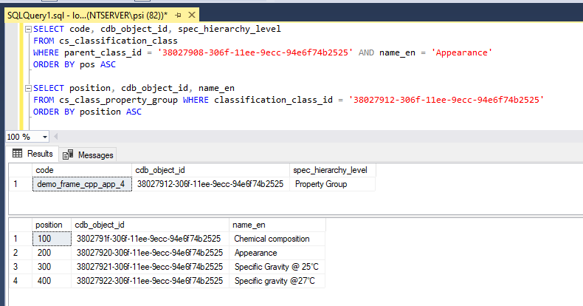
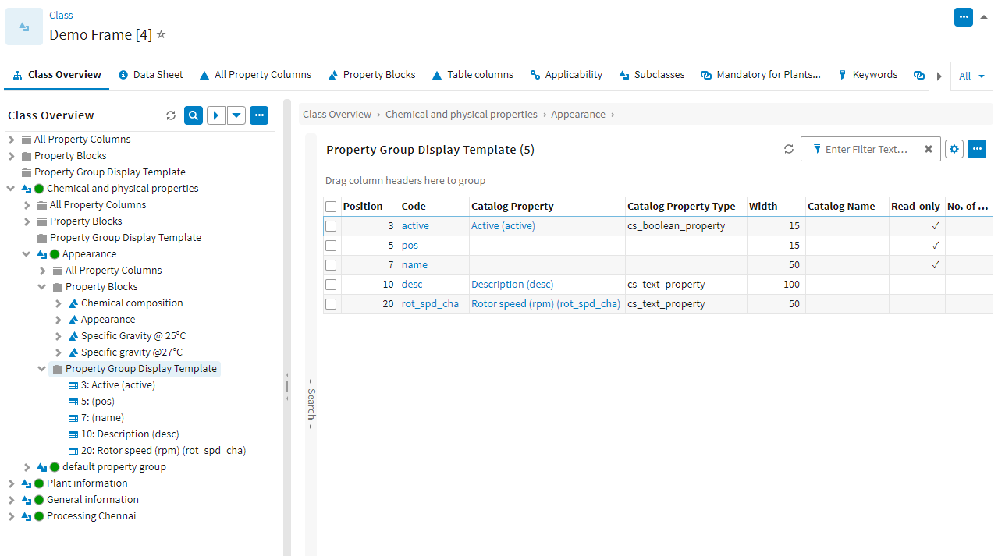
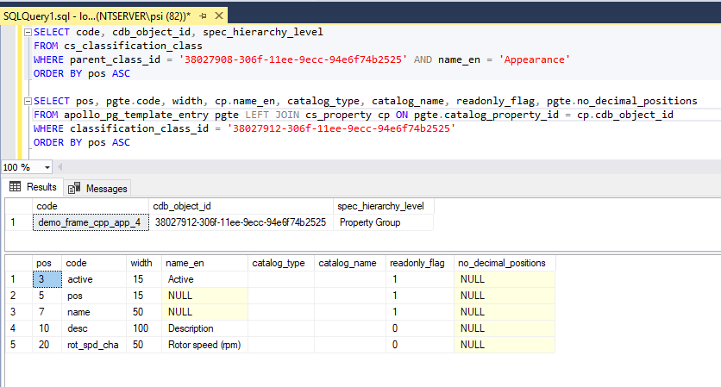
Frames in CONTACT Elements
Corresponding SQL
Properties in PG
PG Display Template

Slide 5
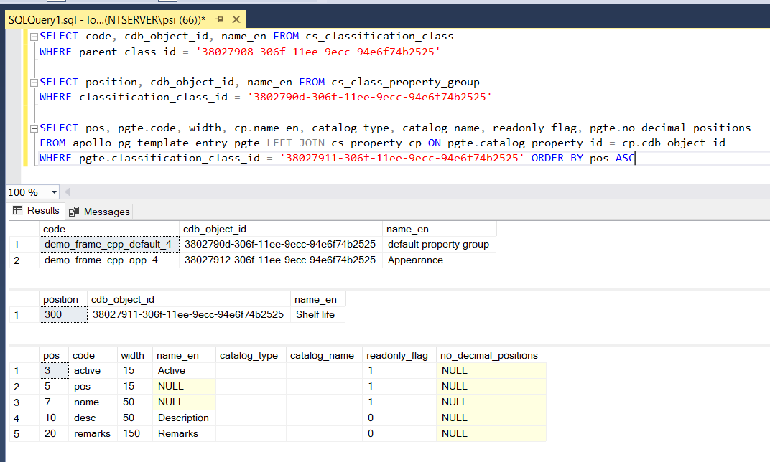
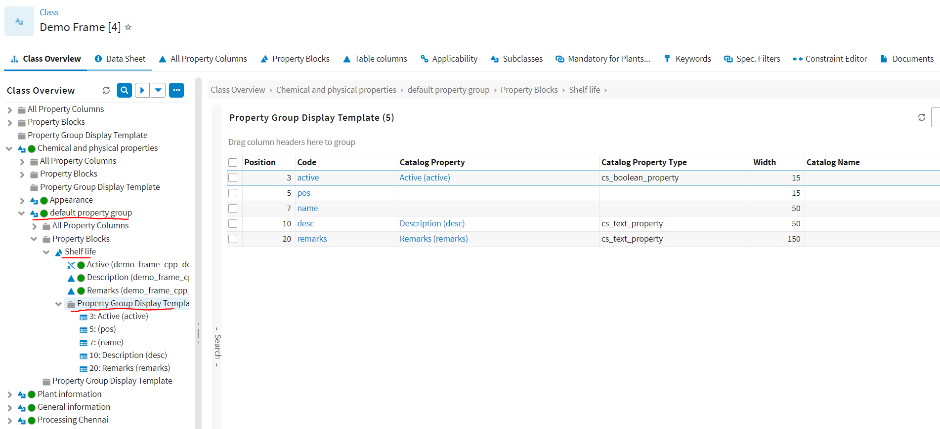
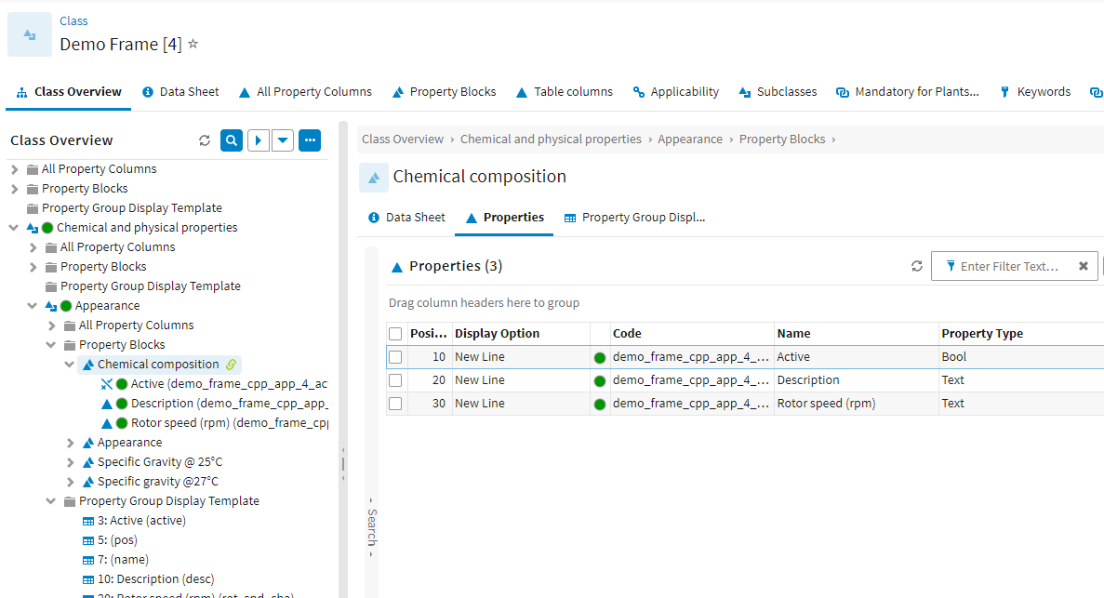
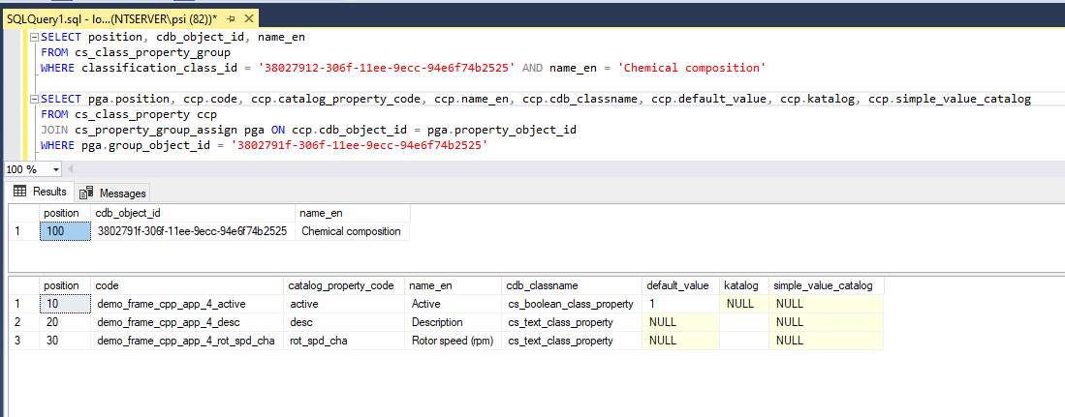
Frames in CONTACT Elements
Corresponding SQL
Single Prop
w/ Template
Class Properties

Slide 6
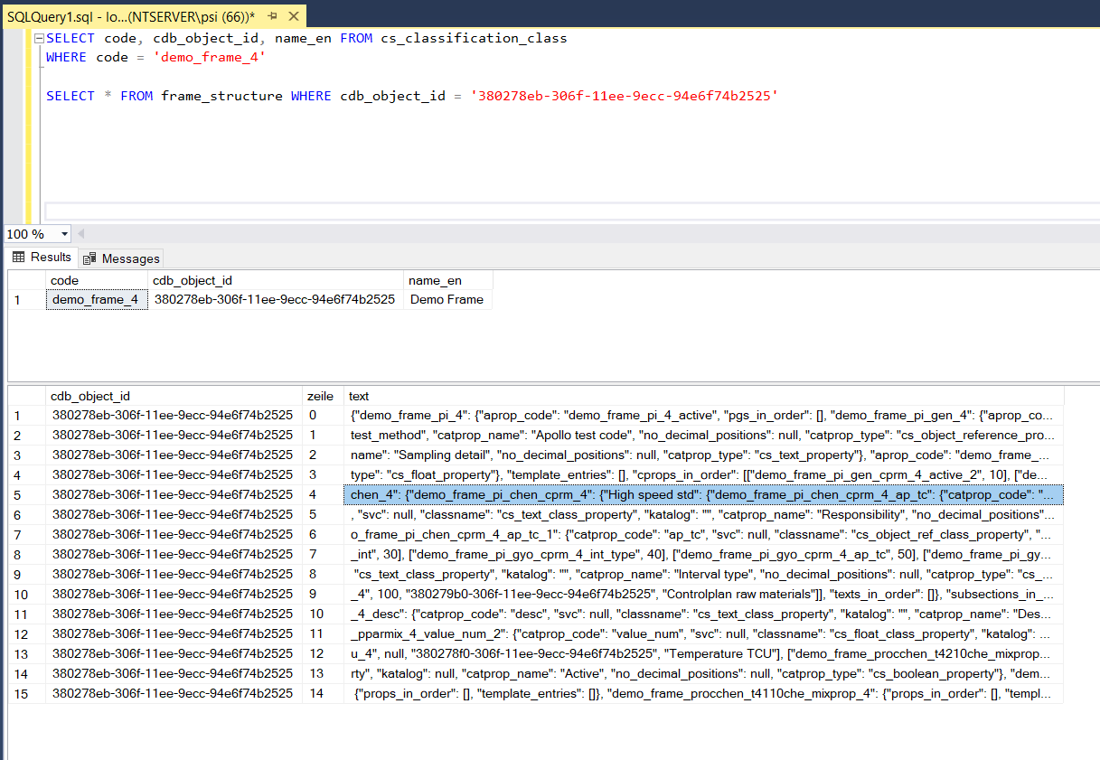
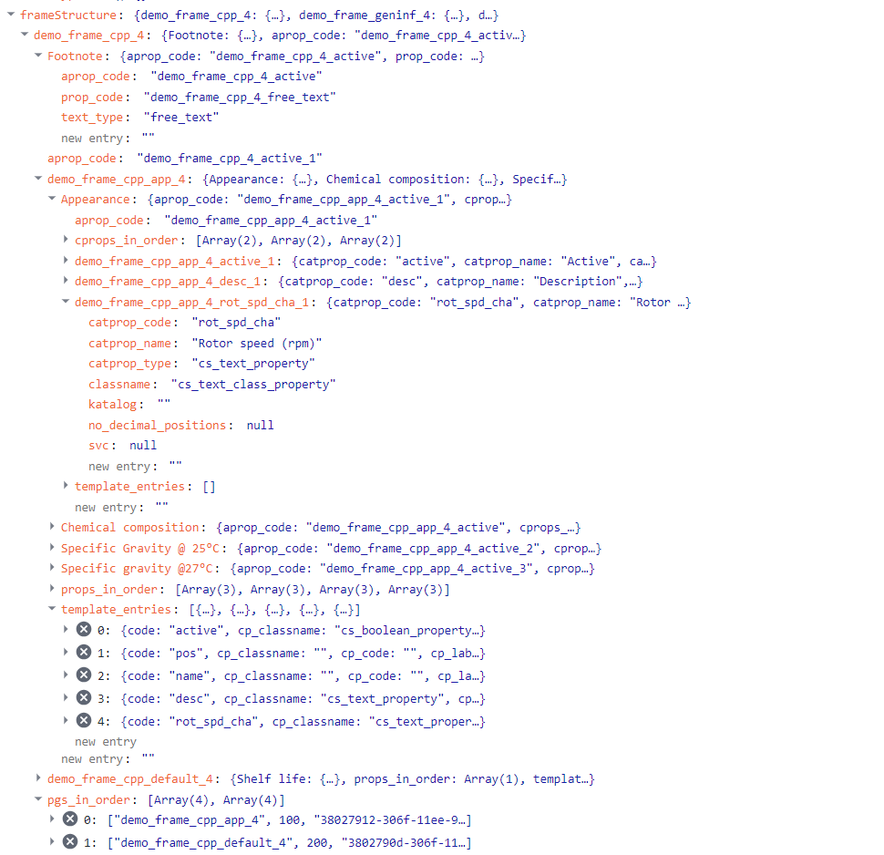
Frames in CONTACT Elements
Corresponding SQL
Frame Structure as JSON Object used in Web UI

Slide 7
SPECIFICATIONS
Configuration Catalog Classes
Specification Structure
Spec. Data Classes
Part Category
(cdb_part_categ)
Product Category
(apollo_product_category)
Specification Types
(apollo_spec_type)
Quantity Units
(cdb_part_unit)
Organizations / Plants
(cdb_org)
Work Centers
(apollo_work_center)
Keywords
(apollo_keyword)
…
Specification/Part
Part
(teile_stamm)
BOM Item
(einzelteile)
Specification <-> Work Center
(apollo_part2work_center)
Keyword <-> Part
(apollo_keyword2part)
Document <-> Part
(cdb_doc2part)
Classification
(cs_object_classification)
Object Value
(cs_object_property_value)
Standard Metadata (fixed)
Part no. and revision, Description, …
Frame code and revision
Categorizations
Plant
Creation/modification dates
…
Related Object Links
BOM Items
Work Centers
Keywords
Documents
…
Universal Classification Data (flexible)
All assigned Classification Classes
All values for the Property cells defined in the Frame

Slide 8
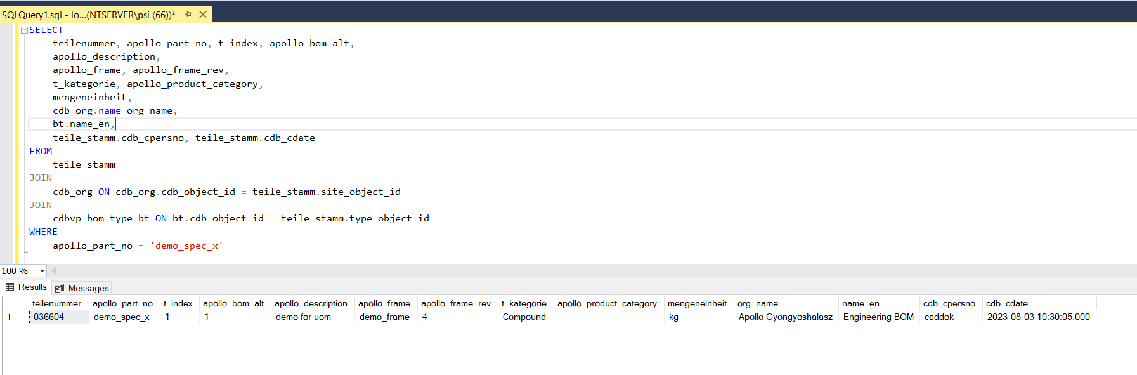
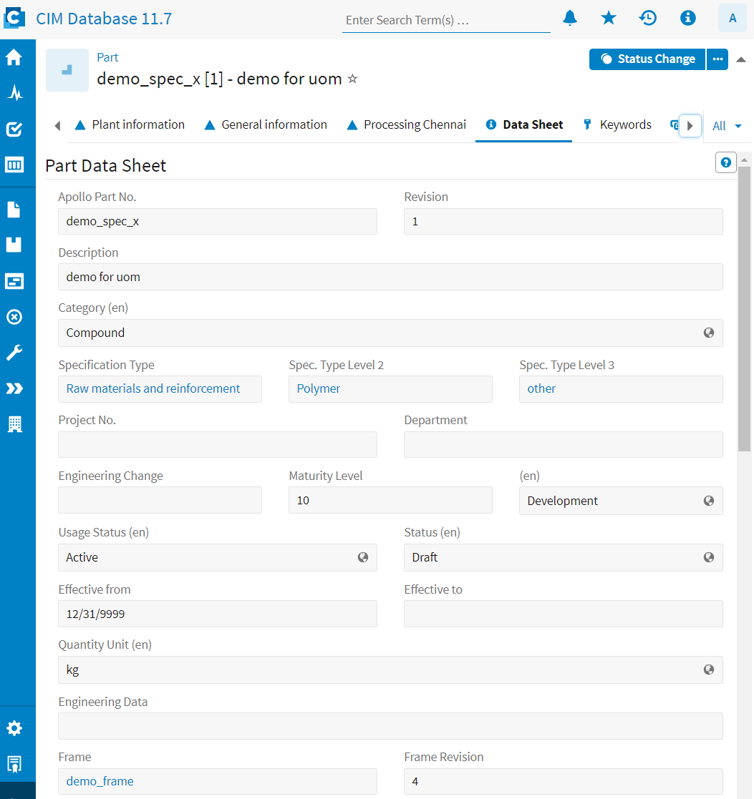
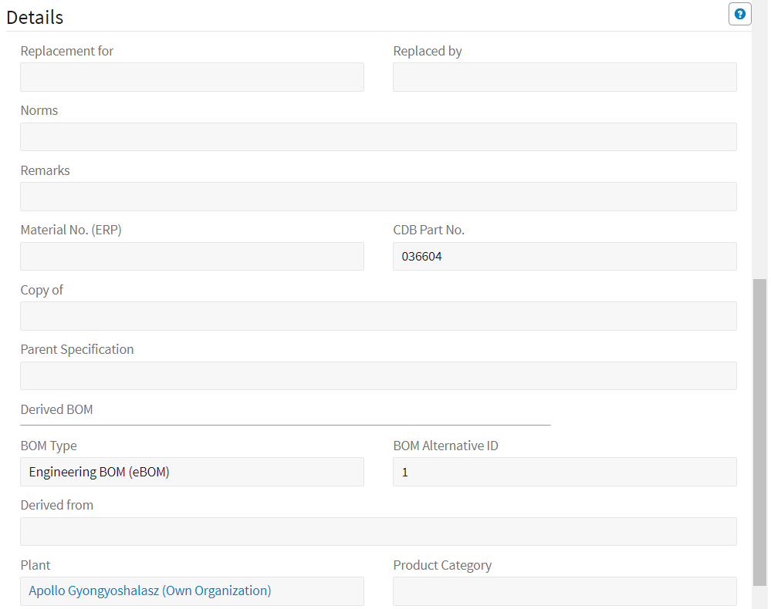





Specs in CONTACT Elements
Corresponding SQL
Part Metadata

Slide 9
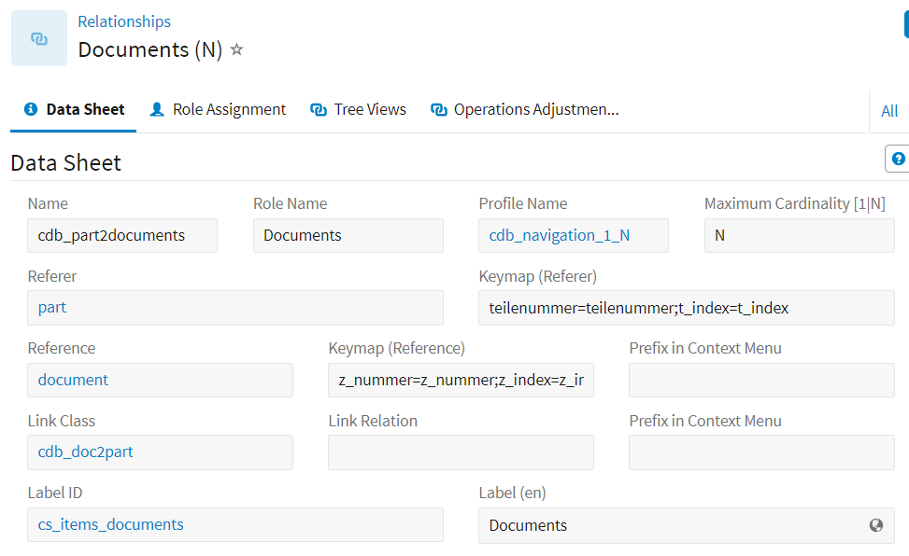
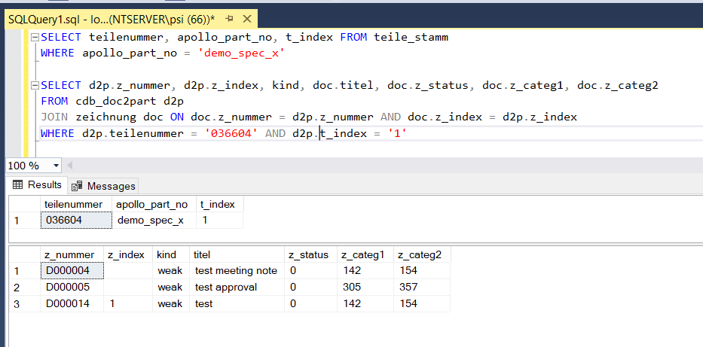
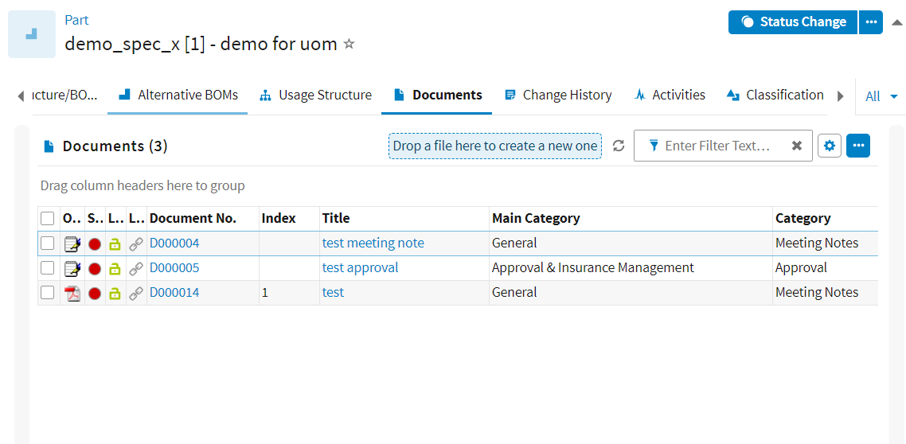
Specs in CONTACT Elements
Corresponding SQL
N:M Relationship

Slide 10
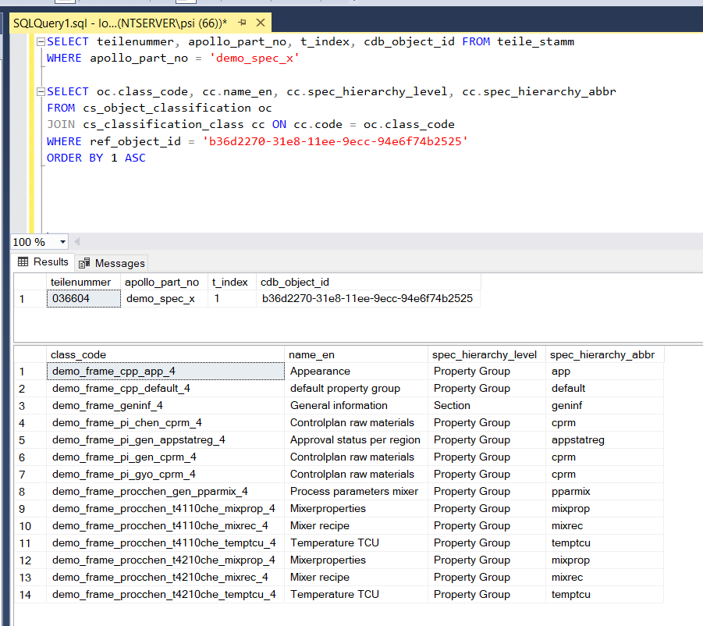
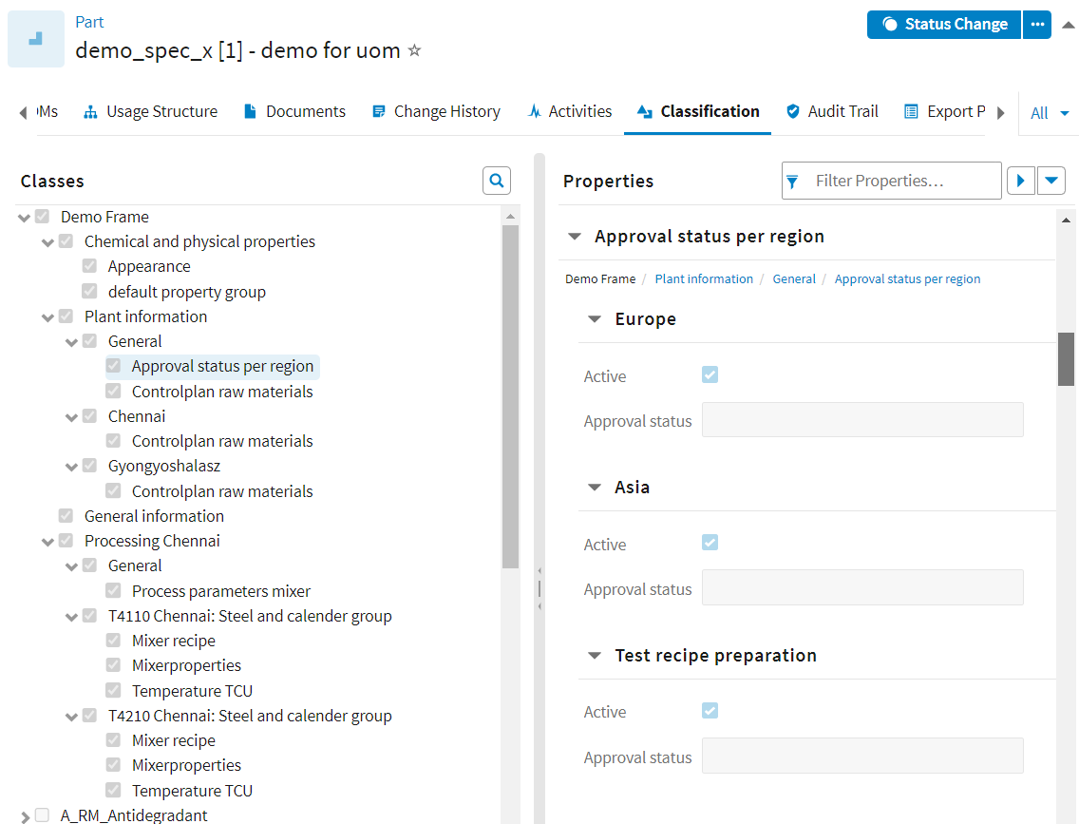
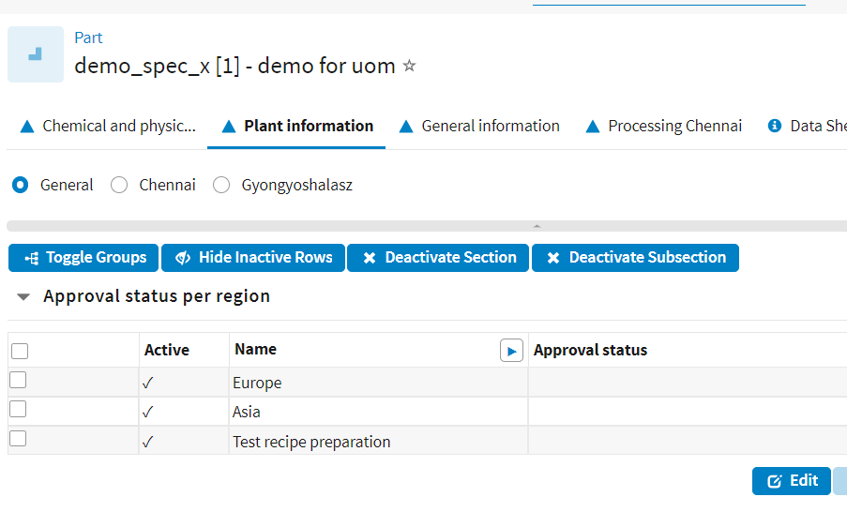
Specs in CONTACT Elements
Corresponding SQL
Assigned UC Classes
Display in Spec. Property Tabs

Slide 11
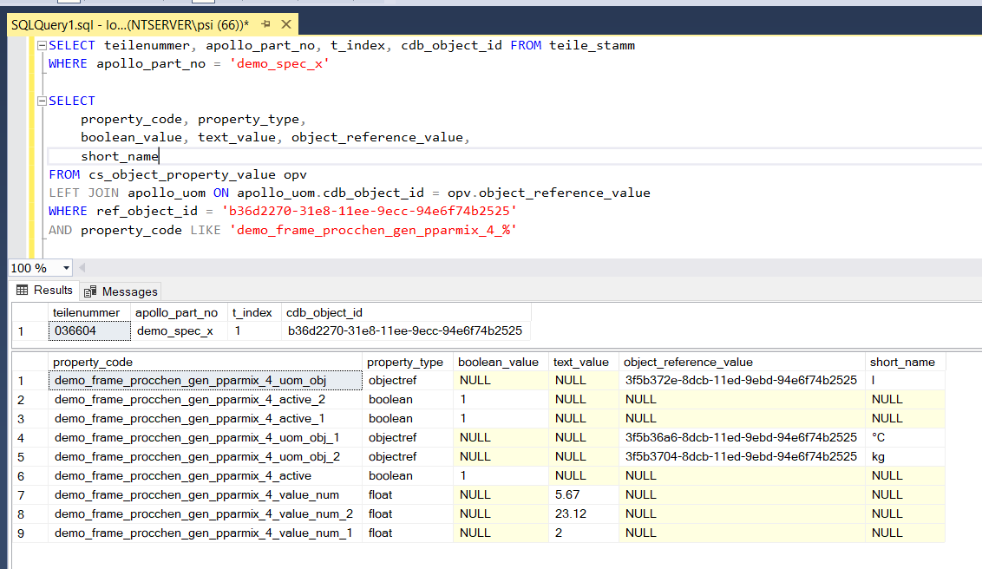
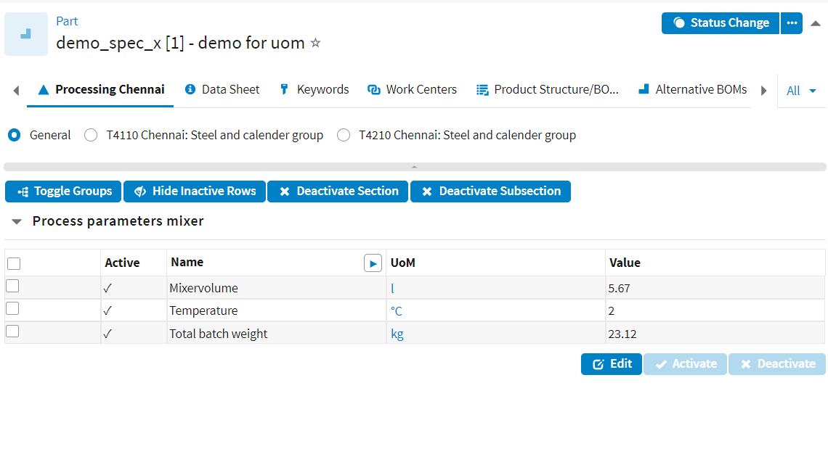
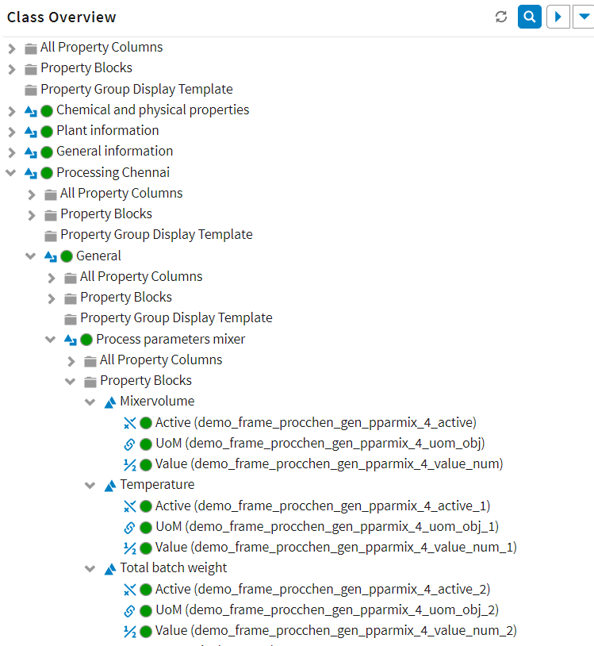
Specs in CONTACT Elements
Corresponding SQL
Classification Property Values

