Slide 1
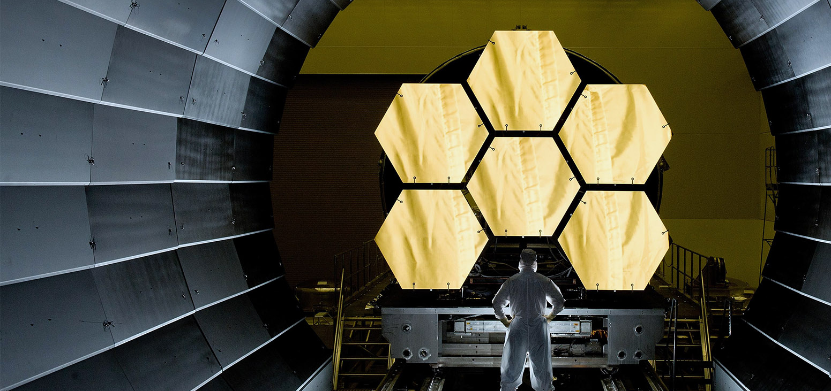
CIM DATABASE 11.x
Architecture and Hardware Sizing
CONTACT Software GmbH
energizing great minds

Slide 2


CONTACT Elements Data Flow
Server side infrastructure
Components can be on same or sperate machines (physical, virtual, cloud…)
Application server and web server
Clients
File transfer
High bandwidth
Meta data
Low latency
Electronic Vault
Conversion server
SQL Database (Oracle or MS SQL)
Enterprise Search

Slide 3
Minimum CPU sizing
Application and database server: 1 CPU core per 30 users but at least 2 cores
Enterprise search: at least 2 CPU cores
Example with 90 users
Application and database servers: 3 CPU cores each
Enterprise search: 2 CPU cores

Slide 4
Minimum RAM sizing
Examples with 60 CAD engineers and 30 non CAD users:
Application server: 4 + ( 60 /1.5 + 30 /3 ) *0.2 = 4 + ( 40 + 10 ) *0.2 = 14 GB RAM
Database server: 4 + ( 60 /1.5 + 30 /3 ) *0.1 = 4+ ( 40 + 10 ) *0.1 = 9 GB RAM
Enterprise search server: 4 GB RAM
Number of non CAD users
Number of CAD engineers
Input = +
3 1.5
Application server: at least 4 GB + Input x 0.2 GB RAM
Database server: at least 4 GB + Input x 0.1 GB RAM
Enterprise search server: at least 4 GB RAM

Slide 5
Conversion server
Technical requirements are given by the software it must load to convert data
Running some CAD software on the conversion requires same resources as if it was running normally
Workload can be distributed on several conversion servers
A user environment can be required by third party software
Some CAD Software run properly only on Workstation hardware and operating system
It is recommended to run it on a separated machine to convert CAD data

Slide 6
Storage sizing
Recommended starting sizes:
Application server
Base software: 15 GB
Additional third party software: 50 GB
Database server
Base software: 60 GB
Each backups: 50 GB
Vault (file sever): 100 GB
Enterprise search: 5GB

Slide 7
Software compatibility
Operating systems on client side and recommended for conversion server:
Windows 10 / 11 64bits – currently support my Microsoft
Operating systems on server side:
Windows Server 2016 / 2019 / 2022 – Office document conversion possible
Suse Linux Enterprise Server 15 to 15.4 64bits – no conversion feature available
Contact us to check other Linux versions compatibility
Databases:
Oracle 19c / 21c
Microsoft SQL 2014 / 2016 / 2017 / 2019 at least Standard Edition – Only if server runs on Windows Server

Slide 8


Vielen Dank! Thank You!
 +49 421 20153–0
www.contact-software.com
energizing great minds

