Slide 1
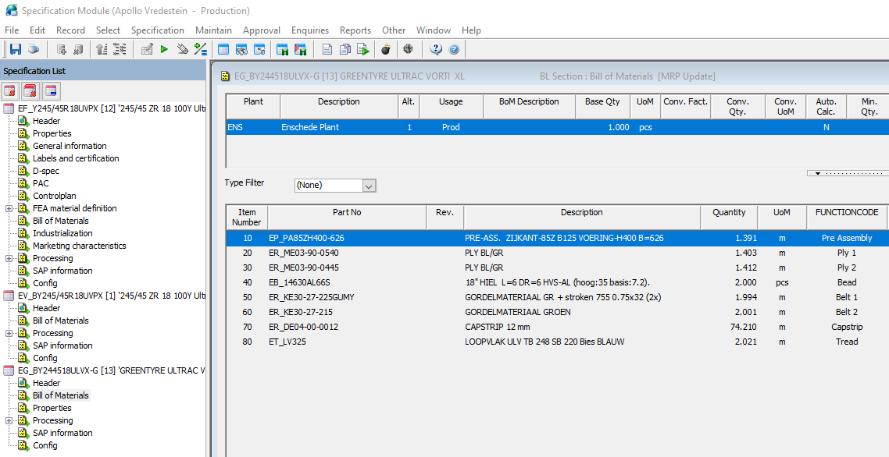
EF_Y245/45R18UVPX
EM_755 used

Slide 2
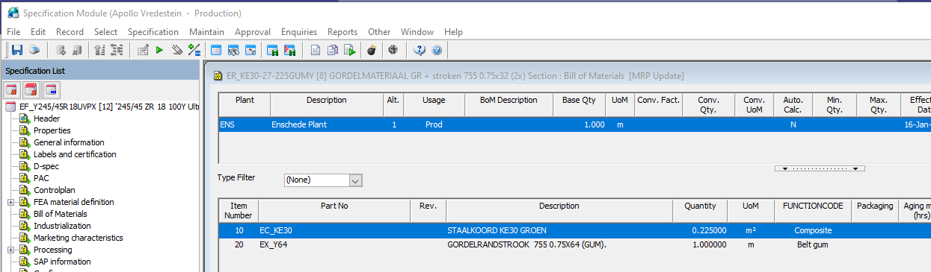
EF_Y245/45R18UVPX

Slide 3
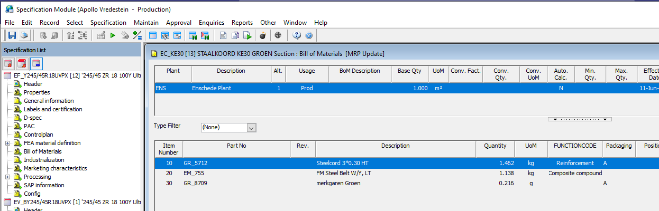
EF_Y245/45R18UVPX

Slide 4
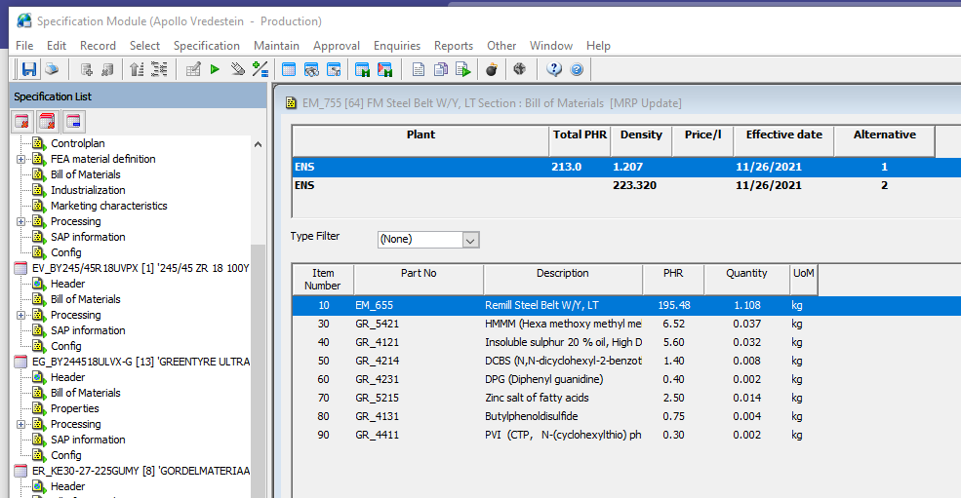
EF_Y245/45R18UVPX

Slide 5
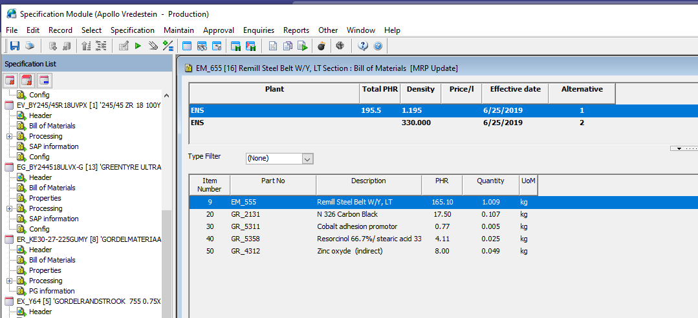
EF_Y245/45R18UVPX

Slide 6
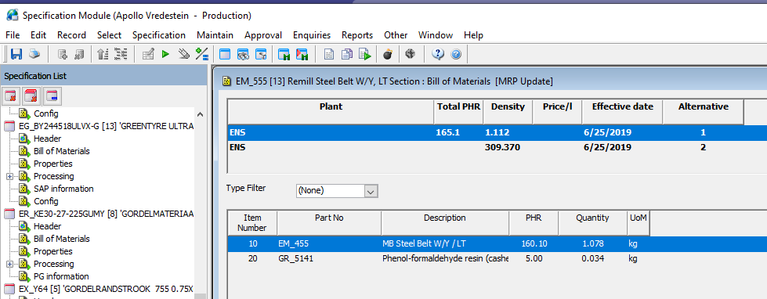
EF_Y245/45R18UVPX

Slide 7
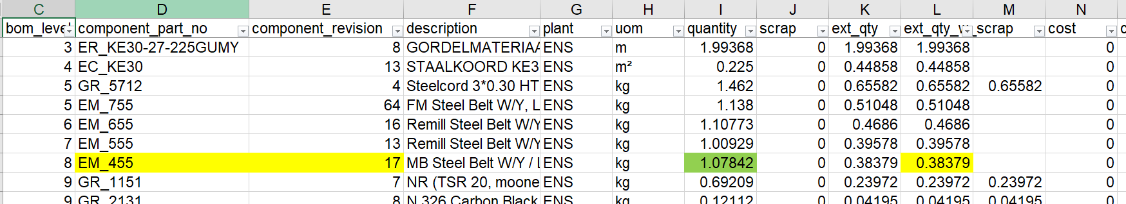
EF_Y245/45R18UVPX
Quantity as in the Bom per base Quantity and in case of compound dbase field density
Not shown in the BOM explosion tabel
Calculation
ER_KE30-27-225Gum =1.99368 m
ER_KE30= 0.225 m2 /base qt(=1)* 1.99368=0.44858 m2
EM_755= 1.138 kg 755 /m2→ 1.338*0.44858=0.51048 kg 755
EM_655=1.107773 kg /base quantity (=1.207kg) → 1.10773/1.207*0.51048=0.4686 kg
EM_555= 1.00929 kg/base Qt (=1.195kg) → 1.00929/1.195 *0.4686=0.39578 kg
EM_455 = 1.078 kg/base Qt (=1.112g) → 1.078/1.112 *0.39578=0.38378 kg
Quantity in tyre

Slide 8
EF_Y245/45R18UVPX

