Slide 1

POLYU SCHOOL OF DESIGN · SD5913 · WEEK 01 · LECTURE
Programming for artists and designers .
pfad a t4x
PFAD.AIT4X.ORG
Notes:
Welcome. Say the course code and that this is the lecture half; tutorial follows in the afternoon.

Slide 2
SD5913 · WEEK 01
Today
01
Why are we here?
05
Programming languages
02
Who are we?
06
Python
03
Computers
07
Tools for the job
04
Programs
08
Assignments and tutorials
Notes:
Eight stops. Point out the two interactive moments and the tutorial block at the end.

Slide 3

01 · QUESTION · WORD CLOUD
Why are we here?
One sentence. Why a programming course for art and design?
Notes:
ClassPoint word cloud. One word each. Leave it on screen for a minute, then read the biggest words aloud.

Slide 4
// what I made with it
02 · WHO IS TEACHING YOU
I came to this from economics.
Musical Fruitstand — fruit you can play. No screen.
No computer science degree. I learned to code because I wanted to make things that could not be made any other way.
A-Eye — the audience, repainted live at M+.
Featherman — a mobile game, with WWF Mai Po.
That is still the only reason I use it.
giovannilion.link — later, not now.
Notes:
Economics background, no CS. The reason to code is to make things that cannot be made another way.

Slide 5
2017–2019 · HANSON ROBOTICS
The robot rebooted minutes before the cue.
I was Sophia's operator for two years. Someone knocked out a power cable during setup, in front of thousands of people. It came back. The show went on.
Notes:
Hanson Robotics 2017-2019. Cable knocked out before a show for thousands. It rebooted; the show went on. Point: things break, you keep going.

Slide 6
02 · WHO ARE WE?
Artists and designers
WHAT'S YOUR X?
Notes:
Chapter two. Who are you? Two questions coming.

Slide 7

QUESTION · MULTIPLE CHOICE
Are you an artist or a designer?
A
Artist
B
Designer
C
Both / not sure
Notes:
ClassPoint multiple choice. Show the split, no judgement.

Slide 8
ARTISTS?
“…a subjective perspective that reminds us of the human condition.”
— Hannah Arendt, 1958
Notes:
Arendt, The Human Condition, 1958. Art keeps a subjective view alive.

Slide 9
QUESTION · MULTIPLE CHOICE
Is programming an art?
A
Yes
B
No
C
It can be
Notes:
ClassPoint multiple choice. Then show two Nake pieces and let them decide again.

Slide 10
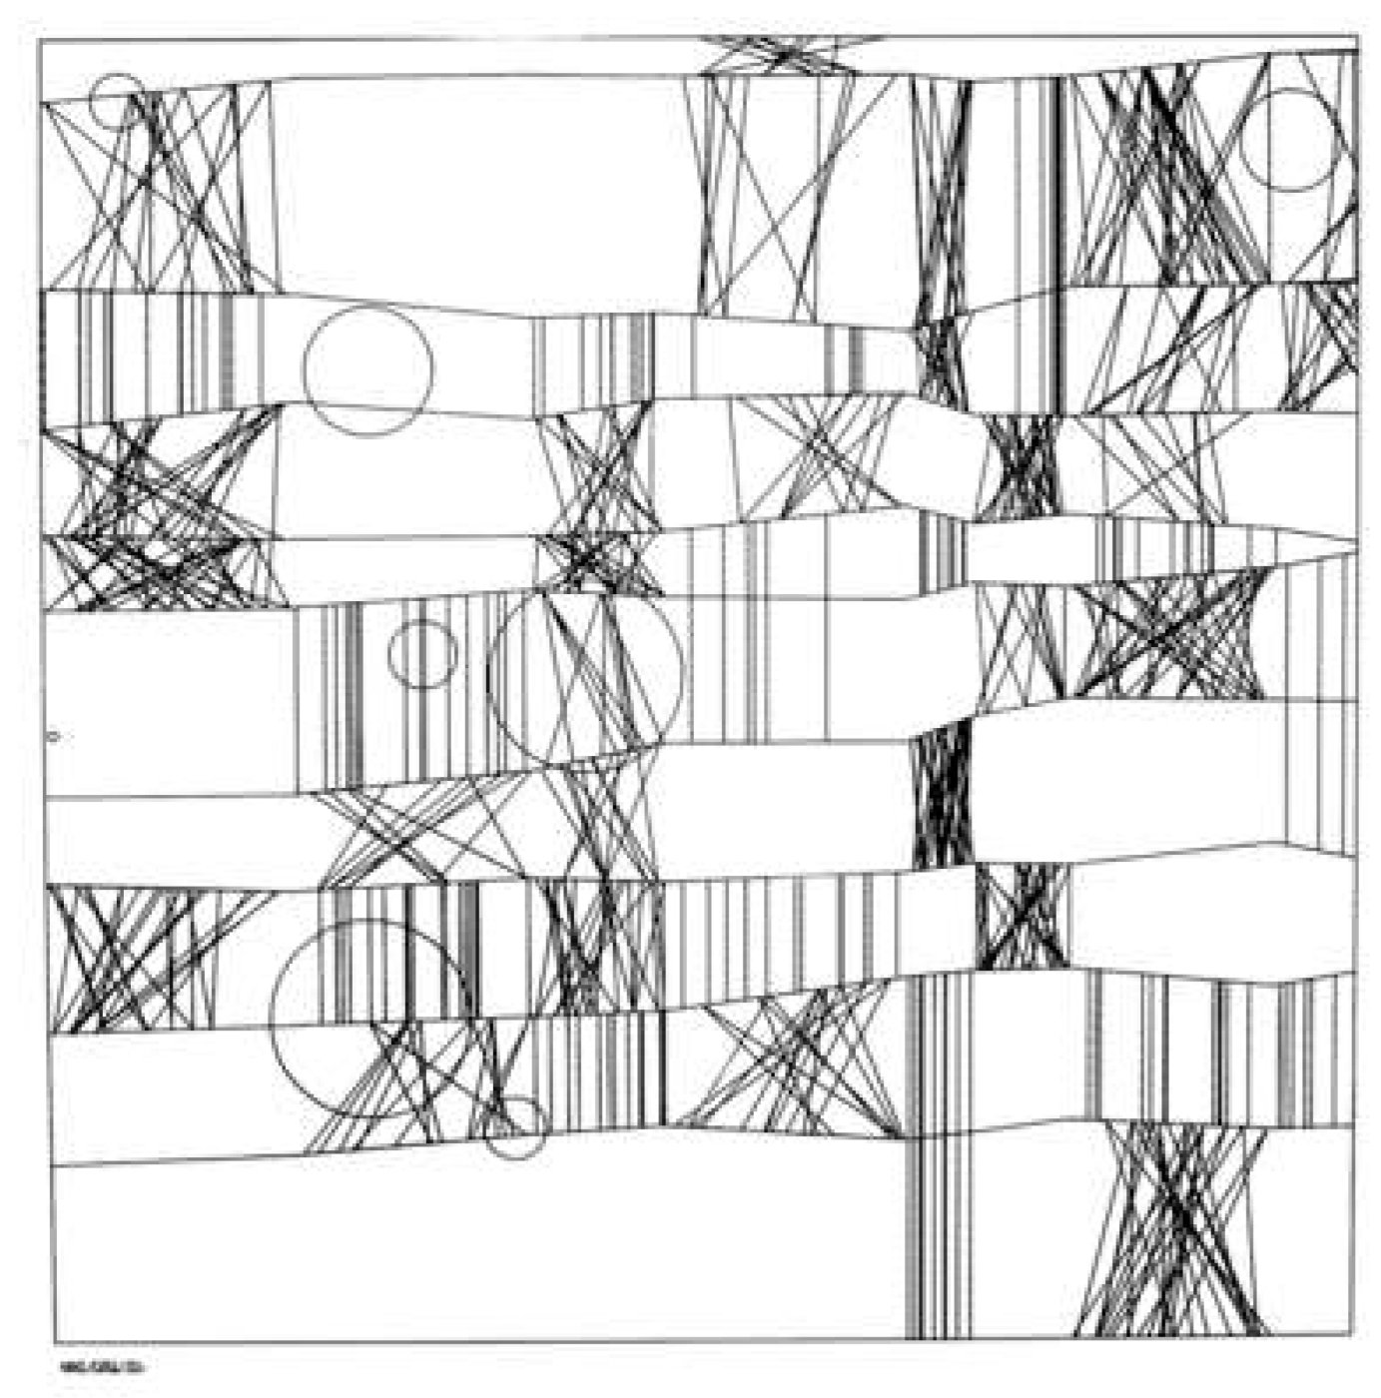
FRIEDER NAKE · 1965
Homage to Paul Klee
Screenprint on paper, 49.2 × 49.2 cm. Victoria and Albert Museum.
Notes:
1965. A program drew this. It hangs in the V&A.

Slide 11

FRIEDER NAKE · 1966
Walk-through-Raster
Series 2, 1–4. C-type print, Germany.
Notes:
1966. Same idea: a rule, run many times, with a little randomness.

Slide 12
TALK · DYLAN BEATTIE
The Art of Code
Inspiration for assignment 1.
youtube.com/watch?v=6avJHaC3C2U
Notes:
Play a few minutes of Dylan Beattie's talk. This is the reference for assignment 1.

Slide 13
GEORG NEES · SCHOTTER · 1968
One rule. One number.
12 squares across, 22 down. The top row is perfect. Every row after it is rotated and moved a little more, until the bottom is rubble.
In the tutorial you change that number and watch it become a different picture.
chaos = 0.8
Notes:
Georg Nees, 1968. 12 across, 22 down. One rule: rotate and shift each row a little more. In the tutorial you change that one number.

Slide 14
DESIGNERS?
…a creative perspective that is data-driven and user-centric.
Notes:
Designers: creative, but they answer to data and to the user.

Slide 15
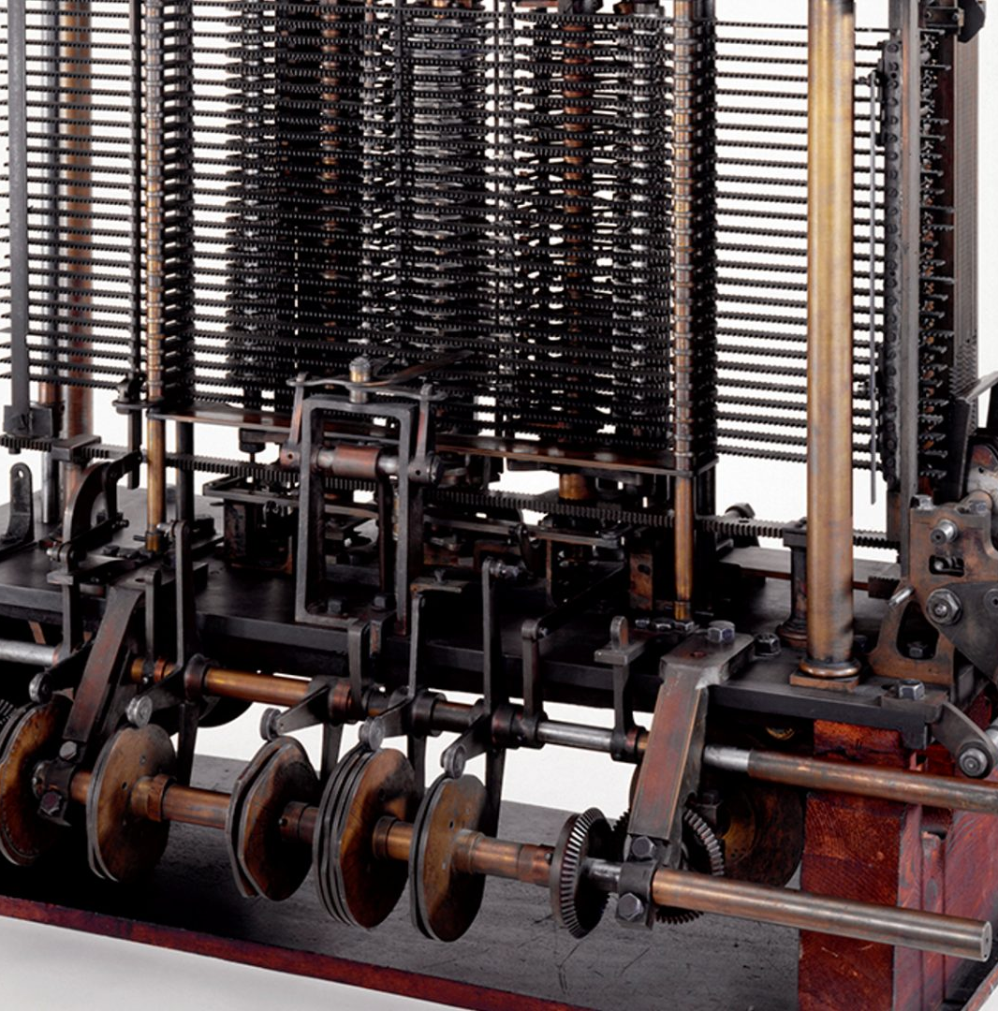
CHARLES BABBAGE · 1837
The Analytical Engine
A computer is a physical thing. Brass, steel and gears, cut by hand by craftsmen.
This one was designed but never finished. Someone wrote a program for it anyway.
Trial model, Science Museum, London.
Notes:
Babbage's Analytical Engine, 1837 onwards. Brass and steel, cut by hand by craftsmen. A computer is a physical, tangible machine — and this one was never finished. Ada Lovelace wrote a program for it anyway.

Slide 16
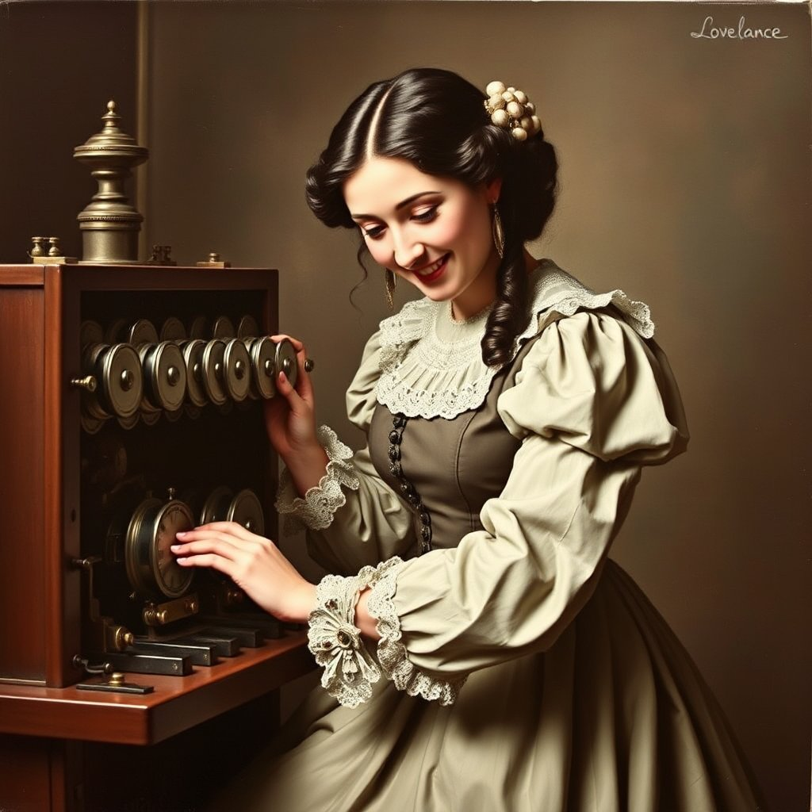
1843 · NOTE G
Ada Lovelace
Wrote the first program — for Babbage's Analytical Engine, a computer that did not exist yet.
Sketch of the Analytical Engine, Note G
Notes:
Note G, 1843: the first published algorithm, written for a machine that was never built.

Slide 17
AGILEMANIFESTO.ORG · 2001
Is programming a craft?
Individuals and interactions
Working software
over processes and tools
over comprehensive documentation
Customer collaboration
Responding to change
over contract negotiation
over following a plan
Notes:
Agile manifesto, 2001. Craft: individuals, working software, collaboration, responding to change.

Slide 18
ART AND DESIGN
Both want to change attitudes and behaviour.
Notes:
Both want to change how people think and act. Code is one more way to do that.

Slide 19
CULTURE AND TECHNOLOGY
Mediated perception
you
tool
world
Technologies do not exist “in themselves.” They exist in relation to people and culture.
— Don Ihde
Notes:
Don Ihde: a tool is never neutral. It changes how we see. Code is a tool like that.

Slide 20

QUESTION · WORD CLOUD
What's your X?
One word. What do you want to make with code this semester?
Notes:
ClassPoint word cloud to close. One word: what do you want to make with code this semester?

Slide 21
problem = None
while semester() == 1:
if not problem:
problem = Problem.current()
while not problem.solved:
try:
code = self.challenge(problem)
problem.solved = code.run(problem)
except:
panic = reality_check()
break
state = check_state()
if state == "bored" or problem.solved:
problem = Problem.find_harder(problem)
elif state == "anxious" or panic:
try:
skill_upgrade(self)
except:
simplify(problem)
finally:
sleep(8*60*60)
HOW TO SURVIVE THE SEMESTER
Stay in flow
Bored? Find a harder problem. Anxious? Learn a skill, or make the problem smaller. Then sleep.
Notes:
Read the loop out loud. Too easy: find a harder problem. Too hard: upgrade a skill or simplify. Then sleep.

Slide 22
ASSESSMENT
Five components
10%
30%
10%
40%
10%
Participation
Individual assignments
Mid-term quiz
Group project
Final quiz
Three, on GitHub, on time
A GitHub repo with everyone's commits. Original code. Multimedia. Scope agreed by week 8.
Notes:
Five parts. The group project is the big one. Participation means: come, or tell us before you don't.

Slide 23
INDIVIDUAL ASSIGNMENTS · 30%
Three repos, three dates
01 · 5%
02 · 10%
03 · 15%
Reflection
Data visualisation
Interactive experience
Why are we here? 500–1000 words.
Get data about a natural phenomenon. Show it.
Something people can play with.
DUE SUN 13 SEP
DUE SUN 27 SEP
LATER IN THE SEMESTER
Notes:
Three assignments, all as GitHub repos. Dates on screen.

Slide 24
VIDEO
The programmer's mindset
youtube.com/watch?v=3o63D0-_x2k
Notes:
Short video. Programmers are not smarter — they are used to being wrong and trying again.

Slide 25
03 · COMPUTERS
Computers are Turing machines
1
0
1
1
0
0
TAPE · HEAD · RULES
Read a symbol. Follow a rule. Write. Move. Repeat.
Turing, 1936 · On Computable Numbers, with an Application to the Entscheidungsproblem
Notes:
Chapter three. Turing, 1936: On Computable Numbers. Every computer you own is one of these machines.

Slide 26
04 · PROGRAMS
Programs are instructions for changing state
STATE 0
PROGRAM
STATE 1
Before
→
Instructions
→
After
a blank canvas, a file, a number
step, step, step…
a picture, a saved file, a result
Notes:
A program reads a state, applies instructions, writes a new state. That is all.

Slide 27
04 · PROGRAMS
A program might have…
01
02
03
04
Inputs
Outputs
Errors
Infinite loops
Notes:
Four things to expect. Infinite loops are not a failure of character — they are a Tuesday.

Slide 28
04 · PROGRAMS
YOUR COMPUTER
Where are your programs running right now?
CPU
RAM
does the steps
holds what is running
Disk
All programs run as processes inside your operating system.
SSD, HDD — keeps files when power is off
process: browser
process: vscode
…except for one.
process: python
kernel
Notes:
CPU does the steps, RAM holds what is running, disk keeps it when the power goes. Every program is a process managed by the OS — except the OS itself.

Slide 29
YOU · APPS · TERMINAL
SHELL
04 · PROGRAMS
Kernel and shell
KERNEL
hardware
The kernel talks to the hardware. The shell is the layer you talk to. A terminal is a shell you type into.
Notes:
Pistachio: the kernel is the nut, the shell is what you touch. A terminal is a shell you type into.

Slide 30
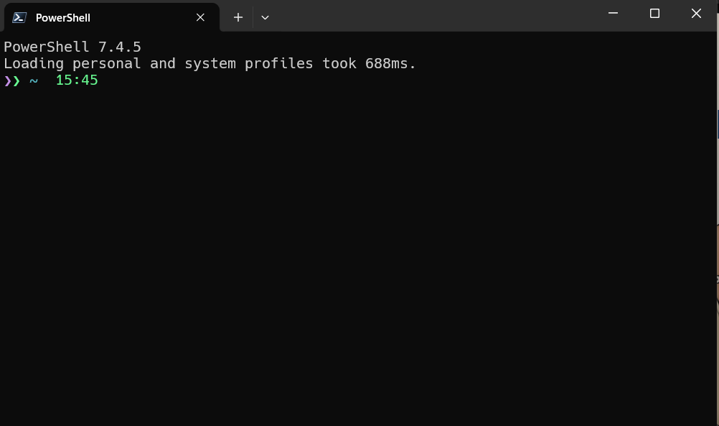
04 · PROGRAMS
A terminal
When you type a program's name, the terminal looks for it inside the folders listed in the PATH variable.
PowerShell · Terminal · bash · zsh
Notes:
When you type a command, the shell looks in the folders listed in PATH. If it's not there: command not found.

Slide 31
04 · PROGRAMS
Programs that install programs
WINDOWS
MACOS
scoop
brew
scoop.sh
brew.sh
scoop install git python
brew install git python
Set one up. It will make your life simpler.
Notes:
Package managers. Set one up in the tutorial; it saves hours later.

Slide 32
05 · PROGRAMMING LANGUAGES
Languages are shared conventions for giving instructions
Notes:
Chapter five. A language is an agreement about how to write instructions.

Slide 33
05 · PROGRAMMING LANGUAGES
Compiled or interpreted
COMPILED · C, C++, Go, Rust, Zig
INTERPRETED · JavaScript, Ruby, ...
source code
→
compiler
→
machine code
→
run
source code
→
interpreter reads and runs, line by line
Translate everything first. Then run fast, many times.
No separate build step. Slower, but you see results right away.
Hybrid — Java
Transpiled — TypeScript → JavaScript
Notes:
Compiled: translate the whole thing first, then run. Interpreted: read one line, do it, next line. Python is interpreted.

Slide 34
05 · PROGRAMMING LANGUAGES
Languages have syntax
# variable
rows = 22
# operator + function
step = 90 / rows
# keyword: flow control
for row in range(rows):
# statement
draw(row, step * row)
•
Statements
•
Variables
•
Operators and functions
•
Keywords for flow control
Notes:
Four building blocks. You will see all of them in the first tutorial file.

Slide 35

06 · PYTHON
Python
A program that interprets text and executes the instructions, following Python's conventions.
Notes:
Chapter six. Python: a program that reads text and executes it, following Python's conventions.

Slide 36
06 · PYTHON
Python is…
Interpreted
Dynamically typed
High-level
Indented
Slower
No build step. Run it and see.
Close to how you think, far from the hardware.
Spaces decide what belongs to what.
Than C or Rust. Fast enough for us.
A variable can hold a number now and text later.
Notes:
Five facts. Indentation is not decoration — it is the grammar.

Slide 37
Beautiful is better than ugly.
Explicit is better than implicit.
06 · PYTHON
Simple is better than complex.
>>> import this
Flat is better than nested.
The Zen of Python, by Tim Peters. Nineteen lines. Here are eight.
Readability counts.
Errors should never pass silently.
Now is better than never.
If the implementation is hard to explain, it's a bad idea.
Notes:
Type import this in Python. Read two or three lines aloud.

Slide 38

QUICK CHECK · MULTIPLE CHOICE
Python reads your code line by line while it runs. Python is…
A
Compiled
B
Interpreted
C
Transpiled
Notes:
ClassPoint multiple choice. Answer: interpreted.

Slide 39
07 · TOOLS FOR THE JOB
Tools for the job
01
02
03
A Python environment
A way to edit code
A way to track changes
Notes:
Chapter seven. Three tools: something to run Python, something to edit it, something to track changes.

Slide 40
07 · TOOLS · 01 + 02
Environment and editor
INSTALL PYTHON
TEXT EDITOR
Many ways. Pick one.
VS Code
python.org/downloads
The easy choice. code.visualstudio.com
anaconda.com
github.com/pyenv/pyenv · pyenv-win
or: scoop / brew install python
The hacker's choice: vim · neovim
Notes:
Install Python any way you like; scoop/brew is easiest. VS Code is the easy editor choice.

Slide 41

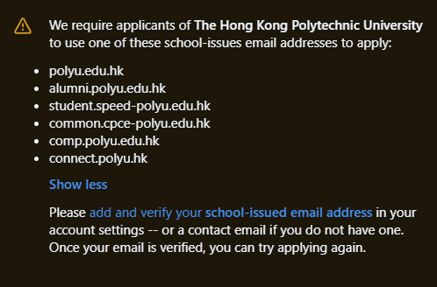
07 · TOOLS · 03
Git and GitHub
Git tracks every change on your computer. GitHub keeps a copy online and lets others see it.
git-scm.com
github.com — add your PolyU email
github.com/settings/education/benefits
github.com/git-guides
GitHub Education only accepts a PolyU address — add yours first.
Notes:
Git tracks changes on your machine. GitHub hosts them online. Register with your PolyU email for the education benefits.

Slide 42
07 · TOOLS · HOW GITHUB WORKS
Issue → fork → commit → pull request
01 · ISSUE
02 · FORK
03 · COMMIT
04 · PULL REQUEST
Say what is wrong
Your own copy
Save a change
Ask to merge
A bug, a feature idea, or “I want to help.” Explain how the code should behave.
→
A fork is your version of the repo. It can pull in new changes from the original any time.
→
Each commit is a named snapshot. Push it and it is public.
→
Propose your commits to the original repo. If accepted, they are merged in.
Notes:
Found a bug or want a feature? Open an issue. Want to change code? Fork, commit, open a pull request. Accepted PRs get merged.

Slide 43
A PUBLIC REPO
The course lives on GitHub
github.com/sd5913/pfad
Our organisation: github.com/sd5913 . Found a bug? Open an issue.
Notes:
Everything for the course lives here. Fork it in the tutorial.

Slide 44
A public GitHub repo.
ASSIGNMENT 01 · 5% · DUE SUN 13 SEP, 23:59
Not a PDF.
Why are we here?
README.md
is the essay
PROCESS.md
is how you used AI
500–1000 words on why you are in this course.
Submit the repo URL on Canvas
canvas.polyu.edu.hk
Notes:
Due end of week 2. A public repo, not a PDF. README is the essay; PROCESS.md says how AI was used. Submit the URL on Canvas.

Slide 45
ASSIGNMENT 02 · 10% · WHAT TO EXPECT
Data visualisation — two high-level tasks
TASK 01
TASK 02
Obtain data about a natural phenomenon
Visualise the data you collected
Notes:
Two high-level tasks. Everything else is breaking these down.

Slide 46
ASSIGNMENT 02 · BREAK IT DOWN
Example: tides
01
02
03 · THE PROBLEM
04 · WEEKS 2–3
Phenomenon
Data provider
Find the pattern
Visualise
Tides in Hong Kong
hko.gov.hk/en/tide/ttext.htm
Art, or design?
…inside a web page
Notes:
Example: Hong Kong tides. Pick a phenomenon, find who publishes the data, then the real problem: find the pattern in a web page.

Slide 47
ASSIGNMENT 02 · INPUTS AND OUTPUTS
“Find the pattern in a web page” — five steps
01
02
03
04
05
Get
Save
Parse
Store
Show
Make an http request.
Write the page to a file, so you ask the server only once.
Read the response as XML and find the pattern.
Keep the data you found in a clean shape.
What data and metadata matter? How is it consumed? What must be validated?
requests
lxml
Notes:
Five steps. Each step has an input and an output. Requests for http, lxml for parsing.

Slide 48
file exists?
ASSIGNMENT 02 · STEP 02
NO
YES
Save the page
make the http request
read the file
Check if the file exists. If not, request it and save it. If yes, just read it.
save the file
parse
Notes:
Caching logic. Check first, then decide. This is the first if/else you will write.

Slide 49
ASSIGNMENT 02 · 10% · DUE SUN 27 SEP
Data visualisation
ARE YOU A PRECRASTINATOR? START HERE
1
Install Python
2
Clone the repo
Code committed to a GitHub repo. Submit the URL on Canvas. It should obtain data about a natural phenomenon and visualise it.
3
Run the code
4
Make it work for the website you need
Notes:
Precrastinators: install Python, clone the repo, run the code, adapt it to your website. Due Sun 27 Sep.

Slide 50
TUTORIALS · MULTIPLE CHOICE
Do you want to leave your current tutorial group and join the 15:30 laptop group instead ?
A
Yes — I will bring my own laptop
B
No — I stay in my group
C
I don't mind either
Notes:
ClassPoint multiple choice. Only the 15:30 group in V1102 is laptop-based. Count the yeses to size the room.

Slide 51
08 · TUTORIALS
Use the tutorials to work on your assignments
V915 · PC
V915 · PC
V915 · PC
V1102 · YOUR LAPTOP
12:30–14:30
14:30–16:30
16:30–18:30
15:30–17:30
Gio
Nicola
Nicola
Gio · laptop group
Notes:
Four groups. Three on university PCs in V915, one laptop group in V1102.

Slide 52
08 · WEEK 1 TUTORIAL GOALS
Leave today with…
A GitHub account — 2FA on, PolyU email added
[Laptop] git and VS Code installed; git name + email set
Registered at pfad.ait4x.org — student ID matched
[Laptop] A clone of the course repo + python installed
github.com/sd5913/pfad open, week01/README.md read
Your own public repo — the sketch in it, run, two commits pushed
You can do every step inside VS Code. The terminal is optional today.
Notes:
Seven things to leave with today. Everything can be done inside VS Code; the terminal is optional.

Slide 53
DESIGN THE MARK · 1 — ALONE
This course needs a mark — a logo, the thing on the repo and at the top of the slides. You are the client.
1 MIN
Silent. Pen and paper. A thing you could point at: an object, a shape, a tool. Not an adjective — you cannot draw “innovative”.
Name one thing it could be built from.
e.g. a cursor that is also a pencil · a grid coming apart at one corner · two square brackets facing each other
Notes:
One minute, silent, paper. One concrete object the course mark could be built from. Not an adjective.

Slide 54
DESIGN THE MARK · 2 — IN PAIRS
Turn to your neighbour. Read each other your object. Leave with one object — not two, not a mix of two.
2 MIN
Keep one, or build a third thing from both. You may not keep both.
Two answers in. One answer out.
Whoever's object gets dropped says in one line what was good about it. Write that down too.
Notes:
Two minutes in pairs. Two answers in, one out. The dropped idea's owner says in one line what was good about it.

Slide 55
DESIGN THE MARK · 4 — TWO PAIRS
Join the pair behind you. Four people, one object. It must work at 16 px wide — the favicon on your repo, the avatar next to your name.
4 MIN
At 16 px you get one shape and one idea. Detail disappears. Decide what survives: “ours is a ___, and at 16px you can still tell, because ___.”
Now it has to survive 16 pixels.
Then one line of anti-brief: the one thing it must never look like.
Notes:
Four minutes in fours. The twist: it must work at 16 pixels — the favicon and the GitHub avatar. One person writes.

Slide 56

DESIGN THE MARK · CAPTURE · 2 MIN · SHORT ANSWER
Scribes only. One line per four.
OBJECT — what survives at 16px — never: ___
e.g. “A grid with one tile falling out — the gap where the tile was — never: a gear.” One submission per group of four. About 28 lines, not 112.
Notes:
ClassPoint short answer. Scribes only, one line per four. These go into a design tool on the projector at the end.

Slide 57
DESIGN THE MARK · WHAT JUST HAPPENED
That was a design brief.
Eight minutes, no software. The room now agrees on an object, what survives at 16 pixels, and one thing it must never be. Everything after this — drawing, variations, file formats — is craft.
A machine can draw it. It cannot decide it.
Notes:
Eight minutes, no software. The room agreed on an object, what survives, and one thing it must never be. Everything after this is craft.

Slide 58
SD5913 · WEEK 01 · TUTORIAL
Tutorial
Sign up. Register. Run week01. Make your own repo.
Notes:
Tutorial half. Tasks are marked TASK.

Slide 59
TUTORIAL · GITHUB
Your GitHub account is your portfolio
# github.com/education/students
if not you.has_account:
register("student email")
else:
you.account.add_email("student email")
Every commit in this course shows up on your profile. Put it on your CV.
github.com/venetanji
Notes:
Your commits become your portfolio. Register with the student email for GitHub Education.

Slide 60
[TASK] · DO IT NOW · ONE MINUTE
Sign up, then register
01 · GITHUB.COM
02 · PFAD.AIT4X.ORG
Sign up
Match your work.
Go to GITHUB.COM
Use your student email. Turn on two-factor authentication — you will need it.
Go to PFAD.AIT4X.ORG and sign in with GitHub. Enter the last 4 digits and the letter of your PolyU student ID.
Public profile only · no password · no access to your repos
Notes:
Two tasks now. GitHub with MFA. Then pfad.ait4x.org: sign in with GitHub, enter the last 4 digits and letter of your student ID. Public profile only.

Slide 61
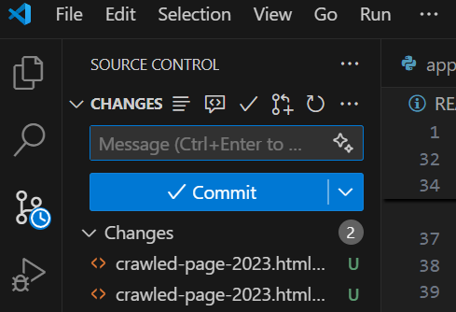
[TASK] · RUN WEEK01
VS Code + Copilot in agent mode
STEP 1 · GIT
STEP 2 · CLONE
STEP 3 · RUN AND COMMIT
Open VS Code, sign in with GitHub, open Copilot chat. Choose Agent. Then ask:
Can you help me clone this repo locally: https://github.com/sd5913/pfad
Open week01/README.md . Run the sketch. Commit from the Source Control panel.
Can you help me install git via winget?
Help me launch VS Code with this new folder
!! RESTART VS CODE AFTER INSTALL !!
Or from the terminal: code pfad
Works best with Claude as the model. Git may need installing on the V915 computers first: git-scm.com/downloads
Notes:
Open VS Code, sign in with GitHub, open Copilot chat in agent mode. Ask it to install git, clone the repo, open the folder. Restart VS Code after installing git.

Slide 62
OPTION · NO INSTALL
1
Create a codespace
VS Code in Codespaces
2
Assign it the repo sd5913/pfad
A full VS Code in your browser, running on GitHub's computer.
3
Work as in VS Code
github.com/codespaces
!
Stop the codespace when you are done
Notes:
No install needed: a VS Code in the browser. Create a codespace, assign the repo. Stop it when done — it uses your free hours.

Slide 63
[TASK] · YOUR REPO
github.com
Make your own repo
New repository → public
You cannot commit to a public repo unless you are a collaborator. To commit code, create your own new repo .
VS Code
Copy the week01 sketch in, run it
Do it on github.com — Copilot cannot do this for you.
Source Control
Two commits, pushed
Notes:
You cannot push to the course repo. Make your own on github.com — Copilot cannot do this for you — then push your sketch there.

Slide 64

SD5913 · WEEK 01 · END
See you next week.
Want more challenges? Code Schotter, with your own number.
a t4x
PFAD.AIT4X.ORG · GITHUB.COM/SD5913/PFAD
Notes:
Want more? Code Schotter with your own number. See you next week.

