Slide 1


Vibecoding in Practice
Sanjit Dutta | February 2026 | Technology Strategy

Slide 2

Vibecoding compressed a 40-hour build into a single afternoon
I set out to solve a real problem: rewards program changes made my credit card strategy obsolete. Using an AI coding agent, I built working software — not a prototype — in a single afternoon session.
10 min
This is materially different from brainstorming in ChatGPT. The agent wrote, tested, and iterated on code autonomously. I directed; it built.
Time to first working application
From blank repo to running, functional app
Many software ideas previously too slow or expensive to build are now viable. The activation energy of software creation has dropped dramatically.
40+ hrs
Prior estimate for equivalent outcome
Traditional software development cycle
Vibecoding in Practice
1

Slide 3
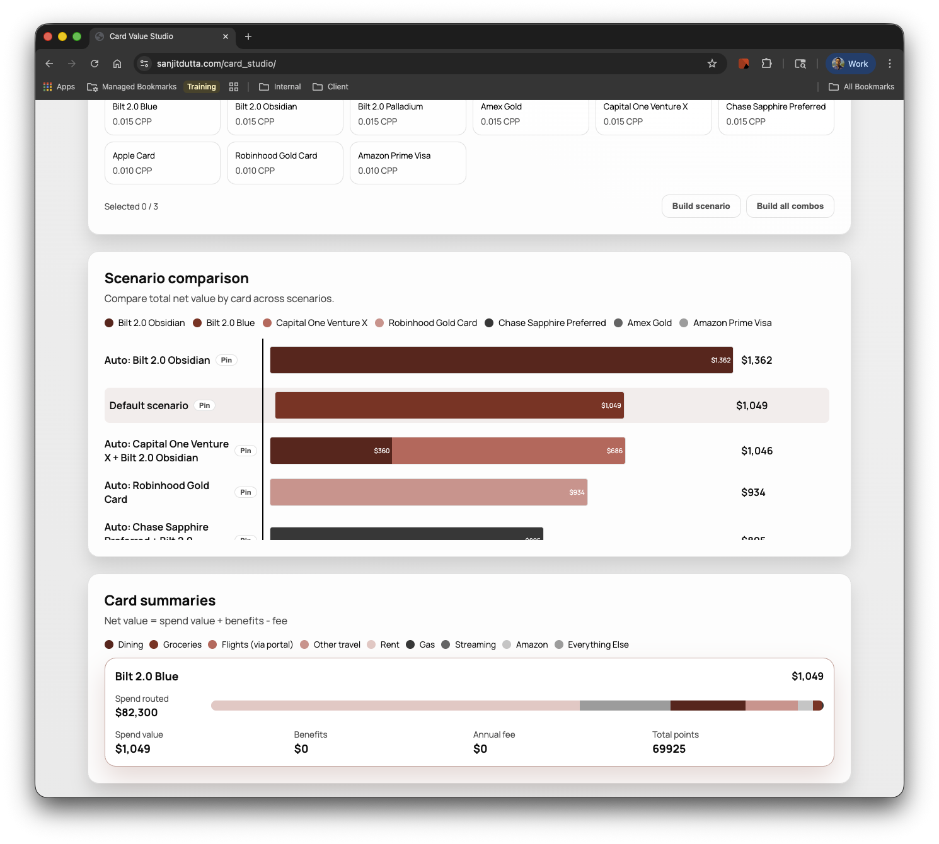
A credit card optimizer built in hours to solve a real financial problem
Rewards program changes made my existing wallet strategy obsolete — I needed to model and compare card portfolios quickly
Built a tool to configure card setups, spend categories, and benefit values — then compare routing scenarios side-by-side
Workspace persists across sessions so users can iterate as card terms and personal spend change over time
$300+ annual wallet upside identified and captured by running scenarios through the app
Demo: lnkd.in/ew2dtgms | Repo: lnkd.in/ejAyzACp
Vibecoding in Practice
2

Slide 4
The numbers make the case: speed, savings, and real-world value
10 min
40+ hrs
Time to first working application
Prior build estimate for equivalent outcome
From blank repo to running app
Traditional software development cycle
~8 hrs
$300+
Actual time to solid, production-ready state
Annual wallet upside identified
Including intermittent refinement and QA
Real financial value from using the app
Vibecoding in Practice
3

Slide 5
AI-generated code is fast code — not automatically good code
Dead code and legacy artifacts accumulate quickly
Vestigial database drivers, unused imports, and orphaned logic persist unless actively pruned. Technical debt accrues by default.
Debug loops can waste time and deepen technical debt
When the agent enters a retry spiral on a complex bug, it often produces workarounds rather than root-cause fixes — increasing fragility.
Complex implementation paths need human blocking
Architecture decisions — data models, API contracts, state management — require deliberate design. AI defaults to the simplest working solution.
Front-end quality and visualization required manual takeover
Responsive layouts, data visualization, and interaction design still demand human judgment. The AI produced functional but unpolished UI.
Vibecoding in Practice
4

Slide 6
Production guardrails are non-negotiable — speed scales only when governance scales with it
Secrets & Repository Hygiene
Security & API Hardening
High Availability & Reliability
No credentials in version control
Input validation at all API boundaries
Systemd service with auto-restart
.env files excluded from commits
Session management with signed cookies
Process supervision and crash recovery
Branch protection and signed commits
Rate limiting and CORS enforcement
Structured error logging
Dependency audit before production deploy
HTTPS + reverse proxy for all traffic
Build and deploy pipeline with rollback
Working model: Free-form, agent-led exploration for POCs and internal tools — structured, step-by-step with human review checkpoints for anything production-facing or client-visible.
Vibecoding in Practice
5

Slide 7
The new diligence question is not "Is AI used?" but "Is it governed?"
Four concrete implications for PE tech strategy and value-creation teams
Implication | What this means in practice | Value-creation angle
Evaluate AI code quality, not just velocity | Audit code review practices, test coverage, and debt accumulation rate at portfolio companies using AI tools | Reduce hidden technical debt that compresses exit multiples
Quantify developer productivity gains | Build AI productivity metrics into 100-day plans — output per engineer, time-to-feature, defect rates | Monetize efficiency as margin improvement in value-creation plans
Assess agentic workflow readiness | Evaluate whether portfolio dev teams have the process maturity to supervise and govern semi-autonomous agents | Identify acceleration opportunities and governance gaps early
Diligence AI velocity and governance together | In due diligence, pair "how much AI is used?" with "how is output reviewed, tested, and deployed?" | Flag governance risk before it becomes a post-close liability
Vibecoding in Practice
6

Slide 8
Start using it now — operate it like a professional software team
The same pattern applies to delivery: rapid generation + disciplined review
CONTEXT
TEAM ASK
This deck itself was 100% vibecoded. If presenting externally or to clients, the same rapid generation + structured editorial review would apply.
Test Codex, Claude Code, or GitHub Copilot Workspace on one real task this week
Bring one client-relevant insight back — speed observed, failure mode hit, governance gap surfaced
You do not need to be a traditional engineer to start learning this workflow — but you do need to operate it with engineering discipline.
Consider: where in your portfolio does vibecoding velocity create diligence or delivery risk today?
The window for establishing AI governance frameworks is now — before velocity becomes liability at scale
Vibecoding in Practice
7

