Slide 1
Vibecoding in Practice
Faster software creation, higher governance stakes
Presenter: Sanjit Dutta Date: Feb 2026

Slide 2
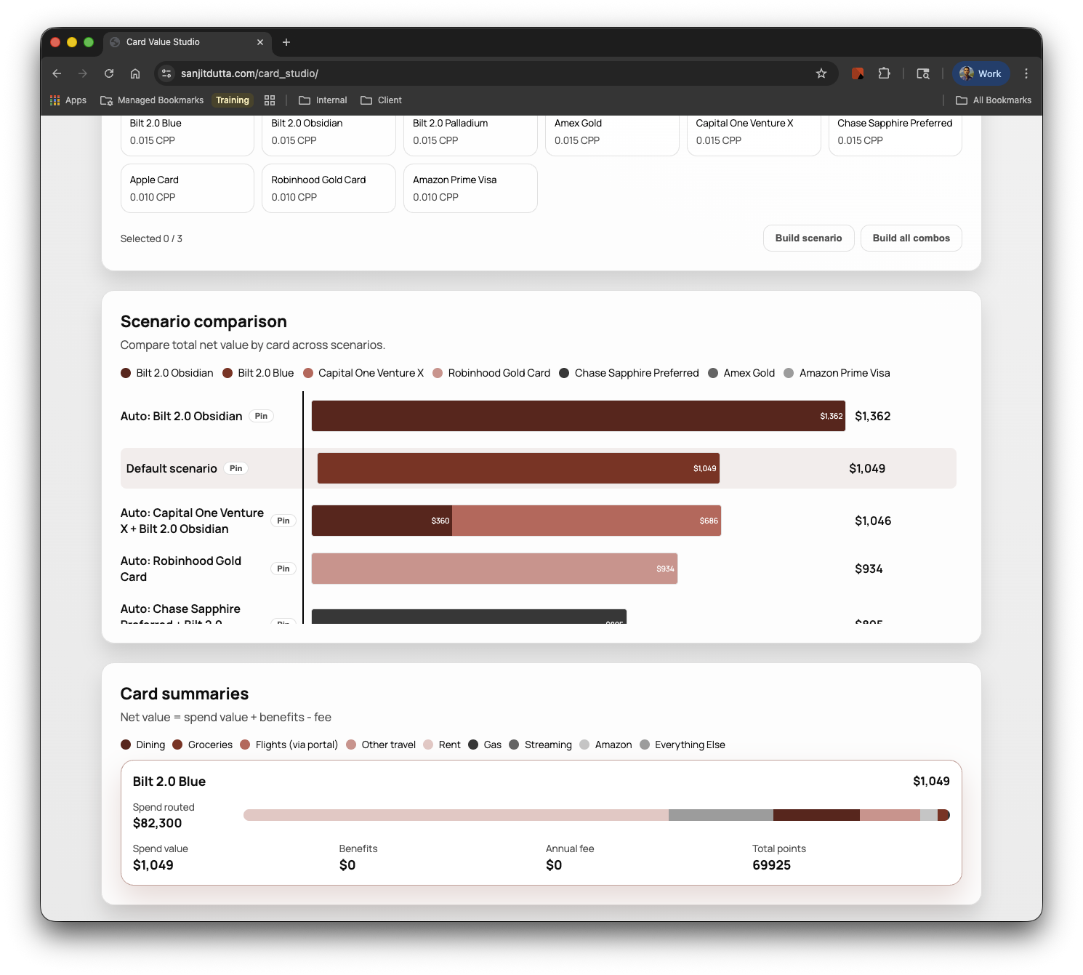
CONTEXT
The Problem and the Product
Rewards program changes made my wallet strategy obsolete
I built a tool to test card portfolio setups and spend-routing scenarios
The app stores inputs locally so users can iterate and compare over time
Demo link: https://lnkd.in/ew2dtgms
Repo for bugs: https://lnkd.in/ejAyzACp
Real user pain can now be translated into software in a single session.

Slide 3
PROOF POINTS
Proof That This Is Real
10 minutes
40+ hours
First working application
Prior build estimate for similar outcome
~8 hours with intermittent refinement
$300+ annual wallet upside
Actual total to solid state
Business outcome from using the app
Time-to-value compression is real for both builders and end users.

Slide 4
FAILURE MODES
Where Vibecoding Breaks Down
!
Dead code and legacy artifacts accumulate quickly (e.g., vestigial Mongo code)
!
Complex implementation paths often need to be blocked or rewritten
!
Debug loops can waste time and increase technical debt
!
Front-end responsiveness and visualization quality still required manual takeover
AI-generated code is fast code, not automatically good code.

Slide 5
OPERATING MODEL
Production Guardrails Are Non-Negotiable
01
02
03
Secrets and repository hygiene
Security and API hardening
High availability and reliability controls
Working model: free-form for POCs, structured step-by-step for production
Speed scales only when governance scales with it.

Slide 6
CLIENT IMPLICATIONS
Implications for PE Tech Strategy Teams
Evaluate AI code quality explicitly, not just output velocity
Developer productivity gains are real and should be quantified in value-creation plans
Agentic workflows can push delivery toward semi-autonomous execution
In diligence, assess AI velocity and software governance together
The new diligence question is not "Is AI used?" but "Is it governed?"

Slide 7
Disclaimer and Call to Action
• This deck itself was 100% vibecoded; if I was presenting externally (“production”), I would have edited and quality-controlled further • The same pattern applies to delivery: rapid generation plus disciplined review
• You do not need to be a traditional engineer to start learning this workflow • Team ask: test Codex, Claude, or GitHub Copilot today and bring one client-relevant insight back
Start using it now, but operate it like a professional software team if you’re going to sell what you make.

