Slide 1
Online Banking System

Slide 2
Team Members: -
Shubhankar singh -RA2011031010039
Naman Mithawani – RA2011031010054
Sanju Das - RA2011031010063

Slide 3
Abstract
An Online Banking System is a software application that allows customers to perform banking transactions and manage their finances through the internet. The system provides a secure and convenient platform for customers to access their bank accounts, view account information, and perform various transactions, such as transfers, bill payments, and money management.
It provides a convenient and secure platform for customers to manage their finances and perform banking transactions. With its user-friendly interface, real-time updates, and secure transactions, the Online Banking System enhances the customer experience and improves the overall performance of the bank.

Slide 4
List of General and Unique Services in the database application
General Services:
Provides login to the banking portal for users.
Includes details like sender’s and receiver’s name, amount, transaction type for each transaction.
Includes details about the different types of payments like RTGS, NEFT, IMPS.
Includes the facilities of admin login.
Unique Services:
Database storage of the transaction details in detail.
Provides the user’s information to the administrator.
Provides the feature of deleting and updating account information to the admin.
Provides a review system for the users to share their experience on the portal.

Slide 5
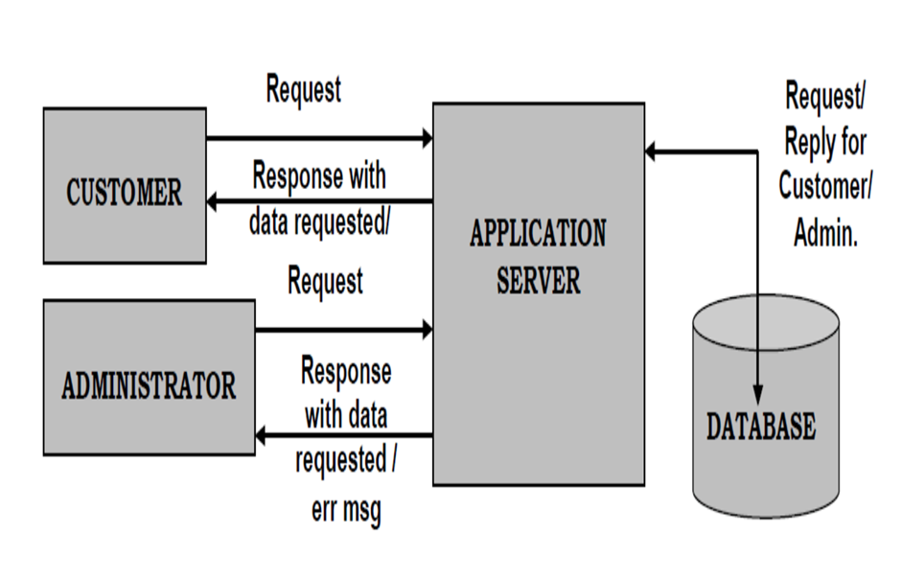
Architecture Diagram

Slide 6
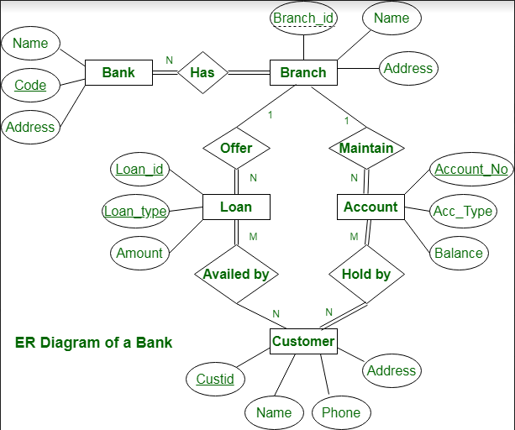
ER Diagram

Slide 7
Front end (UI) Software used
We have used the following technologies for the Front End:
Hyper Text Markup Language (HTML)
Cascading Style Sheets (CSS)
Bootstrap
Javascript (js)

Slide 8
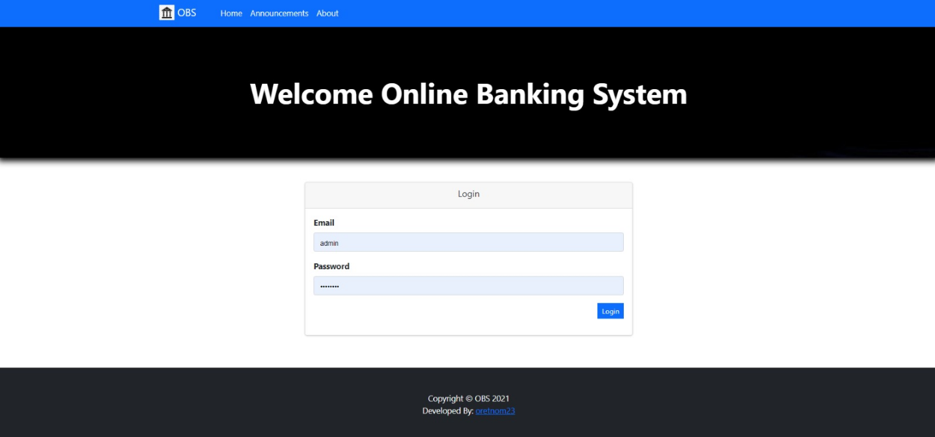
Front end (UI) design
USER-LOGIN PAGE

Slide 9
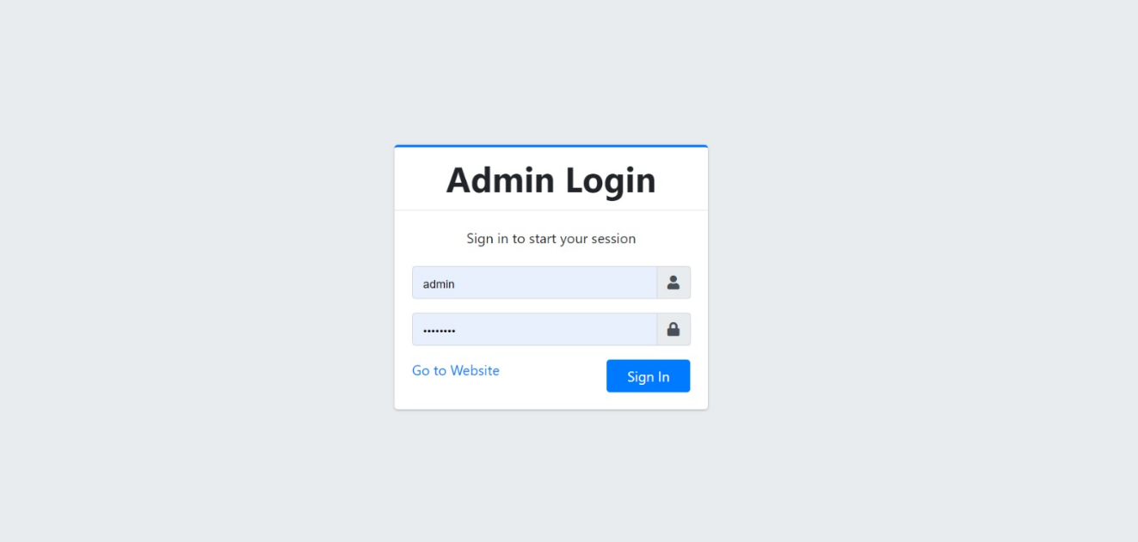
Front end (UI) design
ADMIN-LOGIN PAGE

Slide 10
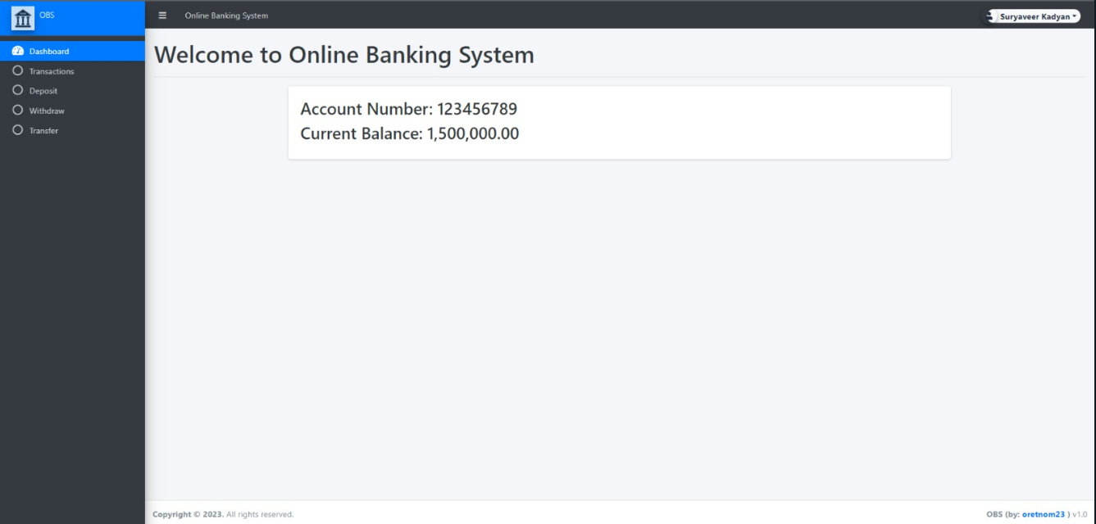
Front end (UI) design
USER-HOME PAGE

Slide 11
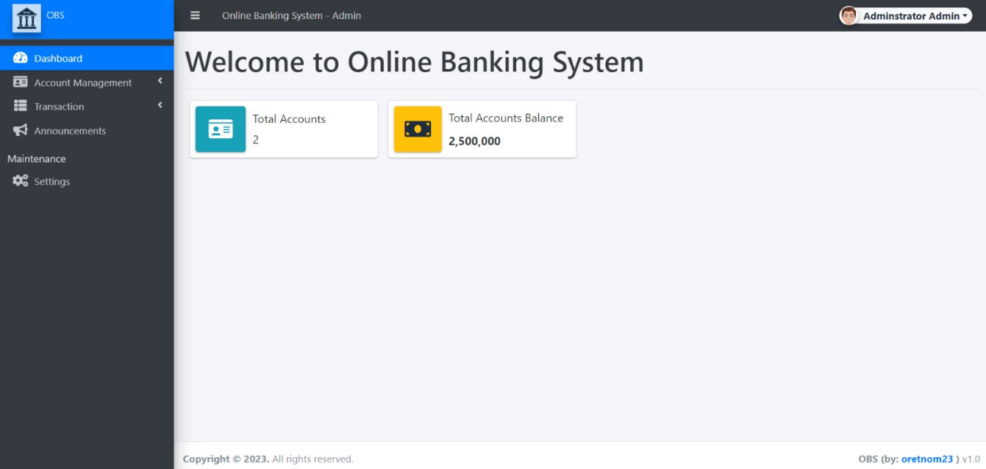
Front end (UI) design
ADMIN-HOME PAGE

Slide 12
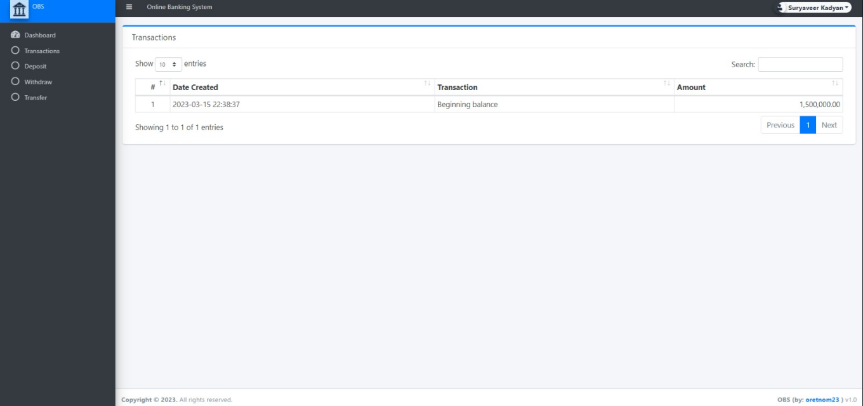
Front end (UI) design
USER-TRANSACTIONS PAGE

Slide 13
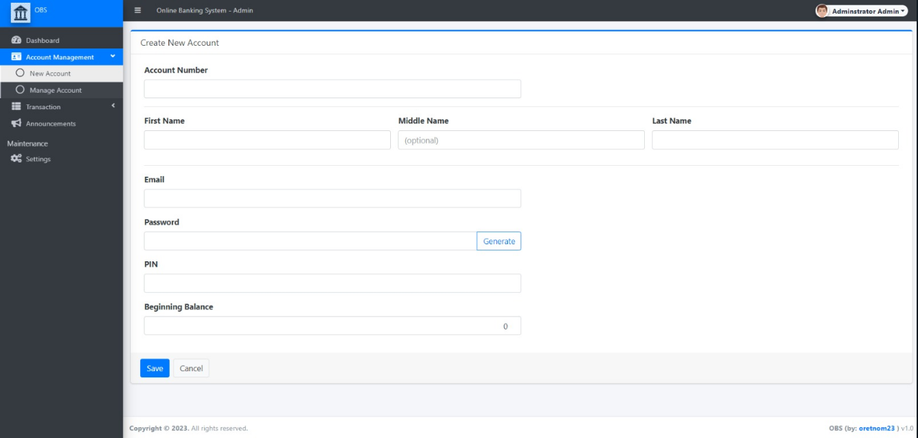
Front end (UI) design
ACCOUNT CREATION PAGE

Slide 14
Back end (Database) Software used
Php
MySQL
XAMPP server

Slide 15
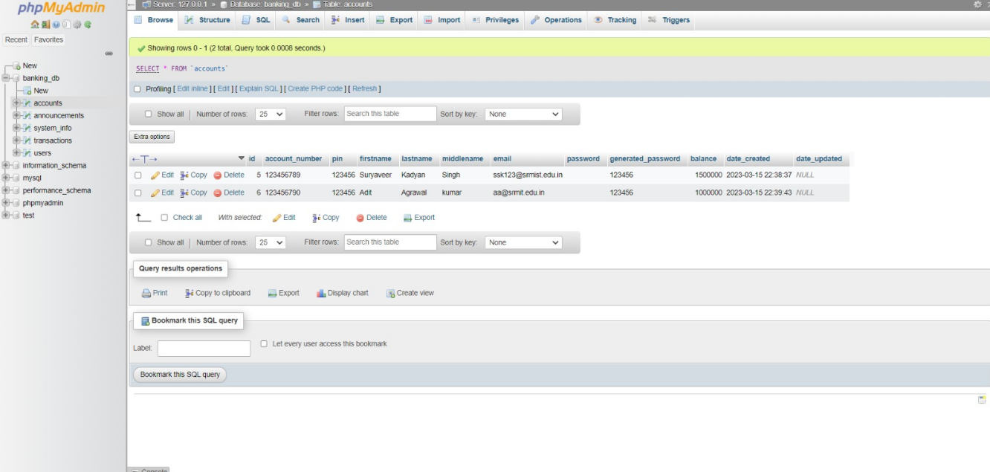
Back end (UI) design
PHP

Slide 16
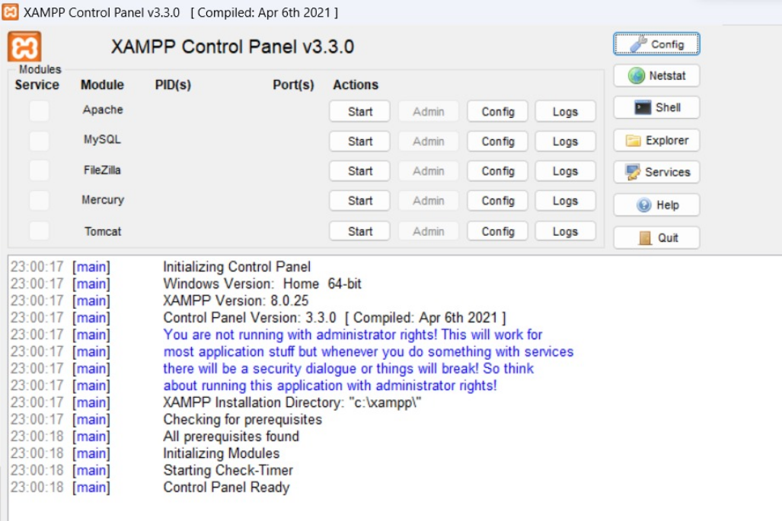
Back end (UI) design
XAMPP CONTROL PAGE

Slide 17
Type of Connectivity used for database access
Client-side:Mobile/Web Site/Portal
Server-side:PHP, MySQL

Slide 18
List of Modules and Functionalities in each of the modules
Login Profile : Helps legitimate customers to access the services offered by the bank
Admin Profile: System Administration
User Profile: User Authentication
Update Profile : Modifying Details of user
Balance Enquiry Profile : Preserves the knowledge
Transaction Profile : Updating the account balance and keeping record of the deposits and withdrawals

Slide 19
References
E-banking in India – major development and issues, by S. S. Debashish and B.P. Mishra- Pranjana, vol. 6, no.1, Jan – July 2003, pg 19.
Financial integration across border and across sectors: implication for regulatory structures, Working Paper, Stern School of Business, NYU. Wiese, C. (2001).
Rao N K,(2005). “Indian Banking system: The Forward March”,Indian Banking 2005, The Icfai journal of Professional Banker,February pp 7-10.
"E-Banking In India – Major Development and Issues", by Sathya Swaroop Debashish and Bishnu Priya Mishra – Pranjana, vol. 6, no.1. Jan – July 2003., page 18

Slide 20
THANK YOU!

