Slide 1
IONIC EXCLUSIVES / FIRST INVESTMENT
A hypothesis about
the first purchase
74%
of viewing time fell within the
first two screenfuls in NN/g’s
2018 desktop study.
What we know
The product team reports portfolio imports without unassisted purchases. The captured Exclusives page has long product shelves; smaller entry routes sit further down.
120 participants. This is an attention
finding, not an Ionic mobile drop-off rate.
84%
What I would test
Put comparable products, costs and risks within the first two screens. Eligible importers should then be more likely to complete a first investment without a call.
say fee disclosure matters.
48% were satisfied.
CFA Institute, 2018.
3,127 retail investors across 12 markets.
Sources: NN/g, Scrolling and Attention (2018); CFA Institute, Investor Trust Survey (2018)
Notes:
The observation is supplied by the product lead and screenshots, not an audited conversion funnel. There is no measured Ionic NPS, scroll abandonment, or conversion baseline in the supplied material. Do not claim that wealthy users refuse to read. The mechanism is a hypothesis about discovery and decision effort.
NN/g: https://www.nngroup.com/articles/scrolling-and-attention/
120 participants, over 130,000 eye fixations on 1920x1080 desktop screens; 74% viewing time in the first two screenfuls. This is not the percentage of mobile users who scroll and not a wealth-specific sample.
CFA Institute: https://www.cfainstitute.org/about/press-room/2018/cfa-institute-calls-for-universal-disclosure-fee-performance-across-investment-industry
2018 global survey: 84% importance versus 48% satisfaction with full fee disclosure, 3,127 retail investors across 12 markets. Evidence of the importance of transparency, not causal proof of this UI proposal.
Prediction: among eligible imported-portfolio users with no prior transaction, seven-day first unassisted funded investment rate improves when the proposed discovery and details replace the current shelves. No uplift is claimed before measurement.

Slide 2
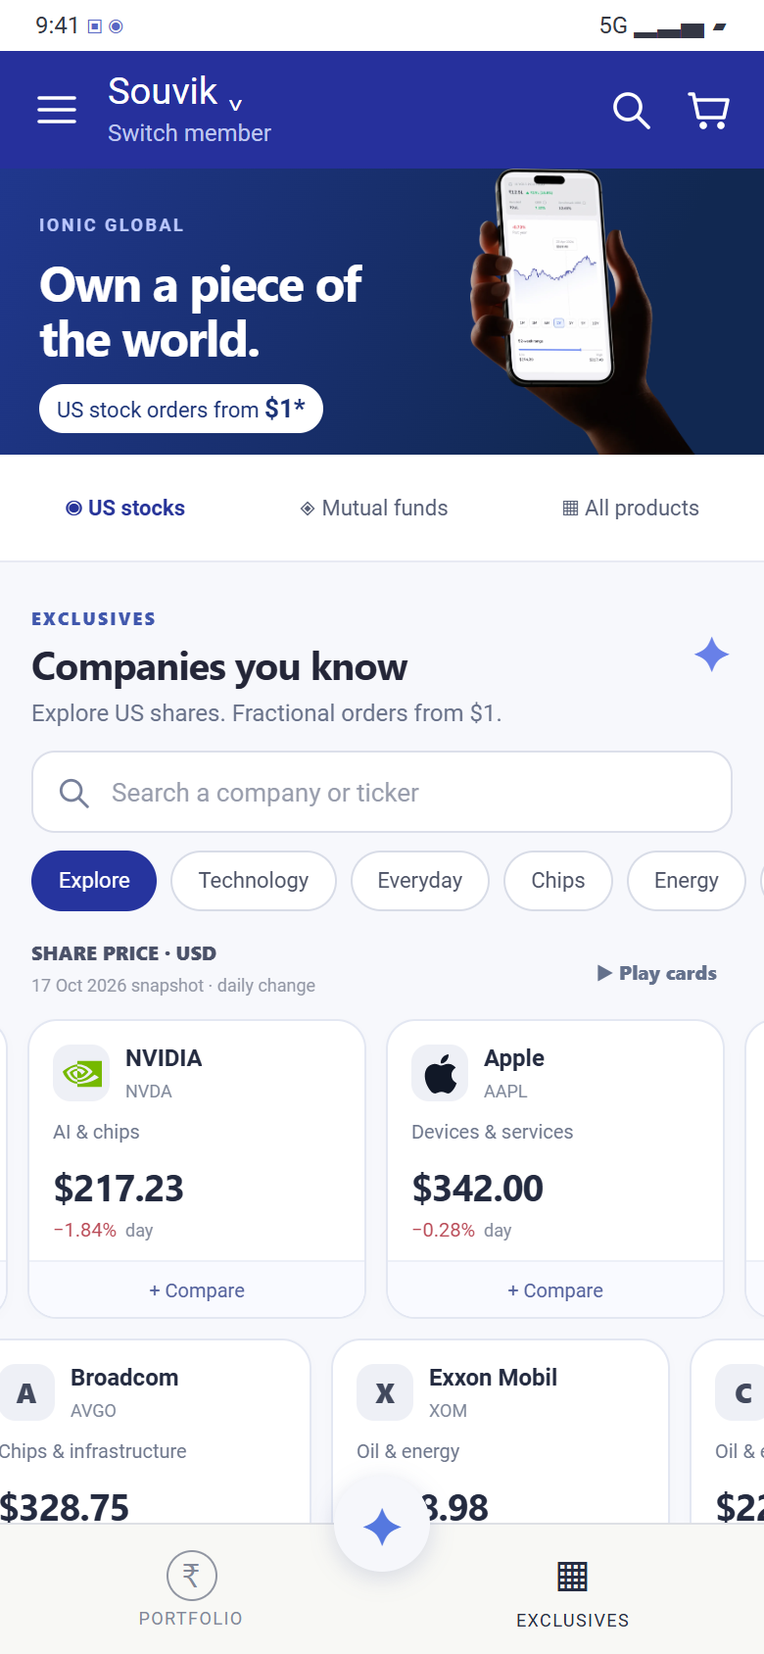
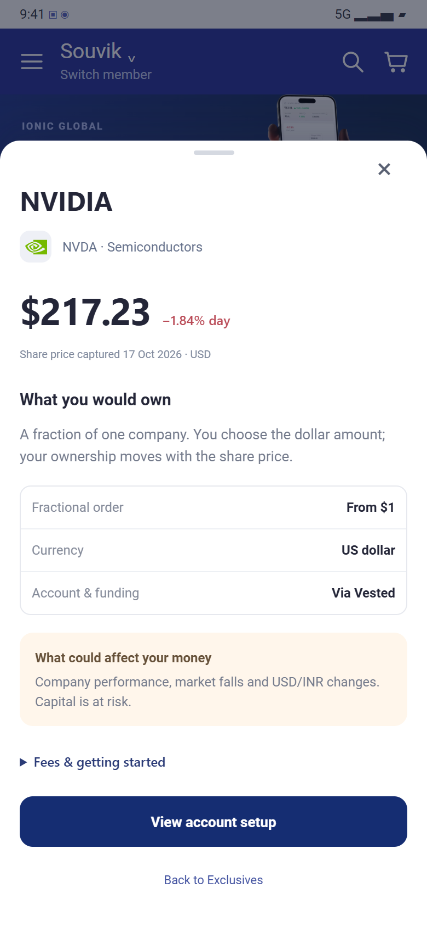
PROPOSED EXPERIENCE
A shorter route to a considered choice
DISCOVERY
PRODUCT DETAILS
Familiar products, useful facts
Company, exposure and price are visible on compact cards. Search narrows the set; it does not add another shelf.
A comparison before commitment
Compare two companies, then open a stable detail screen for entry cost, currency exposure and account setup.
Motion is optional
Two slow, opposite rows. Pause on interaction; a visible pause button and reduced-motion support.
Notes:
Screenshots are from the interactive local prototype built from supplied Ionic captures. Figures are dated fixtures, not live quotes. Keep the brand hero and product access. Make known figures readable; do not fabricate performance charts or fee data. The price shown is a full share quote, while fractional order minimum is a separate amount. US setup and FX costs are separate. The motion shown here is an optional treatment, not a proven conversion lever. Both rows run at 9 pixels per second in opposite directions. Search/filter results remain stationary, pointer interaction pauses motion, hover/focus pauses the affected row, and prefers-reduced-motion is respected. Mouse dragging and touch scrolling are supported. Final order submission and partner KYC are not connected.
Choice-set rationale: Iyengar and Kamenica (2010), Choice Proliferation, Simplicity Seeking, and Asset Allocation, Journal of Public Economics 94, 530–539. https://business.columbia.edu/sites/default/files-efs/pubfiles/4519/simplicitySeeking.pdf
Their laboratory studies and 401(k) records support a mechanism of simplicity seeking in larger choice sets; they do not establish an Ionic conversion effect.

Slide 3
VALIDATION
Measure funded investments
Primary outcome
Test the layout first
First unassisted investment
within 7 days
Current shelves vs compact, static cards.
Keep products and eligibility consistent.
Set sample size from the actual baseline.
Users who complete a first investment
without assistance, divided by all eligible
importers assigned to each experience.
Then test the motion
Static cards vs the two moving rows.
Ship only if comprehension and completed
investments hold up—not just taps.
A click is only a diagnostic
If product opens rise but funded orders do not,
inspect KYC, funding and fees before
concluding that discovery is solved.
Check the cost of the improvement
Track assistance, risk/fee understanding,
errors, cancellations and complaints.
Research basis: Iyengar & Kamenica (2010), Choice Proliferation, Simplicity Seeking, and Asset Allocation. DOI: 10.1016/j.jpubeco.2010.03.006
Notes:
Experiment plan, not observed results. Establish a baseline with production analytics before setting an uplift target or sample size. Unit of randomization: user; intent-to-treat denominator is all eligible imported-portfolio users without a previous funded transaction, assigned on first Exclusives exposure. Exclude internal/test accounts and apply regulatory/provider eligibility consistently. Define assistance using recorded RM calls/chats during the conversion window; report an assisted outcome separately. The primary outcome is first successfully funded/completed investment within seven days of assignment, not just order initiation. Report absolute and relative differences with uncertainty. Stratify by account readiness and product family because US funding introduces a different dependency than domestic funds.
Instrument exposure, product impressions by viewport depth, detail opens, comparison, account setup, funding and completed order. Check fee/risk comprehension with a brief usability task; monitor support, cancellations and complaints. Run baseline collection and choose sample size from an agreed minimum detectable effect; do not invent a conversion rate or target. Motion is a separate follow-up test so it does not confound the layout hypothesis.
Paper: https://business.columbia.edu/sites/default/files-efs/pubfiles/4519/simplicitySeeking.pdf
Iyengar & Kamenica (2010), Journal of Public Economics 94, 530–539. Records of >500,000 employees at 638 institutions plus laboratory experiments; larger choice sets increased preference for simpler options. This is not HNI mobile conversion research.
Additional references used on slide 1:
https://www.nngroup.com/articles/scrolling-and-attention/
https://www.cfainstitute.org/about/press-room/2018/cfa-institute-calls-for-universal-disclosure-fee-performance-across-investment-industry

