Slide 1
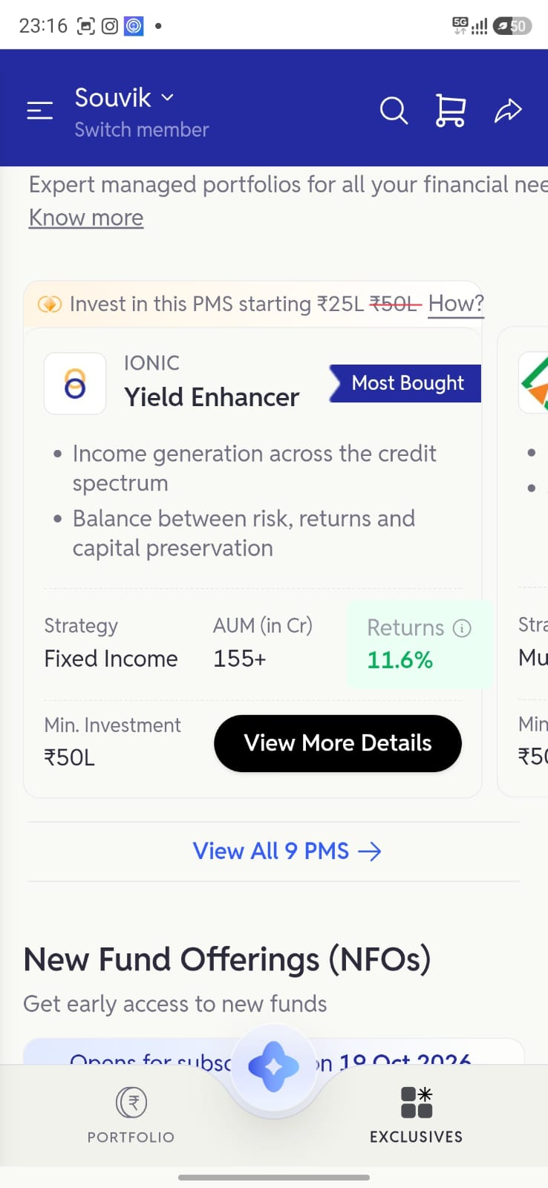
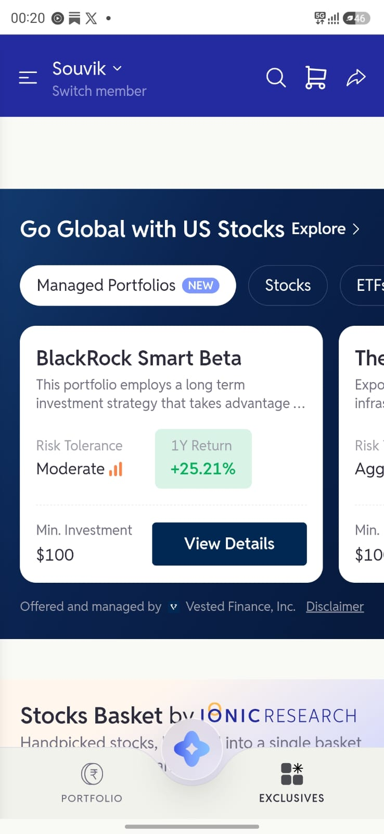
1 / Why change Exclusives?
The gap is between browsing
and the first investment.
What we know
The product lead reports that people import their portfolios for insights, but often need guidance before making their first purchase.
What the screens suggest
Exclusives presents long product shelves. US investing and mutual funds appear later, so users have to keep browsing to find a smaller entry option.
The hypothesis
Bring accessible products forward, with comparable facts and clear next steps. More users may then make a first investment without assisted guidance.
PMS shelf
US investing, later
Original app captures. Scroll drop-off has not been measured.
Notes:
Observation supplied by the product lead, not production funnel data. Screenshots are the original Ionic Android captures supplied by the user: WhatsApp Image 2026-10-17 at 00.22.33 (1).jpeg (PMS shelf) and 00.22.33 (2).jpeg (US investing shelf). The captured catalogue orders PMS and NFOs before US investing, then baskets, SIFs and mutual funds. Side-by-side crops show different scroll positions, not a measured distance or drop-off. This is a proposed causal explanation to test; no conversion baseline, NPS or uplift is claimed. Research and limitations remain in Appendix 4.

Slide 2
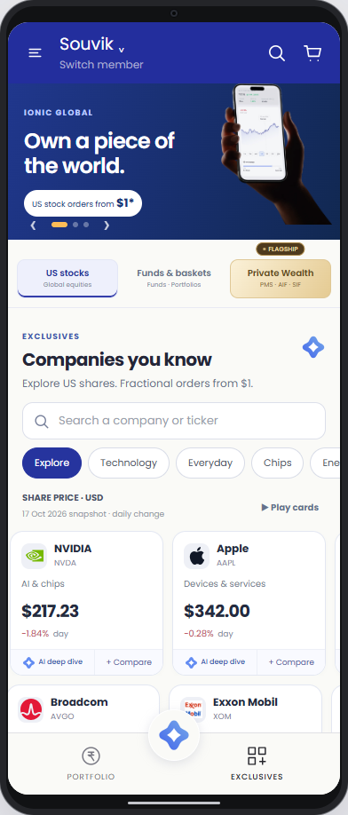
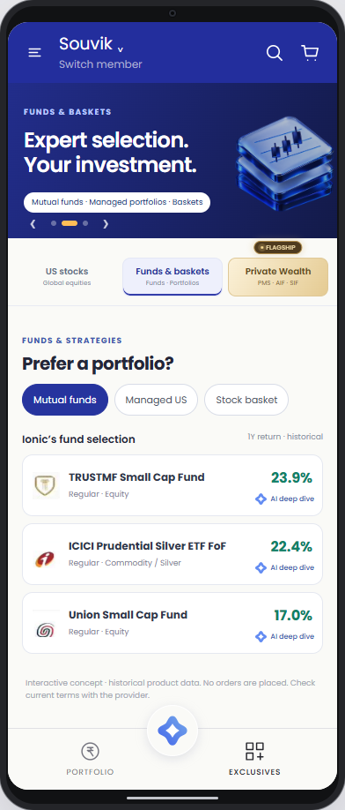
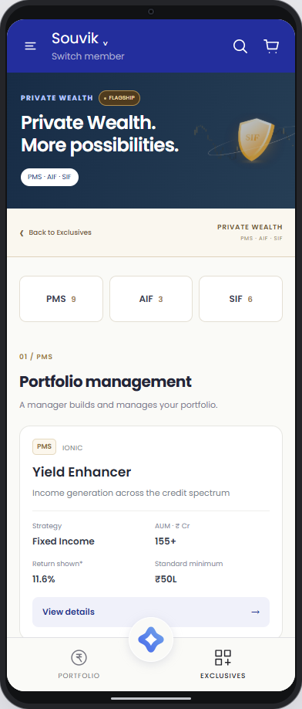
2 / What changes on the screen?
Three clear routes, without losing the full catalogue.
US stocks
Funds & baskets
Private Wealth
Scan share prices and daily moves. Compare two companies, then open details or the AI explanation.
See the fund, category and labelled return period. Open details for the minimum, costs and risks.
Browse all 18 PMS, AIF and SIF offerings in one catalogue, with minimums and working detail links.
Notes:
Screenshots from the current working proposal. All three categories sit below the hero. US stocks show captured prices and daily moves, a two-stock comparison and product details. Funds show captured performance with period labels; details contain investment facts. Historical returns do not predict future returns. Private Wealth screenshot shows the catalogue after the welcome: 9 PMS, 3 AIF and 6 SIF offerings. Figures are fixtures, not live quotes. Desktop uses a 392px presentation frame; real phones fill the viewport without the frame. The two stock rails move at 14 CSS pixels per second, with pause, drag, automatic resumption and reduced-motion support. Welcome animation belongs in Appendix 5, not as the main evidence of product value.

Slide 3
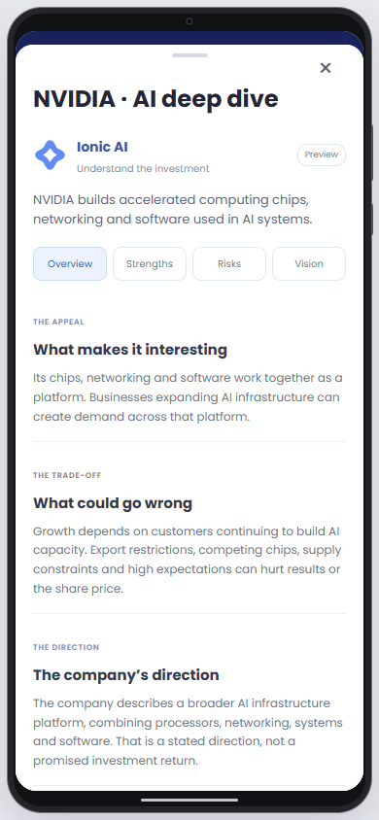
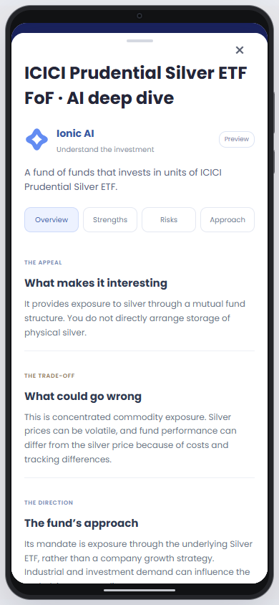
3 / Help users resolve doubt before investing
Answer the questions that interrupt a purchase.
What does this company actually do?
Explain the business and its main strengths in plain English. Link the company's stated plans to its filing so users can check the source.
What could go wrong?
Show risks alongside the appeal. For funds, explain the mandate and exposure. Company plans and past returns are not promises.
What should I check before proceeding?
Explain fees and, for US stocks, funding and FX needs. Return users to product details to continue. Success means an informed first investment, not more AI opens.
Stock deep dive
Mutual fund deep dive
Prototype: prepared explanations with linked sources. Live AI generation and portfolio analysis are not connected.
Notes:
The blue flower uses the existing Ionic assistant mark. Actions are available on all ten stock cards and all three mutual fund rows, and again inside product details. The existing card and row heights are unchanged. The deep dive explains the appeal, risks and management direction for companies, or the mandate and approach for funds. Topic buttons let the user focus on one question. Each explanation has a company filing or official fund source. These are prepared prototype explanations, not live model responses, personalised suitability checks or return forecasts. A live implementation would need approved source retrieval, source timestamps, factual evaluation and explicit handling of missing information. Test whether the explanations improve understanding and first unassisted investments. Do not infer success from AI opens alone. Product facts and costs should remain visible outside AI as well. AI source links are in ai-research-data.js in the shared GitHub repository.

Slide 4
4 / Supporting research
APPENDIX
Research and hypothesis
If people can find an accessible option near the top and understand the costs, risks and next step, more should be able to complete a first investment without a call.
What the Android research tells us
What investment research adds
A study of 145 students on Android 10 phones and tablets found that paging led to more revisiting of earlier information than scrolling. This gives us a reason to make comparison and returning to a product easier.
Iyengar and Kamenica found that larger choice sets increased preference for simpler options in experiments and US retirement-plan data. That supports making the first choice easier to understand.
The study examined reading. It does not establish an Ionic scroll drop-off rate or a universal two-screen limit.
These were retirement choices. We still need to test the effect with Ionic users.
What would count as success?
Track first funded investments without assistance and check fee and risk understanding. Establish a baseline, split by Android and iOS, and test AI explanations separately from layout and motion.
Android reading study: https://doi.org/10.1007/s11145-022-10328-9
Investment choice study: https://business.columbia.edu/sites/default/files-efs/pubfiles/4519/simplicitySeeking.pdf
Motion guidance (W3C): https://www.w3.org/WAI/tutorials/carousels/
Notes:
Android research: Haverkamp et al., Reading and Writing 36 (2023), 1589-1608, published online in 2022. DOI: 10.1007/s11145-022-10328-9. Participants: 145 Norwegian university students. Samsung Galaxy A02s phone and Lenovo Tab M10 tablet, both Android 10. Text: 1492 words. Paging led to more strategic backtracking; better integrated understanding was a tendency. This was a reading study, with no investing task or iOS scroll-depth measure. Choice research: Iyengar and Kamenica (2010), Journal of Public Economics 94, 530-539, DOI 10.1016/j.jpubeco.2010.03.006. Laboratory experiments and records of over 500,000 employees at 638 institutions. Evidence of simplicity seeking, not proof of Ionic conversion uplift. W3C carousel guidance supports user controls to pause moving content. Experiment: first unassisted completed investment within seven days divided by all eligible importers with no prior transaction assigned to each version. Record assistance consistently, and monitor costs, risk understanding, funding failures, cancellations and complaints. Set sample size from the measured baseline. Test static layout first, then motion. The AI feature is an additional hypothesis. Source-linked explanations could help users make sense of products, but no conversion uplift is claimed. Evaluate accuracy, source freshness and whether users understand both the appeal and downside. Test the welcome independently and monitor skips, exits and time to reach products. Retain it only if it helps orientation without harming the purchase flow.

Slide 5
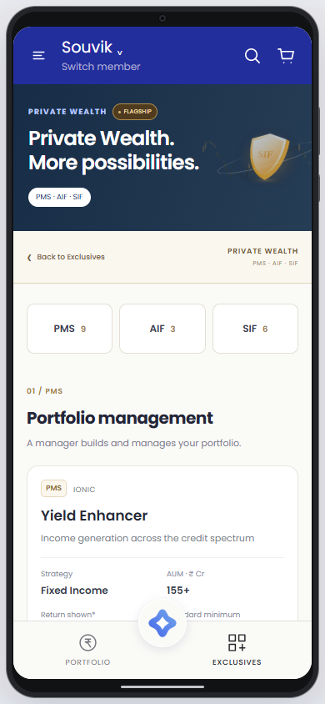
5 / Motion and navigation
APPENDIX
Give each section a clear beginning and end.
Short transitions for everyday browsing
US stocks and Funds & baskets use a one-second transition to signal a change of context. The content stays one tap away.
Private Wealth gets its own space
The welcome introduces the section. Once inside, the other category tabs are hidden. Back to Exclusives plays a short exit and returns to the previous category.
Motion should not become a barrier
Skip and Escape work immediately. Reduced-motion settings remove the transitions. Test skips, exits and time to reach a product before keeping the effect.
Private Wealth after the welcome
Notes:
The intent is to signal a change of context and give Private Wealth a distinct sense of place. This is a design hypothesis rather than evidence of improved conversion. The welcome lasts 3.2 seconds plus a brief reveal, or can be skipped immediately. Short browse transitions last 1 second; the Private Wealth exit lasts 0.9 seconds. Other category tabs and hero paging controls are hidden inside Private Wealth. The dedicated back action returns to the remembered prior category. Keyboard focus is managed while overlays are visible. Reduced-motion settings bypass short transitions and provide a static, user-dismissed welcome. Evaluate skipped transitions, exits before product exposure, time to first product and risk/fee comprehension. Measure first unassisted funded investment and test the effect separately from the layout and AI changes. Avoid interpreting animation engagement as purchase intent.

