Slide 1
FACE MASK DETECTION

Slide 2
INTRODUCTION
The 209th report of the world health organization (WHO) published on 16th August 2020 reported that coronavirus disease (COVID-19) caused by acute respiratory syndrome (SARS-CoV2) has globally infected more than 6 Million people and caused over 379,941 deaths worldwide [1]. According to Carissa F. Etienne, Director, Pan American Health Organization (PAHO), the key to control COVID-19 pandemic is to maintain social distancing, improving surveillance and strengthening health systems [2]. Recently, a study on understanding measures to tackle COVID-19 pandemic carried by the researchers at the University of Edinburgh reveals that wearing a face mask or other covering over the nose and mouth cuts the risk of Coronavirus spread by avoiding forward distance travelled by a person’s exhaled breath by more than 90%.

Slide 3
GOALS
Mandatory face mask rules are becoming more common in public settings around the world. Experts and scientific evidence support the effectiveness of face masks on reducing the spread of the virus. Therefore, face mask detection has become a crucial computer vision task to help the society. This motivated us to make a cost-effective device that detects whether a person is wearing a face mask using deep learning. Potentially, this model can also be deployed at traffic signals or security cameras to check whether a person is wearing a mask or not. The identity detection of faces, violating the mask norms further, increases the utility of the system for public benefits.

Slide 4
BENIFITS
By the development of face mask detection we can detect if the person is wearing a face mask and allow their entry would be of great help to the society. The accuracy of the model will be achieved and the optimization of the model is a continuous process and So we are building a highly accurate solution. We can prevent peoples from Virus Transmission through this System

Slide 5
FUNCTIONAL REQUIREMENTS
The system must be correctly able to load the face mask classifier model.
The system must be able to detect faces in images or video stream.
The system must be able to extract each face’s Region of Interest (ROI).
There must not be any object between the system and the face of the user for a successful face detection and hence the face mask detection.
The end position of the face must be fit inside the webcam frame and must be closer to the camera.
Correctly able to detect masks in ‘png’, ‘jpg’, ‘jpeg’, and ‘gif’ format images.
The system must be able to detect face masks on human faces on every frame in a live video.
The results must be viewed by showing the probability along with the output of ‘Mask’ or ‘NoMask’.

Slide 6
NON-FUNCTIONAL REQUIREMENTS
The face should be localized by detecting the facial landmarks and the background must be ignored.
The system will be implemented in Python script with an accuracy of the model of over 90%.
The user must not move his/her face out of camera’s sight in order to get correct results.
The background must not be too bright or too dark while detecting the face mask. Product revision
The system must be portable and can be applied to embedded devices with limited computational capacity (ex., Raspberry Pi, Google Coral, NVIDIA Jetson Nano, etc.).
The output response operation must be fast and under 5 seconds per person.
The system must be able to correctly detect more than one face if present, and hence the presence of mask in the frame

Slide 7
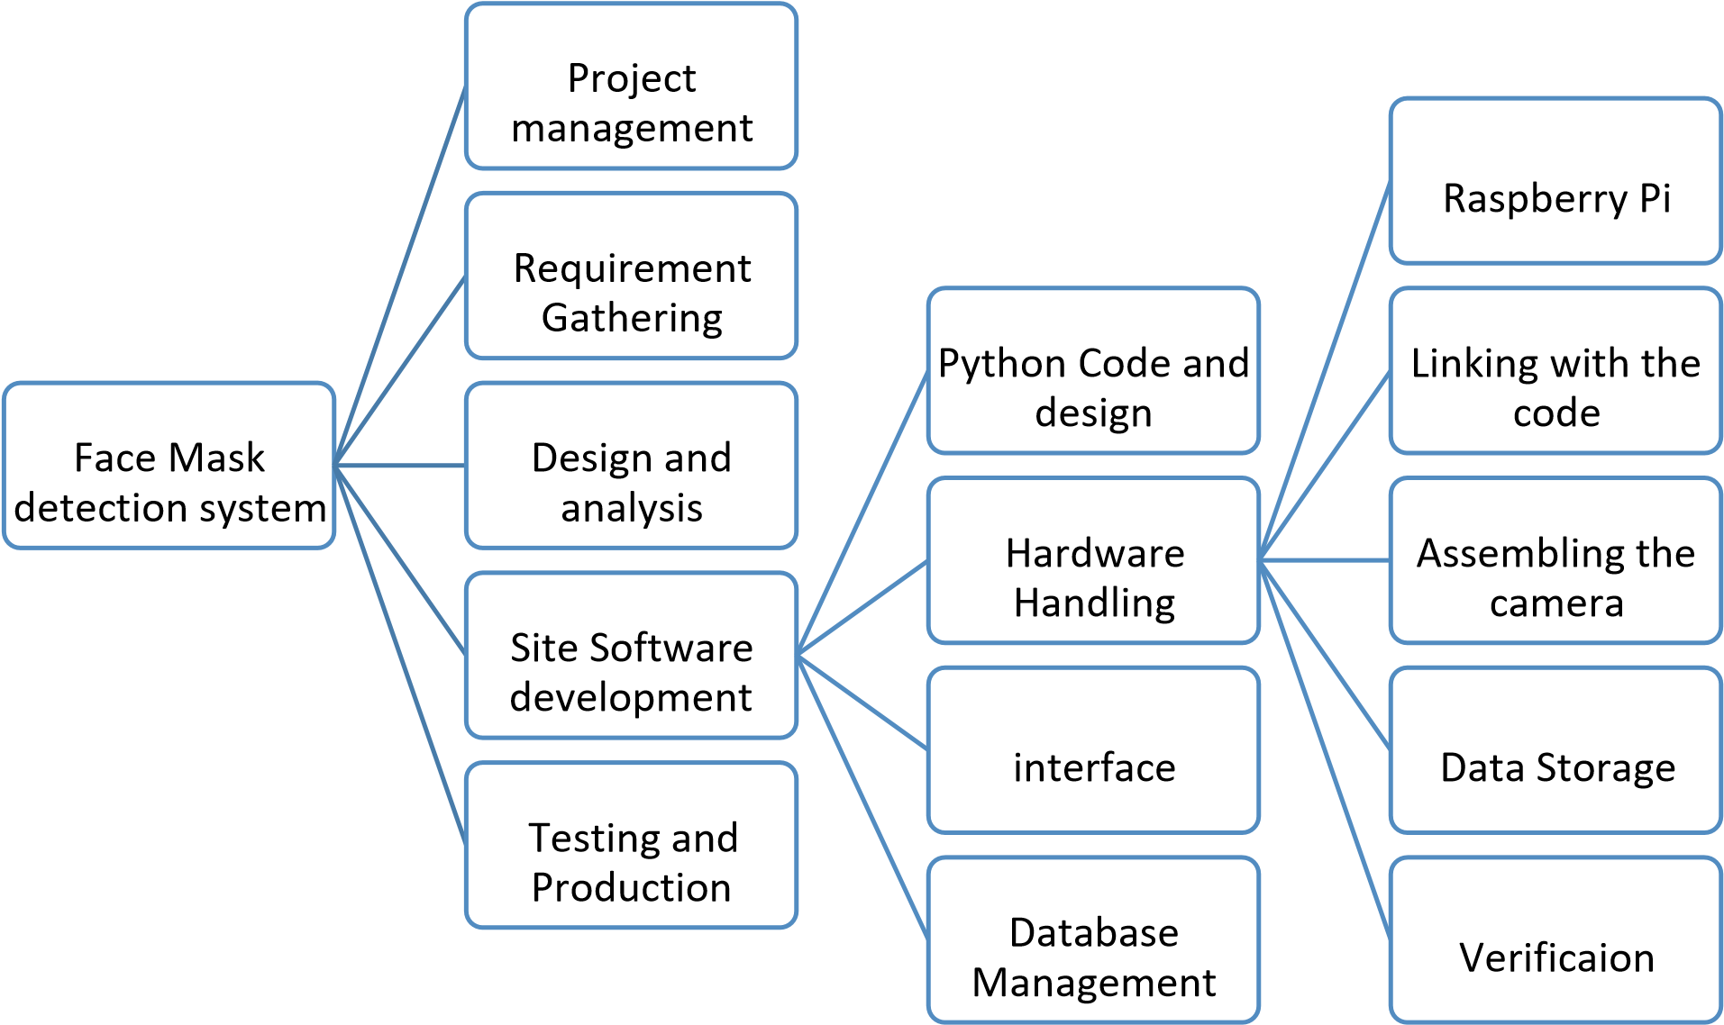
WORK BREAKDOWN STRUCTRE (WBS)

Slide 8
RISK ANALYSIS
Response | Strategy | Examples
Avoid | Risk avoidance is a strategy where the project team takes action to remove the threat of risk or protect from the impact | Extending the schedule Reducing/removing scope Changing the execution strategy
Transfer | Risk transference involves shifting or transferring the risk threat and impact to a third party. Rather transfer the responsibility and ownership | Purchasing insurance Warranties Performance bonds
Mitigate | Risk mitigation is a strategy where the project team takes an action to reduce the probability of the risk occurring. This does not risk or potential impact ,but rather reduces the likelihood of it becoming real | Increasing testing Reducing process complexity
Accept | Risk acceptance means the term acknowledges the risk and its potential impact, but decides not to take any pre-emptive action to prevent it. It is dealt with only if it occurs. | Contingency reserve budgets Management schedule float

Slide 9
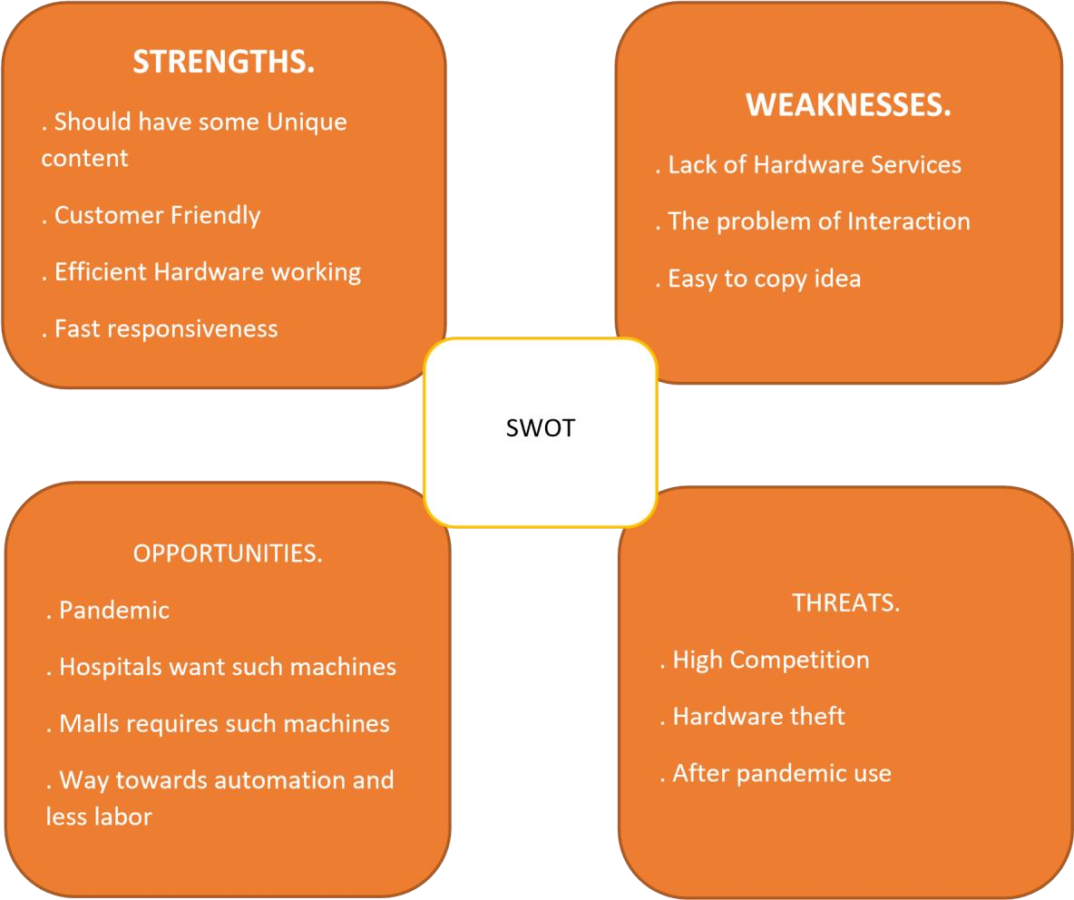
SWOT ANALYSIS

Slide 10
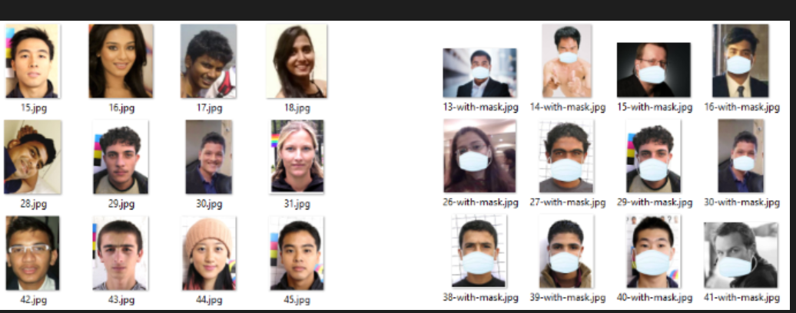
THE DATASET
This dataset consists of 1376 images,690 images with mask and 686 images without masks.

Slide 11
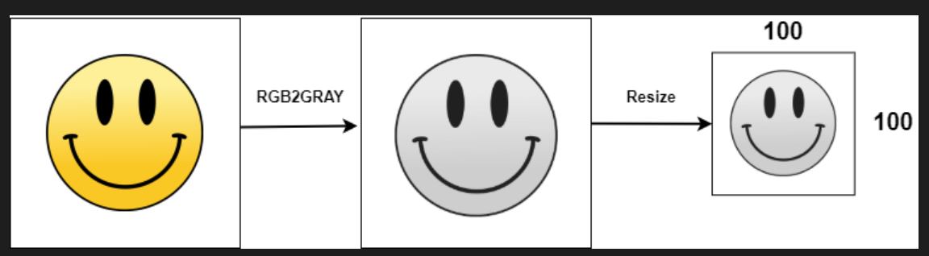
DATA PREPROCESSING
# Data Preprocessing![pre.png](attachment:pre.png)# Data Preprocessing![pre.png](attachment:pre.png)

Slide 12
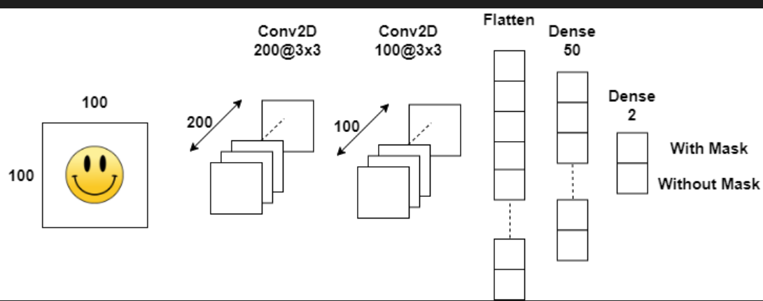
CONVOLUTIONAL NEUTRAL NETWORK ARCHITECTURE

Slide 13
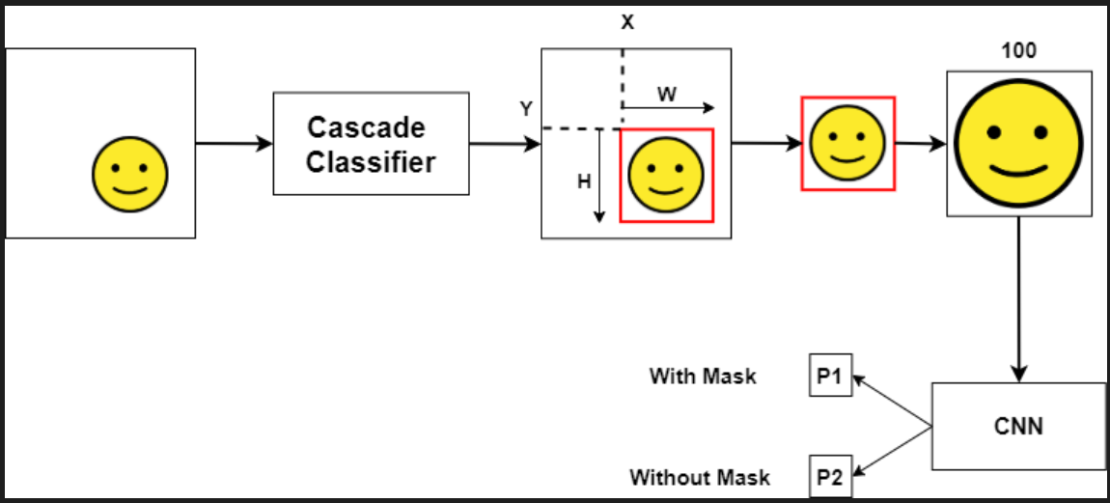
DETECTING FACES WITHOUT MASK

Slide 14
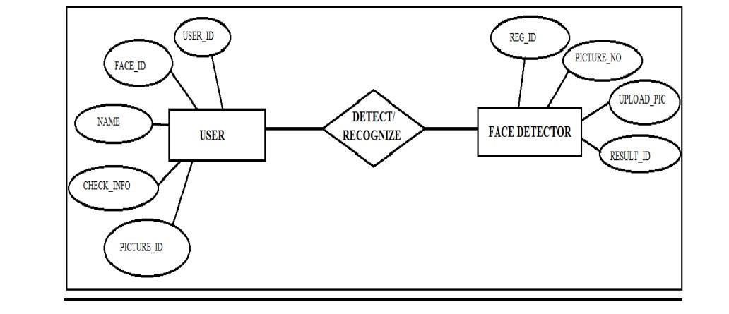
ER Diagram

Slide 15
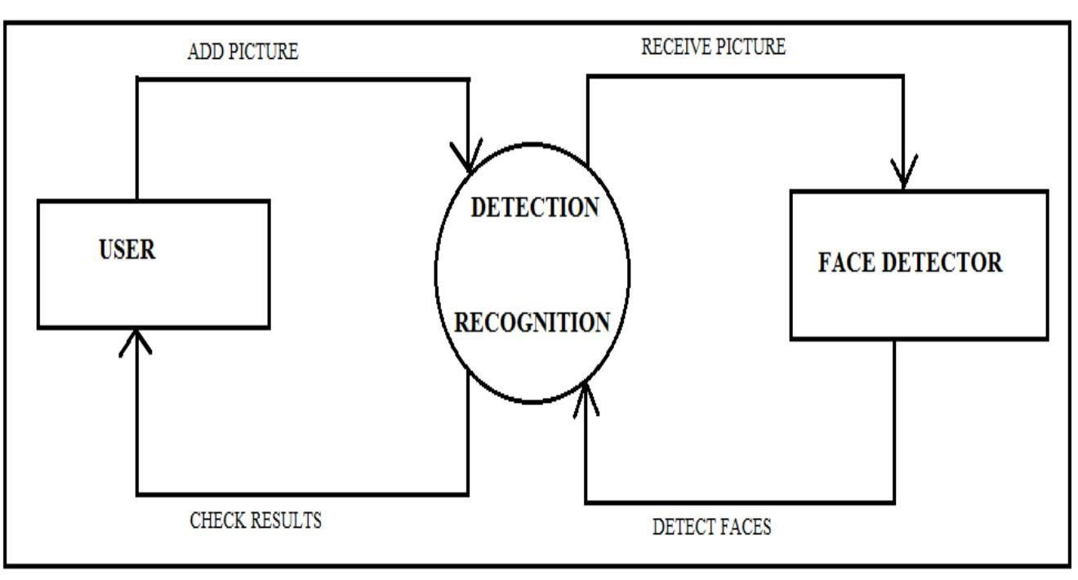
DATA FLOW DIAGRAM

Slide 16
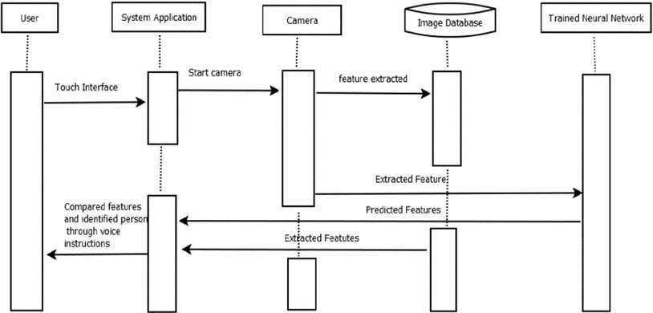
SEQUENCE DIAGRAM

Slide 17
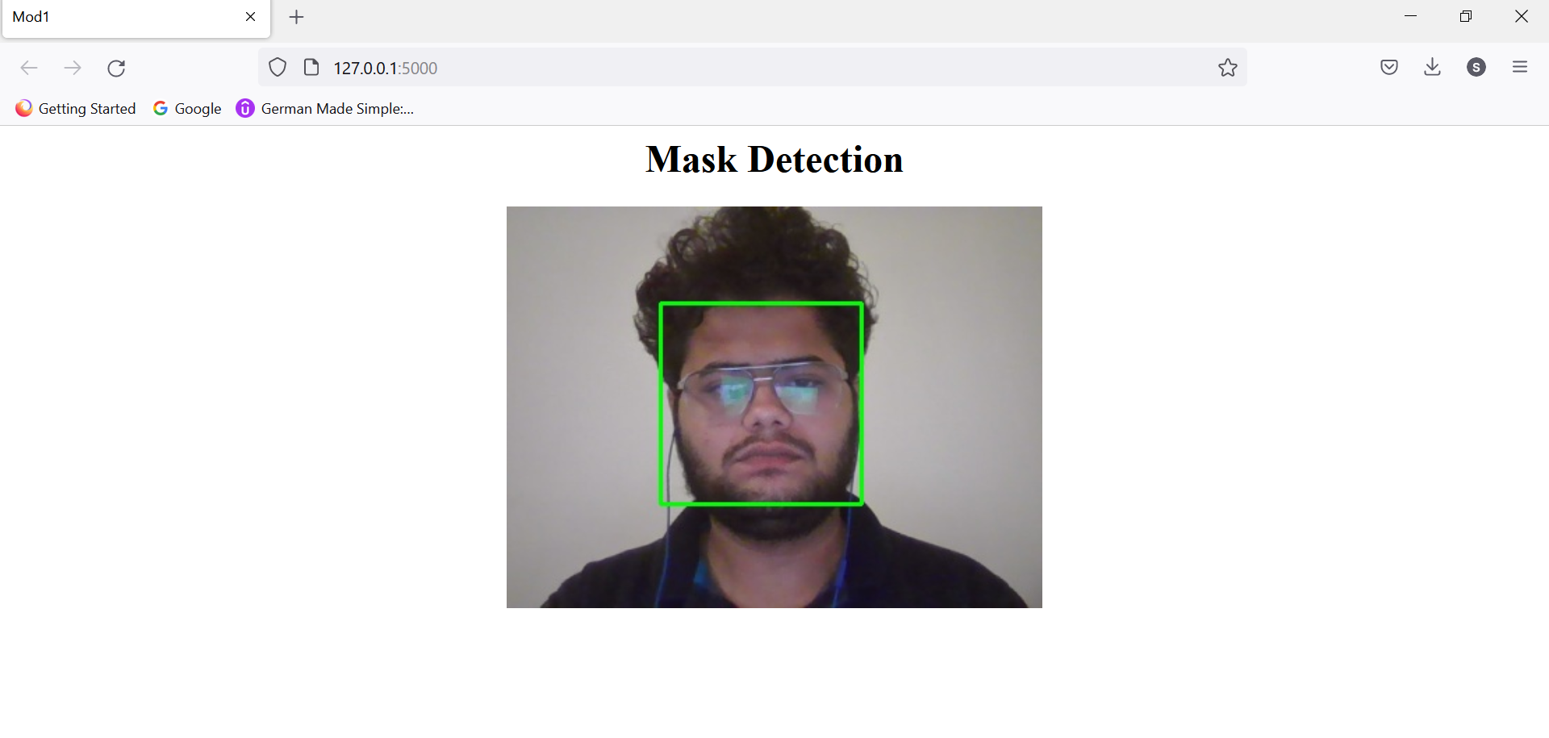
DEMONSTRATION

Slide 18
Conclusion and future scope
In this work, a deep learning-based approach for detecting masks over faces in public places to curtail the community spread of Coronavirus is presented. The proposed technique efficiently handles occlusions in dense situations by making use of an ensemble of single and two-stage detectors at the pre-processing level. The ensemble approach not only helps in achieving high accuracy but also improves detection speed considerably. Furthermore, the application of transfer learning on pre-trained models with extensive experimentation over an unbiased dataset resulted in a highly robust and low-cost system. The identity detection of faces, violating the mask norms further, increases the utility of the system for public benefits.

