Slide 1
CAPSTONE PROJECT · MINING AND EXPLORING
Mining Tourist Sentiment &
Destination Patterns in Timor-Leste
Category classification · Sentiment analysis · Text clustering on Google Maps tourism reviews
INSTITUTION
Dili Institute of Technology (DIT)
TEAM MEMBERS
--
STUDY PROGRAM
S1 Computer Science
SUPERVISOR
--
COURSE
Mining and Exploring
DATE
--
CASE STUDY
Timor-Leste tourism destinations
Google Maps reviews · 705 destinations · 5,270 reviews

Slide 2
01 — BACKGROUND
01
Why this project exists
— Timor-Leste has a wide range of tourism destinations — waterfalls, beaches, historical sites, traditional houses, caves — spread across municipalities including Dili, Liquiçá, Maubara, Ainaro, Bobonaro, Covalima, Manufahi and Ermera.
— Tourists already leave public reviews for these places on Google Maps, written in Tetum, Indonesian, Portuguese and English.
— These reviews are scattered across hundreds of individual listings and written in four languages — nobody is reading them systematically.
— Tourism managers currently have no structured way to know what visitors actually think about a destination, or where attention is most needed.
LANGUAGES IN THE RAW REVIEWS
EN
73%
ID
16%
PT
5%
JA
2%
KO
2%
DE
1%
Four languages, one fragmented picture of visitor experience.
Mining & Exploring — Timor-Leste Tourism Analytics
01 / 22

Slide 3
02 — PROBLEM STATEMENT
02
Three questions nobody could answer
Q1
Q2
Q3
CATEGORY APPRECIATION
ATTENTION NEEDED
HIDDEN PATTERNS
Which destination type — Historical, Religious, Traditional or Modern — receives the strongest tourist appreciation?
Which specific destinations need attention, based on consistently negative sentiment in their reviews?
What natural thematic patterns emerge from tourist comments, beyond the four fixed categories already defined?
Reviews already contain the answers — in four languages, across hundreds of listings. The system below turns that text into evidence.
Mining & Exploring — Timor-Leste Tourism Analytics
02 / 22

Slide 4
03 — OBJECTIVES
03
What the system sets out to do
01
Collect and organize tourist reviews for Timor-Leste tourism destinations
02
Classify every destination into 4 fixed categories: Historical, Religious, Traditional, Modern
03
Determine sentiment — Positive, Neutral or Negative — for every comment
04
Discover natural patterns in review text using K-Means clustering
05
Evaluate every model with formal metrics: Accuracy, Precision, Recall, F1, Confusion Matrix, Silhouette
06
Present results through an interactive dashboard (Streamlit) and Power BI
Out of scope: the system does not generate tourist recommendations — that component was removed per supervisor guidance.
Mining & Exploring — Timor-Leste Tourism Analytics
03 / 22

Slide 5
04 — DATA SOURCE
04
What a data source is, and why Google Maps
Definition: a data source is the origin platform or system from which raw data is obtained for analysis. For this project, that origin is Google Maps — specifically its Places & Reviews system.
WHY GOOGLE MAPS
WHY APIFY
— Already the largest public, continuously-updated repository of visitor-generated reviews tied to an exact destination name and GPS coordinate.
— Naturally multilingual — Tetum, Indonesian, Portuguese, English — exactly the raw material this project needs to classify and mine.
— No comparable free alternative exists with this coverage for Timor-Leste tourism destinations specifically.
— A cloud web-scraping / automation platform; its actor compass/crawler-google-places extracts Google Maps place + review data as structured JSON.
— Lets the project collect public data without holding a billed Google Places API key.
OFFICIAL REFERENCES
Website
apify.com
API docs
docs.apify.com/api/v2
Actor used
compass/crawler-google-places
Ethics: public reviews only; no personal data collected; reviewer name used only for de-duplication and never shown in the dashboard.
Mining & Exploring — Timor-Leste Tourism Analytics
04 / 22

Slide 6
05 — DATA COLLECTION
05
How the system collects reviews, and how often
705
5,496
5,270
3,218
Destinations collected
Review-level rows
Total reviews
Reviews with free text
HOW IT WORKS
UPDATE INTERVAL
— A request is sent to the Apify REST API with an authenticated token (APIFY_API_TOKEN), specifying what to search for and how many results to retrieve.
— Apify scrapes Google Maps server-side and returns the result as a structured JSON dataset once the run completes.
— The system downloads that dataset and merges it into data/raw/, matched by each place's unique Google placeId — nothing already collected is lost or duplicated.
Recommended batch re-collection: every 7 days (weekly). Not claimed as real-time, since the project holds no billed Google Places API key. Near-real-time polling (5-minute interval) is designed for in the code, but not active by default.
BUILT THIS PROJECT: ON DEMAND
The dashboard's Data Collection tab turns the weekly default into an on-demand trigger — request N new places, inspect the raw result, then run the pipeline, whenever needed.
Mining & Exploring — Timor-Leste Tourism Analytics
05 / 22

Slide 7
06 — SAMPLE DATA
06
What sample data looks like, straight from Apify
Definition: sample data is a representative excerpt of the full dataset, shown to demonstrate its real structure. The record below is unedited — collected by this project, not a mock-up.
Jaco Island
A SECOND REVIEW, A DIFFERENT LANGUAGE
CATEGORY
Tourist attraction
"Tout simplement sublime, la plus belle plage que j'ai vue jusqu'à présent. La couleur de l'eau est exceptionnelle, une île à préserver à tout prix."
MUNICIPALITY
Tutuala
ADDRESS
H8M6+QH, Tutuala, Timor-Leste
COORDINATES
-8.4155405, 127.3114579
— D, 5★, 2026-06-27 (FR)
RATING
4.8 ★ (42 reviews)
PLACE_ID
ChIJUfSk_mRVHS0RmE-T5w-13wY
RAW JSON (ABBREVIATED, AS STORED IN data/raw/)
"Eastern most part of East Timor. You can pay fishermen to transport you from Valu Beach to Jaco Island for USD10/pax. The wave was not that strong…"
{
"title": "Jaco Island",
"categoryName": "Tourist attraction",
"city": "Tutuala",
"totalScore": 4.8,
"reviewsCount": 42,
"location": {"lat": -8.4155405, "lng": 127.3114579},
"reviews": [ { "stars": 5, "text": "..." }, ... ]
}
— Andrew Ennio, 5★, 2026-06-22 (EN)
Mining & Exploring — Timor-Leste Tourism Analytics
06 / 22

Slide 8
07 — DATA ATTRIBUTES
07
The fields the system actually uses
DESTINATION-LEVEL ATTRIBUTES
REVIEW-LEVEL ATTRIBUTES
Field | Type | Description
place_id | text | Unique Google place identifier
place_name | text | Tourism destination name
place_category_google | text | Category assigned by Google (e.g. Tourist attraction)
city | text | Municipality (imputed from address where missing)
address | text | Full address as shown on Google Maps
lat / lng | decimal | GPS coordinates (degrees)
place_avg_rating | decimal | Average Google rating (1–5 stars)
place_reviews_count | integer | Total reviews on Google
Field | Type | Description
review_id | text | Unique review identifier
review_text | text | Original comment text (58.6% of reviews)
review_stars | integer | Individual rating (1–5 stars)
review_date_parsed | datetime | Date the review was published (UTC)
review_language | text | Detected original language code
is_local_guide | boolean | Whether the reviewer is a Google Local Guide
has_review | boolean | Row represents a review, not a review-less place
reviewer_name | text | Used only for de-duplication — never shown
Mining & Exploring — Timor-Leste Tourism Analytics
07 / 22

Slide 9
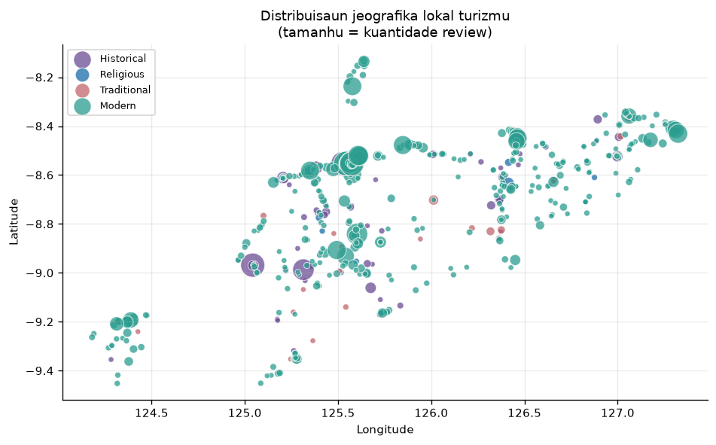
08 — DESTINATION LOCATIONS
08
Where these destinations actually are
Destination | Municipality | Coordinates (lat, lng) | Rating
Jaco Island | Tutuala | -8.4155, 127.3115 | 4.8 ★
Cristo Rei of Dili Timor-Leste | Dili | -8.5205, 125.6084 | 4.6 ★
Balibo Fort Hotel | Balibo | -8.9684, 125.0423 | 4.5 ★
Marobo Hot Spring | Bobonaro | -8.9868, 125.3140 | 4.1 ★
Nino Konis Santana National Park | Muapitine | -8.4561, 127.1757 | 4.1 ★
Pousada de Maubisse | Maubisse | -8.8408, 125.6018 | 4.2 ★
Every destination is stored with its exact name, address and GPS coordinate — not just a municipality label. This example spans six municipalities (Lautem, Dili, Bobonaro, Ainaro) to show the dataset's real national coverage, matching the case study scope: Dili, Liquiçá, Maubara, Ainaro, Bobonaro, Covalima, Manufahi and Ermera.
Mining & Exploring — Timor-Leste Tourism Analytics
08 / 22

Slide 10
09 — METHODOLOGY
09
From raw text to validated insight
Data
Collection
Data
Storage
Preprocessing
EDA
Data
Mining
Evaluation
Visualization
ALGORITHM JUSTIFICATION
Task | Approach | Why this approach
Category — Model 1 | Rule-based multilingual keyword lexicon | Categories are fixed and well-defined; a transparent, auditable baseline
Category — Model 2 | TF-IDF + Naive Bayes / Logistic Regression / SVM / Random Forest | Required comparison set; tests whether review text alone predicts category
Sentiment — Model 1 | Multilingual lexicon with negation handling | No manual sentiment labels exist; lexicon stays transparent and auditable
Sentiment — Model 2 | Same 4 supervised algorithms, same TF-IDF features | Direct, like-for-like comparison against the lexicon baseline
Clustering | K-Means (TF-IDF) vs. Hierarchical (Ward) | Discovers natural structure and validates the 4 fixed categories
Mining & Exploring — Timor-Leste Tourism Analytics
09 / 22

Slide 11
10 — SYSTEM ARCHITECTURE
10
Four data layers, one pipeline
DATA SOURCE
Google Maps Places & Reviews — collected via Apify (batch snapshot)
DATA STORAGE
RAW
data/raw/
PROCESSED
data/processed/
FEATURE
data/features/
OUTPUT
data/output/
PREPROCESSING
Cleaning · missing values · outlier flagging · text tokenization · train/test split
DATA MINING
Model 1
Baseline
Rule-based +
Lexicon
Model 2
Supervised
NB · LR · SVM · RF
Clustering
Unsupervised
K-Means + Ward
EVALUATION
Accuracy · Precision · Recall · F1 · Confusion Matrix · Silhouette · Cross-validation
VISUALIZATION
Streamlit dashboard (5 tabs) + Power BI export (17 CSV, star schema)
Mining & Exploring — Timor-Leste Tourism Analytics
10 / 22

Slide 12
11 — DATA INTEGRATION
11
From Apify response to an analysis-ready table
1
Apify returns one JSON object per destination, with a nested list of its reviews, exactly as scraped — saved unmodified as the RAW layer (data/raw/*.json).
“DATABASE” IN THIS PROJECT
Storage is file-based — versioned JSON and CSV files per layer — rather than a SQL server. For a dataset this size, that keeps every layer human-readable, diffable and auditable by hand, which matters more here than query performance at scale.
2
data_collection.flatten_reviews() turns each place into one row per review, carrying the place's own fields (name, category, address, coordinates) onto every one of its reviews.
3
Every raw file present is merged by placeId, so nothing already collected is ever lost or duplicated when new data arrives.
RAW
data/raw/dataset_turris.json
PROCESSED
data/processed/reviews_processed.csv
4
That merged, review-level table becomes the single input to preprocessing, which produces the Processed → Feature → Output layers used by every model and the dashboard.
FEATURE
data/features/review_features.csv
OUTPUT
data/output/reviews_mined.csv
Mining & Exploring — Timor-Leste Tourism Analytics
11 / 22

Slide 13
12 — DATASET
12
705 destinations, five languages, one table
705
5,496
3,218
4.42
Destinations
Rows (review level)
Reviews with text
Average rating
REVIEW ROWS BY CATEGORY
GROUND-TRUTH COVERAGE
— Human-verified category labels exist for the destinations in the original annotation batch — confirmed from the review text itself, not guessed.
— Destinations added afterwards fall back to a transparent rule-based classifier; every row is tagged with its category_source so the two are never silently mixed.
— Category model evaluation (slide 17) trains and tests only on the human-verified subset, to avoid reporting a fabricated ground truth.
— Languages observed in review text: en, id, pt, ja, ko and 5 more.
Mining & Exploring — Timor-Leste Tourism Analytics
12 / 22

Slide 14
13 — PREPROCESSING
13
Seven steps, nothing silently dropped
Step | What was done | Result on this dataset
Cleaning | Remove duplicate rows (review ID; place + text + reviewer) | 5,506 → 5,496 rows (10 duplicates removed)
Missing values | Flagged, not dropped — has_text/has_rating mark availability; city imputed from address | 2,278 reviews have no text (41.5%)
Transformation | UTC date parsing, numeric conversion, text normalization | applied across all rows
Outliers | IQR method on review length — flagged only, never removed | 270 outliers flagged (> 470 characters)
Text processing | lowercase → strip URL/emoji/symbols → tokenize → remove stopwords (4 languages) | 10,501 unique tokens, 17.9 tokens/review
Train / test split | Stratified by category_label, test_size=0.25, random_state=42 | 2,296 train / 766 test / 2,434 not used
Why flag outliers instead of removing them? A 1,500-character review is valuable text-mining signal, not a data error — removing it would throw away insight, not noise.
Mining & Exploring — Timor-Leste Tourism Analytics
13 / 22

Slide 15
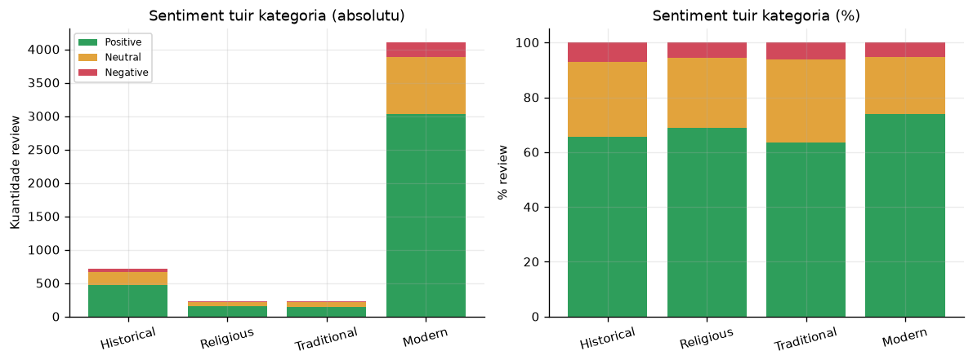
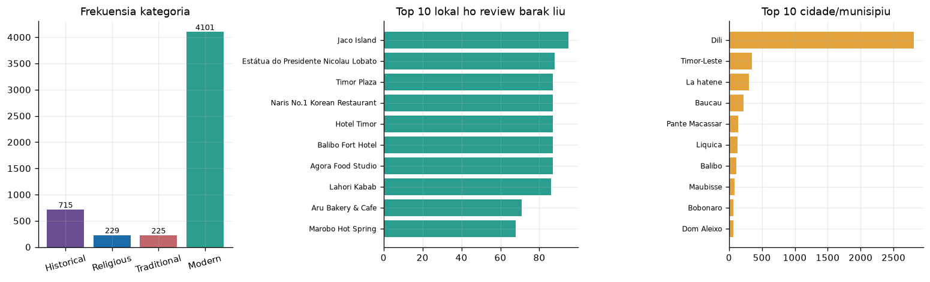
14 — EDA FINDINGS
14
What the numbers show before any model runs
% POSITIVE SENTIMENT BY CATEGORY
Modern destinations score highest on positive sentiment (74.0%), while Traditional sites have the most room to improve (63.6%). Historical and Religious sites sit in between — both show recurring complaints about maintenance and upkeep rather than the destination's core appeal.
Modern
74.0%
Religious
69.0%
Historical
65.7%
Traditional
63.6%
Mining & Exploring — Timor-Leste Tourism Analytics
14 / 22

Slide 16
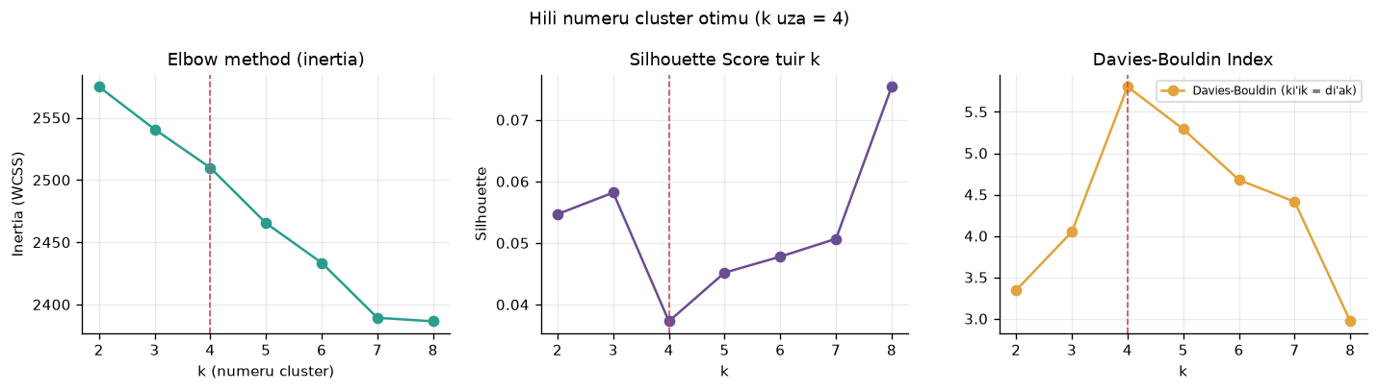
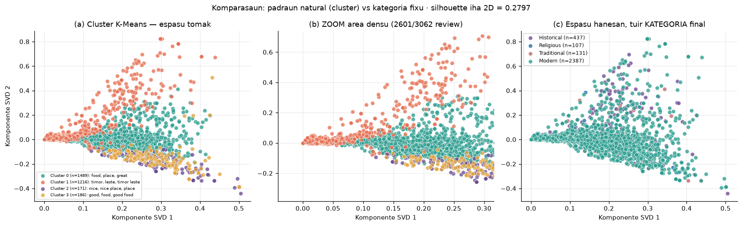
15 — DATA MINING MODEL
15
Baseline, supervised, and unsupervised views
Data mining: discovering patterns, categories and relationships in large datasets using statistical and machine-learning methods — applied here to classify category, determine sentiment, and surface natural clusters.
4
0.0373
5.80
3,062
k (= 4 fixed categories)
Silhouette (TF-IDF space)
Davies-Bouldin (lower = better)
Reviews clustered
k=4 is used to compare directly against the 4 fixed categories. Clusters separate mainly by review length and language rather than theme — a legitimate pattern, and a reason to read silhouette qualitatively (top terms, cluster profile) rather than by its raw value alone.
Mining & Exploring — Timor-Leste Tourism Analytics
15 / 22

Slide 17
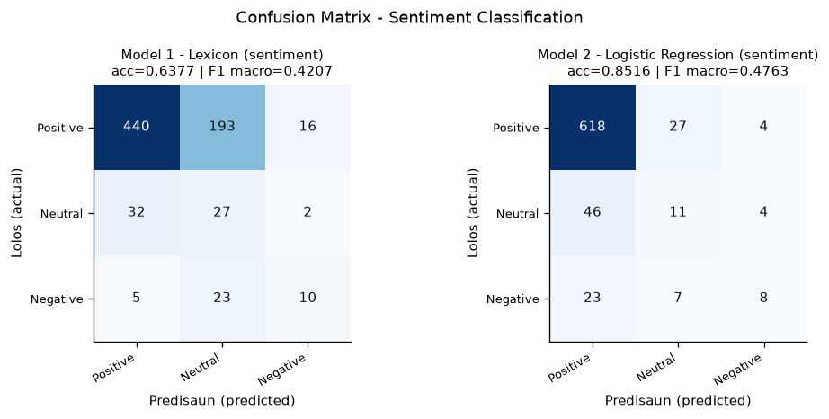
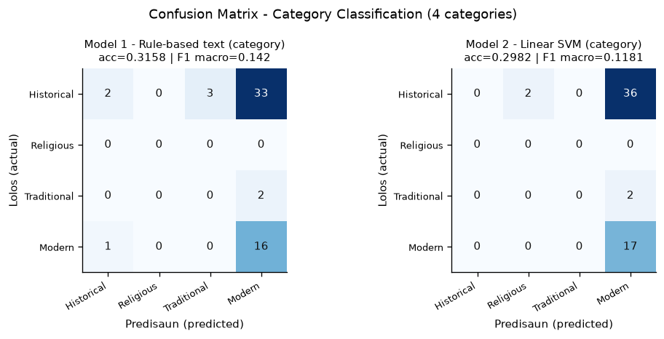
16 — EVALUATION
16
Formal metrics, read honestly
Task | Model | Accuracy | F1 (macro) | CV F1 (macro)
Sentiment | Majority baseline | 0.868 | 0.310 | —
Sentiment | Model 1 — Lexicon | 0.638 | 0.421 | —
Sentiment | Model 2 — Naive Bayes ⚠ degenerate | 0.868 | 0.310 | 0.310
Sentiment | Model 2 — Logistic Regression ⭐ | 0.852 | 0.476 | 0.433
Category | Majority baseline | 0.298 | 0.115 | —
Category | Model 1 — Rule-based | 0.316 | 0.142 | —
Category | Model 2 — Linear SVM ⭐ | 0.298 | 0.118 | 0.229
Degenerate model, correctly excluded: Naive Bayes reaches 86.8% accuracy for sentiment by always predicting “Positive” — the system detects this automatically and excludes it from “best model” selection. This is exactly why the Manual requires F1 / Confusion Matrix, not accuracy alone.
Sentiment — selected model Logistic Regression: macro F1 0.4763, +0.1666 vs. the majority baseline (748 test samples).
Category — selected model Linear SVM: gain over baseline is only +0.0032 — limited by a small human-verified test set (57 samples), flagged as a known limitation, not hidden.
Mining & Exploring — Timor-Leste Tourism Analytics
16 / 22

Slide 18
17 — DASHBOARD
17
Five tabs, one live pipeline
📥 Data Collection
Overview & EDA
Text Clustering
Model Evaluation
Data & Methodology
Request N new places from Apify on demand, inspect the RAW results and real comments, verify on live Google Maps, then run the pipeline with one click.
KPI cards, category × sentiment comparison, trend chart, geographic map, language mix.
Interactive 2D cluster scatter, elbow/silhouette chart, cluster profile table.
Metrics table, confusion matrix heatmaps, model comparison chart.
Full data table with CSV download, data dictionary, manual annotation table.
Filters (sidebar): municipality, category, sentiment, cluster, rating, review period, text-only toggle. Hero badge always shows the last collection timestamp — so every chart states, honestly, how fresh it is.
Mining & Exploring — Timor-Leste Tourism Analytics
17 / 22

Slide 19
18 — LIVE DEMO
18
Screenshots to insert right before presenting
insert screenshot here
insert screenshot here
insert screenshot here
① Data Collection
② Overview & EDA
③ Model Evaluation
Click Request, show the RAW table landing, open one row's real comments + Google Maps link.
KPI cards, category × sentiment chart, and the geographic map of destinations.
Metrics table + confusion matrix heatmap for the selected sentiment model.
Capture these live, just before presenting, so the numbers on screen match today's dataset exactly.
Mining & Exploring — Timor-Leste Tourism Analytics
18 / 22

Slide 20
19 — CONCLUSION & RECOMMENDATION
19
What we found, what comes next
CONCLUSION
RECOMMENDATION
— The pipeline collects, cleans and classifies 705 destinations and 5,270 reviews into 4 fixed categories, end to end, through one command.
— Modern destinations show the strongest positive sentiment (74.0%); Traditional sites have the most room to improve (63.6%).
— The supervised sentiment model (Logistic Regression) clearly beats the majority baseline (+0.1666 macro F1) — proof review text carries real signal.
— Category model gains are marginal, honestly reported — limited by how few destinations currently have human-verified ground truth.
— Clustering confirms structure in the review text beyond the 4 categories, driven more by review length and language than by theme.
— Expand manual ground-truth annotation beyond the original batch, so category evaluation covers more than a handful of test samples.
— Collect manually-labelled sentiment samples to replace the current rating-based proxy with genuine human judgment.
— Investigate the maintenance/infrastructure complaints surfacing in negative reviews at specific Historical sites — directly actionable for site managers.
— Move from on-demand batch snapshots to scheduled polling — the Apify integration built this project already supports it.
Mining & Exploring — Timor-Leste Tourism Analytics
19 / 22

Slide 21
20 — REFERENCES
20
Sources and documentation
RECENT LITERATURE, 2023–2025
ScienceDirect · IEEE Xplore · Emerald
TOOLS & DATA SOURCE DOCUMENTATION
1
Chen, J., Wu, J., Wang, D., & Stantic, B. (2025). Beyond static rankings: a tourist experience-driven approach to measure destination competitiveness. Tourism Management, 106, 105022. SCIENCEDIRECT
Apify — official website
apify.com
2
Primasari, I., & Khadija, M. A. (2024). Opinion mining of tourism village in Magelang based on Google Reviews data. Proc. 2024 Int'l Conf. on Data Science and Its Applications (ICoDSA), IEEE, 189–194. IEEE XPLORE
Apify — API documentation
docs.apify.com/api/v2
Apify actor used
3
Lidiawaty, B. R., Nasution, A. H., Putra, A. R., & Tjahyanto, A. (2024). Design science research for developing risk tourism mapping based on visitor sentiment review. Procedia Computer Science, 234, 1672–1680. SCIENCEDIRECT
compass/crawler-google-places
Streamlit documentation
docs.streamlit.io
4
Puh, K., & Bagic Babac, M. (2023). Predicting sentiment and rating of tourist reviews using machine learning. Journal of Hospitality and Tourism Insights, 6(3), 1188–1204. EMERALD
scikit-learn documentation
scikit-learn.org
Das, R. K., Islam, M., Hasan, M. M., Razia, S., Hassan, M., & Khushbu, S. A. (2023). Sentiment analysis in multilingual context: comparative analysis of machine learning and hybrid deep learning models. Heliyon, 9(9), e20281. SCIENCEDIRECT
Power BI documentation
5
learn.microsoft.com/power-bi
Also applies: scikit-learn (Pedregosa et al. 2011) · Silhouette (Rousseeuw 1987) · Davies-Bouldin Index (1979) · Manning et al. 2008 (IR).
Mining & Exploring — Timor-Leste Tourism Analytics
20 / 22

Slide 22
THANK YOU
Project Links
GITHUB REPOSITORY
--
YOUTUBE DEMO VIDEO
--
DASHBOARD (OPTIONAL DEPLOY)
--
Mining & Exploring Capstone Project · Dili Institute of Technology · 2026

