Slide 1

Diabetes Prediction Using ML Algorithms
Sai Kumar Dacharla

Slide 2

Problem Statement
The objective of the dataset is to diagnostically predict if a patient has diabetes, established on definite diagnostic quantities incorporated in the dataset.

Slide 3
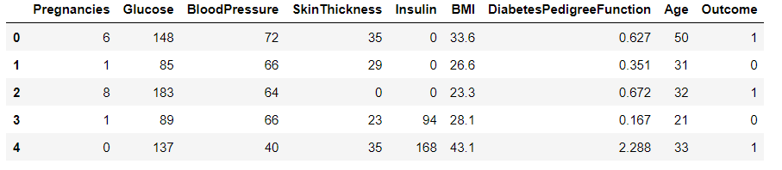
Data Set
There are multiple variables in this dataset – Pregnancies, Glucose, Blood pressure, Skin Thickness,Insulin, BMI, Diabetes Pedigree Function, Age and Outcome.
DatasetSource :Kaggle
Link: https://www.kaggle.com/datasets/mathchi/diabetes-data-set

Slide 4
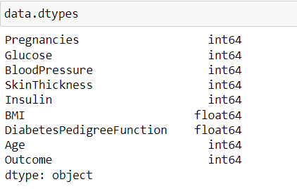
Variable Description
The data types used first are of different types. But I have changed all of them to integers except for the column BMI and Diabetes Pedigree Function.

Slide 5
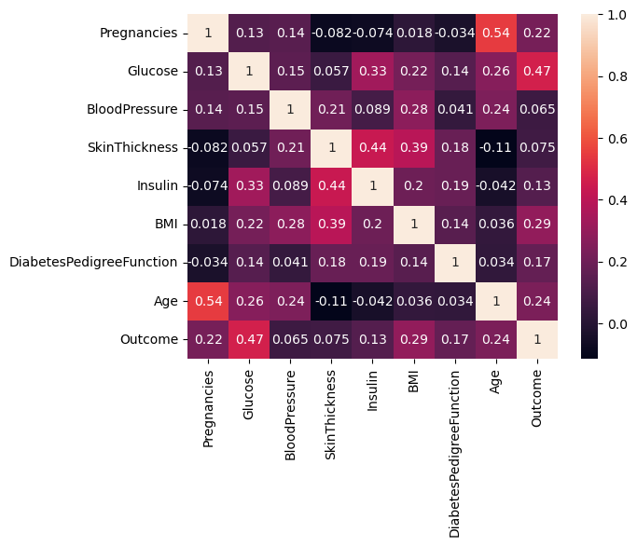
Heat Map

Slide 6
Approaches To Solve
Logistic Regression
KNearestNeighbour
Support Vector Machine
Decision Tree Classifier
GaussianNB
Random Forest Classifier
XG Boosting
And Evaluation metric used is Accuracy Score.

Slide 7
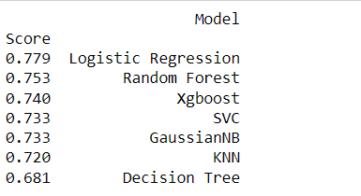
Results

Slide 8


