Slide 1
Extended Labeled Faces in The Wild (ELFW): Augmenting Classes for Face Segmentation
Project Mates
Sai Kumar Dacharla
Charan Sumanth Pulleti

Slide 2
Data Preprocessing
The Extended Labeled Faces in The Wild (ELFW) introduces a broader range of facial attributes, expressions, ages, and ethnicities compared to traditional datasets. This diversity better reflects real-world scenarios and challenges faced in facial segmentation tasks, making models trained on ELFW more robust and applicable across different demographics.
By augmenting classes, ELFW enables finer-grained segmentation, capturing subtle variations in facial features that are vital for applications such as emotion recognition, age estimation, and facial attribute analysis. This finer granularity enhances the precision and accuracy of segmentation models trained on ELFW.
The Extended Labeled Faces in The Wild (ELFW) dataset presents a unique challenge in face segmentation, aiming to augment classes for finer object instance segmentation within facial images. This report delves into the key components of this task, including data preprocessing, model initialization, fine-tuning, and evaluation, with a focus on segmenting faces.

Slide 3
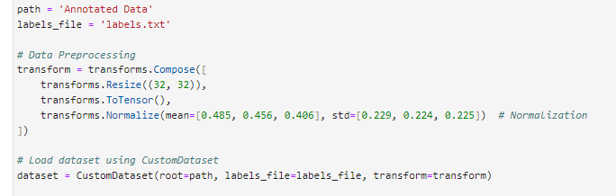
Data Preprocessing
Resize: Images were resized to 32x32 pixels, which is a common practice for reducing computational complexity while retaining essential features for segmentation tasks.
Normalization: Normalization was applied using mean=[0.485, 0.456, 0.406] and std=[0.229, 0.224, 0.225]. These values are standard for many image processing tasks and help in stabilizing the training process by bringing data into a common scale.

Slide 4

Model and Method
To leverage existing knowledge and optimize performance, parameters from a pretrained model are loaded
Model: ResNet18, a popular convolutional neural network architecture, was used as the pretrained model. It is known for its balance between depth and computational efficiency, making it suitable for various computer vision tasks.
Parameters: The pretrained ResNet18 model was loaded with weights learned from the ImageNet dataset. This initialization leverages the network's ability to extract meaningful features from images, which is beneficial for face

Slide 5

Model and Method
Fine-tuning is then performed using the validation dataset to determine optimal hyperparameters such as learning rate and momentum, refining the model's ability to generalize.
Output Layer Replacement: The output layer of ResNet18 was replaced with a new fully connected layer to accommodate the specific task requirements. In this case, the output layer was configured to predict 3 classes: hair, spects, and cap.
Fine-tuning Parameters: The learning rate (lr) was set to 0.001, which controls the step size during optimization, and momentum was set to 0.9, which helps in accelerating convergence and escaping local minima.

Slide 6

Results and Experiments
Accuracy: The model achieved an accuracy of 81.8182% on the test dataset. Accuracy reflects the model's ability to correctly classify instances of hair, spects, and cap among campus landmarks, showcasing its effectiveness in small object segmentation.

Slide 7
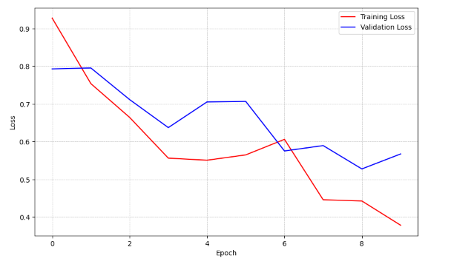
Results and Experiments
The outcomes from training the face segmentation model on the Extended Labeled Faces In The Wild (ELFW) dataset demonstrate a promising trajectory. Over the course of ten epochs, the model exhibited a consistent reduction in training loss, indicating effective learning from the training data.
Correspondingly, the validation loss, while displaying minor fluctuations, generally mirrored the training loss trend, reflecting the model's ability to generalize well to unseen data.
However, a closer examination of the results reveals nuanced performance across different classes.

Slide 8
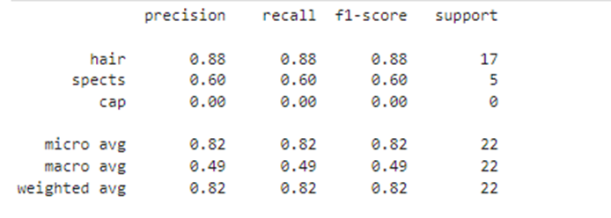
Results and Experiments
The model's accuracy on the test dataset, although respectable at 81.82%, suggests potential areas for enhancement, particularly for classes with lower F1-scores like 'spects' and 'cap’.
The classification report further underscores these disparities, with the 'hair' class demonstrating strong precision (88%) and recall (88%), while the 'spects' class exhibits moderate precision (60%) and recall (60%).
The 'cap' class, unfortunately, shows challenges with precision (0%) and recall (0%), indicating significant difficulties in correctly classifying instances of this class.
Delving into the classification metrics unveils specific insights into the model's strengths and areas needing refinement. The high precision and recall for the 'hair' class indicate the model's robust capability in accurately identifying instances of this class.

Slide 9
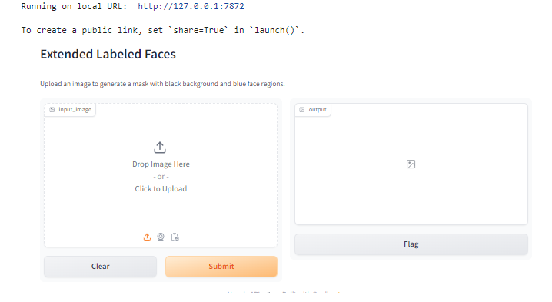
Deployment in Gradio Interface

Slide 10
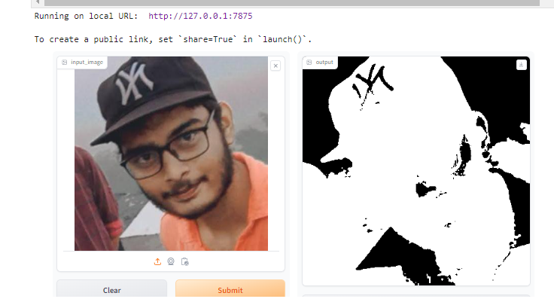
Deployment in Gradio Interface

Slide 11
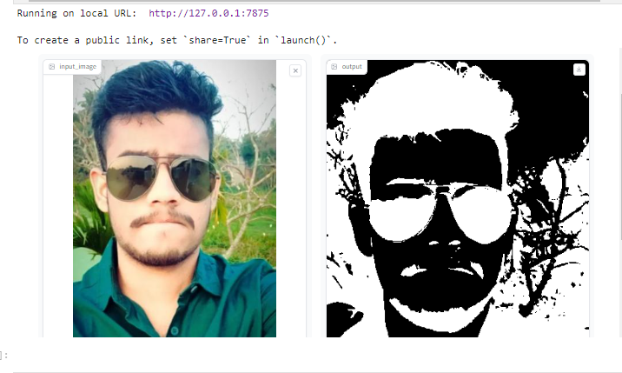
Deployment in Gradio Interface

Slide 12
THANK YOU

