Slide 1


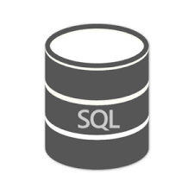

CSV
Postgres / MySQL
SQL Server
Oracle
Teradata
Redshift , Athena (S3)
BigQuery
Presto, Hive

Slide 2
RDMS
Postgres
MySQL
Oracle
SqlLite
Vertica
Teradata
Microsoft SQL Server
SQL on Hadoop
Hive
Presto
Impala
SparkSQL
Data Warehouse
Redshift
Snowflake
Athena (S3)
BigQuery
Real-time DB
ClickHouse
Greenplum
Pinot

Slide 3


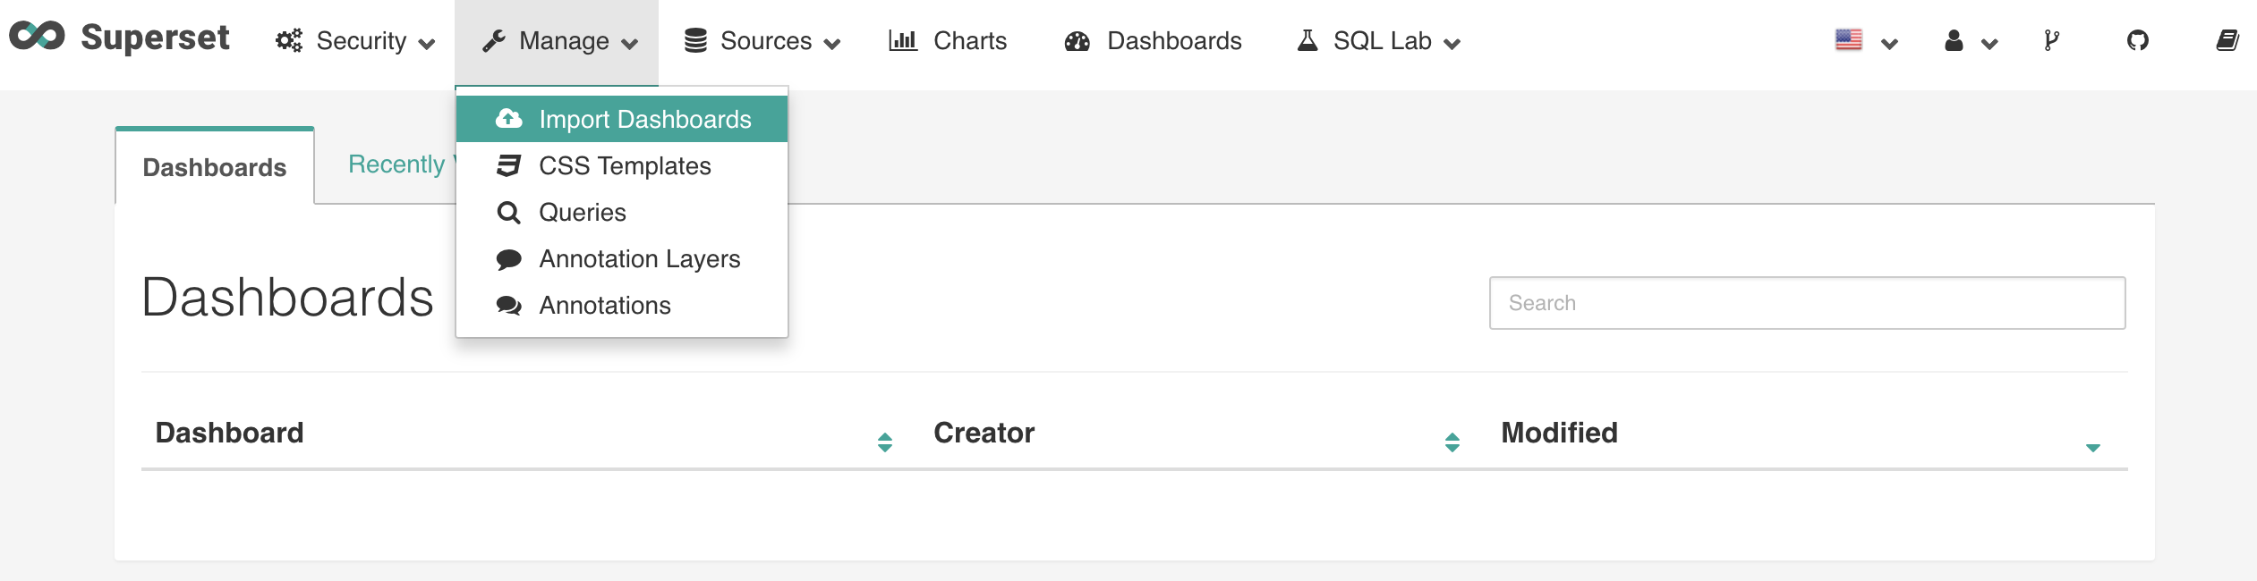

Meta Database
1
Load Balancer
To route request to one of the containers
2
UI Servers
Serves website
4
Celery Worker
For executing the SQL queries in an async mode
3
Cache layer
Storing Queries/Chart data for faster access

Slide 4
1
5
2
3
4
6
7
8
1 : User creates histogram (bar chart of types of pizza)
2 : Superset checks cache (data does not exist)
3 : Send the query to worker (select * from sales group by pizza)
4 : Save results in Cache
5 : Send the result to UI
6 : User asks for same data (somone else is seeing the dashboard)
7 : Data in cache
8 : Show data

