Slide 1
Intergalactic Vegan Soup Factory
Architecture trade study at behavioral fidelity Three variants, one winner - every number reproducible with runFullAnalysis

Slide 2
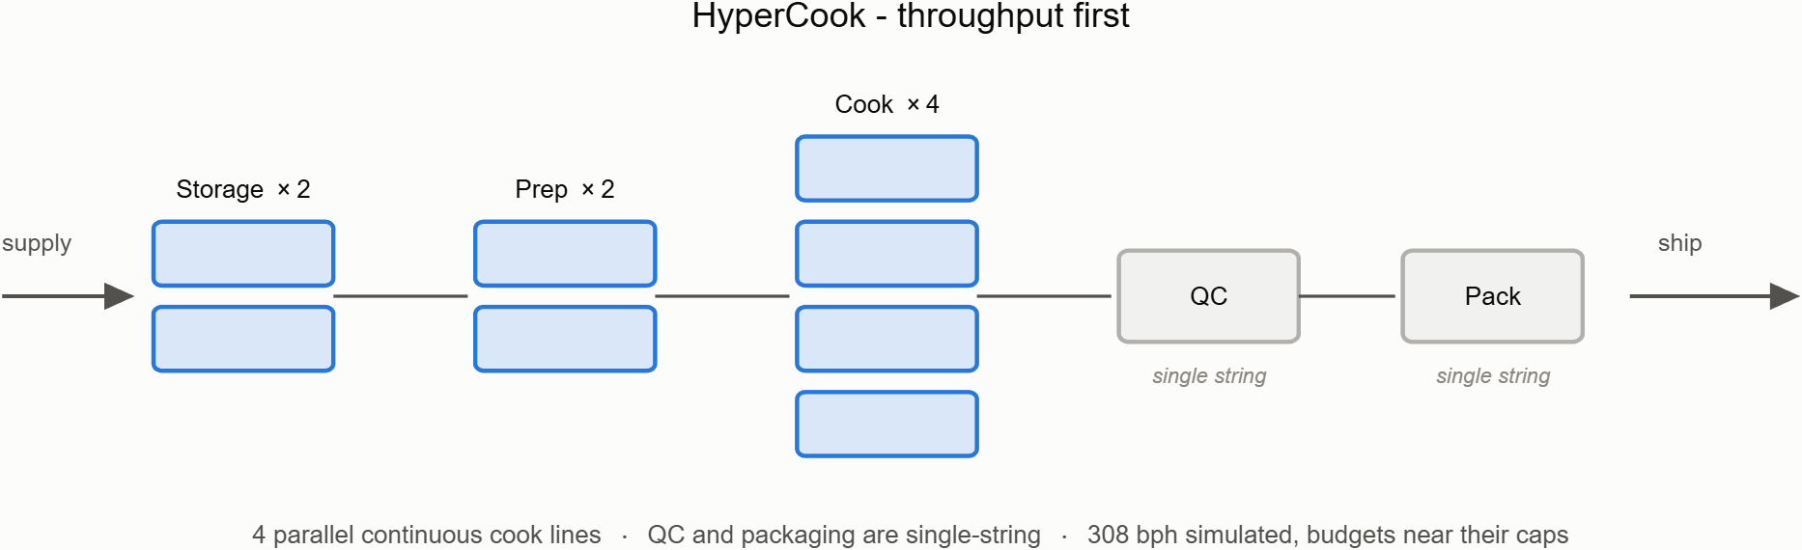
HyperCook - throughput first

Slide 3
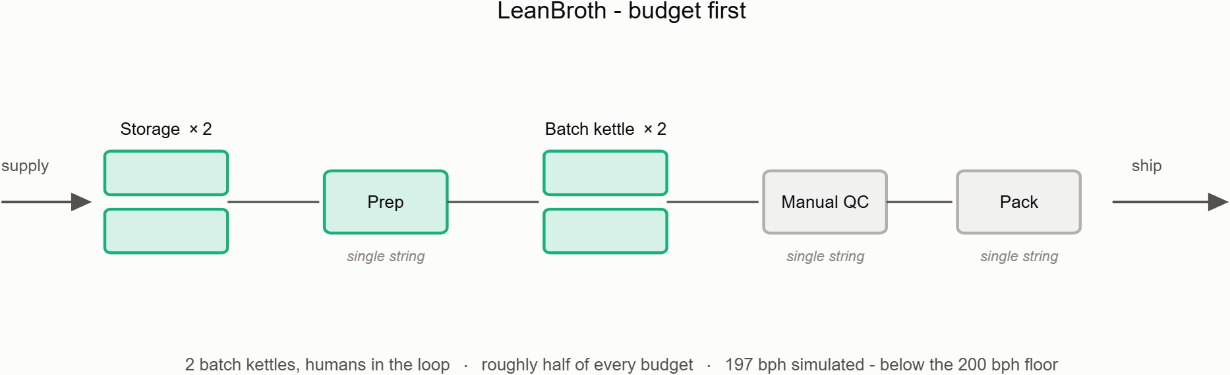
LeanBroth - budget first

Slide 4
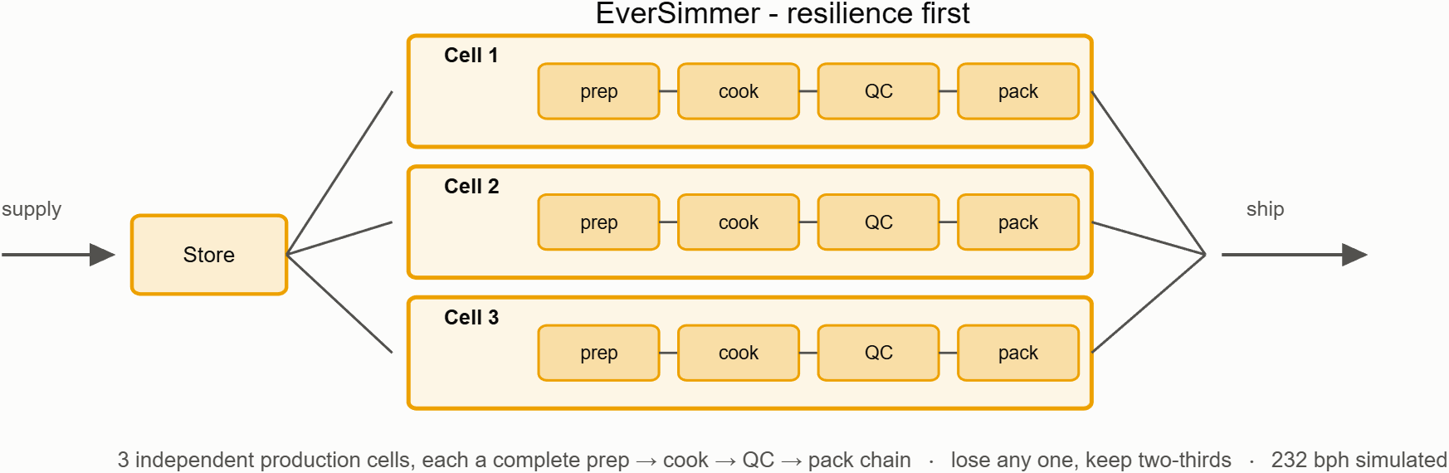
EverSimmer - resilience first

Slide 5
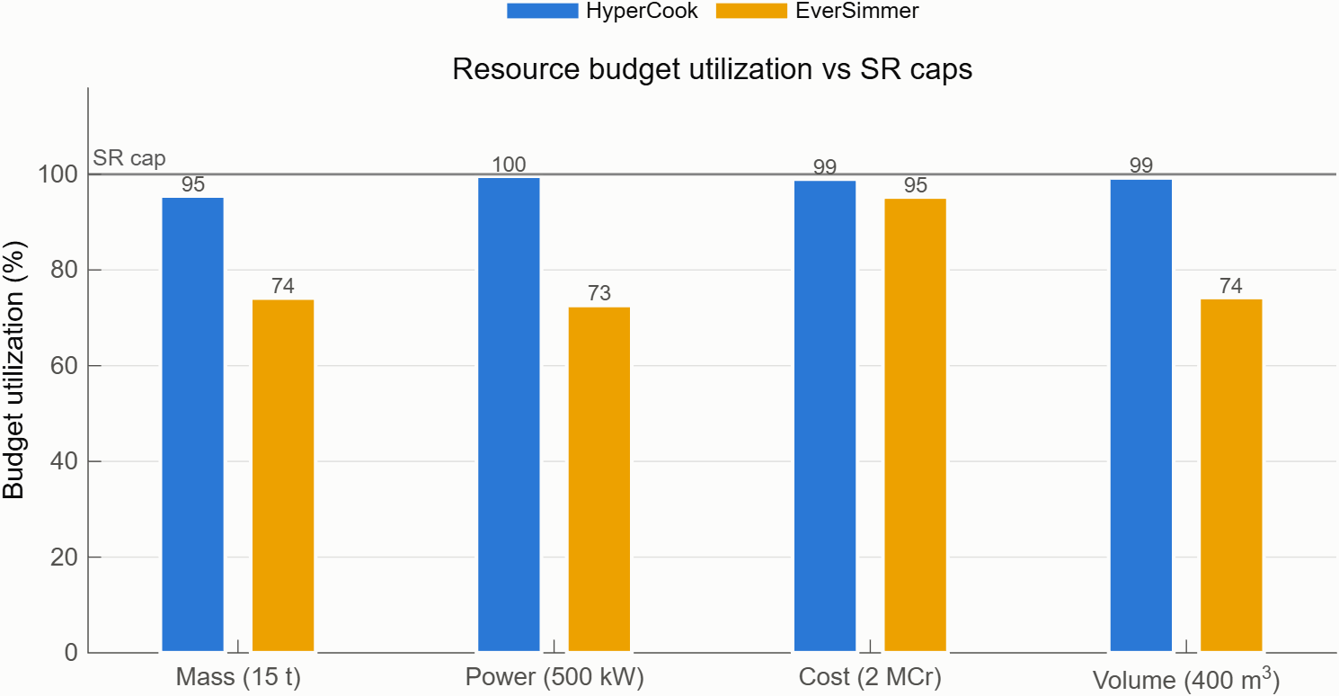
1. The paper numbers (static roll-up)
Every component carries the same 11-property stereotype
Mass, power, cost, volume sum bottom-up through the hierarchy
Throughput is bottleneck math: a chain runs at its slowest stage
Budget caps are parsed from the requirement text at run time
Claims, not evidence: assumes lossless flow

Slide 6
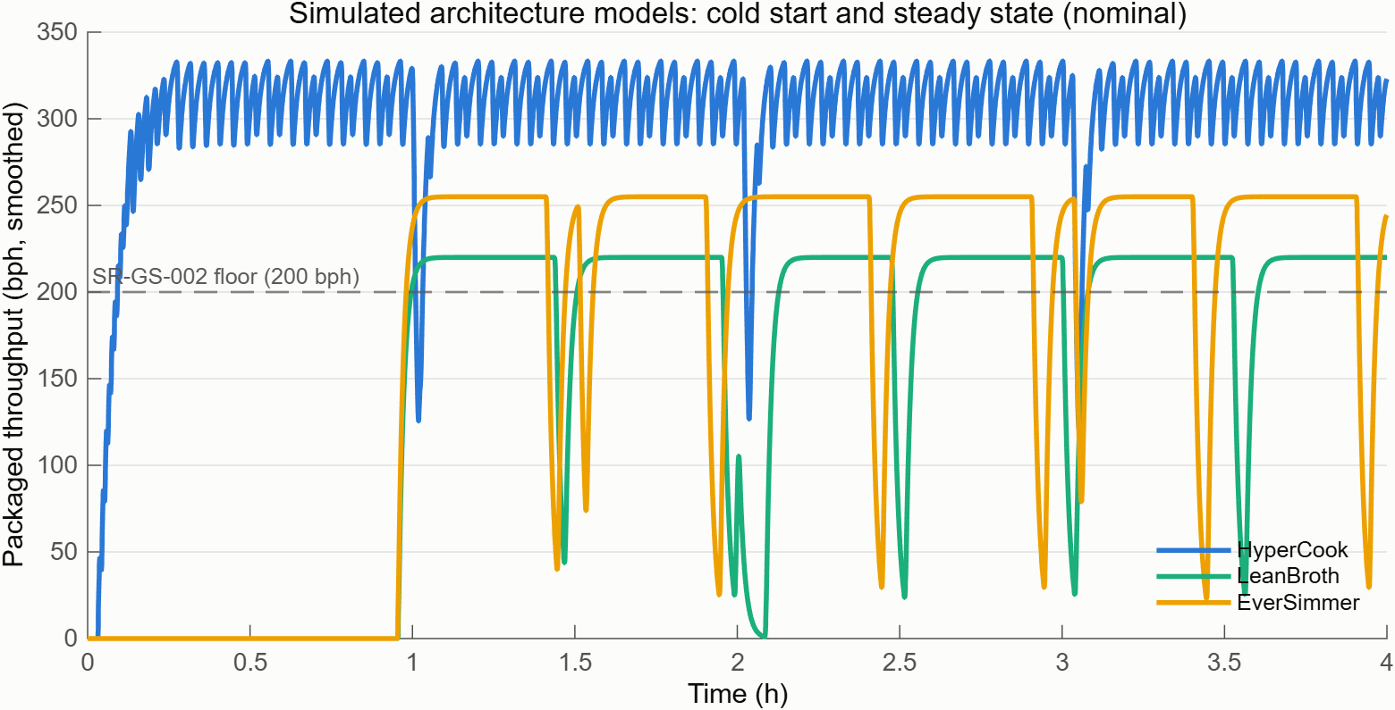
2. Run the factory (nominal simulation)
Behaviors live inside the architecture models themselves
Batch kettles heat up physically; QC rejects a few percent and recalibrates
Simulated vs rated: 308 vs 320, 197 vs 210, 232 vs 240 bph
First bowl: 119 s continuous vs ~57 min batch cold start
LeanBroth's margin is gone before the trade study even starts

Slide 7
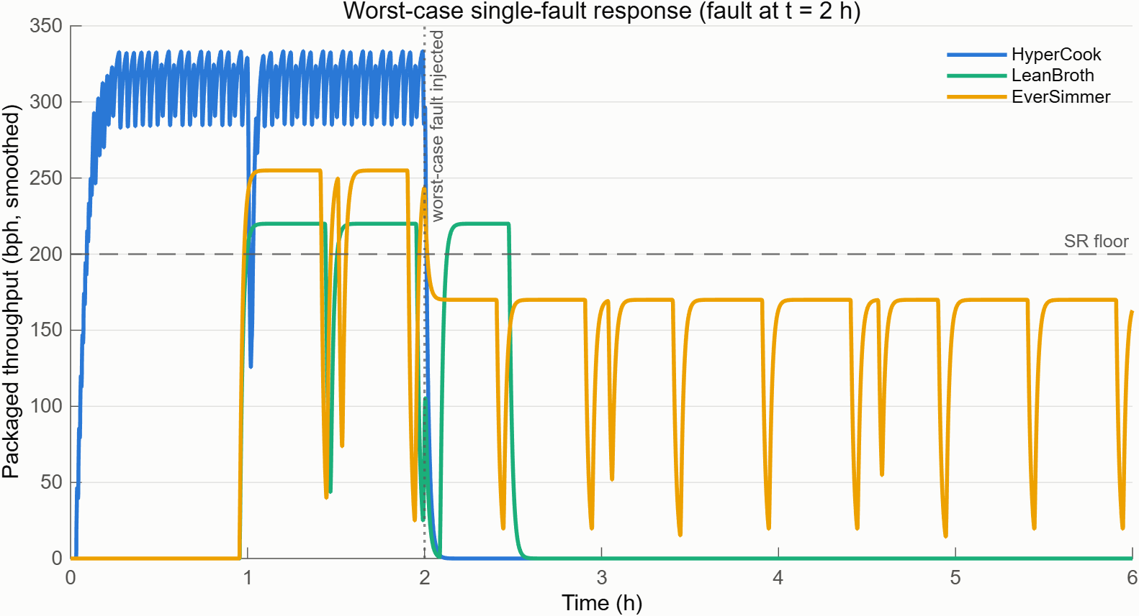
3. Break something on purpose (worst-case fault)
Variant | Worst single fault | Retention
HyperCook | QC scanner (single string) | 0%
LeanBroth | Prep station (single string) | 0%
EverSimmer | One of three cells | 67%

Slide 8
4. The pass/fail line (formal compliance gate)
Eight quantitative requirements as executable Requirements Table rows
Simulated metrics feed the gate; a parallel hand-coded check must agree
Fail any gate and you are excluded from scoring, not ranked lower
An eliminated variant is a finding with a recovery path
Result
Checks passing | 23 of 24
The failure | LeanBroth throughput: 196.8 vs 200 bph floor
Why | 3% QC reject + calibration downtime ate the rated margin
Recovery | QC bench with reject <= ~1.3% restores compliance

Slide 9
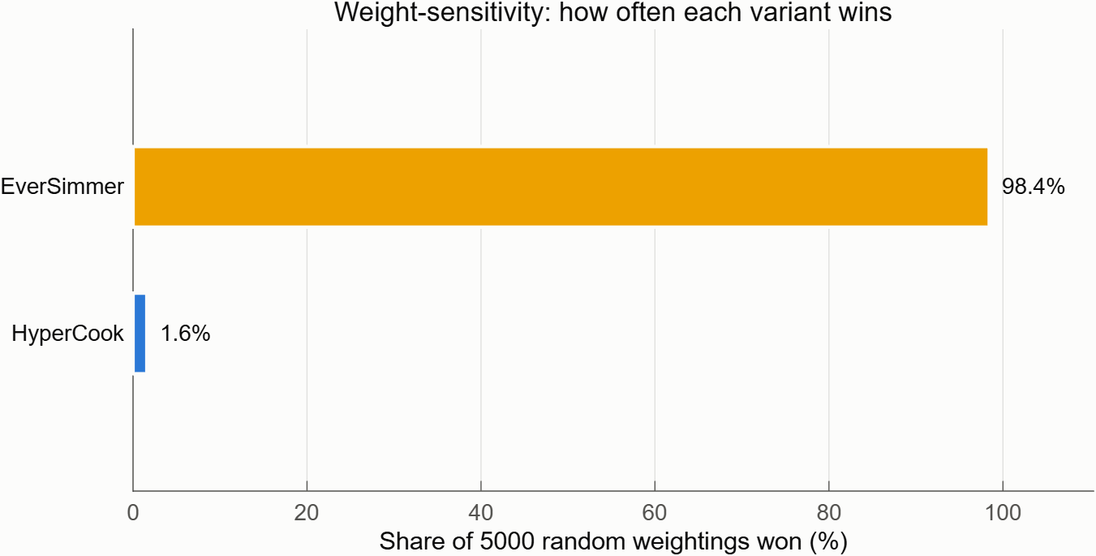
5. Pick a winner you can defend (MCDA + Monte Carlo)
Scenario | EverSimmer | HyperCook
Balanced | 0.80 | 0.20
ThroughputFirst | 0.65 | 0.35
CostLean | 0.90 | 0.10
MissionAssurance | 0.90 | 0.10

Slide 10
Recommendation
Adopt EverSimmer as the baseline architecture
wins all four stakeholder scenarios and 98.4% of 5,000 random weightings
only variant that keeps producing after any single fault (67% retention, Degraded mode)
LeanBroth is eliminated, not dead: a better QC bench puts it back over the throughput floor
HyperCook keeps a niche: 119-second cold start and the highest raw rate, at razor-thin budget margins
Every number regenerates from the repo: runFullAnalysis, seeded Monte Carlo, 21 unit tests, 12 project checks

