Slide 1
There’s a certain feline mammal nearby
Perhaps in the next slide…

Slide 2
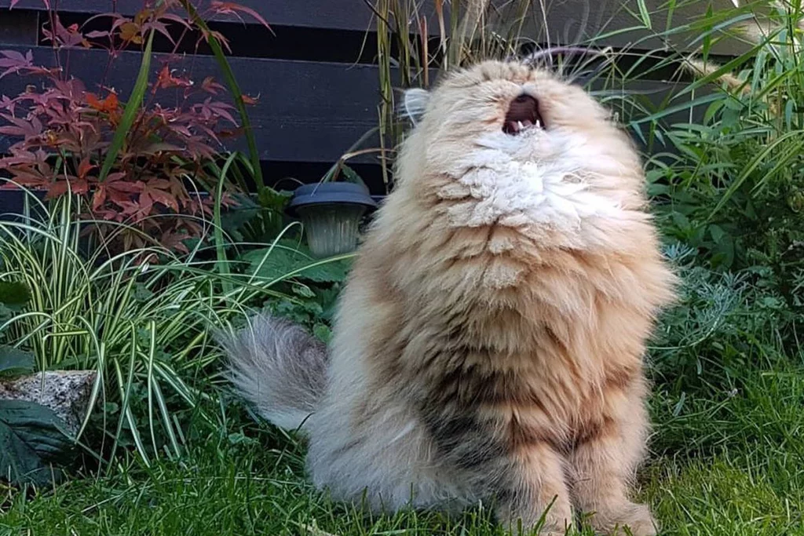
ah… here he is. The cat is here.

