Slide 1
Hashmaps
Data Structures and Algorithms

Slide 2

HASHMAPS
Notes:
Anusha

Slide 3
Hahaha what if we... had key-value pairs? In a list? ????!??!? hahaha jkjkjk… unless??
[
]
(K₁,V₁), (K₂,V₂), (K₃,V₃), .... , (K_{N},V_{N})
Notes:
Anusha

Slide 4
For storing & looking up *important info*
[
]
Jane: 781-239-5555;
Cassandra: 999-666-3333;
Anusha: 781-420-6969
Or like IDK a dictionary…… IDK maybe Python has a data structure for this problem built in…..
Notes:
Anusha

Slide 5

~ T H E B I G
P I C T U R E ~
Hashmaps
We Have: O(N) lookup time
We Want: O(1) lookup time
George Steelman after learning about hashmaps
Notes:
Anusha

Slide 6


To speed up lookup, we can use hash functions to access each key.
That way, we can quickly find the index where the key-value pair is stored by invoking the hash function.
Notes:
Anusha
Remind them we are hashing the key

Slide 7
What is Hashing?
Definition: Converting a piece of data to an array index in [0,M)
Hash functions should be deterministic and easily computable.
Hashable Data
Hash Function
Array
0
1
2
3
4
5
6
7
Notes:
Jane
Hash functions allow us to convert any arbitrary piece of data to an integer of fixed size.
It should be deterministic and easily computable, so it should connect directly from the data structure to the integer value itself and also be pretty fast.

Slide 8
What is Hashing?
Definition: Converting a piece of data to an array index in [0,M)
Hash functions should be deterministic and easily computable.
?
Hashable Data
Hash Function
Array
0
1
2
3
4
5
6
7
Notes:
Jane
Hash functions allow us to convert any arbitrary piece of data to an integer of fixed size.
It should be deterministic and easily computable, so it should connect directly from the data structure to the integer value itself and also be pretty fast.

Slide 9
Example
A classic: modular arithmetic. To hash any number i from [0, M), use the hash function i % M.
Example: hashing this list of key-value pairs using mod₃:
[ (0,3), (5,6), (9,21) ].
To do this, apply our hash function to each key.
[0: (9,21) → (0,3) → null,
1: null,
2: (5,6) → null]
Here, both 0 and 9 hash to the same index: 0; this is called a collision. There are several collision resolutions, one of which is chaining (used here). Notice that at each index, we store a linked list, and we append to the head of the list if something hashes to that index.
Notes:
Jane

Slide 10
Oh no a collision!
Generally, it should be incredibly unlikely two values hash to the same integer.
A good hash function will yield a uniform distribution of indices i.e. it is as likely to hash to 1 as it is to 5. But, it should not be random.
Python has a hash() method.
Notes:
Jane
In general, you want to write your hashing function such that it won’t repeat values very often; while it is impossible to create a hashing function that always returns a unique item, it should maintain a uniform distribution.

Slide 11
Quock Thonk!
With a partner, take a couple minutes to discuss what might be a good hashing function for strings. Remember that it should be deterministic, easily computable, and hash the strings to a defined range of integers [0, M).
Notes:
Jane

Slide 12

Hashing puts (Key, Value) pairs in BUCKETS
We split the original array of N (K,V) pairs into M buckets (subarrays) of (K,V) pairs. So each of the M buckets has depth N/M (let’s call this 𝛂).
Now we operate in O(𝛂), which is constant (for now)!
Notes:
Cassandra

Slide 13
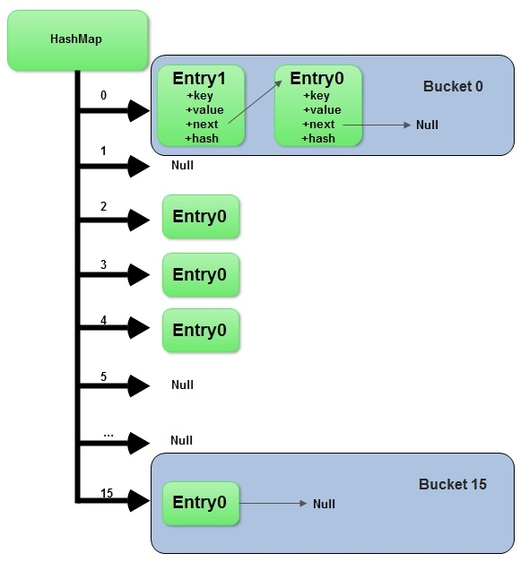

Buckets?
Buckets are a way to refer to linked lists that store the key-value pairs.
Notes:
Cassandra

Slide 14
[
]
(K₁,V₁), (K₂,V₂), (K₃,V₃), .... , (K_{N},V_{N})
Divide all N (K,V) pairs into M buckets
maps =
[
0: [ length 𝛂 ],
1: [ length 𝛂 ],
…
M-1: [ length 𝛂 ]
]
Notes:
Cassandra

Slide 15
Choose Your Bucket
def chooseMap(key):
# hash the key to get the index of the correct bucket
index = hash(key) # apply some hash function
return maps.get(index) # return the correct bucket
This helper method picks out the bucket that the (K,V) pair will go in. All it does is hash the key and returns the correct bucket.
Notes:
Cassandra

Slide 16
Summing up what we have so far
Given a (K,V), we find m = hash(K)
Once we know which bucket (K,V) goes into, we put it into that bucket:
chooseMap(K).append(K,V)
The number of buckets, M, is constant. If N were to be constant, we would have
O(N/M) = O(𝛂) = O(1) lookup time!
Wowee!
Notes:
Cassandra

Slide 17
But what if N GROWS (and it does)?
Oh wait we’re dumb...
We need dynamic resizing.
When do we resize? When the average entries per bucket is higher than our designated 𝛂.
So if 𝛂 = 2, and we have 7 entries over 3 buckets, then 7/3 > 2 → resize();
When resizing, every key-value pair is hashed to the new hashmap. This means when N grows, M also grows, thus N/M = 𝛂 stays constant → operations are always O(𝛂) or constant time.
Notes:
Jane
Point out how this works like Arraylists

Slide 18
HashMaps in the Wild
Python has some built-in data structures which use hashing.
Two common ones are dictionaries and sets.
d = dict() (or) d = {“Key”: Value, … }
s = set() (or) s = {“Item1”, “Item2” ... }
Dictionaries store key-value pairs. Sets store unique items and can quickly identify whether an item is in the set.
Notes:
Anusha

Slide 19

Thanks!!!
Questions? Email George Steelman at gsteelman@olin.edu

