Slide 1
Heat API
OpenStack AWS CloudFormation Orchestration
Steven Dake (sdake@redhat.com)
CloudOpen - Thursday, August 30, 2012

Slide 2
Heat Mission
Provide an AWS CloudFormation implementation
for OpenStack.

Slide 3
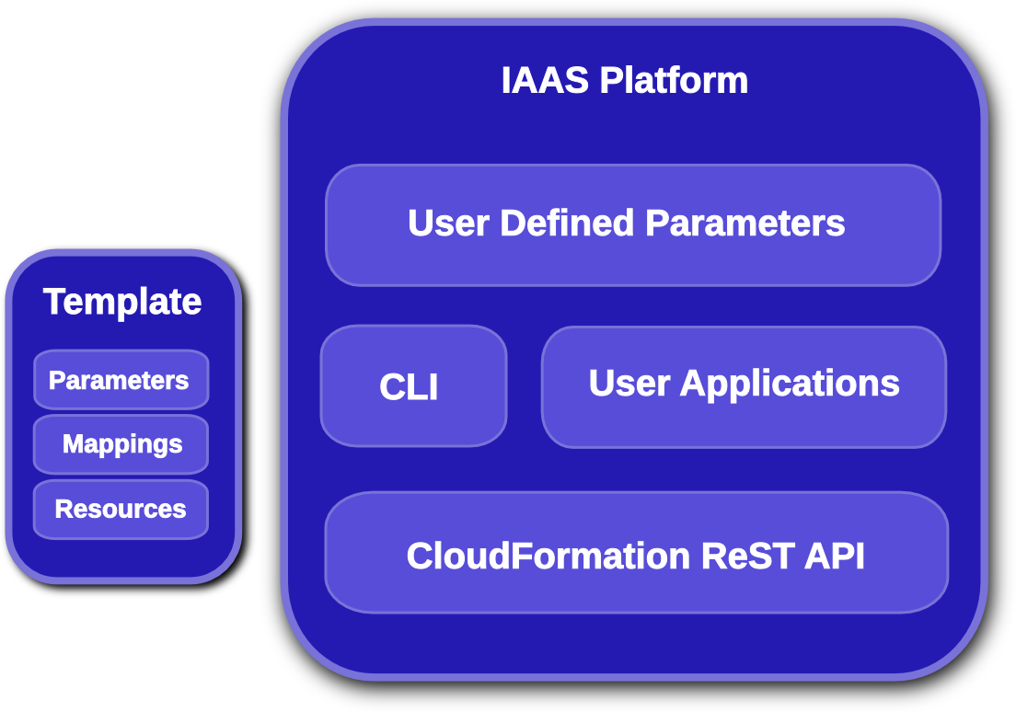
CloudFormation Overview
Notes:
KEY POINTS
User Parameters – user defined inputs that configure stack
Mappings – Translates a user-defined parameter into a stack-related parameter
Resources – Key object type in CloudFormation describing resources
Examples
Instances
Block storage
Relational Database Service
Autoscaling
Template – A json blob composed of parameters, mappings, and resources
Stack – an instantiated teomplate composed of user parameters, mappings, and resources

Slide 4
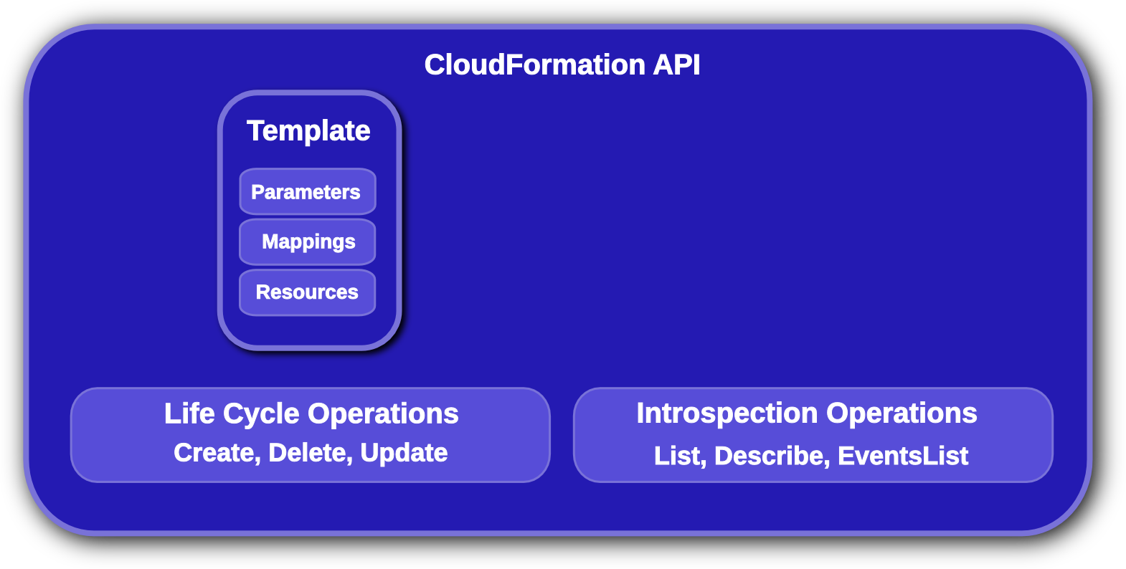
CloudFormation API
Notes:
KEY POINTS
Lifecycle operations
Create creates a stack from a template
Delete deletes an existing instantiated stack
Update updates an existing instantiated stack
Introspection operations
List obtains a list of existing stacks
Describe obtains details of existing stacks
Events List obtains events that have occurred for a stack
List resources lists resources associated with a stack
Template describes a stack

Slide 5
CloudFormation Template Parameters
Definition:
"Parameters" : {
"InstanceType" : {
"Description" : "WebServer EC2 instance type",
"Type" : "String",
"Default" : "m1.large",
"AllowedValues" : [ "t1.micro", "m1.small", "m1.large",
"m1.xlarge", "m2.xlarge","m2.2xlarge", "m2.4xlarge",
"c1.medium", "c1.xlarge", "cc1.4xlarge" ],
"ConstraintDescription" : "must be a valid instance type."
},
}
Using the Parameter:
{ “Ref” : “InstanceType” }
Notes:
KEY POINTS
Description field describes parameter
Type field describes parameter type
Rest of body contrains input

Slide 6
CloudFormation Template Mappings
Definition:
“Mappings”: {
"DistroArch2Inst": {
"F16" : { "32" : "F16-i386-cfntools", "64" : "F16-x86_64-cfntools" },
"F17" : { "32" : "F17-i386-cfntools", "64" : "F17-x86_64-cfntools" },
"U10" : { "32" : "U10-i386-cfntools", "64" : "U10-x86_64-cfntools" }
}
}
Using the Mapping:
“ImageId”: {
"Fn::FindInMap" : [
"DistroArch2Inst", { "Ref" : "Distribution" }, { “Ref” : “Arch” }
]
}
Notes:
KEY POINTS
Key maps to a value
One map can be used as input into another map

Slide 7
CloudFormation Template Resources
Resources {
“WikiDatabase”: {
"Type" : "AWS::EC2::Instance",
.. bunch of stuff ...
},
"DatabaseIPAddress" : {
"Type" : "AWS::EC2::EIP"
},
"DatabaseIPAssoc" : {
"Type" : "AWS::EC2::EIPAssociation",
"Properties" : {
"InstanceId" : { "Ref" : "WikiDatabase" },
"EIP" : { "Ref" : "DatabaseIPAddress" }
}
}
}
Notes:
KEY POINTS
Type describes type of resource
Properties describe properties of resource
Metadata describes resource metadata typically passed into a resource on instantiatioin

Slide 8
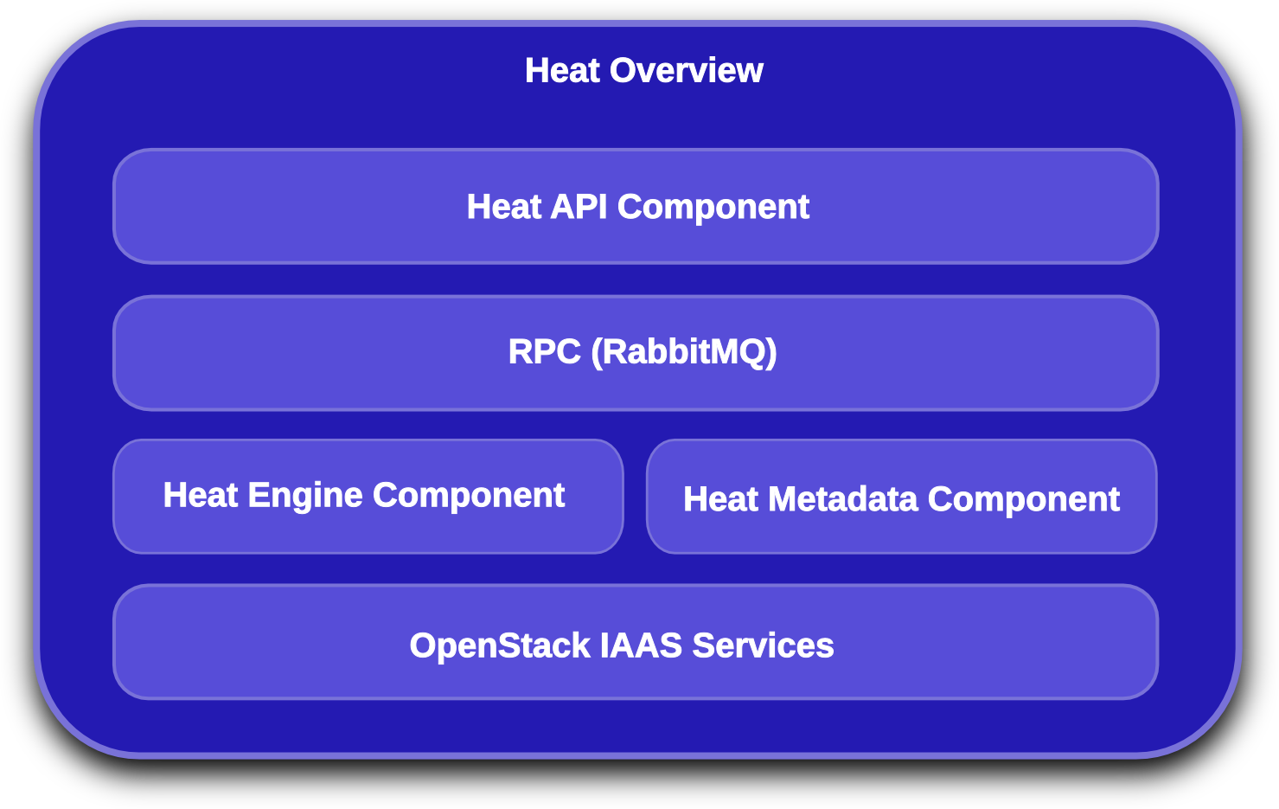
Heat Overview
Notes:
KEY POINTS
API module that services user API operations
Engine module that services API module rpc operations
Metadata module that services instance cloudwatch reporting

Slide 9
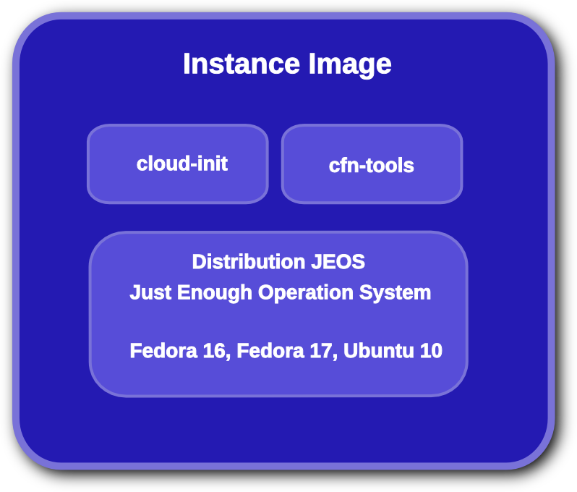
Heat Image Contents
Notes:
KEY POINTS
JEOS operating system
Could optimize JEOS for specific applications
cfn tools provide:
Orderly instance initialization
Signaling of events to heat
Metadata retrieval
Monitor metadata for updates
Cloud-init which acts on:
part handler
config data
retrives metadata server IP
contains VM initialization data
initialization script

Slide 10
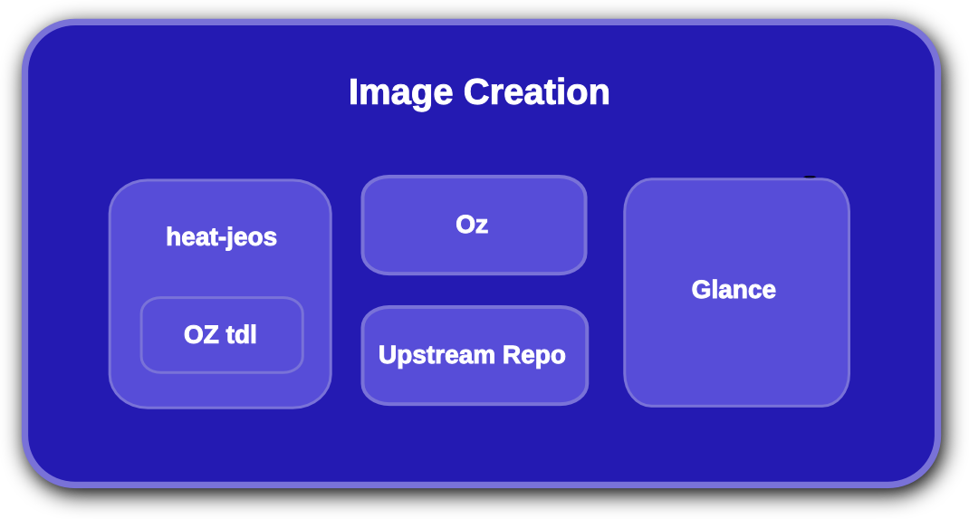
Heat Image Creation
Notes:
KEY POINTS
Oz used to generate JEOS images using native OS tools
Growing library of supported distributions
Do not require prebuilt images but lose some functionality

Slide 11
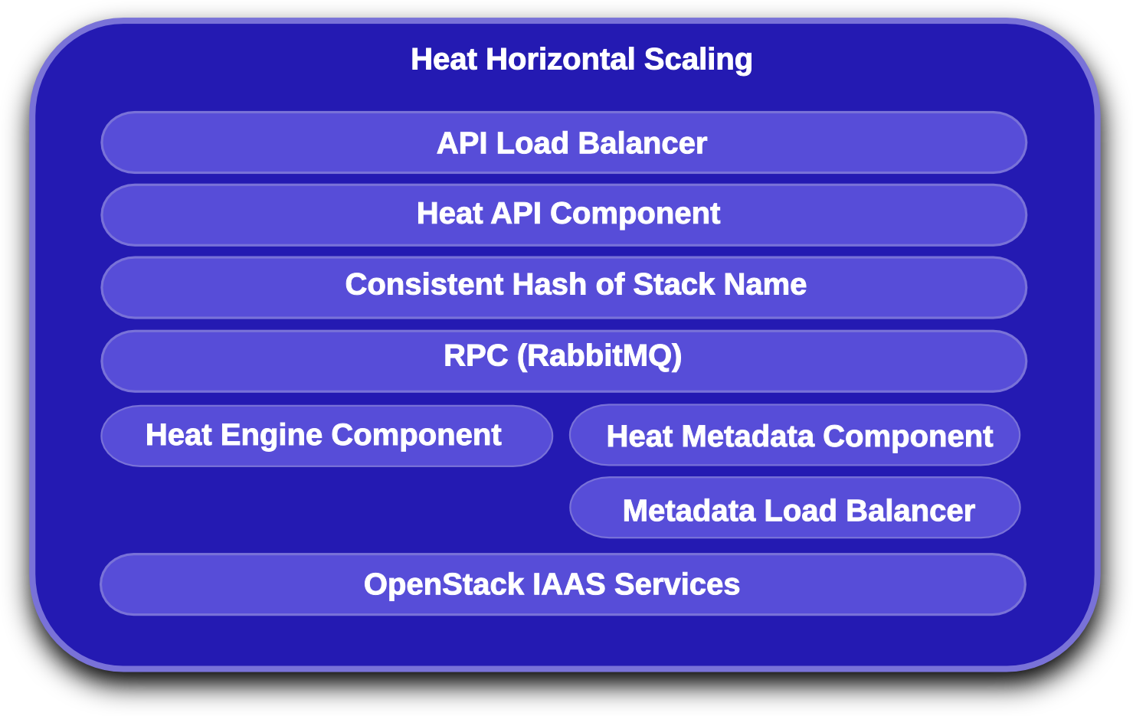
Heat Horizontal Scaling
Notes:
KEY POINTS
API horizontally scales via a front-end LB
Engine horizontally scales by mapping the template name to a specific engine
Metadata service horizontally scalable via a front-end LB
Each service scalable separately by deployment model

Slide 12
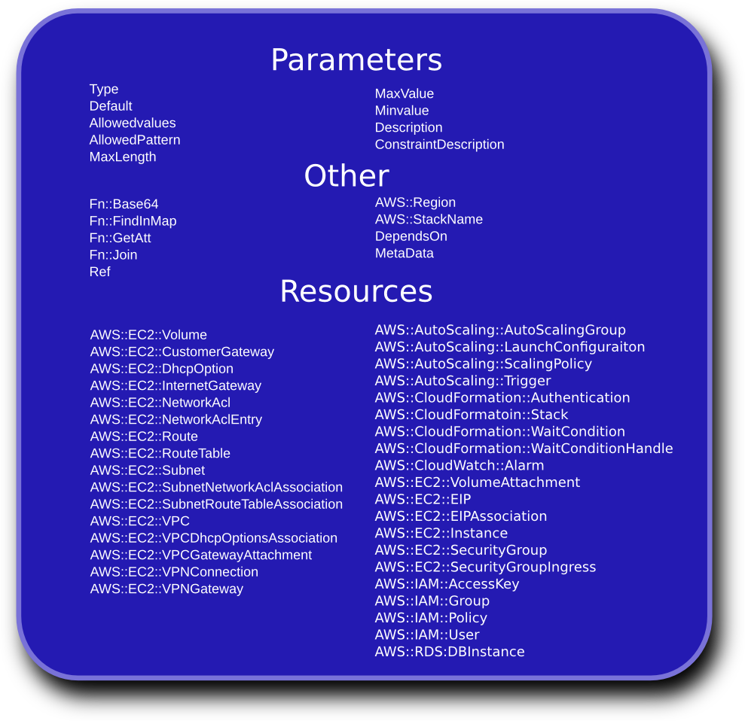
Heat Resource Types
Notes:
KEY POINTS
Heat implements most functionality
Heat upstream has more work to do on network functionality

Slide 13
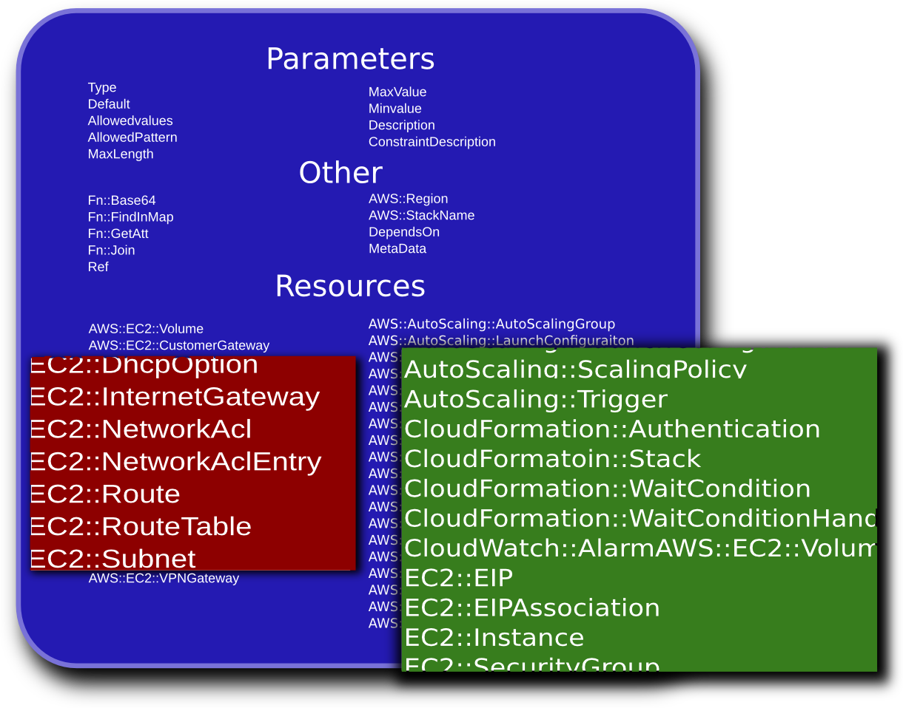
Heat Resource Types
Notes:
KEY POINTS
Heat implements most functionality
Heat upstream has more work to do on network functionality

Slide 14
Demonstration of Nested Stacks
Normal Stack Database Instance Definition:
42 lines
Using a RDS Nested Stack Definition:
13 lines
“Resources”: {
“DatabaseServer”: {
  "Type": "AWS::EC2::Instance",
  ... bunch more stuff ...
  “UserData” :
  "#!/bin/bash -v\n",
  "/opt/aws/bin/cfn-init\n",
  "# Setup MySQL \n",
  "mysqladmin -u root password '", { "Ref" : "DBRootPassword" }, "'\n",
  "cat << EOF | mysql -u root --password='", { "Ref" : "DBRootPassword" }, "'\n",
  "CREATE DATABASE ", { "Ref" : "DBName" }, ";\n",
  "GRANT ALL PRIVILEGES ON ", { "Ref" : "DBName" }, ".* TO \"", { "Ref" : "DBUsername" }, "\"@\"localhost\"\n",
  "IDENTIFIED BY \"", { "Ref" : "DBPassword" }, "\";\n",
  "FLUSH PRIVILEGES;\n",
  "EXIT\n",
  "EOF\n"
  ]
"Resources" : {
"DatabaseServer": {
"Type": "AWS::RDS::DBInstance",
"Properties": {
"DBName" : { "Ref" : "DBName" },
"Engine" : "MySQL",
"MasterUsername" : { "Ref" : "DBUsername" },
"DBInstanceClass" : { "Ref" : "DBClass" },
"DBSecurityGroups" : [],
"AllocatedStorage" : { "Ref" : "DBStorage" },
"MasterUserPassword": { "Ref" : "DBPassword" }
}
}
}
Notes:
KEY POINTS:
Building a database instance is something that happens over and over – simple solution is to add a type to automate that – the RDS type
Nesting allows heat devs to turn a complete template into a resource type
Reduces error-prone 42 lines of template to non-error-prone 13 lines of template
In Example:
Blue is the resource name
Green is the database password
Red is the database username

Slide 15
Demonstration of High Availability
“Resources”: {
"WebServerRestartPolicy" : {
  "Type" : "HEAT::HA::Restarter"
  "Properties" : {
  “InstanceId" : { "Ref" :"WikiServer" }
  }
  },
  "HttpFailureAlarm": {
  "Type": "AWS::CloudWatch::Alarm",
  "Properties": {
  "AlarmDescription": "Restart the
  WikiDatabase if httpd fails > 3 times
  In 5 minutes",
  "MetricName": "ServiceFailure",
  "Namespace": "system/linux",
  "Statistic": "SampleCount",
  "Period": "300",
  "EvaluationPeriods": "1",
  "Threshold": "2",
  "AlarmActions": [ { "Ref": "WebServerRestartPolicy" } ],
  "ComparisonOperator": "GreaterThanThreshold"
  }
  },
  “WebServer”: {
  "Type": "AWS::EC2::Instance",]
  "Metadata" : {
  "AWS::CloudFormation::Init" : {
  "config" : {
  "files" : {
  "/etc/cfn/notify-on-httpd-restarted" : {
  "content" : { "Fn::Join" : ["", [
  "#!/bin/sh\n",
  "/opt/aws/bin/cfn-push-stats --watch ",
  { "Ref" : "HttpFailureAlarm" },
  " --service-failure\n"
  ]]},
  },
  "/tmp/cfn-hup-crontab.txt" : {
  "content" : { "Fn::Join" : ["", [
  "MAIL=\"\"\n",
  "\n",
  "* * * * * /opt/aws/bin/cfn-hup -f\n"
  ]]},
  },
  "/etc/cfn/hooks.conf" : {
  "content": { "Fn::Join" : ["", [
  "[cfn-http-restarted]\n",
  "triggers=service.restarted\n",
  "path=Resources.WebServer.Metadata\n",
  "action=/etc/cfn/notify-on-httpd-restarted\n",
  "runas=root\n"
  ]]},
  }
  }}}}
  ... more instance stuff ...
  }}
Notes:
KEY POINTS:
A custom restarter type is used to restart the VM to achieve escalation after 3 failures of httpd
crontab scripts watch httpd for failures and indicate when a failure has occurred and restart http
Template contents not shown healthchecks the VM and the application restarters
The example colors:
Green is a custom resource for heat
Yellow is a cloudwatch alarm type
Blue is the instance name
Red is the command to run

Slide 16
Demonstration of Autoscaling
  “Resources”: {
  "WebServerGroup" : {
  "Type" :"AWS::AutoScaling::AutoScalingGroup",
  "Properties" : {
  "AvailabilityZones" : { "Fn::GetAZs" : ""},
  "LaunchConfigurationName" : { "Ref" : "LaunchConfig" },
  "MinSize" : "1",
  "MaxSize" : "3",
  "LoadBalancerNames" : [ { "Ref" : "ElasticLoadBalancer" } ]
  }
  },
  "WebServerScaleUpPolicy" : {
  "Type" : "AWS::AutoScaling::ScalingPolicy",
  "Properties" : {
  "AdjustmentType" : "ChangeInCapacity",
  "AutoScalingGroupName" : { "Ref" : "WebServerGroup" },
  "Cooldown" : "60",
  "ScalingAdjustment" : "1"
  }
  },
  "WebServerScaleDownPolicy" : {
  "Type" : "AWS::AutoScaling::ScalingPolicy",
  "Properties" : {
  "AdjustmentType" : "ChangeInCapacity",
  "AutoScalingGroupName" : { "Ref" : "WebServerGroup" },
  "Cooldown" : "60",
  "ScalingAdjustment" : "-1"
  }
  },
"MEMAlarmHigh": {
"Type": "AWS::CloudWatch::Alarm",
"Properties": {
"AlarmDescription": "Scale-up",
"MetricName": "MemoryUtilization",
"Namespace": "system/linux",
"Statistic": "Average",
"Period": "60",
"EvaluationPeriods": "1",
"Threshold": "50",
"AlarmActions": [ { "Ref":
"WebServerScaleUpPolicy" } ],
"Dimensions": [
{
"Name": "AutoScalingGroupName",
"Value": { "Ref": "WebServerGroup" }
}
],
"ComparisonOperator": "GreaterThanThreshold"
}
},
Notes:
KEY POINTS:
Monitoring of the VM for a high memory usage condition occurs via the MemAlarmHigh much as shown in the HA example
When the MemAlarmHigh alarm occurs, the WebServerScaleUpPolicy is executed
Scale constraints are available via MinSize and MaxSize
Example Colors:
Green is the autoscaling group
Blue is the scale up policy

Slide 17
In Closing
Users and developers wanted!
  Connect with the community via IRC on #heat@freenode
  Check out the repository:
    https://github.com/heat-api
  Read the Documentation:
    https://github.com/heat-api/heat/wiki
Heat simple but powerful method for orchestrating OpenStack environments
Heat provides near parity with CloudFormation template and API for OpenStack

