Slide 1
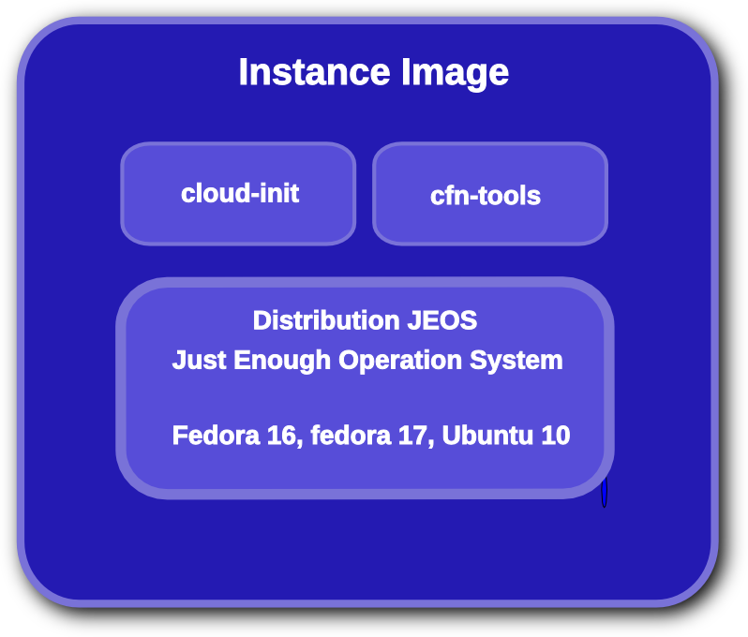
Some stuff here for a slide
Blah blah

Slide 2
Title page
Name and shit here

