Slide 1
OpenStack Heat
Using Autoscaling
Steven Dake (sdake@redhat.com)
CloudOpen 2013- Monday, September 16, 2013

Slide 2
Heat Mission
To explicitly model the relationships between OpenStack resources of all kinds; and to harness those models, expressed in forms accessible to both humans and machines, to manage infrastructure resources throughout the lifecycle of applications.

Slide 3
Agenda
HOT Format Introduction
OpenStack Heat architecture
Autoscaling Introduction
Autoscaling Lifecycle
Autoscaling Example Lifecycle
Future of Autoscaling in OpenStack
In Closing

Slide 4
HOT Format
CloudFormation refactored
Parameters
Resources
Outputs
Full specification:
http://docs.openstack.org/developer/heat/template_guide/hot_spec.html
Notes:
Parameters are user defined data passed into the template for parsing.
Resources are orchestrated by Heat.
Outputs display key information about the instantiated template.

Slide 5
HOT Format - Parameters
User defined parameters passed into template from CLI or GUI
Parameters include type, description, default value, hidden, and constraints
parameters:
InstanceType:
type: string
description: Instance type to create
default: m1.small
hidden: False
constraints:
- allowed_values {m1.tiny, m1.small, m1.large}
Notes:
Type can be of string, number, json, or comma delimited list
Default value defines value if none is specified. If default is not specified and parameter is not specified, a parse error will occur.
Hidden defines whether the value will be displayed in a GUI.
Constraints can be of length, allowed_pattern, range, or allowed_values

Slide 6
HOT Format - Resources
Resources for Heat to Orchestrate
Consists of Type, Properties, DependsOn
Resources produce global attributes
resources:
MyInstance:
type: OS::Nova::Server
properties:
KeyName: { get_param: KeyName }
ImageId: { get_param: ImageId }
InstanceType: { get_param: InstanceType }
Notes:
Resources can be of many types including any OpenStack resources such as Nova Servers, Floating Ips, block storage, Neutron Networks, or heat resources such as wait conditions and wait handles
Type follows a namespace convention of top level namespace::resource provider::resource
Properties are passed as parameters into resource creation and are defined per resource. Each resource has a unique set of properties it comprehends.
Attributes are produced after instantiation of the resource for use by other resources or output sections

Slide 7
Hot Format - Outputs
Displayed via CLI/GUI to identify important information of template
Includes a description and value field
outputs:
InstanceIP:
description: The IP address of the instance
value: {get_attr: [MyInstance, PublicIP] }
Notes:
Description displayed in CLI/GUI
Value retrieved from template parsing after instanstation of the resource

Slide 8
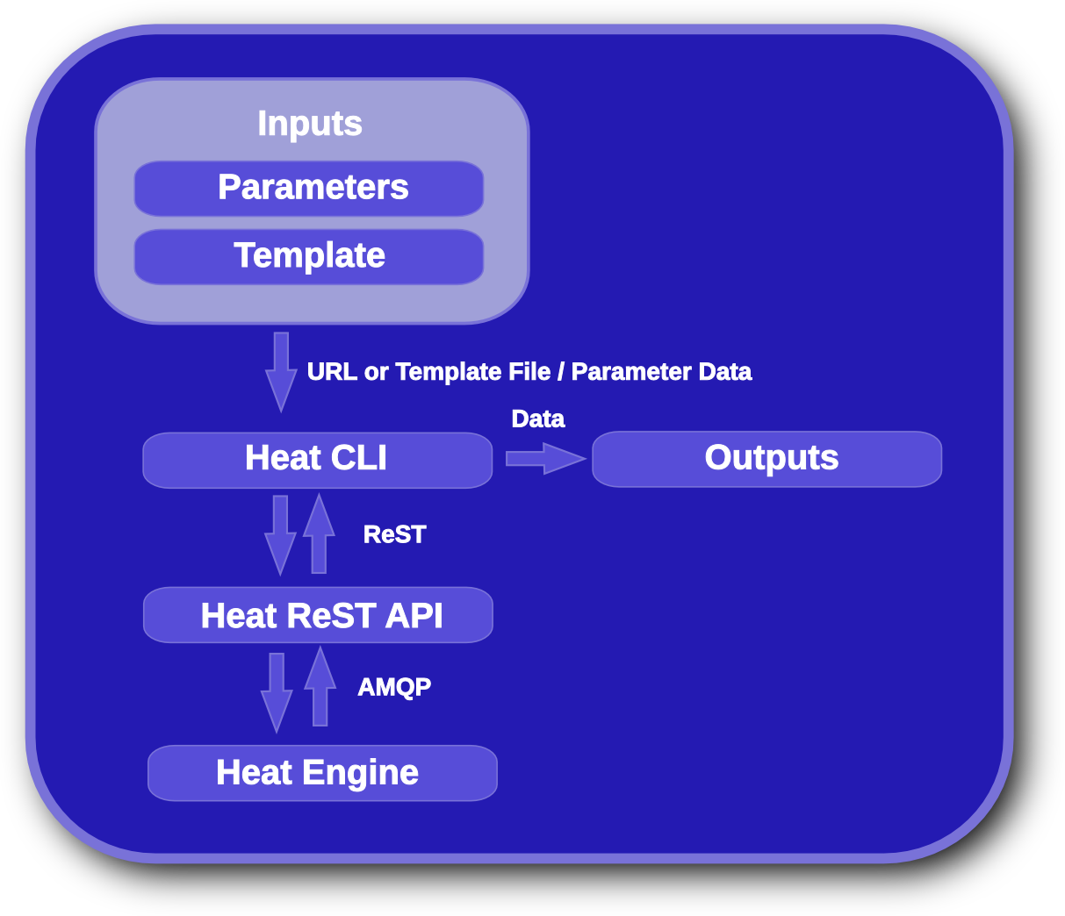
OpenStack Heat Architecture

Slide 9
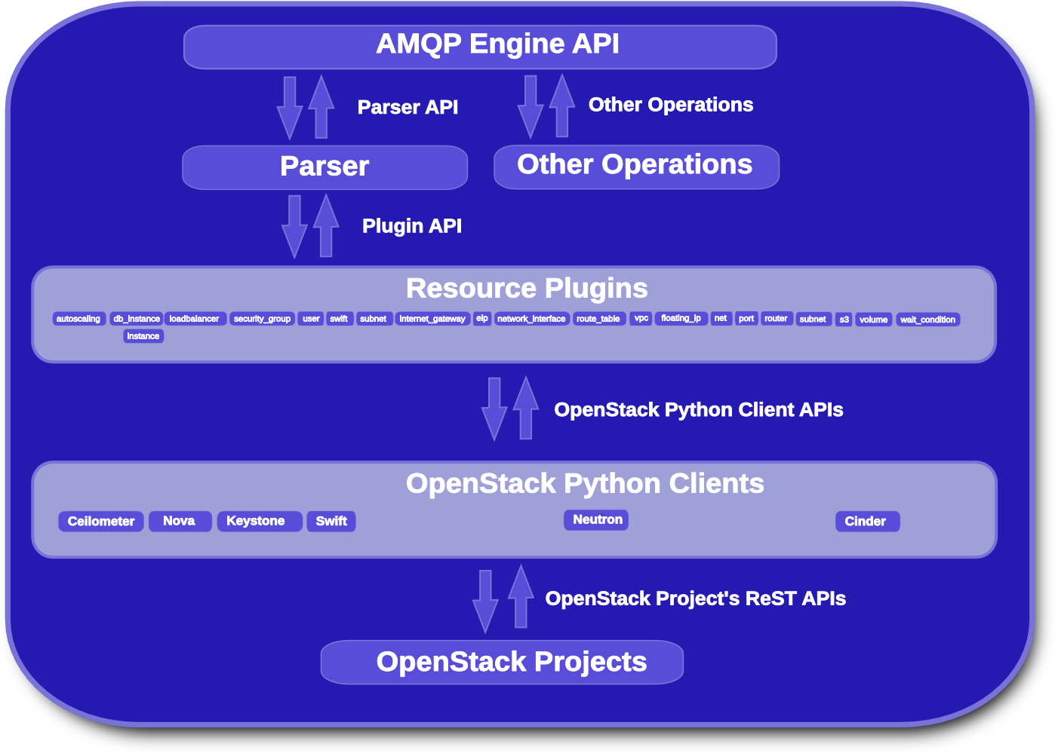
OpenStack Heat Engine Architecture

Slide 10
Autoscaling Introduction
Metrics drive scaling
Metrics can include CPU utilization, memory utilization, and more!
Dynamically add and reduce OS::Nova::Server resources to meet demand
Front end Neutron LBAAS or Heat provided HA-Proxy Load Balancer distributes load to server resources

Slide 11
Autoscaling Lifecycle – User View
Create disk image templates via TripleO's diskimage-builder
Create Heat template
Register diskimage-builder images with Glance
Start Heat template
Notes:
Reasons to precreate images:
Performance of scaling availability
Reliability of not loading at runtime image contents

Slide 12
Autoscaling Lifecycle – Internal View
User instantiates template with Heat's CLI
Heat registers with Ceilometer for callbacks on metric events
Ceilometer tells Heat about metric event changes and Heat makes decision to scale up or down based upon metrics

Slide 13
Autoscaling Example Lifecycle – Create DIB template

Slide 14
Autoscaling Lifecycle Example – Create Heat Template

Slide 15
Autoscaling Lifecycle Example – Register Images with Glance

Slide 16
Autoscaling Lifecycle Example – Launch Heat Template

Slide 17
Future of Autoscaling in OpenStack
Scale other resources beyond OS::Nova::Server
Rackspace considering adding API model for Autoscaling based upon Otter
Autoscaling available today in high quality format in Heat

Slide 18
Conclusion
Entering OpenStack Integrated status in November 2013
  Active code base
    3048 commits as of September 2013
    56 contributors
  Cross Project functionality with OpenStack projects Keystone, Nova, Neutron, Cinder, Ceilometer, Swift, Glance, Horizon, and Tempest
HOT holds significant promise for future de-facto standard orchestration DSL
OpenStack Heat provides application autoscaling today with simplicity

