Slide 1
The Effect of Energy Drinks on Heart Rate and Reaction Time
Group 12
Jude Condon, Selena Dang, Nathaniel Francis, and Madeline Heymann
Notes:
Madeline introduces
Notes: don’t say “as you see”
Use “sans serif” font consistently

Slide 2
Summary
Evaluate changes in heart rate and reaction time before and after energy drink consumption
Focus on physiological and cognitive effects of caffeine on college students
Test correlation between caffeine doses and performance
Caffeine range:
80 mg – 300 mg
Notes:
MH 40s

Slide 3
Background
92% of college students consume caffeine (avg. 159 mg/day)
Reasons: stay awake, improve concentration, social aspects, reduce stress
Caffeine = adenosine receptor antagonist → reduces drowsiness, increases alertness
Prior studies: mixed results on heart rate and reaction time
Notes:
1:20
Heart rate was found to have ”little change” due to caffeine (Ragsdale, Leimrot), though reaction time did decrease as a result of caffeine (Attwood and Bartrim).

Slide 4
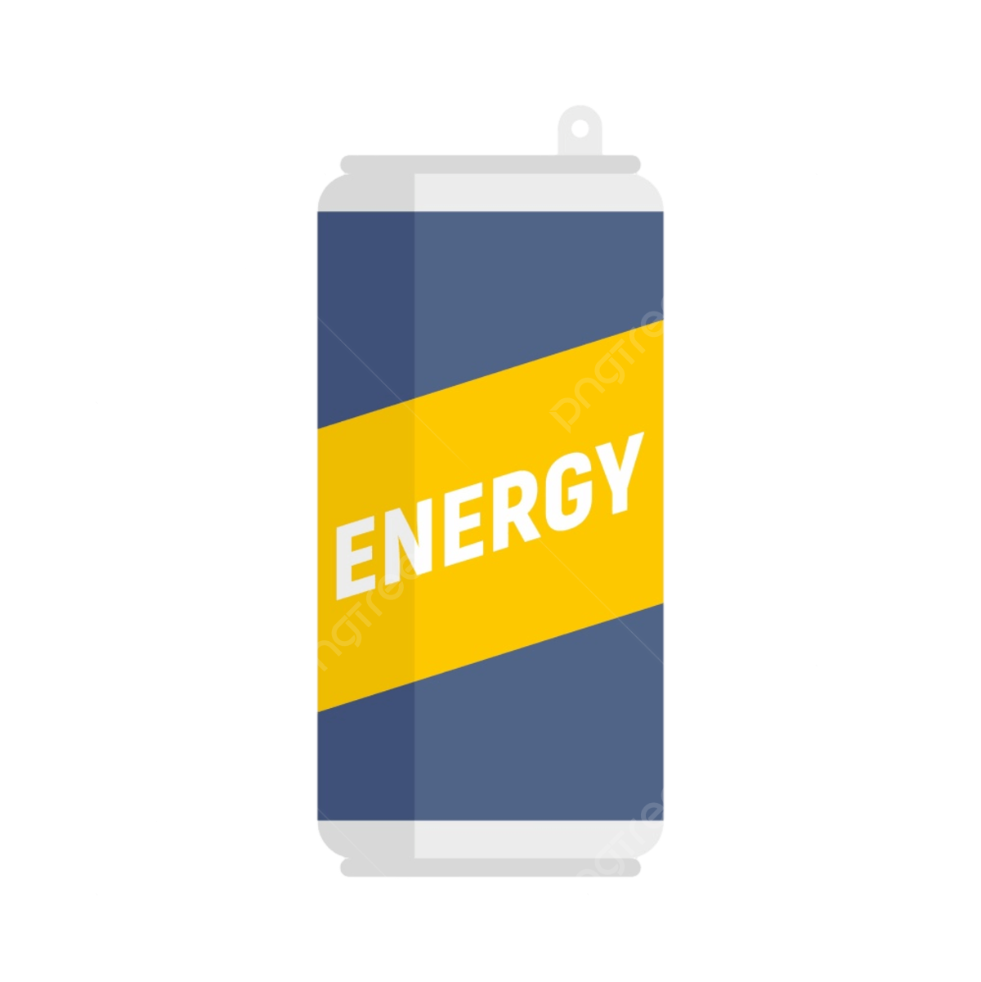
Objective
The relationship between caffeine/energy drinks with performance will be evaluated by measuring heart rate and reaction time
Notes:
1:35

Slide 5
Hypothesis
Heart Rate:
𝐻₀: 𝜇_{𝑤} = 𝜇_{𝑐𝑎𝑓𝑓}
𝐻₁: 𝜇_{𝑤} < 𝜇_{𝑐𝑎𝑓𝑓}
Reaction Time:
𝐻₀: 𝜇_{𝑤} = 𝜇_{𝑐𝑎𝑓𝑓}
𝐻₁: 𝜇_{𝑤} > 𝜇_{𝑐𝑎𝑓𝑓}
Notes:
2:15
Null and alternative hypotheses for heart rate:
$$H_{0}:μ_{w}=μ_{caff}$$
(There is no difference in mean heart rate before and after caffeine consumption)
$$H_{1}:μ_{w}<μ_{caff}$$
(mean heart rate increases after caffeine consumption)
Null and alternative hypotheses for reaction time:
$$H_{0}:μ_{w}=μ_{caff}$$
(There is no difference in mean reaction time before and after caffeine consumption)
$$H_{1}:μ_{w}>μ_{caff}$$
(mean reaction time decreases after caffeine consumption, showing improvements)

Slide 6
Equipment
Different caffeinated beverages:
8.4 oz. Red Bull (80 mg)
16 oz. Monster (160 mg)
12 oz. Celsius (200 mg)
16 oz. Reign (300 mg)
Watch that measures HR
Laptop for the Reaction Test: Human Benchmark - Reaction Time Test
Notes:
MH

Slide 7
Methods & Procedures
Baseline: 5 heart rate readings (1/min), 5 reaction time tests
After drink: Wait 30 min → repeat measurements
Independent variable: caffeine amount (80 mg, 160 mg, 200 mg, 300 mg)
Dependent variables: heart rate (bpm), reaction time (ms)
Control: water (0 mg caffeine)
Notes:
MH

Slide 8
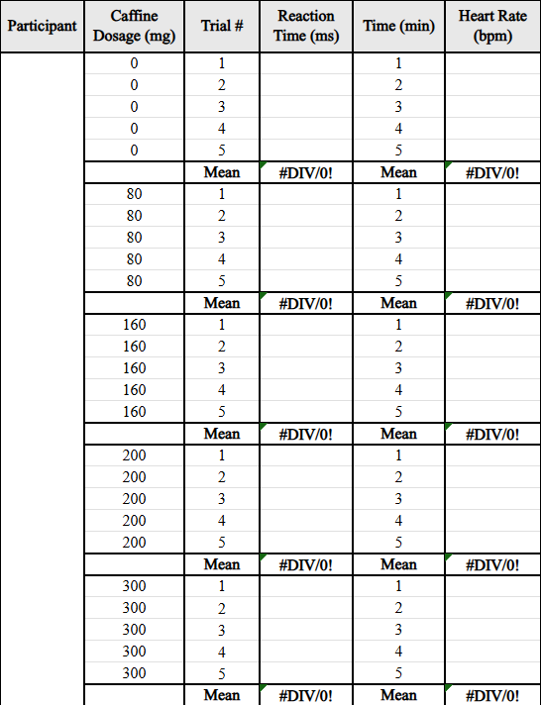
Data Sheet
Notes:
4:00
MH
Data was compiled onto Excel tables just like this one

Slide 9
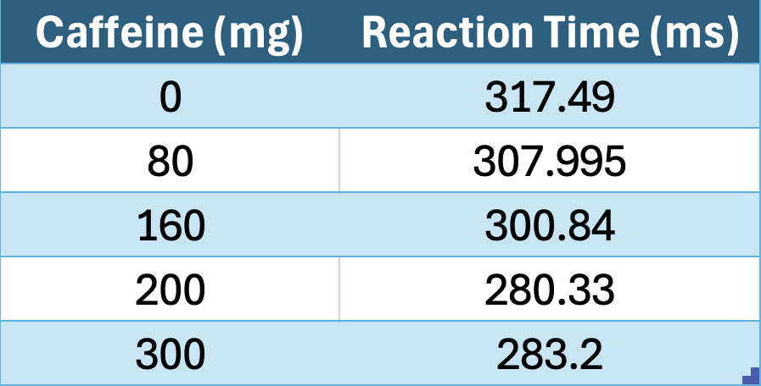
Data: Reaction Time Mean Values
Decrease of ~34 ms

Slide 10
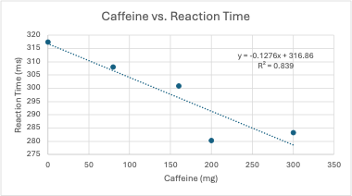
Data: RT Graph
Notes:
4:45
R^2 value is close to 1, indicating strong linear relationship when evaluating the mean values

Slide 11
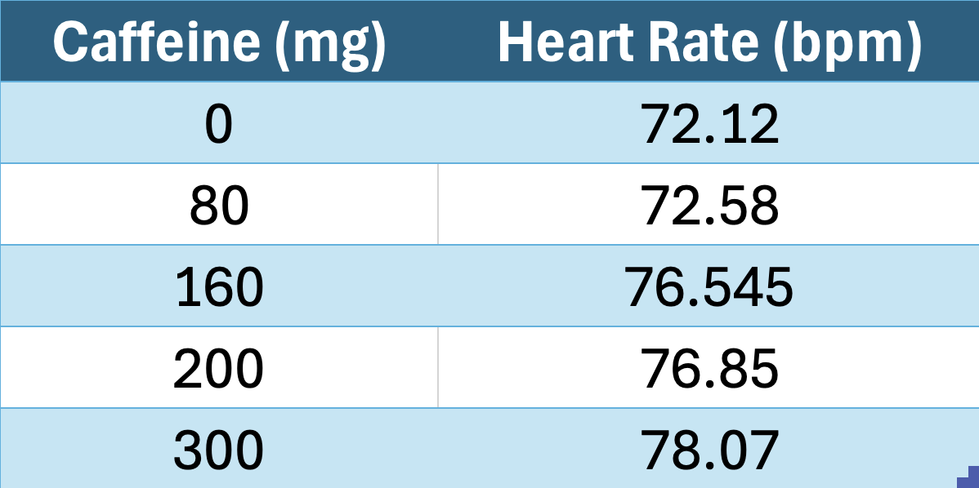
Data: Heart Rate Mean Values
Increase of ~6 bpm
Notes:
5

Slide 12
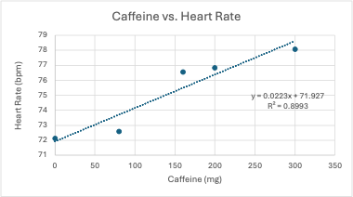
Data: HR Graph
Notes:
5:20
R^2 value is close to 1, indicating strong linear relationship when evaluating the mean values

Slide 13
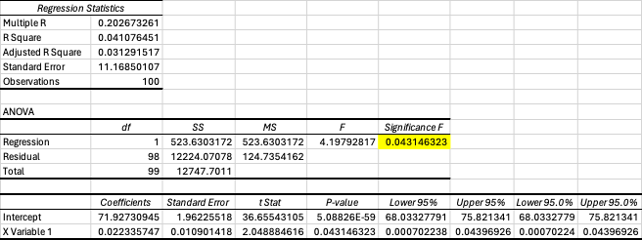
Statistical Significance Analysis: HR
𝐻₀: 𝜇_{𝑤} = 𝜇_{𝑐𝑎𝑓𝑓}
𝐻₁: 𝜇_{𝑤} < 𝜇_{𝑐𝑎𝑓𝑓}
p value: 0.043
⍺ = 0.05
0.043 < 0.05
Reject null hypothesis
Notes:
6

Slide 14
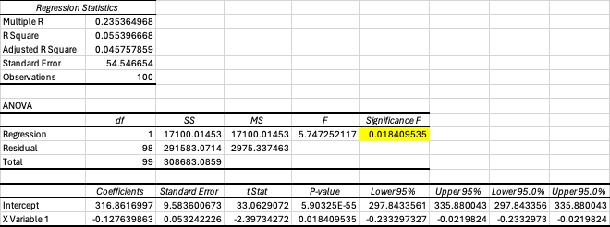
Statistical Significance Analysis: RT
𝐻₀: 𝜇_{𝑤} = 𝜇_{𝑐𝑎𝑓𝑓}
𝐻₁: 𝜇_{𝑤} > 𝜇_{𝑐𝑎𝑓𝑓}
p value: 0.0184
⍺ = 0.05
0.0184 < 0.05
Reject null hypothesis
Notes:
6:10

Slide 15
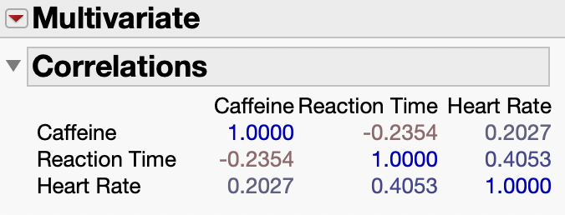
JMP Correlation Analysis
Caffeine and Reaction Time : weak negative correlation (as caffeine increases, RT decreases)
Caffeine and Heart Rate : weak positive correlation (as caffeine increases, HR increases)
Notes:
6:40

Slide 16
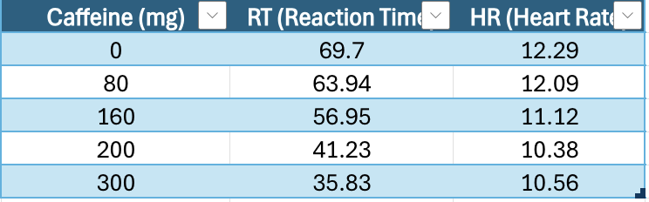
Data: Standard Deviations
Notes:
As caffeine increased, the variation in reaction times decreased. High doses led to more consistent reaction times—participants responded more similarly to one another. Heart rate variability slightly decreased with higher caffeine doses. The responses became a bit more uniform across participants.

Slide 17
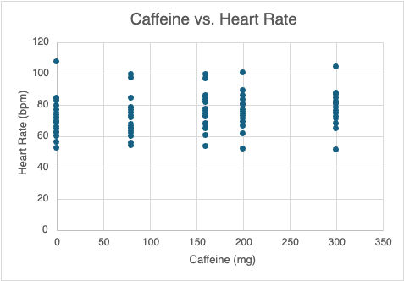
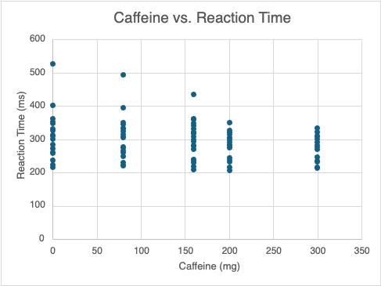
Data: SD Graphs
Notes:
Overall, higher caffeine doses reduced variability in both reaction time and heart rate, meaning people responded more consistently as the caffeine amount increased. Not only did caffeine affect average reaction time and heart rate, but the decreasing standard deviations show that higher caffeine made participants’ responses more predictable and consistent.

Slide 18
Conclusion
Caffeine consumption impacts performance
  Relationship exists, although weak
  Further investigation needed
Notes:
So overall, our results show that caffeine does impact performance, both in reaction time and in heart rate. We saw that as caffeine increased, reaction times tended to get faster and also more consistent, which suggests caffeine can sharpen performance to a point. Heart rate also increased and became slightly more predictable. But even though these trends exist, the relationship isn’t extremely strong. The body’s response to caffeine varies from person to person, and our sample size was small, so we can’t say caffeine definitely causes these changes for everyone. It’s more like we’re seeing a general pattern rather than a perfect correlation.

Slide 19
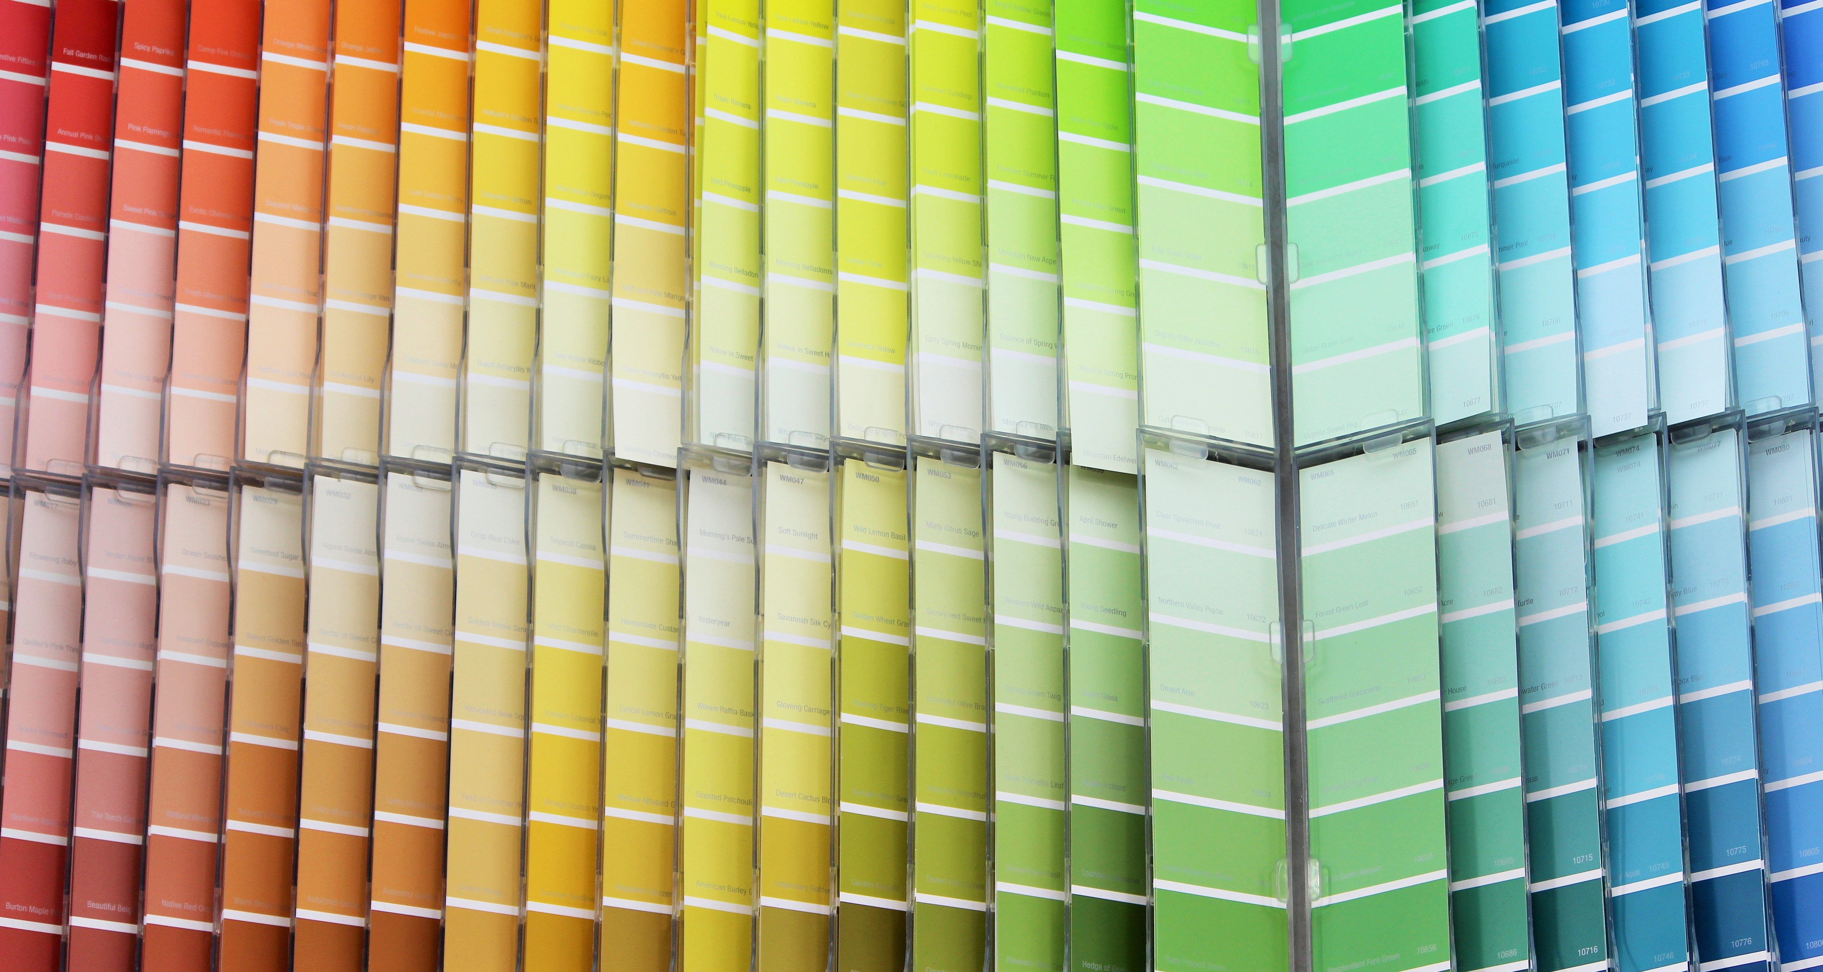

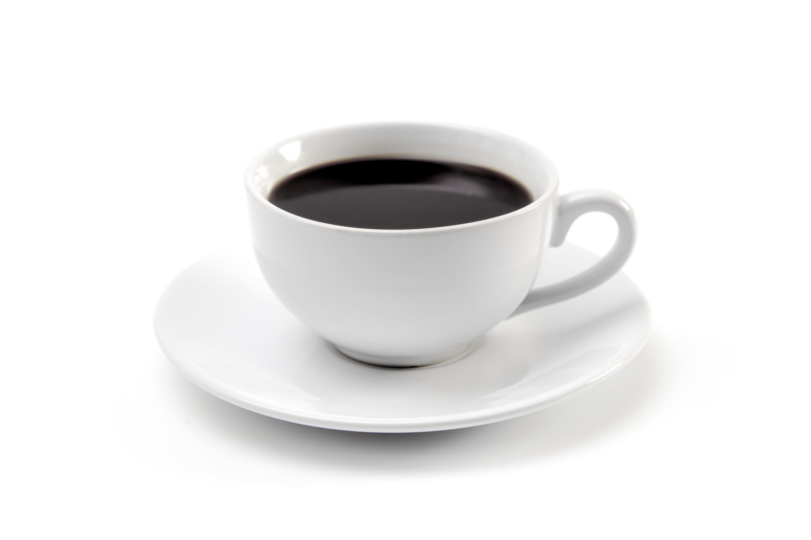
Limitations
ADHD
Sample Size
Anxiety
Caffeine tolerance and time of consumption
Learning curve of reaction time test
Notes:
Finish to 8 minutes
Our small sample size of only 20 participants limited our experiment; testing 50 or even 100 undergraduates would significantly help our study. Additionally, prior underlying conditions such as ADHD and anxiety could have influenced our experiment. ADHD can give people different base reaction times while anxiety can give differing heart rates. Caffeine tolerance is also a variable, as someone who drinks caffeine, especially energy drinks, on a regular basis would find less variability than one who does not drink caffeine regularly. Lastly, there is a potential learning curve of the reaction time test; as people take the test more often, they get better at it (caffeine or not.)
ADHD: have different base reaction time
Anxiety: have differing heart rates

Slide 20
Questions
Notes:
Need to have 2 question?

Slide 21
Question 1
Did the background support our findings for reaction time and heart rate?
a) Yes, for both reaction time and heart rate
b) No, not for either
c) Supported for reaction time, not supported for heart rate
Notes:
A: Yes and no; while our reaction time findings were supported by other studies, heart rate was previously found to not change as a result of caffeine intake

Slide 22
Question 2
Which conclusion is most supported if the experiment found that HR increased significantly while reaction time decreased after consuming energy drinks?
a) Energy drinks improve alertness but may increase cardiovascular strain
b) Energy drinks reduce alertness and lower cardiovascular activity
c) Energy drinks have no measurable effect on performance
d) Energy drinks improve both cardiovascular health and reaction time
Notes:
A: Energy drinks improve alertness but may increase cardiovascular strain

Slide 23
References
Attwood, A. S., Higgs, S., & Terry, P. (2007). Differential responsiveness to caffeine and perceived effects of caffeine in moderate and high regular caffeine consumers. Psychopharmacology, 190(4), 469–477. https://doi-org.libezp.lib.lsu.edu/10.1007/s00213-006-0643-5
Bartrim, K., McCarthy, B., McCartney, D., Grant, G., Desbrow, B., & Irwin, C. (2020). Three consecutive nights of sleep loss: Effects of morning caffeine consumption on subjective sleepiness/alertness, reaction time and simulated driving performance. Transportation Research: Part F, 70, 124–134. https://doi-org.libezp.lib.lsu.edu/10.1016/j.trf.2020.02.017
Hachenberger, J., Li, Y.-M., Realo, A., & Lemola, S. (2025). The association of caffeine consumption with positive affect but not with negative affect changes across the day. Scientific Reports, 15(1), 1–12. https://doi-org.libezp.lib.lsu.edu/10.1038/s41598-025-14317-0
Herz, R. S. (1999). Caffeine effects on mood and memory. Science Direct. https://doi.org/10.1016/S0005-7967(98)00190-9
Leimroth, S., Villarey, F., Pawlenko, N., DeBlasio, F., & Barry, R. (2023). Heart rate and heart rate variability: Unaffected by caffeine consumption. International Journal of Psychophysiology, 188, N.PAG. https://doi-org.libezp.lib.lsu.edu/10.1016/j.ijpsycho.2023.05.212
Liu, C., Wang, L., Zhang, C., Hu, Z., Tang, J., Xue, J., & Lu, W. (2024). Caffeine intake and anxiety: a meta-analysis. Frontiers in psychology, 15, 1270246. https://doi.org/10.3389/fpsyg.2024.1270246
Mayo Foundation for Medical Education and Research. (2025, February 21). Caffeine: How much is too much?. Mayo Clinic. https://www.mayoclinic.org/healthy-lifestyle/nutrition-and-healthy-eating/in-depth/caffeine/art-20045678#:~:text=Up%20to%20400%20milligrams%20(mg,two%20%22energy%20shot%22%20drinks
Michael, N., Johns, M., Owen, C., & Patterson, J. (2008). Effects of caffeine on alertness as measured by infrared reflectance oculography. Psychopharmacology, 200(2), 255–260. https://doi-org.libezp.lib.lsu.edu/10.1007/s00213-008-1202-z
Prabhavathi, K., Selvi, K. T., Poornima, K. N., & Sarvanan, A. (2014). Role of biological sex in normal cardiac function and in its disease outcome - a review. Journal of clinical and diagnostic research : JCDR, 8(8), BE01–BE4. https://doi.org/10.7860/JCDR/2014/9635.4771
Ragsdale, F. R., Gronli, T. D., Batool, N., Haight, N., Mehaffey, A., McMahon, E. C., Nalli, T. W., Mannello, C. M., Sell, C. J., McCann, P. J., Kastello, G. M., Hooks, T., & Wilson, T. (2010). Effect of Red Bull energy drink on cardiovascular and renal function. Amino Acids, 38(4), 1193–1200. https://doi-org.libezp.lib.lsu.edu/10.1007/s00726-009-0330-z
Vázquez, J. C., Martin de la Torre, O., López Palomé, J., & Redolar-Ripoll, D. (2022). Effects of Caffeine Consumption on Attention Deficit Hyperactivity Disorder (ADHD) Treatment: A Systematic Review of Animal Studies. Nutrients, 14(4), 739. https://doi.org/10.3390/nu14040739
Watson, J., Deary, I., & Kerr, D. (2002). Central and peripheral effects of sustained caffeine use: tolerance is incomplete. British journal of clinical pharmacology, 54(4), 400–406. https://doi.org/10.1046/j.1365-2125.2002.01681.x
Zhang, Y., Yang, W., Xue, Y., Hou, D., Chen, S., Xu, Z., Peng, S., Zhao, H., Wang, C., & Liu, C. (2024). Timing Matters: Time of Day Impacts the Ergogenic Effects of Caffeine-A Narrative Review. Nutrients, 16(10), 1421. https://doi.org/10.3390/nu16101421

