Slide 1

Routing Optimization for deliveries
26-S98-3
SELENA DANG
MICHAEL PICKNEY
AVERI STEVEN
RACHEL STONE
Corporate Sponsor: Monty Doggett
Faculty Advisor: Dr. Bhaba Sarker

Slide 2
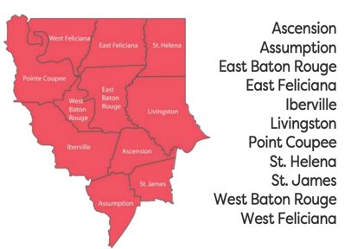
Introduction
Problem
  Agency-based routing → optimization strategy
  Coordinating deliveries to >116 agencies
Management Objectives
  Decrease non-value-added time
  Suggest agency reroutes for 2027
Introduction
Data Collection
Data Analysis
Recommendations
Implementation
Assessment
Continuation
Conclusion
RS
Notes:
Hi everyone, excited to share our final recommendations for delivery transportation optimization. The GBRFB is a 501c3 non-profit, who has served the greater baton rouge region for the past 40 years. The food bank distributes about 16 million pounds of food to over 116 agencies across 11 parishes.
The current issue faced by the food bank is agency-based routing, where routes are created solely based on agency requests. This leads to excess miles and spend.
We have developed a route optimization strategy that will assist the food bank in grouping agencies by location to minimize these costs, and our strategy also focuses on increasing efficiency and data clarity in the delivery logistics process

Slide 3
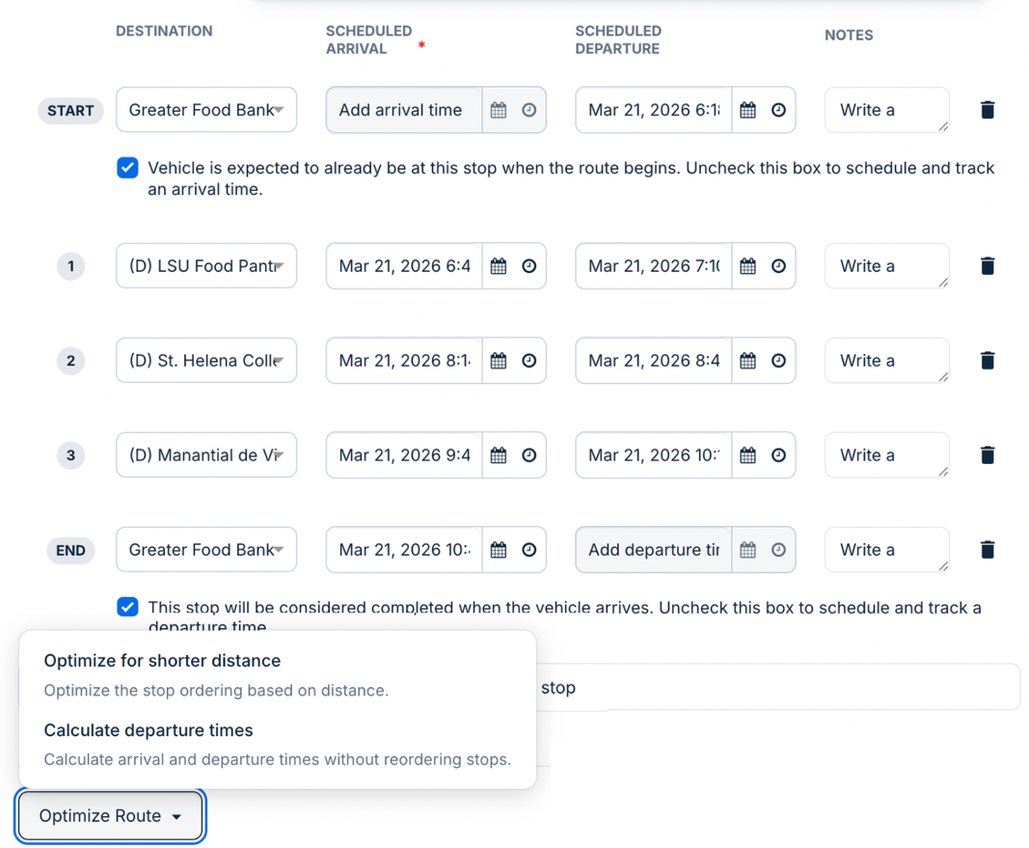
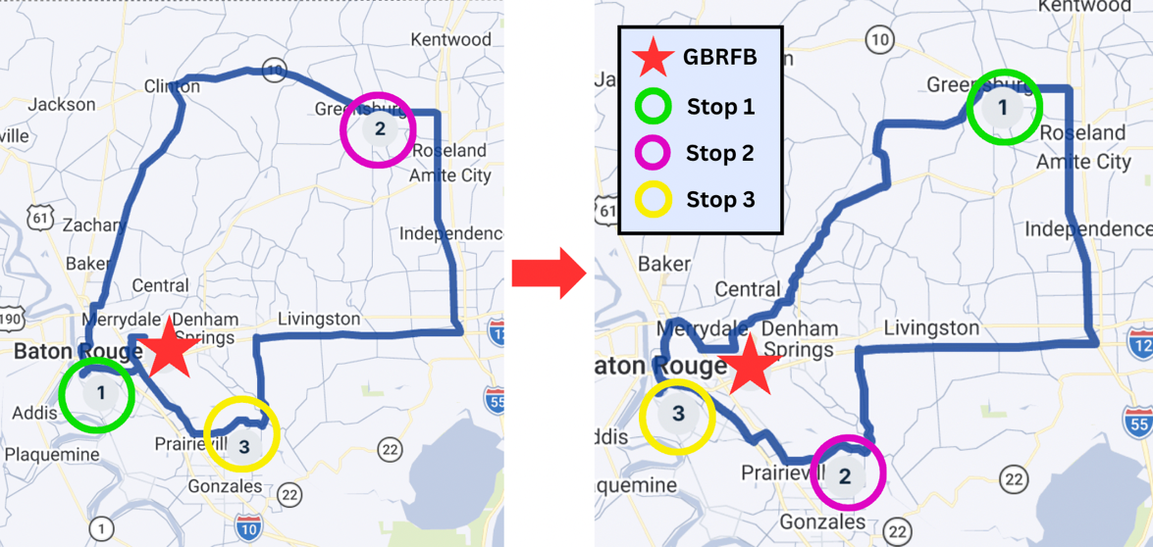
Introduction
Samsara Fleet Management
  AI Route Optimization
Data Analysis
Recommendations
Implementation
Assessment
Continuation
Conclusion
Introduction
Data Collection
MP
Notes:
For some more information, we wanted to discuss Samsara,

Slide 4
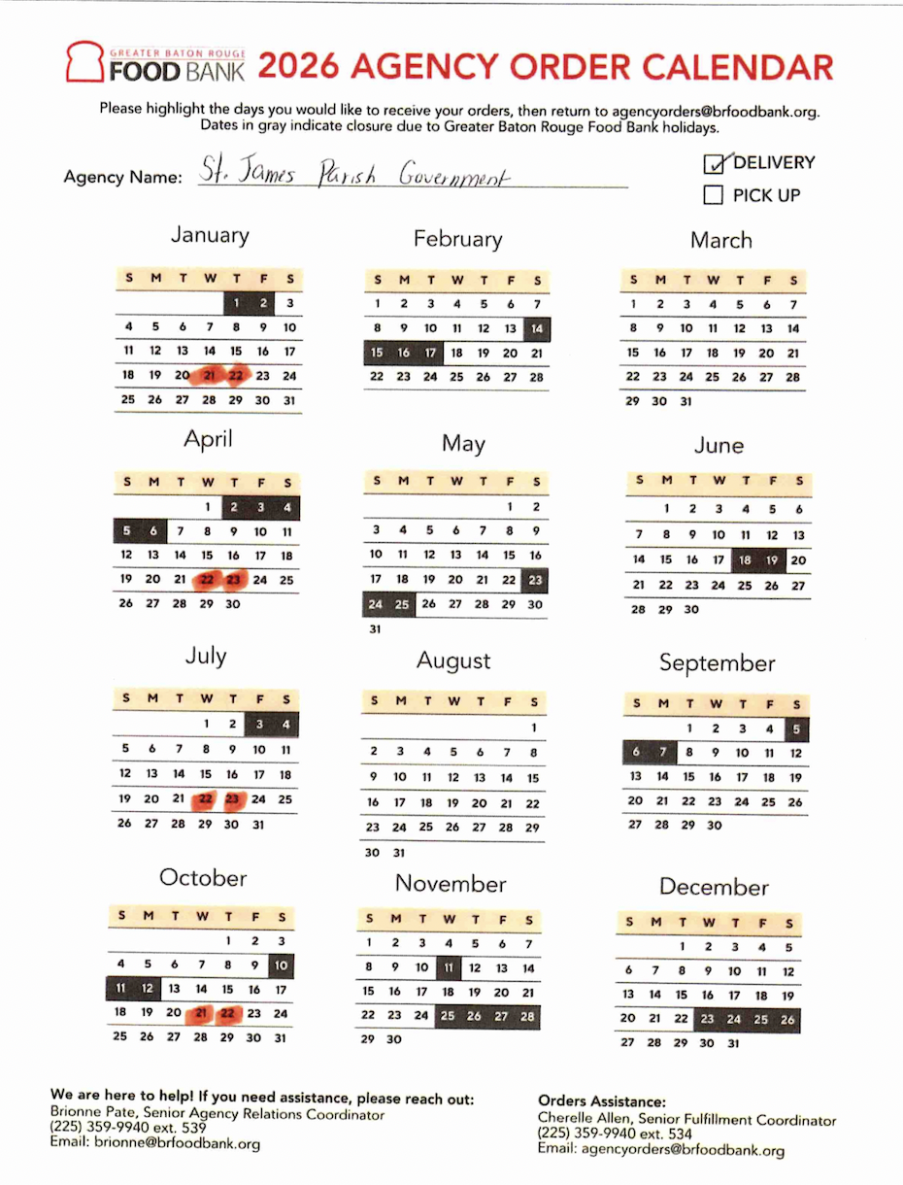
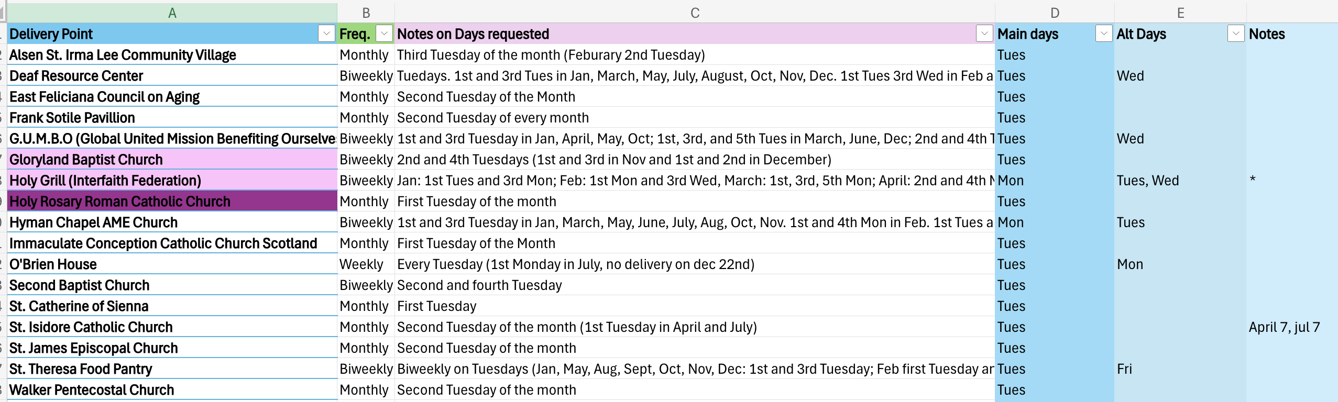
Data Collection
Agency Digital Data Collection
  Sorting through the requests
Introduction
Data Collection
Data Analysis
Recommendations
Implementation
Assessment
Continuation
Conclusion
RS
Notes:
A majority of our data collection involved sifting through agency request files, as shown on the right
Using scanned PDF’s, the team took detailed notes on frequency and delivery trends, to digitize previously printed information and create the basis for a data sorting tool

Slide 5
Data Collection
Truck Audits for Arrival, Departure, and Mileage
​ Route​ | ​ Date​ | ​ Departure Time (Manual)​ | ​ Departure Time (Samsara)​ | ​ Return Time​ (Manual)​ | ​ Return Time​ (Samsara)​ | ​ Mileage​ (Manual)​ | ​ Mileage​ (Samsara)​
​ 1​ | ​ 10/08/2025​ | ​ 6:49 AM​ | ​ 6:49 AM​ | ​ 1:16 PM​ | ​ 1:16 PM​ | ​ 165​ | ​ 164​
​ 2​ | ​ 10/10/2025​ | ​ 6:36 AM​ | ​ 6:36 AM​ | ​ 8:24 AM​ | ​ 8:23 AM​ | ​ 43​ | ​ 43.09​
​ 3​ | ​ 10/10/2025​ | ​ 7:11 AM​ | ​ 7:11 AM​ | ​ 9:56 AM​ | ​ 9:56 AM​ | ​ 137.6​ | ​ 132​
Introduction
Data Collection
Data Analysis
Recommendations
Implementation
Assessment
Continuation
Conclusion
MP
Notes:
Truck Audits and Samsara Metrics

Slide 6
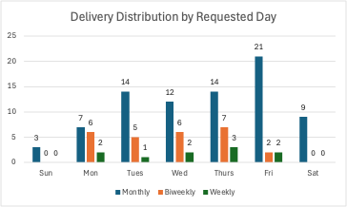
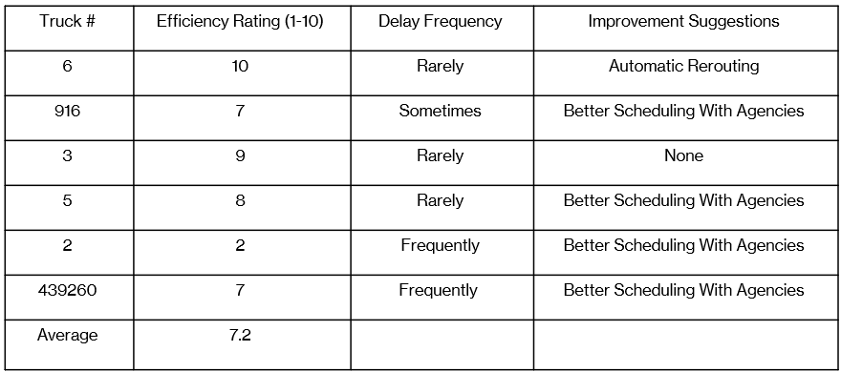
Data Analysis
Agency Data Analysis
Driver Survey Results
Introduction
Data Collection
Data Analysis
Recommendations
Implementation
Assessment
Continuation
Conclusion
MP

Slide 7
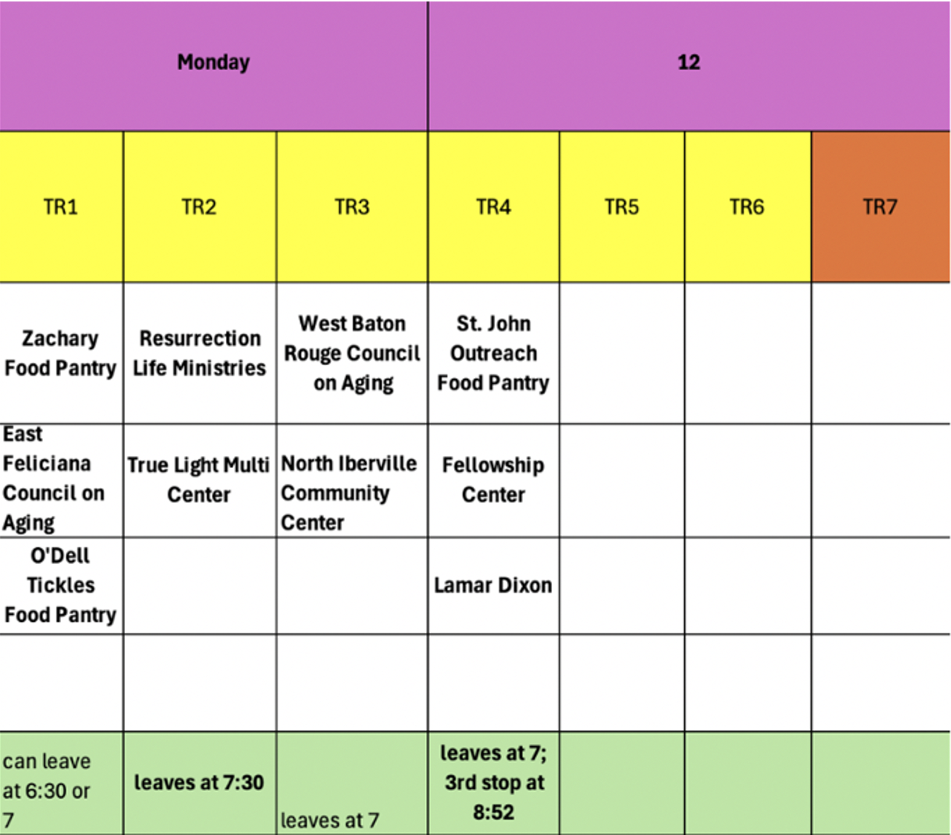
Recommendations
To optimize scheduling strategy:
    MyMaps Visual Clustering
    EDL
    Agency Pivot Tool
    Google Form for Agency Information
    Power BI Dashboard
Introduction
Data Collection
Data Analysis
Recommendations
Implementation
Assessment
Continuation
Conclusion
AS

Slide 8
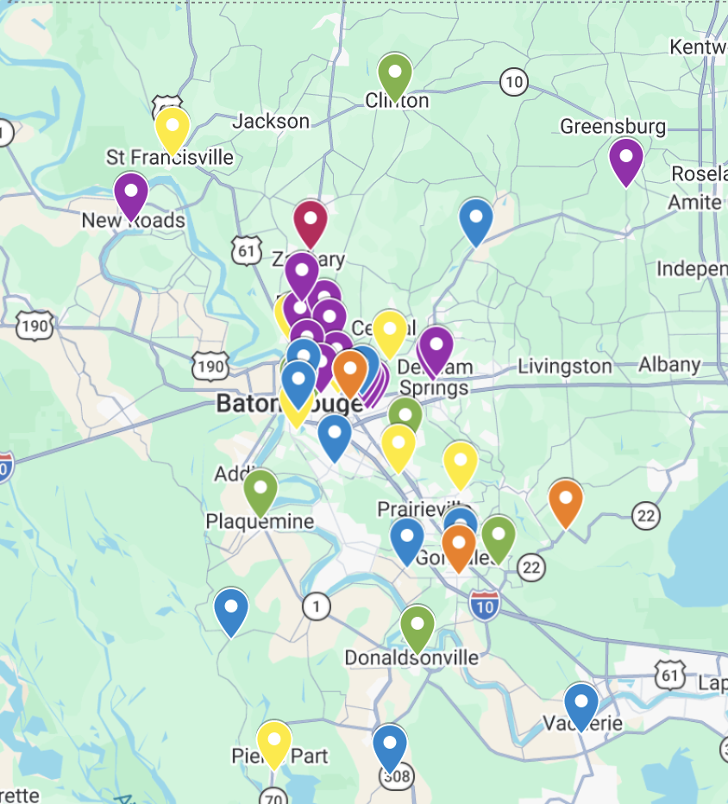
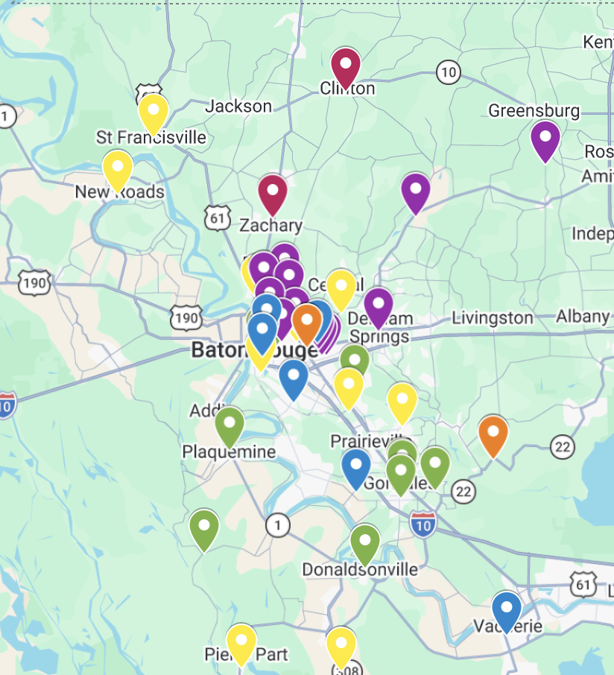
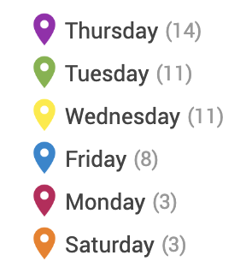
Implementation
MyMaps Original
Map of every week, each month
Introduction
Data Collection
Data Analysis
Recommendations
Implementation
Assessment
Continuation
Conclusion
SD
Notes:
For our implementation, we looked into MyMaps, which is a free geospatial data tool that allows users to create custom maps with different markers. We started with creating csv files for each week of each month in January, Feburary, and March to analyze the agency locations and their respective requests. By visually clustering and considering the frequency of the deliveries (if they were weekly, monthly etc), we were able to come up with a list of suggestions for which agencies to be delivered together for the most efficient routes and least amount of back tracking.

Slide 9
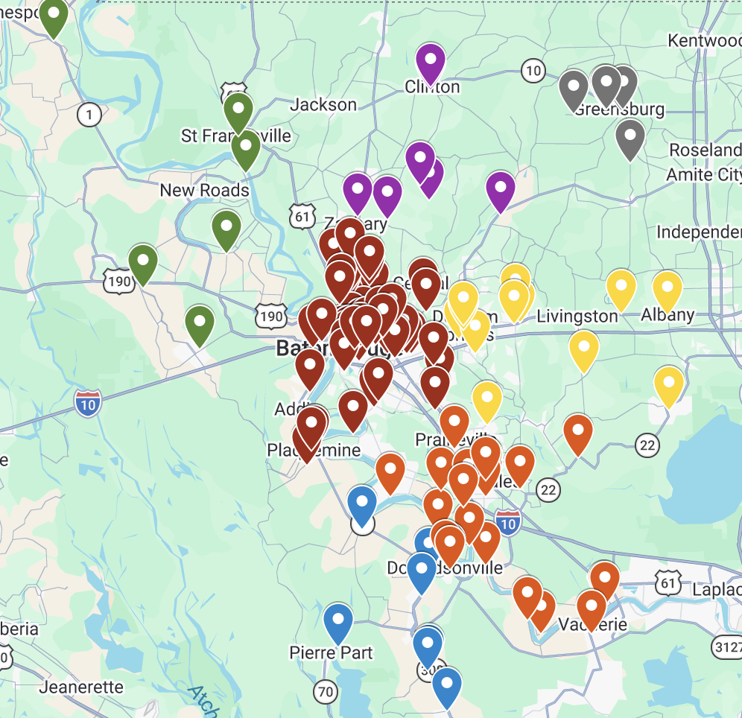
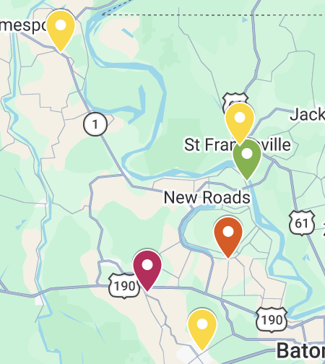
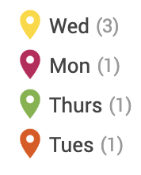
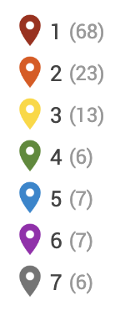
Implementation
MyMaps Zones
k-means clustering
7 zones
Individual zone sheets
Introduction
Data Collection
Data Analysis
Recommendations
Implementation
Assessment
Continuation
Conclusion
SD
Notes:
However, the process of creating a map for each week can be time consuming, and the recreation of it would be unfeasible for the food bank. We decided on this zoning strategy based off of k-means clustering, with a k value of 7 for the seven truck constraint. Using this method, we were able to populate a comprehensive map that shows all of the agencies. Zones 1 and 2 , which are EBR and Ascension, are the most populated, however agencies in farther zones contribute to the most additional mileage for routes.. This zone sheet allows the food bank to see which agencies are adding the most mileage, which will be helpful when they are proposing different delivery days and creating routes for the next operational year. We also created separate maps for each zone, showing the primary requested day, pulled from the agency requests.

Slide 10
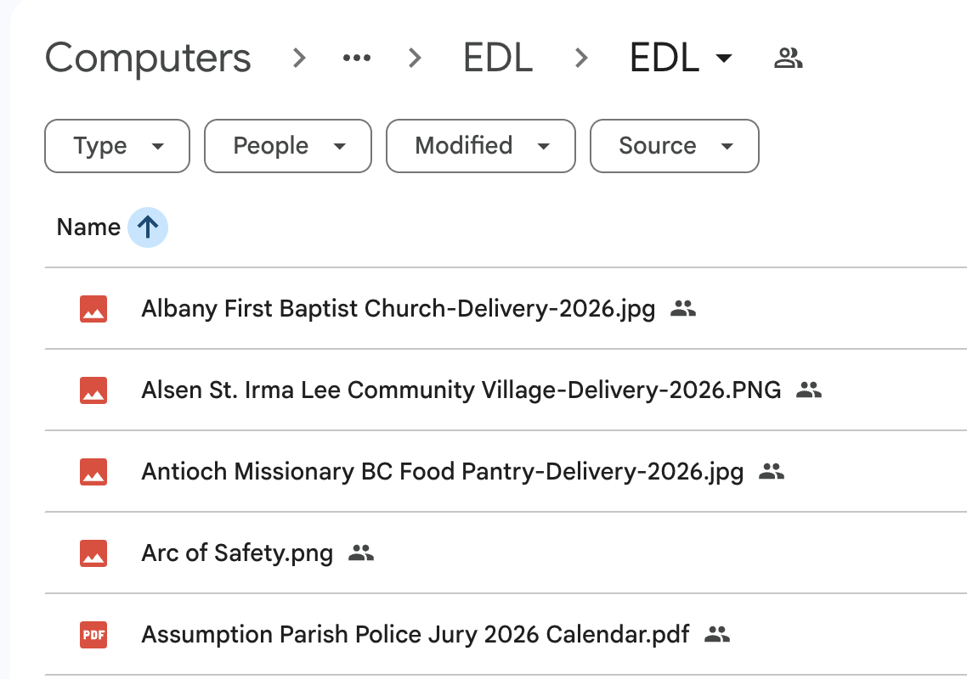
Implementation
EDL
  Scanned the paper calendars into a searchable folder
Introduction
Data Collection
Data Analysis
Recommendations
Implementation
Assessment
Continuation
Conclusion
AS
Notes:
Mention originally in large binder

Slide 11
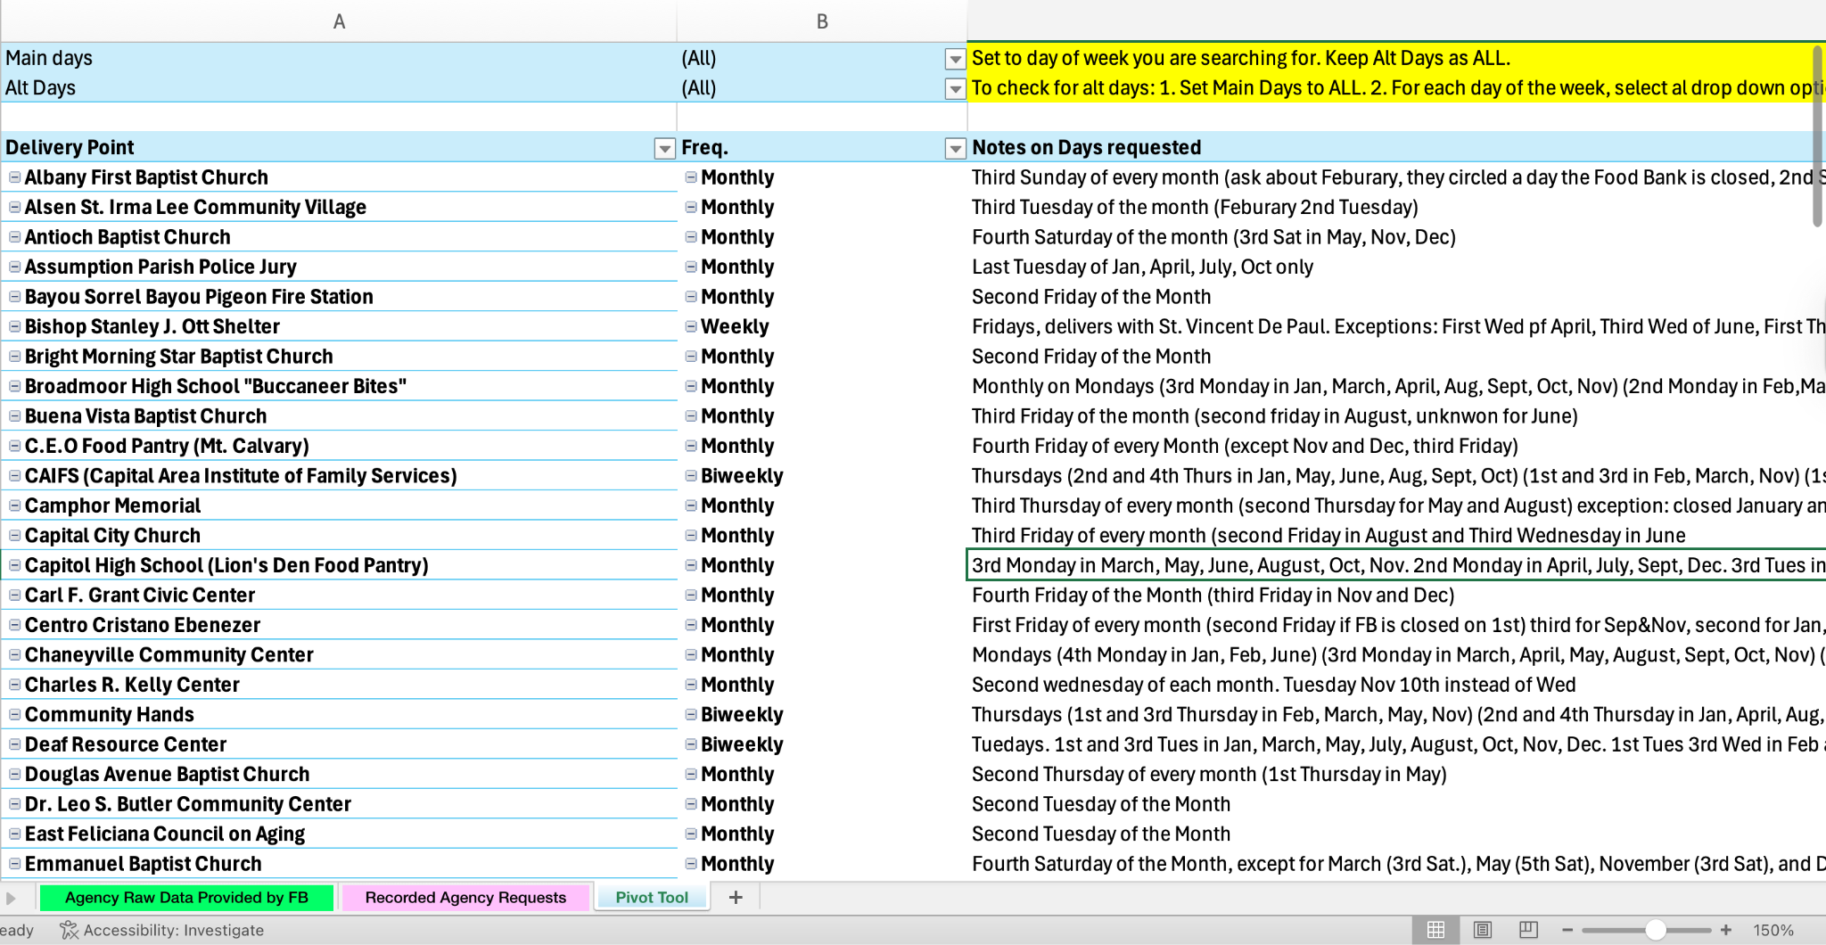
Implementation
Pivot Tool
Introduction
Data Collection
Data Analysis
Recommendations
Implementation
Assessment
Continuation
Conclusion
RS
Notes:
Using our digital agency notes, we created the Client Records Pivot Tool, to improve the delivery schedule creation process. Using the tool, employees can sort requests by day of the week so that they can efficiently place orders on each monthly calendar. This tool expediates the process for delivery scheduling, giving employees more time to focus on other transportation tasks

Slide 12
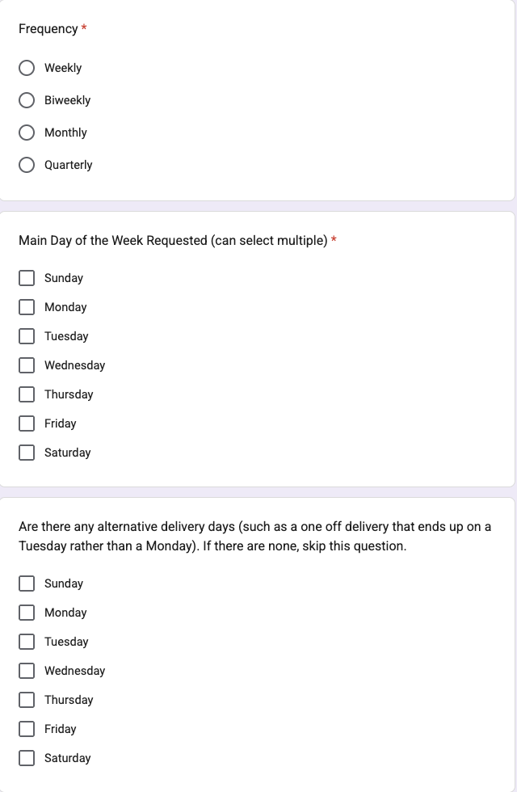
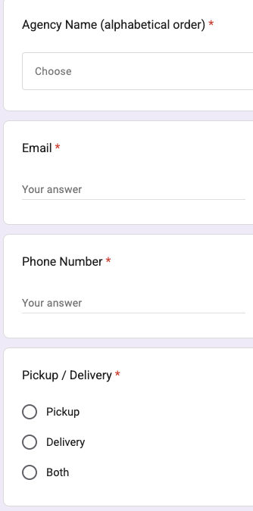
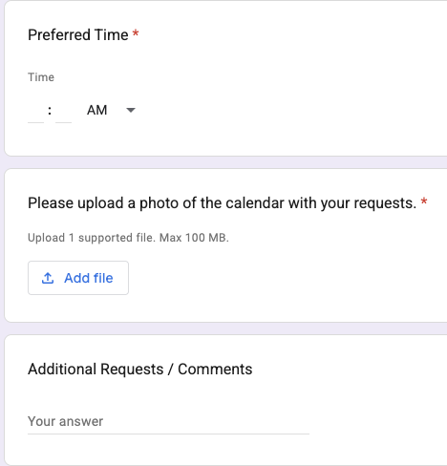
Implementation
Google Form
Introduction
Data Collection
Data Analysis
Recommendations
Implementation
Assessment
Continuation
Conclusion
SD
Notes:
As another aspect of our plan to help digitalize the current process, we created a google form that collects all of the agency information electronically. The agency name question as a dropdown allows for consistent address data to be pulled from the address book, in order to recreate the pivot tool Rachel just mentioned. The food bank can extract all of the responses in a google sheet, and also have the calendar request file to recreate the EDL.

Slide 13
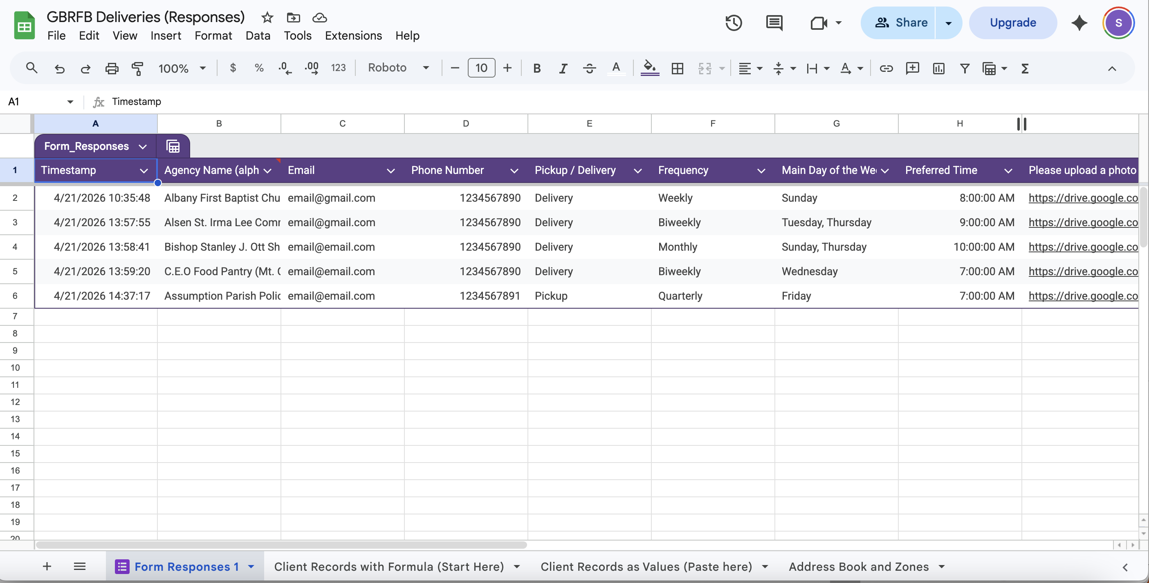
Implementation
Google Form
  Assists with future digitization
Introduction
Data Collection
Data Analysis
Recommendations
Implementation
Assessment
Continuation
Conclusion
SD
Notes:
This is a sample of the response sheet, we added a few responses to show what it would look like and to create the standard operating procedures for recreating the pivot tool. Theres multiple tabs at the bottom that are for the recreation of the pivot tool, with the last one being the comprehensive address book and zones for each agency.

Slide 14
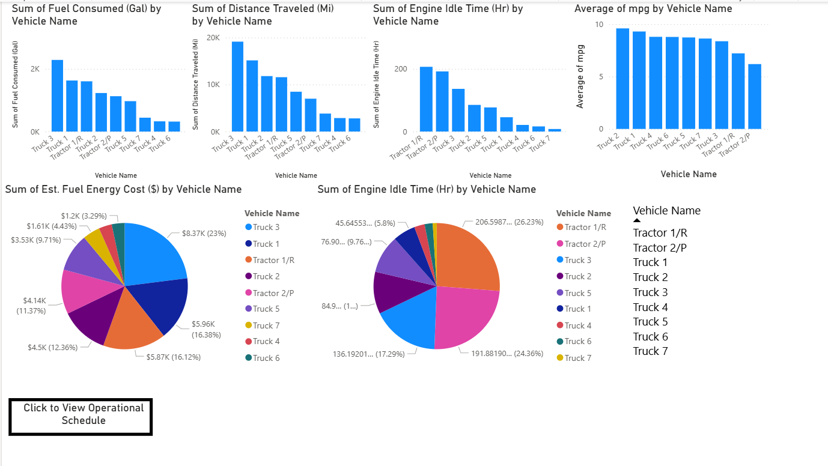
Implementation
Power BI
Driver Metrics Dashboard
Information pulled from Samsara
Introduction
Data Collection
Data Analysis
Recommendations
Implementation
Assessment
Continuation
Conclusion
AS

Slide 15
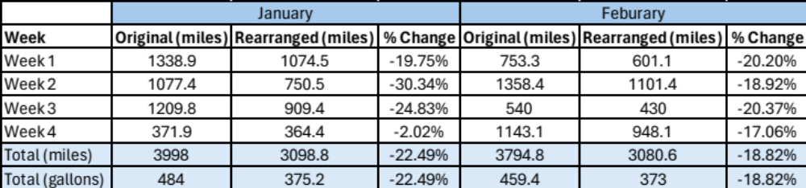
Economic Assessment
20% reduction of miles
  ~$700 saved (Jan + Feb) if *$3.50/gallon -> ~$4200/year
Introduction
Data Collection
Data Analysis
Recommendations
Implementation
Assessment
Continuation
Conclusion
SD
Notes:
We analyzed the mileage reduction if the food bank was able to make all of the changes suggested by inputting the routes into Google Maps, this came to around to _1800 miles, or 195 gallons of gas saved across the two months. Gas prices are fluctuating, but we used $3.50/gallon to produce the potential savings of around $700 for these two months, or $4,200 for the entire year.
(3998-3099)+(3975-3081)
(484-375)+(459-373)
Should say if implement all suggestions from agency zoning

Slide 16
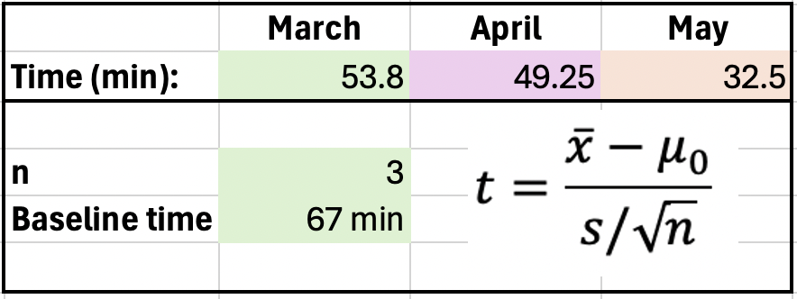
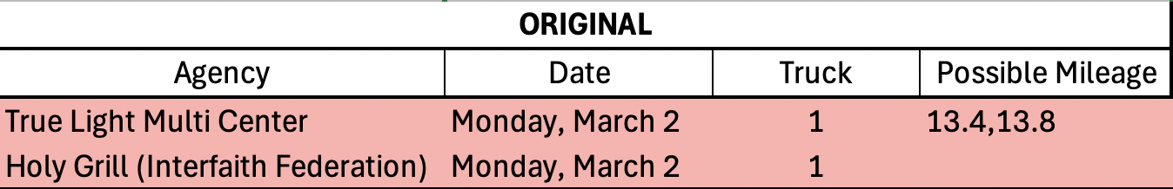
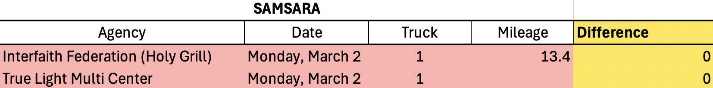
Statistical Assessment
Non-inferiority and time study
  Samsara route within 0.35 mi of optimal
  67 min -> 45 min on average for calendar creation
Introduction
Data Collection
Data Analysis
Recommendations
Implementation
Assessment
Continuation
Conclusion
RS
Notes:
We completed two rounds of statistical analysis to demonstrate the benefits of the tools and strategies we recommend. The first test was a time study on the time required to place one month of requests on the calendar. We found that over the three months tested, the average time to complete one month was 45 minutes, and after collecting feedback, cherelle said this tool was much easier to use
We then conducted a non inferiority test, which is a specific t test that compares one set of results to another to see how close they are and if one is an acceptable alternative to the original.
We wanted to ensure that Samsara is accurate in producing optimal routes, and we found that Samsara's optimized routes were 0.35 miles longer than what was determined to be the optimal route. This value was well within our 2 mile margin of acceptance, statistically proving that samsara is effective in producing optimal routes and we do encourage the FB to continue using this tool to its fullest capacity to reach their optimization goals

Slide 17
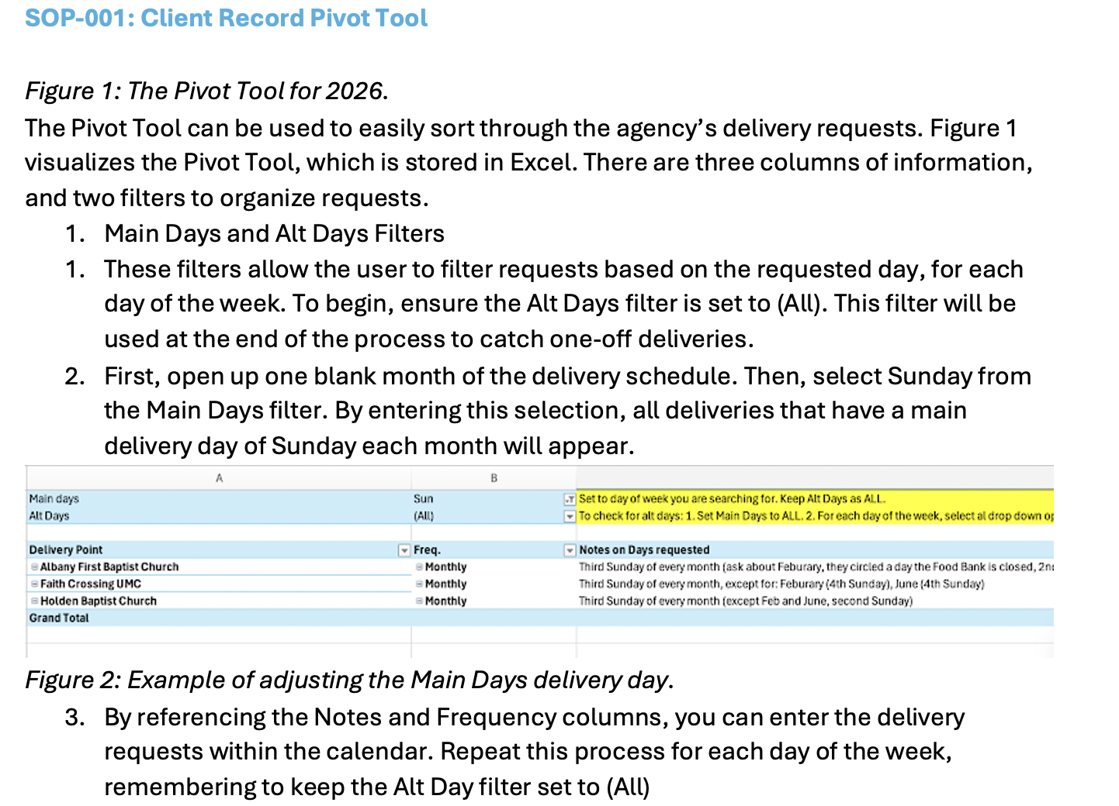
Project Continuation Plan
SOPs
  Pivot Tool
  MyMaps
  Google Form
  Power BI
  Drivers
Introduction
Data Collection
Data Analysis
Recommendations
Implementation
Assessment
Continuation
Conclusion
AS

Slide 18

Conclusion
  Questions?
Introduction
Data Collection
Data Analysis
Recommendations
Implementation
Assessment
Continuation
Conclusion
MP

Slide 19
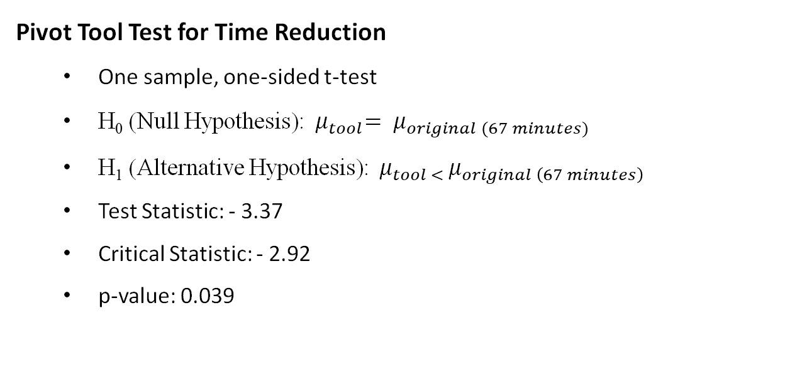
Statistical Analysis
Pivot Tool Test for Time Reduction
  One sample, one-sided t-test
  H₀ (Null Hypothesis):${ μ}_{tool}= μ_{original (67 minutes)}$
  H₁ (Alternative Hypothesis):${ μ}_{tool < }μ_{original \left(67 minutes\right)}$
  Test Statistic: - 3.37
  Critical Statistic: - 2.92
  p-value: 0.039
RS

Slide 20
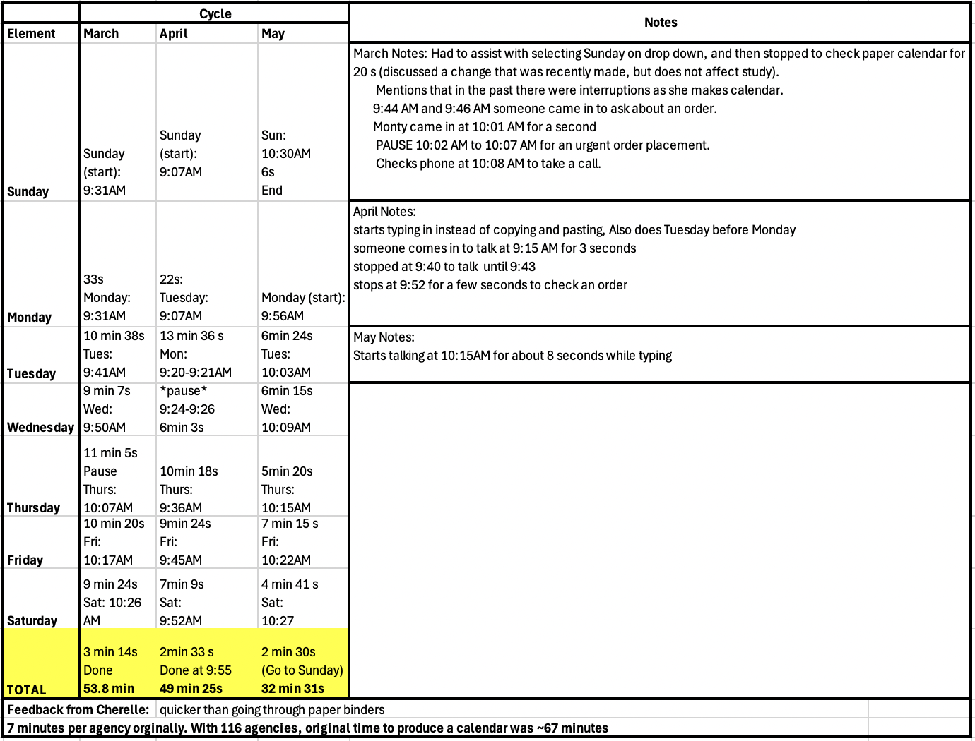
Time study
RS

Slide 21
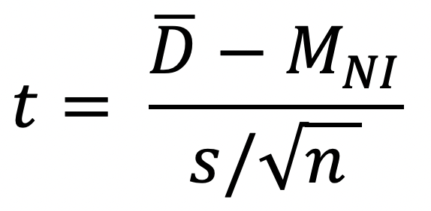
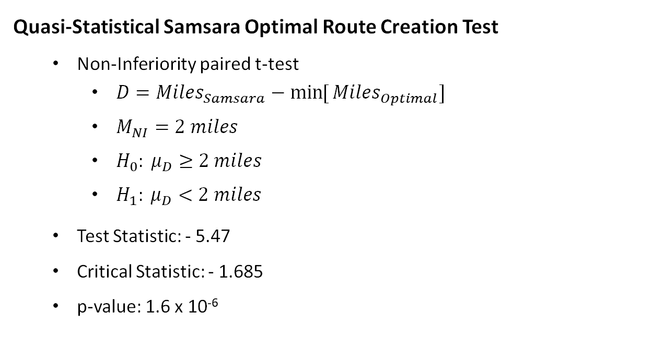
Statistical Analysis
Quasi-Statistical Samsara Optimal Route Creation Test
  Non-Inferiority paired t-test
    $D={Miles}_{Samsara}−{\min{[}Miles}_{Optimal}]$
    $M_{NI}=2 miles$
    $H_{0}: μ_{D}≥2 miles$
    $H_{1}: μ_{D}<2 miles$
  Test Statistic: - 5.47
  Critical Statistic: - 1.685
  p-value: 1.6 x 10⁻⁶
RS

Slide 22
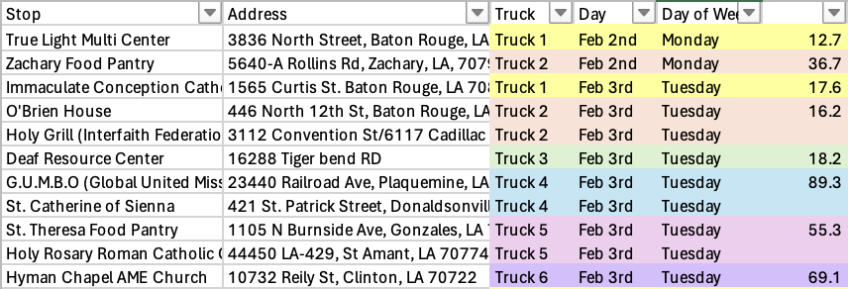
MILEAGE
RS

Slide 23
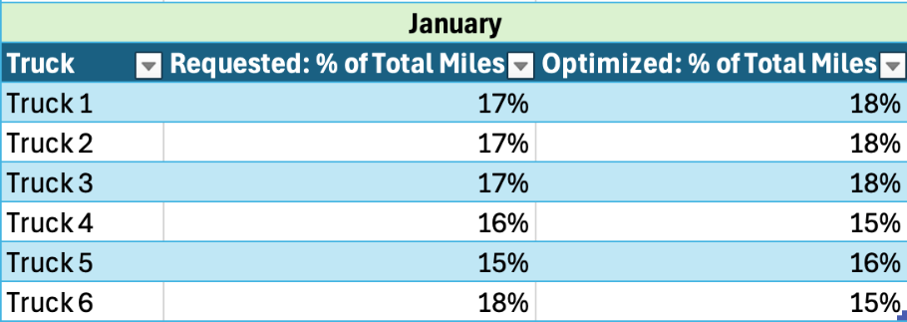
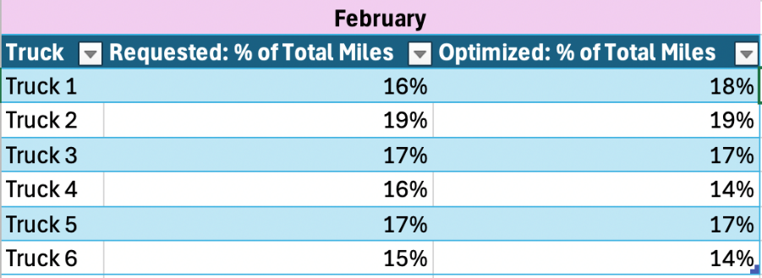
Driver utilization
RS

Slide 24
SOP-001: Client Record Pivot Tool
RS

Slide 25
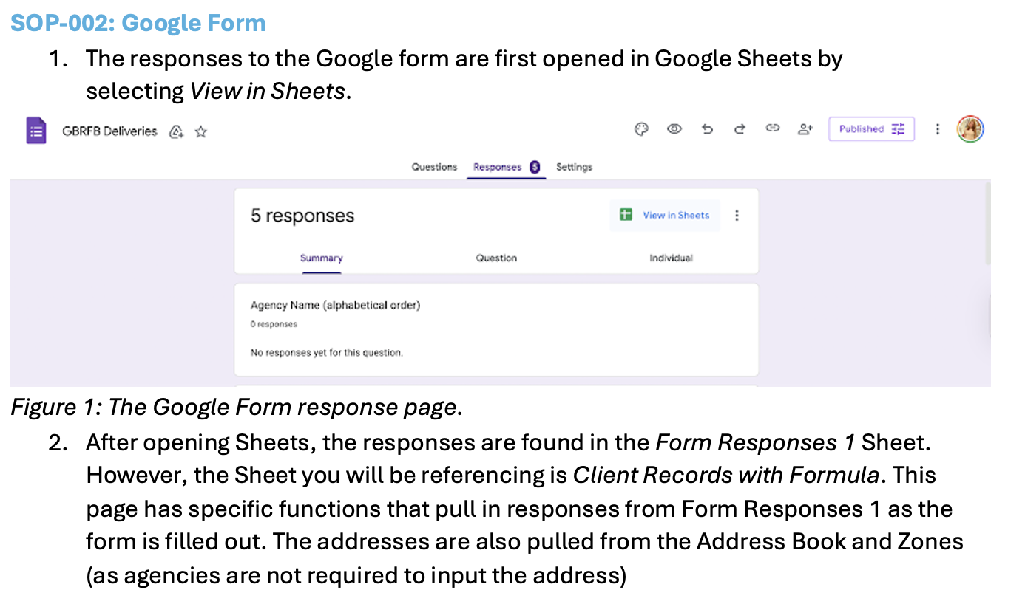
SOP-002: Google Form
RS

Slide 26
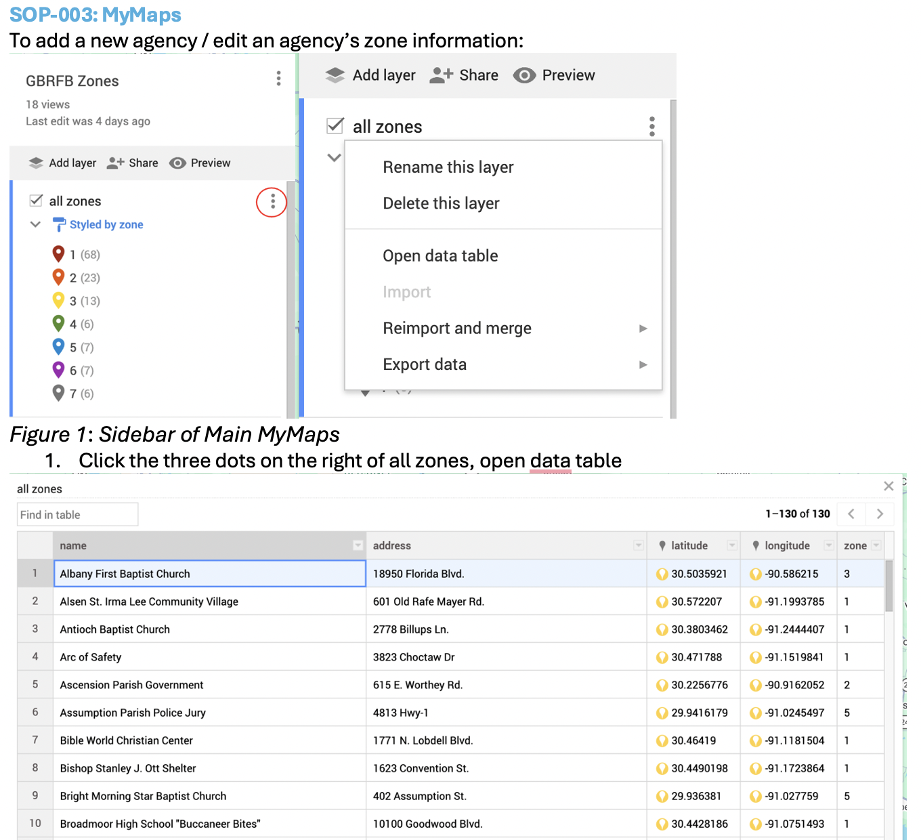
SOP-003: MyMaps
RS

Slide 27
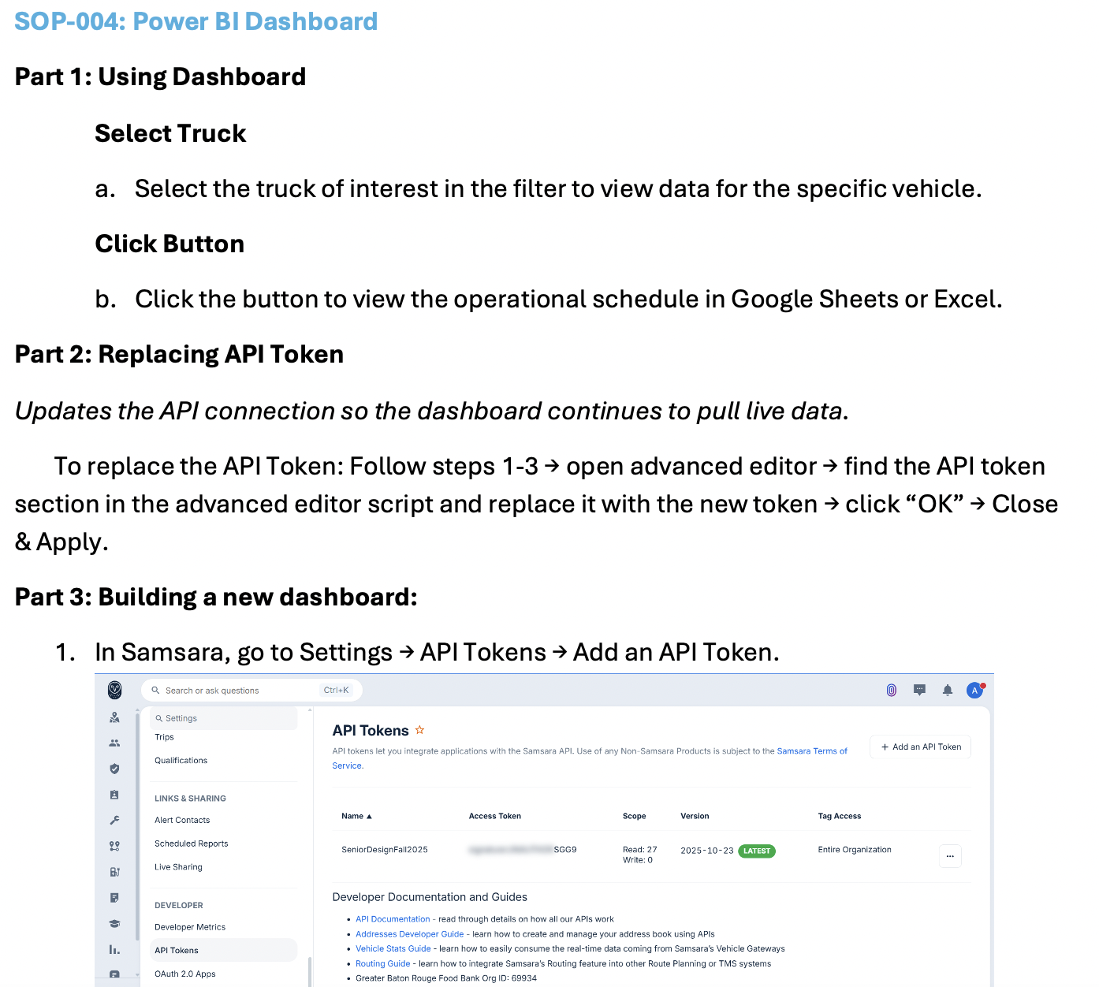
SOP-004: Power BI Dashboard
RS

Slide 28
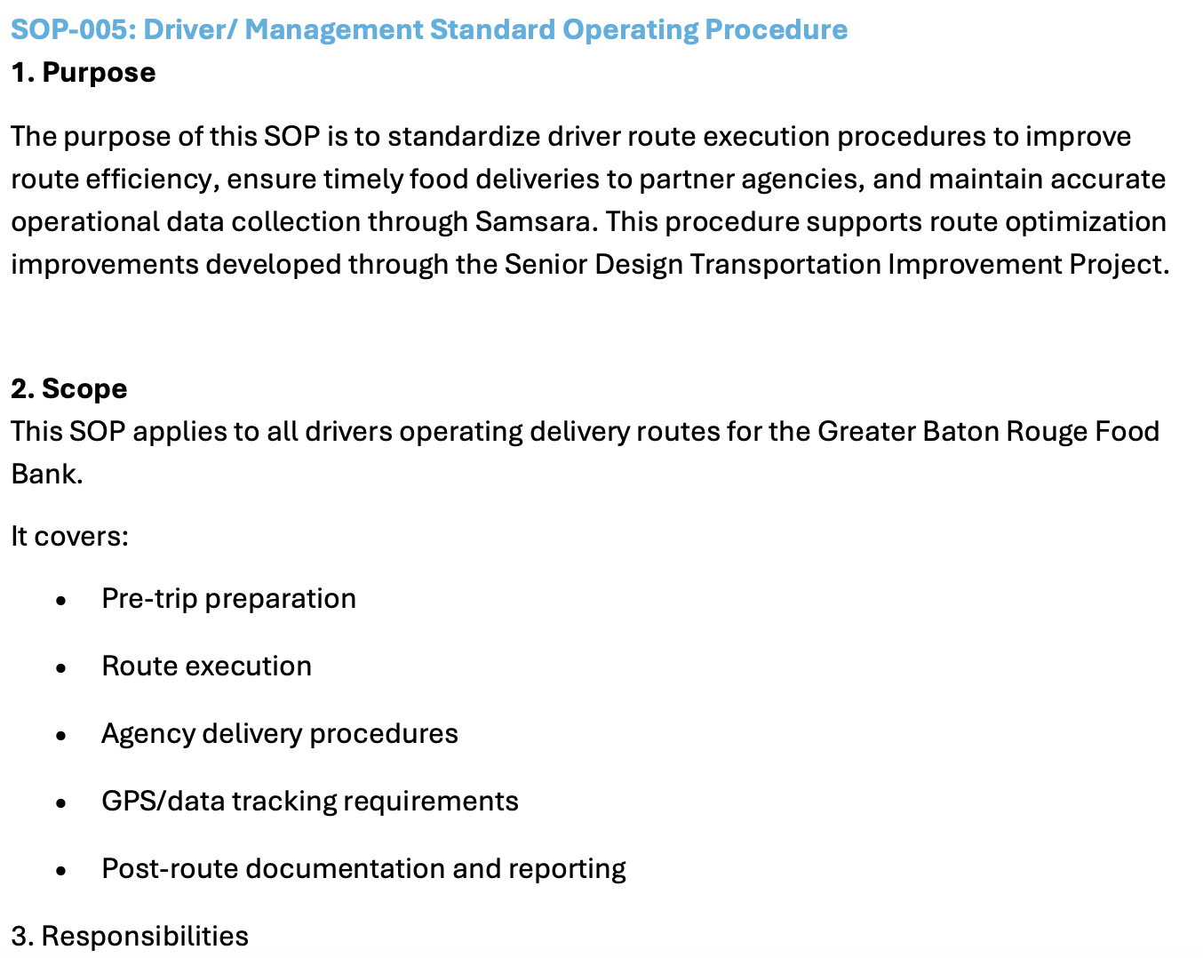
SOP-005: Driver / management SOP
RS

Slide 29
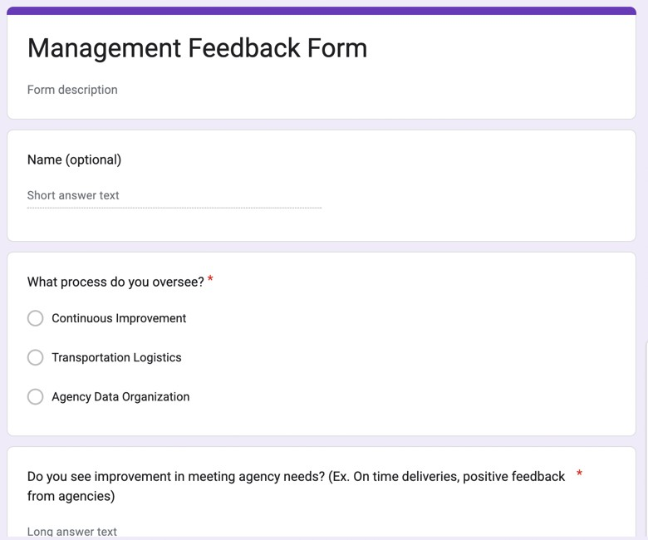
Feedback form
RS

Slide 30
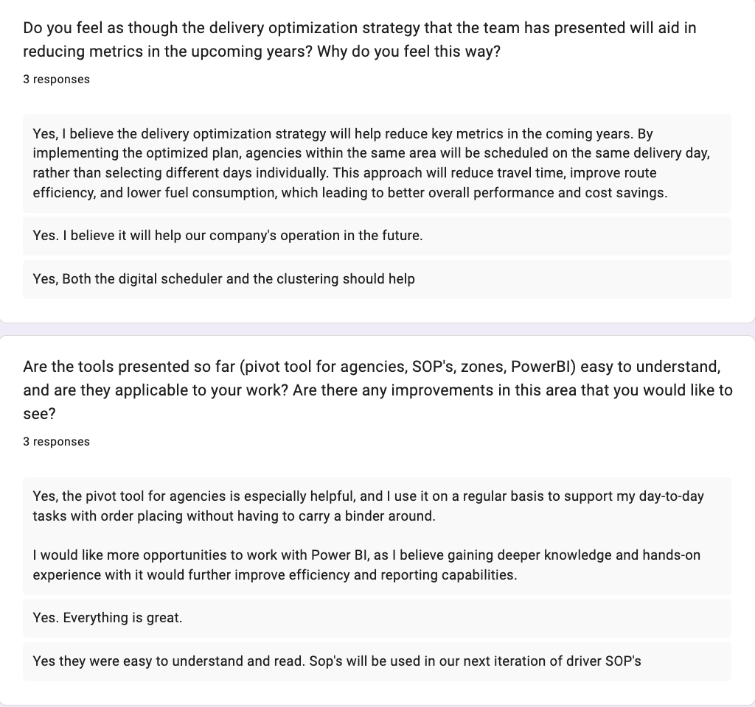
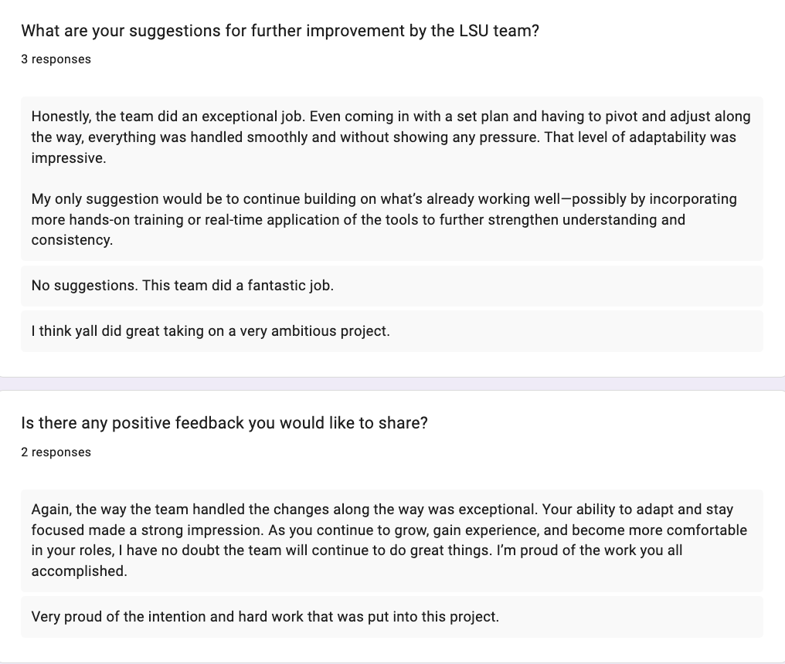
Feedback form
RS

