Slide 1
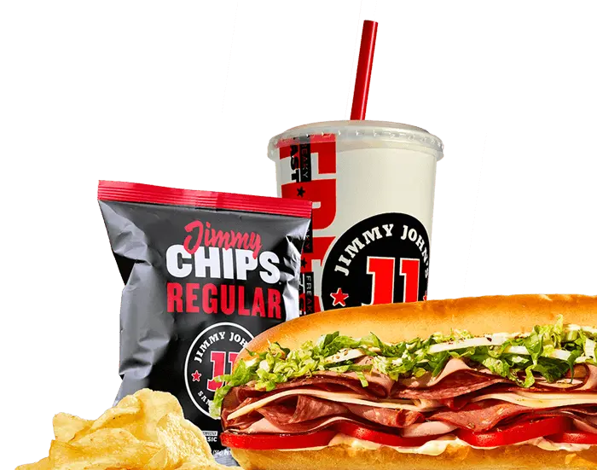
Jimmy Johns
Ordering System
Selena Dang, Gracie Roule, Jacqueline Saba, & Rachel Stone

Slide 2
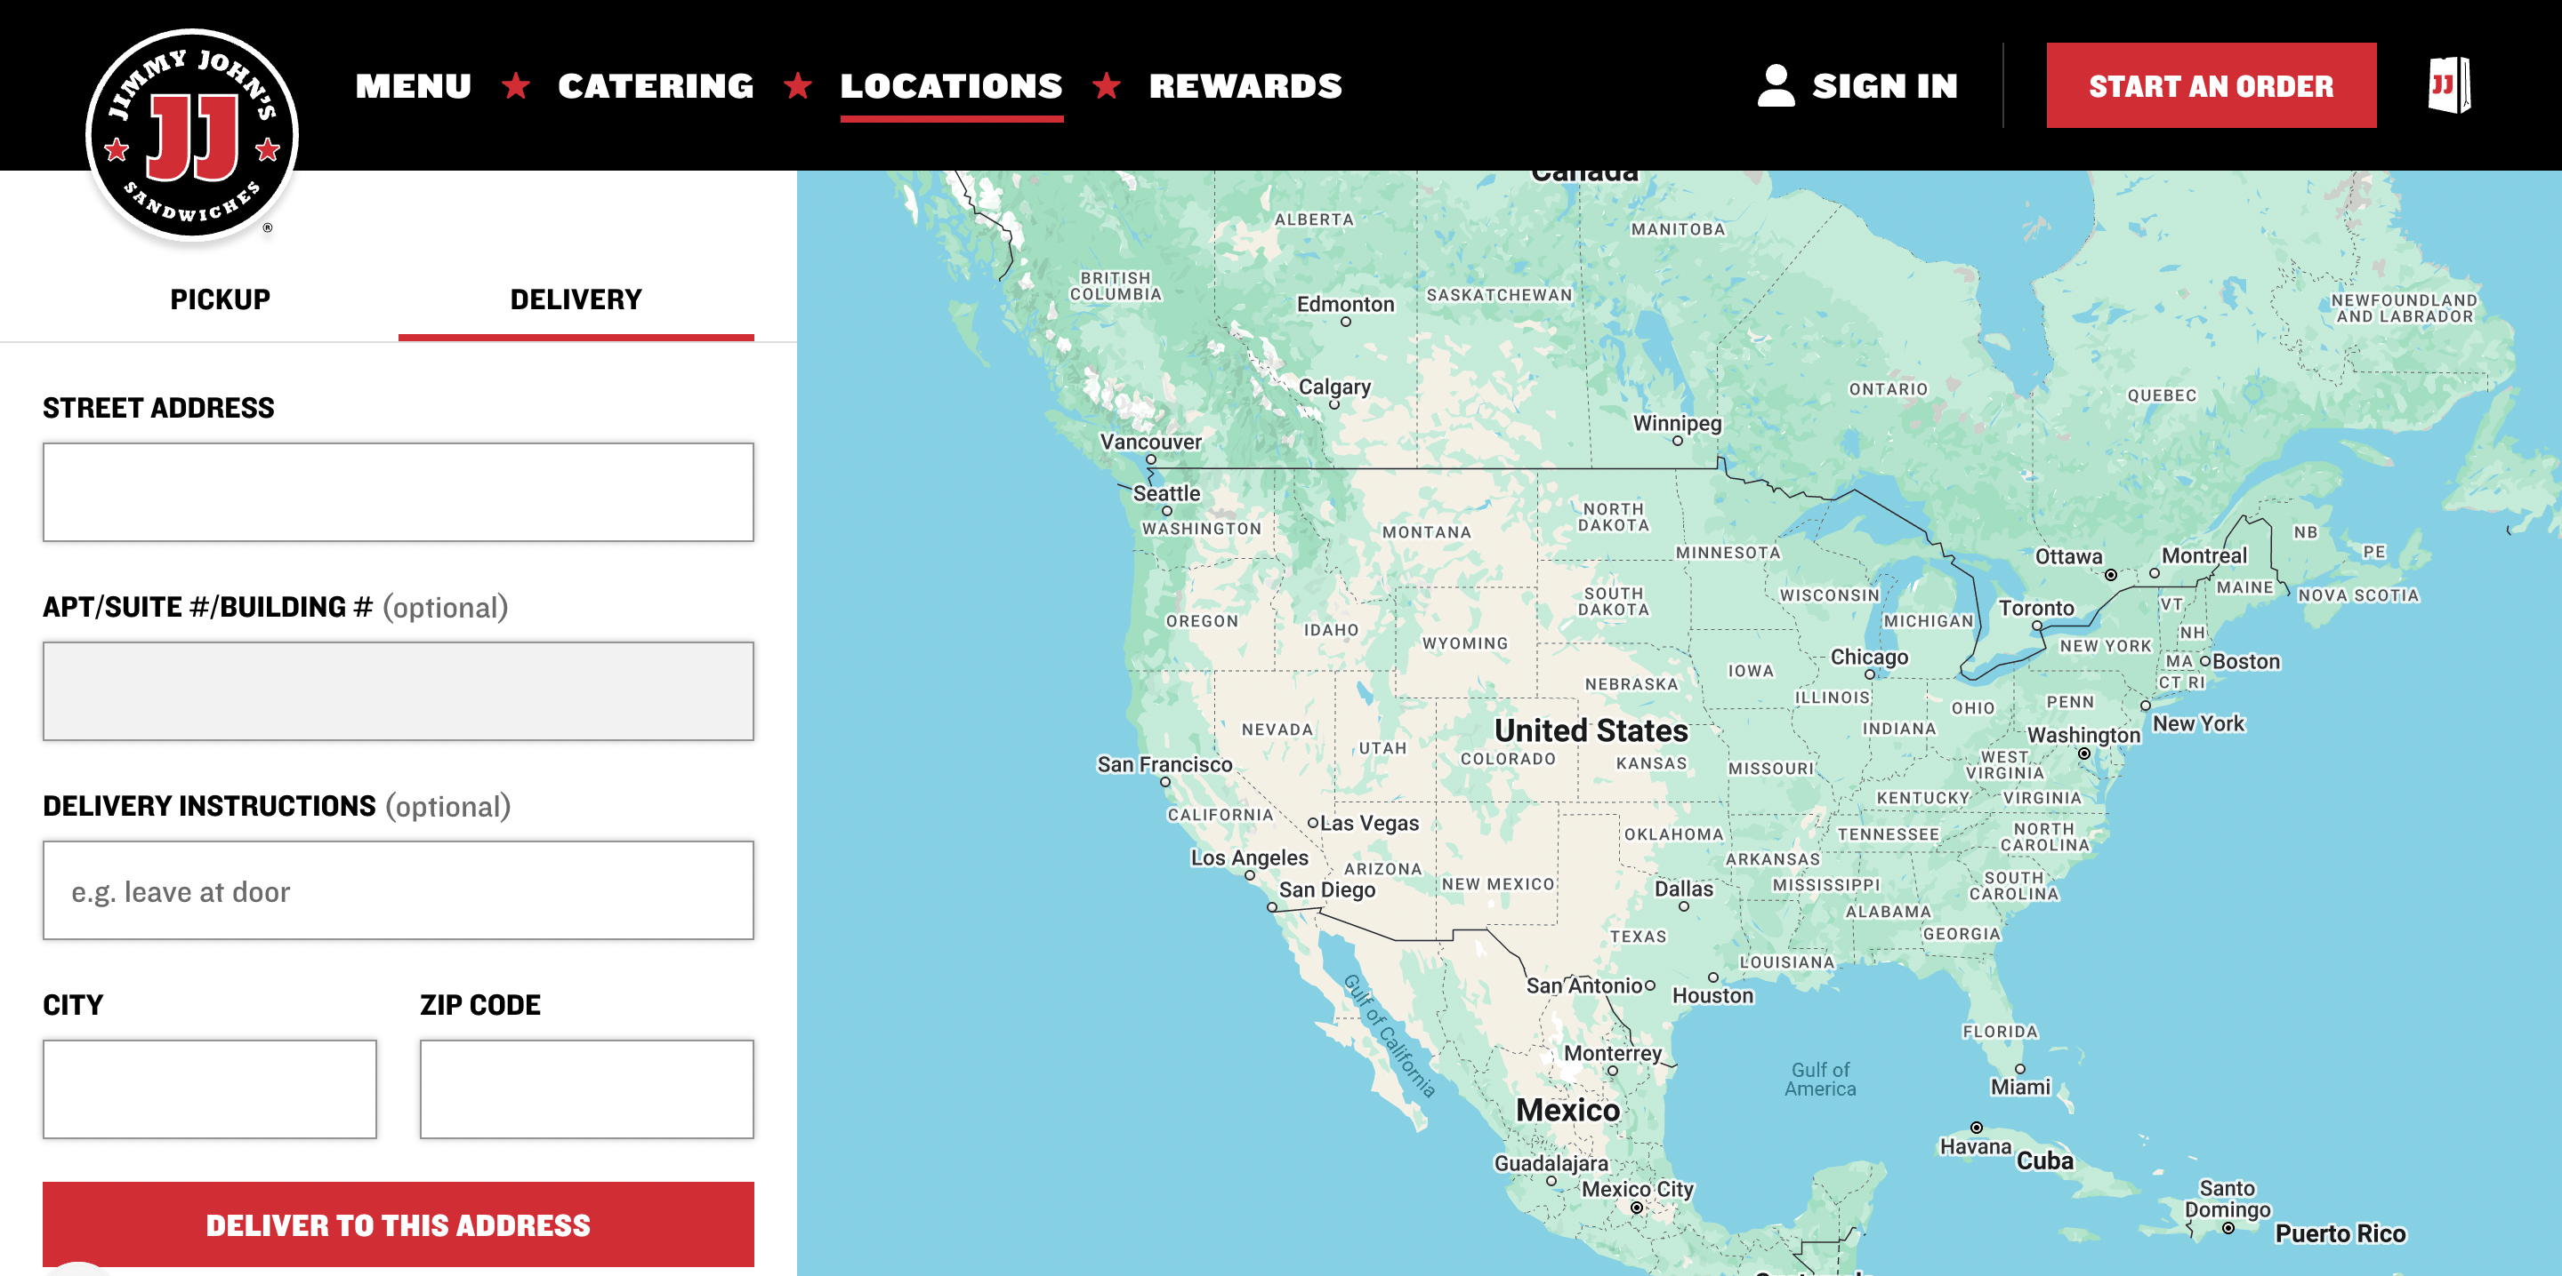
Introduction
"Freaky Fast Delivery"
Customer Satisfaction
GR
Notes:
basis of jimmy johns is fast delivery, so updates to their ordering system allows for this process to be more successful. The updated order system also increases customer satisfaction, leading to higher return rates. Also organization better for employees to be faster

Slide 3
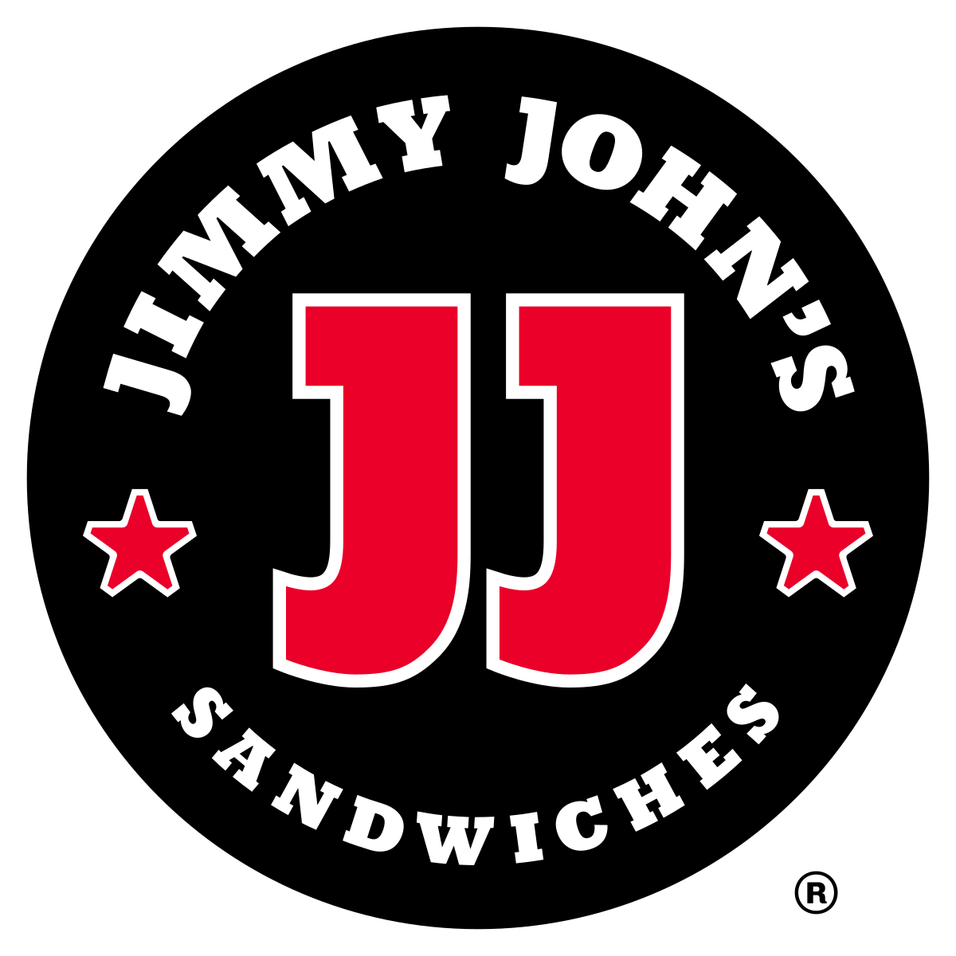
Objectives
Creating an online ordering system
  Customer portals
  Employee portals
  Live order updates
  Menu updates and delivery assignments
GR

Slide 4
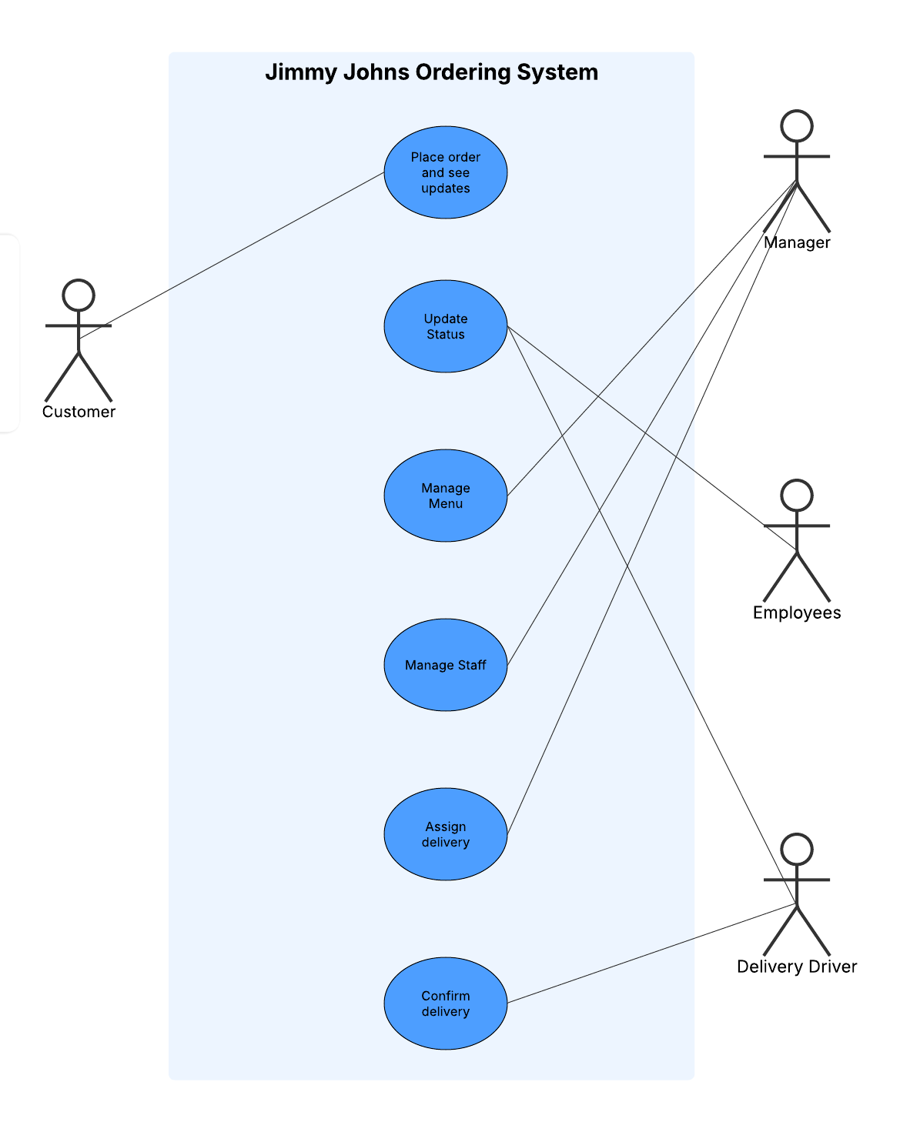
Use Case Diagram
Customers
Managers
Employees
Delivery Drivers
GR
Notes:
use case is a task that a user (in some user role) sits down at the information system to perform, as part of a business process.
Briefly explain each one

Slide 5
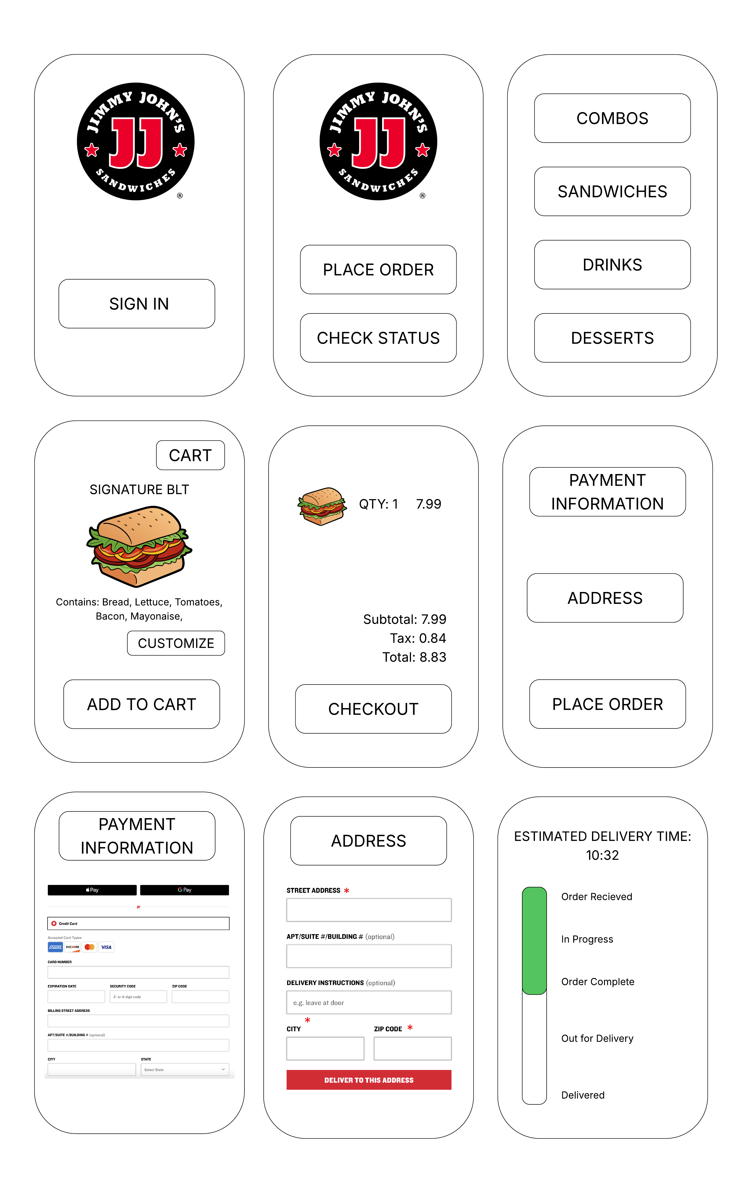
Use Case 1
Customer interface
Menu items
Checkout
SD

Slide 6
Use Case 1
Personal information
Check status
SD

Slide 7
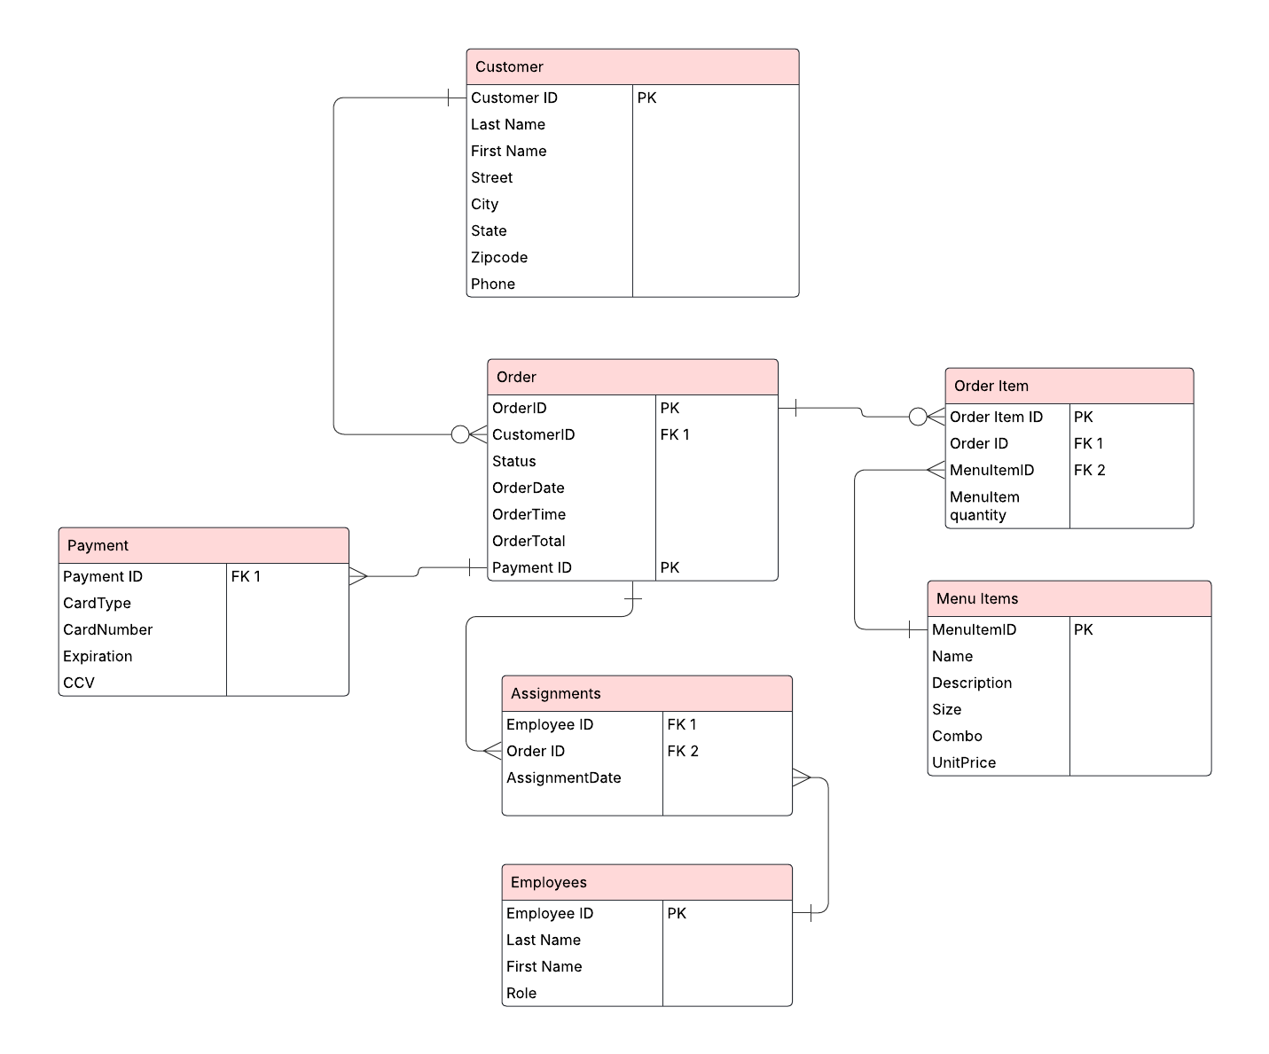
ERD
RS

Slide 8
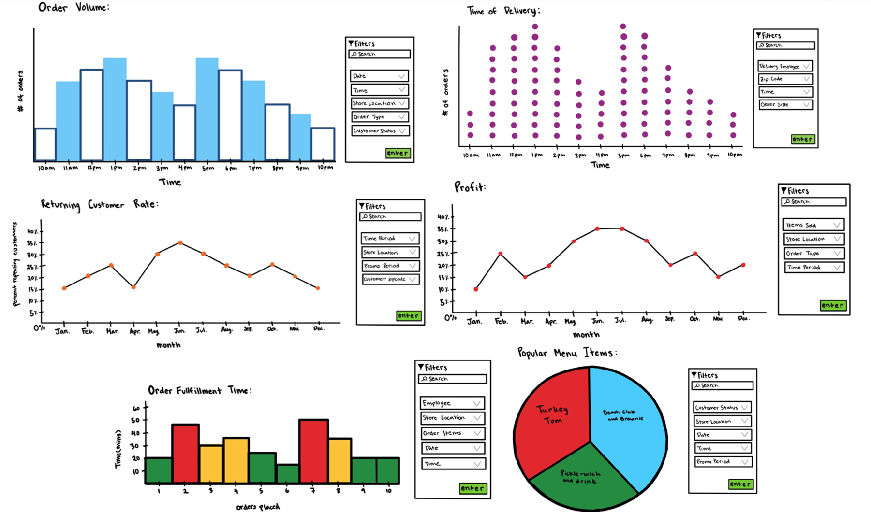
KPIs & Dashboard Design
JS

Slide 9
Conclusion
Improving the process
User friendly
Company’s slogan
JS

