Slide 1

Black Friday Simulation model
Team #8: SELENA DANG, AVERI STEVEN, RACHEL STONE, CAROLINE TURLEY

Slide 2
Introduction & Background
  Simulation models Macys (a department store) during Black Friday holiday
  Departments include Backstage, Shoes and Juniors, Women’s, Men’s and Children’s, Perfume, Jewelry, and Furniture and Appliances
  Cashiers will be able to perform transactions, returns, exchanges, etc.
Problem and Conceptual Model
Input Analysis
Simulation Model
Output Analysis
Conclusion
CT
Notes:
The Greater baton rouge food bank has been in operation for 40 years, suppling meals to those in need across 11 parishes in greater baton rouge. Currently, the food bank plans their deliveries around the requests of their 126 agencies, however, these requests do not result in the most optimal delivery schedules. The food bank also struggles with using their online system, Samsara, to its fullest potential. Our overall objective is to plan the 2026 operational schedule with a focus on delivery location clustering, with the goal of reducing key KPIs, such as fuel consumption, by 5-10%
Main issue at hand is that schedules are based on agency requests, rather than delivery location proximity . Important to keep agencies in mind, however the current setup ineffectively uses the routing optimization software and leads to increased fuel costs and excess miles. The main objective is to optimize the delievry schedule based on locations, so that we can cut fuel concumption

Slide 3
Problem Description
  Congestion for nearly all simulated servers, due to Black Friday influx
  Extreme wait times and queue lengths for customers
  Inconsistent flow of customers and a limited number of resources to accommodate
  The primary focus will be on server utilization and flow times
Problem and Conceptual Model
Input Analysis
Simulation Model
Output Analysis
Conclusion
CT
Notes:
The Greater baton rouge food bank has been in operation for 40 years, suppling meals to those in need across 11 parishes in greater baton rouge. Currently, the food bank plans their deliveries around the requests of their 126 agencies, however, these requests do not result in the most optimal delivery schedules. The food bank also struggles with using their online system, Samsara, to its fullest potential. Our overall objective is to plan the 2026 operational schedule with a focus on delivery location clustering, with the goal of reducing key KPIs, such as fuel consumption, by 5-10%
Main issue at hand is that schedules are based on agency requests, rather than delivery location proximity . Important to keep agencies in mind, however the current setup ineffectively uses the routing optimization software and leads to increased fuel costs and excess miles. The main objective is to optimize the delievry schedule based on locations, so that we can cut fuel concumption

Slide 4
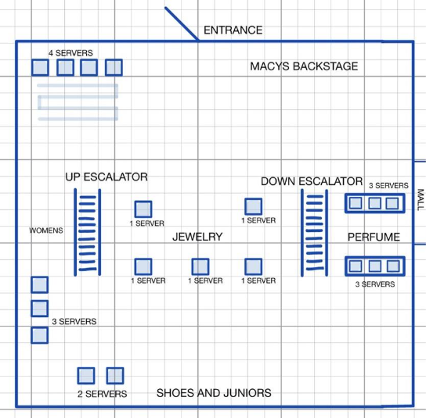
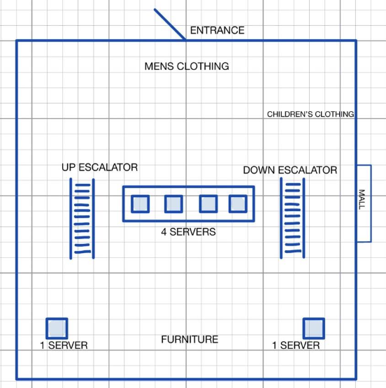
Conceptual Model Diagram
Problem and Conceptual Model
Input Analysis
Simulation Model
Output Analysis
Conclusion
CT

Slide 5
Data Collection
  Management confirmed 35,000 visitors for Black Friday
  Sensitivity analysis, since not all visitors would make purchases
    20%, 30%, 40% of original estimated visitors
  Simulate arrivals by utilizing a rate table for customers
    More customers arrive earlier in the day, between 8:00 AM and 9:00 AM
    Another surge during the afternoon from 12:00 PM to 2:00 PM
Problem and Conceptual Model
Input Analysis
Simulation Model
Output Analysis
Conclusion
SD
Notes:
The Greater baton rouge food bank has been in operation for 40 years, suppling meals to those in need across 11 parishes in greater baton rouge. Currently, the food bank plans their deliveries around the requests of their 126 agencies, however, these requests do not result in the most optimal delivery schedules. The food bank also struggles with using their online system, Samsara, to its fullest potential. Our overall objective is to plan the 2026 operational schedule with a focus on delivery location clustering, with the goal of reducing key KPIs, such as fuel consumption, by 5-10%
Main issue at hand is that schedules are based on agency requests, rather than delivery location proximity . Important to keep agencies in mind, however the current setup ineffectively uses the routing optimization software and leads to increased fuel costs and excess miles. The main objective is to optimize the delievry schedule based on locations, so that we can cut fuel concumption

Slide 6
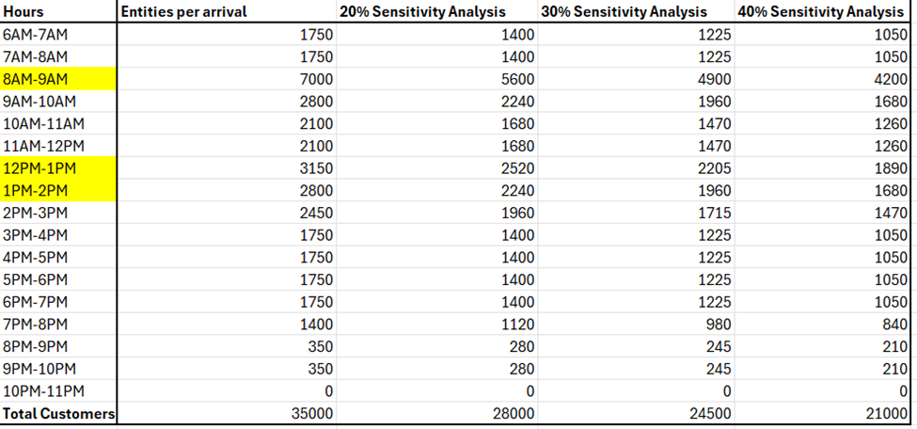
Results of Data Collection
Problem and Conceptual Model
Input Analysis
Simulation Model
Output Analysis
Conclusion
SD

Slide 7
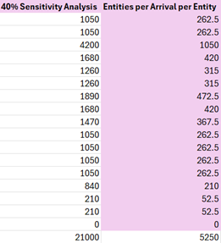
Base Model
  Rate Table – using 40%
    Calculated total of individuals to place in the system by hour
    All hourly arrivals were divided by four to account for the four model entities (Woman 1, Woman 2, Man 1, Man 2)
Problem and Conceptual Model
Input Analysis
Simulation Model
Output Analysis
Conclusion
SD
Notes:
Husbands and wives and children

Slide 8
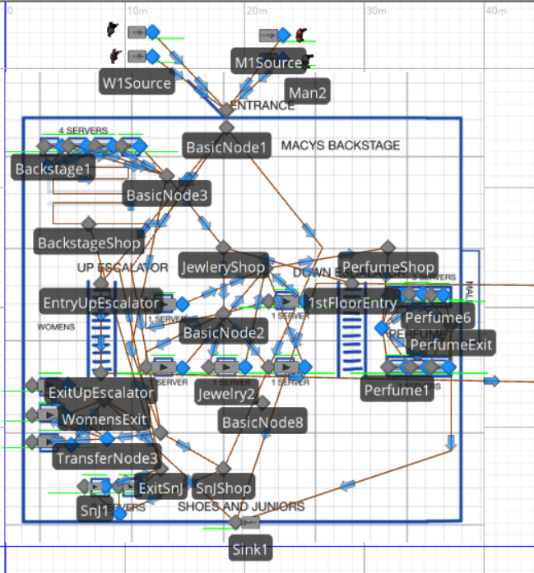
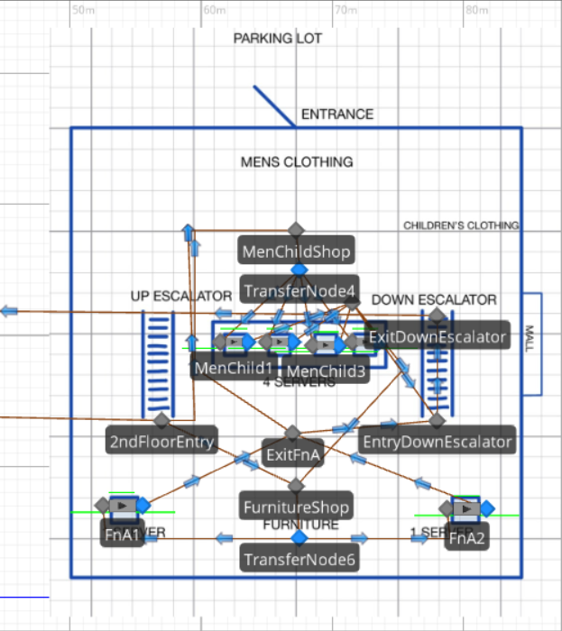
Base Model
Problem and Conceptual Model
Input Analysis
Simulation Model
Output Analysis
Conclusion
SD
Notes:
4 entities, time varying arrival rate
2 W and 2 M
Paths to simulate walking
Basic nodes with add on process delays for shopping areas
Transfer nodes with logic for shoppers to pick the shortest queue
Probabilistic Balk Decision Type at the source, with the probability at 35%
Renege triggers if in line for an hour
Balk is set at 50

Slide 9
Base Model
  Issues That Mirrored Real-Life Problems
    Getting all customers out of the system
      It had to run for a total of 40 hours, (23 hours after closing)
      The real-world model will stay open an hour past closed
    Scheduled utilizations for each server ranged between 36% - 80%
      Variance is high
Problem and Conceptual Model
Input Analysis
Simulation Model
Output Analysis
Conclusion
SD
Notes:
To analyze our agency information, we used lookup functions to pull notes, frequencies, and days into the main datasheet, to create an all encompasing tool to be used by the food bank for future calendar creation.

Slide 10
Alterative 1: Capacity Adjustments
Suggestions
  Seasonal employees would be brought into Macy’s for Black Friday
  Allocating more workers to departments with higher traffic
Adjustments
Backstage Capacity: 4
Jewelry Capacity: 3
Women’s Capacity: 5
Shoes and Juniors Capacity: 7
Perfume Capacity: 3
Men and Children’s Capacity: 4
Furniture and Appliances Capacity: 9
Problem and Conceptual Model
Input Analysis
Simulation Model
Output Analysis
Conclusion
RS
Notes:
Our first alternative to better the Black Friday shopping experience was to adjust capacity within our service departments
INITIAL:
Men’s and children’s clothing: 4 servers (capacity 2 each)
Furniture/household appliances: 2 servers (capacity 4 each)
Macy’s Backstage: 4 servers (capacity 2 each)
Women’s clothing: 3 servers (capacity 2 each)
Shoes and junior’s clothing: 2 servers (capacity 4 each)
Jewelry: 5 servers (capacity 2 each)
Perfume: 6 servers (capacity 2 each)

Slide 11
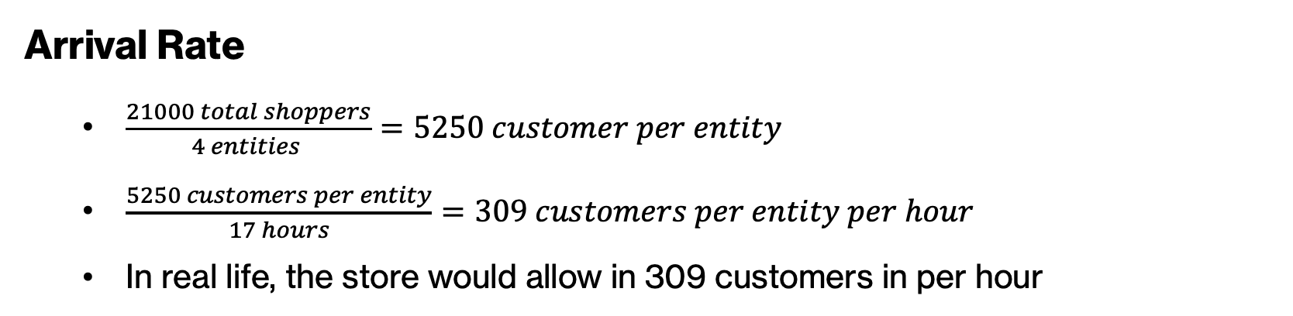
Alternative 2: Constant Arrivals
Arrival Rate
  $\frac{21000 total shoppers}{4 entities }=5250 customer per entity$
  $\frac{5250 customers per entity}{17 hours}=309 customers per entity per hour$
  In real life, the store would allow in 309 customers in per hour
Problem and Conceptual Model
Input Analysis
Simulation Model
Output Analysis
Conclusion
RS
Notes:
To analyze our agency information, we used lookup functions to pull notes, frequencies, and days into the main datasheet, to create an all encompasing tool to be used by the food bank for future calendar creation.

Slide 12
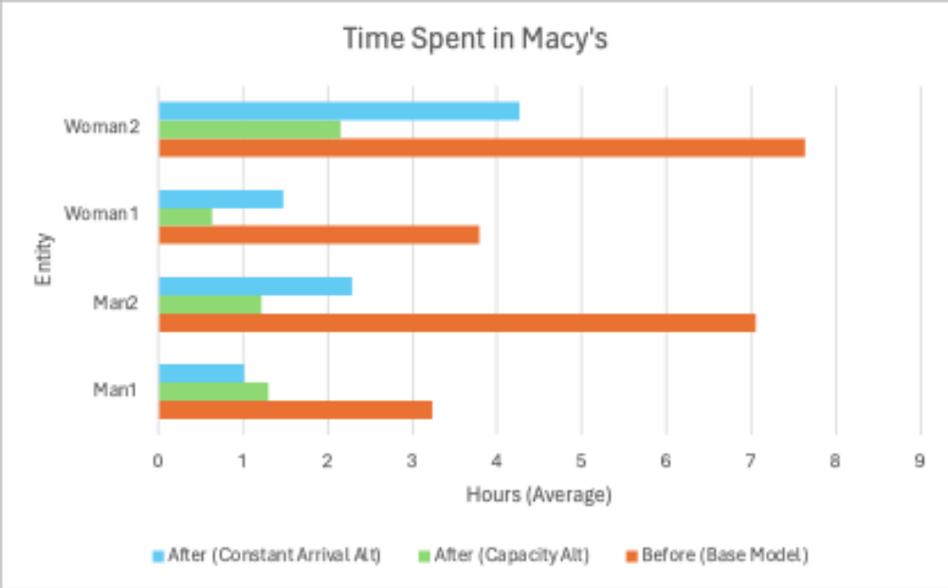
Alternatives Evaluation
Problem and Conceptual Model
Input Analysis
Simulation Model
Output Analysis
Conclusion
RS
Notes:
After running experiments for each alternative, we can visually see that the capacity alt, in green, reduced customer flow time the most

Slide 13
Validation
Entities Stuck (Base Model)
  Within the original model, not all entities were leaving the store at the end of the day
    Model needed to run additional hours
    Not all customers will be finished shopping or checking out by closing time
  This output demonstrated consistency between the base model and the real-life situation (Symptom Generation)
Problem and Conceptual Model
Input Analysis
Simulation Model
Output Analysis
Conclusion
AS
Notes:
Not all entities leaving by end of day
Needed additional hours to run
This is realistic because irl not all customers would be done shopping
The behavior creates symptom generation
For validation, in our base model, entities were not all leaving the system before the store closed so it had to be ran for additional hours. This is symptom generation of real life because not everyone can always be checked out before the store closes.

Slide 14
Validation
Base Model
Consistency confirmed
    Model ran multiple times and similar values obtained for the number of entities created and destroyed
    Degeneracy
    Slowly changing the capacities of the servers
    Reduced flowtime for the entities and a lower scheduled utilization for servers
    No absurd conditions, such as zero flow times or infinite values for queues and flow times
Problem and Conceptual Model
Input Analysis
Simulation Model
Output Analysis
Conclusion
AS
Notes:
Consistency confirmed by running model several times and number entities created and destroyed stayed about the same
Adjusting server capacity reduced flowtime and utilization
Did not cause any absurd conditions
We confirmed consistency by running the model several times and ensuring the numbers of entities created and destroyed stayed about the same. We tested degeneracy by adjusting server capacities and seeing reduced flowtime and utilization. We didn’t see any weird conditions such as zero flow time or infinite queues

Slide 15
Verification
Logic Check
  Model Trace
  Building incrementally
  Walking through to visually confirm entity movement
    Correct order, no entities teleporting or walking in free space
  Unit checks
Problem and Conceptual Model
Input Analysis
Simulation Model
Output Analysis
Conclusion
AS
Notes:
We utilized model trace
Built model incrementally
Walked through steps visually to make sure entities move correctly
We checked units (minutes)
We used the model trace throughout building the to quickly identity any issues in the system. We built the model incrementally, doing checks to make sure everything made sense between steps. We visually checked entity movement to make sure no one was going off path and going in correct order. We also checked units to make sure everything was in minutes.

Slide 16
Experiments
No warm up period
10 replications were run at a run length of 17 hours
The team added capacity controls for each server using real properties
  This allows multiple scenarios to be run with varying capacities for each server
The specific data used for statistical analysis was cycle times
Problem and Conceptual Model
Input Analysis
Output Analysis
Conclusion
Simulation Model
AS
Notes:
$3-4k
Geographic information system using spatial analysis to visualize and analyze geographic data
What are live or historical traffic conditions like, and how do they affect my network analysis results?
route our fleet of delivery vehicles to minimize overall transportation costs and improve customer service
origin-destination cost matrices that the ArcGIS Network Analyst extension
mathematical expressions to help make trip forecasts.
For our experiments, we didn’t use a warmup period because we wanted data to reflect the arrivals at all points throughout the day, similar to the restaurant problem we did in lab. We did 10 replications of 17 hours. The hours include 1 hour after closing to allow entities to leave the system. We added capacity controls using real properties for each server to allow multiple capacities to be tested at once for each server. We used cycle times for our statistical analysis

Slide 17
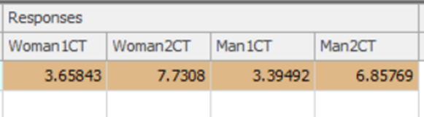
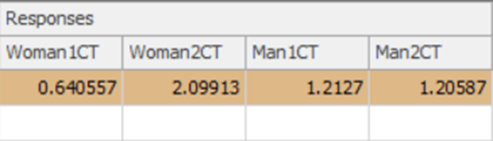
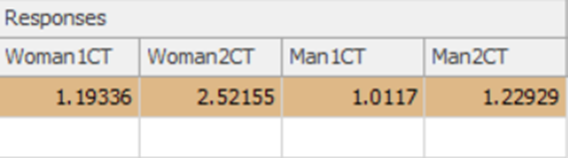
Experiments
Base model
Capacity alternative
Constant arrival alternative
Problem and Conceptual Model
Input Analysis
Output Analysis
Conclusion
Simulation Model
AS
Notes:
Here are the cycle times for the base model and alternatives. The capacity alternative had the shortest cycle times.

Slide 18
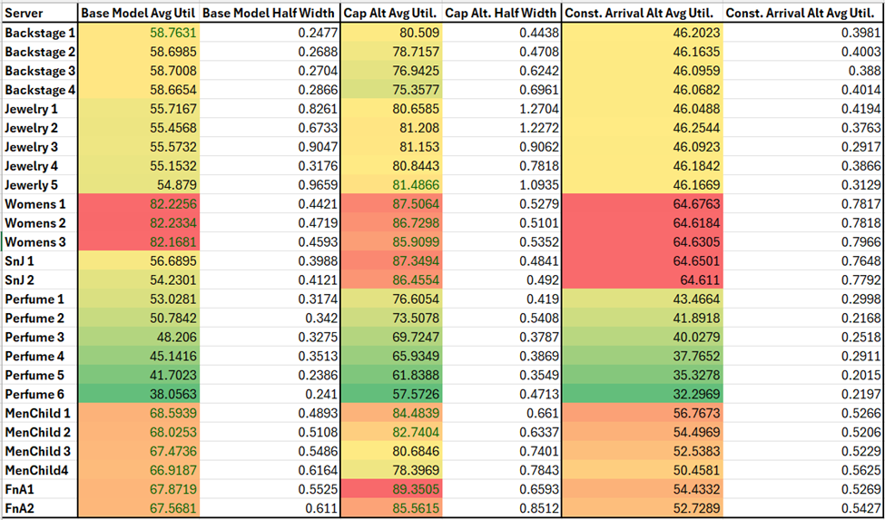
Statistical Results
Problem and Conceptual Model
Input Analysis
Output Analysis
Conclusion
Simulation Model
RS

Slide 19
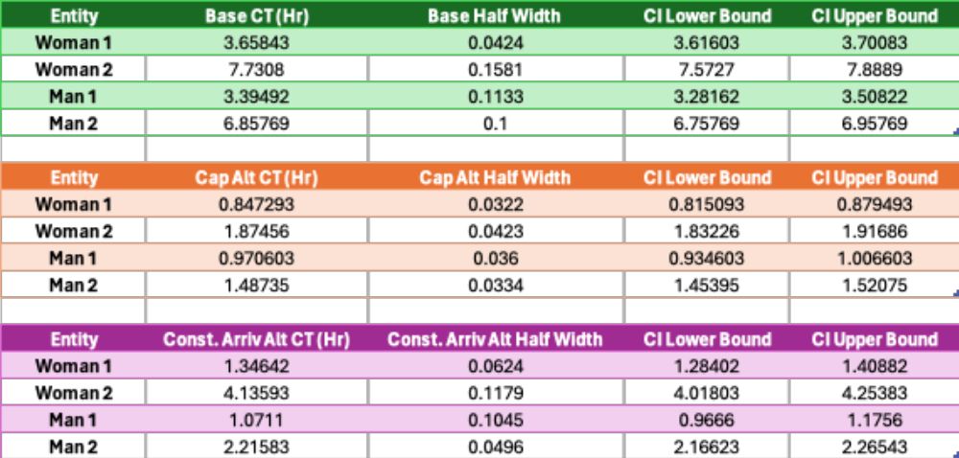
Statistical Results
Problem and Conceptual Model
Input Analysis
Output Analysis
Conclusion
Simulation Model
RS
Notes:
$3-4k
Geographic information system using spatial analysis to visualize and analyze geographic data
What are live or historical traffic conditions like, and how do they affect my network analysis results?
route our fleet of delivery vehicles to minimize overall transportation costs and improve customer service
origin-destination cost matrices that the ArcGIS Network Analyst extension
mathematical expressions to help make trip forecasts.

Slide 20
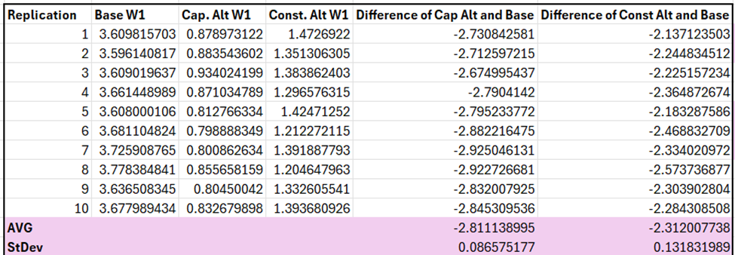
Alternative Statistics
Problem and Conceptual Model
Input Analysis
Output Analysis
Conclusion
Simulation Model
RS
Notes:
While our capacity alternative has shown the

Slide 21
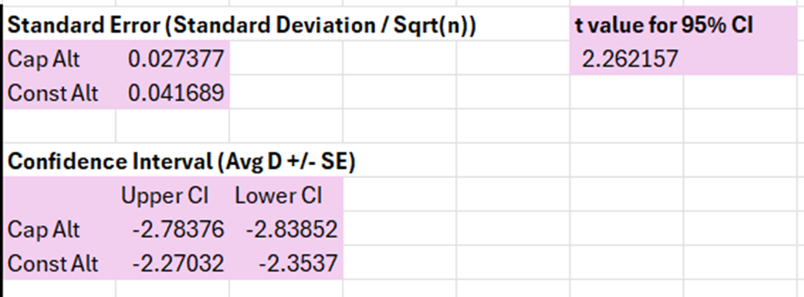
Alternative Statistics
The next steps were to find the standard error
  (Standard deviation divided by the square root of number of replications)
Problem and Conceptual Model
Input Analysis
Output Analysis
Conclusion
Simulation Model
RS
Notes:
$3-4k
Geographic information system using spatial analysis to visualize and analyze geographic data
What are live or historical traffic conditions like, and how do they affect my network analysis results?
route our fleet of delivery vehicles to minimize overall transportation costs and improve customer service
origin-destination cost matrices that the ArcGIS Network Analyst extension
mathematical expressions to help make trip forecasts.

Slide 22
Challenges
  The system would warn when there more than 20,000 active entities in the system
  The number of entities exiting the system was not consistent with the rate table
  Small changes would take a substantial amount of time to run and see the results
  There are too many possibilities to account for
    The model can only reasonably depict some common scenarios
Problem and Conceptual Model
Input Analysis
Output Analysis
Conclusion
Simulation Model
CT
Notes:
$3-4k
Geographic information system using spatial analysis to visualize and analyze geographic data
What are live or historical traffic conditions like, and how do they affect my network analysis results?
route our fleet of delivery vehicles to minimize overall transportation costs and improve customer service
origin-destination cost matrices that the ArcGIS Network Analyst extension
mathematical expressions to help make trip forecasts.

Slide 23
Conclusion
Changing capacity is the most effective alternative
For more accuracy, real data from Macy’s from previous years is needed
  Concrete numbers
  Need more consumer data on how people shop on Black Friday
  Time study
Limitations to this study, but overall valuable information
  Time and resource constraint
  Some aspects cannot be simulated accurately
Introduction
Data Collection
Data Analysis
Project Plan
Conclusion
CT

