Slide 1


IE 3699
Manufacturing & Maintenance reliability
Selena dang
COMPANY EXTERNAL © 2025 Textron Systems Corporation, Overwatch Systems, Ltd., Avco Corporation, Howe & Howe, Inc., Airborne Tactical Advantage Company, Textron Systems Australia Pty Ltd.

Slide 2
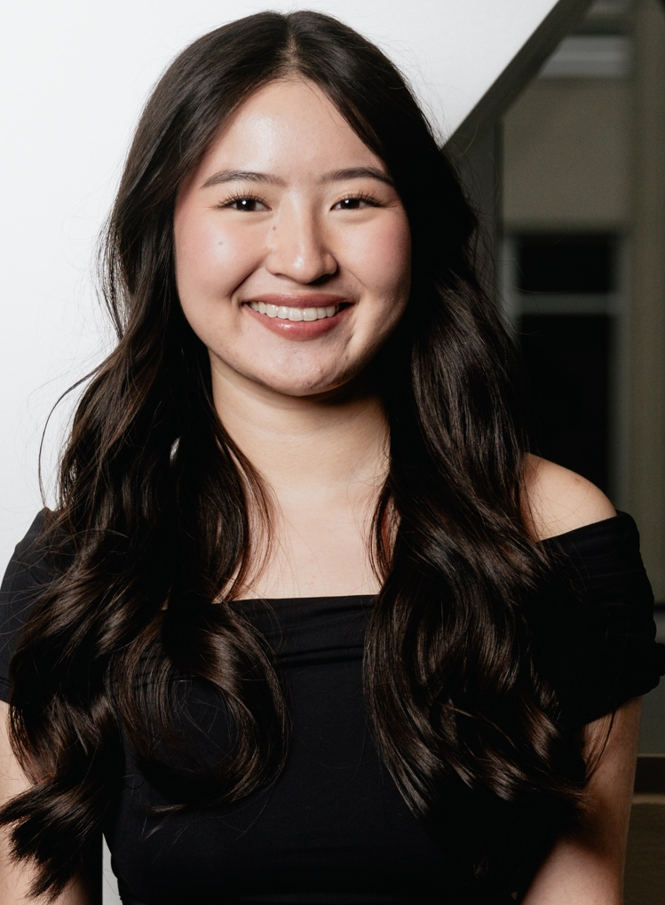
About me
SELENA DANG
JUNIOR IN IE – MAY 2027
GONZALES, LOUISIANA
Manufacturing and Maintenance Reliability Intern
Textron Systems, New Orleans location
sdang2@lsu.edu

Slide 3




INTERNSHIP PROCESS – HOW I got THE JOB
BEFORE
DURING
  HANDSHAKE
    Phone screening
    Zoom interview
    Career Expo, Engineering Networking Reception
      LinkedIn
    Club meetings (IISE, SWE, TBP, etc)
  TALEO – JOB PAGE
    Ranking system
    Matching system
    Return offer next summer in Wichita, Kansas

Slide 4
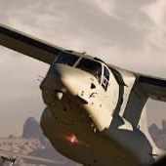
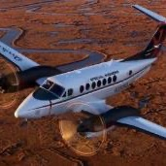
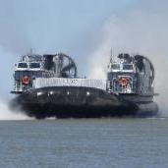






Textron – “pushing past possible”
BELL
TEXTRON AVIATION
TEXTRON SYSTEMS
INDUSTRIAL
FINANCE

Slide 5
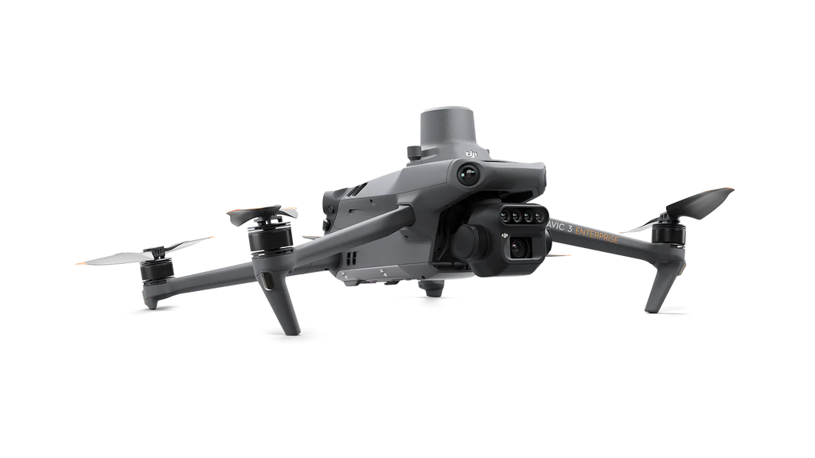

MAINTENANCE AND RELIABILITY
projects
  Drone for Roof and Gutter inspections
    DJI Mavic Mini 4
    Security approval
    Safety reduction
    Efficiency
  iMaint inventory systems – adding barcodes
    SQL based system
    Equipment, asset numbers, part numbers, etc
  Sprinkler systems
  Equipment location
    Moving plasma cutter, forklift parking spots

Slide 6
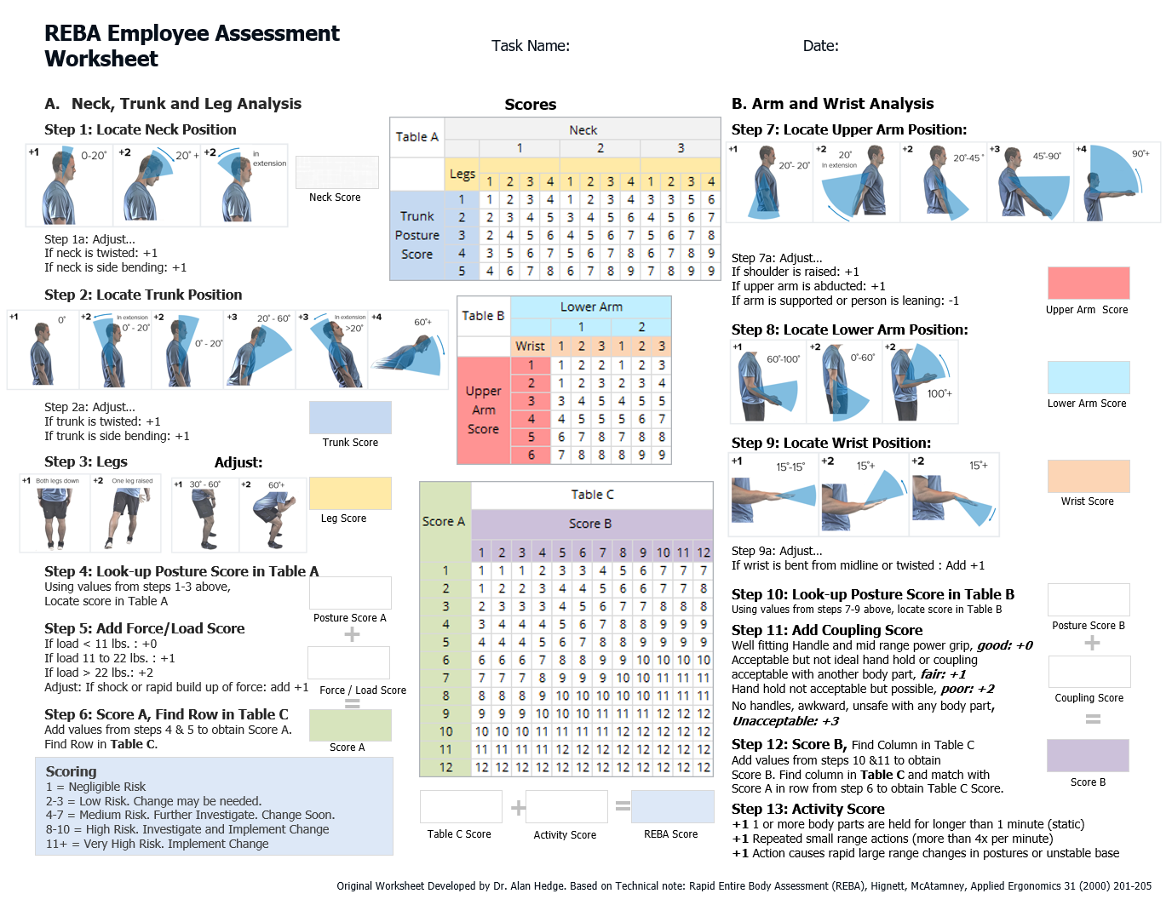

MANUFACTURING
projects
  Weld Table improvements
    Cost Analysis / Labor Savings
    Ergonomics
    4-blocker

Slide 7
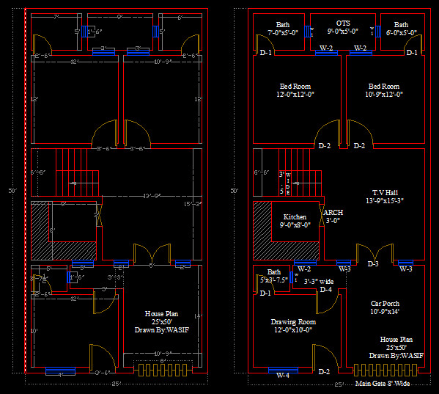
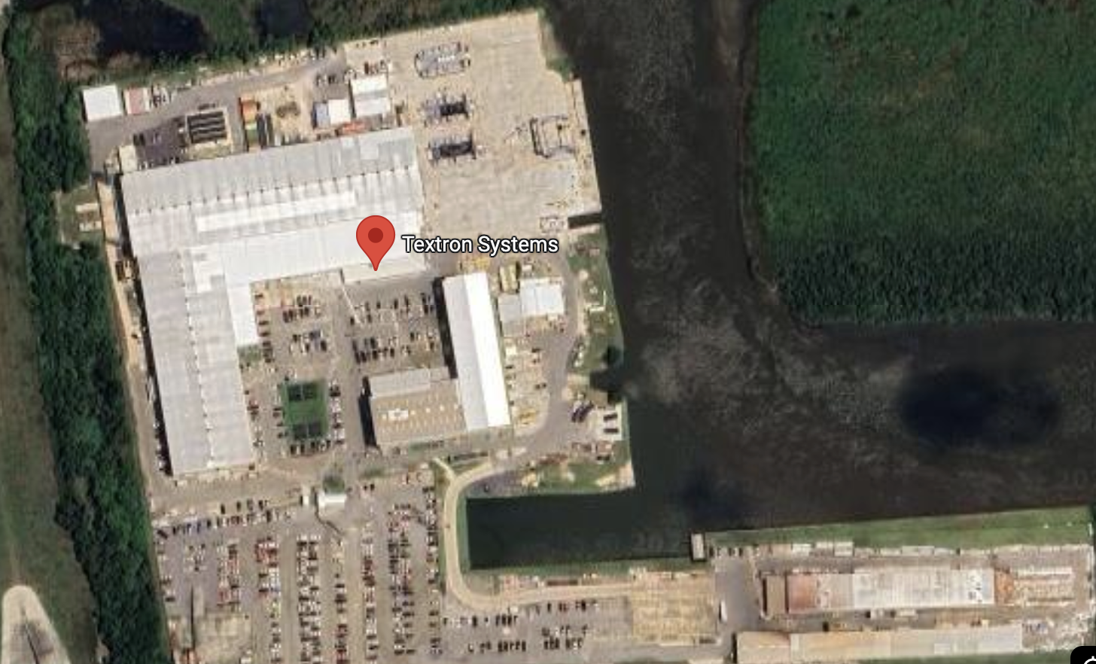
MANUFACTURING
projects
  Facility Map
    AutoCad introduction
    Ease of use, accessibility
    Important for tracking digital footprint
    Determining space constraints

Slide 8
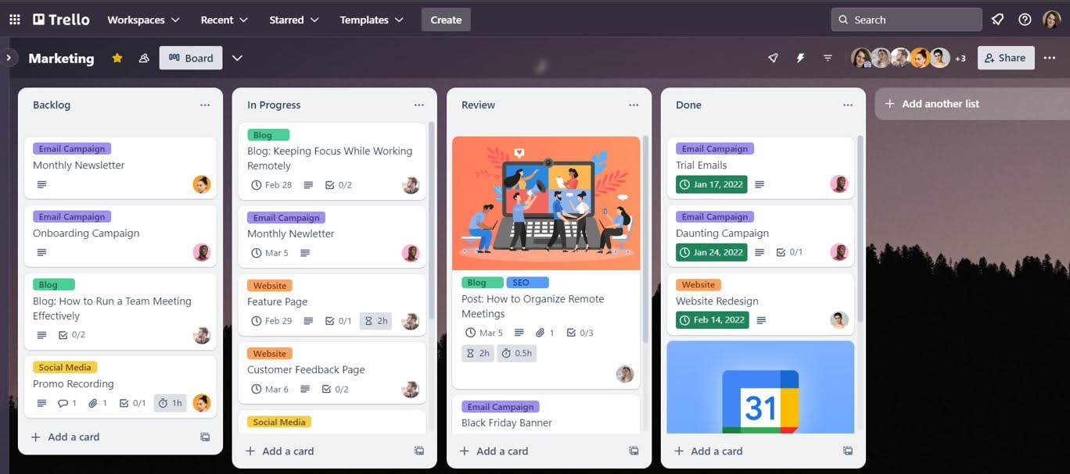
MANUFACTURING
projects
  Ops Team and Floor Team
    Trello cards - daily shop floor requests
      Solumina
      Oracle
      Matrix / eMatrix
      Solidworks
      Citrix
  Resource Allocation / Material Planning
    Logistics and Warehousing Department
      Moving tools
      Moving forklifts

Slide 9
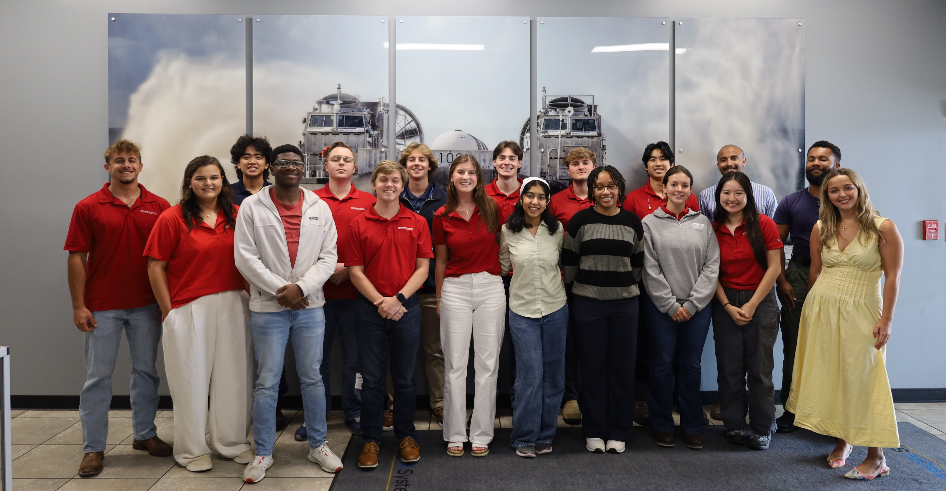
other information
  Mentor Program
  Intern Events
    Swamp Tours
    Happy Hour
    Gator Grub
    National Intern Day
    Department Events
  Full time
    High return offer rate, around 80-90%
    Internship counts as a year, after 5 years fully vested (401k matching)
  LDP program

Slide 10
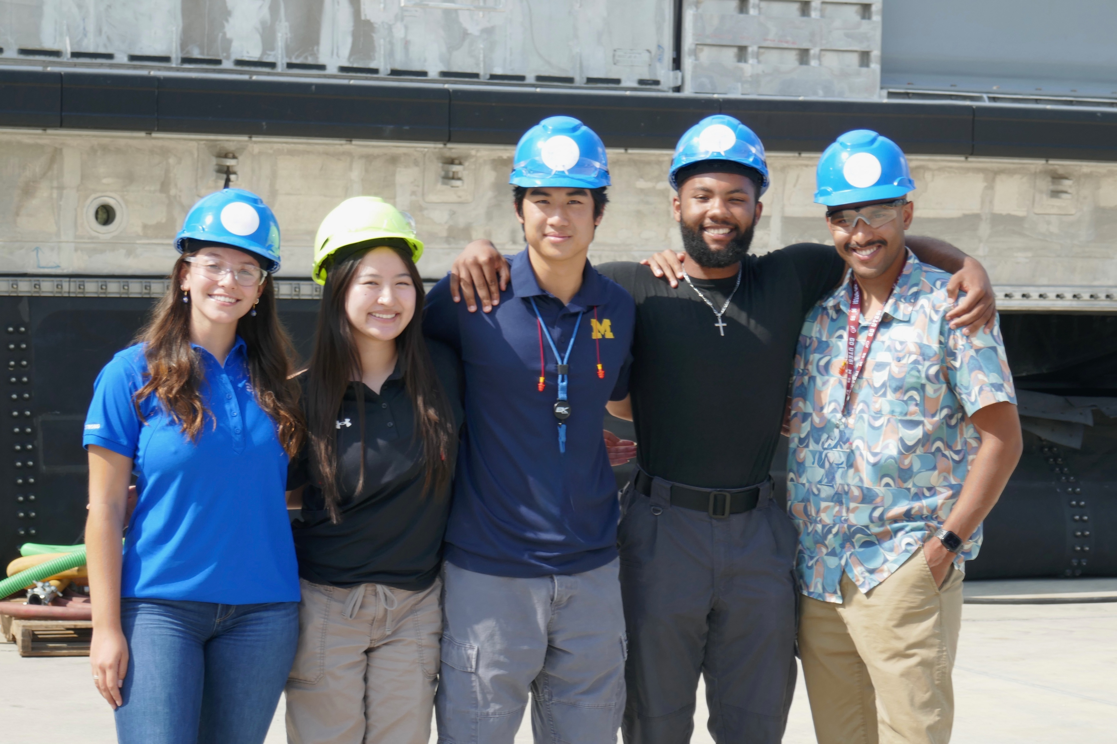
Key takeaways
  Ask questions
  Understand full process
  Effective communication
  Get out of comfort zone
  Willingness to learn
  Take initiative
  Friends !!

Slide 11

QUESTIONS?
sdang2@lsu.edu
COMPANY EXTERNAL © 2025 Textron Systems Corporation, Overwatch Systems, Ltd., Avco Corporation, Howe & Howe, Inc., Airborne Tactical Advantage Company, Textron Systems Australia Pty Ltd.

Slide 12
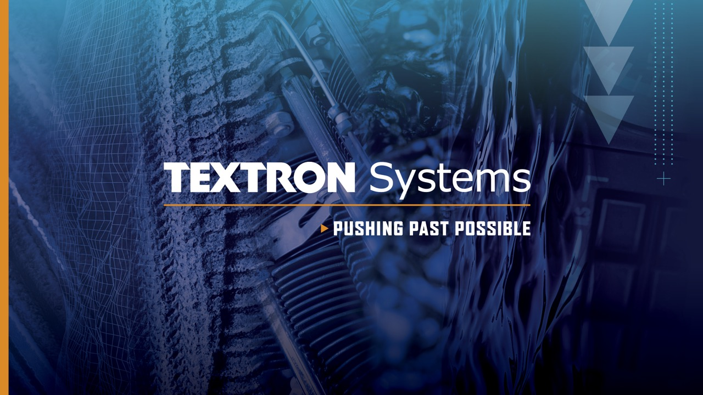
COMPANY EXTERNAL © 2025 Textron Systems Corporation, Overwatch Systems, Ltd., Avco Corporation, Howe & Howe, Inc., Airborne Tactical Advantage Company, Textron Systems Australia Pty Ltd.

