Slide 1
Introduction to Java bytecode
Dariusz Stefanowicz
Notes:
Good overview: http://www.cubrid.org/blog/dev-platform/understanding-jvm-internals/

Slide 2
Bytecode
Intermediate language between Java and machine code - "Write once, run anywhere"
One-byte instructions (opcode)
256 possible opcodes (200+ in use)
Not many changes since JDK1.0 (last INVOKEDYNAMIC in Java 7)
Most opcodes fit into one of a number of families
Notes:
Bytecode is an intermediate representation of a program—halfway between human readable java source and machine code.
JVM bytecode consists of a sequence of operation codes (opcodes), possibly with some arguments following each instruction.

Slide 3
Why should we learn java bytecode
Better understanding of the JVM
Many libraries manipulate bytecode
Build custom tools (profilers, tracers, etc.)
Build new JVM language
Understanding bytecode makes you a better programmer
It is easy and it’s fun
Notes:
Bytecode is part of a JVM, we cannot realy understand bytecode without understanding JVM and vice versa.
Profilers, tracers, measuring code coverage, mocking frameworks, AOP etc..
If you realy need this… DSL possible.
Two different java statements may produce the same byte code, and two very similar instructions can produce very different bytecode. In some cases, the bytecode generated is not what you expect. This knowledge is crucial when debugging and doing performance and memory usage tuning. Understanding bytecode makes you a better programmer.
Learning bytecode opens gives real power and opens lots of possibilities when writing java code. It can be real fun.

Slide 4
JVM Internals
Compilation
Execution
public class A {
class B { }
}
A.class
javac
A$B.class
Linking
Execution
engine
Verification
Interpreter
Preparation
Class
Loading
JIT Compiler (C1, C2, Tiered)
Resolution
Initialization
Machine Code
OS
Notes:
In order to fully understand bytecode, you need to understand the runtime environment that it executes in.
The class is the smallest unit of program code that the platform can load. The first step is to take the data stream of bytes that constitute the class file (byte array) and produces a Class object (not initialized and not usable yet). Some basic checks performed.
Verification is complex, few steps process. These checks are done for performance reasons—they enable the skipping of runtime checks, thus making the interpreted code run faster. One of the step is checking the bytecode of methods:
Check that all methods respect access control keywords
Check that methods are called with the right number of parameters
Ensure that variables are properly initialized before they’re used
3. Preparing the class involves allocating memory and getting static variables in the class ready to be initialized, but it doesn’t initialize variables or execute any VM bytecode.
4. Load all referenced types (full process).
5. Init: in this final phase, any static variables can be initialized and any static initialization blocks run.
5. JIT Optimizations
Inlining
Loop unrolling
Escape analysis
Monomorphic calls
http://www.ibm.com/support/knowledgecenter/SSYKE2_7.1.0/com.ibm.java.aix.71.doc/diag/understanding/jit_overview.html

Slide 5
Java class file format
Magic number
4 byte header: 0xCAFEBABE
Version
Java 9 -> 53, Java 8 -> 52, etc.
Constant pool
Indexed pool of constants for the class
Access flags
Whether the class is abstract, static, etc.
This class
The name of the current class
Super class
The name of the super class
Any interfaces implemented by the class
Interfaces
Fields
Any fields (also static) in the class
Methods
Any methods in the class (also static)
Attributes
Class attributes e.g. name of the source file
Notes:
Each class file contains one Java type, either a class or an interface
A class file contains
Symbol table (constant pool)
Class information (super class, interfaces, fields)
Method with that contains execution bytecode
Additional attributes
The constant pool table is where most of the literal constant values are stored. This includes values such as numbers of all sorts, strings, identifier names, references to classes and methods, and type descriptors. All indexes, or references, to specific constants in the constant pool table are given by 16-bit numbers (max 65535 symbols in class), where index value 1 refers to the first constant in the table (index value 0 is invalid).

Slide 6
Decompiling classes with javap
Class files are binary blobs, so they aren’t easy to work with directly.
The standard Oracle JVM ships with a tool called javap for disassembling class files.
javap uses human-readable form for displaying class content.
Example: javap –verbose <class-file>
Notes:
The compiled bytecode of any Java class can be disassembled into a human-readable listing of bytecode instructions by using javap, a standard tool included in the Java development kit.

Slide 7
Bytecode execution model
1 + 2 * 3
Reverse Polish Notation: 1 2 3 * +
Easy to evaluate by using a stack.
In RPN you can write down any expression without using brackets:
PUSH 1 (ICONST_1)
PUSH 2 (ICONST_2)
PUSH 3 (ICONST_3)
MUL (IMUL)
ADD (IADD)
1
2
1
3
2
1
6
1
7
Notes:
Reverse Polish or postfix notation – that is, the arguments or parameters for some command are stated before the actual command itself. For example, in Reverse Polish notation, one would say "2, 3, multiply" instead of "multiply, 2, 3" (prefix or Polish notation) or "2 multiply 3" (infix notation).
Why reverse Polish notation - it is easy to evaluate such expression by using a stack.
In RPN you can write down any expression without using brackets
Invented by matemetisian - Jan Lukasiewicz - 1920
JVM uses a stack for all calculations and operations. This is sometimes called the operand (or evaluation) stack.
Opcodes expect to find the stack in a given state, and transform the stack, so that the arguments are removed and results placed there instead.
Intel x86 Architecture and ARM Architecture run based on a register.

Slide 8
RPN – method call example
Expression: this.add(1, 2)
Reverse Polish Notation: this 1 2 add
Stack operations:
PUSH this (ALOAD 0)
PUSH 1 (ICONST_1)
PUSH 2 (ICONST_2)
ADD (INVOKESPECIAL #2)
this
1
this
2
1
this
3

Slide 9
Method call stack, method frame
Thread-1
Array of local variables
32bit
main()
Method
call
method1()
This
Method parameters
Local variables
32bit
method2()
Growth
Return or
Exception
method3()
Frame
Constant Pool
Operand stack
Notes:
Call Stack
Each time a method is invoked a new stack frame is created.
Each thread has its own stack that holds a frame for each method executing on that thread.
Currently executing method is at the top of the stack.
A new frame is created and added (pushed) to the top of stack for every method invocation.
The frame is removed (popped) when the method returns normally or if exception is thrown.
Frame objects may be allocated in the Heap and the memory does not need to be contiguous.
StackOverflowError - 6000 – 8500 (depends on JVM, configuration and memory available)
Method Frame:
Array of local variables
Contains the parameters of the method and values of the local variables.
If the frame is for a constructor or an instance method, ‘this’ reference is stored at location 0
The size of the array of local variables is determined at compile time
Operand stack
LIFO stack used to push and pop values
size is determined at compile time
certain opcode instructions push values onto the operand stack; others take operands from the stack, manipulate them, and push the result. The operand stack is also used to receive return values from methods
3. Reference to the runtime constant pool of the class of the current method
4. Common
JVM stack slots (and local vars) are 32-bit
64-bit values (double, long) takes up two slots and updates are not atomic!
Boolean is internally represented by 0 or 1

Slide 10
Bytecode Instructions
Contains type prefix: IADD, LADD, DADD
Shortcut forms: ILOAD_1, ILOAD_2 (equivalent to: ILOAD n)
Instructions families:
Stack load and store opcodes
Arithmetic opcodes
Control flow opcodes
Invocation opcodes
…

Slide 11
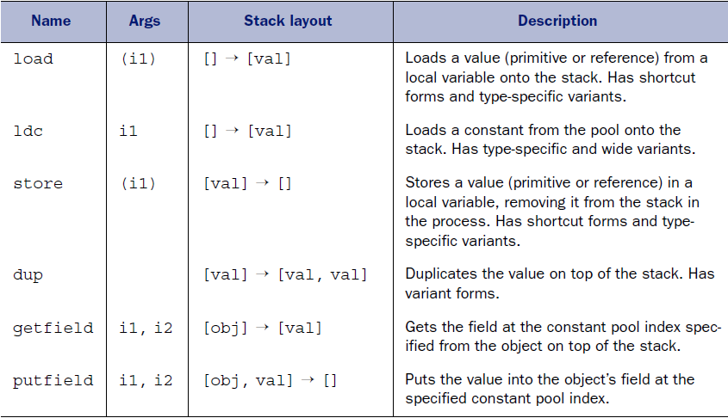
Load and store opcodes
Notes:
The family of load and store opcodes is concerned with loading values onto the stack, or retrieving them.

Slide 12
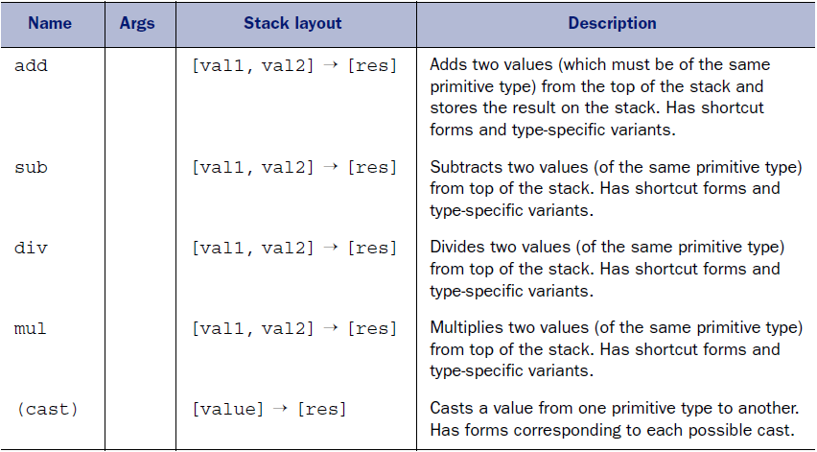
Arithmetic opcodes
Notes:
These opcodes perform arithmetic on the stack.

Slide 13
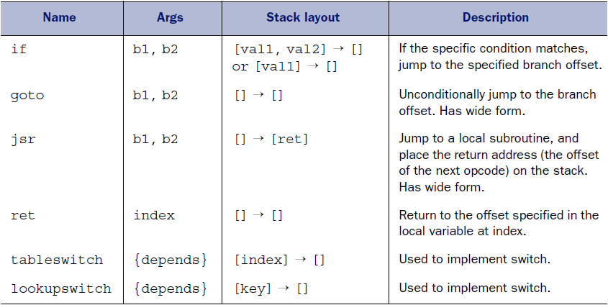
Execution control opcodes
Notes:
High-level languages control constructs aren’t present in JVM bytecode (while, do-while)

Slide 14
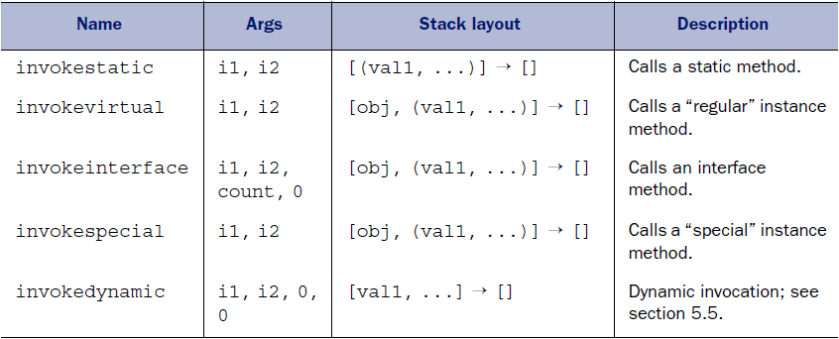
Invocation opcodes

Slide 15
Bytecode manipulation (instrumentation, weaving)
Process where new functionality is added to a program by modifying the bytecode.
Compile-time (hibernate bytecode-enhancements, AspectJ, project lambok)
Run-time – using java agents or custom class loader (profilers, coverage tools, spring AOP)
Notes:
There are several ways to “hook” this instrumentation mechanism into the JVM.
You could implement your own special-purpose class loader and load parts of the code with it

Slide 16
Java Agent Framework
Since JDK 1.5 (java.lang.instrument)
Allow us to operate on classes before (and even after) they are loaded
Enabling the agent for a specific application:
Command line argument:
java -javaagent:myagent.jar yourapp.MainClass
Attach API:
VirtualMachine.attach (processid);
Notes:
Available since the Java version 1.5.0, the package java.lang.instrument defines a standard API for instrumenting the bytecode of classes before they’re loaded by the virtual machine.
Following line in the manifest file: Premain-Class: asm.Agent
Agent is loaded in bootstrap classloader.
http://blog.javabenchmark.org/2013/05/java-instrumentation-tutorial.html

Slide 17
Bytecode manipulation libraries
ASM
Industry standard
Designed to be as fast and as small as possible
Bytecode outline plugin (Eclipse, Intellij)
CGLIB
Javaassist
ByteBuddy
AspectJ
Notes:
ASM
industry standard for bytecode manipulation, almost all other libraries are built on top of ASM
small, fast, very close to bytecode
up-to-date (there is version for 1.9)
used in jdk, requires understanding of how the JVM works (bytecode, class format)
CGLIB
designed and implemented more than ten years ago
Built on top of ASM
Poor documentation
allows the creation of Java proxies for non-interface types
Used by hibernate (not anymore), spring (cglib-proxy)
Javaassist
subproject of jboss
both a high level and low level API
suffered from inactivity
may still have issues with Java 8 support
slower than cglib
Byte Buddy
quite new player built on top of ASM
High-level api, does not require an understanding of Java byte code
Allowes everything that cglib and javaassist
Mockito gave up cglib for byte buddy
AspectJ
tool for aspect-oriented programming (only)
manipulation at compile-time

Slide 18
Bytecode examples
Empty class
Empty method
String concatenation
Boxing
Initialization
Synchronization
Lambdas

