Slide 1
Hardware Hacking Meetup Capturing XYZRGB data using Microsoft Kinect
December 8, 2016
Presented by S. Darkhovsky

Slide 2
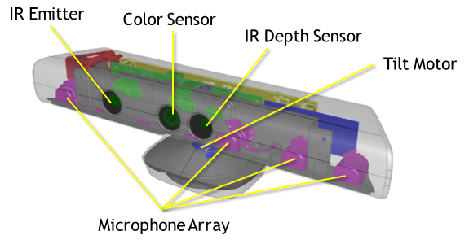
Kinect Sensor
(https://msdn.microsoft.com/en-us/library/jj131033.aspx)
An RGB camera that stores three channel data in a 1280x960 resolution. This makes capturing a color image possible.
An infrared (IR) emitter and an IR depth sensor. The emitter emits infrared light beams and the depth sensor reads the IR beams reflected back to the sensor. The reflected beams are converted into depth information measuring the distance between an object and the sensor. This makes capturing a depth image possible.

Slide 3
Specifications for the Kinect
Kinect | Array Specifications
Viewing angle | 43° vertical by 57° horizontal field of view
Vertical tilt range | ±27°
Frame rate (depth and color stream) | 30 frames per second (FPS)
Audio format | 16-kHz, 24-bit mono pulse code modulation (PCM)
Audio input characteristics | A four-microphone array with 24-bit analog-to-digital converter (ADC) and Kinect-resident signal processing including acoustic echo cancellation and noise suppression
Accelerometer characteristics | A 2G/4G/8G accelerometer configured for the 2G range, with a 1° accuracy upper limit.

Slide 4
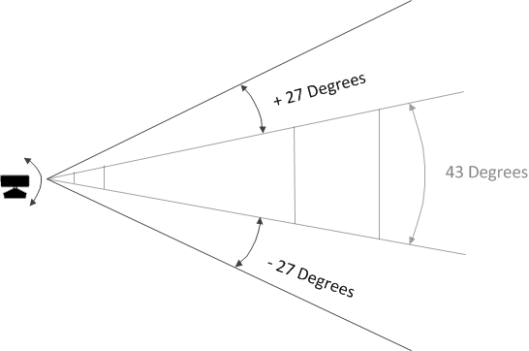
The interaction space is defined by the field of view of the Kinect cameras, which is listed in Kinect for Windows Sensor Components and Specifications. To increase the possible interaction space, tilt the sensor using the built-in tilt motor. The tilt motor supports an additional +27 and -27 degrees, which greatly increases the possible interaction space in front of the sensor.

Slide 5
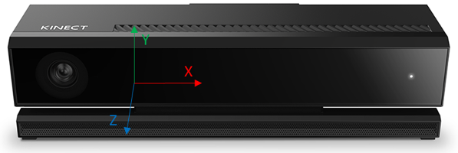
Camera space
Camera space refers to the 3D coordinate system used by Kinect. The coordinate system is defined as follows:
The origin (x=0, y=0, z=0) is located at the center of the IR sensor on Kinect
X grows to the sensor’s left
Y grows up (note that this direction is based on the sensor’s tilt)
Z grows out in the direction the sensor is facing
(https://msdn.microsoft.com/en-us/library/dn785530.aspx)

Slide 6
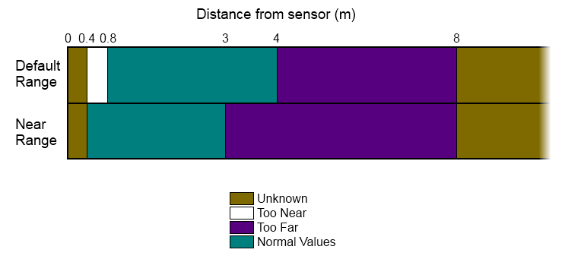
(https://msdn.microsoft.com/en-us/library/hh973078.aspx)
The Kinect depth sensor range is: minimum 800mm and maximum 4000mm. The Kinect for Windows Hardware can however be switched to Near Mode which provides a range of 500mm to 3000mm instead of the Default range (https://msdn.microsoft.com/en-us/library/hh438998.aspx).

Slide 7
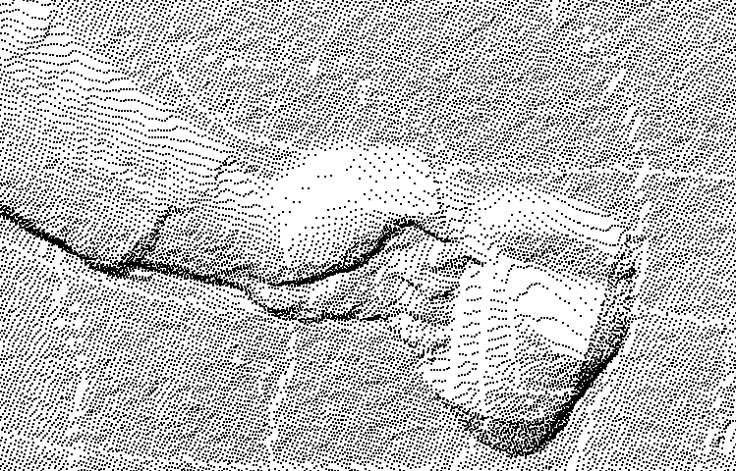
A basic sample application using Microsoft Kinect and Microsoft Kinect SDK to capture XYZRGB data can be found at https://github.com/sdarkhovsky/KinectCapture.
An example of XYZ data captured by the application and viewed with PointCloudViz Viewer (pointcloudviz.com):
A hand holding a cup

Slide 8
The real macro world operates in three dimensions according to Newton laws. As result, the cause-effect relations of the world as learned by intelligent robotics are expressed in three dimensions.
The depth data collected by the Kinect infrared sensor contain the distances to the unobstructed points in the sensor’s
field of view. Using such 3D data in the intelligent robotics applications allows to bypass the pipeline calculating the 3D features from 2D image data and learn the features and cause-effect relations in 3D.
A basic robotic task is the localization and mapping (LAM), which are often combined into simultaneous LAM (SLAM).
The Mapping refers to creating a map of the environment. The Localization refers to finding the robot position and orientation in the environment.
The LAM models are based on knowledge of the system dynamics, describing how the environment and the robot change with time, and observation model, describing the measurements, given the system state.
For example: dX/dt=f(X) and Z=h(X), where X is the system state and Z is the observation.
Usually a noise is added to the equations to account for unknown factors.
Then LAM algorithm becomes the two-steps process:
In the first (prediction) step the system state at the next time step is predicted according to the system dynamics.
In the second (update) step the system state estimation is improved based on the observation.
Such two-steps approach is used in Kalman and particle filters, which are probably main models used in SLAM problems.

Slide 9
If the system state includes three-dimensional coordinates of its points, then the observation model becomes simpler, when using XYZ Kinect data.
But the system dynamics model which is probably based on Newton laws remains complex if the environment is not static.
Another challenge in using RGBXYZ data is that the color of a point depends not just on reflective and absorptive properties of the object at the point, but also on positions of the camera, light sources and other factors. This complicates the learning of the system dynamics.

