Slide 1

Map your cycling and running sessions on the go
TOP FEATURES:
1 : Simple UI
2 : Loads Fast
3 : Build with modern web technologies
4 : Mobile Friendly Design
5 : No need to Sign in

Slide 2
TECHNOLOGY USED
1 : HTML5
2 : CSS3
3 : JavaScript 2015 & 2016
4 : ES6 Classes
5 : Leafletjs library
6 : Browser Local Storage API

Slide 3
PROJECT DESCRIPTION
Maptify is a web app for people who are passionate about cycling and running. With a single click on the map, you can log your cycling or running sessions and save them for future reference. After clicking on the map, it provides a separate input field for both cycling and running.
In case, if you want to log a cycling session, just select the cycling option from the drop-down menu and the particular input fields related to cycling will appear. Same happens when you select running.
The app is completely mobile-friendly and works best on both small and large screen devices. The Mapty app doesn’t require singing in thus users can anonymously create and save their workout sessions.

Slide 4
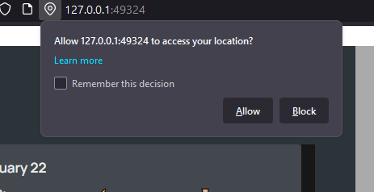
To get started, allow the web app to access your location. Just click on the Allow button to let the app use the GPS on your system. If you block GPS access, the map won’t get your current location and thus the app won’t be able to load the map.

Slide 5
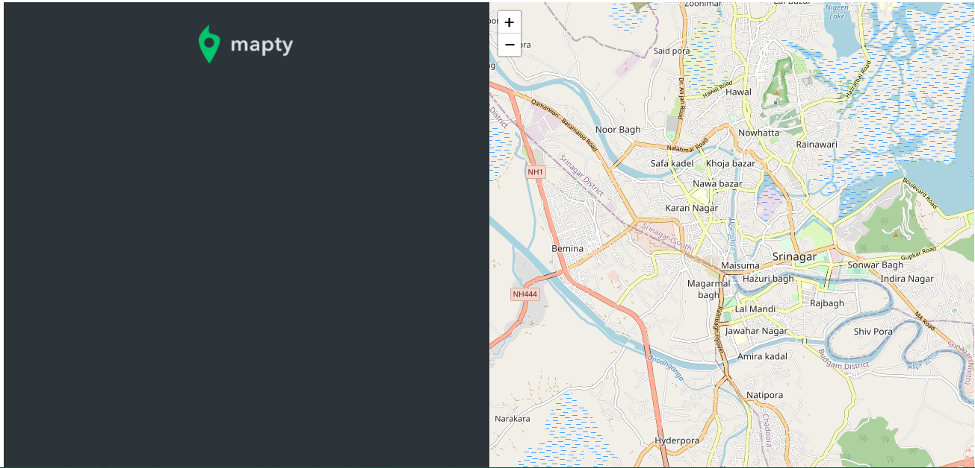
When you load the app for the first time, the app would look like this.
There are no dummy items added to the workouts. The layout is divided into two columns using grid and each item of 1fr width.

Slide 6
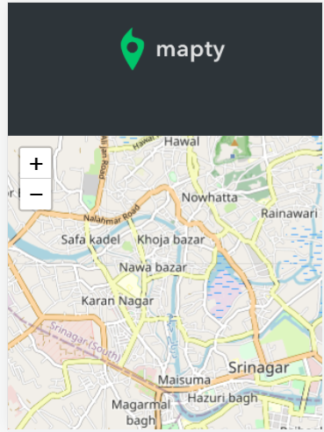

Mobile View
The app is mobile friendly. In order to make it responsive, I added a CSS media query and set the grid-template-columns to min-content(to only one column) while the grid-template-rows to min-content.

Slide 7
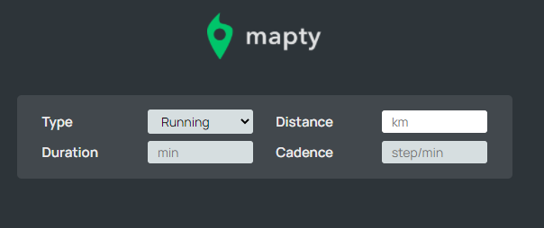
To create a new workout session, tap on the location on map where you want to log. After tapping on the map the following form will appear.
The type is a drop-down menu. It’s the following two options

Slide 8
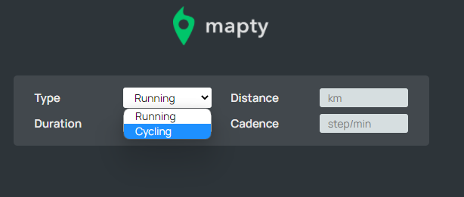
The two options are
1) Running: Logs the running workout. Note that when the running option is selected, the fourth input element is cadence instead of elevation-gain.

Slide 9
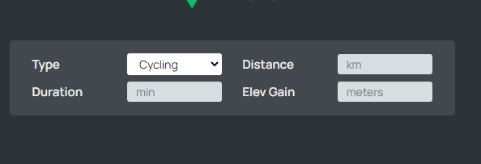
2) Cycling: Logs the cycling workout. Note that when the cycling option is selected, the fourth input element is elevation gain instead of cadence.

Slide 10
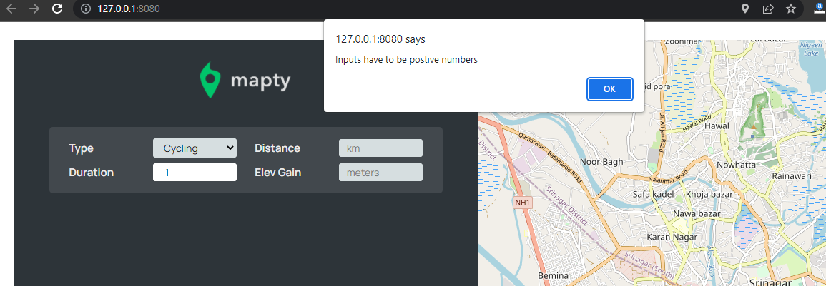
The app supports input validation. And throws an alert when a negative value or a string is supplied as an input. Below is the example where we supply a negative number as duration, which is supposed to be wrong since time can’t be negative. After pressing enter the alert shows up

Slide 11
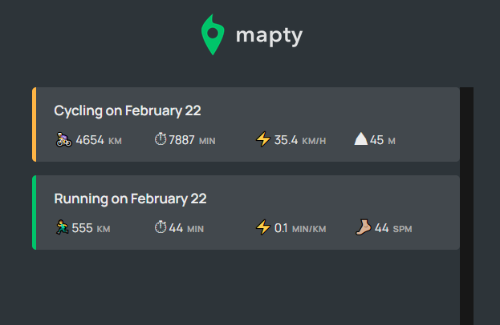
The list of workouts is stored in the browser storage using local storage API, Which means that your workout sessions won’t go away if we exit the browser. When you come back they will be rendered again.

Slide 12
Features to add in the future.
Database
Authentication
Drawing the shape of run and cycling journey
Adding social share part, where people can see and share things related to the workout sessions.
Calculation the amount of time and distance travelled based on time periods such as weekly, monthly and yearly
Calculate the amount of calories burned during the workout session, as well as during the week and month.
Add Facebook auth to see which Facebook friends are on Mapty
Adding a component where you can find tips related to running and walking
Sorting: To find out where you love to workout
Deleting and editing workout sessions
Introducing latest technologies like Reactjs and other JavaScript based frameworks and libraries

