Slide 1
2013 UFE Analysis
Prepared by Data Aggregation
May 2014 PWG Meeting

Slide 2
UFE Basics
UFE (unaccounted for energy) is computed as follows:
UFE = Generation – (Load + Losses)
Negative UFE indicates load/losses are overestimated
Sources of UFE include:
■ Generation Measurement Errors
■ DC Tie Inadvertent Energy
■ Load - Missing/Erroneous Usage Data
- Backcast Profile Error
- Load Profile ID Assignment Error
- Theft
■ Losses - Model Error
- Loss Calculation Error
- Loss Code Assignment Error
May 2014 PWG Meeting

Slide 3
UFE Basics
UFE
Net Generation for Settlement Interval
GAP - - - - - - >
Losses:
Transmission & Distribution
Interval Data
Energy Usage
Net Generation
Compared to
Load Buildup
Profiled Energy Usage
Non-Metered Accounts
May 2014 PWG Meeting

Slide 4
Protocol Language 11.6 - Unaccounted For Energy Analysis
11.6.1 Overview
(1) ERCOT will provide an annual Unaccounted For Energy (UFE) analysis report consisting of UFE data analysis from the preceding calendar year. This report will be based on final Settlement data and will be posted to the Market Information System (MIS) Public Area by April 30th. The appropriate …
11.6.2 Annual Unaccounted For Energy Analysis Report
The annual UFE analysis report will contain both ERCOT-wide and UFE allocation category quantities as follows:
(a) Total UFE MWhs;
(b) Total UFE cost;
(c) Percent of total UFE to ERCOT Load;
(d) Percent of total UFE cost; and
(e) Notice of any factors that may be contributing to UFE.
May 2014 PWG Meeting

Slide 5
Data Required Per Protocol Section 11.6.2
 | A - Total UFE MWHs | B - Total UFE Cost | C - Percent of total UFE to ERCOT Load | D - Percent of total UFE Cost
TOTUFE_U1 | -395,393 | ($17,061,127) | -0.119% | 100.00%
UFEIDR_U1 | -354,915 | ($15,211,096) | -0.107% | 89.16%
UFENIDR_U1 | -26,409 | ($1,277,750) | -0.008% | 7.49%
UFETRANS_U1 | -14,069 | ($572,280) | -0.004% | 3.35%
May 2014 PWG Meeting

Slide 6
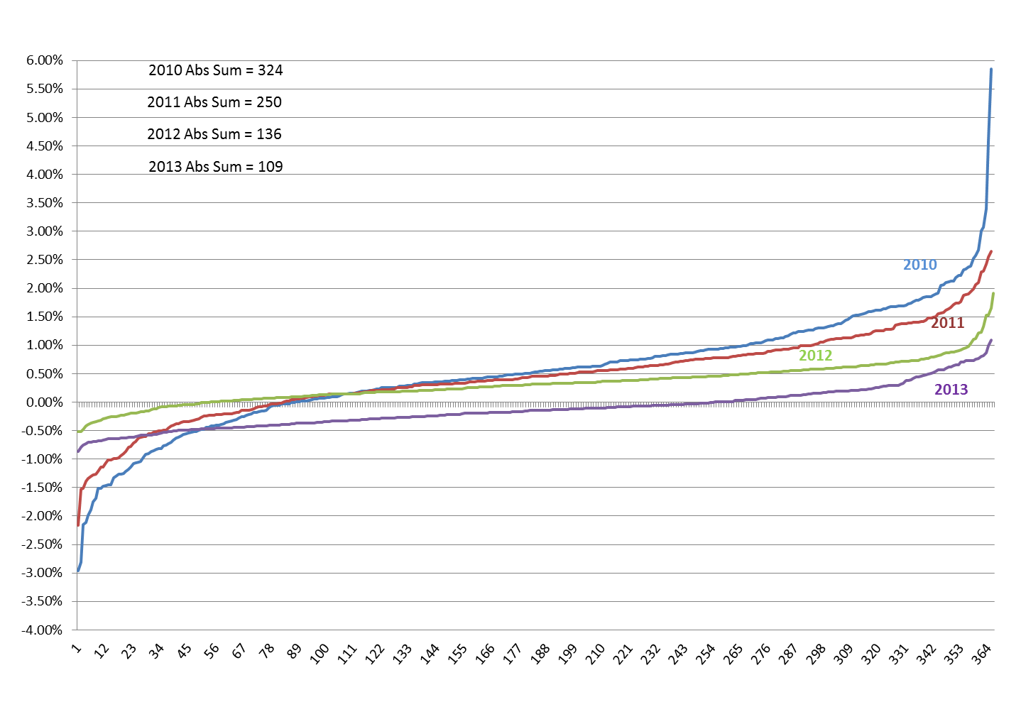
Average Daily % UFE (sorted low to high)
May 2014 PWG Meeting

Slide 7
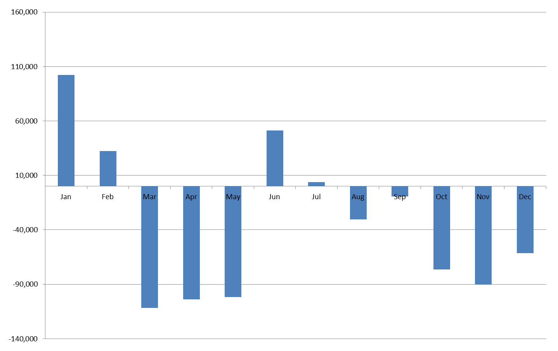
UFE Monthly MWH
May 2014 PWG Meeting

Slide 8
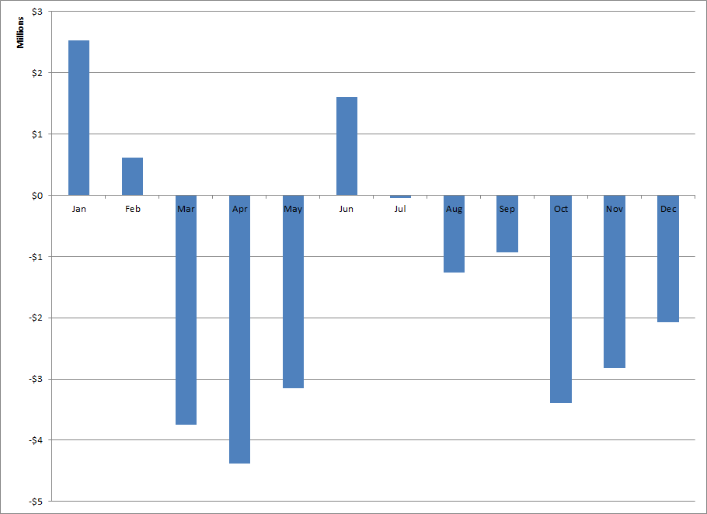
UFE Monthly Cost
May 2014 PWG Meeting

Slide 9
Historical Yearly Values
 | MWH | COST | % of LOAD | AVG PRICE
2003 | 1,672,727 | $156,733,428 | 0.40% | $41.31
2004 | 1,344,289 | $102,693,690 | 0.40% | $42.00
2005 | 1,082,561 | $174,154,088 | 0.30% | $65.91
2006 | 2,304,458 | $187,975,534 | 0.70% | $51.26
2007 | 2,914,297 | $206,949,832 | 0.90% | $52.77
2008 | 1,541,086 | $134,692,211 | 0.40% | $68.04
2009 | 1,351,187 | $44,857,873 | 0.40% | $30.89
2010 | 1,756,344 | $85,406,714 | 0.55% | $35.74
2011 | 1,453,256 | $31,666,952 | 0.43% | $43.30
2012 | 1,002,761 | $25,945,816 | 0.31% | $26.60
2013 | -395,393 | -$17,061,127 | -0.12% | $31.71
May 2014 PWG Meeting

Slide 10
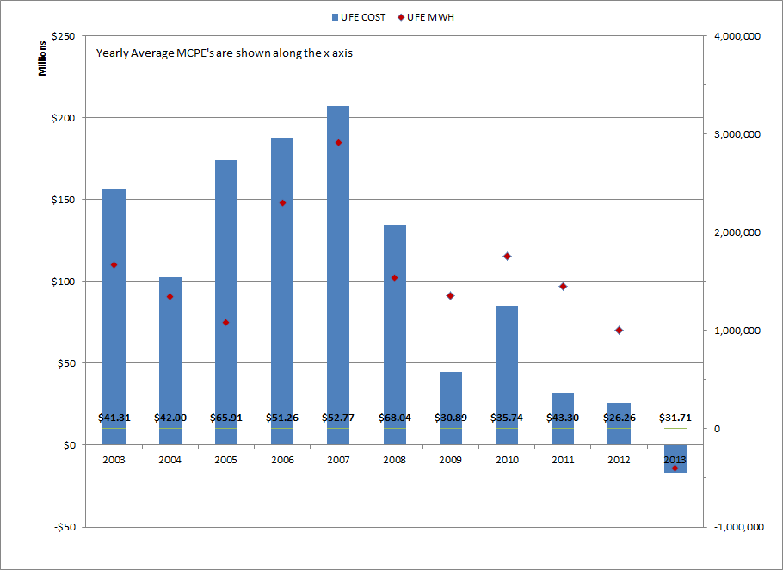
Historical UFE Cost, MWH and Average MCPE
May 2014 PWG Meeting

Slide 11
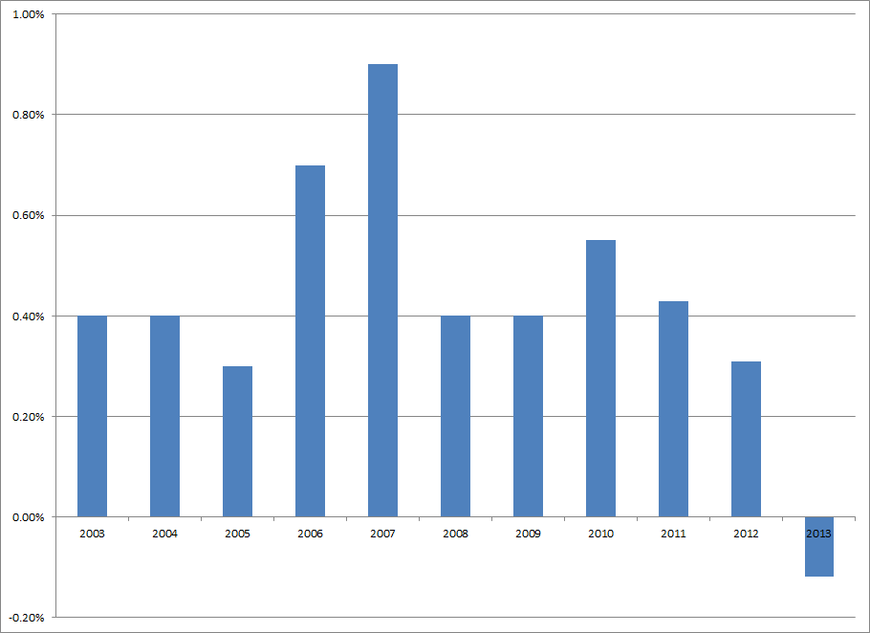
Historical UFE as Percent of Load
May 2014 PWG Meeting

Slide 12
Transmission Loss Factor Calculation Review
13.2.3 Transmission Loss Factor Calculations
  The following formulas shall be used to translate the seasonal on-peak and off-peak TLFs into Settlement Interval TLFs.
    TLF_{i} = (SSC * SIEL_{i}) + SIC
Variable | Unit | Description
i | none | Interval
TLF_{i} | none | Transmission Loss Factor for a Settlement Interval
SIEL_{i} | MWh | Settlement Interval ERCOT System Load (forecasted or actual)
SSC | none | Seasonal Slope Coefficient
SIC | none | Seasonal Intercept Coefficient
And
 | SSC = (SONLF – SOFFLF)/(SONL-SOFFL)
 | SIC = [(SOFFLF*SONL)-(SONLF*SOFFL)]/(SONL-SOFFL)
Variable | Unit | Description
SONLF | none | Seasonal on-peak percent loss factor
SOFFLF | none | Seasonal off-peak percent loss factor
SONL | none | Seasonal on-peak Load value
SOFFL | none | Seasonal off-peak Load value
May 2014 PWG Meeting

Slide 13
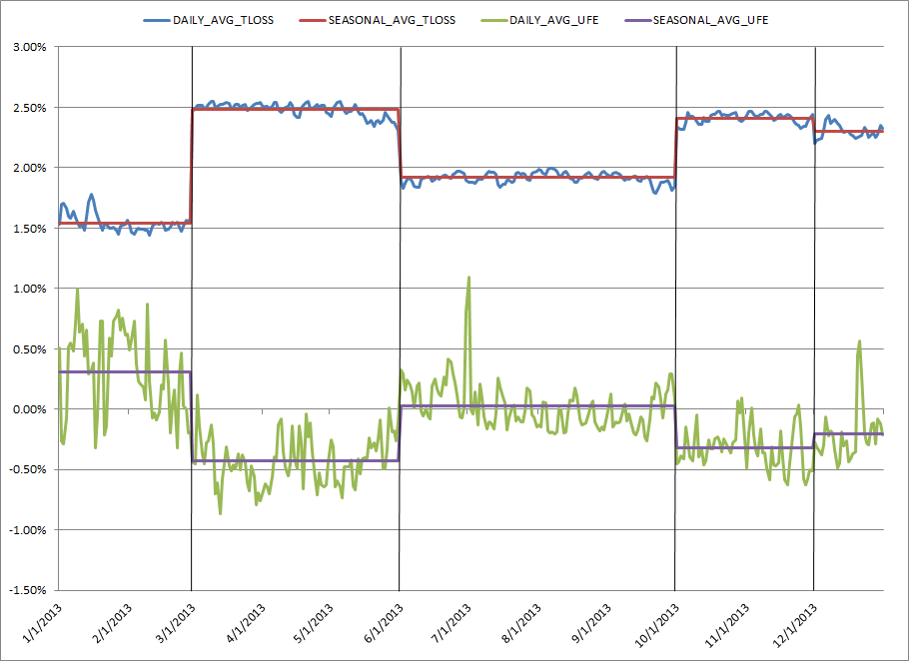
2013 Transmission Loss vs. UFE
May 2014 PWG Meeting

Slide 14
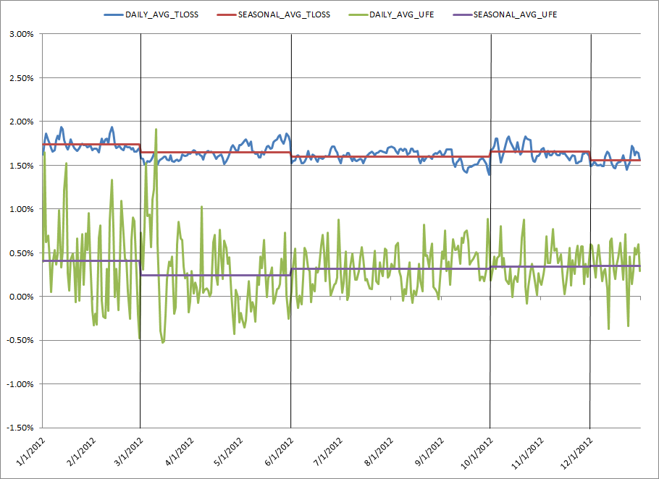
2012 Transmission Loss vs. UFE
May 2014 PWG Meeting

Slide 15
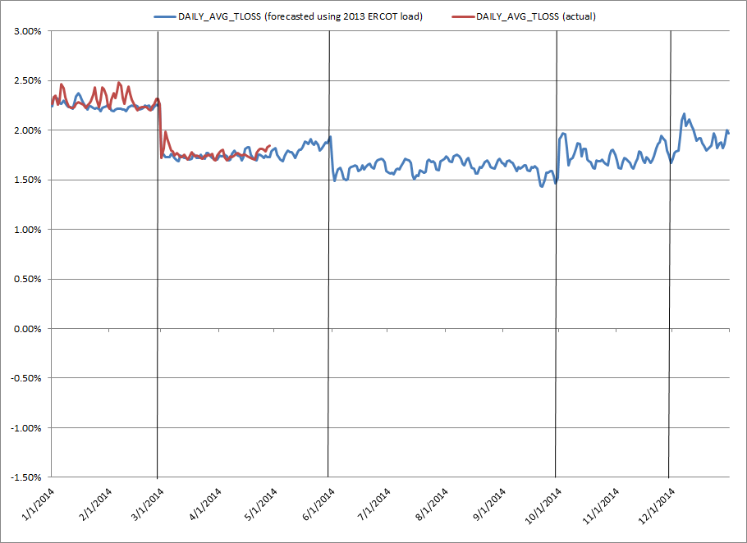
2014 Transmission Loss (Actual & Forecasted)
May 2014 PWG Meeting

