Slide 1

UFE 2007 ANALYSIS
Compiled by Load Profiling
ERCOT Energy Analysis & Aggregation

Slide 2
UFE Basics
UFE (unaccounted for energy) is computed as follows:
UFE = Generation – (Load + Losses)
Sources of UFE include:
■ Generation Measurement Errors
■ Load - Missing/Erroneous Usage Data
- Model Error
- Load Profile ID Assignment Error
- Theft
■ Losses - Model Error
- Loss Code Assignment Error
Negative UFE indicates load/losses are overestimated

Slide 3
UFE Basics
UFE
Net Generation for Settlement Interval
GAP - - - - - - >
Losses:
Transmission & Distribution
Profiled Energy Usage
Non-Interval Data
Non-Metered Accounts
Net Generation
Compared to
Load Buildup
Interval Data
Energy Usage

Slide 4

OVERVIEW OF THE SETTLEMENT PROCESS
UFE is computed for each 15-minute interval of a settlement run.
Initial Settlement
(posted on day 10 after the operating day)
Final Settlement
(posted on day 60 after the operating day)
True-up Settlement (posted 6 months after operating day)
Resettlement statement (posted as needed)
Final
Settlement
Initial
True-Up

Slide 5
Load Weighted Calculation of MCPE
Market Clearing Price for Energy (MCPE) is the highest price by Congestion Zone for a Settlement Interval for Balancing Energy deployed during the Settlement Interval.
In 2007 there were 4 congestion zones – H07, N07, S07 and W07.
The load weighted MCPE is calculated for each 15 min. interval using the LCMZone cuts as follows:
  MCPE_LWTD =
  ((LCMZone_H07_MWh * MCPEL_H07) +
  (LCMZone_N07_MWh * MCPEL_N07) + (LCMZone_S07_MWh * MCPEL_S07) +
  (LCMZone_W07_MWh * MCPEL_W07)) /
  (LCMZone_H07_MWh + LCMZone_N07_MWh + LCMZone_S07_MWh + LCMZone_W07_MWh)

Slide 6
Events that Influenced 2007 UFE
Annual validation 2006 was completed resulting in some changes to Profile ID assignments.
New profile models were implemented, effective May 15, 2007.
Transmission and distribution loss factors were updated in March 2007. Transmission losses are based on a March - February year.
The ERCOT region experienced unusually cool temperatures during the summer.

Slide 7
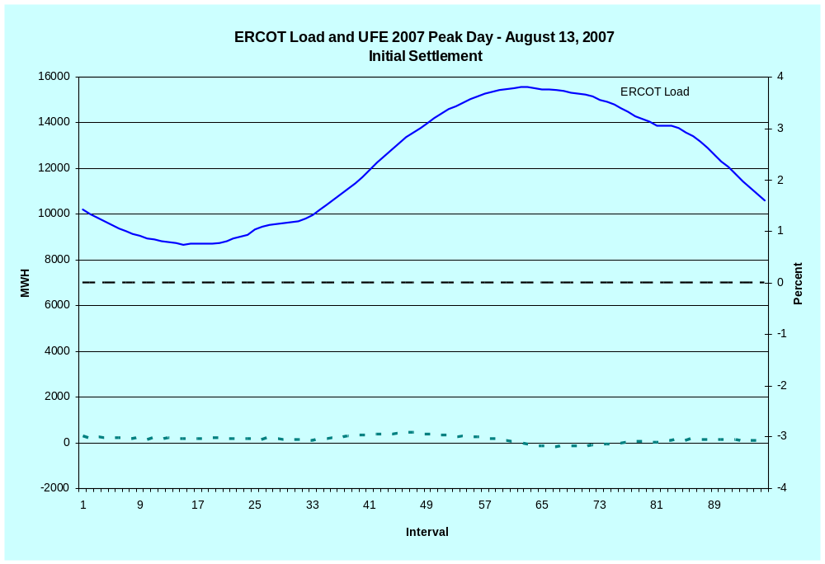
LOAD AND UFE – ERCOT PEAK 2007
Initial Settlement
SR01

Slide 8
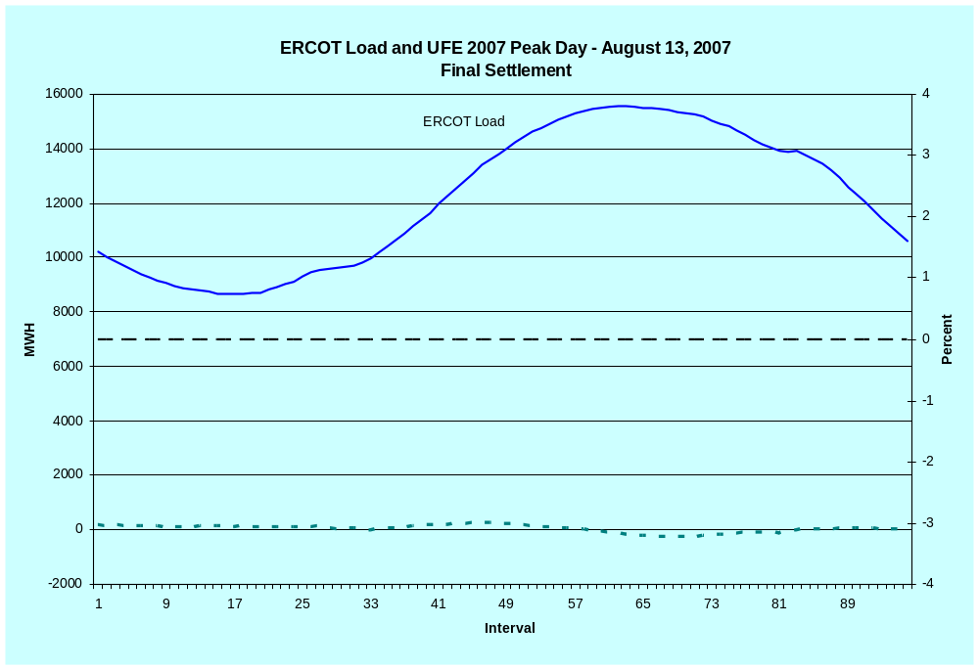
LOAD AND UFE – ERCOT PEAK 2007
Final Settlement
SR02

Slide 9
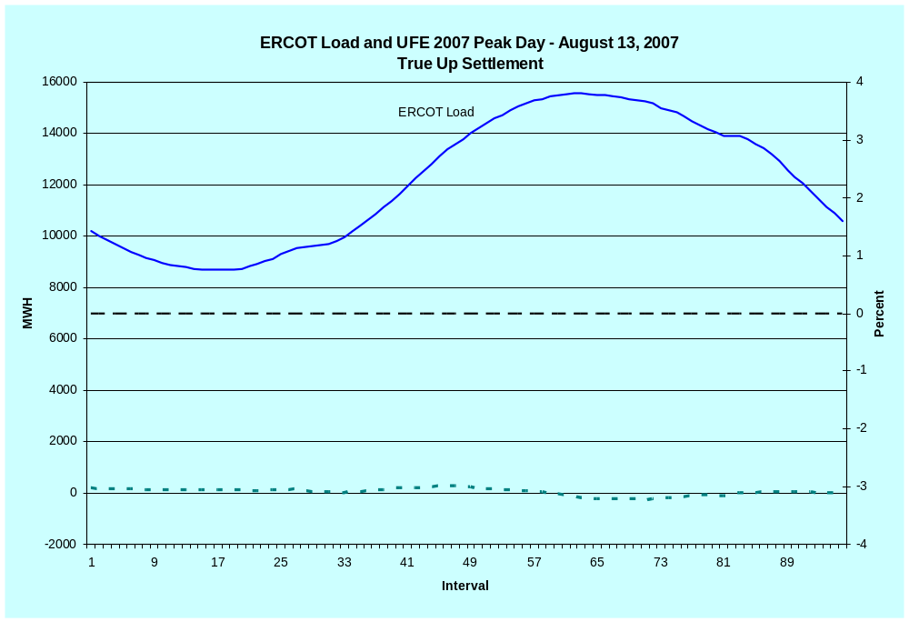
LOAD AND UFE – ERCOT PEAK 2007
True Up Settlement
SR03

Slide 10
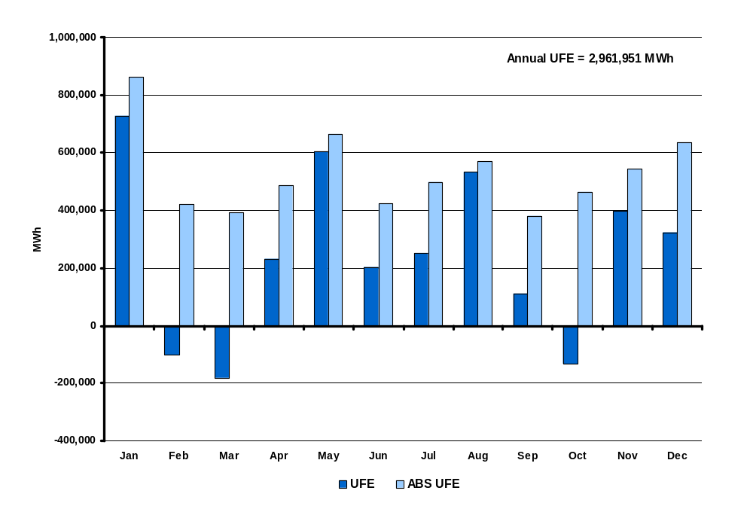
UFE MWh by Month in 2007
Initial Settlement
SR04
Notes:
This is NET UFE. + and – are canceling out. May and Oct (shoulder months) are the highest while April (another shoulder month) is lowest. Winter months are generally higher than summer months.

Slide 11
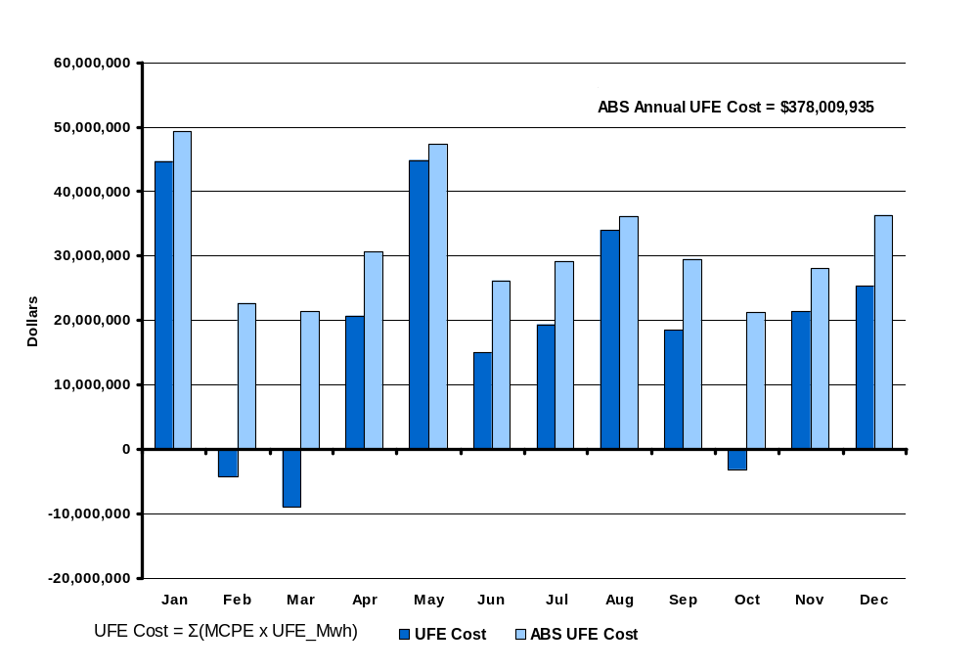
UFE Cost by Month in 2007
Initial Settlement
SR05

Slide 12
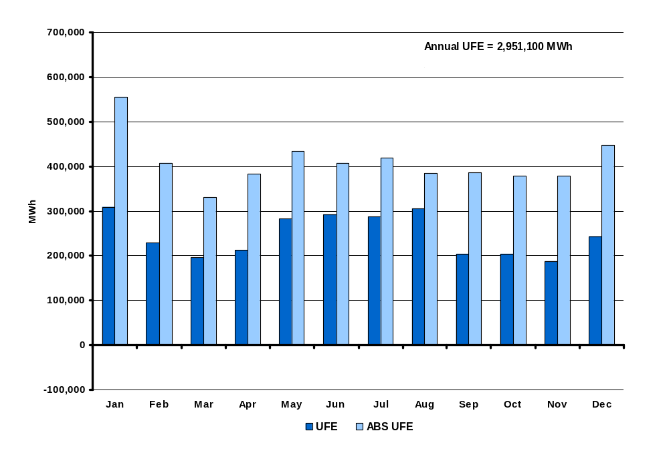
UFE MWh by Month in 2007
Final Settlement
SR06
Notes:
This is NET UFE. + and – are canceling out. May and Oct (shoulder months) are the highest while April (another shoulder month) is lowest. Winter months are generally higher than summer months.

Slide 13
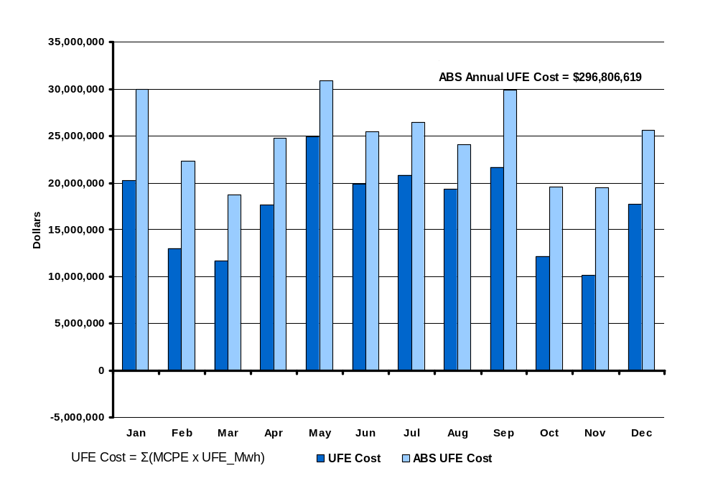
UFE Cost by Month in 2007
Final Settlement
SR07
Notes:
Annual total is 1,676,343 Mwh. Again, this is NET UFE.

Slide 14
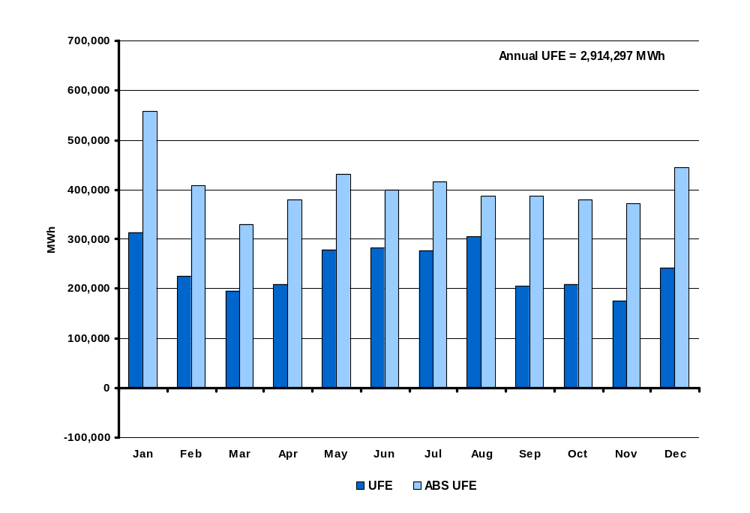
UFE MWh by Month in 2007
True-Up Settlement
SR08
Notes:
This is NET UFE. + and – are canceling out. May and Oct (shoulder months) are the highest while April (another shoulder month) is lowest. Winter months are generally higher than summer months.

Slide 15
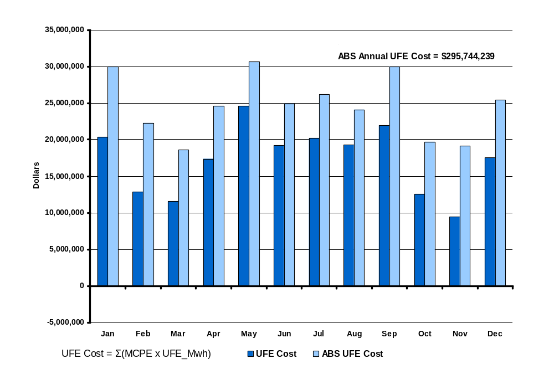
UFE Cost by Month in 2007
True-UP Settlement
SR09
Notes:
Annual total is 1,676,343 Mwh. Again, this is NET UFE.

Slide 16
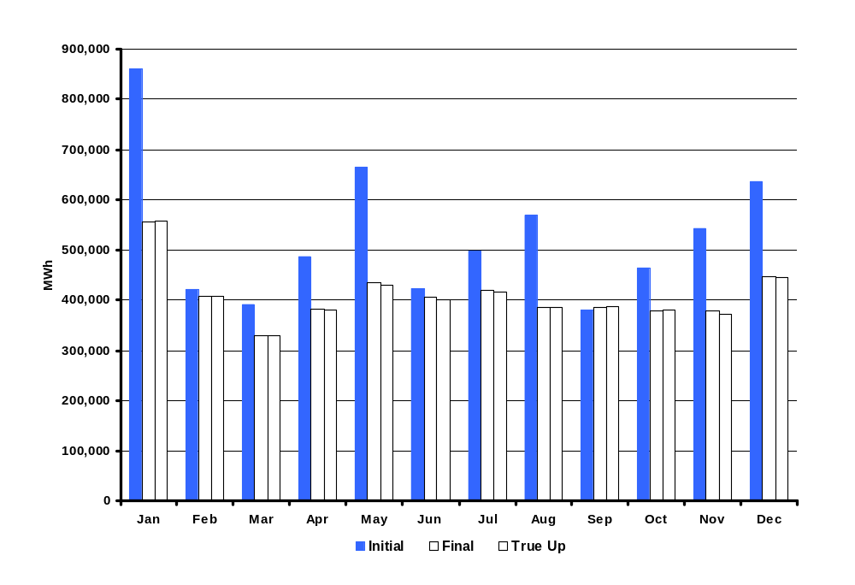
ABS UFE MWh by Month in 2007
Initial, Final and True Up Settlements
SR09a
Notes:
Annual total is 1,676,343 Mwh. Again, this is NET UFE.

Slide 17
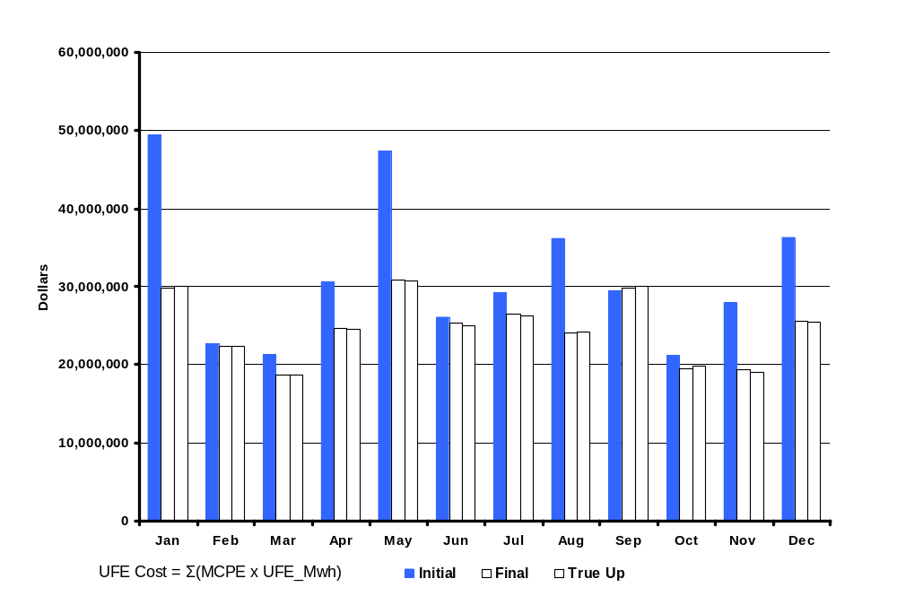
ABS UFE Cost by Month in 2007
Initial, Final and True-Up Settlements
SR09b
Notes:
Annual total is 1,676,343 Mwh. Again, this is NET UFE.

Slide 18
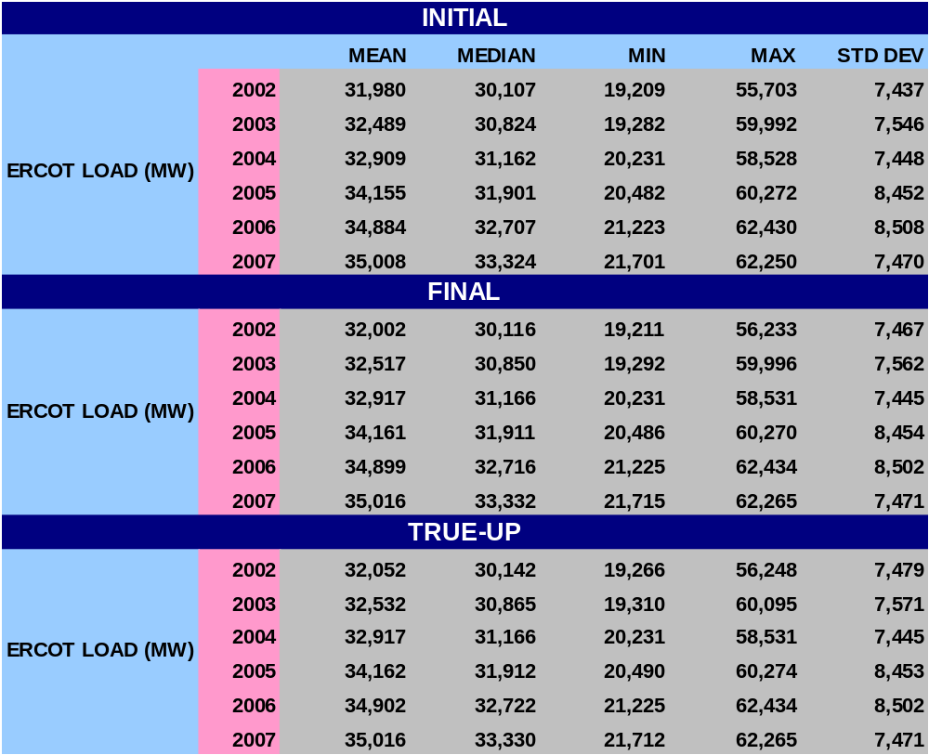
STATISTICAL SUMMARY - 2007
SR10

Slide 19
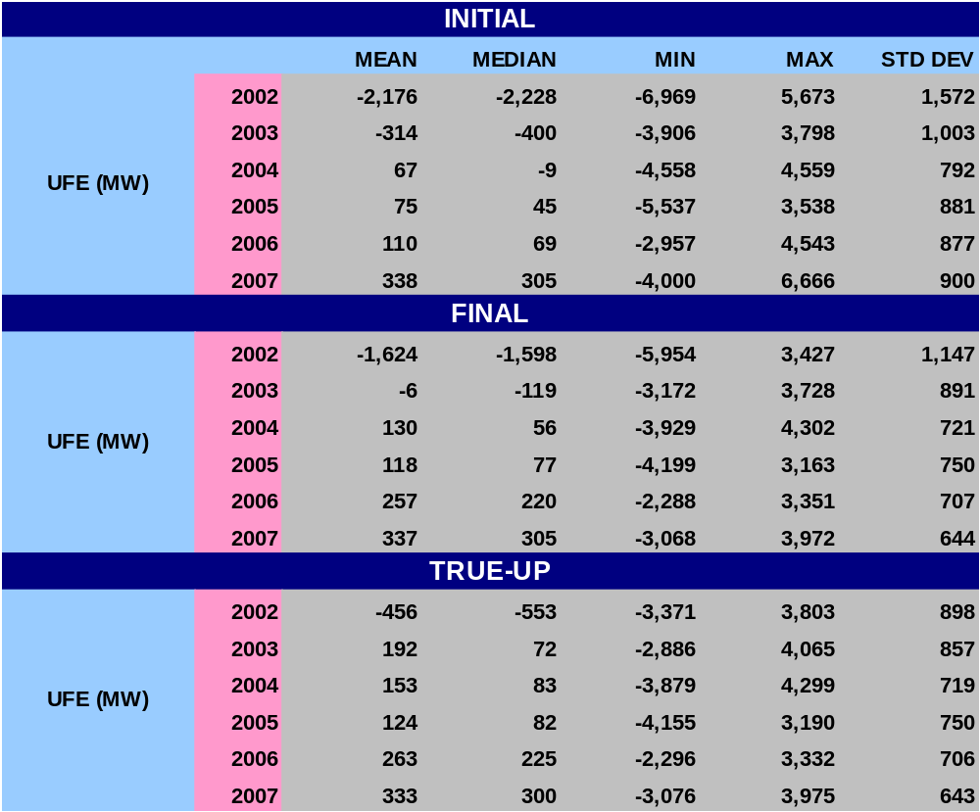
STATISTICAL SUMMARY - 2007
SR11a

Slide 20
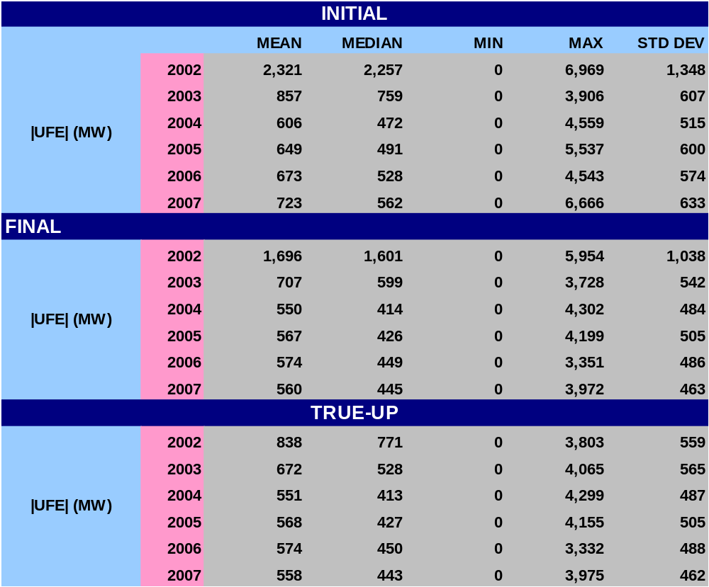
STATISTICAL SUMMARY - 2007
SR11b

Slide 21
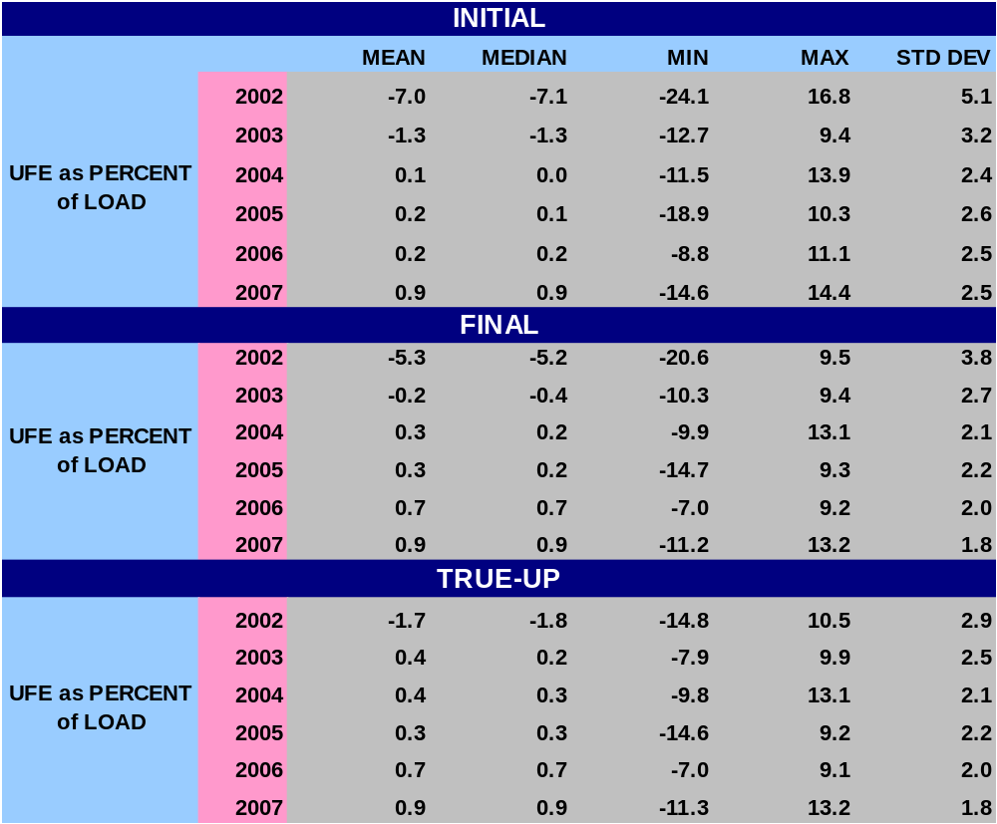
STATISTICAL SUMMARY - 2007
SR12a
Notes:
Last bullet – w/ regard to Mean and Median, UFE gets better with later settlements.

Slide 22
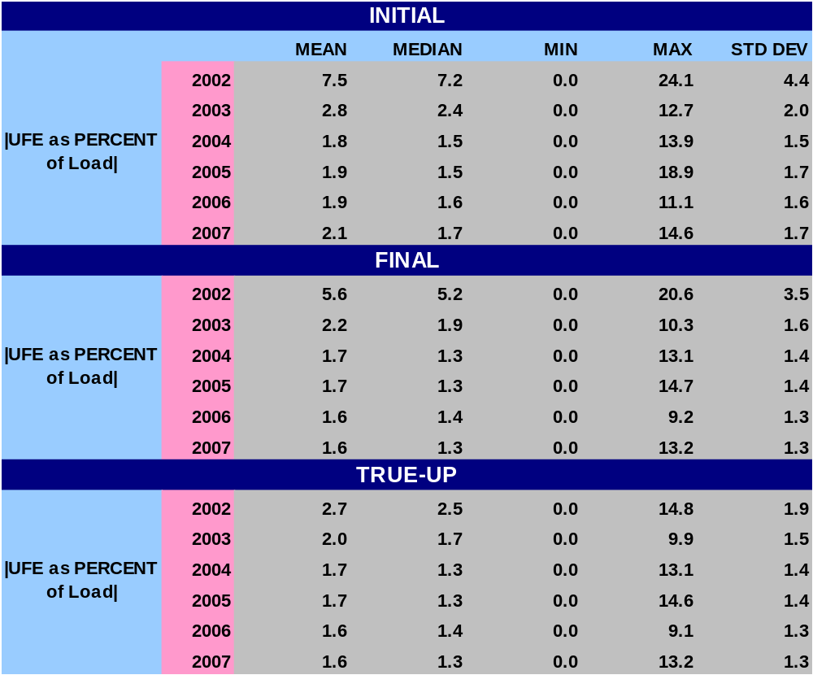
STATISTICAL SUMMARY - 2007
SR12b
Notes:
Last bullet – w/ regard to Mean and Median, UFE gets better with later settlements.

Slide 23
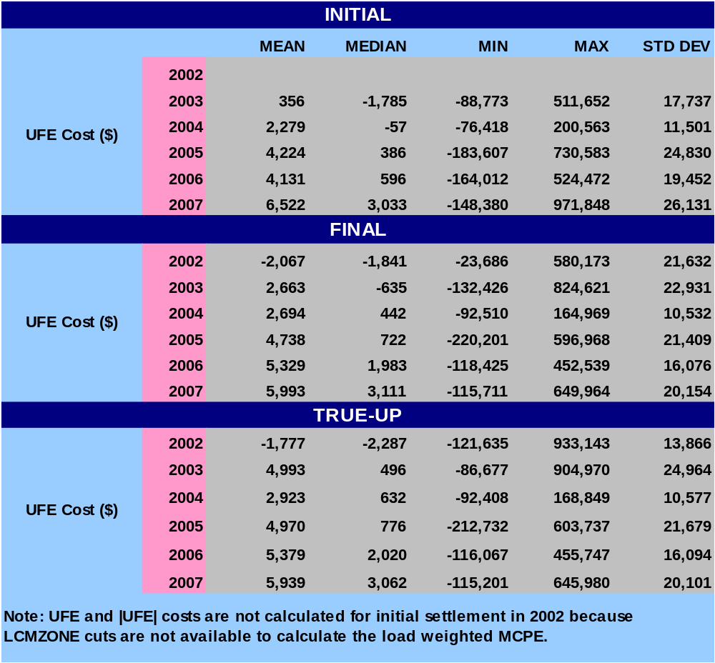
STATISTICAL SUMMARY - 2007
SR13a
Notes:
Last bullet – w/ regard to Mean and Median, UFE gets better with later settlements.

Slide 24
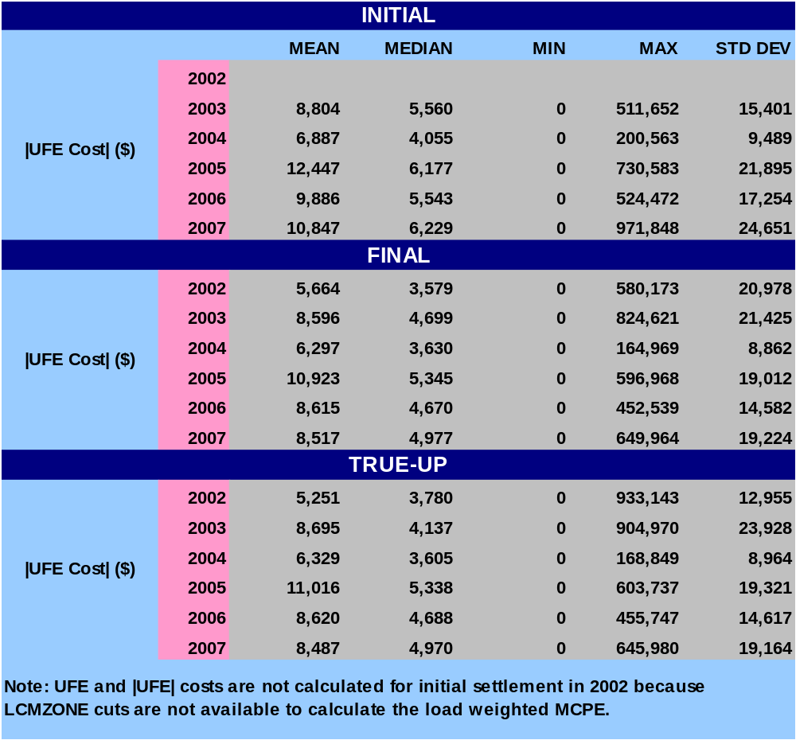
STATISTICAL SUMMARY - 2007
SR13b
Notes:
Last bullet – w/ regard to Mean and Median, UFE gets better with later settlements.

Slide 25
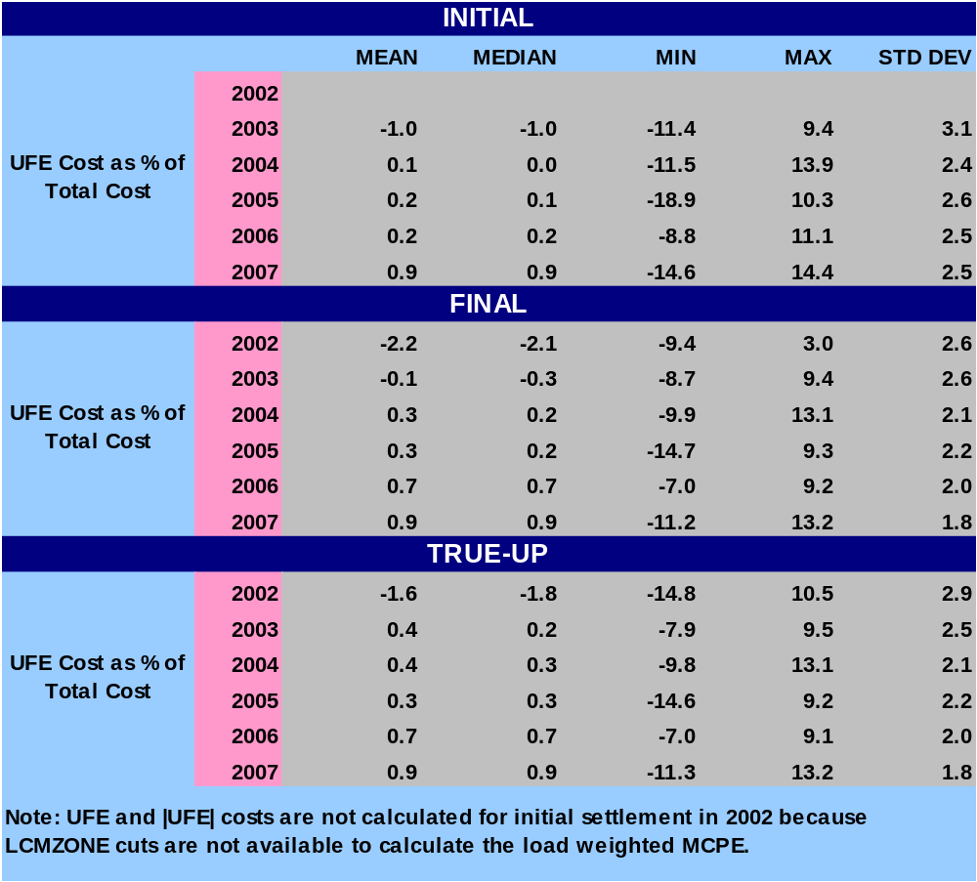
STATISTICAL SUMMARY - 2007
SR14a
Notes:
Last bullet – w/ regard to Mean and Median, UFE gets better with later settlements.

Slide 26
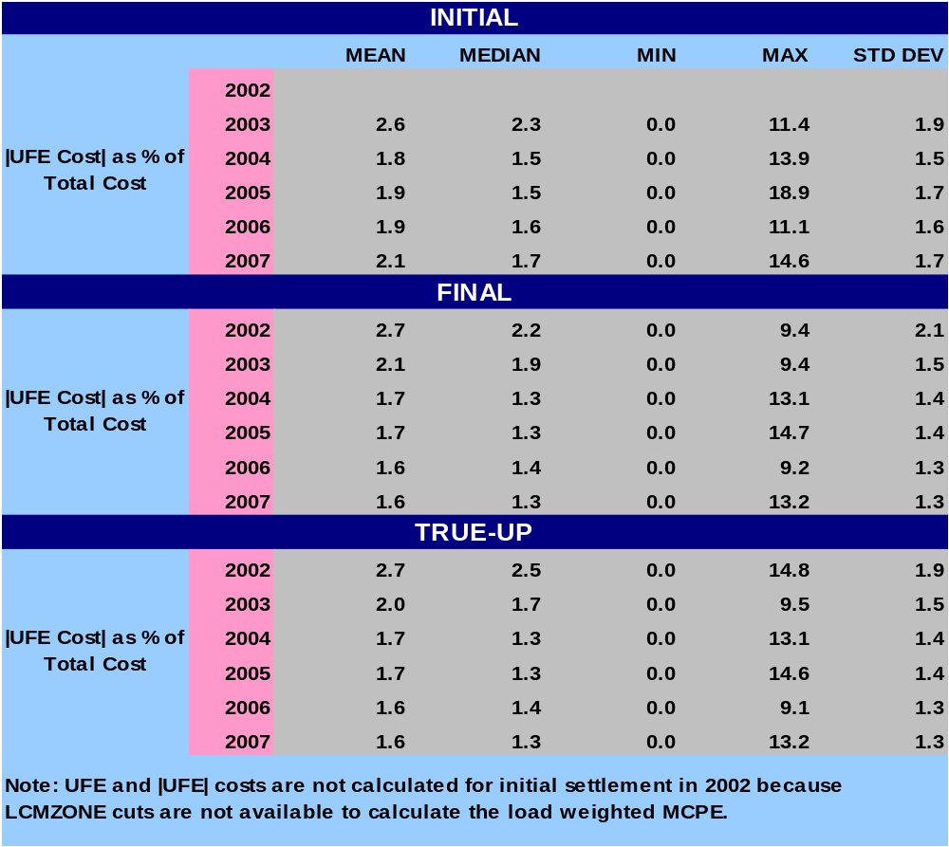
STATISTICAL SUMMARY - 2007
SR14b
Notes:
Last bullet – w/ regard to Mean and Median, UFE gets better with later settlements.

Slide 27
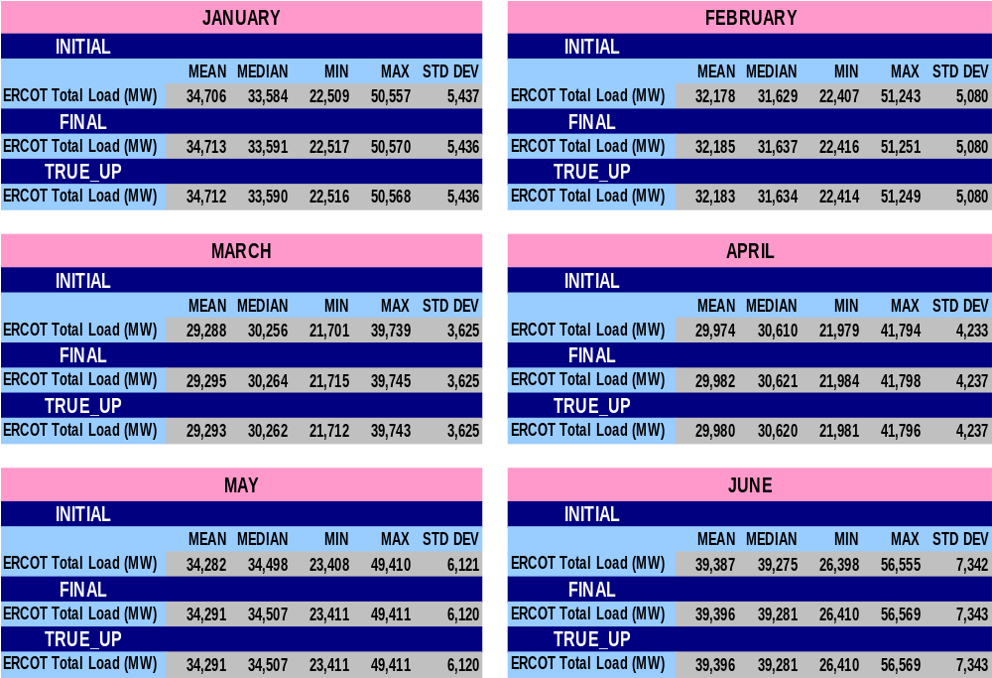
STATISTICAL SUMMARY – MONTHLY for 2007
SR15

Slide 28
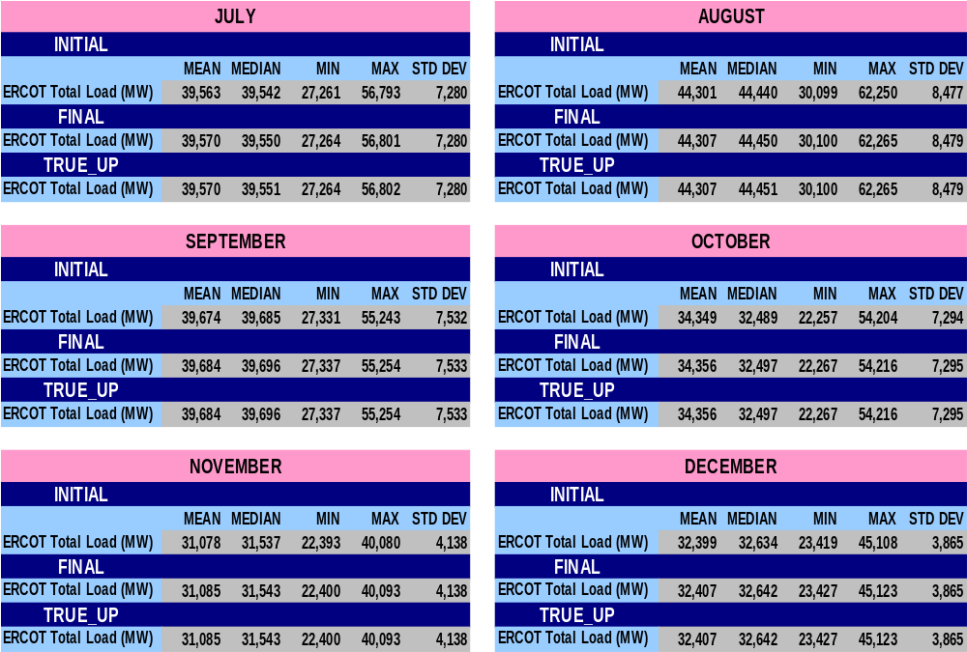
STATISTICAL SUMMARY – MONTHLY for 2007
SR16

Slide 29
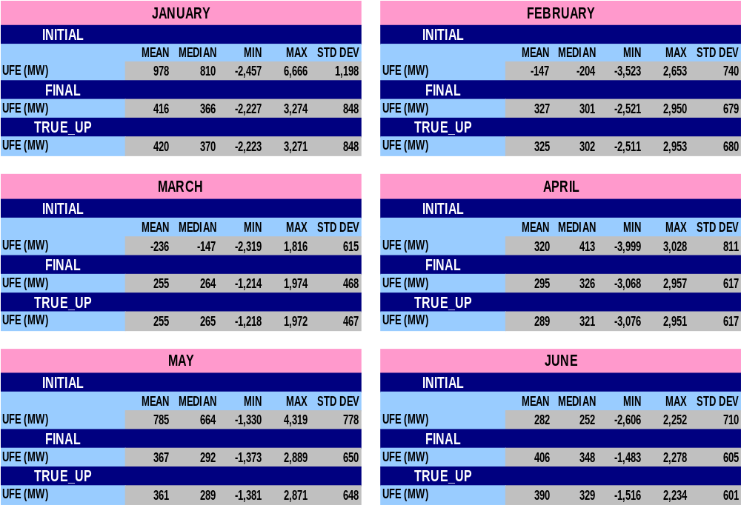
STATISTICAL SUMMARY – MONTHLY for 2007
SR17

Slide 30
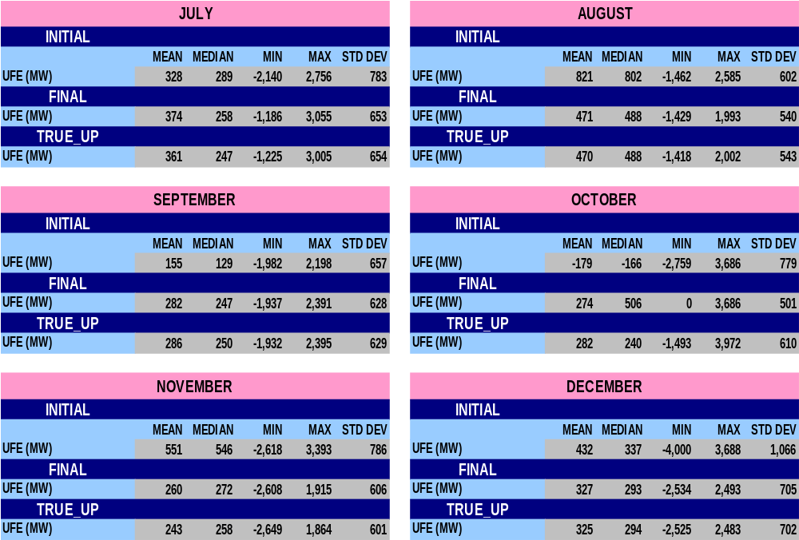
STATISTICAL SUMMARY – MONTHLY for 2007
SR18

Slide 31
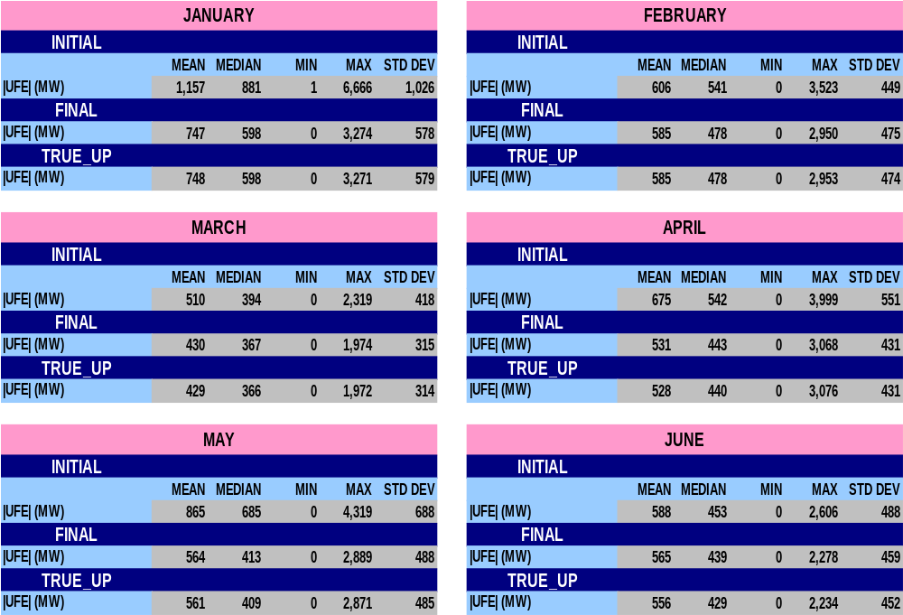
STATISTICAL SUMMARY – MONTHLY for 2007
SR19

Slide 32
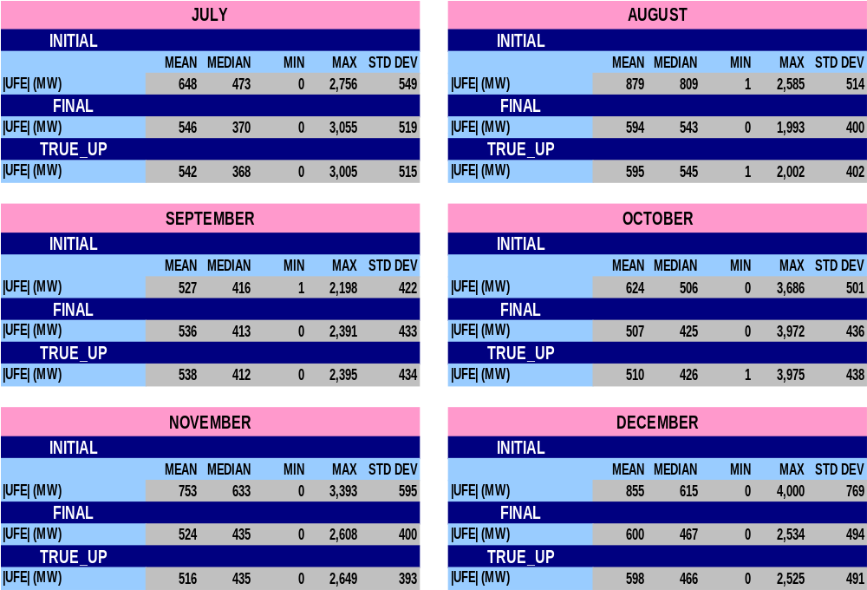
STATISTICAL SUMMARY – MONTHLY for 2007
SR20

Slide 33
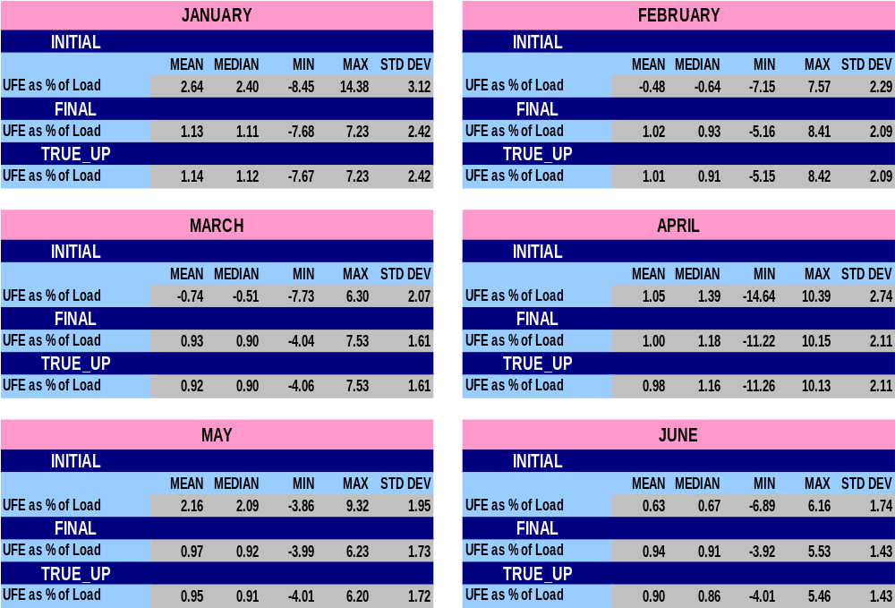
STATISTICAL SUMMARY – MONTHLY for 2007
SR21

Slide 34
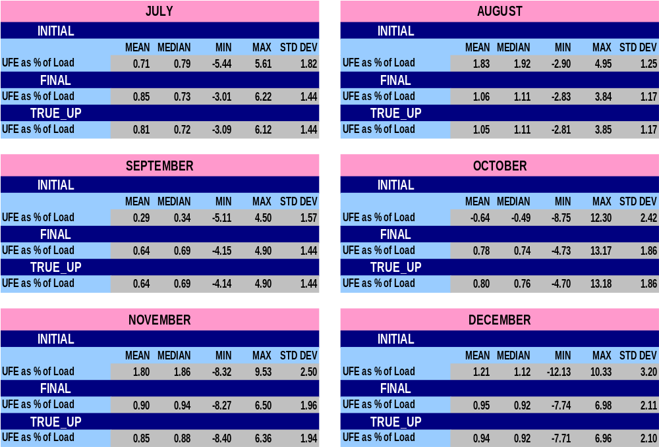
STATISTICAL SUMMARY – MONTHLY for 2007
SR22

Slide 35
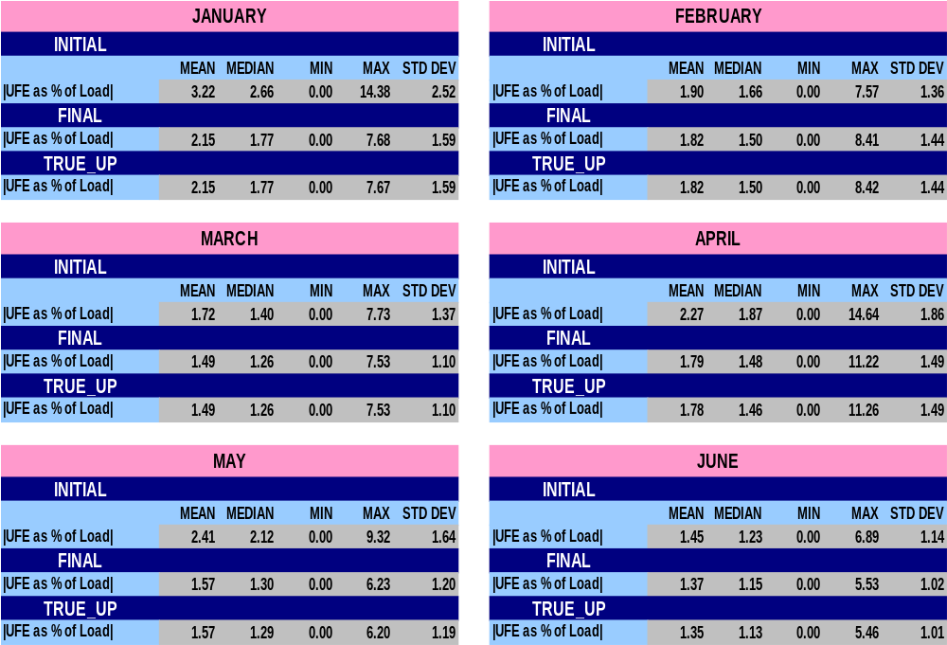
STATISTICAL SUMMARY – MONTHLY for 2007
SR23

Slide 36
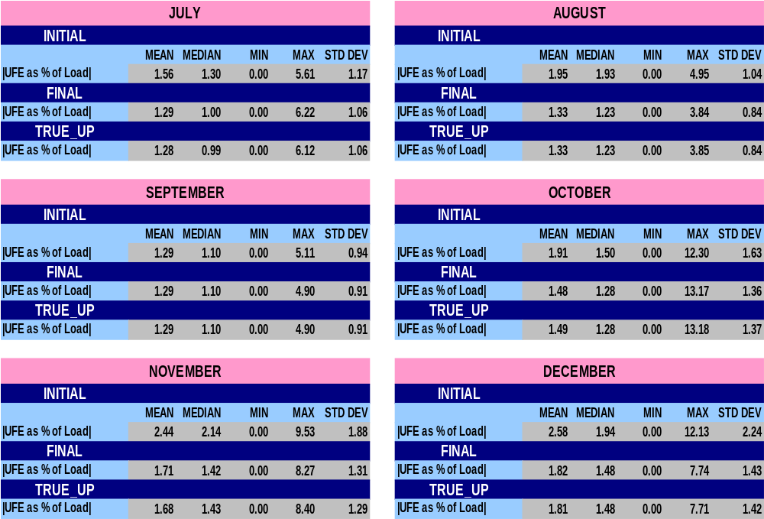
STATISTICAL SUMMARY – MONTHLY for 2007
SR24

Slide 37
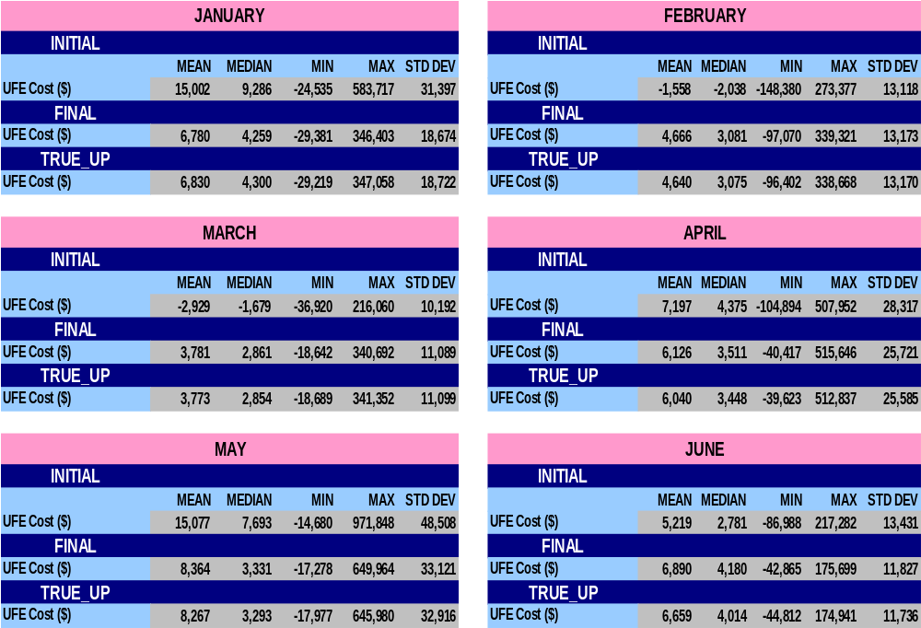
STATISTICAL SUMMARY – MONTHLY for 2007
SR25

Slide 38
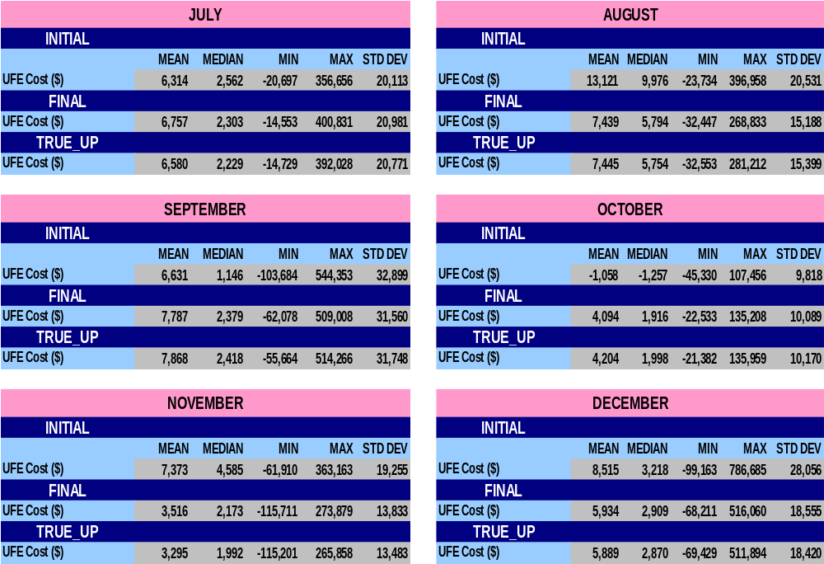
STATISTICAL SUMMARY – MONTHLY for 2007
SR26

Slide 39
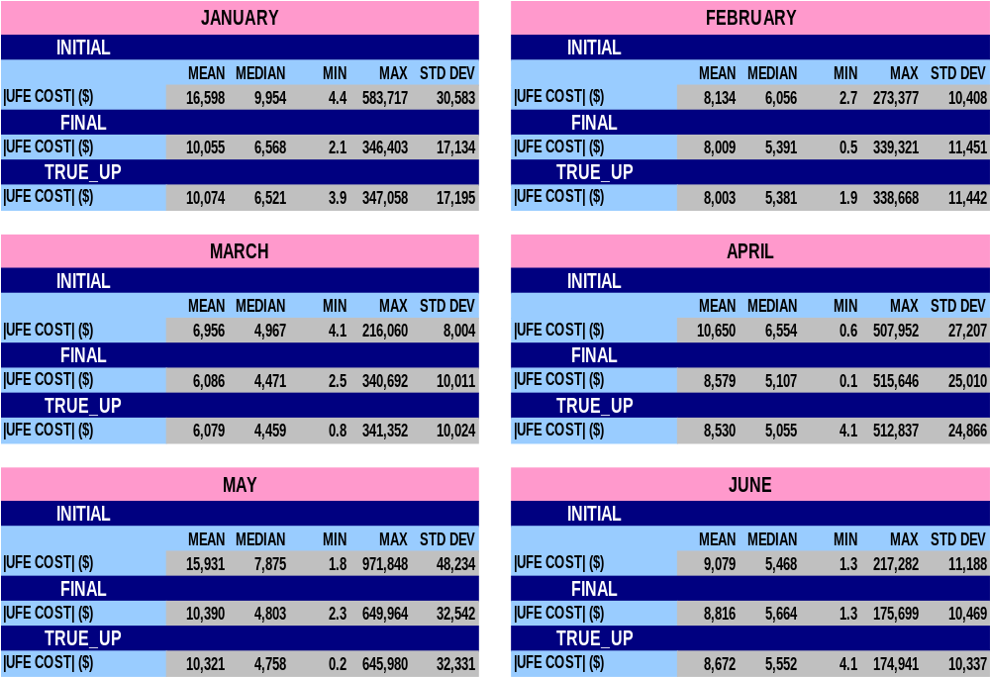
STATISTICAL SUMMARY – MONTHLY for 2007
SR27

Slide 40
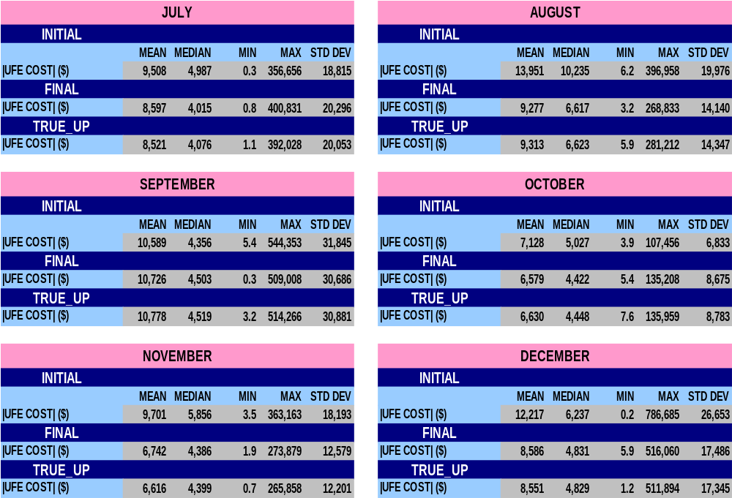
STATISTICAL SUMMARY – MONTHLY for 2007
SR28

Slide 41
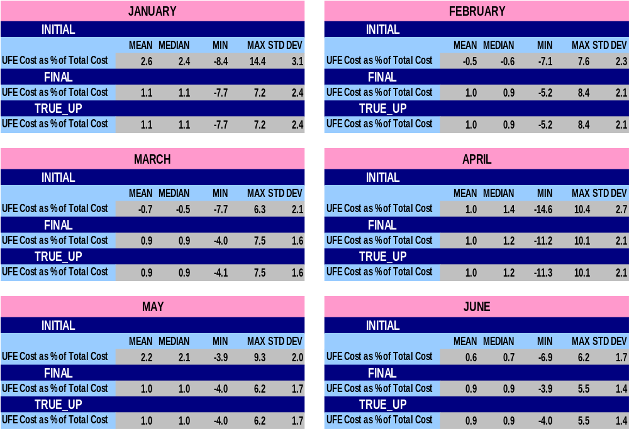
STATISTICAL SUMMARY – MONTHLY for 2007
SR29

Slide 42
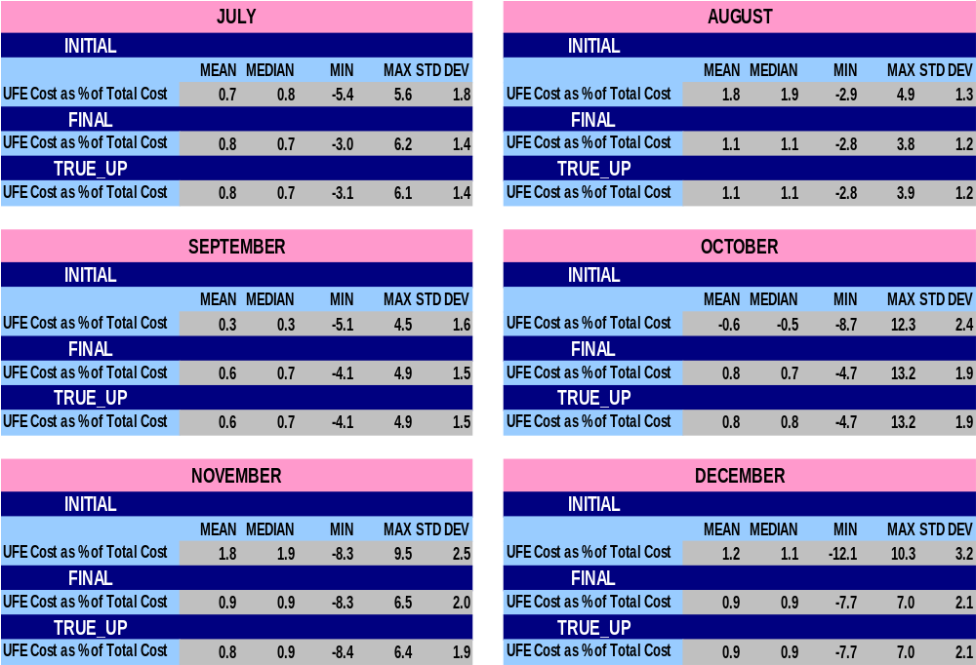
STATISTICAL SUMMARY – MONTHLY for 2007
SR30

Slide 43
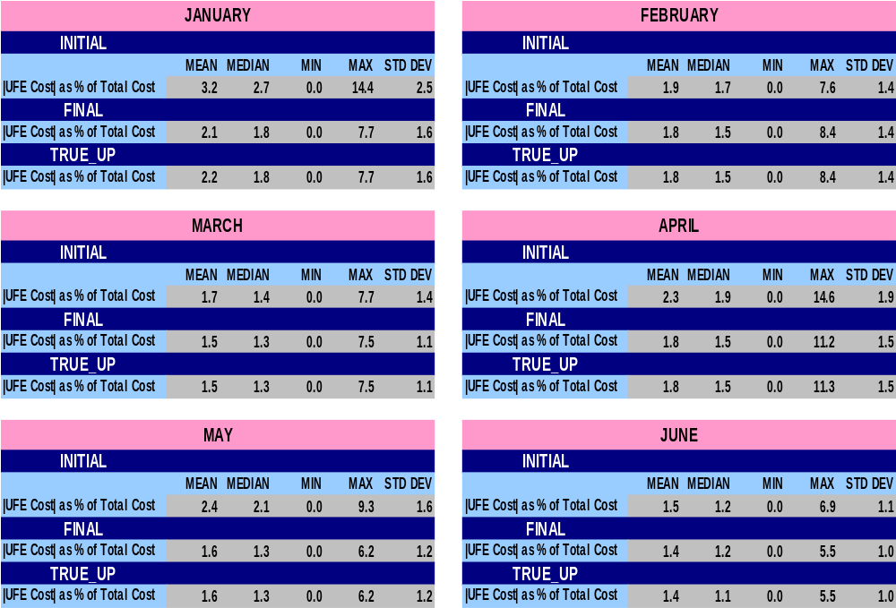
STATISTICAL SUMMARY – MONTHLY for 2007
SR31

Slide 44
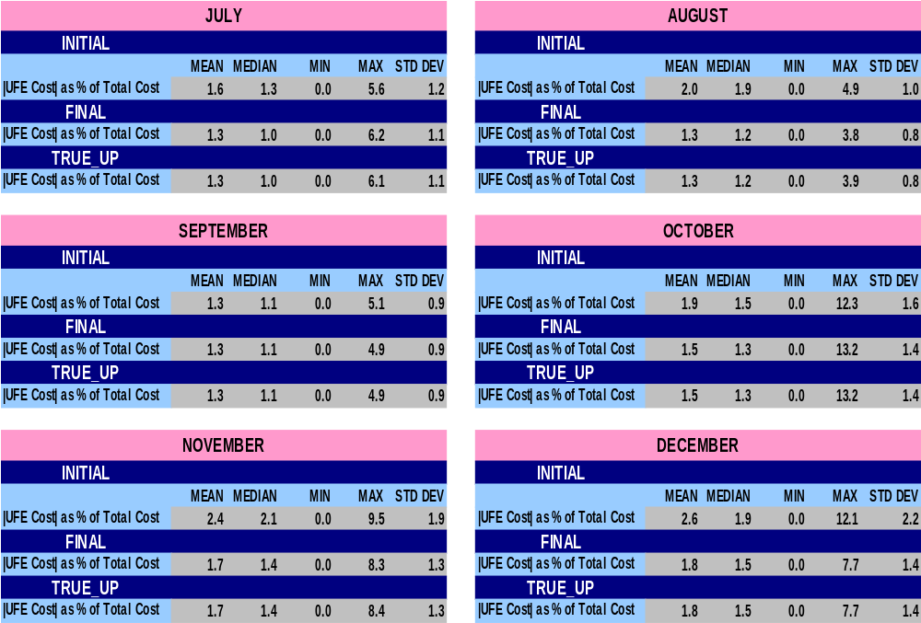
STATISTICAL SUMMARY – MONTHLY for 2007
SR32

Slide 45
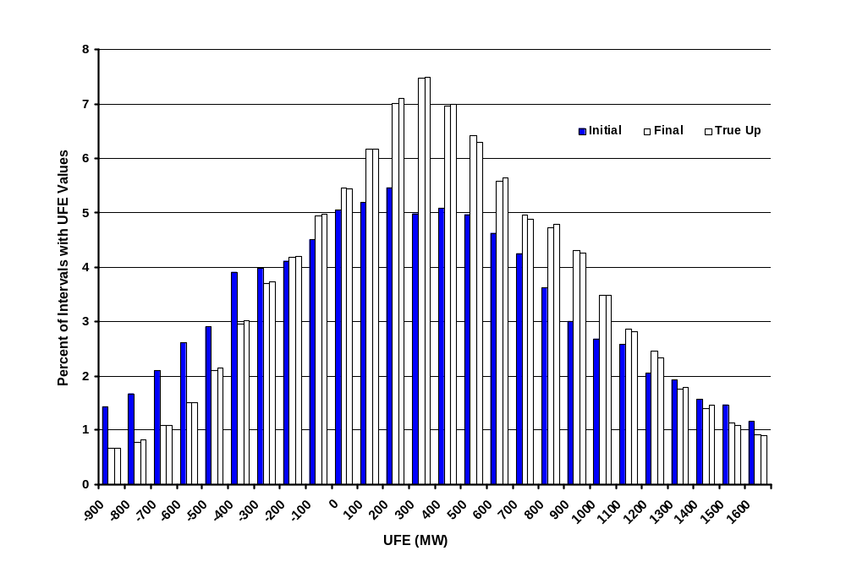
Distribution of UFE MW
Initial, Final, and True Up - 2007
UFD01
Notes:
UFE shifts in a positive direction from Initial to Final.

Slide 46
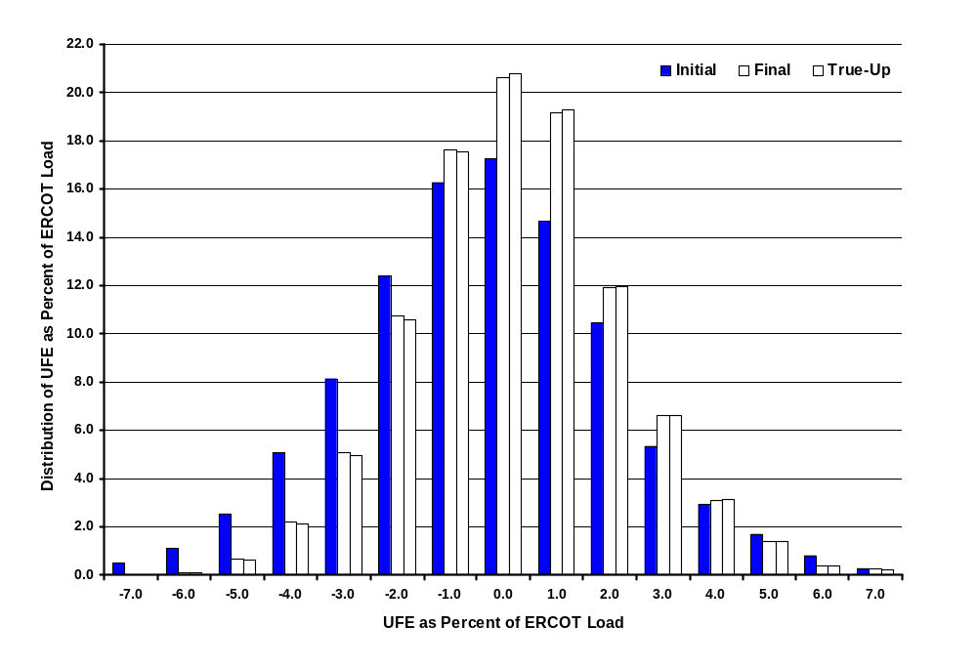
2007 Distribution of UFE as Percent of ERCOT Load
UFD03
Notes:
The UFE percent moves in a positive direction from Initial to Final thru True-Up.

Slide 47
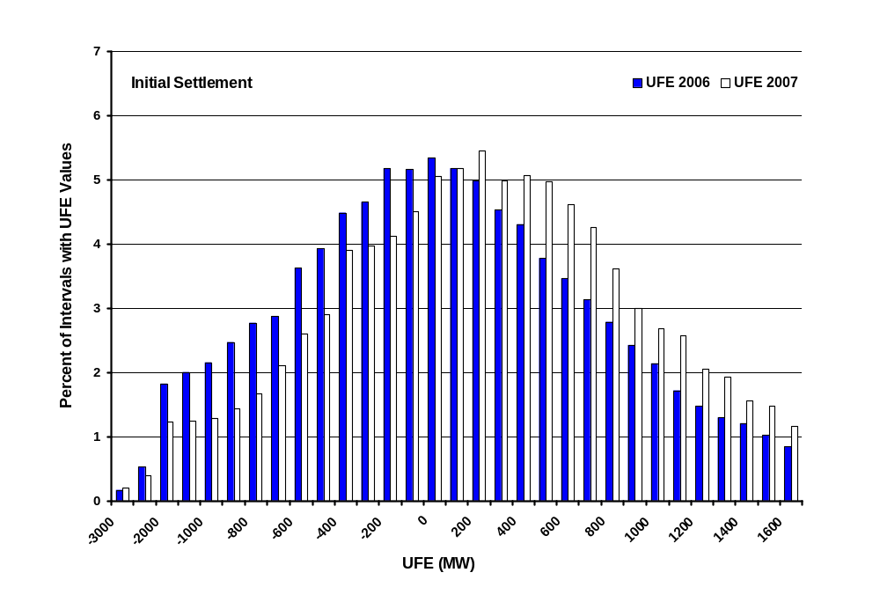
Distribution of UFE MW
2006 vs. 2007 - Initial Settlement
UFD04
Notes:
The UFE percent moves in a positive direction from Initial to Final thru True-Up.

Slide 48
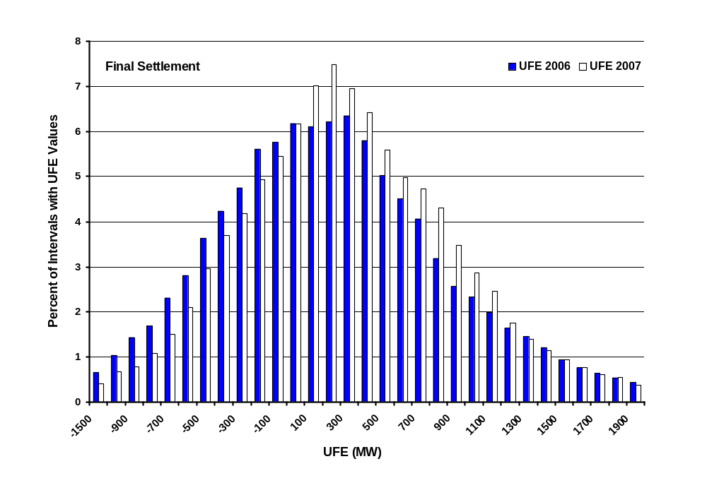
Distribution of UFE MW
2006 vs. 2007 - Final Settlement
UFD05
Notes:
The UFE percent moves in a positive direction from Initial to Final thru True-Up.

Slide 49
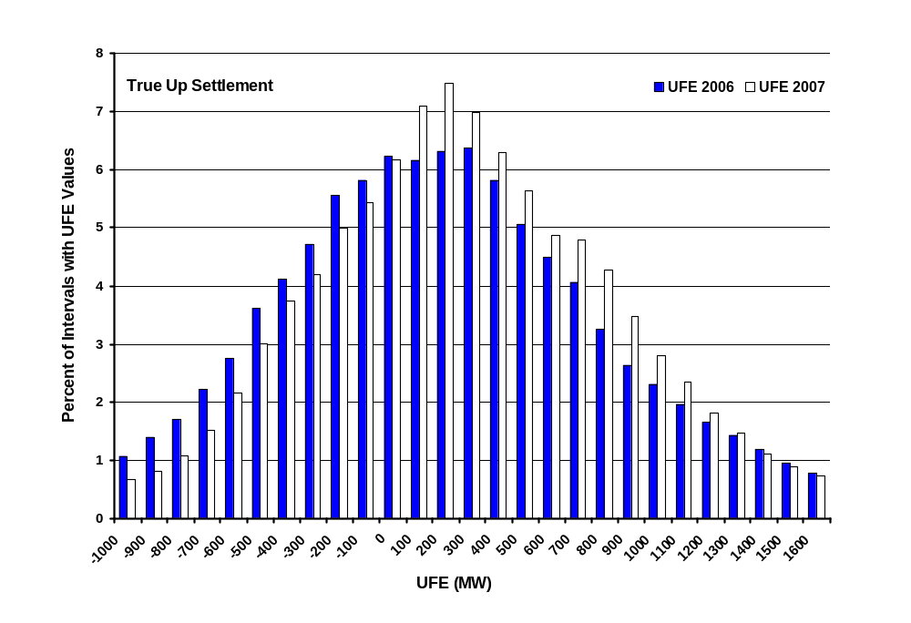
Distribution of UFE MW
2006 vs. 2007 – True Up Settlement
UFD06
Notes:
The UFE percent moves in a positive direction from Initial to Final thru True-Up.

Slide 50
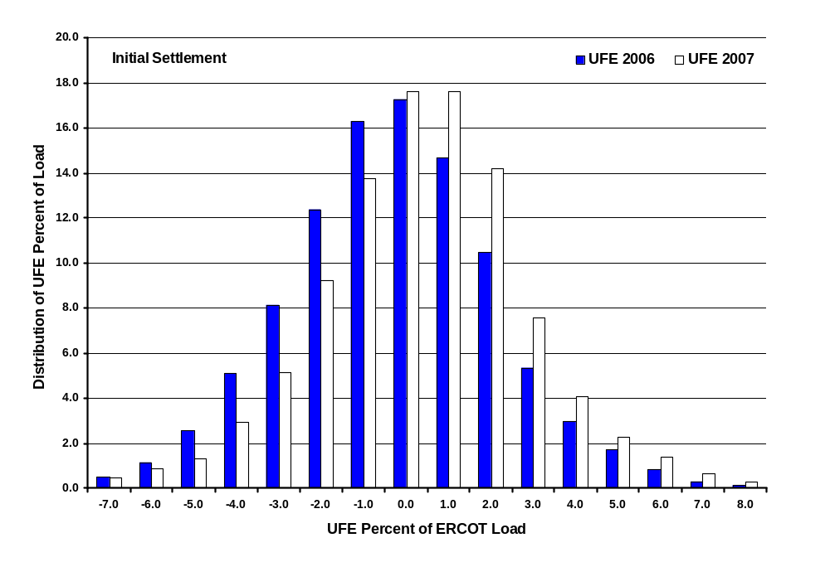
Distribution of UFE Percent of ERCOT Load
2006 vs 2007 – Initial Settlement
UFD07
Notes:
The UFE percent moves in a positive direction from Initial to Final thru True-Up.

Slide 51
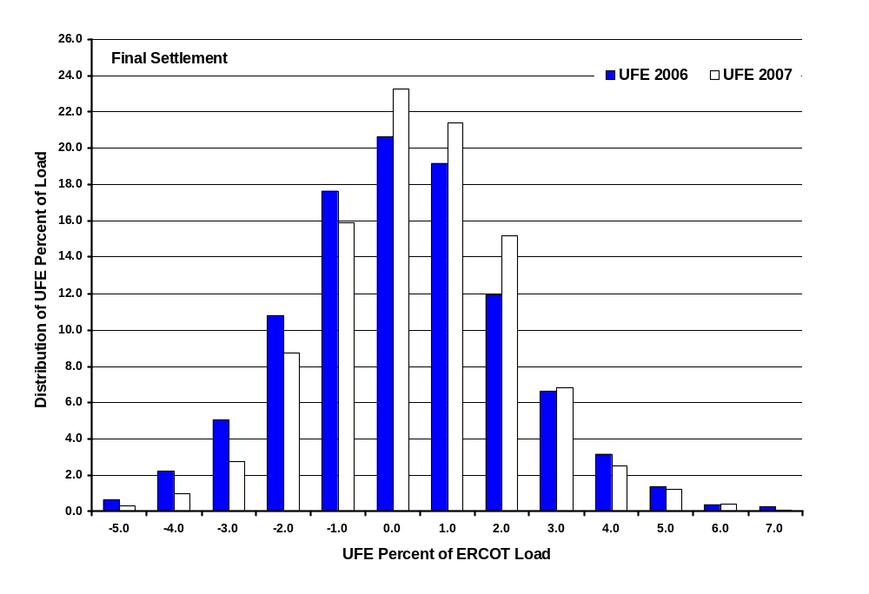
Distribution of UFE Percent of ERCOT Load
2006 vs 2007 – Final Settlement
UFD08
Notes:
The UFE percent moves in a positive direction from Initial to Final thru True-Up.

Slide 52
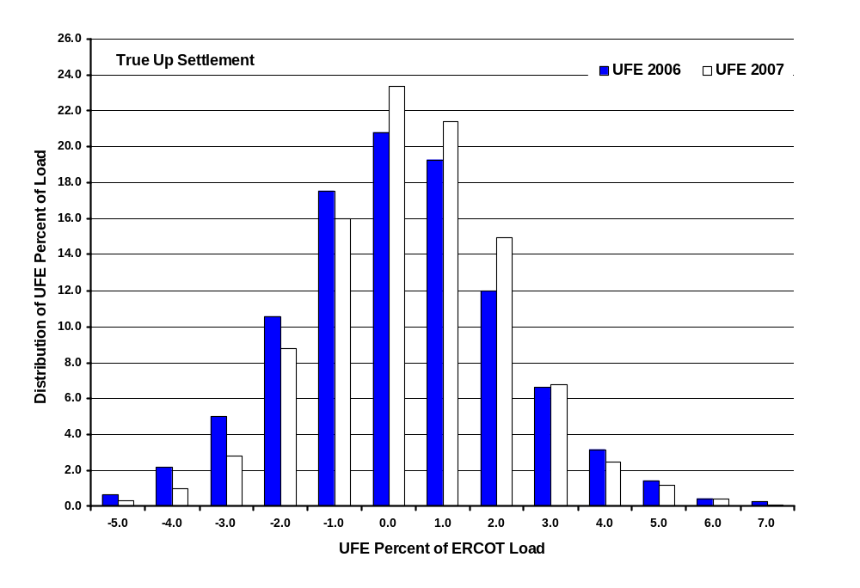
Distribution of UFE Percent of ERCOT Load
2006 vs 2007 – True Up Settlement
UFD09
Notes:
The UFE percent moves in a positive direction from Initial to Final thru True-Up.

Slide 53
UFE Distribution
Initial

Slide 54
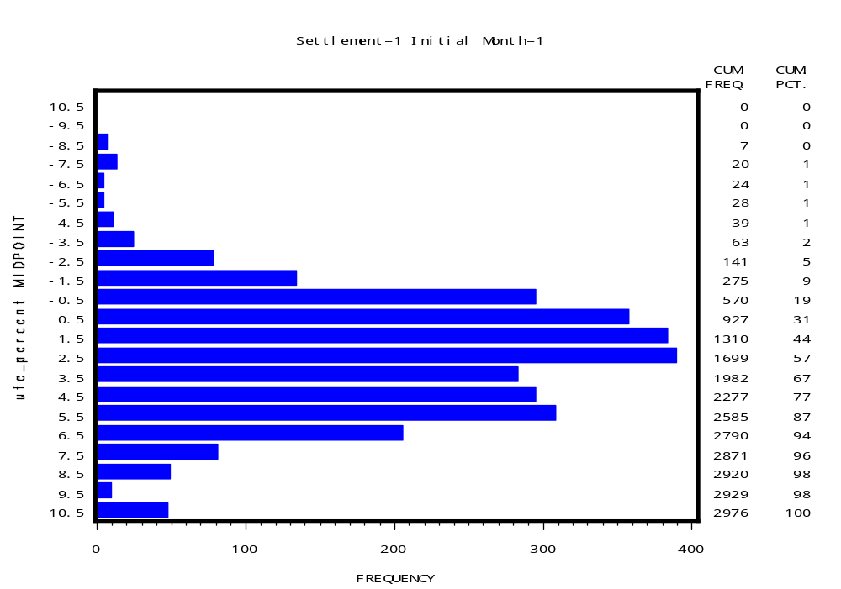
UFE Distribution 2007
Initial - January
UFD10

Slide 55
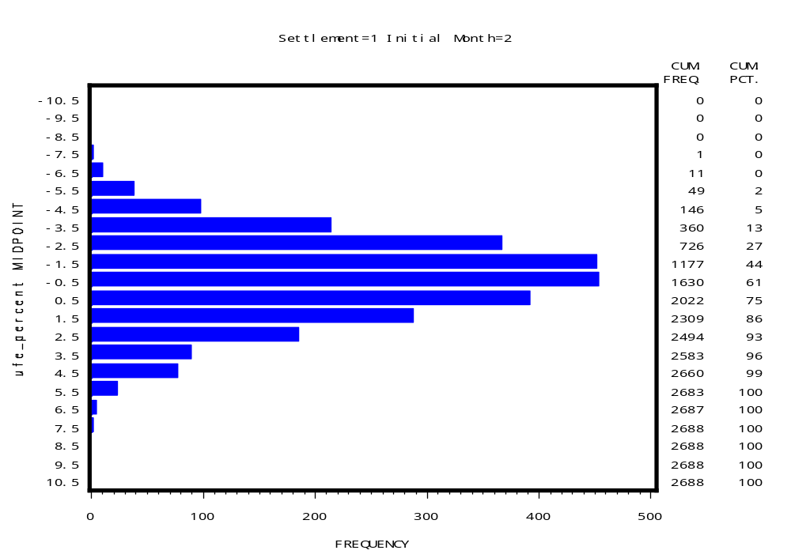
UFE Distribution 2007
Initial - February
UFD11

Slide 56
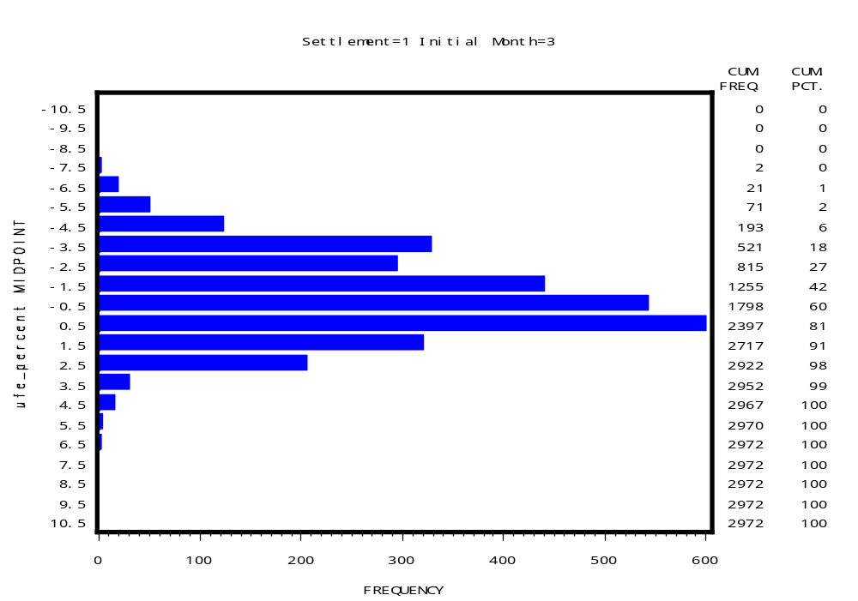
UFE Distribution 2007
Initial - March
UFD12

Slide 57
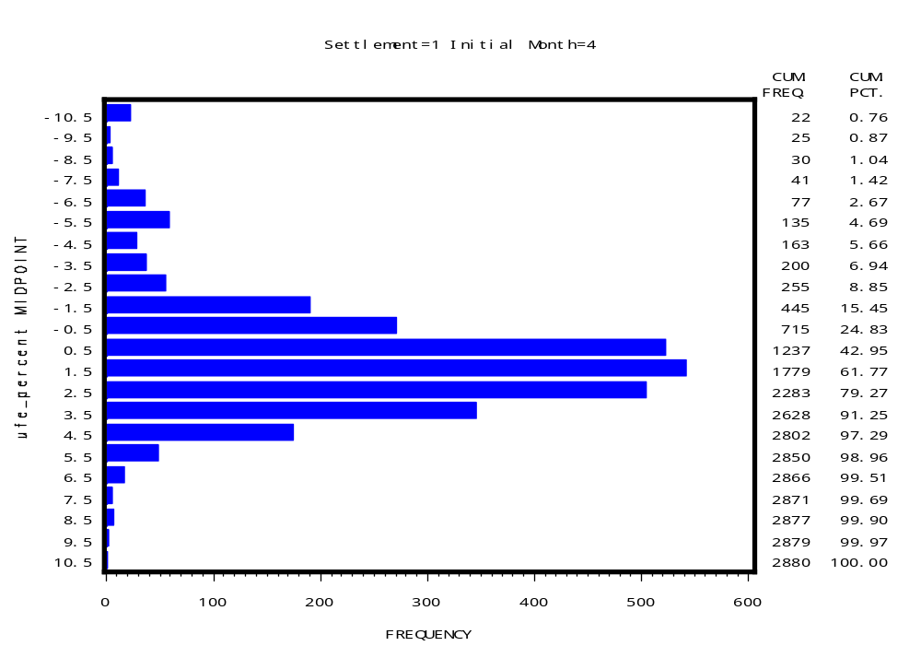
UFE Distribution 2007
Initial - April
UFD13

Slide 58

UFE Distribution 2007
Initial - May
UFD14

Slide 59

UFE Distribution 2007
Initial - June
UFD15

Slide 60

UFE Distribution 2007
Initial - July
UFD16

Slide 61

UFE Distribution 2007
Initial - August
UFD17

Slide 62

UFE Distribution 2007
Initial - September
UFD18

Slide 63

UFE Distribution 2007
Initial - October
UFD19

Slide 64

UFE Distribution 2007
Initial - November
UFD20

Slide 65

UFE Distribution 2007
Initial - December
UFD21

Slide 66
UFE Distribution
Final

Slide 67

UFE Distribution 2007
Final - January
UFD22

Slide 68

UFE Distribution 2007
Final - February
UFD23

Slide 69

UFE Distribution 2007
Final - March
UFD24

Slide 70

UFE Distribution 2007
Final - April
UFD25

Slide 71

UFE Distribution 2007
Final - May
UFD26

Slide 72

UFE Distribution 2007
Final - June
UFD27

Slide 73

UFE Distribution 2007
Final - July
UFD28

Slide 74

UFE Distribution 2007
Final - August
UFD29

Slide 75

UFE Distribution 2007
Final - September
UFD30

Slide 76

UFE Distribution 2007
Final - October
UFD31

Slide 77

UFE Distribution 2007
Final - November
UFD32

Slide 78

UFE Distribution 2007
Final - December
UFD33

Slide 79
UFE Distribution
True Up

Slide 80

UFE Distribution 2007
True Up - January
UFD34

Slide 81

UFE Distribution 2007
True Up - February
UFD35

Slide 82

UFE Distribution 2007
True Up - March
UFD36

Slide 83

UFE Distribution 2007
True Up - April
UFD37

Slide 84

UFE Distribution 2007
True Up - May
UFD38

Slide 85

UFE Distribution 2007
True Up - June
UFD39

Slide 86

UFE Distribution 2007
True Up - July
UFD40

Slide 87

UFE Distribution 2007
True Up - August
UFD41

Slide 88

UFE Distribution 2007
True Up - September
UFD42

Slide 89

UFE Distribution 2007
True Up - October
UFD43

Slide 90

UFE Distribution 2007
True Up - November
UFD44

Slide 91

UFE Distribution 2007
True Up - December
UFD45

Slide 92

UFE Percent of ERCOT Load 2007
Initial Settlement plus
95% Confidence Interval
CIP01
Notes:
Indicative of systematic estimation problem. Full year – blend of seasons. Seasonal detail comes later.

Slide 93

UFE Percent of ERCOT Load 2007
Final Settlement plus
95% Confidence Interval
CIP02

Slide 94

UFE Percent of ERCOT Load 2007
True-Up Settlement plus
95% Confidence Interval
CIP03

Slide 95

UFE Percent of ERCOT Load 2007
Comparison of Medians for Initial & Final
CIP04

Slide 96

Seasonal Comparison - Spring 2007
UFE Percent of ERCOT Load and ERCOT Load
SEA01

Slide 97

Seasonal Comparison - Summer 2007
UFE Percent of ERCOT Load and ERCOT Load
SEA02

Slide 98

Seasonal Comparison - Fall 2007
UFE Percent of ERCOT Load and ERCOT Load
SEA03

Slide 99

Seasonal Comparison - Winter 2007
UFE Percent of ERCOT Load and ERCOT Load
SEA04
Notes:
Looks like profiles are underestimating morning load, overestimating evening load.

Slide 100

Seasonal Comparison of Medians – Initial Settlement
UFE Percent of ERCOT Load - 2007
SEA05
Notes:
Idea of seasonal differences by settlement.

Slide 101

Seasonal Comparison of Medians – Final Settlement
UFE Percent of ERCOT Load - 2007
SEA06

Slide 102

Seasonal Comparison of Medians – True Up
UFE Percent of ERCOT Load - 2007
SEA07

Slide 103

Percent UFE vs ERCOT Load
Initial Settlement - 2007
MPL01

Slide 104

Percent UFE vs ERCOT Load
Final Settlement - 2007
MPL02

Slide 105

Percent UFE vs ERCOT Load
True-Up Settlement – 2007
MPL03

Slide 106

Comparison of Median Percent UFE
Initial, Final and True-Up Settlements - 2007
MPL04
Notes:
True-up median ufe is worse than final ufe for ERCOT load > 34000 mw, similarly final is worse than initial for ERCOT load > 38000 mw

Slide 107

Load Weighted Average MCPE vs Load
Initial Settlement - 2007
MPL05
Notes:
Showing there is a significant relationship between UFE and load. If pure random errors, it would be bouncing around 0 – no upward trend. Gives indication of shift from overestimating to underestimating – around 40000 Mw. Shift moves to lower loads for subsequent settlements – point out on next 2 slides.

Slide 108

Load Weighted Average MCPE vs Load
Final Settlement - 2007
MPL06
Notes:
Showing there is a significant relationship between UFE and load. If pure random errors, it would be bouncing around 0 – no upward trend. Gives indication of shift from overestimating to underestimating – around 40000 Mw. Shift moves to lower loads for subsequent settlements – point out on next 2 slides.

Slide 109

Load Weighted Average MCPE vs Load
True Up Settlement - 2007
MPL07
Notes:
Showing there is a significant relationship between UFE and load. If pure random errors, it would be bouncing around 0 – no upward trend. Gives indication of shift from overestimating to underestimating – around 40000 Mw. Shift moves to lower loads for subsequent settlements – point out on next 2 slides.

Slide 110

Comparison of Median Load Weighted Average MCPE vs Load for Initial, Final and True-Up Settlements - 2007
MPL08

Slide 111

Load Weighted Average MCPE vs Percent UFE
Initial Settlement - 2007
MPL09

Slide 112

Load Weighted Average MCPE vs Percent UFE
Final Settlement - 2007
MPL10

Slide 113

Load Weighted Average MCPE vs Percent UFE
True-Up Settlement - 2007
MPL11

Slide 114

Comparison of Median Load Weighted Average MCPE vs Percent UFE for
Initial, Final and True-Up Settlements - 2007
MPL12

Slide 115

Sum of Dollars from Positive UFE across the Week 2007
UCT02

Slide 116

Sum of Dollars from Negative UFE across the Week 2007
UCT03

Slide 117

Sum of Dollars from Absolute Value of UFE across the Week 2007
UCT04

Slide 118

Sum of Dollars from Net UFE across the Week 2007
UCT05

Slide 119




SUM of UFE Dollars
Compare All Seasons in 2007
Positive and Negative UFE
UCT06

Slide 120

SUM of UFE Dollars – Spring 2007
Positive and Negative UFE
UCT07

Slide 121

SUM of UFE Dollars – Summer 2007
Positive and Negative UFE
UCT08

Slide 122

SUM of UFE Dollars – Fall 2007
Positive and Negative UFE
UCT09

Slide 123

SUM of UFE Dollars – Winter 2007
Positive and Negative UFE
UCT10

Slide 124




SUM of UFE Dollars
Compare All Seasons in 2007
Absolute Value and Net UFE
UCT11

Slide 125

SUM of UFE Dollars – Spring 2007
Absolute Value and Net UFE
UCT12

Slide 126

SUM of UFE Dollars – Summer 2007
Absolute Value and Net UFE
UCT13

Slide 127

SUM of UFE Dollars – Fall 2007
Absolute Value and Net UFE
UCT14

Slide 128

SUM of UFE Dollars – Winter 2007
Absolute Value and Net UFE
UCT15

Slide 129




Mean of UFE Dollars
Compare All Seasons in 2007
Positive and Negative UFE
UCT16

Slide 130

Mean of UFE Dollars – Spring 2007
Positive and Negative UFE
UCT17

Slide 131

Mean of UFE Dollars – Summer 2007
Positive and Negative UFE
UCT18

Slide 132

Mean of UFE Dollars – Fall 2007
Positive and Negative UFE
UCT19

Slide 133

Mean of UFE Dollars – Winter 2007
Positive and Negative UFE
UCT20

Slide 134




Mean of UFE Dollars
Compare All Seasons in 2007
Absolute Value and Net UFE
UCT21

Slide 135

Mean of UFE Dollars – Spring 2007
Absolute Value and Net UFE
UCT22

Slide 136

Mean of UFE Dollars – Summer 2007
Absolute Value and Net UFE
UCT23

Slide 137

Mean of UFE Dollars – Fall 2007
Absolute Value and Net UFE
UCT24

Slide 138

Mean of UFE Dollars – Winter 2007
Absolute Value and Net UFE
UCT25

Slide 139
UFE 2007 Analysis Observations
Since 2002, Average and Median NET UFE as a Percent of ERCOT Load continues to move in a positive direction.
Average and Median ABS UFE as a Percent of ERCOT Load remained the same for 2006-2007. In fact, for 2002-2007, Average and Median ABS UFE as a Percent of ERCOT Load is trending downward.
For 2003-2007, the Standard Deviation of NET UFE as a Percent of ERCOT Load and ABS UFE as a Percent of ERCOT Load are trending downward.
Daily patterns of UFE as a Percent of ERCOT Load appear to be related to the magnitude of the load.

Slide 140
Steps to Reduce UFE
Improve Business Profile ID assignment process
Improve models using Round 2 load research data
Implement settlement using 15 minute interval data from AMI meters where appropriate
Evaluate the application of lagged dynamic profiling techniques to the ERCOT System
Continue to evaluate improvements to algorithms for missing AMI, IDR and NIDR data estimation
To improve distribution loss estimations, PWG should consider recommending that TDSP’s perform updated loss studies.

