Slide 1

UFE 2008 ANALYSIS
Compiled by Load Profiling
Energy Analysis & Aggregation

Slide 2
UFE Basics
UFE (unaccounted for energy) is computed as follows:
UFE = Generation – (Load + Losses)
Sources of UFE include:
■ Generation Measurement Errors
■ Load - Missing/Erroneous Usage Data
- Model Error
- Load Profile ID Assignment Error
- Theft
■ Losses - Model Error
- Loss Code Assignment Error
Negative UFE indicates load/losses are overestimated

Slide 3
UFE Basics
UFE
Net Generation for Settlement Interval
GAP - - - - - - >
Losses:
Transmission & Distribution
Profiled Energy Usage
Non-Interval Data
Non-Metered Accounts
Net Generation
Compared to
Load Buildup
Interval Data
Energy Usage

Slide 4

OVERVIEW OF THE SETTLEMENT PROCESS
UFE is computed for each 15-minute interval of a settlement run.
Initial Settlement
(posted on day 10 after the operating day)
Final Settlement
(posted on day 60 after the operating day)
True-up Settlement (posted 6 months after operating day)
Resettlement statement (posted as needed)
Final
Settlement
Initial
True-Up

Slide 5
Load Weighted Calculation of MCPE
Market Clearing Price for Energy (MCPE) is the highest price by Congestion Zone for a Settlement Interval for Balancing Energy deployed during the Settlement Interval.
In 2008 there were 4 congestion zones – H08, N08, S08 and W08.
The load weighted MCPE is calculated for each 15 min. interval using the LCMZone cuts as follows:
  MCPE_LWTD =
  ((LCMZone_H08_MWh * MCPEL_H08) +
  (LCMZone_N08_MWh * MCPEL_N08) + (LCMZone_S08_MWh * MCPEL_S08) +
  (LCMZone_W08_MWh * MCPEL_W08)) /
  (LCMZone_H08_MWh + LCMZone_N08_MWh + LCMZone_S08_MWh + LCMZone_W08_MWh)

Slide 6
Events that Influenced 2008 UFE
Annual validation 2007 was completed.
Hurricanes Dolly, Edouard and Ike struck the Texas coast.
  Dolly made landfall at 1 p.m. CDT, July 23 on South Padre Island as a Category 1 hurricane.
  Edouard made landfall in Southeast Texas near Port Arthur on the morning of August 5 as a strong tropical storm.
  Ike made landfall on Galveston Island on September 13 as a strong Category 2 hurricane. Its large size brought storm surge of over 12 feet from Galveston Island eastward into southern Louisiana. Power was disrupted in most of the Houston area. Coast Weather Zone profiles were adjusted.

Slide 7
Events that Influenced 2008 UFE
Edouard conclusions:
  Ercot Load at model peak (8-4-08 16:45) was reduced by about 1,682 MW as a result of Hurricane Edouard
    IDR Coast: 529 MW
    IDR Non-Coast: 490 MW
    NIDR: 662 MW
  Ercot Actual Load returned to predicted load levels on 8-6-08
    IDR Coast actual load returned to predicted load levels on 8-8-08
  Total Ercot energy reduction was about 23.1GWH as a result of Hurricane Edouard

Slide 8
Events that Influenced 2008 UFE
Ike conclusions:
  Ercot Load was reduced across the 9-10-08 to 9-28-08 time period by about 1,378 GWH as a result of Hurricane Ike
  Largest 1-Day loss:
    206 GWH on 9-13-08

Slide 9
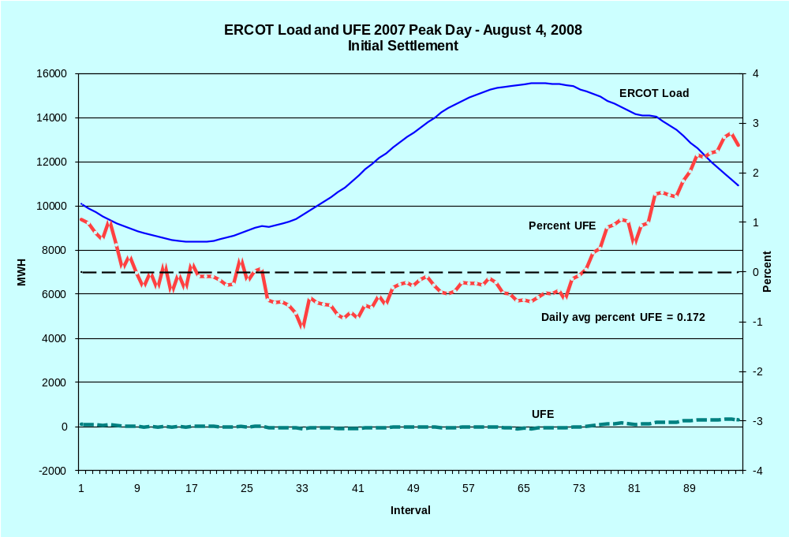
LOAD AND UFE – ERCOT PEAK 2008
SR01

Slide 10
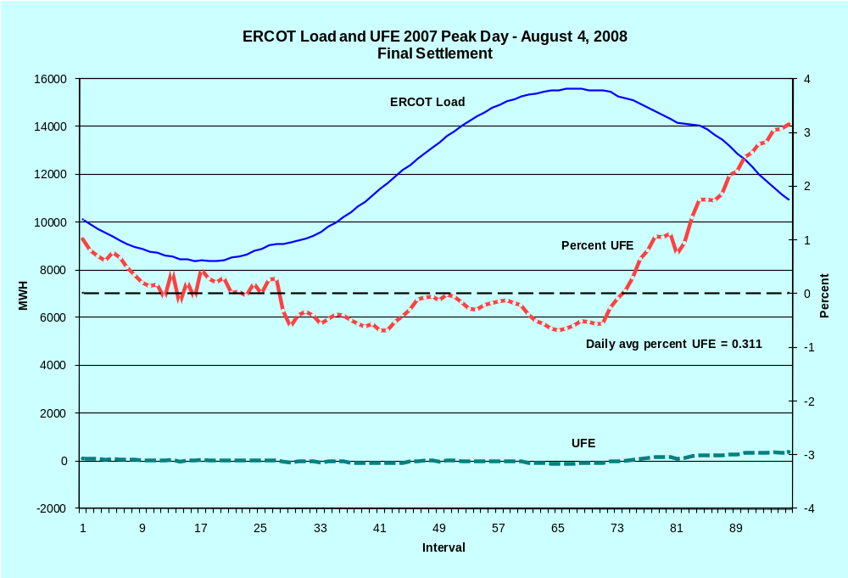
LOAD AND UFE – ERCOT PEAK 2008
SR02

Slide 11
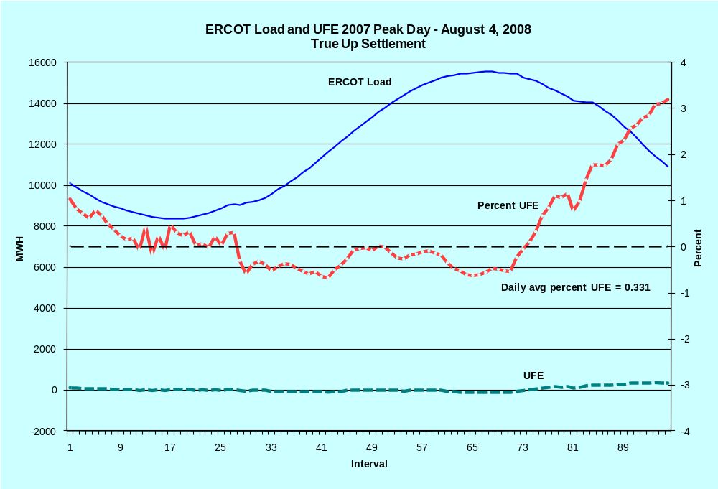
LOAD AND UFE – ERCOT PEAK 2008
SR03

Slide 12
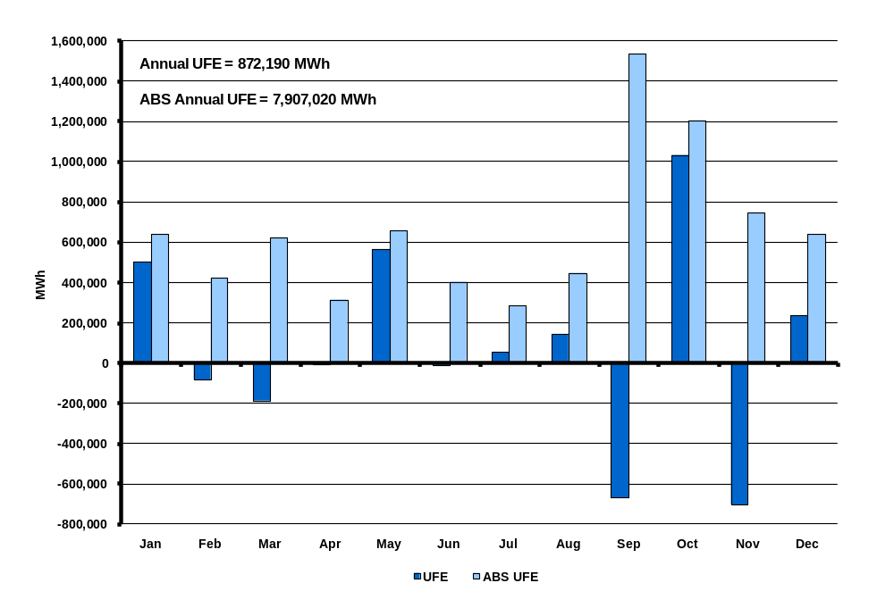
UFE MWh by Month in 2008
Initial Settlement
SR04
Notes:
This is NET UFE. + and – are canceling out. May and Oct (shoulder months) are the highest while April (another shoulder month) is lowest. Winter months are generally higher than summer months.

Slide 13
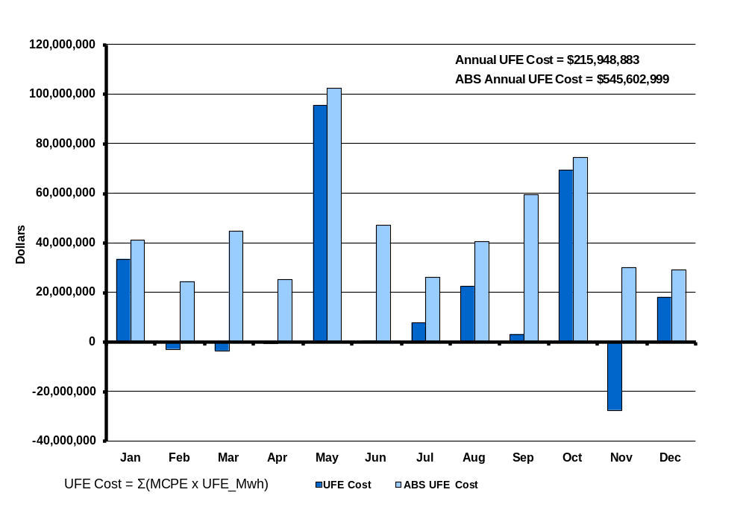
UFE Cost by Month in 2008
Initial Settlement
SR05

Slide 14
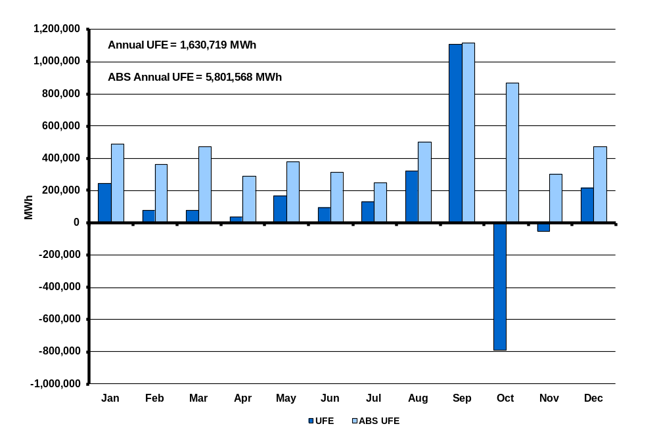
UFE MWh by Month in 2008
Final Settlement
SR06
Notes:
This is NET UFE. + and – are canceling out. May and Oct (shoulder months) are the highest while April (another shoulder month) is lowest. Winter months are generally higher than summer months.

Slide 15
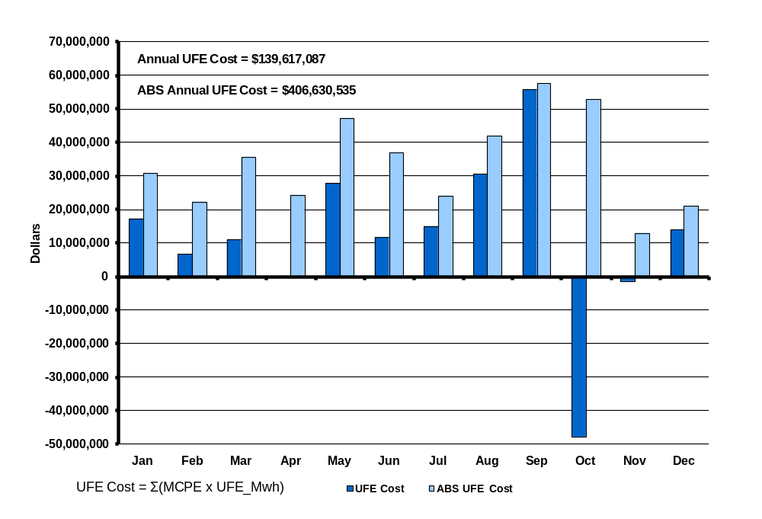
UFE Cost by Month in 2008
Final Settlement
SR07
Notes:
Annual total is 1,676,343 Mwh. Again, this is NET UFE.

Slide 16
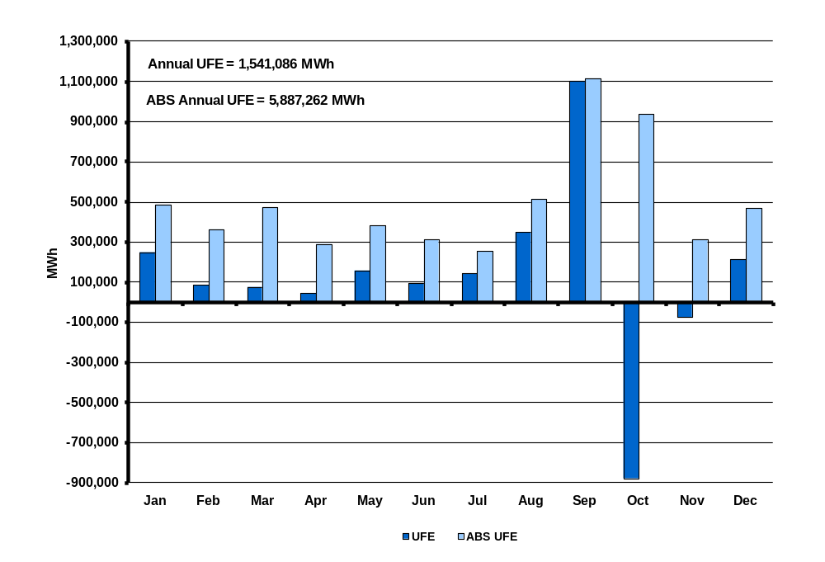
UFE MWh by Month in 2008
True-Up Settlement
SR08
Notes:
This is NET UFE. + and – are canceling out. May and Oct (shoulder months) are the highest while April (another shoulder month) is lowest. Winter months are generally higher than summer months.

Slide 17
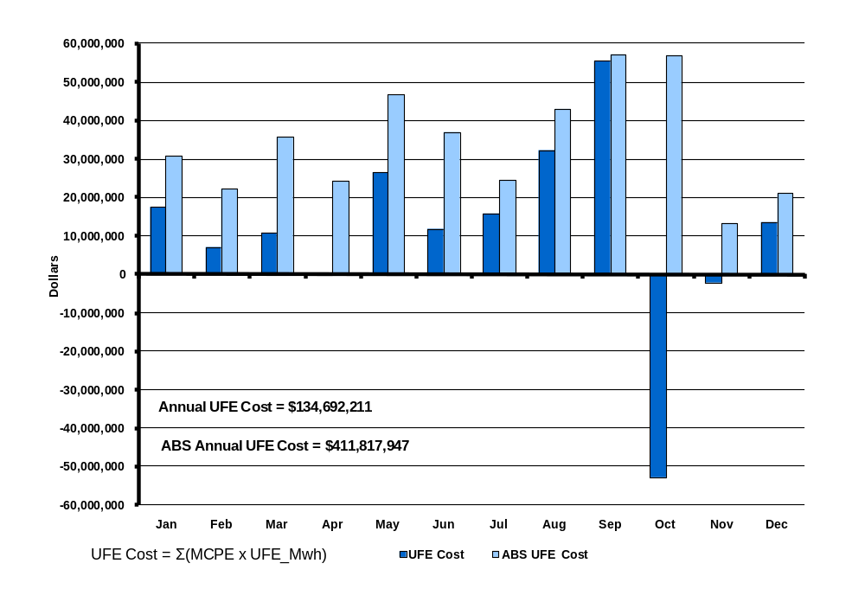
UFE Cost by Month in 2008
True-UP Settlement
SR09
Notes:
Annual total is 1,676,343 Mwh. Again, this is NET UFE.

Slide 18
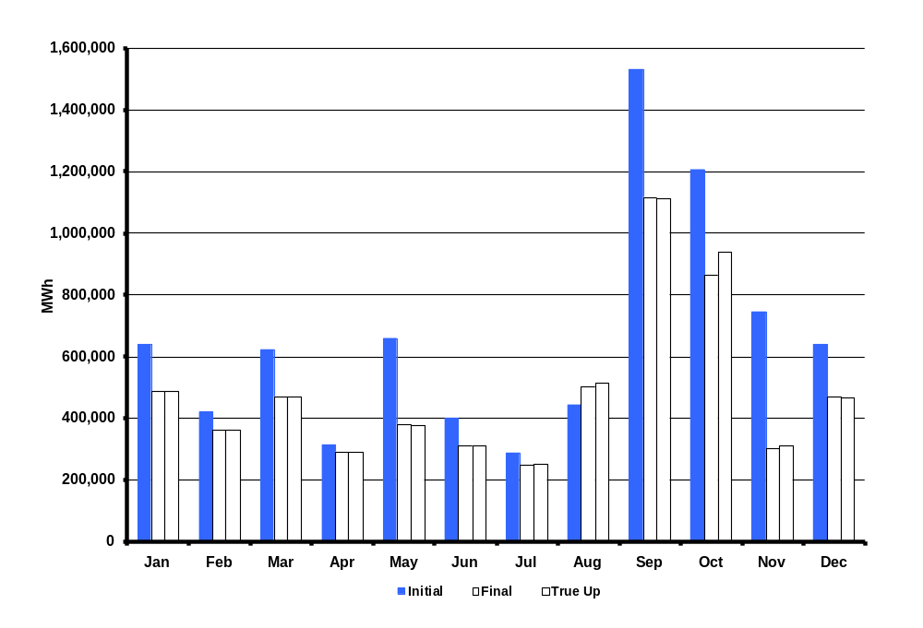
ABS UFE MWh by Month in 2008
Initial, Final and True Up Settlements
SR09a
Notes:
Annual total is 1,676,343 Mwh. Again, this is NET UFE.

Slide 19
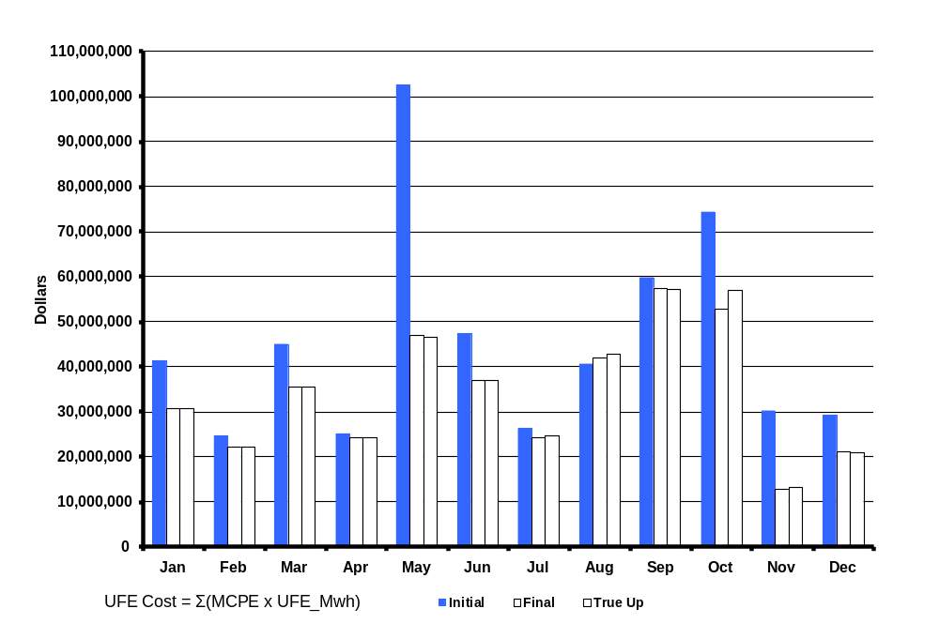
ABS UFE Cost by Month in 2008
Initial, Final and True-Up Settlements
SR09b
Notes:
Annual total is 1,676,343 Mwh. Again, this is NET UFE.

Slide 20
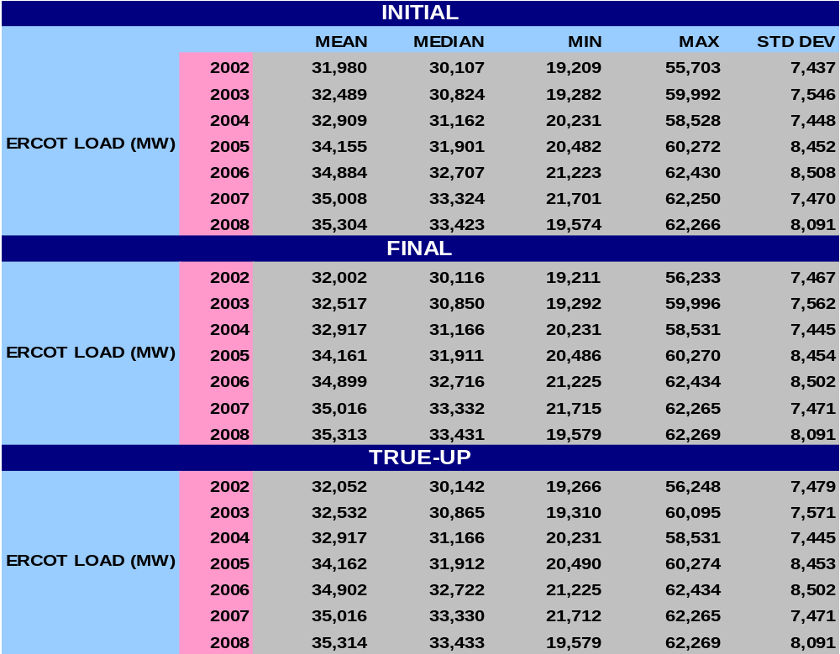
STATISTICAL SUMMARY - 2008
SR10

Slide 21
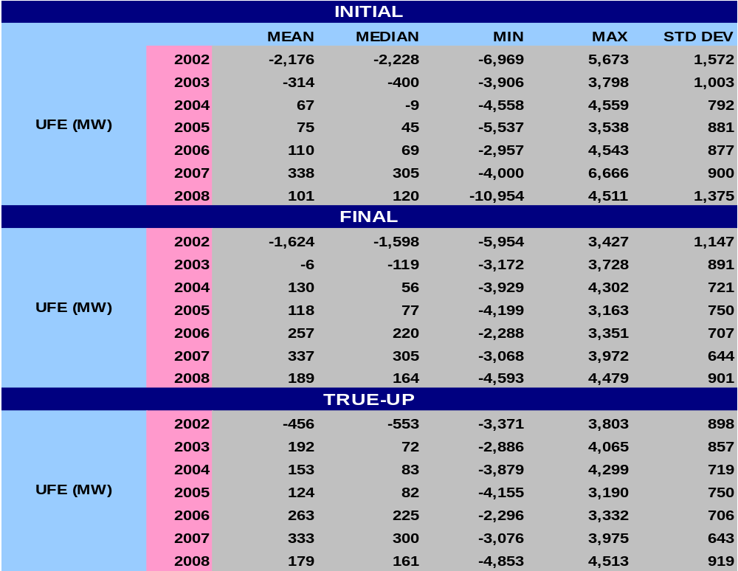
STATISTICAL SUMMARY - 2008
SR11a

Slide 22
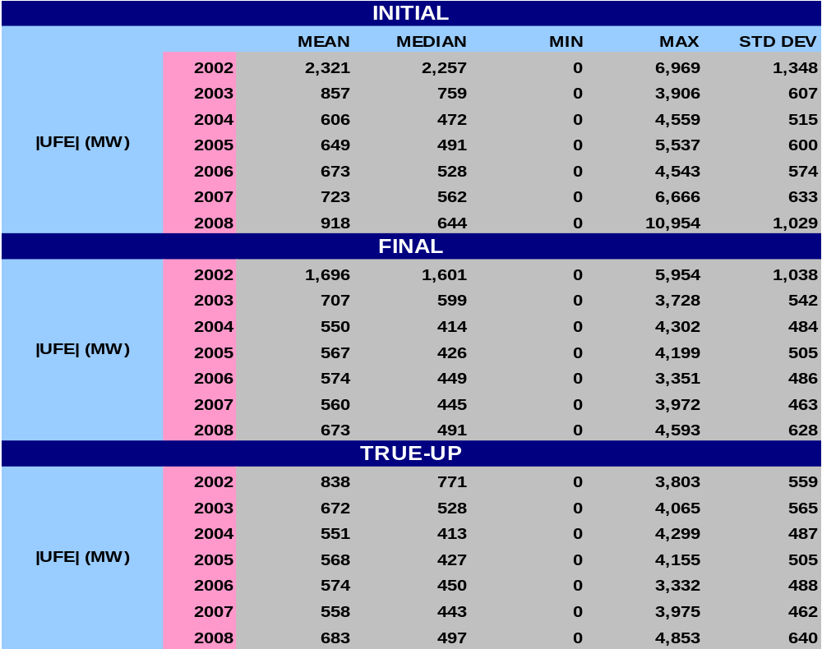
STATISTICAL SUMMARY - 2008
SR11b

Slide 23
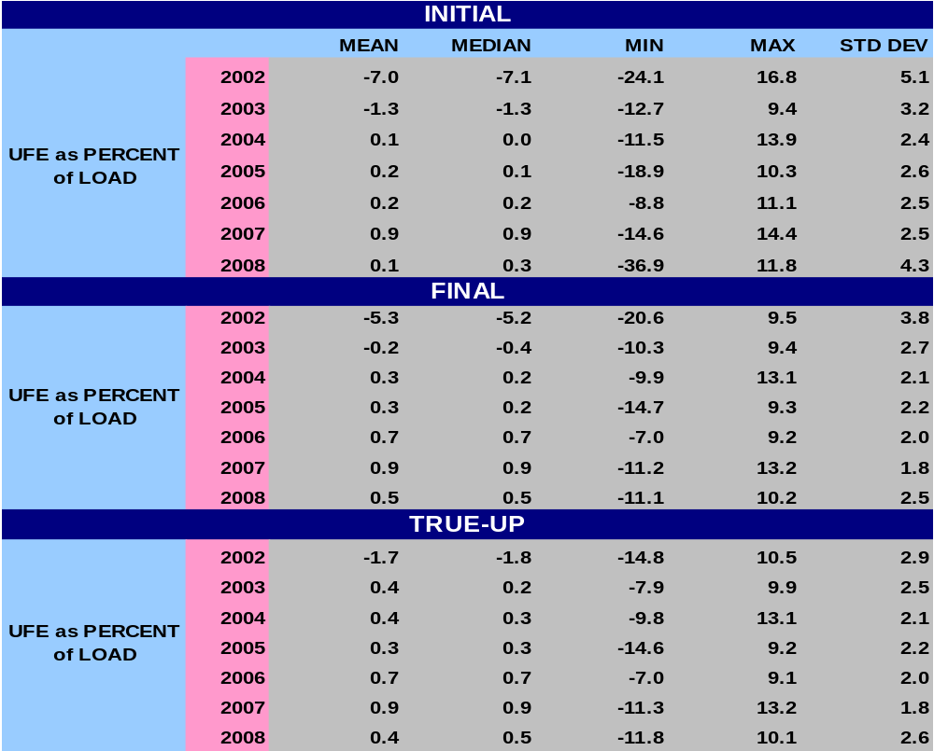
STATISTICAL SUMMARY - 2008
SR12a
Notes:
Last bullet – w/ regard to Mean and Median, UFE gets better with later settlements.

Slide 24
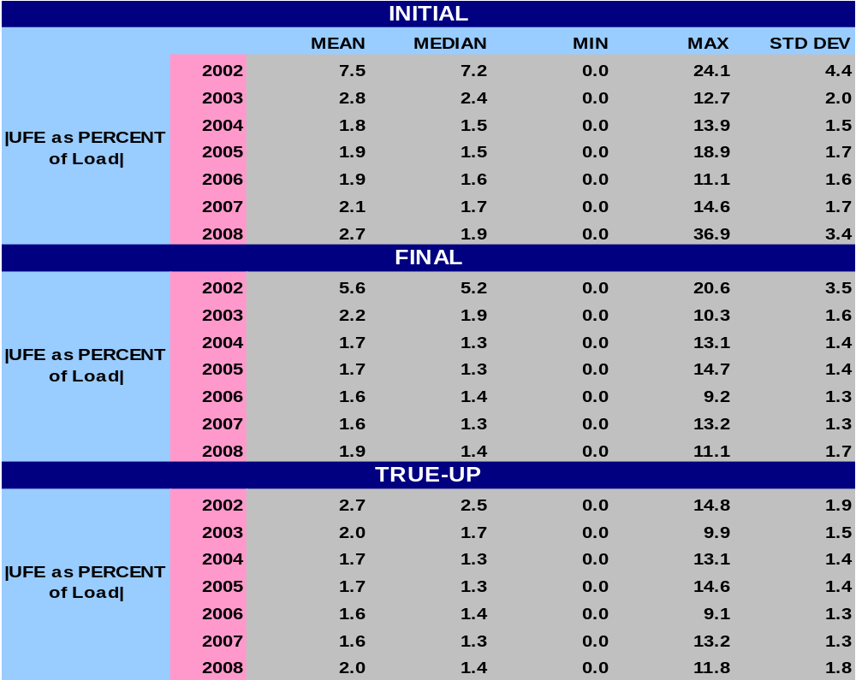
STATISTICAL SUMMARY - 2008
SR12b
Notes:
Last bullet – w/ regard to Mean and Median, UFE gets better with later settlements.

Slide 25
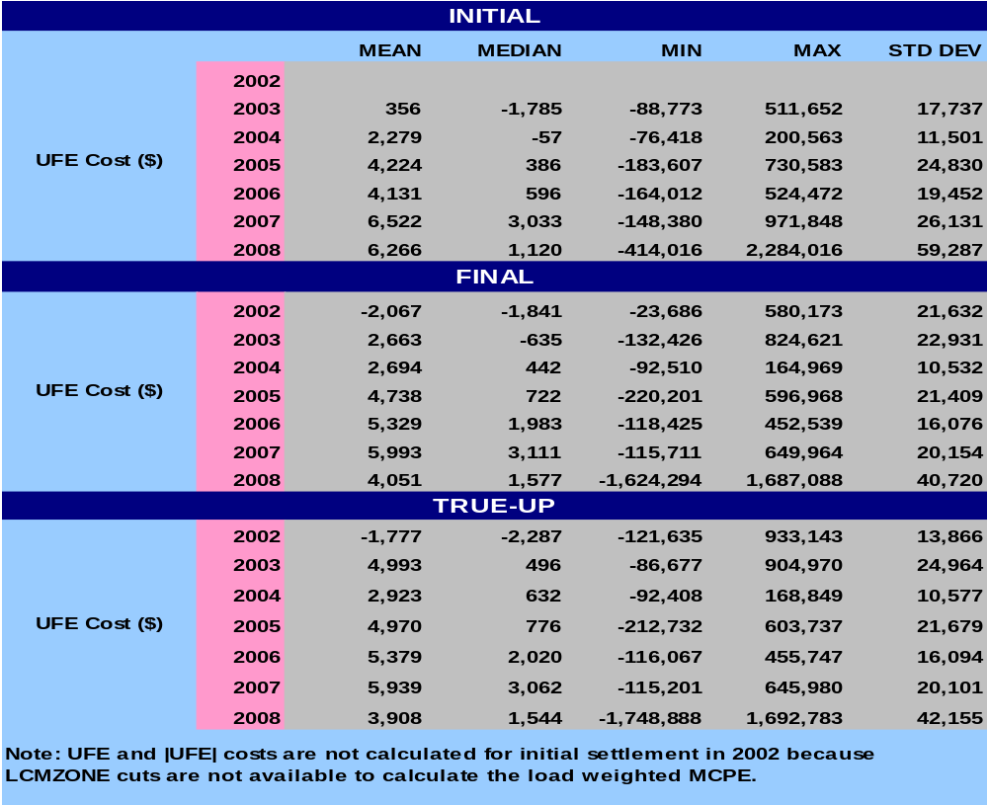
STATISTICAL SUMMARY - 2008
SR13a
Notes:
Last bullet – w/ regard to Mean and Median, UFE gets better with later settlements.

Slide 26
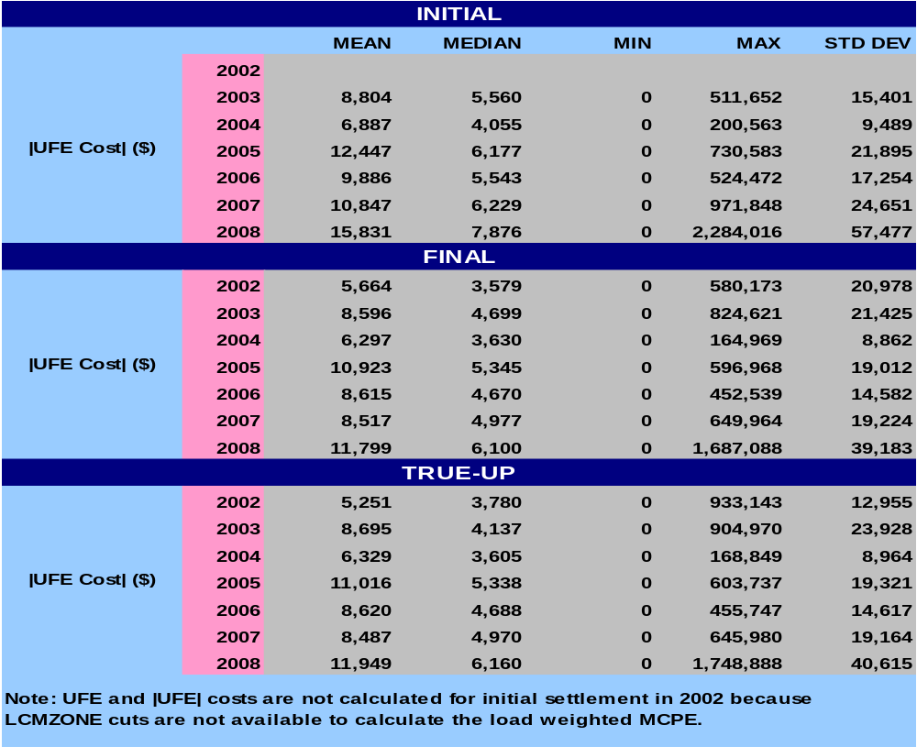
STATISTICAL SUMMARY - 2008
SR13b
Notes:
Last bullet – w/ regard to Mean and Median, UFE gets better with later settlements.

Slide 27
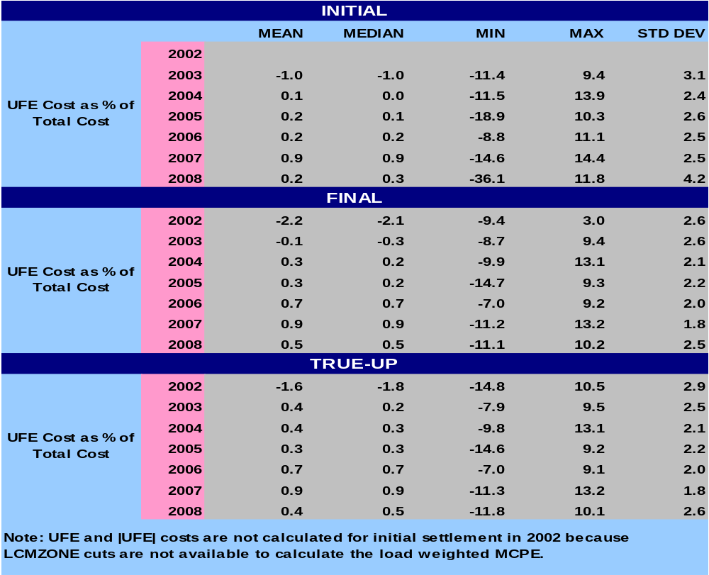
STATISTICAL SUMMARY - 2008
SR14a
Notes:
Last bullet – w/ regard to Mean and Median, UFE gets better with later settlements.

Slide 28
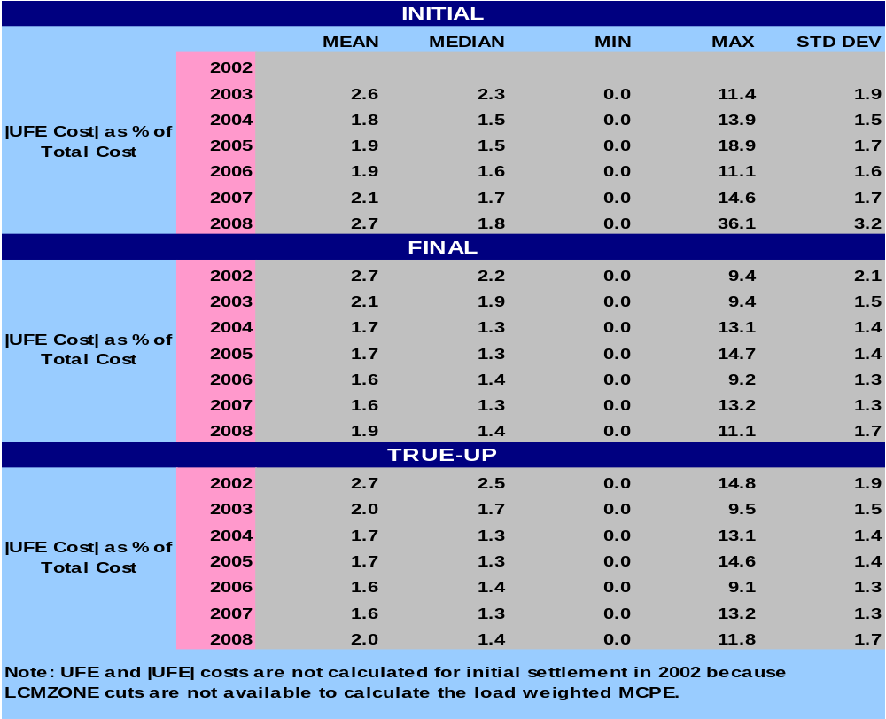
STATISTICAL SUMMARY - 2008
SR14b
Notes:
Last bullet – w/ regard to Mean and Median, UFE gets better with later settlements.

Slide 29
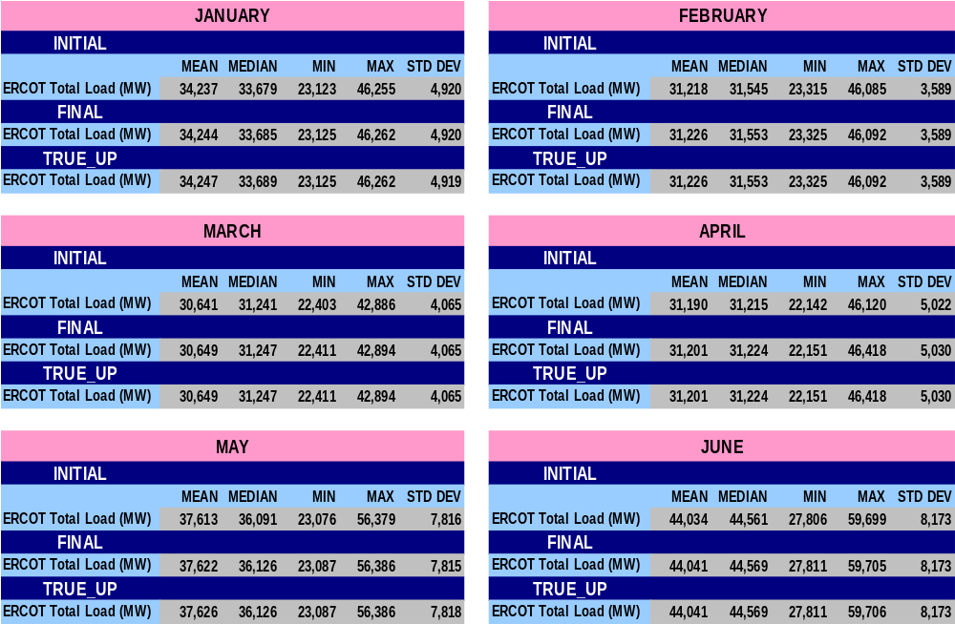
STATISTICAL SUMMARY – MONTHLY for 2008
SR15

Slide 30
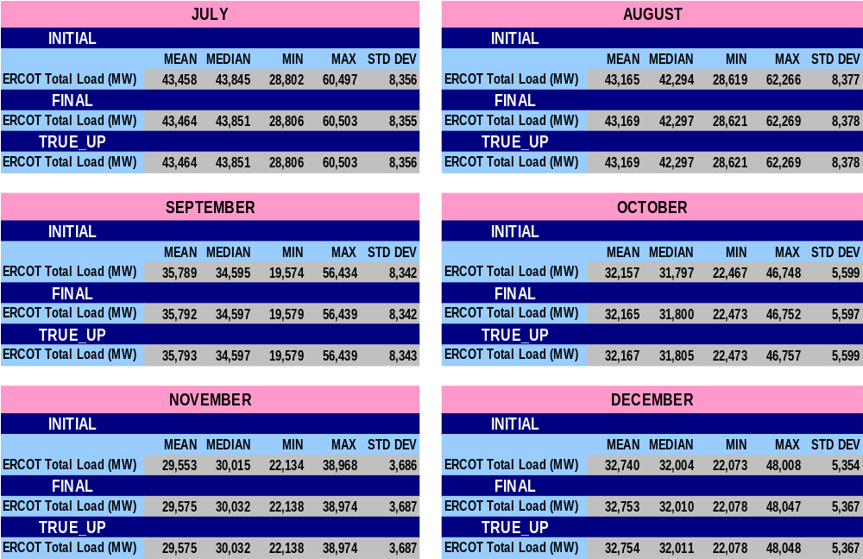
STATISTICAL SUMMARY – MONTHLY for 2008
SR16

Slide 31
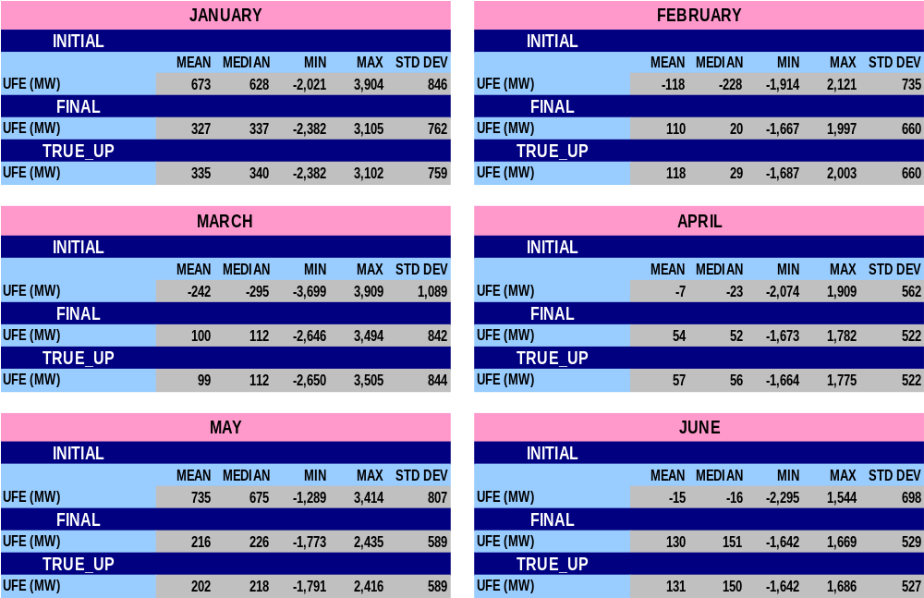
STATISTICAL SUMMARY – MONTHLY for 2008
SR17

Slide 32
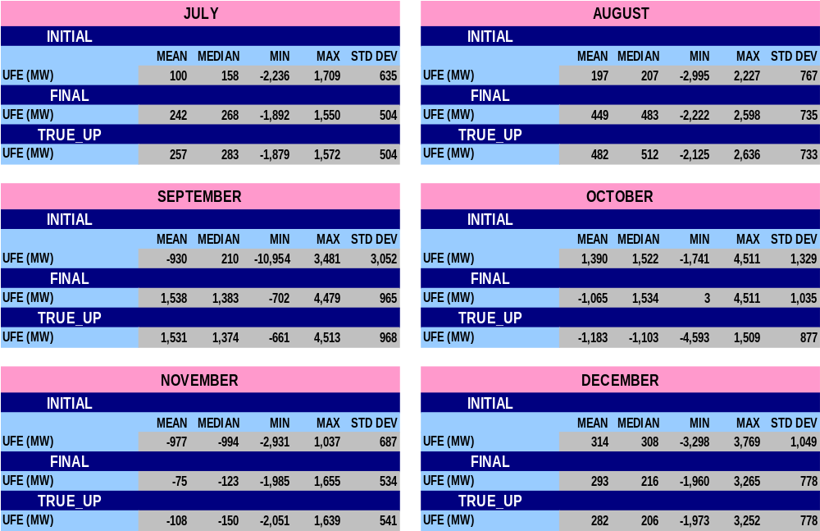
STATISTICAL SUMMARY – MONTHLY for 2008
SR18

Slide 33
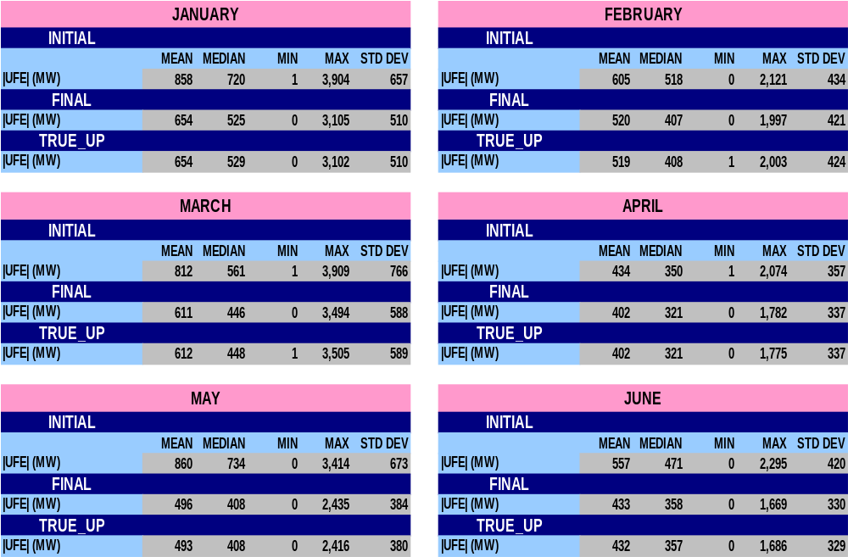
STATISTICAL SUMMARY – MONTHLY for 2008
SR19

Slide 34
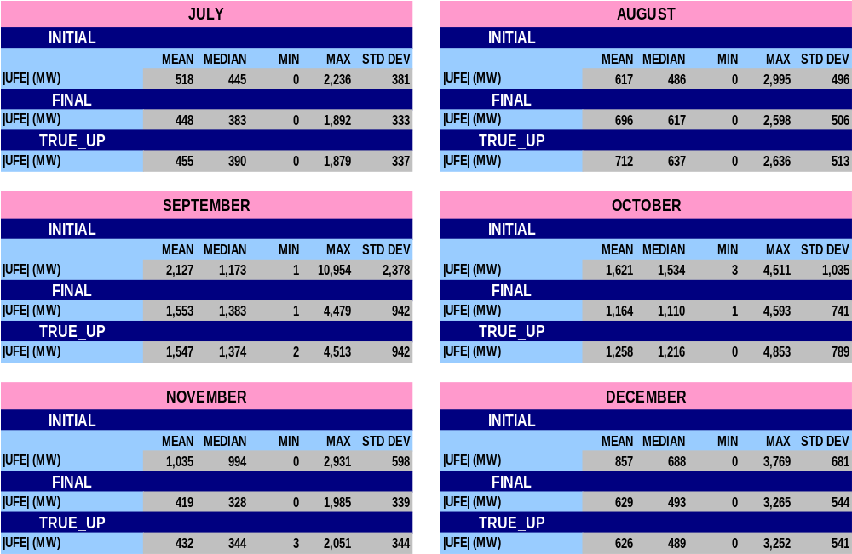
STATISTICAL SUMMARY – MONTHLY for 2008
SR20

Slide 35
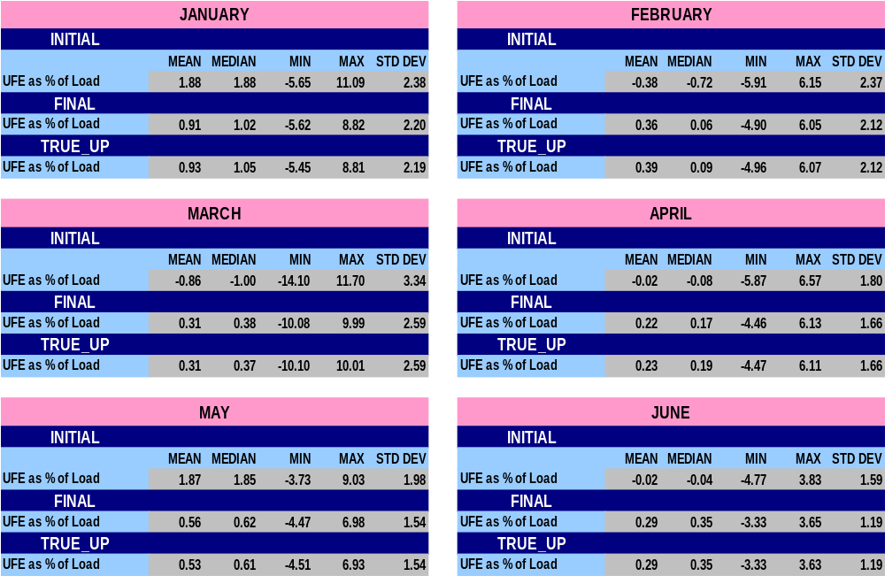
STATISTICAL SUMMARY – MONTHLY for 2008
SR21

Slide 36
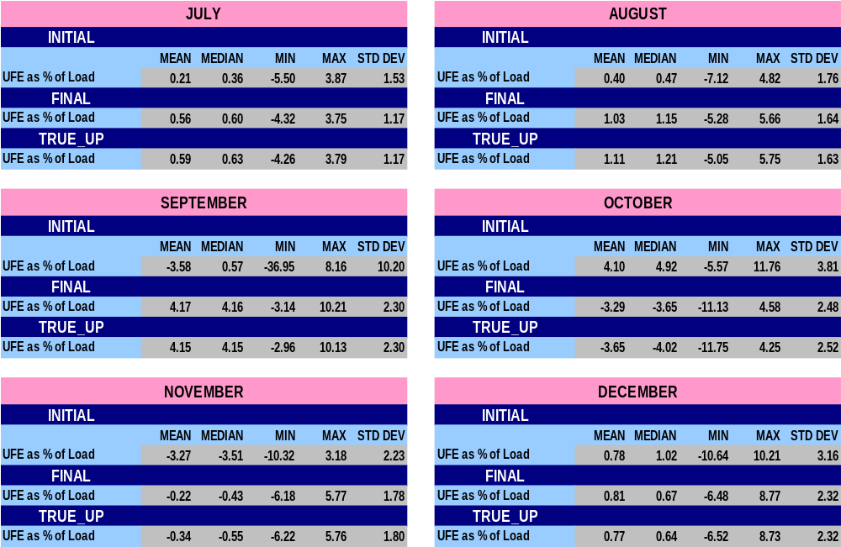
STATISTICAL SUMMARY – MONTHLY for 2008
SR22

Slide 37

STATISTICAL SUMMARY – MONTHLY for 2008
SR23

Slide 38
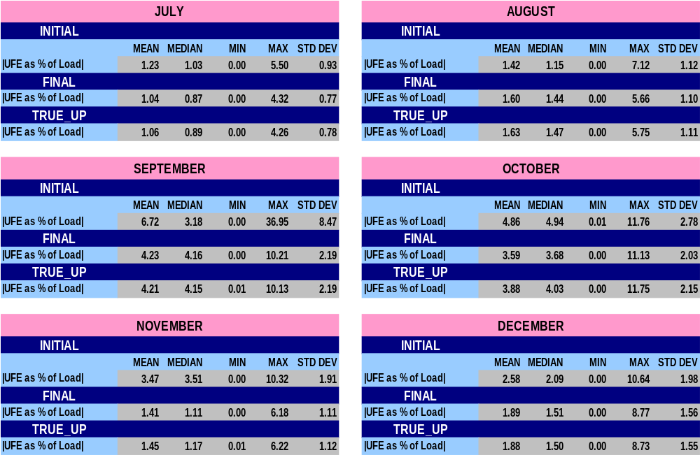
STATISTICAL SUMMARY – MONTHLY for 2008
SR24

Slide 39
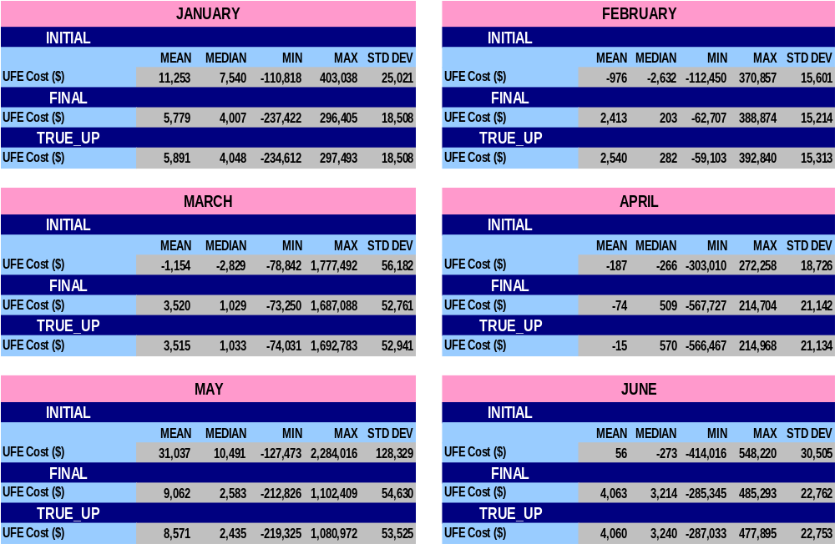
STATISTICAL SUMMARY – MONTHLY for 2008
SR25

Slide 40
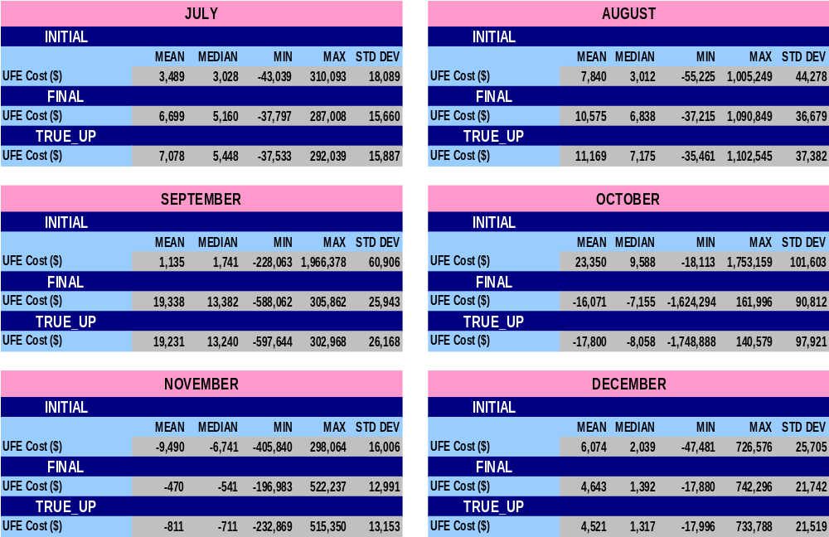
STATISTICAL SUMMARY – MONTHLY for 2008
SR26

Slide 41
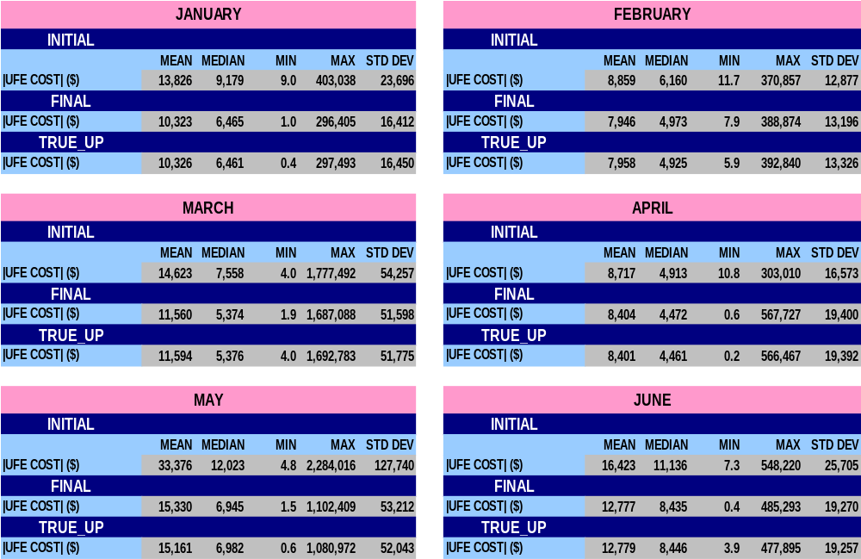
STATISTICAL SUMMARY – MONTHLY for 2008
SR27

Slide 42
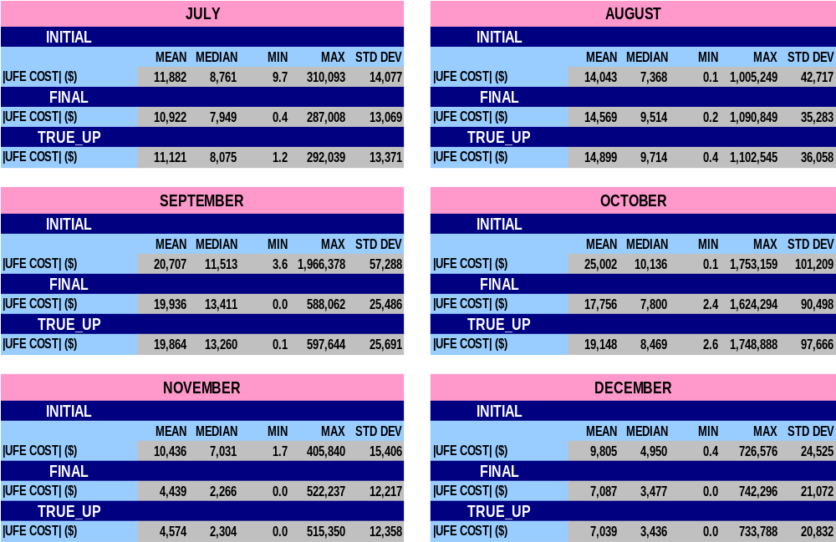
STATISTICAL SUMMARY – MONTHLY for 2008
SR28

Slide 43
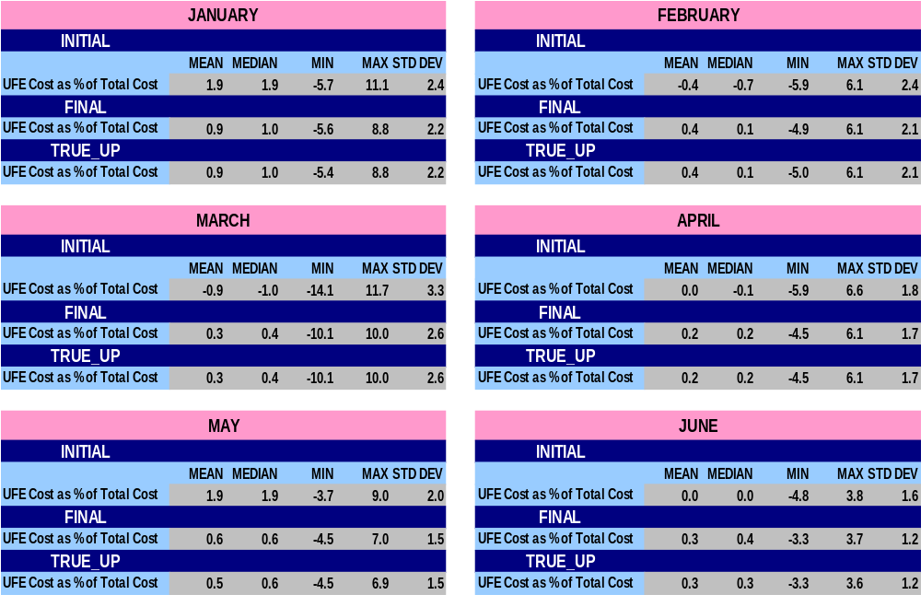
STATISTICAL SUMMARY – MONTHLY for 2008
SR29

Slide 44
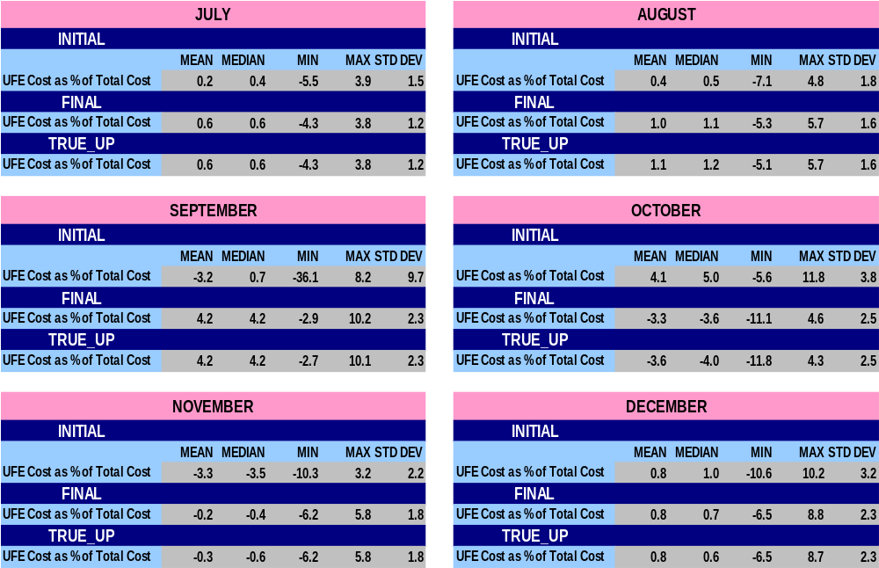
STATISTICAL SUMMARY – MONTHLY for 2008
SR30

Slide 45
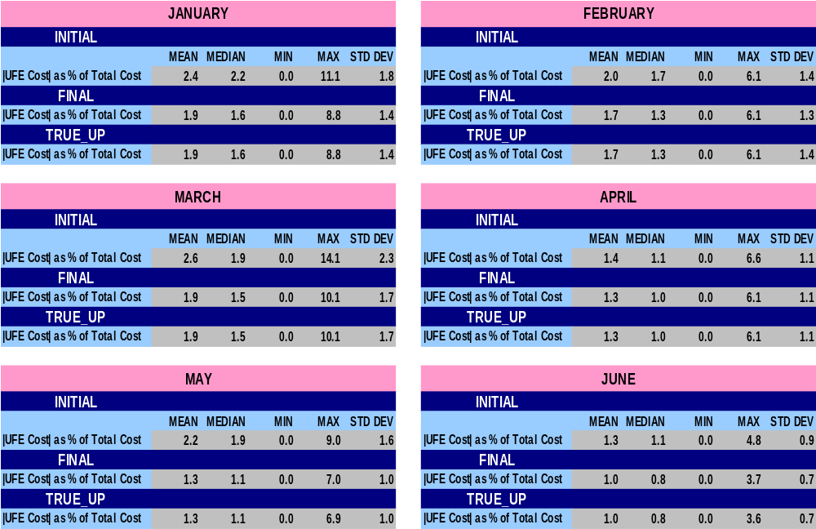
STATISTICAL SUMMARY – MONTHLY for 2008
SR31

Slide 46
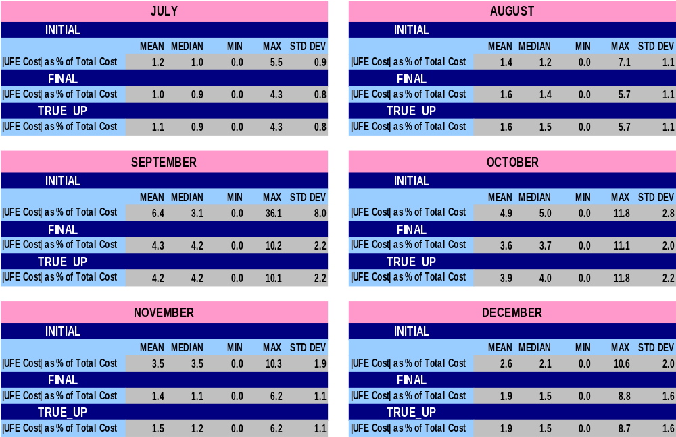
STATISTICAL SUMMARY – MONTHLY for 2008
SR32

Slide 47
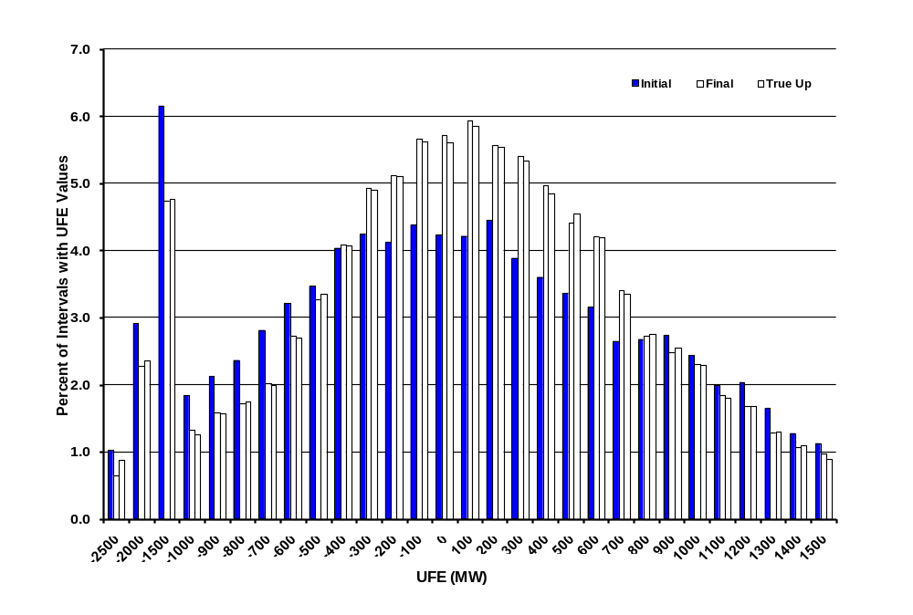
Distribution of UFE MW
Initial, Final, and True Up - 2008
UFD01
Notes:
UFE shifts in a positive direction from Initial to Final.

Slide 48
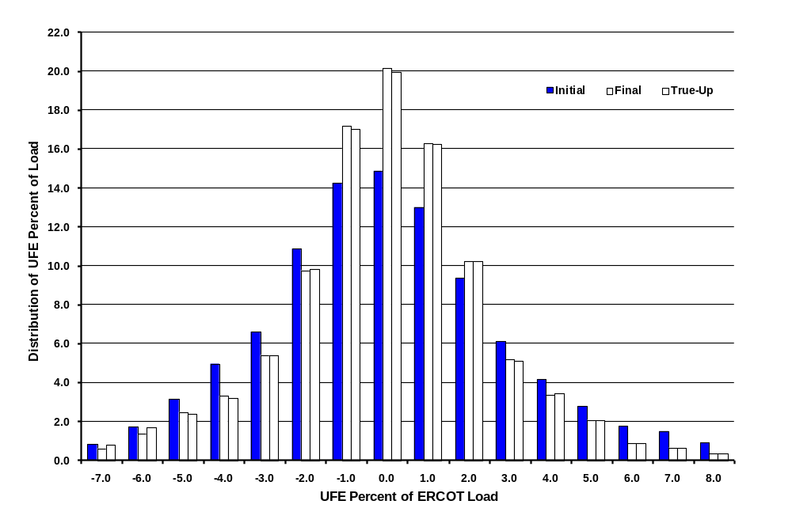
Distribution of UFE as Percent of ERCOT Load - 2008
UFD03
Notes:
The UFE percent moves in a positive direction from Initial to Final thru True-Up.

Slide 49
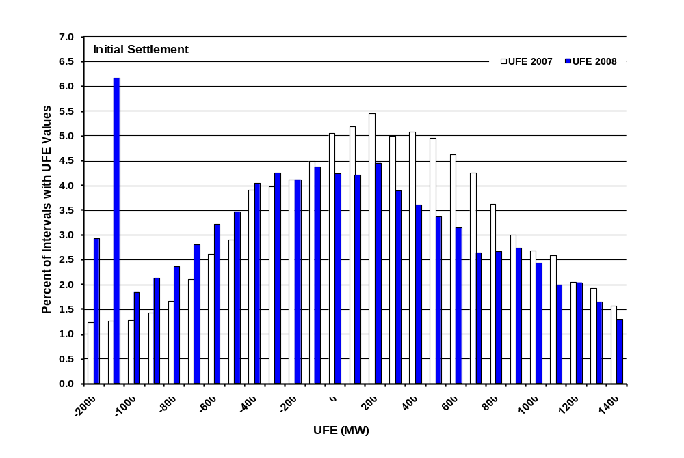
Distribution of UFE MW
2007 vs. 2008 - Initial Settlement
UFD04
Notes:
The UFE percent moves in a positive direction from Initial to Final thru True-Up.

Slide 50
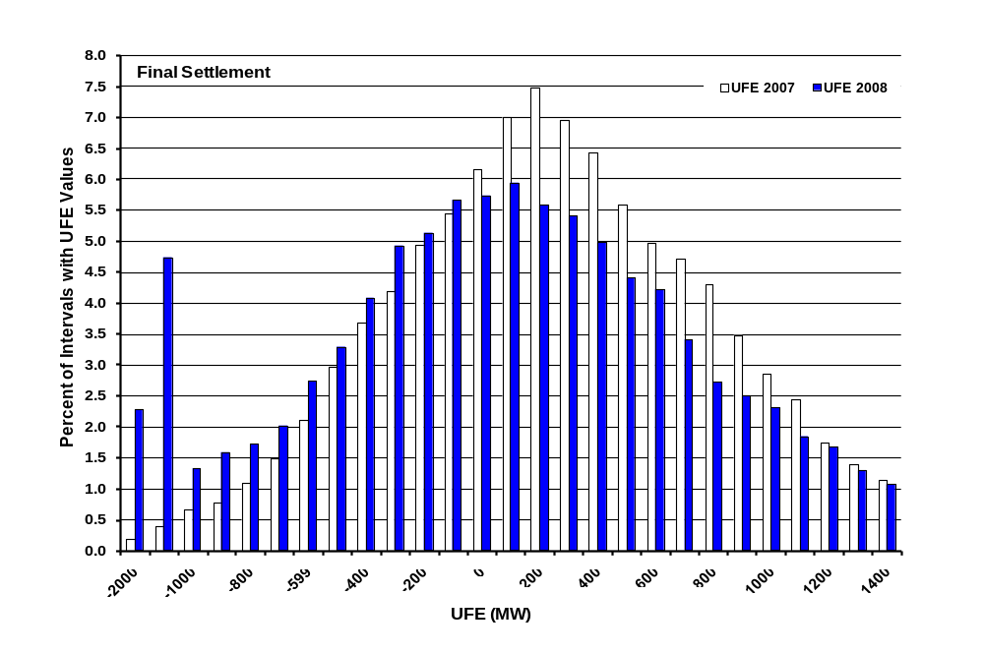
Distribution of UFE MW
2007 vs. 2008 - Final Settlement
UFD05
Notes:
The UFE percent moves in a positive direction from Initial to Final thru True-Up.

Slide 51
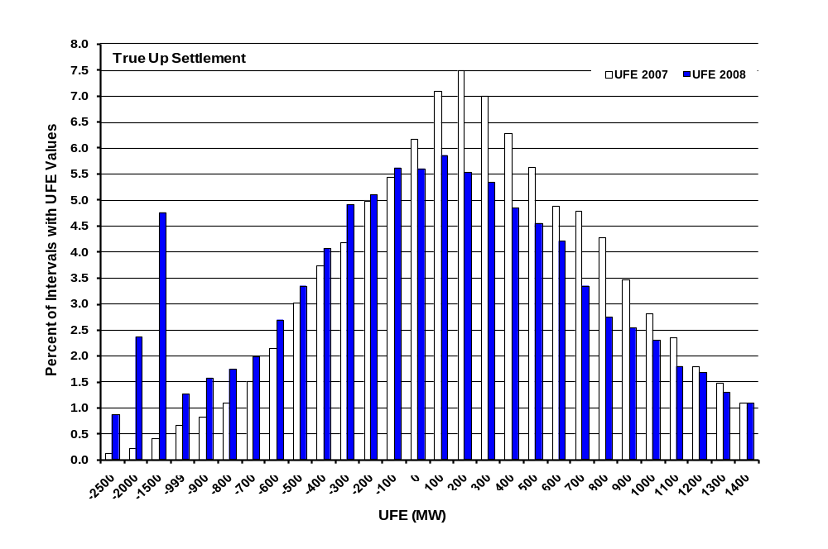
Distribution of UFE MW
2007 vs. 2008 – True Up Settlement
UFD06
Notes:
The UFE percent moves in a positive direction from Initial to Final thru True-Up.

Slide 52
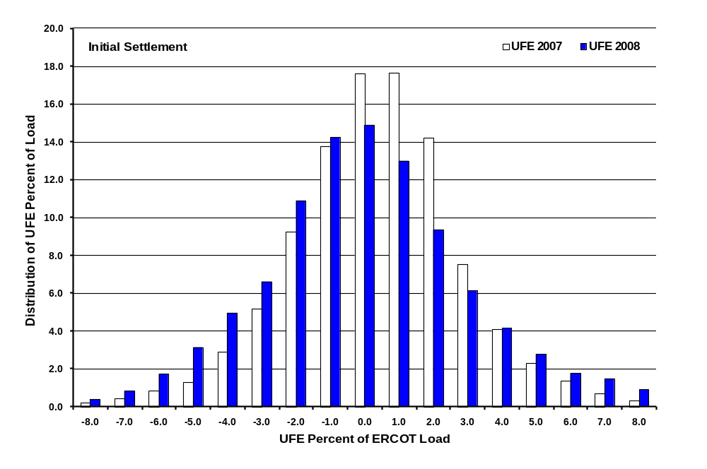
Distribution of UFE Percent of ERCOT Load
2007 vs 2008 – Initial Settlement
UFD07
Notes:
The UFE percent moves in a positive direction from Initial to Final thru True-Up.

Slide 53
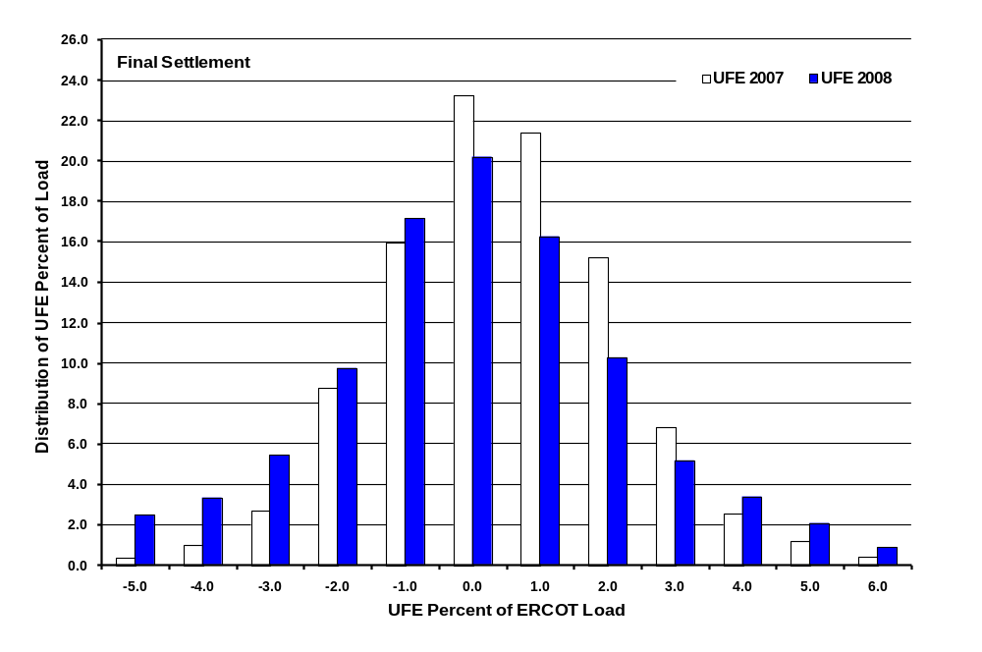
Distribution of UFE Percent of ERCOT Load
2007 vs 2008 – Final Settlement
UFD08
Notes:
The UFE percent moves in a positive direction from Initial to Final thru True-Up.

Slide 54
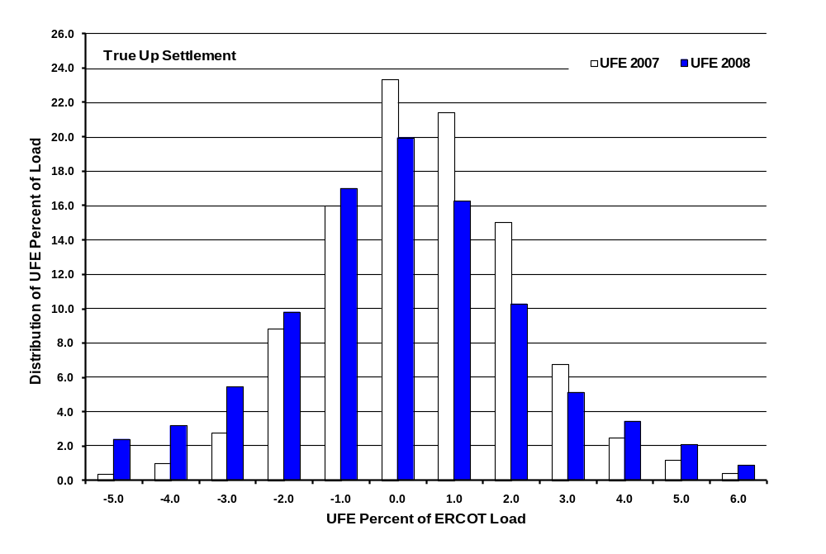
Distribution of UFE Percent of ERCOT Load
2007 vs 2008 – True Up Settlement
UFD09
Notes:
The UFE percent moves in a positive direction from Initial to Final thru True-Up.

Slide 55
UFE Distribution
Initial

Slide 56
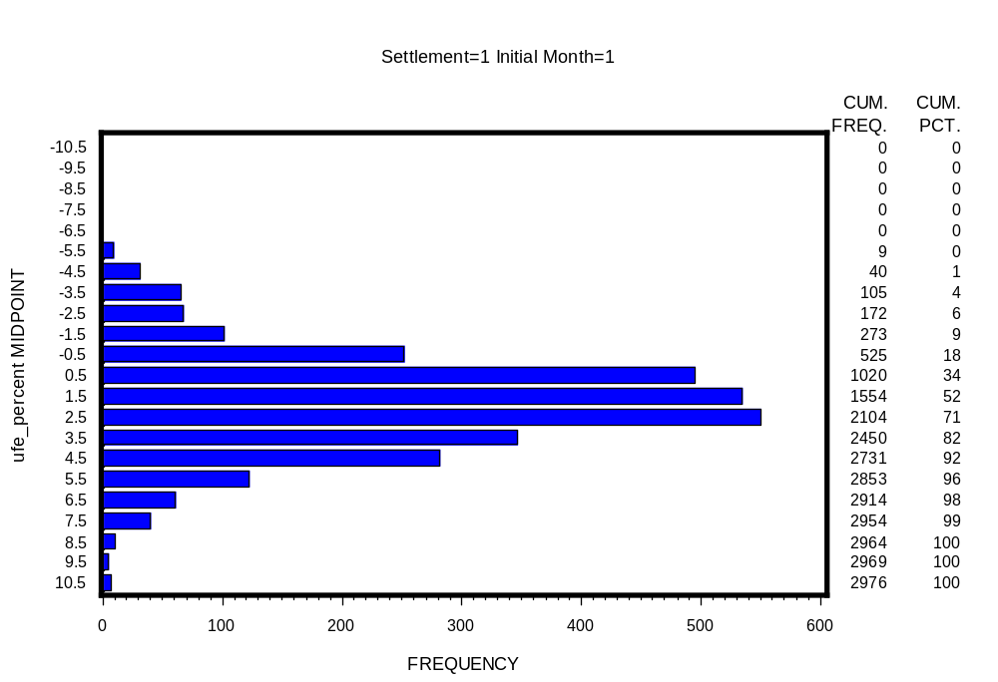
UFE Distribution 2008
Initial - January
UFD10

Slide 57
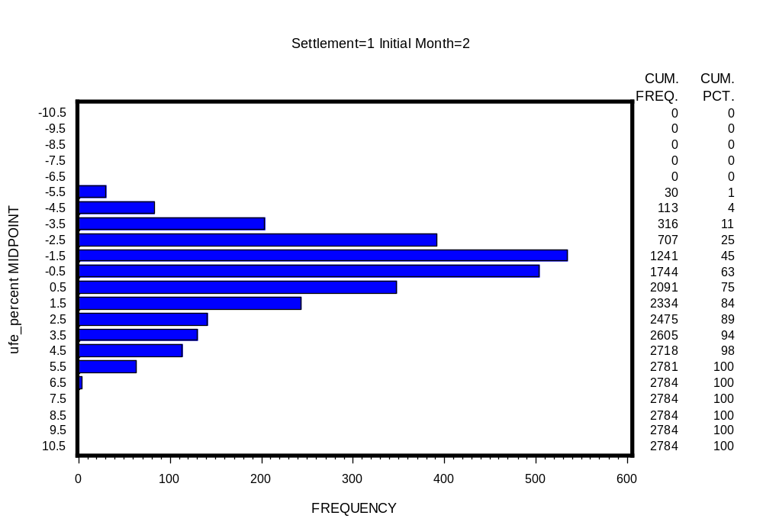
UFE Distribution 2008
Initial - February
UFD11

Slide 58
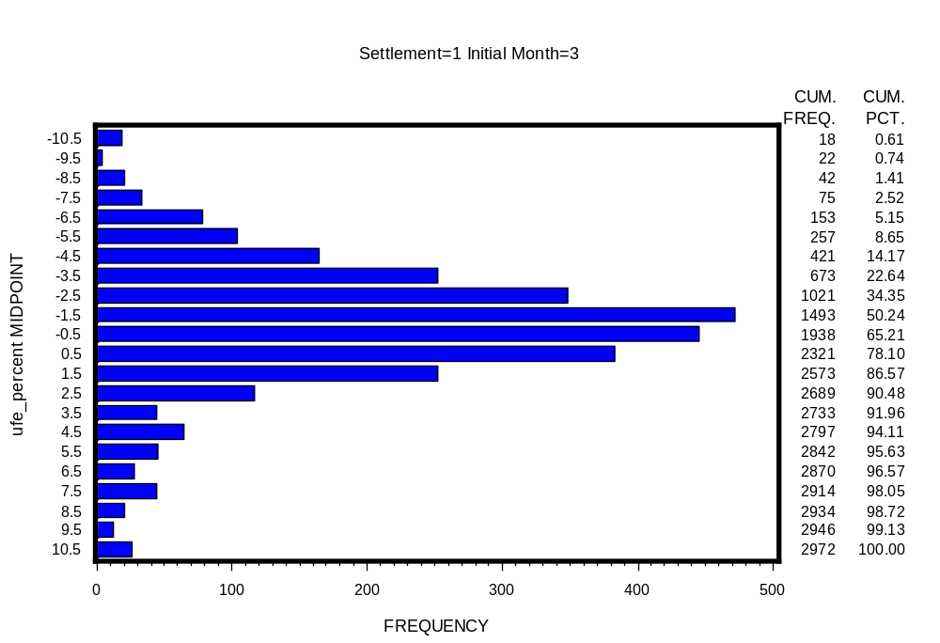
UFE Distribution 2008
Initial - March
UFD12

Slide 59
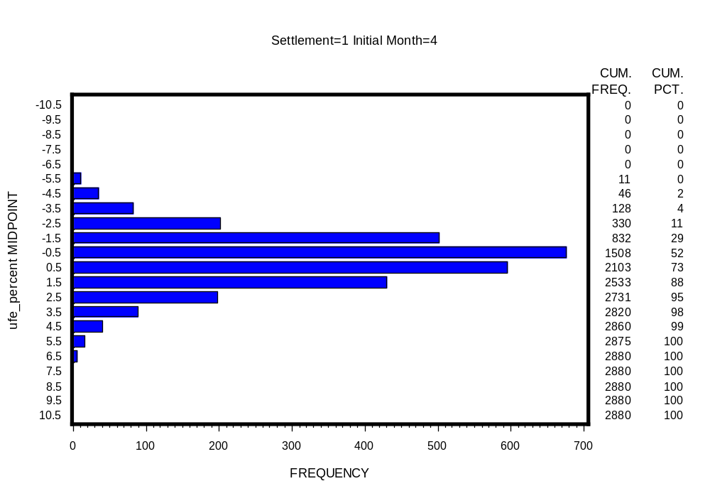
UFE Distribution 2008
Initial - April
UFD13

Slide 60
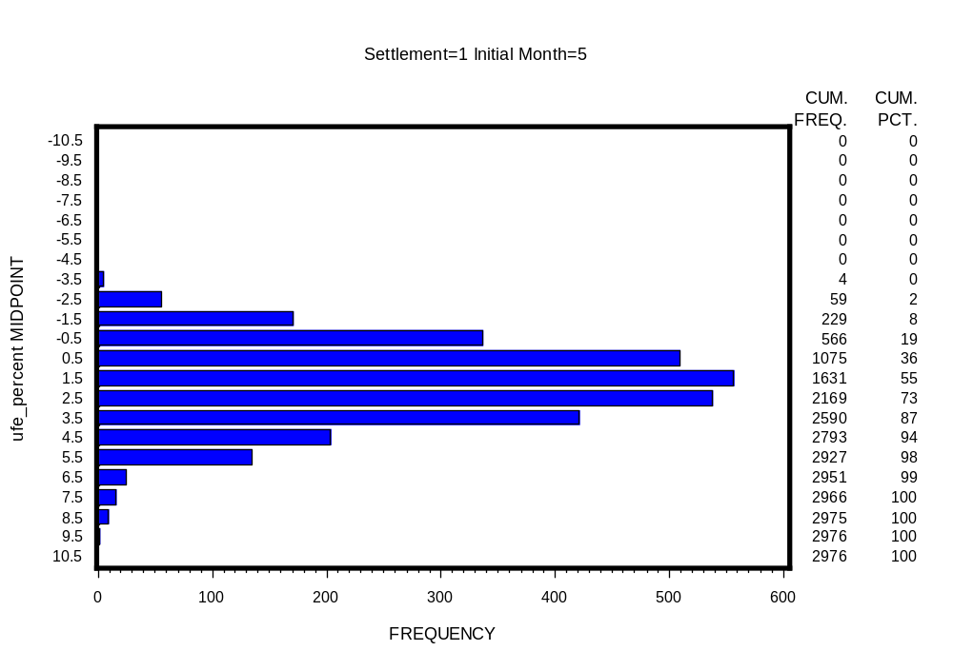
UFE Distribution 2008
Initial - May
UFD14

Slide 61

UFE Distribution 2008
Initial - June
UFD15

Slide 62

UFE Distribution 2008
Initial - July
UFD16

Slide 63

UFE Distribution 2008
Initial - August
UFD17

Slide 64

UFE Distribution 2008
Initial - September
UFD18

Slide 65

UFE Distribution 2008
Initial - October
UFD19

Slide 66

UFE Distribution 2008
Initial - November
UFD20

Slide 67

UFE Distribution 2008
Initial - December
UFD21

Slide 68
UFE Distribution
Final

Slide 69

UFE Distribution 2008
Final - January
UFD22

Slide 70

UFE Distribution 2008
Final - February
UFD23

Slide 71

UFE Distribution 2008
Final - March
UFD24

Slide 72

UFE Distribution 2008
Final - April
UFD25

Slide 73

UFE Distribution 2008
Final - May
UFD26

Slide 74

UFE Distribution 2008
Final - June
UFD27

Slide 75

UFE Distribution 2008
Final - July
UFD28

Slide 76

UFE Distribution 2008
Final - August
UFD29

Slide 77

UFE Distribution 2008
Final - September
UFD30

Slide 78

UFE Distribution 2008
Final - October
UFD31

Slide 79

UFE Distribution 2008
Final - November
UFD32

Slide 80

UFE Distribution 2008
Final - December
UFD33

Slide 81
UFE Distribution
True Up

Slide 82

UFE Distribution 2008
True Up - January
UFD34

Slide 83

UFE Distribution 2008
True Up - February
UFD35

Slide 84

UFE Distribution 2008
True Up - March
UFD36

Slide 85

UFE Distribution 2008
True Up - April
UFD37

Slide 86

UFE Distribution 2008
True Up - May
UFD38

Slide 87

UFE Distribution 2008
True Up - June
UFD39

Slide 88

UFE Distribution 2008
True Up - July
UFD40

Slide 89

UFE Distribution 2008
True Up - August
UFD41

Slide 90

UFE Distribution 2008
True Up - September
UFD42

Slide 91

UFE Distribution 2008
True Up - October
UFD43

Slide 92

UFE Distribution 2008
True Up - November
UFD44

Slide 93

UFE Distribution 2008
True Up - December
UFD45

Slide 94

UFE Percent of ERCOT Load 2008
Initial Settlement plus
95% Confidence Interval
CIP01
Notes:
Indicative of systematic estimation problem. Full year – blend of seasons. Seasonal detail comes later.

Slide 95

UFE Percent of ERCOT Load 2008
Final Settlement plus
95% Confidence Interval
CIP02

Slide 96

UFE Percent of ERCOT Load 2008
True-Up Settlement plus
95% Confidence Interval
CIP03

Slide 97

UFE Percent of ERCOT Load 2008
Comparison of Medians for Initial & Final
CIP04

Slide 98

Seasonal Comparison - Spring 2008
UFE Percent of ERCOT Load and ERCOT Load
SEA01

Slide 99

Seasonal Comparison - Summer 2008
UFE Percent of ERCOT Load and ERCOT Load
SEA02

Slide 100

Seasonal Comparison - Fall 2008
UFE Percent of ERCOT Load and ERCOT Load
SEA03

Slide 101

Seasonal Comparison - Winter 2008
UFE Percent of ERCOT Load and ERCOT Load
SEA04
Notes:
Looks like profiles are underestimating morning load, overestimating evening load.

Slide 102

Seasonal Comparison of Medians – Initial Settlement
UFE Percent of ERCOT Load - 2008
SEA05
Notes:
Idea of seasonal differences by settlement.

Slide 103

Seasonal Comparison of Medians – Final Settlement
UFE Percent of ERCOT Load - 2008
SEA06

Slide 104

Seasonal Comparison of Medians – True Up
UFE Percent of ERCOT Load - 2008
SEA07

Slide 105

Percent UFE vs ERCOT Load
Initial Settlement - 2008
MPL01

Slide 106

Percent UFE vs ERCOT Load
Final Settlement - 2008
MPL02

Slide 107

Percent UFE vs ERCOT Load
True-Up Settlement – 2008
MPL03

Slide 108

Comparison of Median Percent UFE
Initial, Final and True-Up Settlements - 2008
MPL04
Notes:
True-up median ufe is worse than final ufe for ERCOT load > 34000 mw, similarly final is worse than initial for ERCOT load > 38000 mw

Slide 109

Load Weighted Average MCPE vs Load
Initial Settlement - 2008
MPL05
Notes:
Showing there is a significant relationship between UFE and load. If pure random errors, it would be bouncing around 0 – no upward trend. Gives indication of shift from overestimating to underestimating – around 40000 Mw. Shift moves to lower loads for subsequent settlements – point out on next 2 slides.

Slide 110

Load Weighted Average MCPE vs Load
Final Settlement - 2008
MPL06
Notes:
Showing there is a significant relationship between UFE and load. If pure random errors, it would be bouncing around 0 – no upward trend. Gives indication of shift from overestimating to underestimating – around 40000 Mw. Shift moves to lower loads for subsequent settlements – point out on next 2 slides.

Slide 111

Load Weighted Average MCPE vs Load
True Up Settlement - 2008
MPL07
Notes:
Showing there is a significant relationship between UFE and load. If pure random errors, it would be bouncing around 0 – no upward trend. Gives indication of shift from overestimating to underestimating – around 40000 Mw. Shift moves to lower loads for subsequent settlements – point out on next 2 slides.

Slide 112

Comparison of Median Load Weighted Average MCPE vs Load for Initial, Final and True-Up Settlements - 2008
MPL08

Slide 113

Load Weighted Average MCPE vs Percent UFE
Initial Settlement - 2008
MPL09

Slide 114

Load Weighted Average MCPE vs Percent UFE
Final Settlement - 2008
MPL10

Slide 115

Load Weighted Average MCPE vs Percent UFE
True-Up Settlement - 2008
MPL11

Slide 116

Comparison of Median Load Weighted Average MCPE vs Percent UFE for
Initial, Final and True-Up Settlements - 2008
MPL12

Slide 117

Sum of Dollars from Positive UFE across the Week 2008
UCT02

Slide 118

Sum of Dollars from Negative UFE across the Week 2008
UCT03

Slide 119

Sum of Dollars from Absolute Value of UFE across the Week 2008
UCT04

Slide 120

Sum of Dollars from Net UFE across the Week 2008
UCT05

Slide 121




SUM of UFE Dollars
Compare All Seasons in 2008
Positive and Negative UFE
UCT06

Slide 122

SUM of UFE Dollars – Spring 2008
Positive and Negative UFE
UCT07

Slide 123

SUM of UFE Dollars – Summer 2008
Positive and Negative UFE
UCT08

Slide 124

SUM of UFE Dollars – Fall 2008
Positive and Negative UFE
UCT09

Slide 125

SUM of UFE Dollars – Winter 2008
Positive and Negative UFE
UCT10

Slide 126




SUM of UFE Dollars
Compare All Seasons in 2008
Absolute Value and Net UFE
UCT11

Slide 127

SUM of UFE Dollars – Spring 2008
Absolute Value and Net UFE
UCT12

Slide 128

SUM of UFE Dollars – Summer 2008
Absolute Value and Net UFE
UCT13

Slide 129

SUM of UFE Dollars – Fall 2008
Absolute Value and Net UFE
UCT14

Slide 130

SUM of UFE Dollars – Winter 2008
Absolute Value and Net UFE
UCT15

Slide 131




Mean of UFE Dollars
Compare All Seasons in 2008
Positive and Negative UFE
UCT16

Slide 132

Mean of UFE Dollars – Spring 2008
Positive and Negative UFE
UCT17

Slide 133

Mean of UFE Dollars – Summer 2008
Positive and Negative UFE
UCT18

Slide 134

Mean of UFE Dollars – Fall 2008
Positive and Negative UFE
UCT19

Slide 135

Mean of UFE Dollars – Winter 2008
Positive and Negative UFE
UCT20

Slide 136




Mean of UFE Dollars
Compare All Seasons in 2008
Absolute Value and Net UFE
UCT21

Slide 137

Mean of UFE Dollars – Spring 2008
Absolute Value and Net UFE
UCT22

Slide 138

Mean of UFE Dollars – Summer 2008
Absolute Value and Net UFE
UCT23

Slide 139

Mean of UFE Dollars – Fall 2008
Absolute Value and Net UFE
UCT24

Slide 140

Mean of UFE Dollars – Winter 2008
Absolute Value and Net UFE
UCT25

Slide 141
UFE 2008 Analysis Observations
Hurricanes Edouard and Ike were the largest single event contributors to UFE in 2008.
Mean and median UFE (MW) and UFE as Percent of Load declined from 2007 values. Min and std dev values increased due to the hurricane effects.
Mean and median UFE Cost ($) and UFE Cost as Percent of Total Cost declined from 2007 values. Min and std dev values increased due to the hurricane effects.

Slide 142
Steps to Reduce UFE
Develop new profile models using Round 2 load research data.
Perform settlements using 15 minute interval data from AMI meters.
Evaluate algorithms for replacing missing AMI, IDR and NIDR data estimation.
Improve distribution loss estimates.

