Slide 1

UFE 2010 ANALYSIS
Prepared by Data Aggregation for PWG

Slide 2
UFE Basics
UFE (unaccounted for energy) is computed as follows:
UFE = Generation – (Load + Losses)
Sources of UFE include:
■ Generation Measurement Errors
■ DC Tie Inadvertent Energy
■ Load - Missing/Erroneous Usage Data
- Model Error
- Load Profile ID Assignment Error
- Theft
■ Losses - Model Error
- Loss Calculation Error
- Loss Code Assignment Error
Negative UFE indicates load/losses are overestimated

Slide 3
UFE Basics
UFE
Net Generation for Settlement Interval
GAP - - - - - - >
Losses:
Transmission & Distribution
Interval Data
Energy Usage
Net Generation
Compared to
Load Buildup
Profiled Energy Usage
Non-Metered Accounts

Slide 4
Protocol Language – 11.6
Unaccounted For Energy Analysis
11.6.1 Overview
(1) ERCOT will provide an annual Unaccounted For Energy (UFE) analysis report consisting of UFE data analysis from the preceding calendar year. This report will be based on final Settlement data and will be posted to the Market Information System (MIS) Public Area by April 30th. The appropriate …
11.6.2 Annual Unaccounted For Energy Analysis Report
The annual UFE analysis report will contain both ERCOT-wide and UFE allocation category quantities as follows:
(a) Total UFE MWhs;
(b) Total UFE cost;
(c) Percent of total UFE to ERCOT Load;
(d) Percent of total UFE cost; and
(e) Notice of any factors that may be contributing to UFE.

Slide 5
Annual Data
2010 | Item A - Total UFE MWHs | Item B - Total UFE Cost | Item C - Percent of total UFE to ERCOT Load | Item D - Percent of total UFE Cost
TOTUFE_U1 | 1,756,344 | $85,406,714 | 0.55% | 100.00%
UFEIDR_U1 | 372,016 | $17,146,558 | 0.12% | 20.08%
UFENIDR_U1 | 1,347,614 | $66,698,349 | 0.42% | 78.09%
UFETRANS_U1 | 36,714 | $1,561,807 | 0.01% | 1.83%
***Data above can be provided at the 15-minute level if requested***

Slide 6
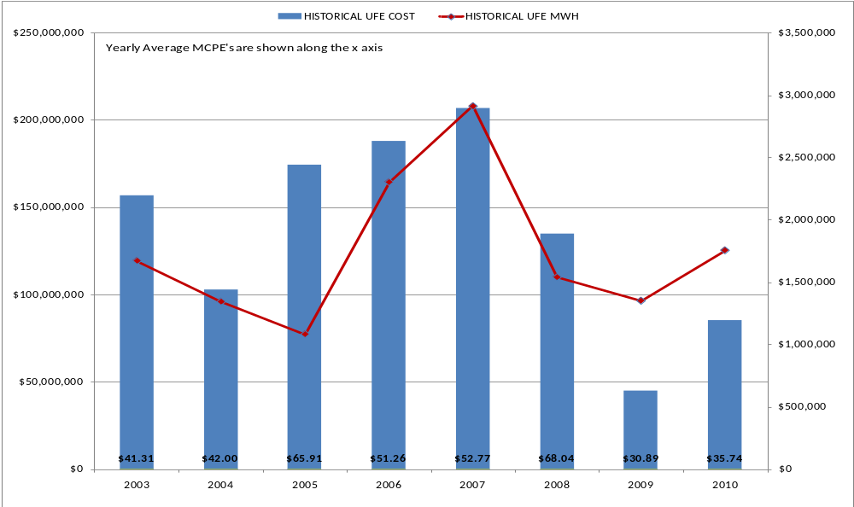
Historical UFE Cost, MWH & Avg MCPE
Notes:
This is NET UFE. + and – are canceling out. May and Oct (shoulder months) are the highest while April (another shoulder month) is lowest. Winter months are generally higher than summer months.

Slide 7
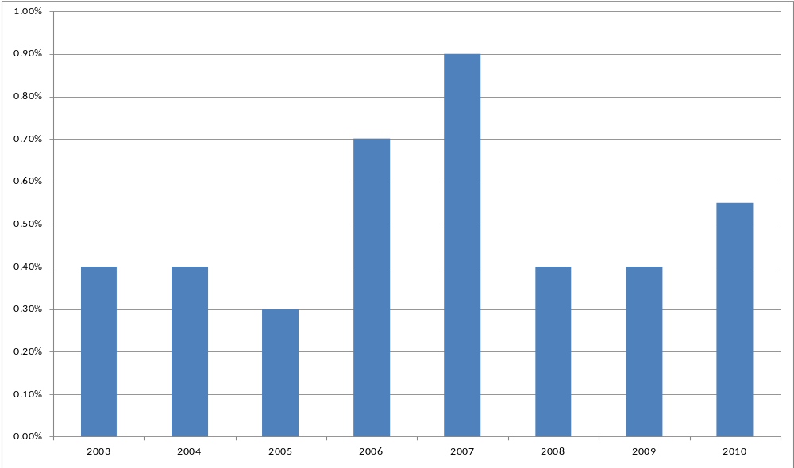
Historical UFE as Percent of Load
Notes:
This is NET UFE. + and – are canceling out. May and Oct (shoulder months) are the highest while April (another shoulder month) is lowest. Winter months are generally higher than summer months.

Slide 8
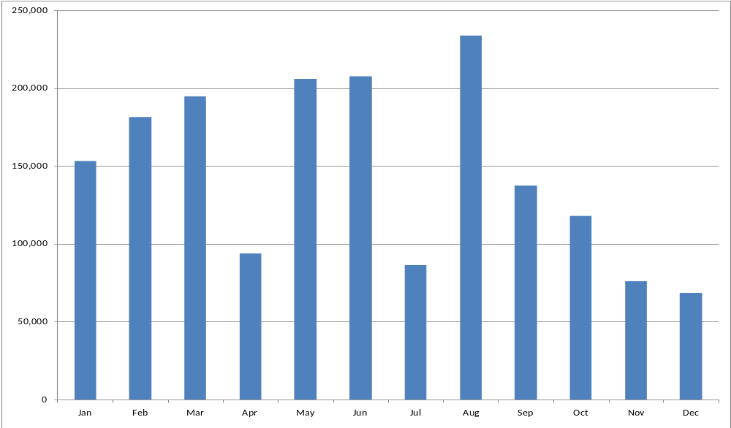
UFE MWh by Month in 2010
SR04
Notes:
This is NET UFE. + and – are canceling out. May and Oct (shoulder months) are the highest while April (another shoulder month) is lowest. Winter months are generally higher than summer months.

Slide 9
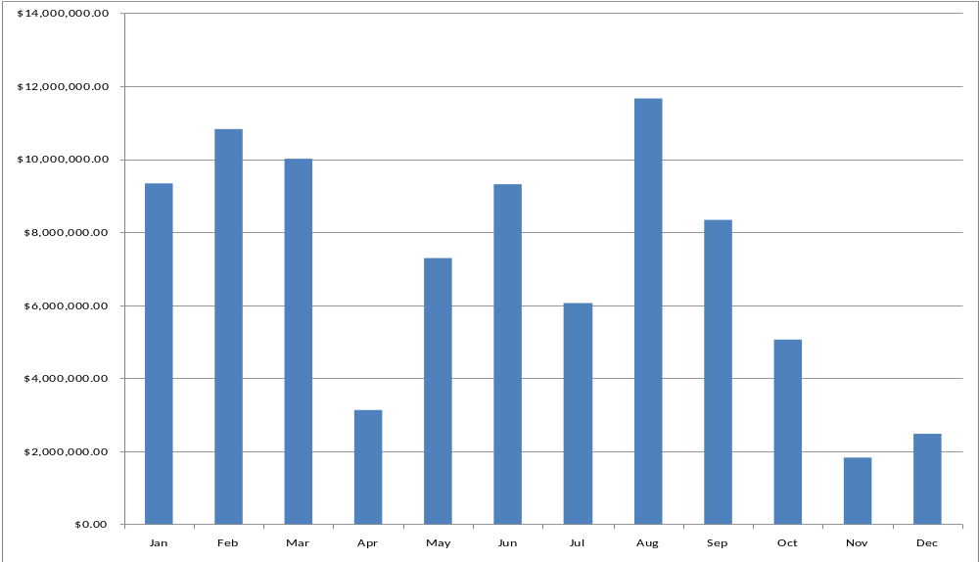
UFE Cost by Month in 2010

Slide 10
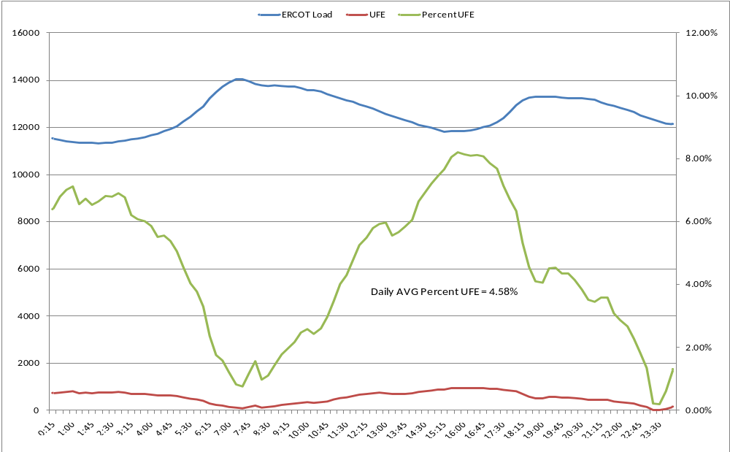
LOAD AND UFE – 1/8/2010
(Day with highest interval UFE & daily total UFE)

Slide 11
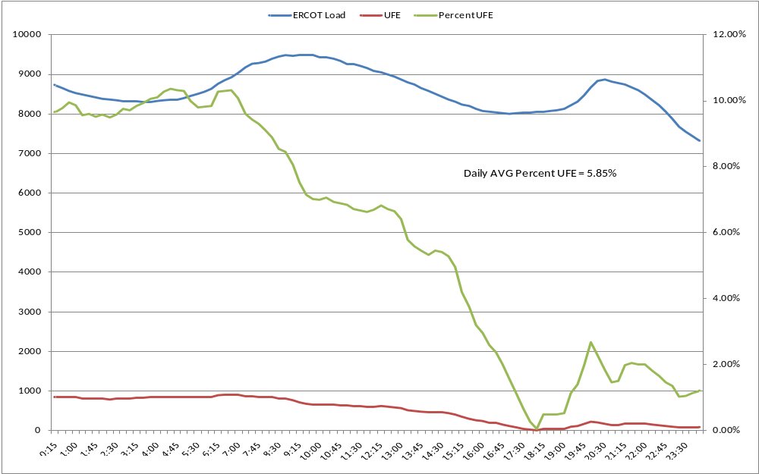
LOAD AND UFE – 3/21/2010
(Day with highest daily average UFE)

Slide 12
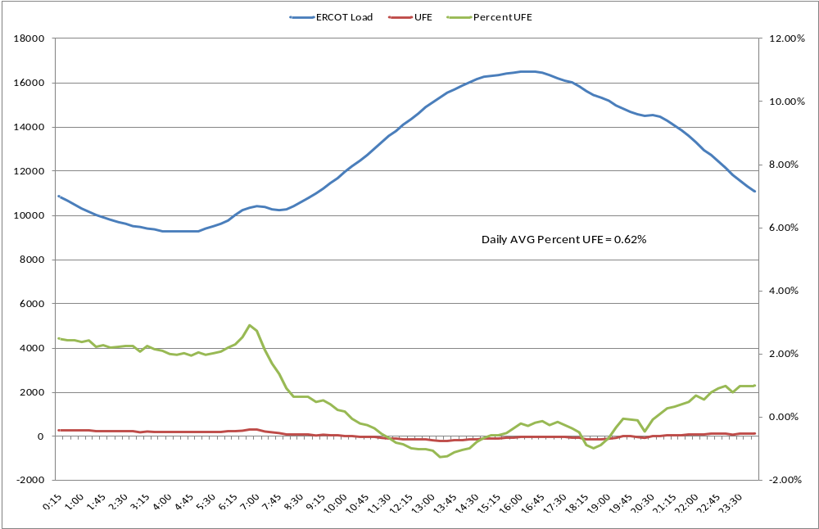
LOAD AND UFE – 8/23/2010
(ERCOT peak day)

Slide 13
QUESTIONS
?

