Slide 1
2011 UFE Analysis
Prepared by Data Aggregation
May 2012 PWG Meeting

Slide 2
UFE Basics
UFE (unaccounted for energy) is computed as follows:
UFE = Generation – (Load + Losses)
Negative UFE indicates load/losses are overestimated
Sources of UFE include:
■ Generation Measurement Errors
■ DC Tie Inadvertent Energy
■ Load - Missing/Erroneous Usage Data
- Backcast Profile Error
- Load Profile ID Assignment Error
- Theft
■ Losses - Model Error
- Loss Calculation Error
- Loss Code Assignment Error
May 2012 PWG Meeting

Slide 3
UFE Basics
UFE
Net Generation for Settlement Interval
GAP - - - - - - >
Losses:
Transmission & Distribution
Interval Data
Energy Usage
Net Generation
Compared to
Load Buildup
Profiled Energy Usage
Non-Metered Accounts
May 2012 PWG Meeting

Slide 4
Protocol Language 11.6 - Unaccounted For Energy Analysis
11.6.1 Overview
(1) ERCOT will provide an annual Unaccounted For Energy (UFE) analysis report consisting of UFE data analysis from the preceding calendar year. This report will be based on final Settlement data and will be posted to the Market Information System (MIS) Public Area by April 30th. The appropriate …
11.6.2 Annual Unaccounted For Energy Analysis Report
The annual UFE analysis report will contain both ERCOT-wide and UFE allocation category quantities as follows:
(a) Total UFE MWhs;
(b) Total UFE cost;
(c) Percent of total UFE to ERCOT Load;
(d) Percent of total UFE cost; and
(e) Notice of any factors that may be contributing to UFE.
May 2012 PWG Meeting

Slide 5
Annual Data
2011 | Item A - Total UFE MWHs | Item B - Total UFE Cost | Item C - Percent of total UFE to ERCOT Load | Item D - Percent of total UFE Cost
TOTUFE_U1 | 1,453,256 | $31,666,952 | 0.43% | 100.00%
UFEIDR_U1 | 594,314 | $14,088,446 | 0.18% | 44.49%
UFENIDR_U1 | 822,706 | $16,612,138 | 0.25% | 52.46%
UFETRANS_U1 | 36,236 | $966,367 | 0.01% | 3.05%
***Data above can be provided at the 15-minute level if requested***
May 2012 PWG Meeting

Slide 6
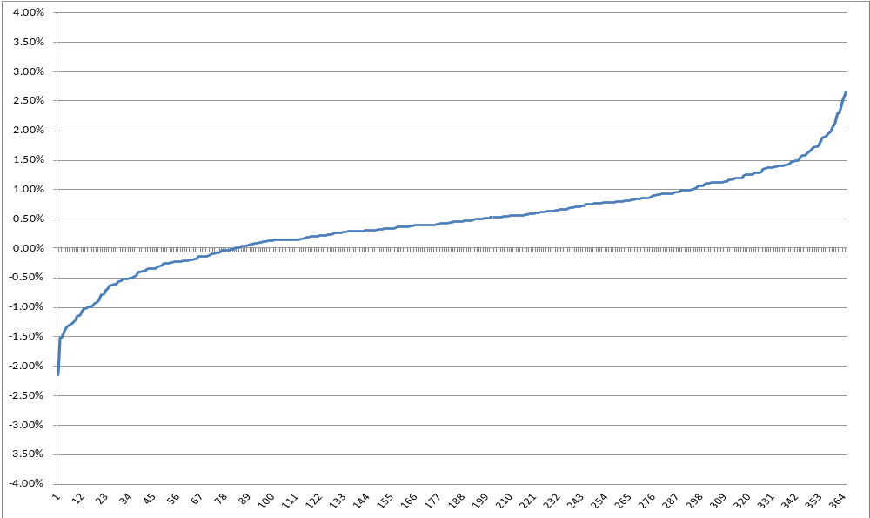
Average Daily UFE (sorted low to high)
May 2012 PWG Meeting

Slide 7
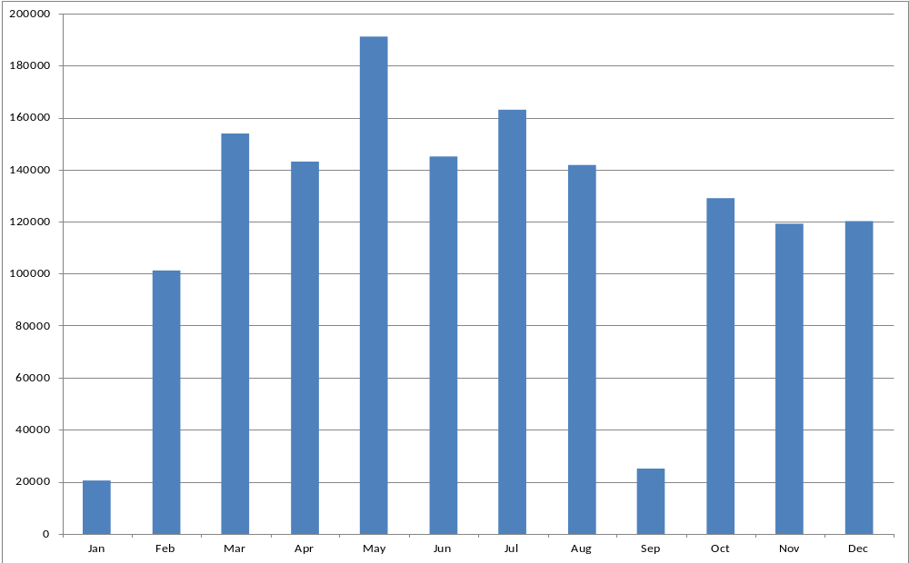
UFE Monthly MWH
May 2012 PWG Meeting

Slide 8
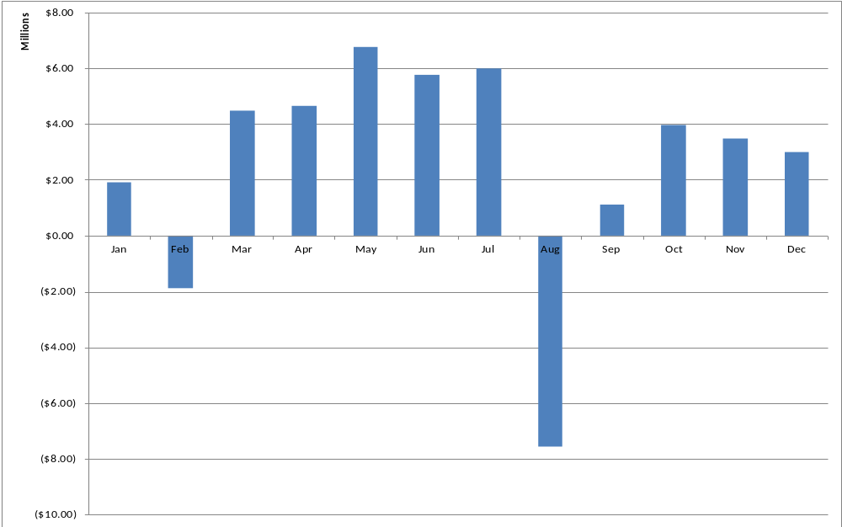
UFE Monthly Cost
May 2012 PWG Meeting

Slide 9
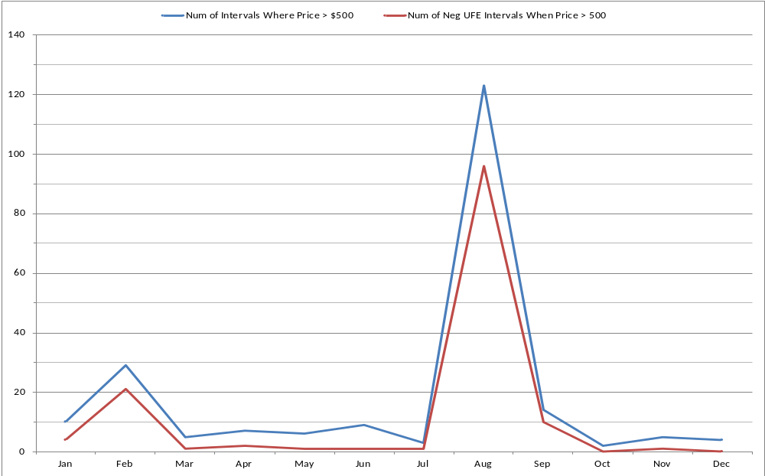
Monthly View of High Price/Negative UFE
May 2012 PWG Meeting

Slide 10
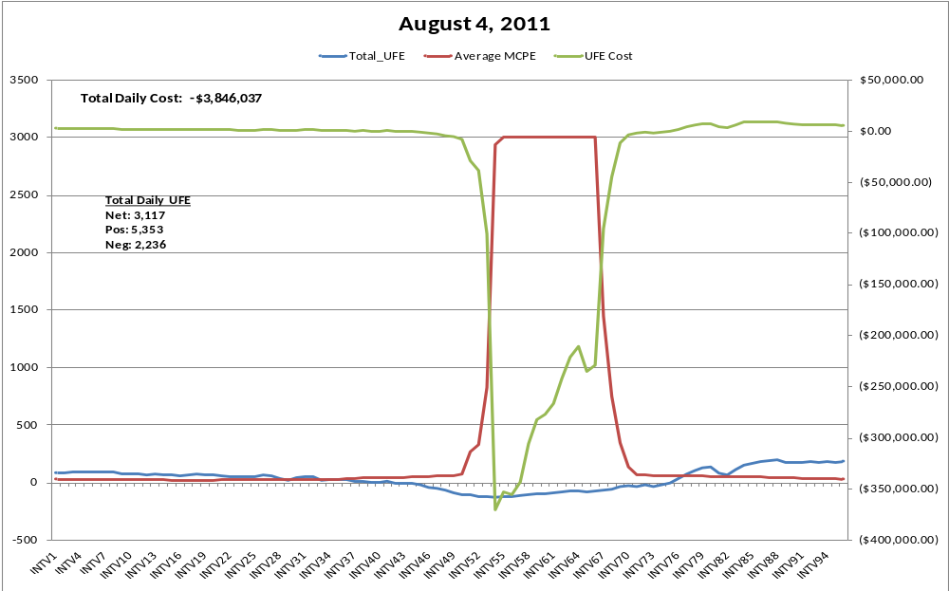
High Negative Cost Day
May 2012 PWG Meeting

Slide 11
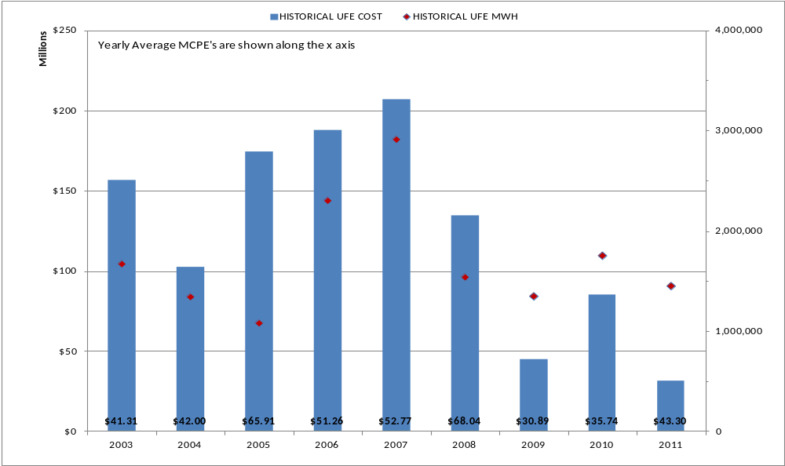
Historical UFE Cost, MWH and Average MCPE
May 2012 PWG Meeting

Slide 12
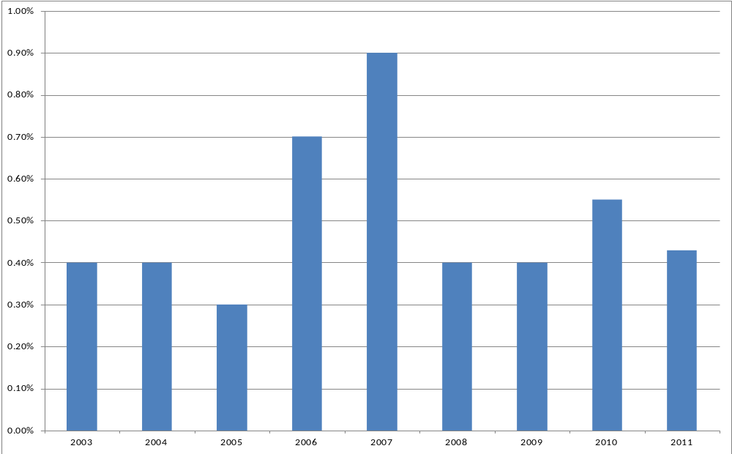
Historical UFE as Percent of Load
May 2012 PWG Meeting

