Slide 1
2021 UFE Analysis Report
Randy Roberts
May 2022 WMS

Slide 2
UFE Basics 1
UFE (Unaccounted For Energy) is computed as follows:
UFE = Generation – (Load + Losses)
Negative UFE indicates load/losses are overestimated
Sources of UFE include:
■ Generation Measurement Errors
■ DC Tie Inadvertent Energy
■ Load - Missing/Erroneous Usage Data
- Backcast Profile Error
- Load Profile ID Assignment Error
- Theft
■ Losses - Model Error
- Loss Calculation Error
- Loss Code Assignment Error

Slide 3
UFE Basics 2
UFE
Net Generation for Settlement Interval
GAP - - - - - - >
Losses:
Transmission & Distribution
Interval Data
Energy Usage
Net Generation
Compared to
Load Buildup
Profiled Energy Usage
Non-Metered Accounts

Slide 4
Protocol Language 11.6 – Unaccounted for Energy Analysis
11.6.1 Overview
(1) ERCOT will provide an annual Unaccounted For Energy (UFE) analysis report consisting of UFE data analysis from the preceding calendar year. This report will be based on final Settlement data and will be posted to the Market Information System (MIS) Public Area by April 30th. The appropriate …
11.6.2 Annual Unaccounted For Energy Analysis Report
The annual UFE analysis report will contain both ERCOT-wide and UFE allocation category quantities as follows:
(a) Total UFE MWHs;
(b) Total UFE cost;
(c) Percent of total UFE to ERCOT Load;
(d) Percent of total UFE cost; and
(e) Notice of any factors that may be contributing to UFE.

Slide 5
Data Required Per Protocol Section 11.6.2
 | A – Total UFE MWHs | B – Total UFE Cost | C – Percent of Total UFE to ERCOT load | D – Percent of Total UFE Cost
TOTUFE_U1 | 356,388 | $246,439,449 | 0.0906% | 100.00%
UFEIDR_U1 | 313,388 | $240,744,482 | 0.0796% | 97.69%
UFENIDR_U1 | 9,454 | $1,712,381 | 0.0024% | 0.69%
UFETRANS_U1 | 33,546 | $3,982,585 | 0.0085% | 1.62%
Legend:
TOTUFE_U1 - Total ERCOT Wide UFE
UFEIDR_U1 - Distribution IDR UFE
UFENIDR_U1 - NIDR UFE
UFETRANS_U1 - Transmission IDR UFE

Slide 6
Average Daily % UFE (sorted low to high)

Slide 7
UFE Monthly MWH

Slide 8
UFE Monthly Cost

Slide 9
Historical Yearly Values
 | MWH | COST | % of LOAD | AVG PRICE
2003 | 1,672,727 | $156,733,428 | 0.40% | $41.31
2004 | 1,344,289 | $102,693,690 | 0.40% | $42.00
2005 | 1,082,561 | $174,154,088 | 0.30% | $65.91
2006 | 2,304,458 | $187,975,534 | 0.70% | $51.26
2007 | 2,914,297 | $206,949,832 | 0.90% | $52.77
2008 | 1,541,086 | $134,692,211 | 0.40% | $68.04
2009 | 1,351,187 | $44,857,873 | 0.40% | $30.89
2010 | 1,756,344 | $85,406,714 | 0.55% | $35.74
2011 | 1,453,256 | $31,666,952 | 0.43% | $43.30
2012 | 1,002,761 | $25,945,816 | 0.31% | $26.60
2013 | -395,393 | -$17,061,127 | -0.12% | $31.71
2014 | 298,578 | $2,286,431 | 0.09% | $38.02
2015 | 240,091 | $1,441,929 | 0.07% | $24.80
2016 | 644,293 | $11,037,155 | 0.18% | $22.60
2017 | -452,775 | -$20,469,613 | -0.13% | $26.53
2018 | 657,974 | $7,209,457 | 0.17% | $32.28
2019 | 252,851 | -$22,095,272 | 0.07% | $38.83
2020 | -265,915 | -$20,023,844 | -0.07% | $24.03
2021 | 356,388 | $246,439,449 | 0.09% | $150.40

Slide 10
Historical UFE Cost, MWH, and Average MCPE

Slide 11
Historical UFE as Percent of Load

Slide 12
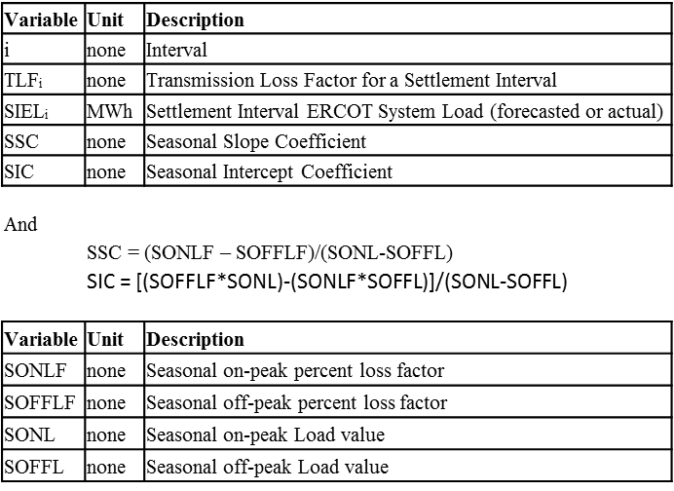
Transmission Loss Factor Calculation Review
13.2.3 Transmission Loss Factor Calculations
The following formulas shall be used to translate the seasonal on-peak and off-peak TLFs into Settlement Interval TLFs.
TLF_{i} = (SSC * SIEL_{i}) + SIC

Slide 13
2021 Deemed Transmission Loss vs. UFE

Slide 14
2022/2023 Transmission Losses (Forecasted & Deemed Actual)

Slide 15
WMS Parking Lot Item
Parking Lot Items | Responsible | Notes | Assigned
Look at actual loss factors compared to calculated losses in modeling | WMWG | Still Open – tabled until RTC work is done Requested update Regarding 2018 UFE Analysis | 11/04/2020 12/04/2019 09/04/2019 07/10/2019

Slide 16
August 2019 TLF Comparison

Slide 17
August 2019 Original vs. New UFE Comparison

