Slide 1
2023 UFE Analysis Report
Joe Lara
June 2024 WMS

Slide 2
UFE Basics 1
UFE (Unaccounted For Energy) is computed as follows:
UFE = Generation – (Load + Losses)
Negative UFE indicates load/losses are overestimated
Sources of UFE include:
■ Generation Measurement Errors
■ DC Tie Inadvertent Energy
■ Load - Missing/Erroneous Usage Data
- Backcast Profile Error
- Load Profile ID Assignment Error
- Theft
■ Losses - Model Error
- Loss Calculation Error
- Loss Code Assignment Error

Slide 3
UFE Basics 2
UFE
Net Generation for Settlement Interval
GAP - - - - - - >
Losses:
Transmission & Distribution
Interval Data
Energy Usage
Net Generation
Compared to
Load Buildup
Profiled Energy Usage
Non-Metered Accounts

Slide 4
Protocol Language 11.6 – Unaccounted for Energy Analysis
11.6.1 Overview
(1) ERCOT will provide an annual Unaccounted For Energy (UFE) analysis report consisting of UFE data analysis from the preceding calendar year. This report will be based on final Settlement data and will be posted to the Market Information System (MIS) Public Area by April 30th. The appropriate …
11.6.2 Annual Unaccounted For Energy Analysis Report
The annual UFE analysis report will contain both ERCOT-wide and UFE allocation category quantities as follows:
(a) Total UFE MWHs;
(b) Total UFE cost;
(c) Percent of total UFE to ERCOT Load;
(d) Percent of total UFE cost; and
(e) Notice of any factors that may be contributing to UFE.

Slide 5
Data Required Per Protocol Section 11.6.2
 | A – Total UFE MWHs | B – Total UFE Cost | C – Percent of Total UFE to ERCOT load | D – Percent of Total UFE Cost
TOTUFE_U1 | -1,078,199 | -$92,779,500 | -0.2412% | 100.00%
UFEIDR_U1 | -1,012,282 | -$88,198,181 | -0.2265% | 95.06%
UFENIDR_U1 | -7,757 | -$529,209 | -0.0017% | 0.57%
UFETRANS_U1 | -58,160 | -$4,052,109 | -0.0130% | 4.37%
Legend:
TOTUFE_U1 - Total ERCOT Wide UFE
UFEIDR_U1 - Distribution IDR UFE
UFENIDR_U1 - NIDR UFE
UFETRANS_U1 - Transmission IDR UFE

Slide 6
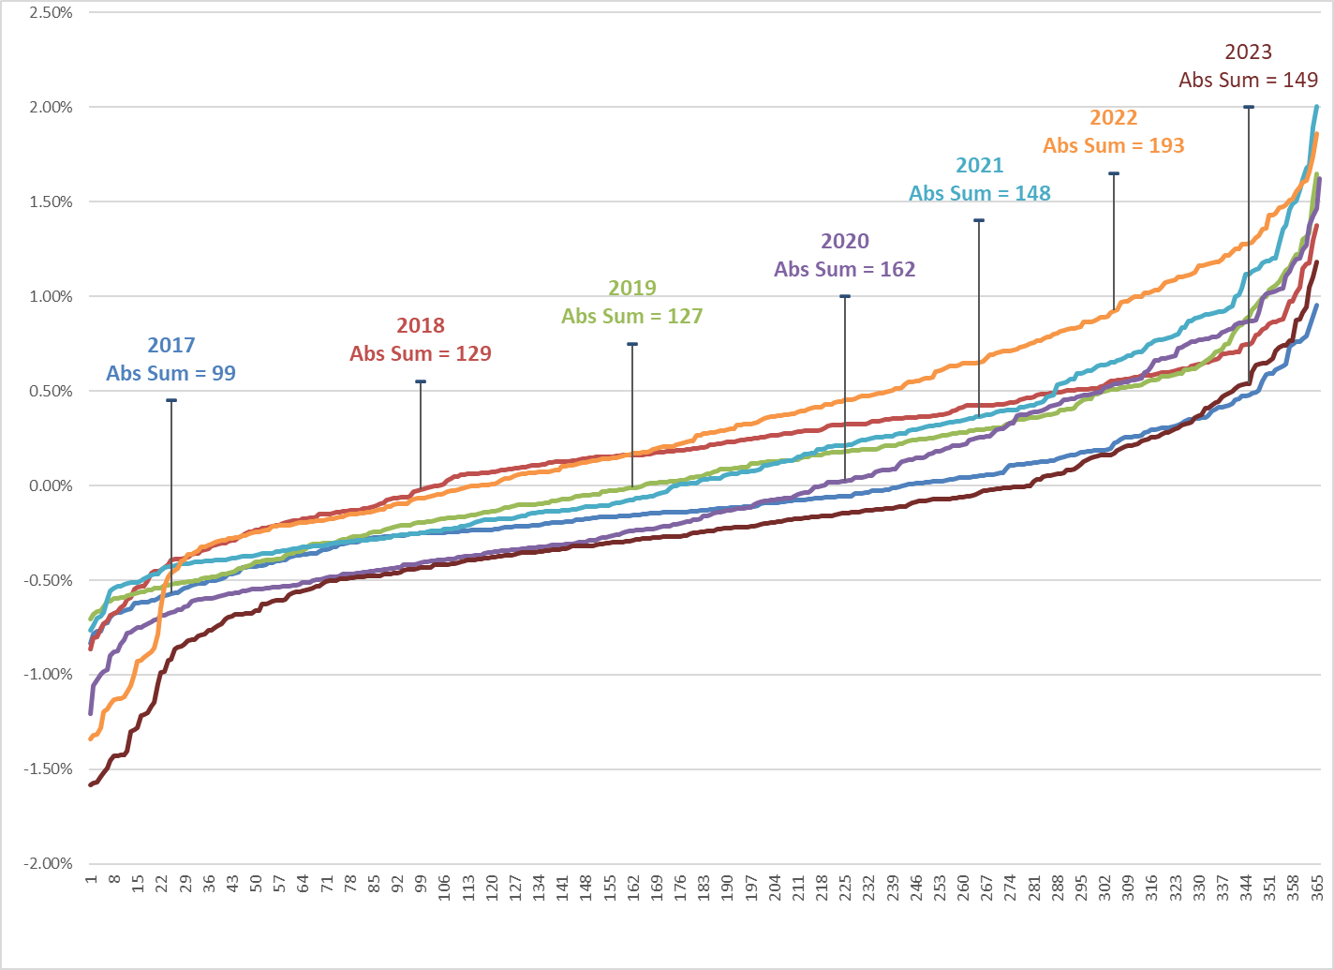
Average Daily % UFE (sorted low to high)

Slide 7
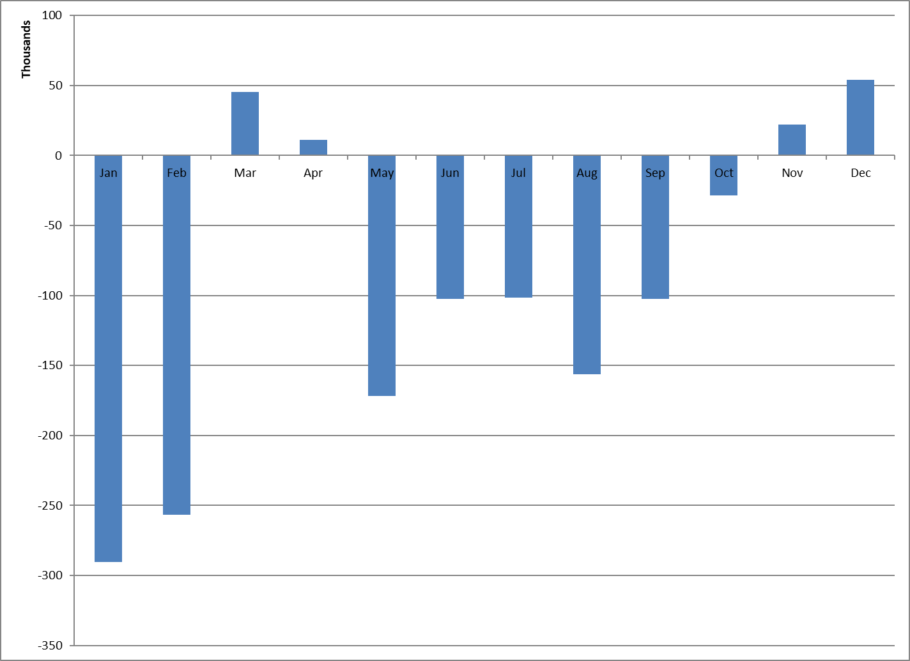
UFE Monthly MWH

Slide 8
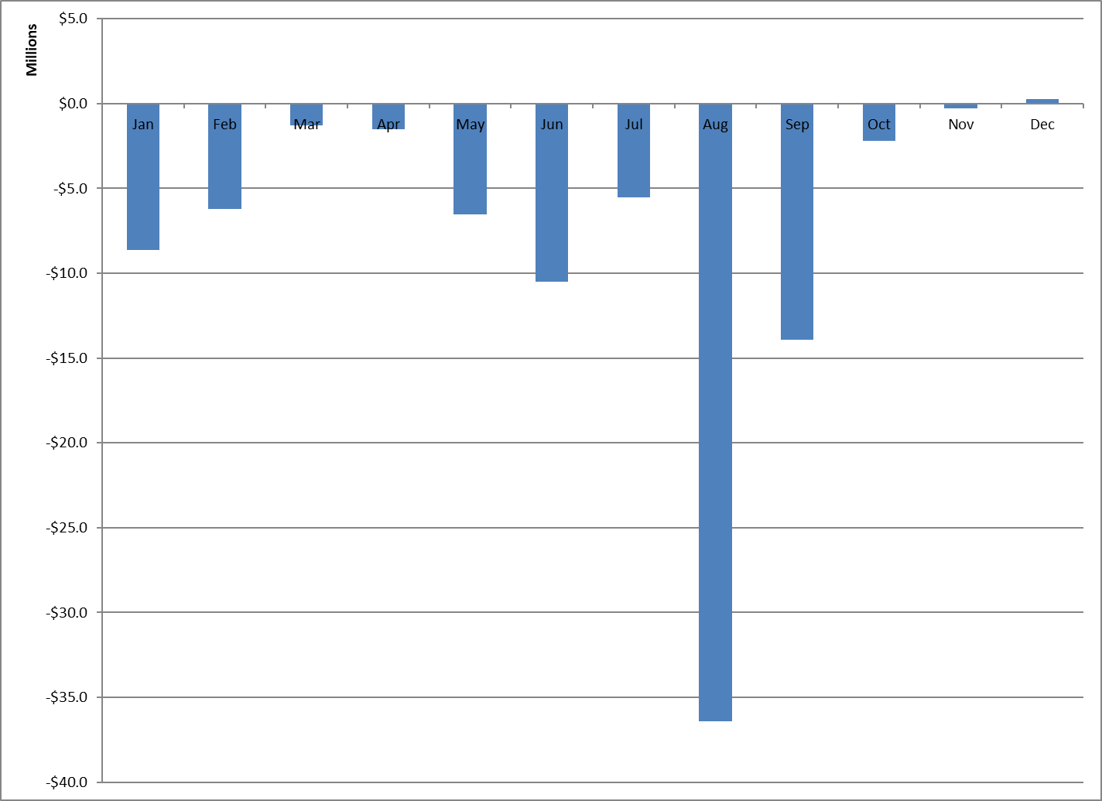
UFE Monthly Cost

Slide 9
Historical Yearly Values
 | MWH | COST | % of LOAD | AVG MCP
2004 | 1,344,289 | $102,693,690 | 0.40% | $42.00
2005 | 1,082,561 | $174,154,088 | 0.30% | $65.91
2006 | 2,304,458 | $187,975,534 | 0.70% | $51.26
2007 | 2,914,297 | $206,949,832 | 0.90% | $52.77
2008 | 1,541,086 | $134,692,211 | 0.40% | $68.04
2009 | 1,351,187 | $44,857,873 | 0.40% | $30.89
2010 | 1,756,344 | $85,406,714 | 0.55% | $35.74
2011 | 1,453,256 | $31,666,952 | 0.43% | $43.30
2012 | 1,002,761 | $25,945,816 | 0.31% | $26.60
2013 | -395,393 | -$17,061,127 | -0.12% | $31.71
2014 | 298,578 | $2,286,431 | 0.09% | $38.02
2015 | 240,091 | $1,441,929 | 0.07% | $24.80
2016 | 644,293 | $11,037,155 | 0.18% | $22.60
2017 | -452,775 | -$20,469,613 | -0.13% | $26.53
2018 | 657,974 | $7,209,457 | 0.17% | $32.28
2019 | 252,851 | -$22,095,272 | 0.07% | $38.83
2020 | -265,915 | -$20,023,844 | -0.07% | $24.03
2021 | 356,388 | $246,439,449 | 0.09% | $150.40
2022 | 1,126,521 | $20,085,214 | 0.26% | $64.89
2023 | -1,078,199 | -$92,779,500 | -0.24% | $50.68
Note: Avg MCP excludes NOIE load zones

Slide 10
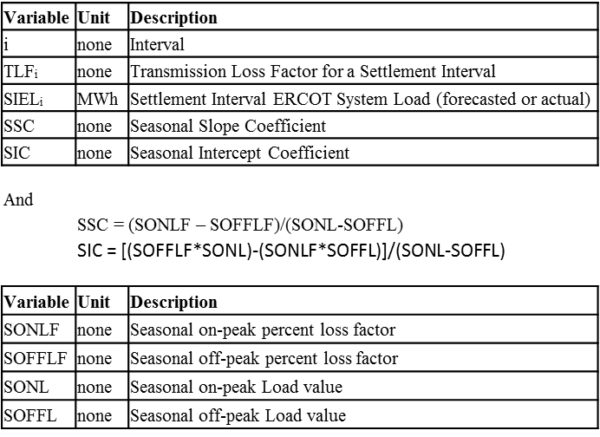
Transmission Loss Factor Calculation Review
13.2.3 Transmission Loss Factor Calculations
The following formulas shall be used to translate the seasonal on-peak and off-peak TLFs into Settlement Interval TLFs.
TLF_{i} = (SSC * SIEL_{i}) + SIC

Slide 11
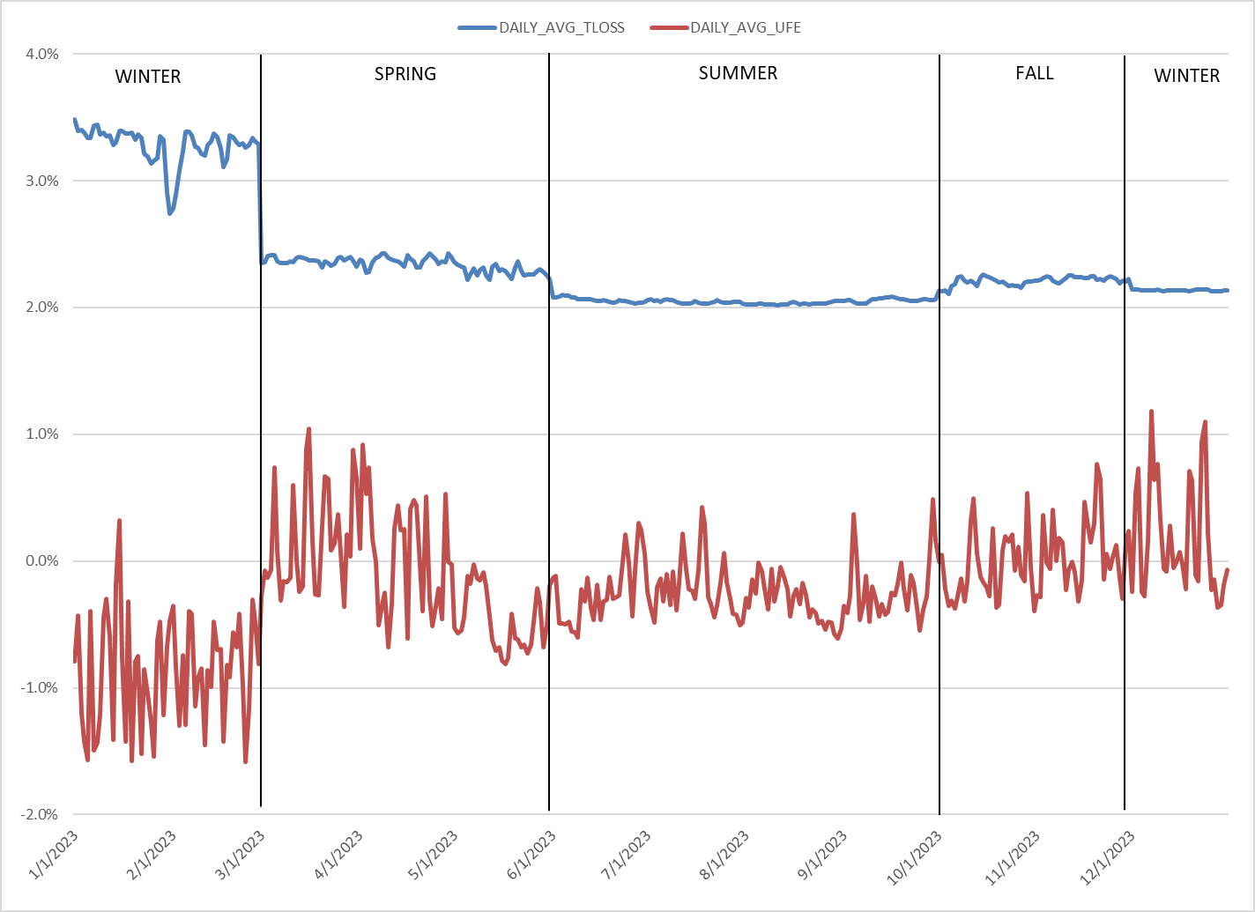
2023 Deemed Transmission Loss vs. UFE

Slide 12
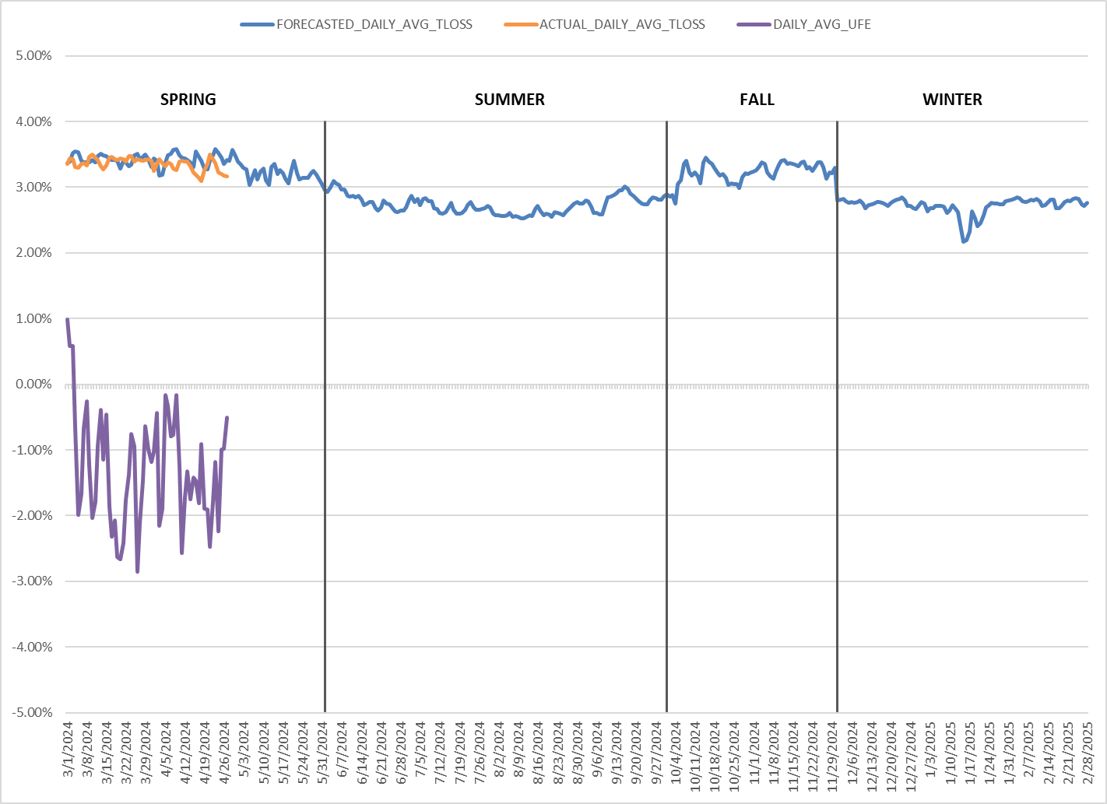
2024/2025 Transmission Losses & Actual UFE To Date

Slide 13
2024/2025 Higher TLFs
ERCOT has not performed a deep analysis but believe the higher TLFs are due to the reasons below.
Increase in wind generation which results in more load flowing through CREZ lines from wind generation areas to large population centers
Higher load from large flexible loads (LFLs)
The need for additional voltage tuning in the SSWG cases
System wide trends regarding a change in generation and load mix

Slide 14
NPRR1145 – Use of State Estimator-Calculated ERCOT-Wide TLFs in Lieu of Seasonal Base Case ERCOT-Wide TLFs for Settlement
Approved By Public Utility Commission on 5/11/2023
Priority – 2024
Rank – 4010
Comments
$50k-$80k, 3-6 months
Impacted Systems: S&B, EMS, Data Analytics
Project delayed due to EMS upgrade/freeze
ERCOT is currently considering a Q3 2024 start for this project

Slide 15
QUESTIONS?

