Slide 1
2024 UFE Analysis Report
Joe Lara
May 2025 WMS

Slide 2
UFE Basics 1
UFE (Unaccounted For Energy) is computed as follows:
UFE = Generation – (Load + Losses)
Negative UFE indicates load/losses are overestimated
Sources of UFE include:
■ Generation Measurement Errors
■ DC Tie Inadvertent Energy
■ Load - Missing/Erroneous Usage Data
- Backcast Profile Error
- Load Profile ID Assignment Error
- Theft
■ Losses - Model Error
- Loss Calculation Error
- Loss Code Assignment Error

Slide 3
UFE Basics 2
UFE
Net Generation for Settlement Interval
GAP - - - - - - >
Losses:
Transmission & Distribution
Interval Data
Energy Usage
Net Generation
Compared to
Load Buildup
Profiled Energy Usage
Non-Metered Accounts

Slide 4
Protocol Language 11.6 – Unaccounted for Energy Analysis
11.6.1 Overview
(1) ERCOT will provide an annual Unaccounted For Energy (UFE) analysis report consisting of UFE data analysis from the preceding calendar year. This report will be based on final Settlement data and will be posted to the Market Information System (MIS) Public Area by April 30th. The appropriate …
11.6.2 Annual Unaccounted For Energy Analysis Report
The annual UFE analysis report will contain both ERCOT-wide and UFE allocation category quantities as follows:
(a) Total UFE MWHs;
(b) Total UFE cost;
(c) Percent of total UFE to ERCOT Load;
(d) Percent of total UFE cost; and
(e) Notice of any factors that may be contributing to UFE.

Slide 5
Data Required Per Protocol Section 11.6.2
 | A – Total UFE MWHs | B – Total UFE Cost | C – Percent of Total UFE to ERCOT load | D – Percent of Total UFE Cost
TOTUFE_U1 | -4,080,762 | -$144,444,551 | -0.8759% | 100.00%
UFEIDR_U1 | -3,753,989 | -$133,719,690 | -0.8058% | 92.58%
UFENIDR_U1 | -42,103 | -$1,434,246 | -0.0090% | 0.99%
UFETRANS_U1 | -284,670 | -$9,290,616 | -0.0611% | 6.43%
Legend:
TOTUFE_U1 - Total ERCOT Wide UFE
UFEIDR_U1 - Distribution IDR UFE
UFENIDR_U1 - NIDR UFE
UFETRANS_U1 - Transmission IDR UFE
May 2025 WMS

Slide 6
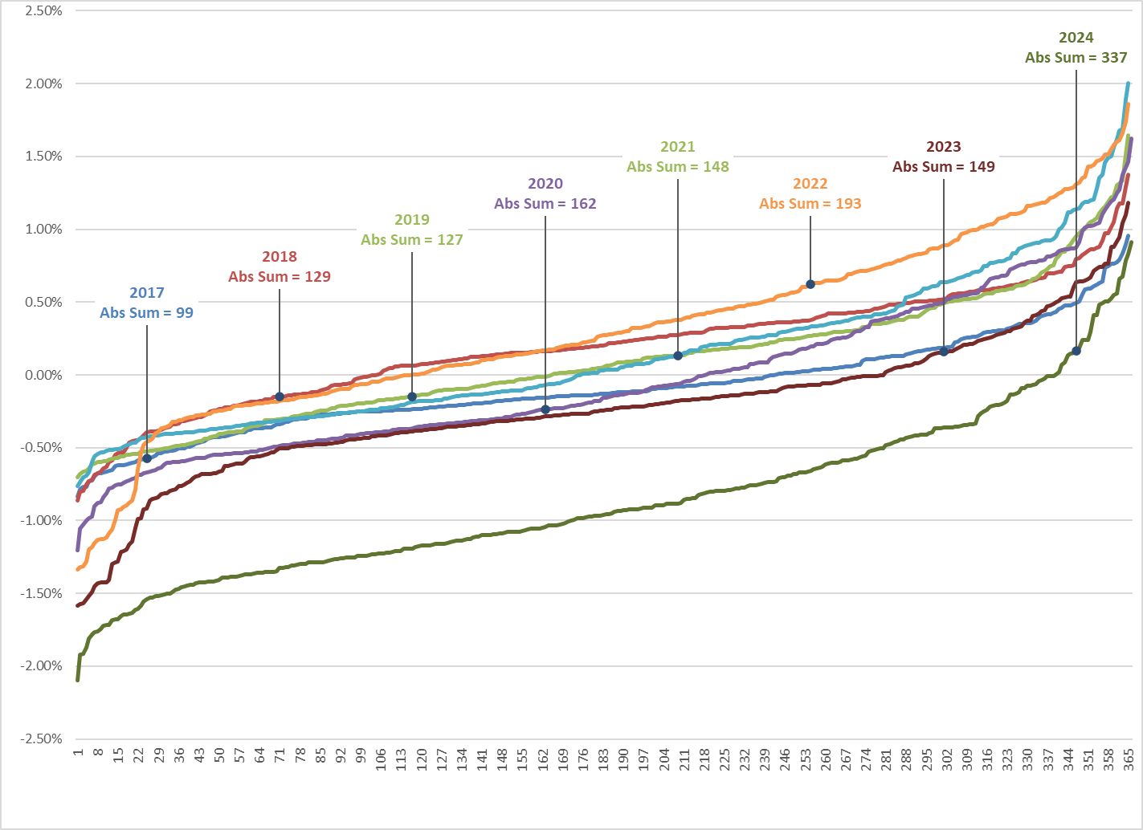
Average Daily % UFE (sorted low to high)

Slide 7
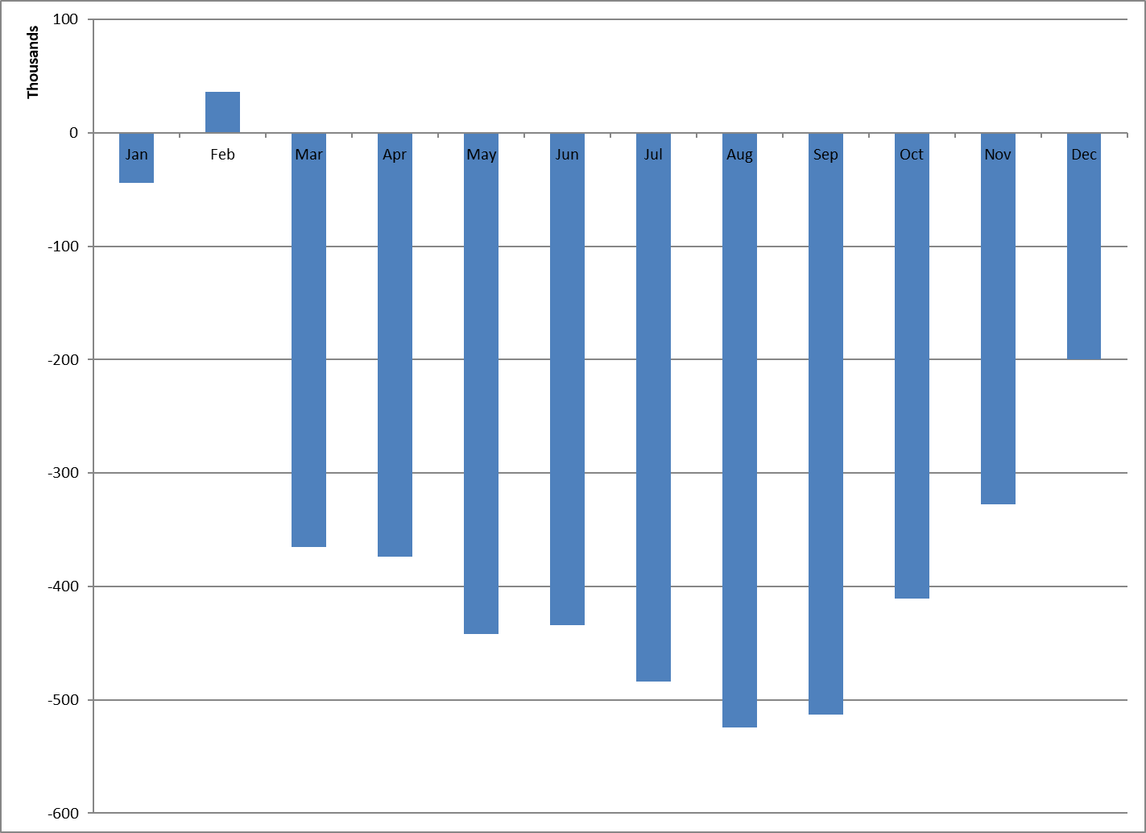
UFE Monthly MWH

Slide 8
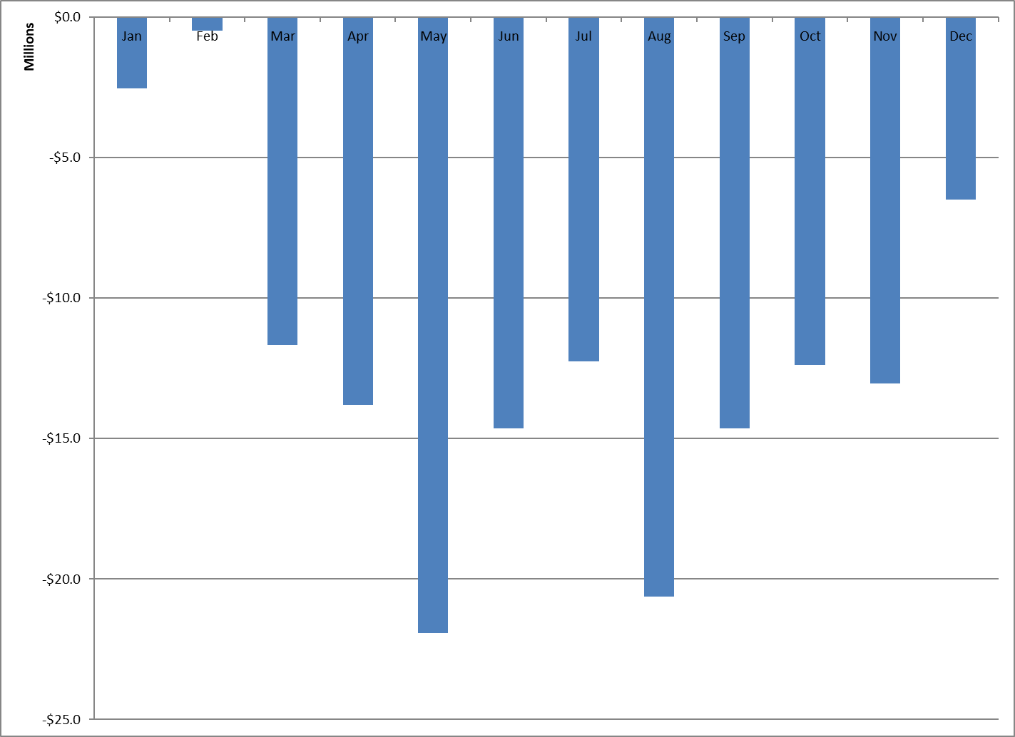
UFE Monthly Cost

Slide 9
Historical Yearly Values
 | MWH | COST | % of LOAD | AVG MCP
2006 | 2,304,458 | $187,975,534 | 0.70% | $51.26
2007 | 2,914,297 | $206,949,832 | 0.90% | $52.77
2008 | 1,541,086 | $134,692,211 | 0.40% | $68.04
2009 | 1,351,187 | $44,857,873 | 0.40% | $30.89
2010 | 1,756,344 | $85,406,714 | 0.55% | $35.74
2011 | 1,453,256 | $31,666,952 | 0.43% | $43.30
2012 | 1,002,761 | $25,945,816 | 0.31% | $26.60
2013 | -395,393 | -$17,061,127 | -0.12% | $31.71
2014 | 298,578 | $2,286,431 | 0.09% | $38.02
2015 | 240,091 | $1,441,929 | 0.07% | $24.80
2016 | 644,293 | $11,037,155 | 0.18% | $22.60
2017 | -452,775 | -$20,469,613 | -0.13% | $26.53
2018 | 657,974 | $7,209,457 | 0.17% | $32.28
2019 | 252,851 | -$22,095,272 | 0.07% | $38.83
2020 | -265,915 | -$20,023,844 | -0.07% | $24.03
2021 | 356,388 | $246,439,449 | 0.09% | $150.40
2022 | 1,126,521 | $20,085,214 | 0.26% | $64.89
2023 | -1,078,199 | -$92,779,500 | -0.24% | $50.68
2024 | -4,080,762 | -$144,444,551 | -0.88% | $29.37
Notes: (1) Negative Cost indicates load/losses are overestimated. (2) [Loss Adjusted Load] + UFE = [Final Aggregation for Settlements]

Slide 10
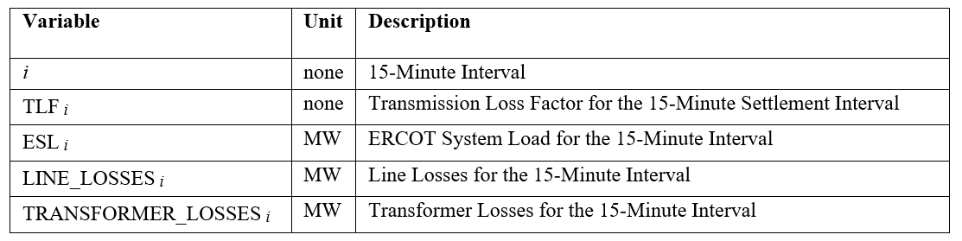
Transmission Loss Factor Calculation Review Following implementation of NPRR 1145
13.2.2 Actual Transmission Loss Factor Calculations
ERCOT shall determine the Actual TLF for each interval in the Operating Day by dividing the sum of line and transformer MW losses by the total ERCOT Load as determined by the State Estimator in the Energy Management System (EMS).
The day after the Operating Day, ERCOT shall publish Actual TLFs to be used in Settlement calculations.
13.2.5 Actual Transmission Loss Factor Calculation
(1) The following formula shall be used by ERCOT’s State Estimator process to determine Actual TLFs.
TLF _{i} = (ΣLINE_LOSSES _{i}) + (ΣTRANSFORMER_LOSSES _{i}) / ESL _{i}

Slide 11
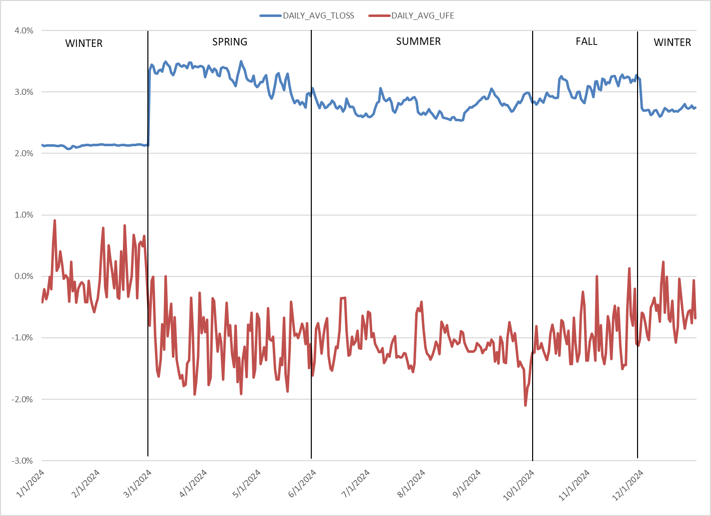
2024 Deemed Transmission Loss vs. UFE

Slide 12
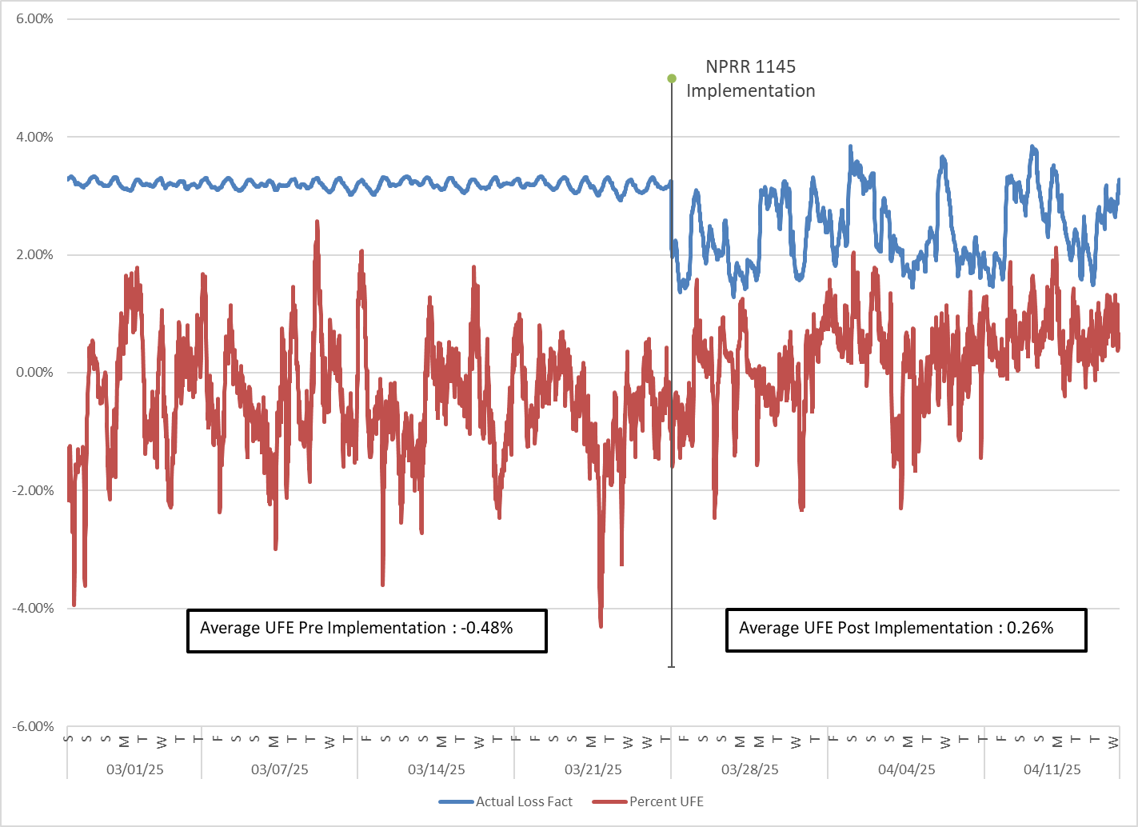
2025 Transmission Losses & Actual UFE To Date

Slide 13
2025 Transmission Losses & Actual UFE To Date
NPRR 1145 Implemented March 28, 2025
Since implementation,
Average TLF is lower than the seasonal base case models
Daily Average UFE is positive
Daily Average UFE
03.01.25 – 03.27.25 : -0.48%
03.28.25 – 04.16.25 : 0.26%

Slide 14
QUESTIONS?

