Slide 1
FERC Order 676j Managed Encumbrance
2023 G&I Training

Slide 2
Managed Encumbrance

Slide 3
FERC Order 676j – Managed Encumbrance and Dynamic Notifications
Managed Encumbrance
An allocation of unconditional (not subject to Preemption) Firm Transmission Services that is set-aside in part or full and is treated in a manner similar to firm scheduled use of reserved capacity.
Dynamic Notifications
The Notification Entry has been updated to show the e-mail addresses in list format, allowing OASIS users to easily add/delete rows

Slide 4
Adding New Managed Encumbrance – Untagged Pseudo-Ties

Slide 5
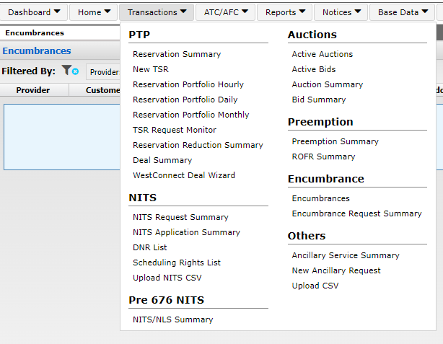
New Managed Encumbrance
Log onto OASIS
Click on the Transactions dropdown
Select either Encumbrances or Encumbrance Request Summary

Slide 6
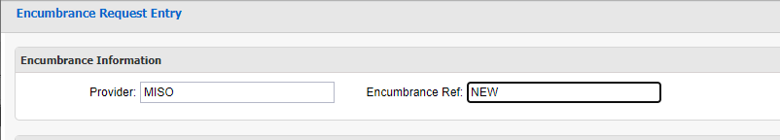
New Encumbrance Request
Once the Encumbrances or Encumbrance Request Summary is open
Click on the icon
When clicking on the icon an Encumbrance Request Entry box will open
Enter the Encumbrance Information by
Selecting the Transmission Provider from the dropdown
Selecting NEW in the Encumbrance Ref dropdown

Slide 7
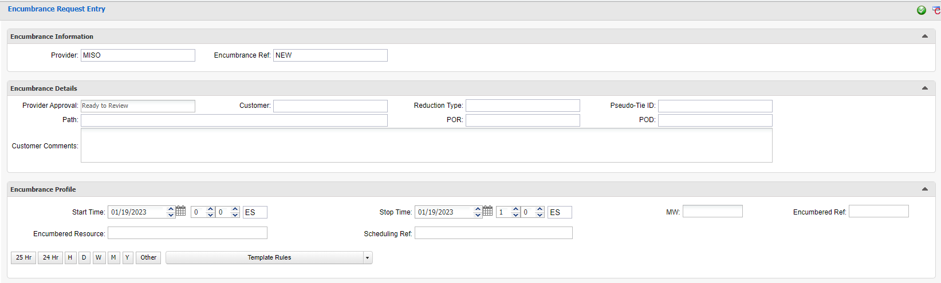
New Encumbrance Request
Once the Encumbrance Information has been chosen the Encumbrance Details and Encumbrance Profiles will pop up to be filled in

Slide 8
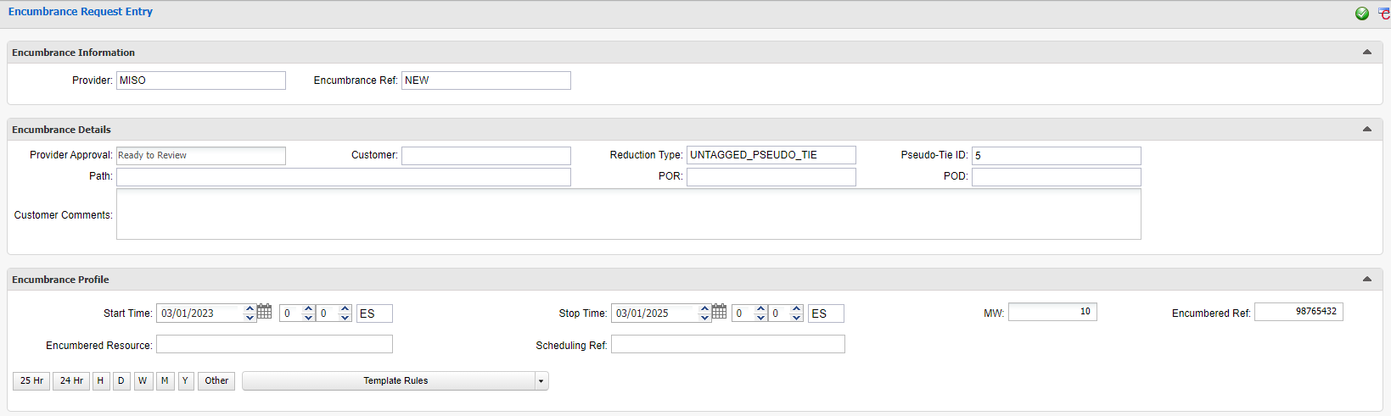
New Untagged Pseudo Tie Using PTP
Fill in required boxes
Select Customer
Reduction Type: UNTAGGED_PSEUDO_TIE
Select Pseudo-Tie ID from the dropdown
Fill in the POR/POD (Path will the auto populate), Start/Stop Time and MWs
Enter the PTP TSR number in the Encumbered Ref box
Click the Submit button

Slide 9
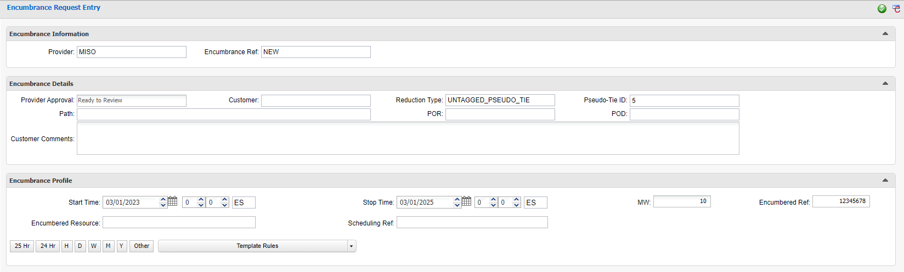
New Untagged Pseudo Tie Using NITS TSR
Fill in required boxes
Select Customer
Reduction Type: UNTAGGED_PSEUDO_TIE
Select Pseudo-Tie ID from the dropdown
Fill in the POR/POD (Path will the auto populate), Start/Stop Time and MWs
Enter the NITS TSR number in the Encumbered Ref box
Click the Submit button

Slide 10
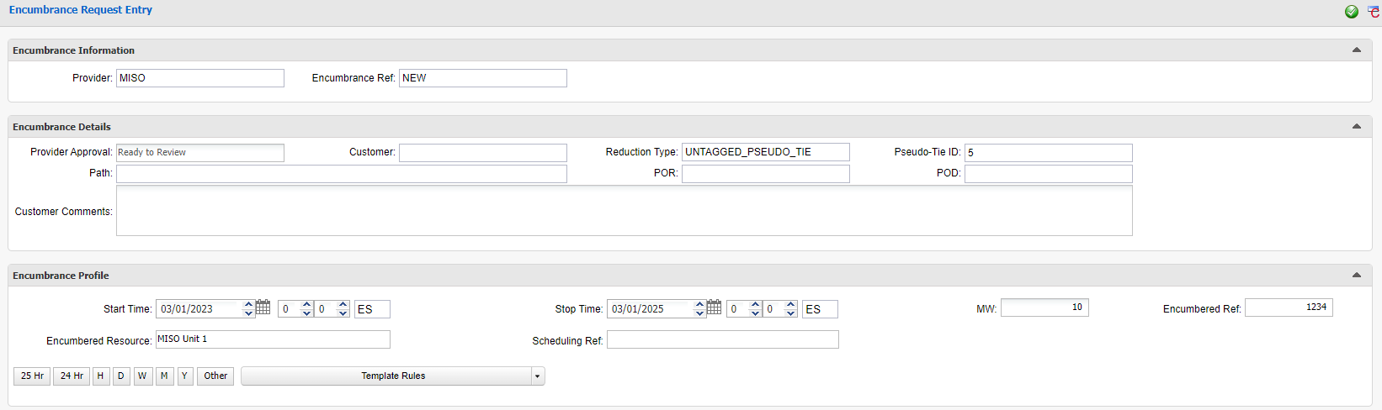
New Untagged Pseudo Tie Using NITS Application Number
Fill in required boxes
Select Customer
Reduction Type: UNTAGGED_PSEUDO_TIE
Select Pseudo-Tie ID from the dropdown
Fill in the POR/POD (Path will the auto populate), Start/Stop Time and MWs
Enter the NITS Application number in the Encumbered Ref box
Enter the Encumbered Resource name exactly as registered
Click the Submit button

Slide 11
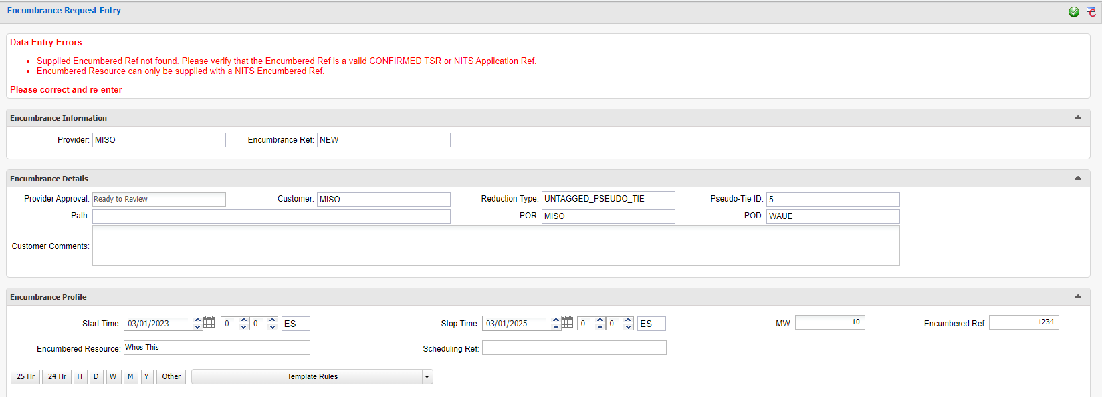
New Untagged Pseudo-Tie Using NITS Application Number
Use of NITS Application Number and NITS Resource Errors
Must enter the correct NITS Application number in the Encumbered Ref box
Must enter the Encumbered Resource name as registered in webTrans Application Detail – NITS Resource Description
If either are entered incorrectly a Data Entry Error will pop up

Slide 12
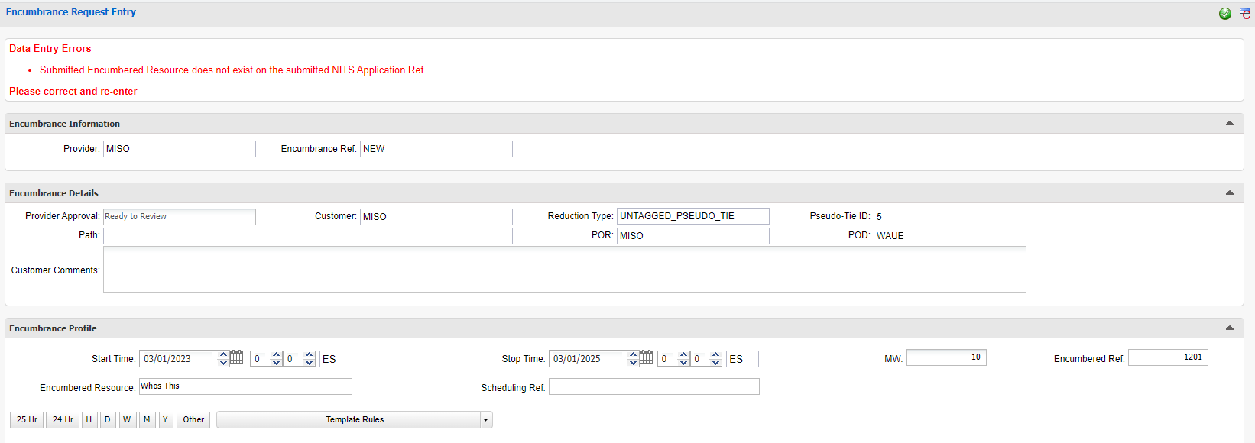
New Untagged Pseudo-Tie Using NITS Application Number
Use of NITS Application Number and NITS Resource Errors
Must enter the Encumbered Resource name as registered in webTrans Application Detail – NITS Resource Description
If entered incorrectly a Data Entry Error will pop up

Slide 13
Modify Untagged Pseudo-Tie
Once the Encumbrances or Encumbrance Request Summary is open
Click on the icon
When clicking on the icon an Encumbrance Request Entry box will open
Enter the Encumbrance Information by
Selecting the Transmission Provider from the dropdown
Selecting the Encumbrance Ref number from the dropdown
Selecting the Action MODIFY

Slide 14
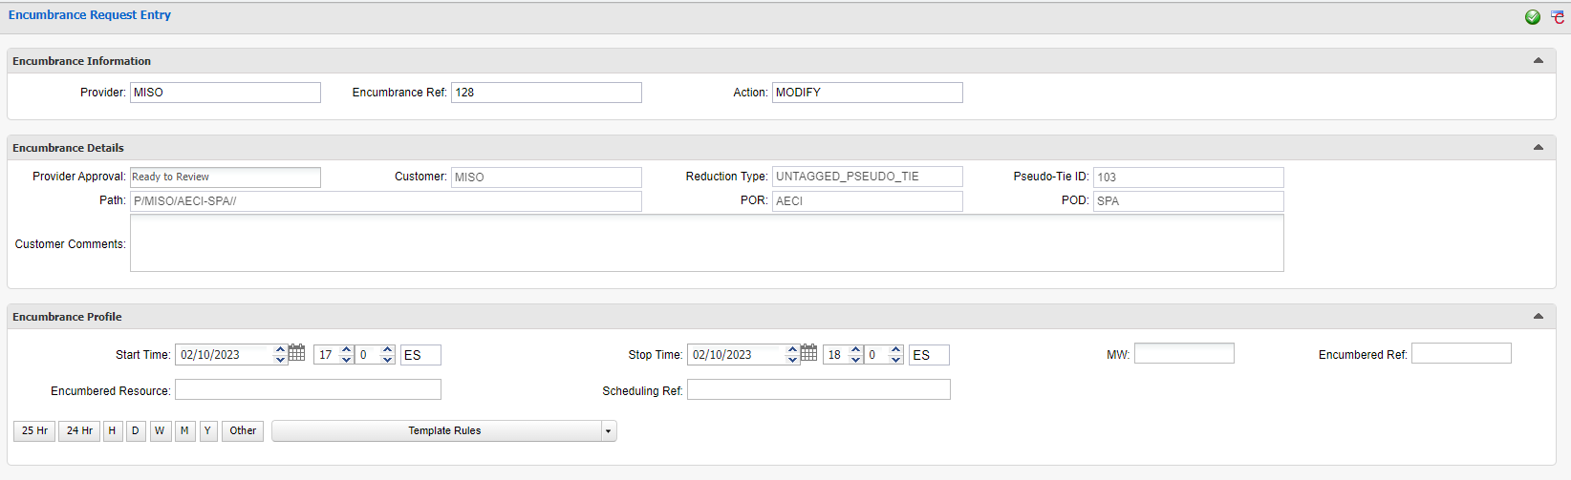
Modify Untagged Pseudo Tie
Fill in required boxes
Only editable information will be in the Encumbrance Profile area
Start/Stop, MW, Encumbered Ref, and Encumbered Resource
Click the Submit button

Slide 15
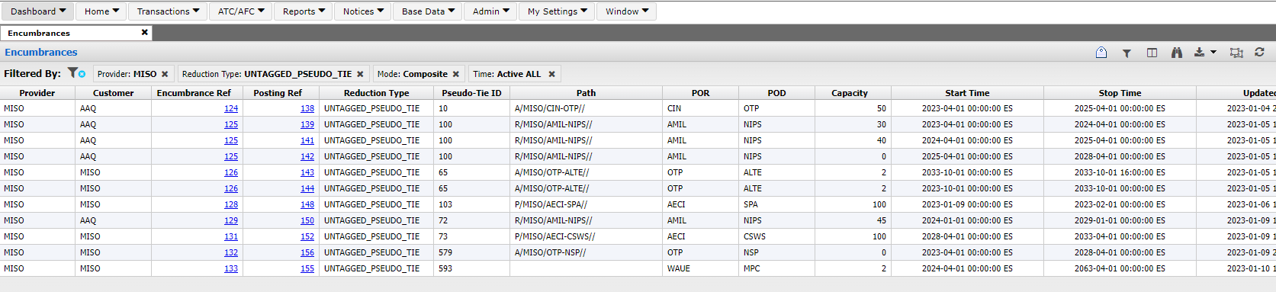
Encumbrances
All Approved Encumbrances will be populated in the Encumbrance page
In the Composite Mode
Encumbrance Ref Number
Posting Ref Number
Capacity Encumbered

Slide 16
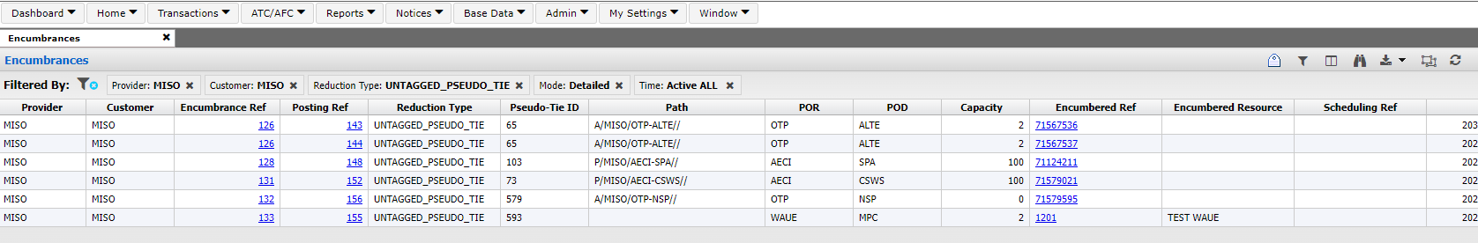
Encumbrances
All Approved Encumbrances will be populated in the Encumbrance page
In the Detailed Mode
Encumbrance Ref Number
Posting Ref Number
Capacity Encumbered
Encumbered Ref
Encumbered Resource

Slide 17
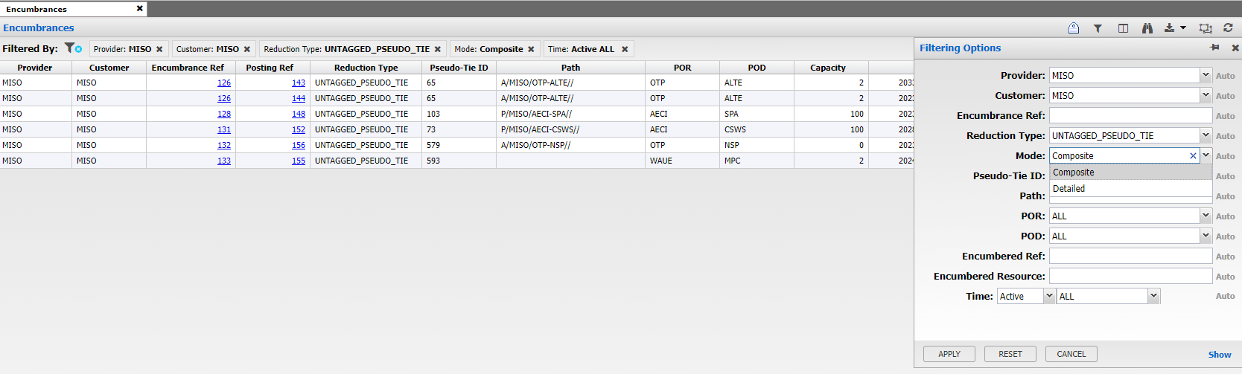
Encumbrances
Filtering for more specific Encumbrance
Clicking on the icon will open the Filtering Option
Ability to change the view Mode to either Composite or Detailed

Slide 18
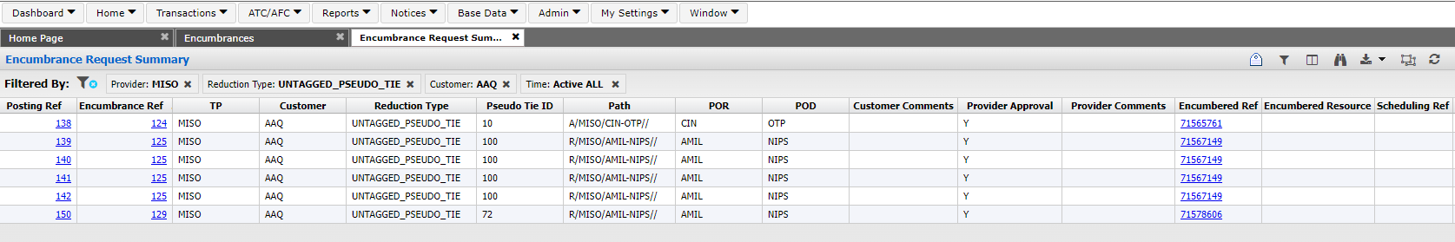
Encumbrance Request Summary
All NEW and MODIFIED Encumbrances will be populated in the Encumbrance Request Summary page
The Posting Ref number associated for each Encumbrance Ref number
Each time a modification is made to an Encumbrance Ref there will be a new Posting Ref number given to it
The last Approved Posting Ref number will be the one associated with the Encumbrance Ref number on the Encumbrance page

Slide 19
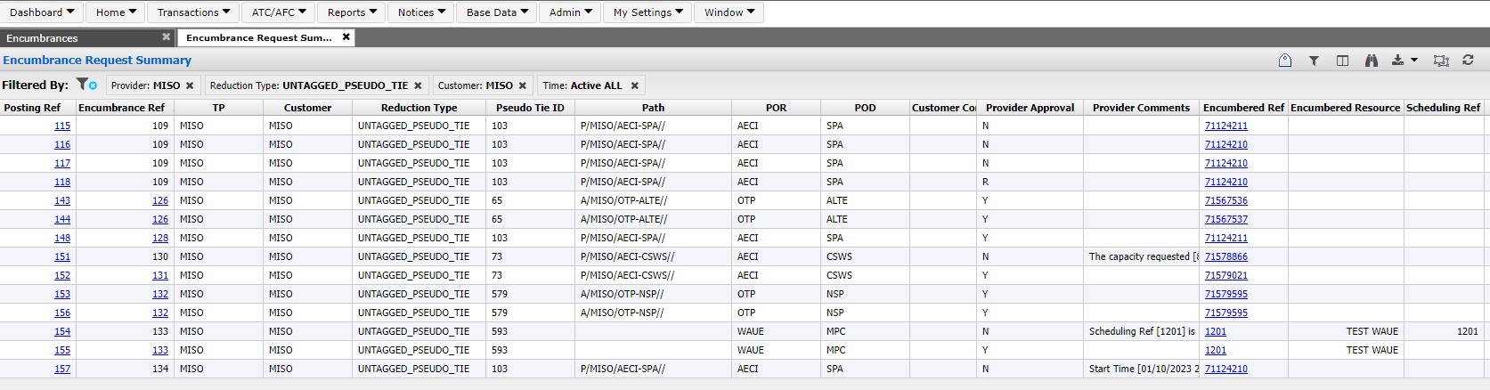
Encumbrance Request Summary Continued
Highlighted Encumbrance Ref number have Provider Approval (Y)
Un-Highlighted Encumbrance Rev number are NOT Approved (N) or in Review (R)
Each Posting Ref and Encumbrance Ref posts the Pseudo Tie ID associated with it
Each Posting Ref and Encumbrance Ref posts the Encumbered Ref associated with it

Slide 20
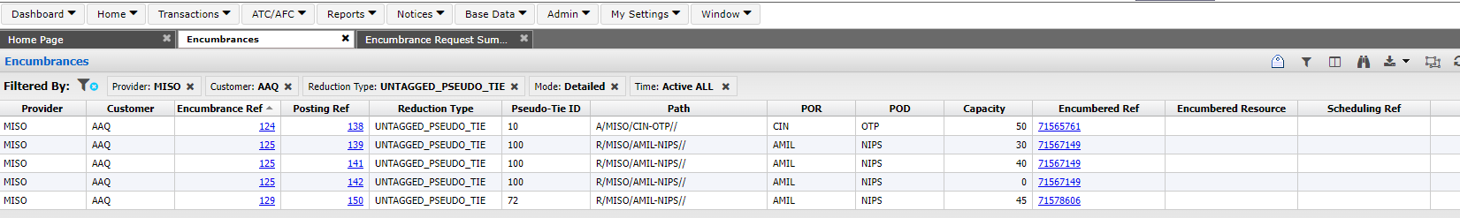
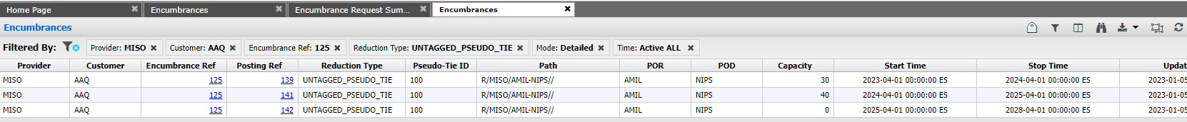
Encumbrance Ref Actions
Clicking on the Encumbrance Ref number from either the Encumbrance tab or the Encumbrance Request Summary tab
Opens a new Encumbrance tab for just that specific Encumbrance Ref number
Clicking on an Encumbrance Ref opens just that Posting Ref number

Slide 21
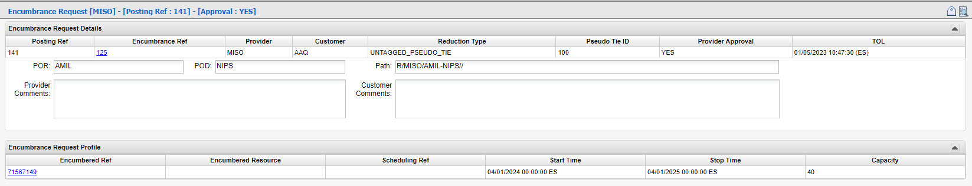
Posting Ref Actions
Detailed Posting Ref Data
Clicking on the Posting Ref number will open a new tab with that specific Encumbrance Request detailed data
Clicking on the Encumbered Ref number located in the Encumbrance Request Profile will open the Transmission Reservation Detail

Slide 22
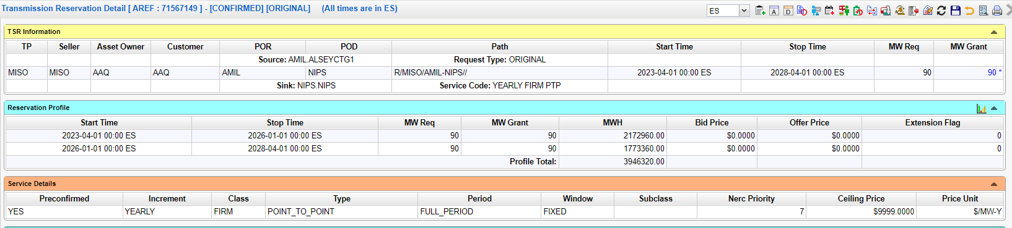
Encumbrances
Transmission Reservation Detail
Clicking on the MW Grant in the TSR Information
Opens the Reservation Profile Detail of the Encumbered MWs

Slide 23
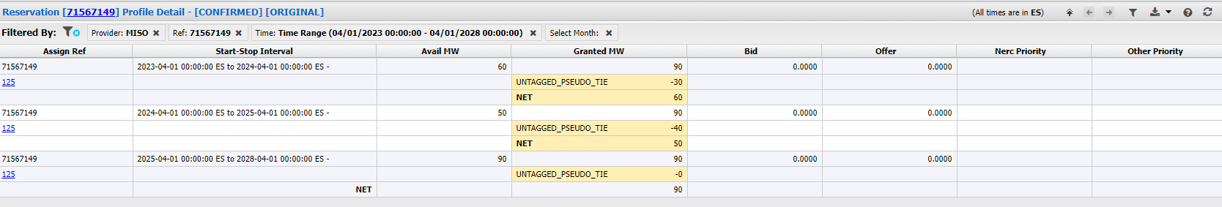
Encumbrances
Reservation Profile Detail
Shows Available MWs
Granted MW
Show the Encumbered MWs along with the type of Encumbrance
NOTE – The Encumbered MWs are not cumulative
NET remaining MWs

Slide 24
Dynamic Notifications
Dynamic Notifications
The Notification Entry has been updated to show the e-mail addresses in list format, allowing OASIS users to easily add/delete rows.
Change Impacts – Notification (Admin > Notification).

Slide 25
Questions
Contact:
John Marhoefer
JMarhoefer@misoenergy.org
317-249-5306
Darrin Landstrom
DLandstrom@misoenergy.org
651-632-8524

